Slide 1
Default of Credit Card Clients Subject: Data and Predictive Analysis
Presented By,
Nikita Patel

Slide 2
Table of Content
Introduction
Dataset Overview
Problem Definition
Data Preparation
Exploration and Visualization
Modeling and Evaluation
6.1. Logistic Regression (LR)
6.2 KNN Classification
6.3 Decision Tree (CART)
6.4 Naïve Bayes Classifier (NB)
6.5 Random Forest Classification (RFC)
7. Conclusion
8. References

Slide 3
1. Introduction
The banks with the invent of credit card are more focused on increasing the number of clients using their credit service.
In the process of increasing the number of clients the bank neglects that there are client's who are not being able to pay back the credit in time.
This became an issue that led bank to effectively decide the credit limit to be allowed to a person.
The motivation of the project is to provide any banking organizations to ﬁnd a simple and an effective predictive model to determine if their customers could make the credit card payments on-time.

Slide 4
2. Dataset Overview
Original Dataset: 'UCI Machine Learning Repository, Center of Machine Learning and Intelligent System’.
Updated Dataset: ‘Kaggle’
Attributes: 24
Observation: 30,000
Independent Variable: Customer ID, Credit limit, Gender, Age, Marital Status, Level of Education, History of past payment (from April 2005 to Sep. 2005), Amount of bill statement (April 2005 to Sep. 2005) and Amount of previous payment (April 2005 to Sep. 2005)
Dependent Variable: ‘default.payment.next.month’ (customer who will default payment next month)
0 = No defaulters because they will make the payment
1 = Defaulters because they will not make the payment
Payment is inversely proportional to Defaulter.
Notes:
To default is to fail to make a payment on a debt by the due date. If this happens with a credit card, creditors might raise interest rates to the default (or penalty rate) or decrease the line of credit. In case of serious delinquency, the card issuer can even take legal action to enforce payment or to garnish wages. Therefore in this dataset, attribute 'default.next.month' that has 0 and 1 value, here 0 = No means 'No Defaulters' and 1 = Yes means 'Defaulters'

Slide 5
3. Problem Definition
A Taiwan-based credit card issuer wants to better predict the likelihood of default for its customers, as well as identify the key drivers that determine this likelihood.
How does the probability of default payment vary by categories of different demographic variables?
Which variables are the strongest predictors of default payment?

Slide 6
4. Data Preparation
The attribute PAY_0 is converted to PAY_1, to make it equivalent with other attribute such as BILL_AMT1 and PAY_AMT1.
The dependent variable ‘default.next.month’ is renamed to ‘DEFAULT’ for naming convenience
Level of Education 0, 5, and 6 are converted to value 4 (Others)
There were no null values or duplicate values in this dataset.

Slide 7
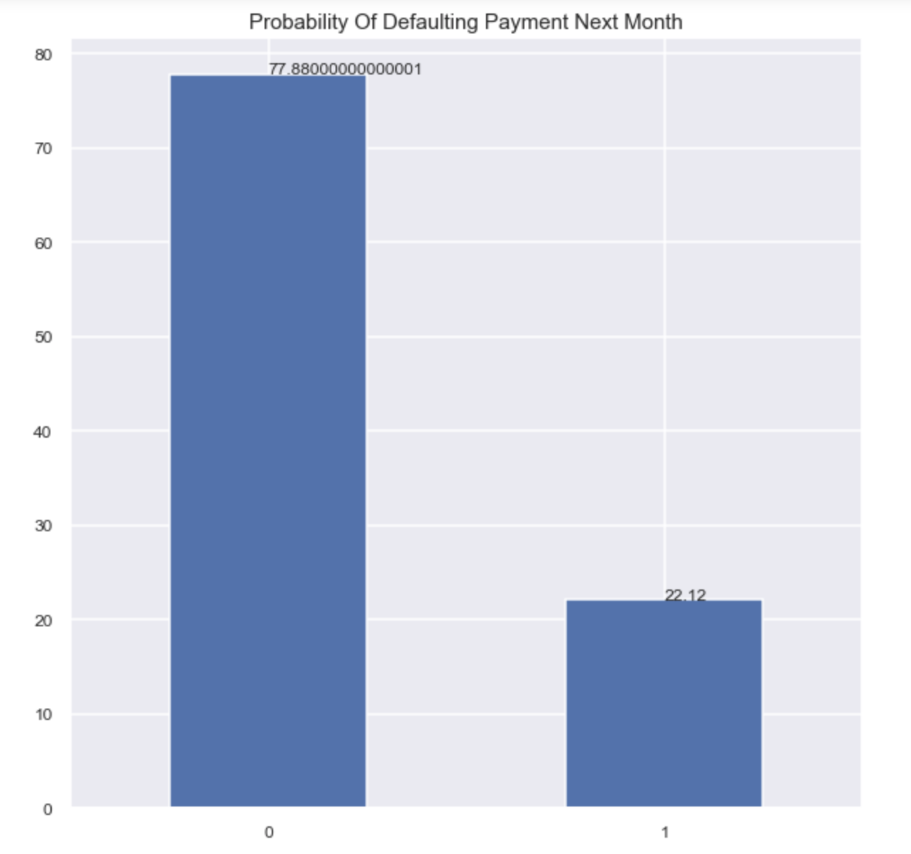
5. Exploration and Visualization
DEFAULT
0: No Defaulters
1: Defaulters
The graph shows the total percentage record of defaulters and non-defaulters
If they will do payment or not next month.
1 = Yes
0 = No
22.12% - Defaulters
77.88% - No Defaulters
Notes:
0 = No defaulters because they will make the payment
1 = Defaulters because they will not make the payment
Payment is inversely proportional to Defaulter.

Slide 8
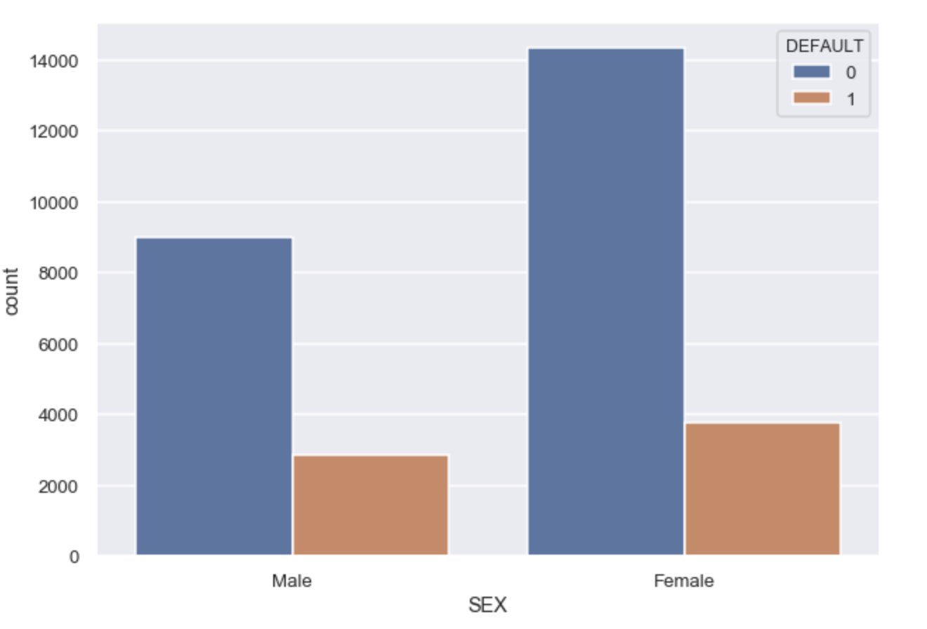
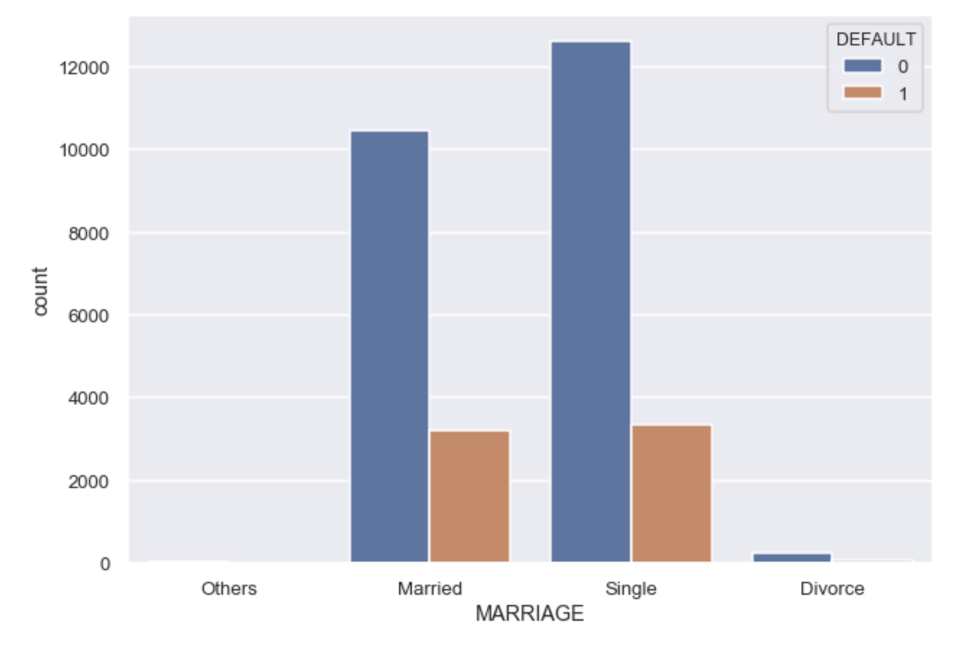
Continue…
This graph shows default count for ‘sex’ attribute
2. This graph shows default count for ‘marriage’ attribute

Slide 9
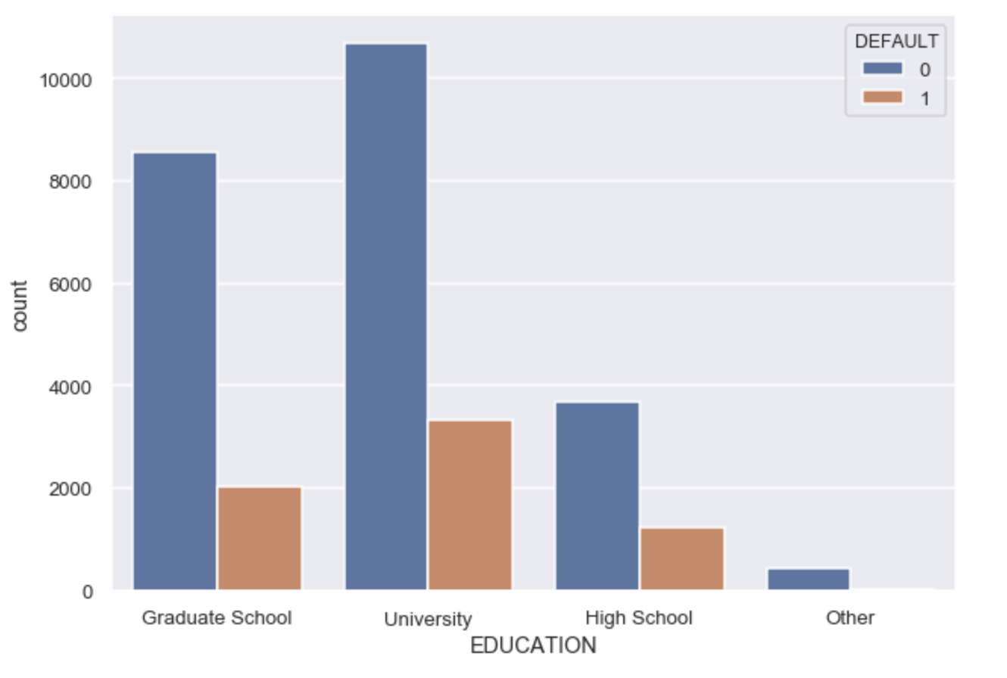
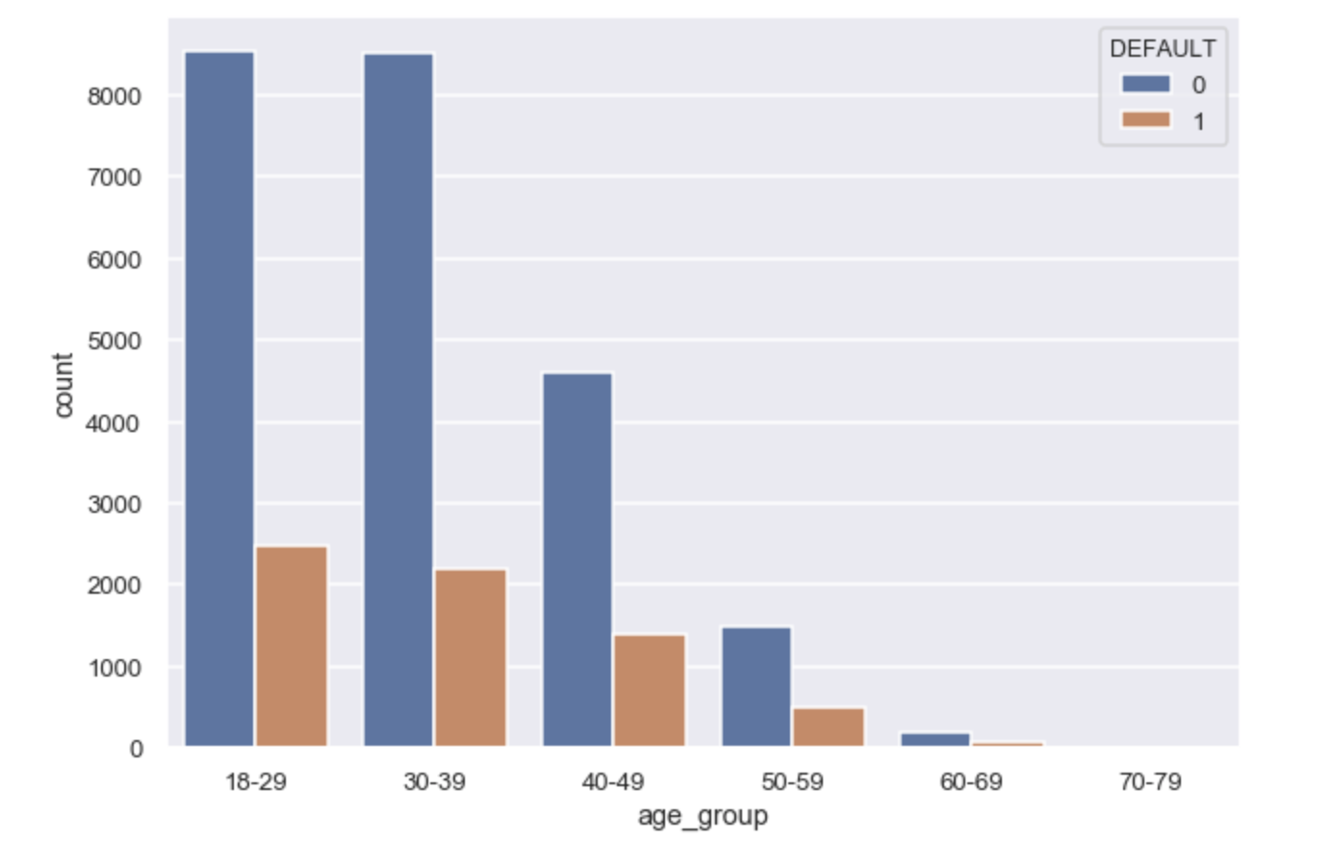
Continue…
This graph shows default count for ‘Level of Education ’ attribute
2. This graph shows default count for ‘age_group’ attribute

Slide 10
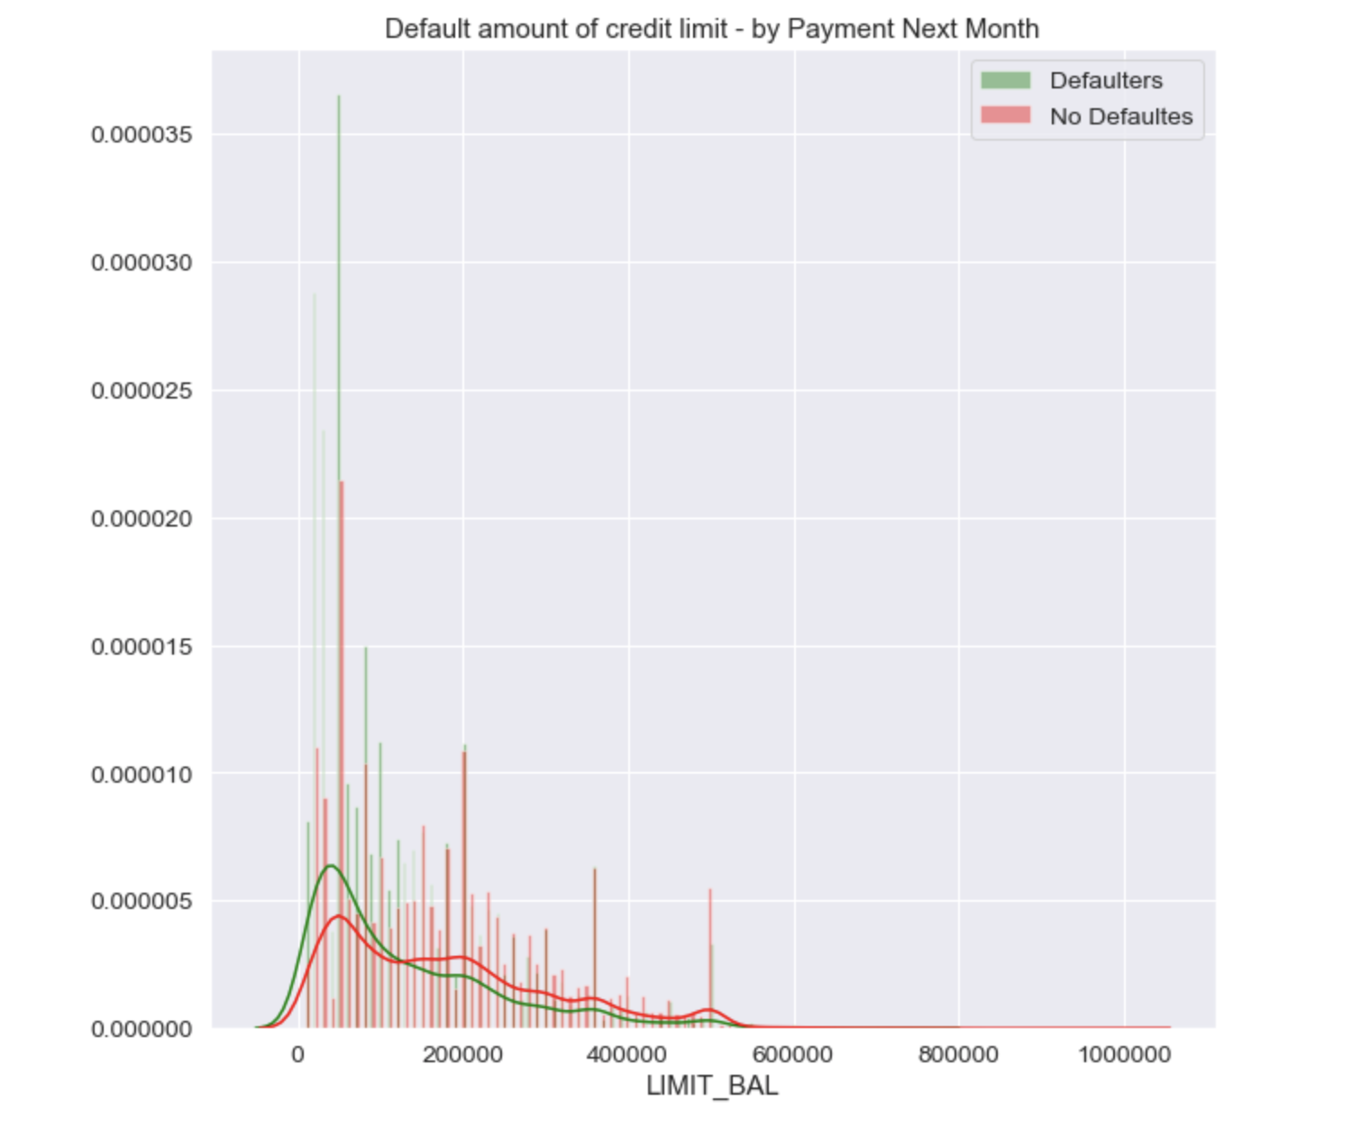
Continue…
From this graph it is observed that clients who are defaulters has the low credit limit compared to clients who are not defaulters .
Most of defaults are for credit limits 0-100,000 (this interval is larger for defaults than for non-defaults). Larger defaults number are for the amounts of 50,000, 20,000 and 30,000.
Notes:
Green: Defaulters, not going to make payment
Red: No Defaulters, will make payment.

Slide 11
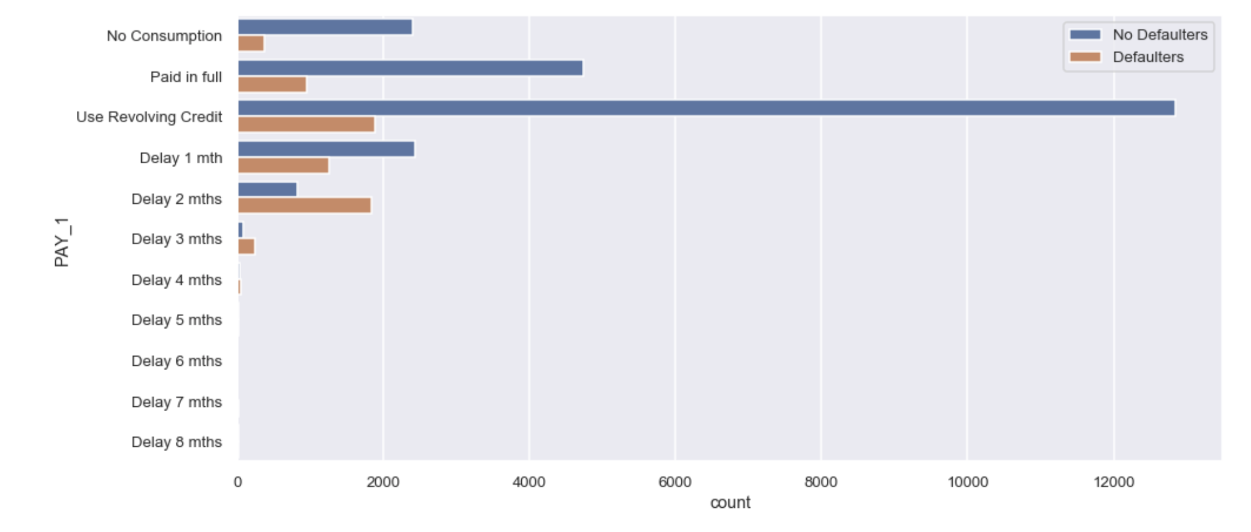
Continue…
Notes:
It can be seen that clients using revolving credit to pay the amount have high tendency to no default payment compared to clients who make full payment on time or delayed by one month. So we can say Repayment status will be one of the important feature to predict default payment for next month.

Slide 12
6. Modeling and Evaluation
Since our target variable is discrete (1,0) we plan to use:
6.1. Logistic Regression (LR)
6.2 KNN Classification
6.3 Decision Tree (CART)
6.4 Naïve Bayes Classifier (NB)
6.5 Random Forest Classification (RFC)

Slide 13
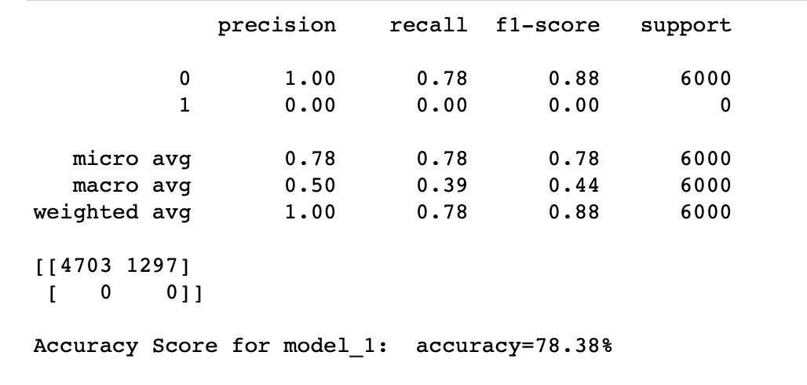
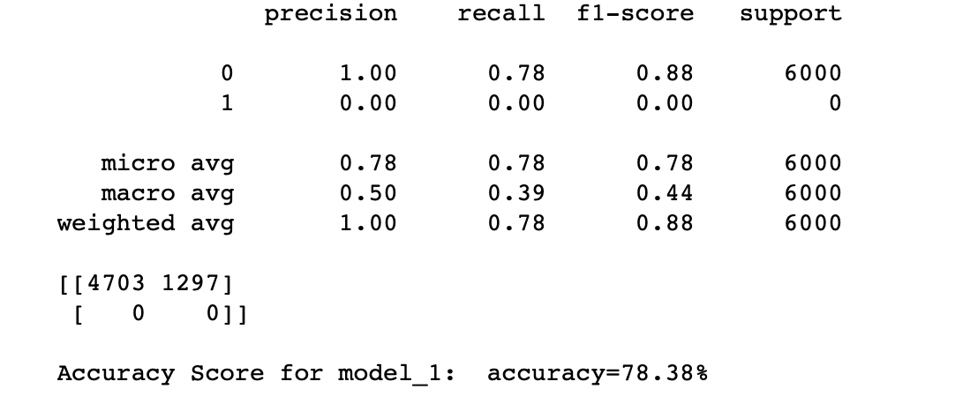
6.1 Logistic Regression (LR)
Including all independent features
Excluding unimportant independent features
Analysis on LR: In Logistic Regression even after excluding unimportant features, AUC score does not increase or decrease.
Notes:
Mainly used for predicting the probability of an event.
Advantage of LR:
Outputs have a nice probabilistic interpretation, and the algorithm can be regularized to avoid over fitting. Logistic models can be updated easily with new data using stochastic gradient descent. Logistic regression is more robust because the independent variables and Dependent variable don’t have to be normally distributed, or have equal variance in each group. It does not assume a linear relationship between the Independent Variable and Dependent Variable, it can handle nonlinear effects.
Disadvantage of LR
The advantages of logistic regression come at a cost, it requires much more data to achieve stable, meaningful results. Logistic regression tends to underperform when there are multiple or non-linear decision boundaries. They are not flexible enough to naturally capture more complex relationships. With standard regression, and Data Analysis, typically 20 data points per predictor is considered the lower bound. For logistic regression, at least 50 data points per predictor is necessary to achieve stable results.

Slide 14
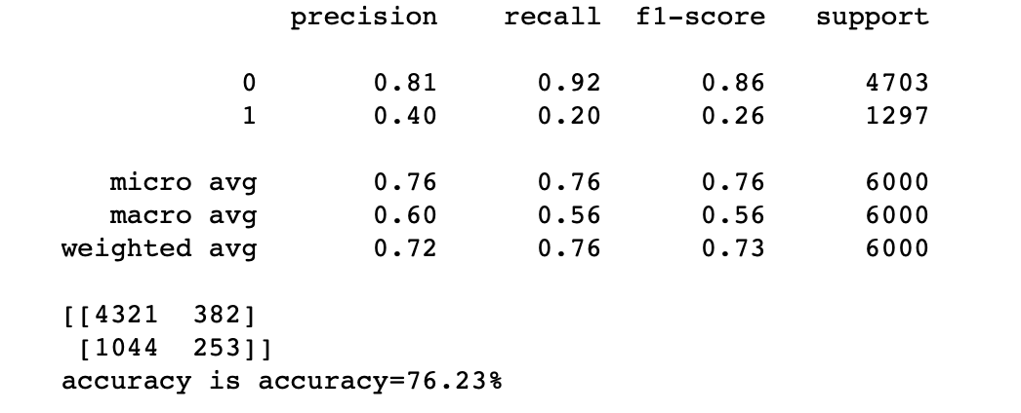
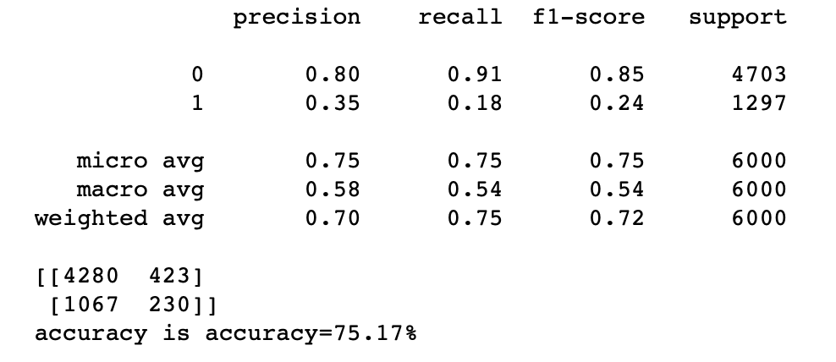
6.2 KNN Classification
Including all independent features
Excluding unimportant independent features
Analysis on KNN: We can see that by removing the unimportant and multicollinear data, the accuracy has marginally decreased by 1.06%
Notes:
KNN often used in search applications where you are looking for similar items; that is, when task is some for of “find similar to this one.”
Advantage: KNN is called Lazy Learner (Instance based learning). It does not learn anything in the training period. It does not derive any discriminative function from the training data. In other words, there is no training period for it. It stores the training dataset and learns from it only at the time of making real time predictions. This makes the KNN algorithm much faster than other algorithms that require training.
Disadvantage: Does not work well with large dataset, in large datasets, the cost of calculating the distance between the new point and each existing points is huge which degrades the performance of the algorithm. Does not work well with high dimensions, the KNN algorithm doesn't work well with high dimensional data because with large number of dimensions, it becomes difficult for the algorithm to calculate the distance in each dimension. Need feature scaling, that is we need to do feature scaling (standardization and normalization) before applying KNN algorithm to any dataset. If we don't do so, KNN may generate wrong predictions.

Slide 15
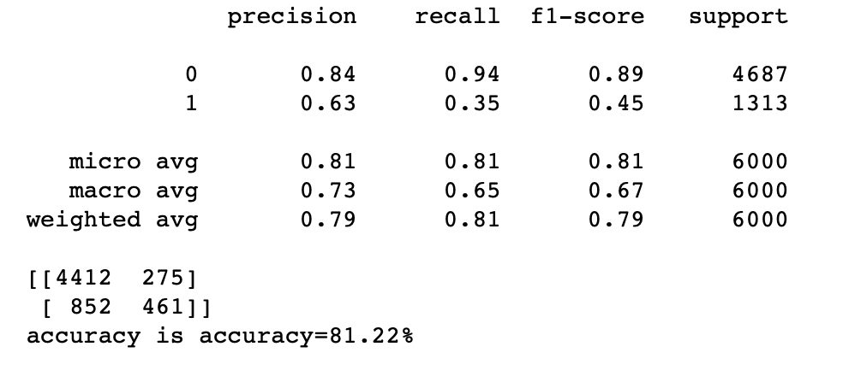
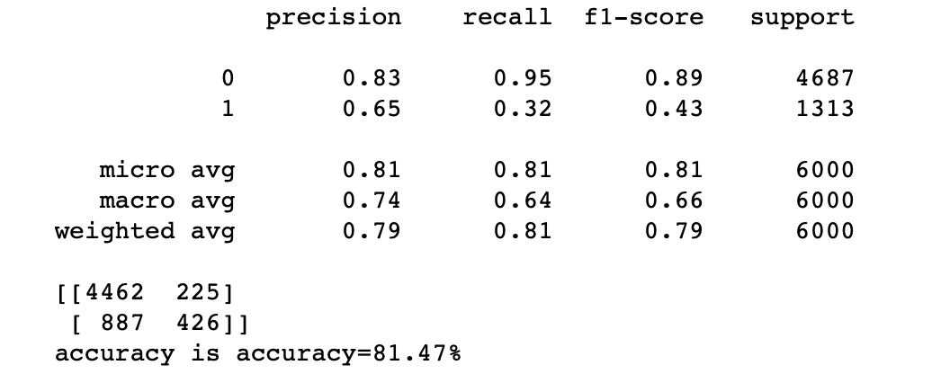
6.3 Decision Tree (CART)
Including all independent features
Excluding unimportant independent features
Analysis on Decision Tree: We got a +0.25% in accuracy just by choosing the right features.
Notes:
Advantage is that the classifier generated is highly interpretable and can handle a mix of both discrete and continuous input. It performs well on large datasets and are extremely fast.
Advantage: The Tree is very easy to use and imagine. Decision Trees can be applied for both Numerical and Categorical independent variables, it efficiently handles missing values, it help with the probability & payoffs of decisions - Information Gain. In this model, Linearity between independent and dependent variable is not a constraint for prediction. The internal workings are capable of being observed and thus make it possible to reproduce work. Factors/Feature selection is a byproduct of Decision Trees. Thus this model is fast.
Disadvantage: Decision-tree learners can create over-complex trees that do not generalize the data well, so it is easy to fall into the trap of overfitting (i.e. creating a very complex model that perfectly describes your training set but fails in predicting). It is also said to be sensitive to small changes in the data, leading to different results. For this reason, it is common to use ensembles such as Random Forest to avoid this risk.
There are a few parameters to be settle for the classifier, such as the function to determine the quality of a split, or how deep the tree has to be.

Slide 16
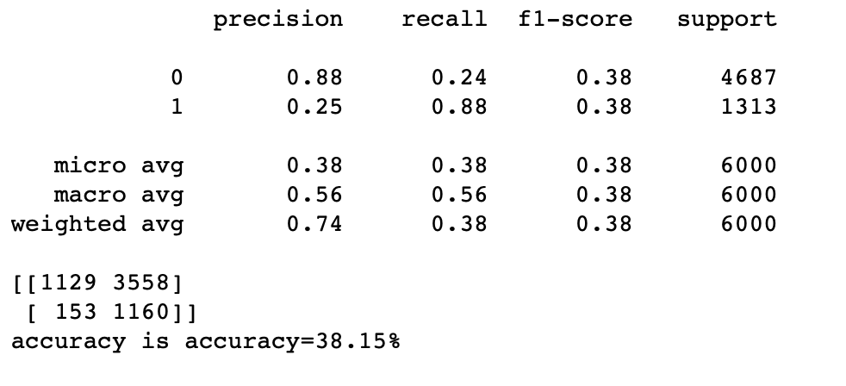
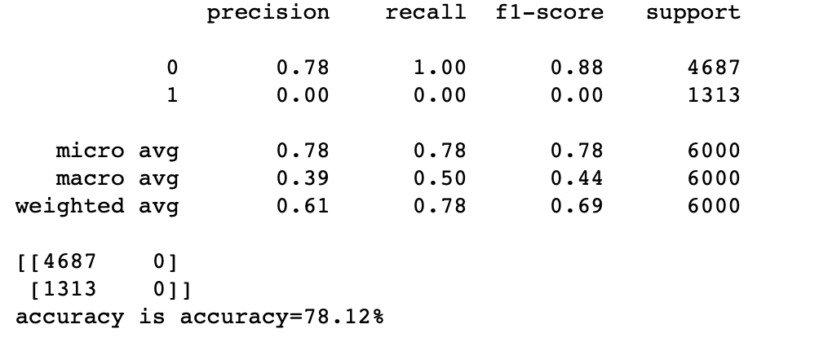
6.4 Naïve Bayes Classifier (NB)
Including all independent features
Excluding unimportant independent features
Analysis on Naive Bayes Classification: Surprisingly we got a +39.97% in accuracy just by focusing on some important features.
Notes:
Categorizing news, email spam detection, face recognition and weather prediction are few popular cases of Naïve Bayes algorithm. If the categorical variable has a category in test dataset which is not observed in training dataset, the model will assign zero probability and will be unable to make predictions.
Advantage: Since the predictions of Naive Bayes algorithms are based on the posterior probability of each conditional feature, it is easy to understand which features are influencing the predictions. This helps users to understand the predictions. Since all the probabilities are pre-computed in the Naive Bayes algorithm, the prediction time of this algorithm is very efficient.
Disadvantage: The first disadvantage is that the Naive Bayes classifier makes a very strong assumption on the shape of your data distribution, i.e. any two features are independent given the output class. Due to this, the result can be (potentially) very bad - hence, a “naive” classifier. Another problem happens due to data scarcity. For any possible value of a feature, we need to estimate a likelihood value by a frequentist approach. This can result in probabilities going towards 0 or 1, which in turn leads to numerical instabilities and worse results. As we can see from AUC score for model_NB_1 (38.15%) and model_NB_2 (78.12%)

Slide 17
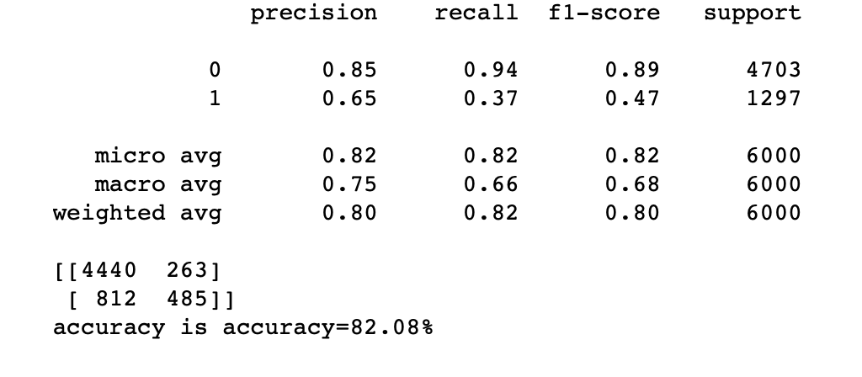
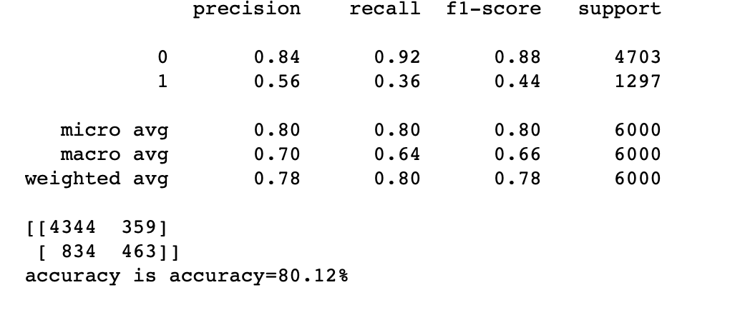
6.5 Random Tree Classification (RFC)
Including all independent features
Excluding unimportant independent features
Analysis on Random Forest: We can see that by removing the unimportant and multicollinear data, the accuracy has marginally decreased by 2.36%
Notes:
Random Forest builds multiple decision trees and merges them together to get more accurate and stable predictions. Instead of searching for most important features it searches for the best features among a random attributes. This results in a wide diversity that generally results in a better model. So is the reason among all classifications Random Forest is giving highest AUC score, 82.08%, but when I try to focus on important features, accuracy score drops by 2.36%, and reason can be while focusing on important features I might have missed a best feature that can be useful in this algorithms.
In Banking, Random Forest algorithm is used to find loyal customers, which means customers who can take out plenty of loans and pay interest to the bank properly, and fraud customers, which means customers who have bad records like failure to pay back a loan on time or have dangerous actions.
Advantage: Random Forest is based on the bagging algorithm and uses Ensemble Learning technique. It creates as many trees on the subset of the data and combines the output of all the trees. In this way it reduces overfitting problem in decision trees and also reduces the variance and therefore improves the accuracy. As compared to Decision Tree AUC score for all features, Random Tree classification is giving us a better score. In large dataset with many features, this classification can be really helpful if a user is unaware of important independent features. Random Forest can automatically handle missing values, no feature scaling (standardization and normalization) is required in case of Random Forest as it uses rule based approach instead of distance calculation. Handles non-linear parameters efficiently: Non linear parameters don't affect the performance of a Random Forest unlike curve based algorithms. So, if there is high non-linearity between the independent variables, Random Forest may outperform as compared to other curve based algorithms.
Disadvantage: Random Forest creates a lot of trees (unlike only one tree in case of decision tree) and combines their outputs. By default, it creates 100 trees in Python sklearn library. To do so, this algorithm requires much more computational power and resources. On the other hand decision tree is simple and does not require so much computational resources.Random Forest require much more time to train as compared to decision trees as it generates a lot of trees (instead of one tree in case of decision tree) and makes decision on the majority of votes.

Slide 18
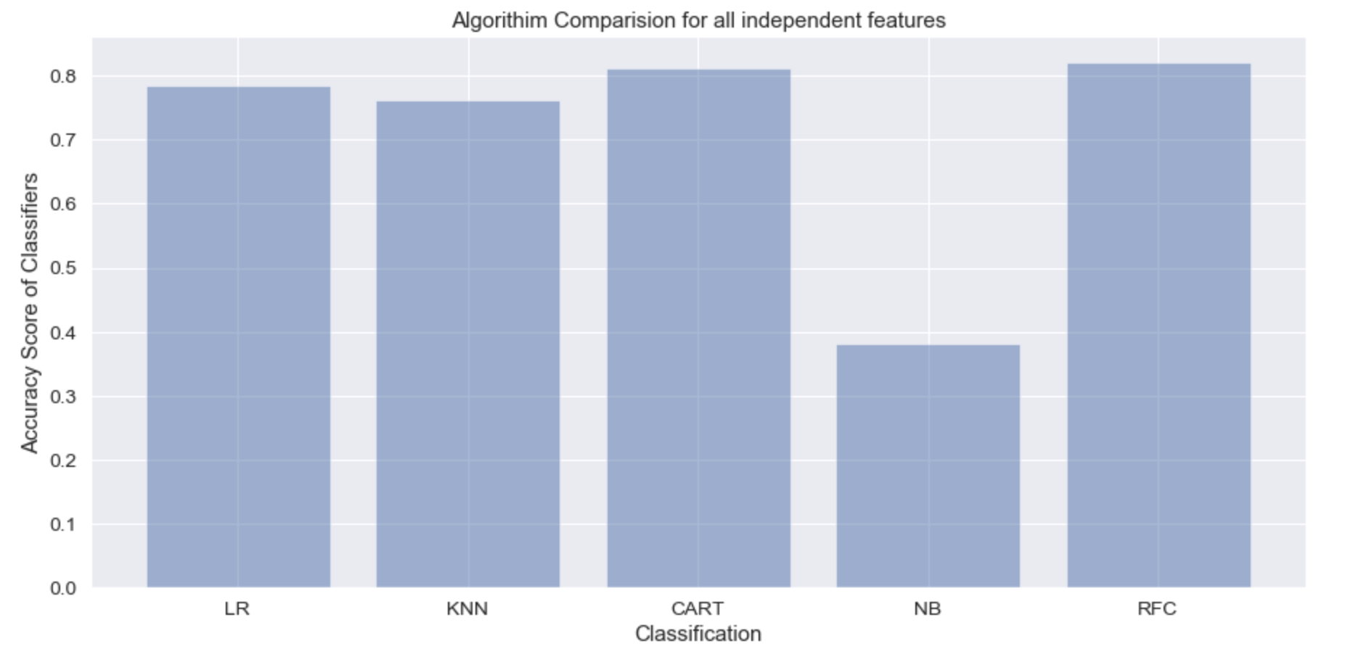
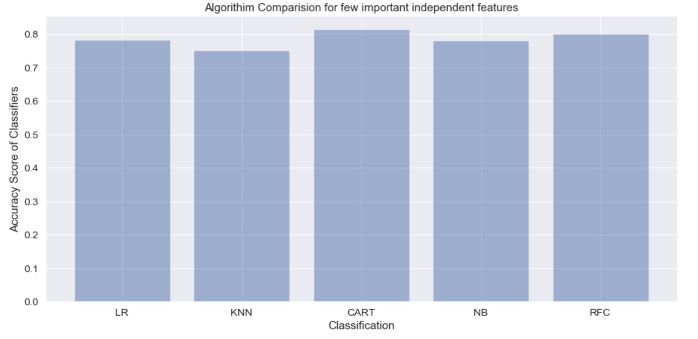
Comparison of AUC Score of Classifications
Notes:
Model Selection: Comparing the AUC Scores of all classifications, we have analyzed 'Decision Tree' and 'Random Forest' can be the best fit for our dataset. Further only one model, **Random Forest'** has been chosen based on high precision and high recall.
High Recall: This means that most of the positive examples are correctly recognized (low FN).
High Precision: Those we predict as positive are indeed positive (low FP)

Slide 19
7. Conclusion
EDA Conclusion:
From the data provided we see that we want to predict whether a person will default in next month or not.
This prediction depends mostly on previous repayment history, and few factors such as the Sex, Education, Marriage, Age and Limiting Balance. The visualization helped us to find relationship between important features and target variable, that is 'default.payment.next.month’
Modeling and Evaluation Conclusion:
Model selection solely based on accuracy does not make much sense because the data-set is unbalanced and skewed.
Therefore sensitivity or recall (True Positive Rate)along with precision of the model is of importance. High recall means more defaulters being caught, and reasonably high precision means less False Positives.
A good model is a balance between high recall and reasonable high precision.
Notes:
How useful is your model for interested parties (i.e., the companies or organizations that might want to use it for prediction)? How would you measure the model's value if it was used?
The performance of the algorithms is evaluated through following performance metrics: accuracy, precision and recall. This approach could improve and ease the process of credit card default, and therefore help the banking system in decision making. The selected model would help the issuer (interested parties) have a better understanding of their current and potential customers, which would inform their future strategy, including their planning of offering targeted credit products to their customers. This would also inform the issuer’s (interested parties) decisions on who to give a credit card to and what credit limit to provide.

Slide 20
8. References
Default of Credit Card Clients Dataset, Default Payments of Credit Card Clients in Taiwan from 2005 https://www.kaggle.com/uciml/default-of-credit-card-clients-dataset
Yeh, I. C., & Lien, C. H. (2009). The comparisons of data mining techniques for the predictive accuracy of probability of default of credit card clients. Expert Systems with Applications, 36(2), 2473-2480.

