Slide 1
Student Performance Analysis Using Machine Learning
Nasser Hasan Padilla Advanced Big Data and Data Mining (MSCS-634-B01) April 2026

Slide 2

Problem & Dataset
Problem:
- Understand student performance
- Predict academic outcomes
Dataset:
- UCI Student Performance Dataset
- Demographic, behavioral, and academic features

Slide 3
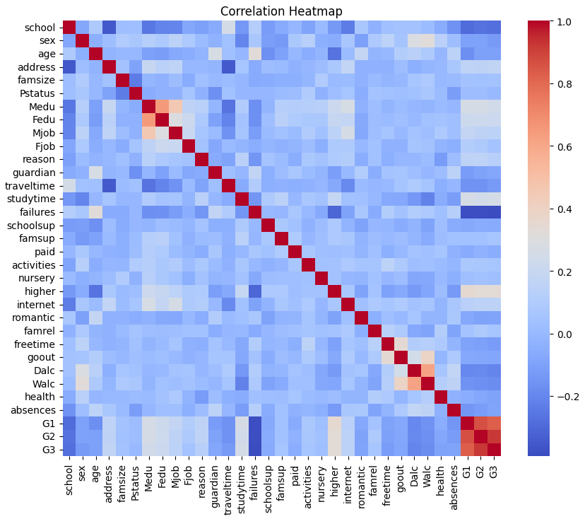
Exploratory Data Analysis
Key Insights:
- Strong correlation: G1, G2 → G3
- Study time improves performance
- Absences negatively impact grades

Slide 4
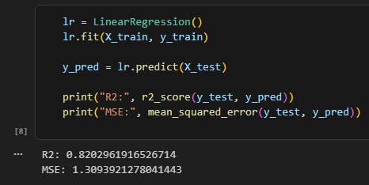
Regression Modeling
Models: - Linear Regression - Ridge Regression Evaluation: - R² Score - Mean Squared Error Result: - Ridge performed slightly better
Results:- R² Score: 0.82- Mean Squared Error: 1.31

Slide 5
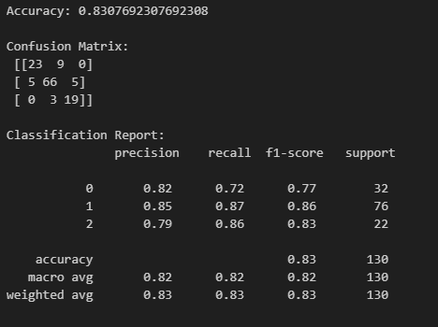
Classification Modeling
Models: - Decision Tree - K-Nearest Neighbors (KNN) Accuracy: - ~83% Approach: - Train-test split to avoid overfitting

Slide 6
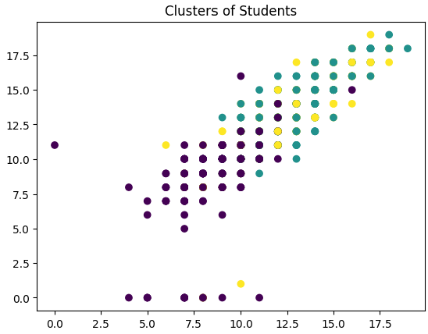
Clustering & Patterns
Clustering: - K-Means → student groups Association Rules: - Behavioral patterns identified Insight: - Low study time + high absences → lower performance

Slide 7

Recommendations
Recommendations:
- Monitor early grades
- Encourage study habits
- Reduce absences
- Identify at-risk students early

Slide 8
Conclusion
Conclusion:
- ML helps analyze student performance
- Models provide actionable insights
- Future: larger datasets, advanced models

