Slide 1
Constraining the Supersonic Relative Velocity Effect
Jenna Freudenburg, Physics 472
April 30, 2013

Slide 2
The Primordial Universe
Inflation
Quantum fluctuations
Macroscopic density anisotropies
“Seeds” of later structure formation
Hot, dense plasma

Slide 3
The Baryon Acoustic Oscillations
Before: free charged particles, photons
perturbations → acoustic waves
Recombination epoch
The time: 300,000 years
The place: z ~ 1100
The temperature: 3000 K
After: neutral hydrogen + photons
Photons formed CMB, baryons formed BAO

Slide 4
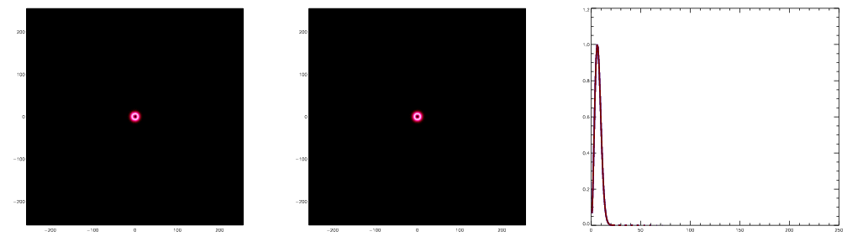
The Baryon Acoustic Oscillations
Baryons Photons Mass Profile
Figures from M.White, http://astro.berkeley.edu/~mwhite/bao/

Slide 5
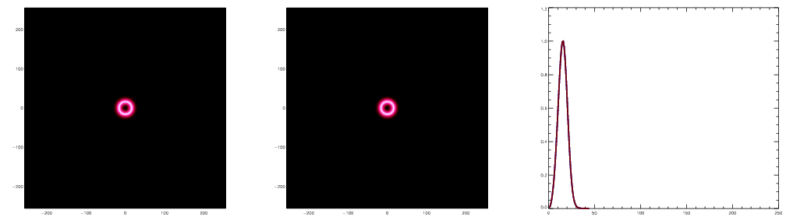
The Baryon Acoustic Oscillations
Baryons Photons Mass Profile
Figures from M.White, http://astro.berkeley.edu/~mwhite/bao/

Slide 6
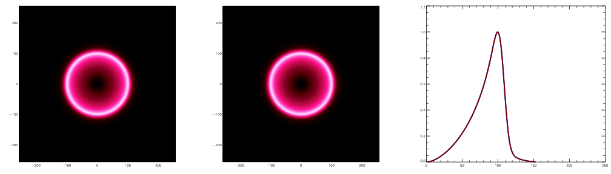
The Baryon Acoustic Oscillations
Baryons Photons Mass Profile
Figures from M.White, http://astro.berkeley.edu/~mwhite/bao/

Slide 7
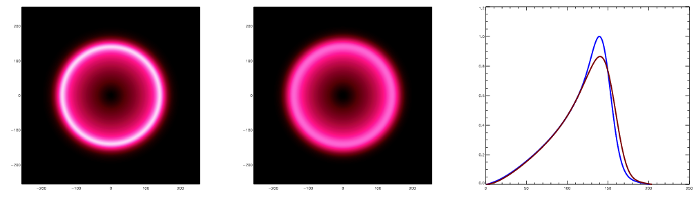
The Baryon Acoustic Oscillations
Baryons Photons Mass Profile
Figures from M.White, http://astro.berkeley.edu/~mwhite/bao/

Slide 8
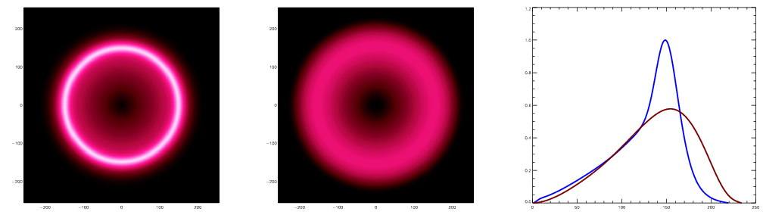
The Baryon Acoustic Oscillations
Baryons Photons Mass Profile
Figures from M.White, http://astro.berkeley.edu/~mwhite/bao/

Slide 9
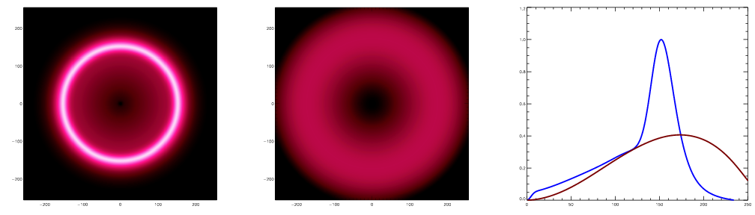
The Baryon Acoustic Oscillations
Baryons Photons Mass Profile
Figures from M.White, http://astro.berkeley.edu/~mwhite/bao/

Slide 10
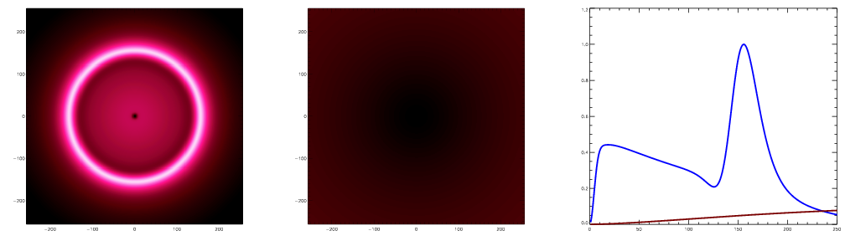
The Baryon Acoustic Oscillations
Baryons Photons Mass Profile
Figures from M.White, http://astro.berkeley.edu/~mwhite/bao/

Slide 11
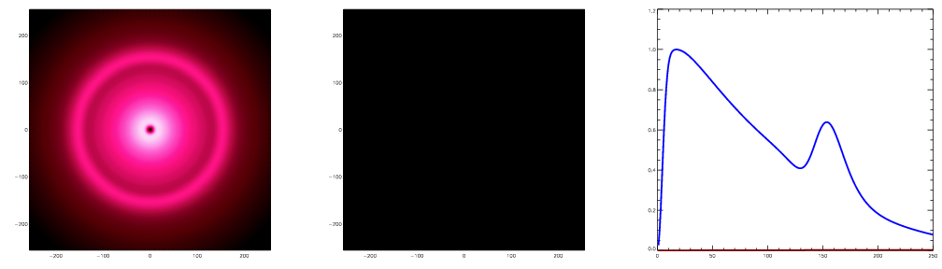
The Baryon Acoustic Oscillations
Baryons Photons Mass Profile
Figures from M.White, http://astro.berkeley.edu/~mwhite/bao/

Slide 12
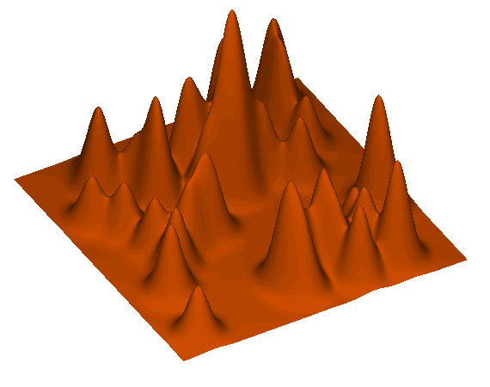
The Baryon Acoustic Oscillations
D. Eisenstein, https://www.cfa.harvard.edu/~deisenst/acousticpeak/

Slide 13
The Baryon Acoustic Oscillations
Why do we care?
Charactericstic length
s = c_{s}t_{last scatter}
independent standard ruler
Dark Energy!

Slide 14
The Supersonic Relative Velocity Effect
At recombination, baryonic sound speed drops
Results in supersonic velocity relative to dark matter
→ Jeans mass increases
→ Structure formation delayed
In theory, this effect shifts the BAO peak (Yoo et al).
GOAL: Reproduce this result and test theoretical model with simulations/real data.

Slide 15
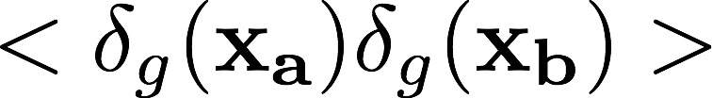
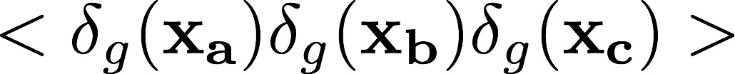
The Supersonic Relative Velocity Effect
Galaxy Density Fluctuation (Yoo et. al):
Relevant measurements:
Correlation function (power spectrum)
Three-point function (bispectrum)

Slide 16
The Supersonic Relative Velocity Effect: Power Spectrum

Slide 17
Future Work
Convert Yoo et al model to configuration space
Construct simulations for three-point function
Compare these results to real data from SDSS
Goal: constrain bias parameters, and thus the supersonic relative velocity contribution

Slide 18
References and Acknowledgements
[1] J. Yoo, N. Dalal, and U. Seljak, Supersonic relative velocity effect on the baryonic acoustic oscillation measurements, J. Cosmol. Astropart. Phys. 7, 018 (2011).
[2] D. Eisenstein et al., Detection of the baryon acoustic peak in the large- scale correlation function of SDSS luminous red galaxies, Astrophys. J. 633, 2 (2005).
[3] D. Eisenstein et al., On the robustness of the acoustic scale in the low-redshift clustering of matter, Astrophy. J. 664, 660 (2007)
[4] D. Tseliakhovich and C. Hirata, Relative velocity of dark matter and baryonic fluids and the formation of the first structures, Phys. Rev. D 82, 083520 (2010).
[5] I. Szapudi, Three-point statistics from a new perspective, Astrophys. J. 605, 2 (2004).
Thanks to my adviser, Nikhil Padmanabhan, for guiding me through this project

Slide 19
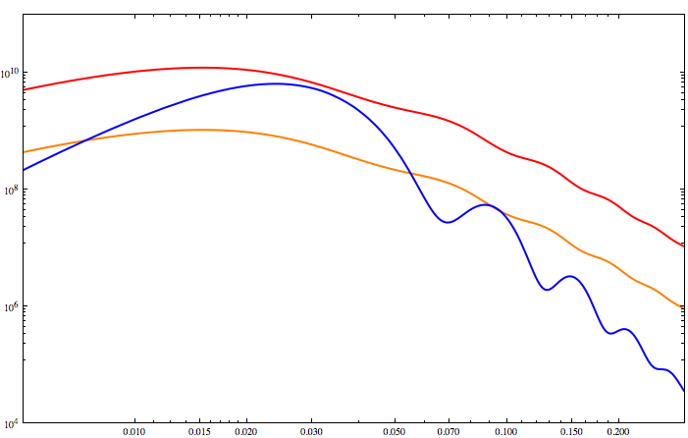
The Supersonic Relative Velocity Effect: Bispectrum
Galaxy Bispectrum (Mpc⁶)
k (h Mpc⁻¹)

