Slide 1
Life Expectancy: Prediction & Analysis using ML

Slide 2
Roles and Responsibilities:
Saikumar kandukuri – 700740522
Created and validated predictive models that can estimate life expectancy by utilizing specific features. After evaluating the models, I effectively conveyed the results to the team. Additionally, I promptly reported any encountered problems to the team and collaborated with them to find suitable solutions.
Padma Priya Naraharisetty – 700743220
Collected, sanitized, and prepared the data for analysis by extracting and preprocessing it. I enhanced the model to ensure optimal performance and scalability. Employing statistical methods, I identified significant features and patterns within the data. I implemented machine learning algorithms using the selected features and models created during the data analysis phase.
Madala Lingaiah Chowdary – 700747365
Performed experiments to assess the effectiveness of the developed models, aiming to ensure their accuracy and reliability. Through rigorous testing and validation, I identified and addressed any errors or issues present in the models. Additionally, I took responsibility for creating and maintaining comprehensive documentation for the models, including user manuals and technical specifications.
.

Slide 3
Objectives
The primary goal of the project is to predict life expectancy using machine learning techniques.
Understanding life expectancy is important for assessing public health and capturing child mortality rates.
The project focuses on conducting an experimental analysis using country-level life expectancy data.
The study primarily focuses on the impact of immunization on life expectancy.
Our project aims to determine the statistical significance of different features/attributes by experimenting with various combinations of models. We utilize multiple regression models to assess the linear relationship between the dependent and independent variables.

Slide 4
Related work
The study investigated many factors that have the potential to impact life expectancy, including GDP, illness rates, and education levels.
Three separate multiple linear regression models were created to predict life expectancy, with each model focusing on income, health indicators, and education levels as independent variables.
The study concluded that these three factors, namely income, health indicators, and education levels, have a significant influence on life expectancy.

Slide 5
The main objectives of life expectancy research are to develop parametric life expectancy models and forecasting models using mortality patterns and sample populations.
These models integrate empirical research on factors like weight, respiration rate, heart rate, and blood pressure to estimate life expectancy.
The study revealed that education, healthcare, and technology have a significant and positive influence on life expectancy.
The findings of this research can be valuable for governments and insurance companies in developing nations, as it provides insights into the impact of these factors on life expectancy.

Slide 6
The study intends to assess the efficacy of two feature selection methods in conjunction with data from thoracic surgery, along with seven machine learning techniques.
Feature selection plays a crucial role in identifying factors that influence post-operative life expectancy for lung cancer patients who undergo major thoracic surgeries.
The research emphasizes the significance of the patient's pre-existing health conditions as a possible predictor of surgical-related mortality.
The study evaluates the performance of seven machine learning techniques, including Naive Bayes, Linear SVM, MLP, RBF Network, SMO, KNN, and CART.

Slide 7
The task of predicting life expectancy is complex due to the extensive range of variables that must be taken into account.
Attempting to measure, classify, characterize, and predict using generic statistical values can be challenging and may result in inaccuracies.
The emergence of smartphone and wearable device applications, combined with advancements in data science technologies, has improved the accessibility of health-related data.
This increased accessibility to health data can be advantageous in predicting life expectancy more accurately.

Slide 8
Despite some countries having life expectancy surpassing 70 years, there are regions with low life expectancy requiring analysis.
The study examines life expectancy data using 18 features, including GDP, illness rates, and school index.
Three MLR models are used to analyze the data, recording R2 values for both developed and emerging nations.
The data on life expectancy has a high number of dimensions, necessitating careful examination to uncover significant insights.
Two feature selection techniques, correlation coefficient and mutual information, are combined with Decision Tree Regression, K Nearest Neighbor Regression, and Linear Regression algorithms.
The performance of the models is assessed using metrics such as RMSE, MAE, and R2 error to determine their effectiveness.

Slide 9
The project focuses on examining the factors that affect mortality rates or life expectancy.
The dataset used for this project is sourced from Kaggle and includes 22 indicators related to hepatitis, economic factors, social aspects, and other variables.
The primary emphasis of the study is on the vaccination component and its influence on life expectancy.
Machine learning algorithms and feature selection approaches will be employed to predict life expectancy based on the available indicators.
The recommended algorithms for this investigation are the Linear Regressor, Random Forest Regressor, and XGBoost Regressor.
The project aims to analyze and understand the relationship between various factors and life expectancy using data-driven methods.

Slide 10
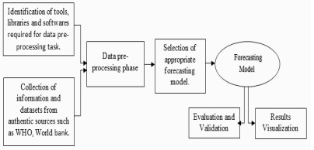

Slide 11
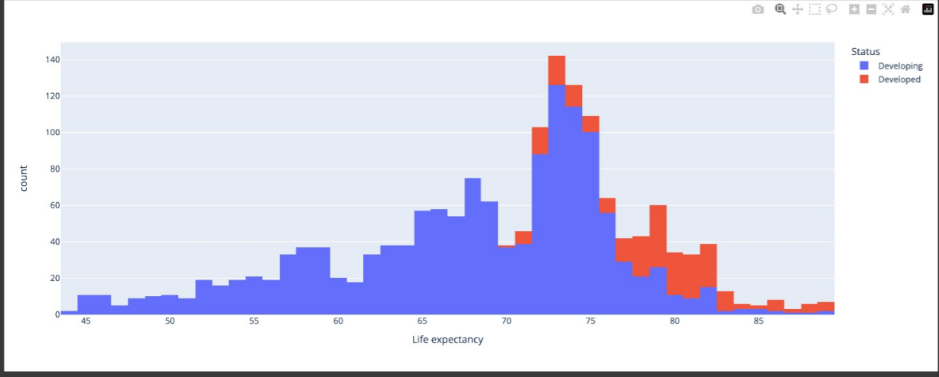

Slide 12
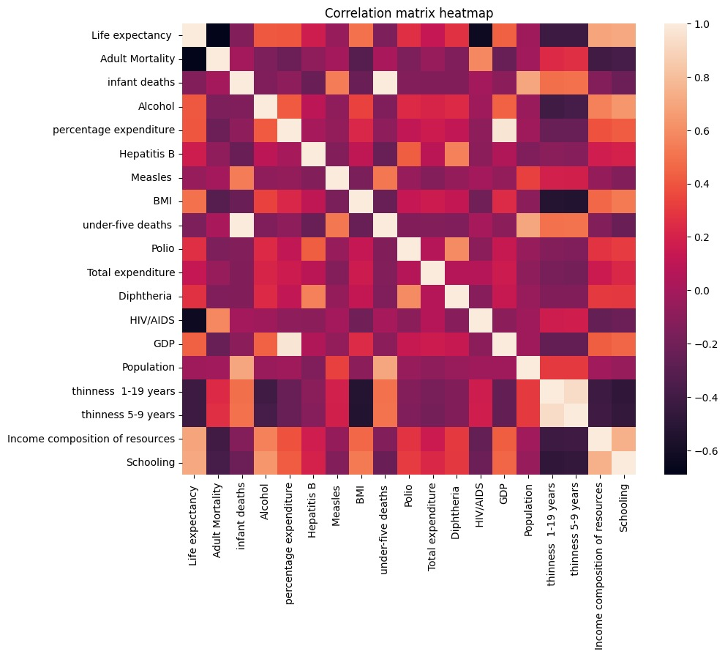
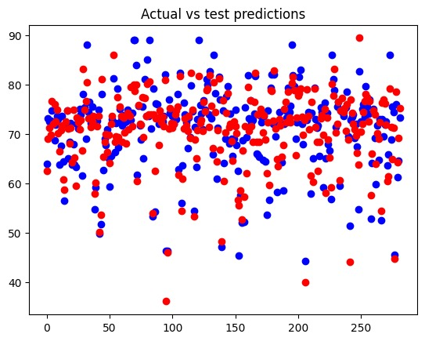

Slide 13
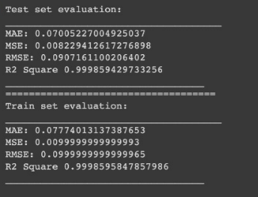
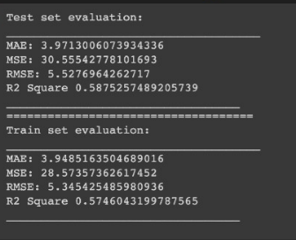
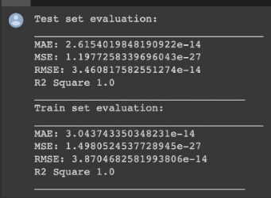
Linear , Ridge and Lasso Test evaluation

Slide 14
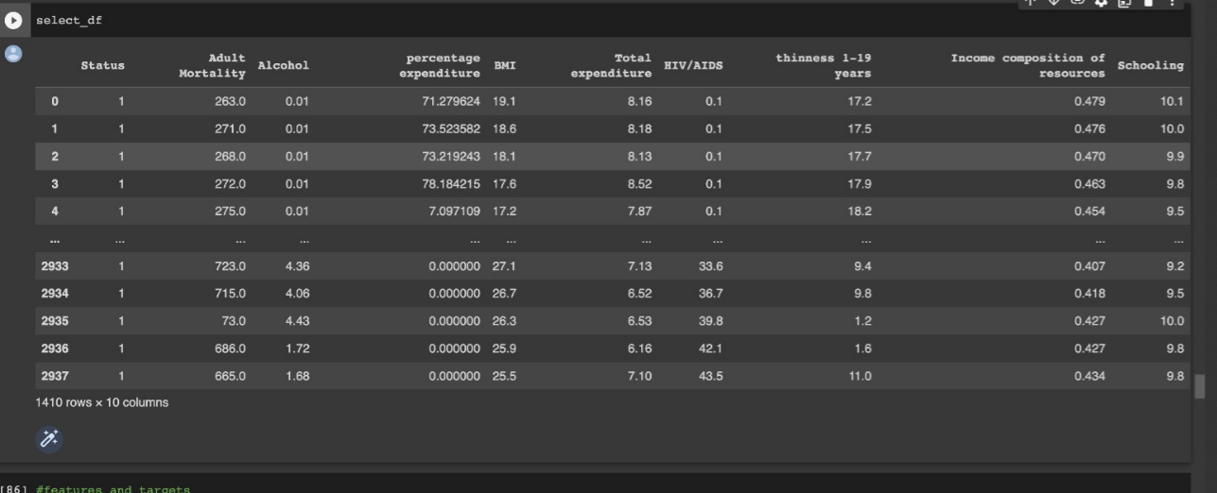
Feature Selection

Slide 15
REFERENCES
Bhosale, A.A. and Sundaram, K.K., “Life prediction equation for human beings,” International Conference on Bio informatics and Biomedical Technology, vol. IEEE, pp. 266-268, 2019.
Kerdprasop, N. and Foreman, K. J., “Association of economic and environmental factors to life expectancy of people in the Mekong basin,” IEEE Conference on Industrial Electronics and Applications (ICIEA), pp. 1984-1989, 2017.
Beekshma., “A neural-network analyzer for mortality forecast,” ASTINBulletin: The Journal of the IAA, vol. 48, no. 2, pp. 481-508, 2018.
Sormin, M.K.Z., Sihombing, P., Amalia, A., Wanto, A.,Hartama, D. and Chan, D.M., “Predictions of World Population Life Expectancy Using Cyclical Order Weight/Bias,” Physics: Conference Series (IOP Publishing), vol. 1255, no. 1, p. 012017,2019.
Foreman, K.J., Marquez, N., Dolgert, A., Fukutaki, K., Fullman,N., McGaughey, M., Pletcher, M.A., Smith, A.E., Tang, K.,Yuan, C.W. andBrown, J.C., “Forecasting life expectancy, yearsof life lost, and all- cause and cause-specific mortality for 250causes of death: reference and alternative scenarios for 2016–40 for 195 countries and territories,” The Lancet, vol. 392, no.10159, pp. 2052- 2090, 2018.
Aggarwal, D., Mittal, S., Bali V., “Prediction Model Based on Performance using Machine Learning Techniques,” International Journal of Recent Technology and Engineering, vol.8 p.2S7, 496-503, 2019

Slide 16
REFERENCES
Mathias, J.S., Agrawal, A., Feinglass , Cooper, A.J., Baker,D.W. andChoudhary, A., “Development of a 5-year life expectancy index in older adults using predictive mining of electronic health record data,” Journal of the American Medical Informatics Association, vol. 20, no. e1, pp. 118- 124, 2013.
Verberne, S., van den Bosch, A., Das, E., Hendrickx, I. and Groenewoud, S., “Predicting life expectancy with a long short-term memory recurrent neural network using electronic medical records,” BMC medical informatics and decision making, vol.19, no. 1, p. 36, 2019.

Slide 17
Thank you
Sai Kumar Kandukuri - 700740522
Padma Priya Naraharisetty - 700743220
Madala Lingaiah Chowdary - 700747365

