Slide 1
COVID-19 and the Weather: A Data Visualization
Nick Palacio
Master’s Capstone Project Proposal

Slide 2
Background
Warmer weather…
Influenza and the weather?
COVID-19 and the weather

Slide 3
Proposed Project
COVID-19 and Weather Data Visualization…
…for the kids

Slide 4
Related Work
Existing COVID-19 Data Visualizations
John Hopkins
The COVID Tracking Project by The Atlantic
The Institute for Health Metrics and Evaluation (IHME) at the University of Washington

Slide 5
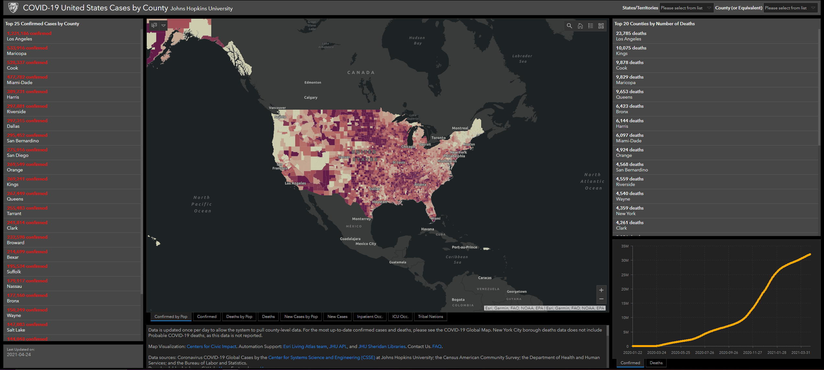
Related Work
John Hopkins

Slide 6
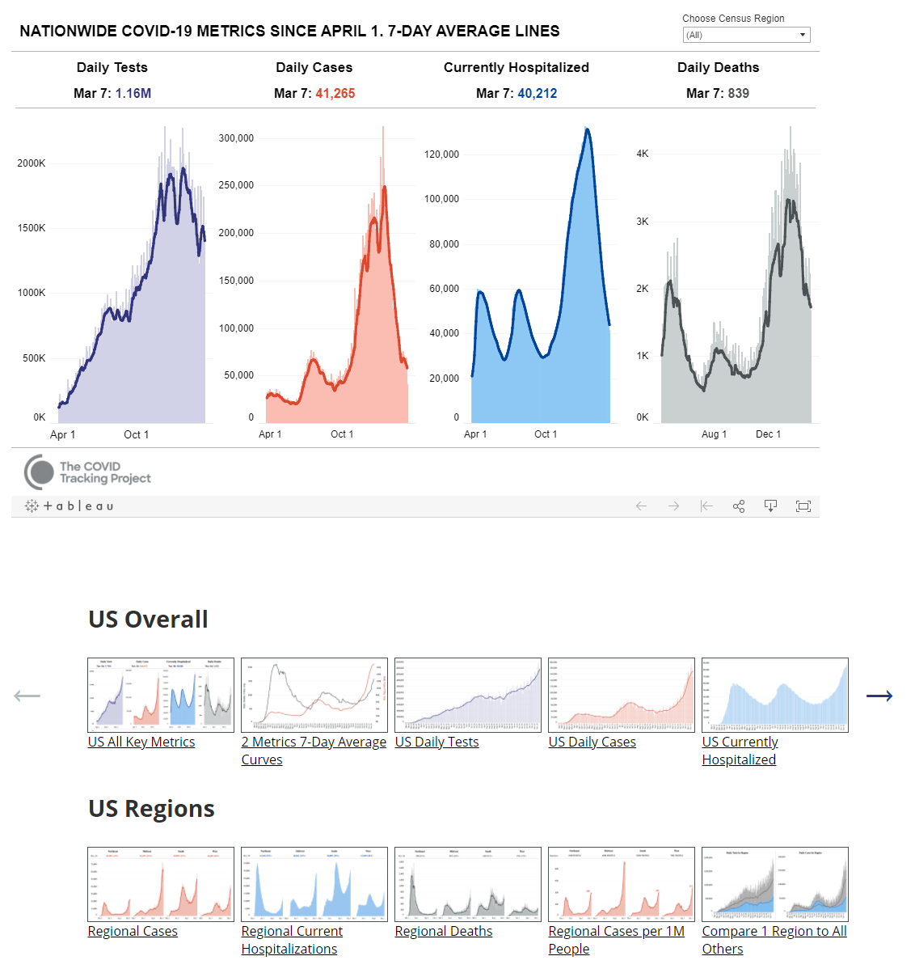
Related Work
The COVID Tracking Project by The Atlantic

Slide 7
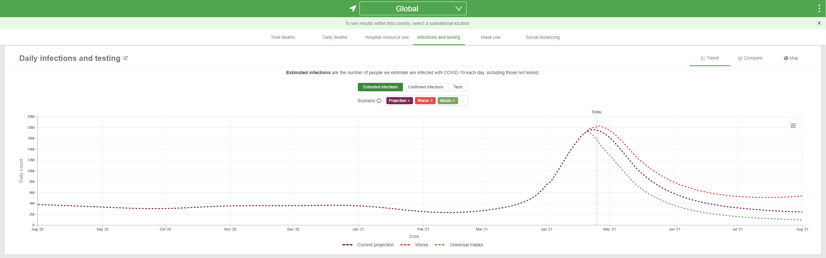
Related Work
(IHME) at the University of Washington

Slide 8
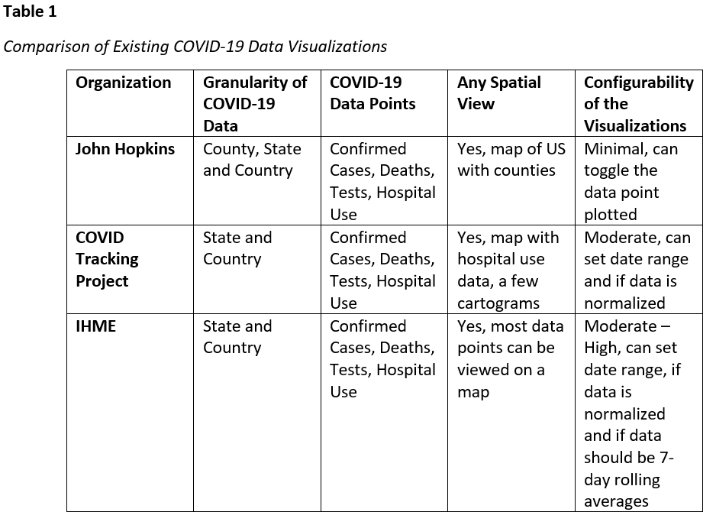
Related Work

