Slide 1
COVID-19 and the Weather: A Data Visualization
Nick Palacio
Master’s Capstone Project Proposal
Notes:
-who am I
-Nick Palacio
-Application Developer at FCSA for 2.5 years
-Been working on my Masters in Computer Science from UNO since 2017, set to graduate this August
-FCSA: what is this presentation
-This is my project proposal for my Masters Capstone project
-Will be presenting this to my graduate committe this Thursday
-This committee consists of 3 professors from UNO:
-Dr. Brian Dorn, Associate Professor of Computer Science
-Dr. Rex Cammack, Associate Professor of Geography
-Dr. Brian Ricks, Associate Professor of Computer Science
-They will decide if my project can move forward where I would implement it over the summer or if changes need to be made before that can happen
-This presentation will be:
-me creating some context around what my project is and why it is important
-then I'm going to talk about some related work already out there that is similar to what I want to do
-finally I will go in depth on what my project actually is and how I will build it as well as why

Slide 2



Background
Warmer weather…
Influenza and the weather?
(Roussel et al., 2016)
COVID-19 and the weather
(Jamshidi et al., 2020)
(McClymont & Hu, 2021)
Notes:
-Some of you might remember when this pandemic began last spring some people said this would all just 'go away' with warmer weather...
-While we know that this did not all just 'go away', people were bringing this up because weather's effect on the season flu is actually well established.
-There was a study done in France in 2016 that looked at weather's role on seasonal influenza spread (Roussel et al., 2016)
-This study found that a couple groups of weather variables had an impact of influenza spread
-The first group was temperature, aboslute humidity and daily variation of aboslute humidity
-The second group was sunshine duration, relative humidity and daily variation of relative humidity
-The impact of these groups of weather variables was found to be between 3% - 6%, so relatively low but still there
-This study mentioned that their results were consistent with similar studies in other parts of the world where a weather impact on influenza spread was found to be a few percent as well
-There have been a few studies this last year looking at weather's role in the COVID-19 pandemic
-Results have been mixed
-One literature review summarized the work of 23 studies that investigated the relationship between COVID-19 transmission and different weather variables (McClymont & Hu, 2021)
-This literature review found that most studies who looked at temperature or humidity found a correlation with COVID-19 transmission\
-However, some reported a positive correlation while others reported a negative correlation
-Another study published in the same journal highlighted an issue with the existing research on COVID-19 and weather (Jamshidi et al., 2020)
-They said that existing research only considers weather variables during analysis
-Instead, this study looked at weather variables alongside other things like population mobility (how much are people moving around) and urban density (how populated is this area)
-They found that weather's impact was small, a few percent, where as things like population mobility and urban density had a much higher impact, 34% and 13%
-One limitation to point out with both of these studies is the data that they had to work with
-One study was submitted for review in September 2020 while the other study was submitted in November 2020 meaning that both of them were missing out on spikes seen in the US around the November - January timeframe

Slide 3

Proposed Project
COVID-19 and Weather Data Visualization…
…for the kids
Students and data
(Lee, et al., 2018)
Notes:
-My proposed project is a visualization tool that would allow a user to look into this relationship between weather variables and COVID-19 transmission
-What we have going on right now is an open scientific debate around weather's role in the pandemic
-This presents a unique opportunity to engage students which is why the target user for my tool would be a middle school scientist
-A tool like this could be used in a classroom activity where students are tasked with the same question of investigating weather's role in the pandemic
-Students would be expected to follow the scientific process of creating their own hypothesis and then gathering evidence to support a conclusion
-My tool would help them gather that evidence
-Students would be expected to think critically about the limitations of what they might see in the tool and what conclusions can or cannot be drawn based on what they find
-In 2018 there was a study done that looked at data use by middle and secondary school students (Lee, et. al., 2018)
-One thing they looked at was how teachers can best support students working with data
-One of their recommendations was that data should be leveraged in the classroom in the context of meaningful scientific pursuits
-My tool falls right in line with this recommendation because students would be asked to participate in this open scientific debate

Slide 4
Related Work
Existing COVID-19 Data Visualizations
John Hopkins
The COVID Tracking Project by The Atlantic
The Institute for Health Metrics and Evaluation (IHME) at the University of Washington
Notes:
-In order to start figuring out what my visualization might look like I looked at 3 existing COVID-19 data visualizations
-John Hopkins
-The COVID Tracking Project by The Atlantic
-The Institute for Health Metrics and Evaluation (IHME) at the University of Washington

Slide 5
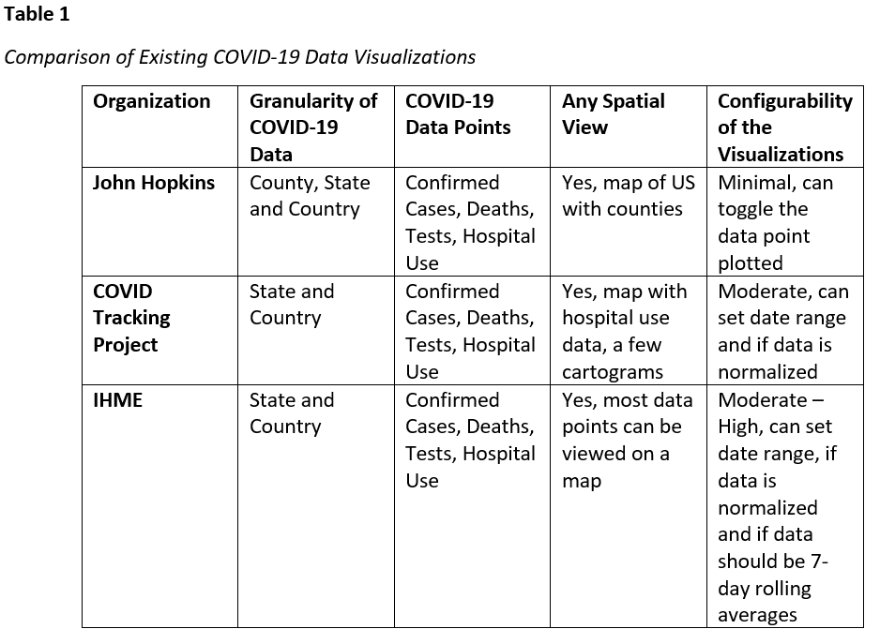
Related Work
Notes:
-I evaluated them along 4 dimensions in order to compare and contrast them with what I might want to do:
-How granular is the data?
-Which COVID-19 data points are used?
-Do they provide any spatial view?
-How configurable are they?

Slide 6
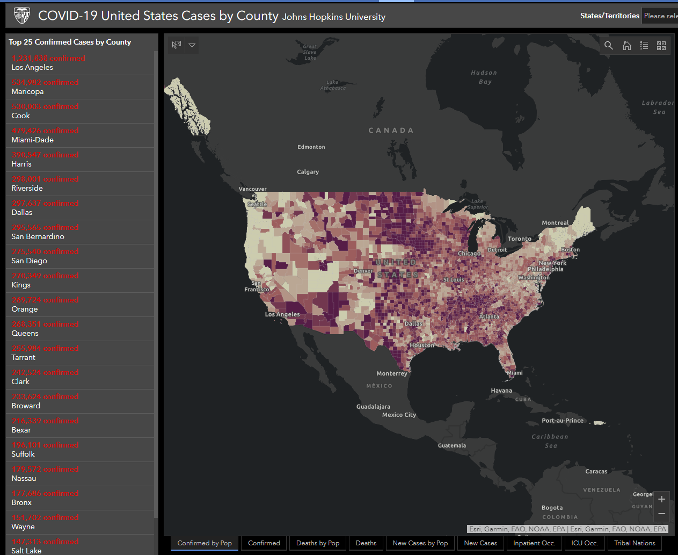
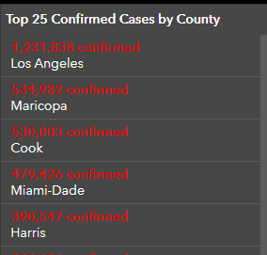
Related Work - Granularity
Notes:
-Only 1 had COVID-19 data granularity at the county level, the rest were at the state or country level
-Given that weather can vary greatly across any state the location granularity becomes much more important which is why I will use county level COVID-19 data

Slide 7
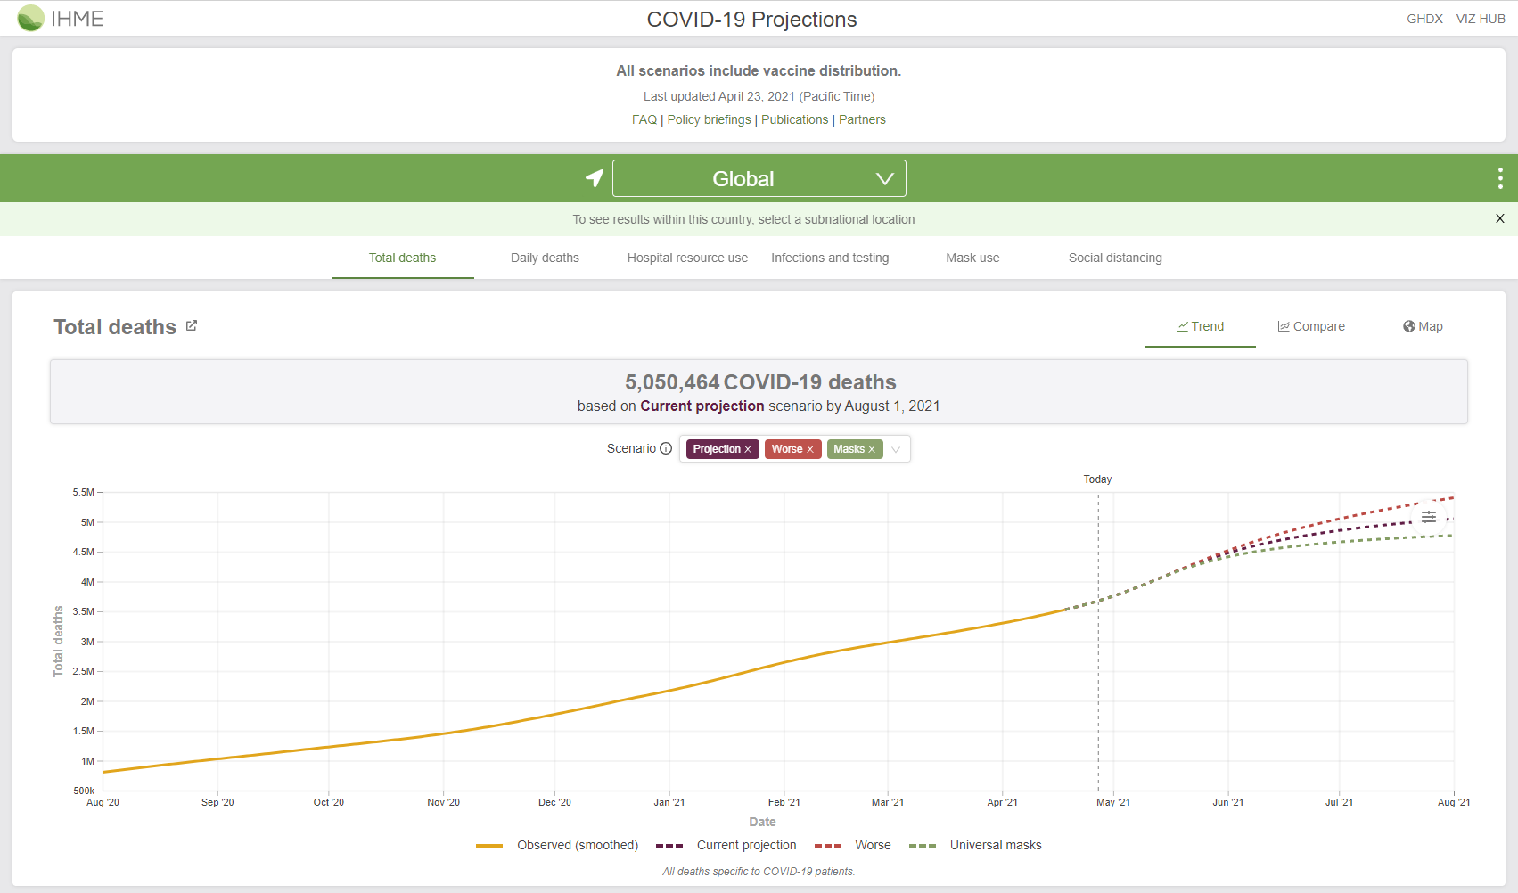
Related Work – Data Points
Notes:
-All of them used similar COVID-19 data points
-For my purposes I will be using confirmed cases

Slide 8
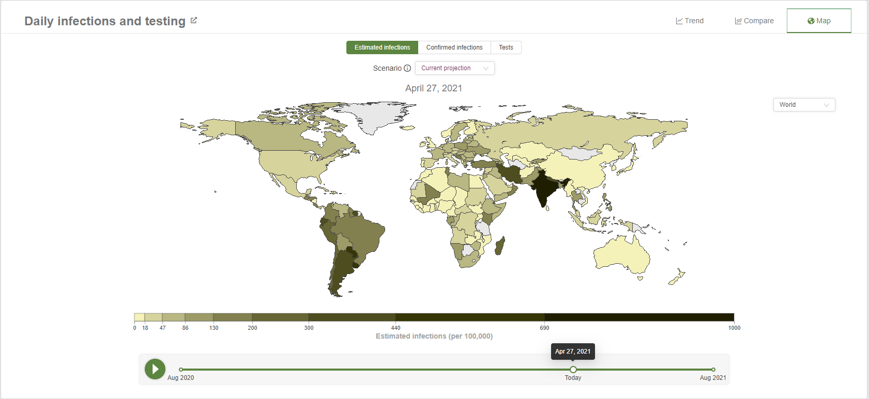
Related Work – Spatial View
Notes:
-All of them provided a spatial or map based view of the data
-Since weather and COVID-19 data has a spatial component a spatial view for my visualization would be warranted

Slide 9
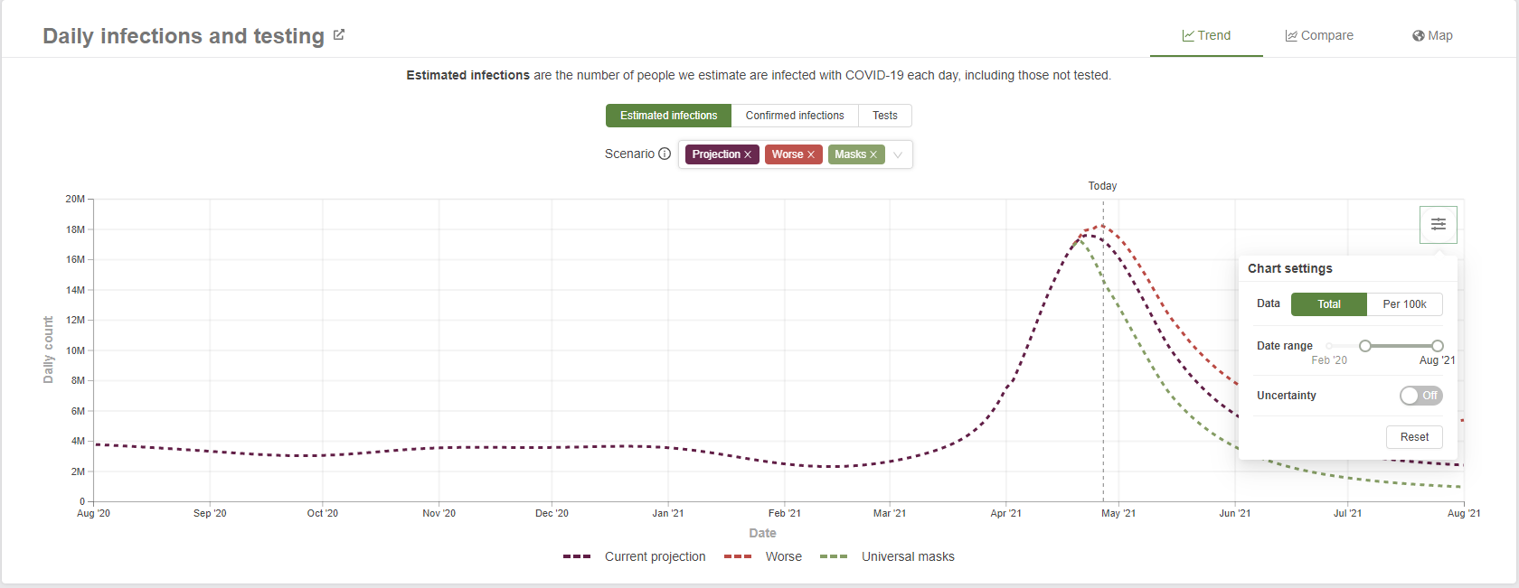
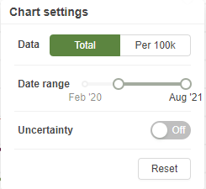
Related Work – Configurability
Notes:
-Varying levels of configurability in these visualizations
-I will offer a high level of configurability in my visualization in order to allow the user to visualize the data in a few different ways

Slide 10
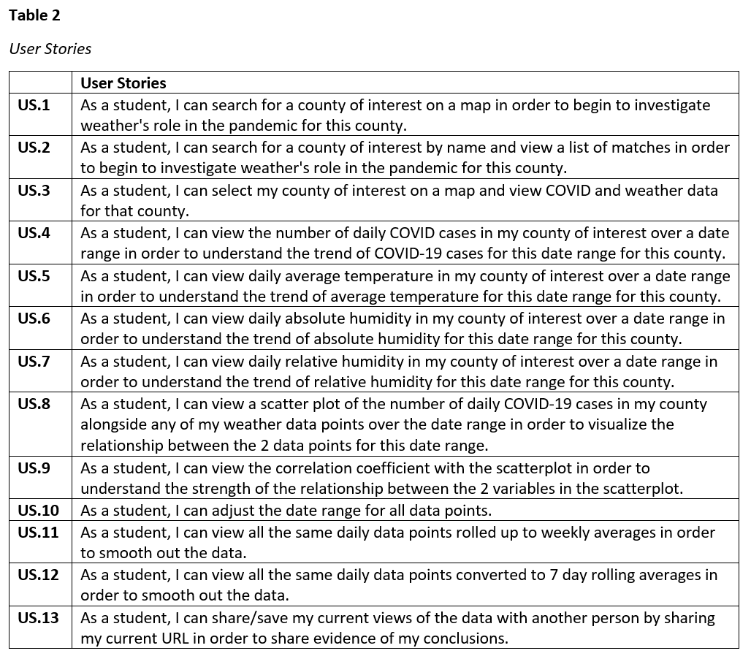
Methods
A map based web application
Notes:
-For the next part of my presentation I am going to talk about what exactly I propose building and how I think I can accomplish that
-I propose building a map based web application that will allow a user to visualize COVID-19 and weather data alongside each other in order to investigate the relationship between the two.
-The table here on the right shows the list of user stories for the project
-I’m going to walk through these in more detail with some mockups of what the screens might look like

Slide 11
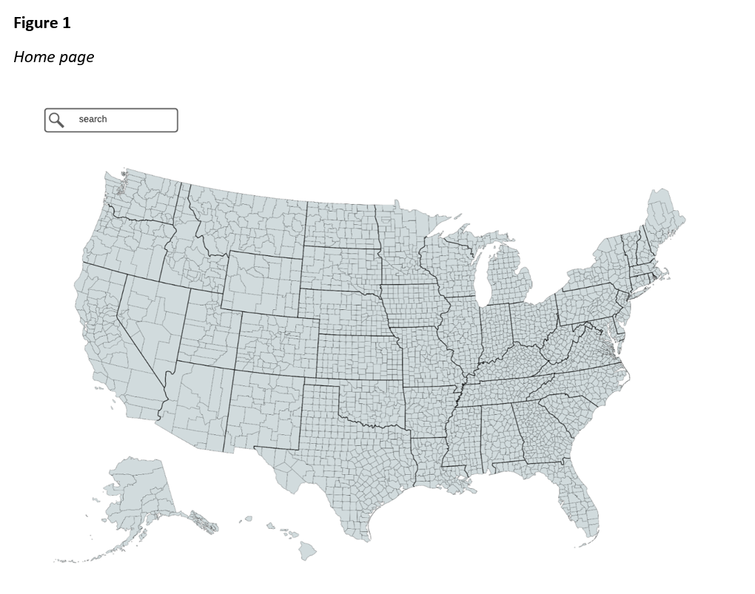
Methods
Notes:
-The image here on the left shows what the home page of the application might look like
-This mockup is related to my first 3 user stories
-These user stories center around allowing a user to find and select a county that they are interested in

Slide 12
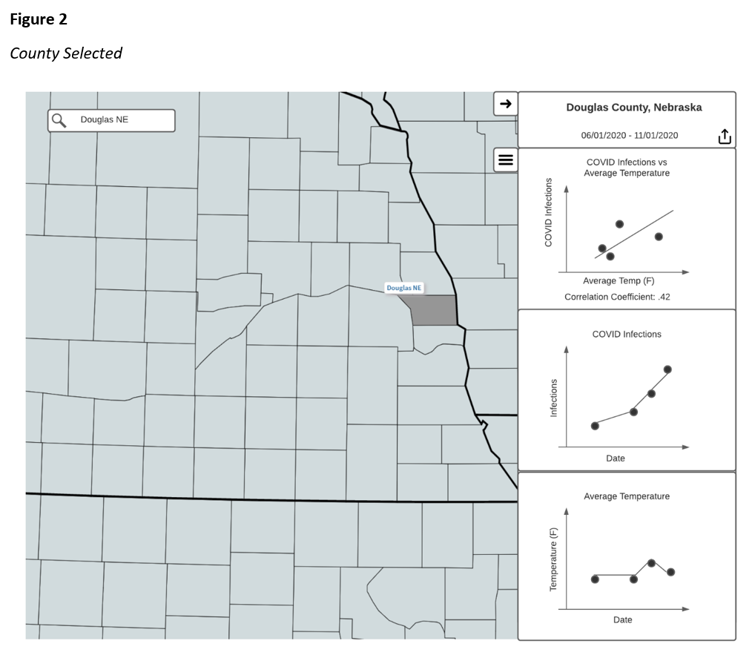
Methods
Notes:
-This next mockup shows what the screen might look like once a user has selected a county
-This is related to user stories 4 – 9
-These user stories center around visualizing the COVID-19 and weather data together

Slide 13
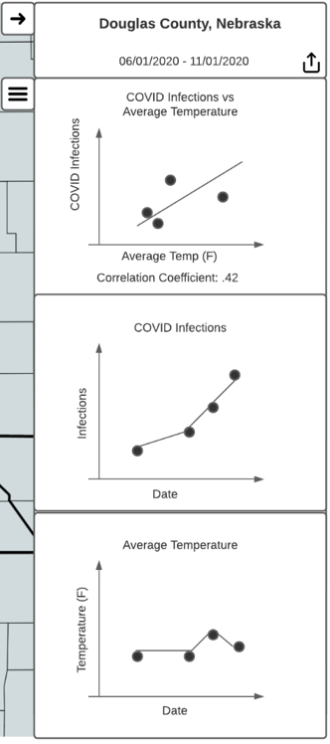
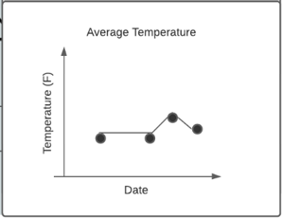
Methods
Notes:
-I’m going to talk through each of these charts we see but before I do that I wanted to provide some context around why the mockup is laid out the way it is
-There was a literature review performed in 2002 that looked at the cognitive literature on how people understand graphs. This paper looked at 3 factors that influence a viewer's understanding of a graph:
-the visual characteristics of the graph
-a viewer's knowledge about graphs
-a viewer's knowledge about the data in the graph
-This paper synthesized their findings into recommendations for how to best present graphs to students. One of their recommendations was to represent the same data in multiple formats because this helps students' understanding when there are multiple quantitative facts to communicate about the data. I have 3 quantitative facts that I wish to communicate about the data
-what is the trend of COVID-19 infections
-what is the trend of the weather data point, temperature for instance
-what is the covariance of COVID-19 infections with the weather data point
-On this bottom chart we can see the average temperature for this county across this date range

Slide 14
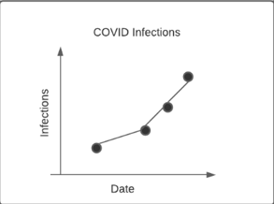
Methods
Notes:
-On this middle chart we can see the COVID-19 infections for this county across this date range

Slide 15
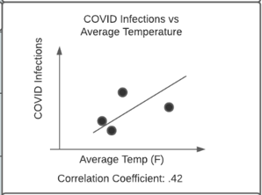
Methods
Notes:
-On this top chart we can see a scatter plot of COVID-19 infections and average temperature along with the correlation coefficient which, from a high level, is a number that shows you how correlated 2 variables are

Slide 16
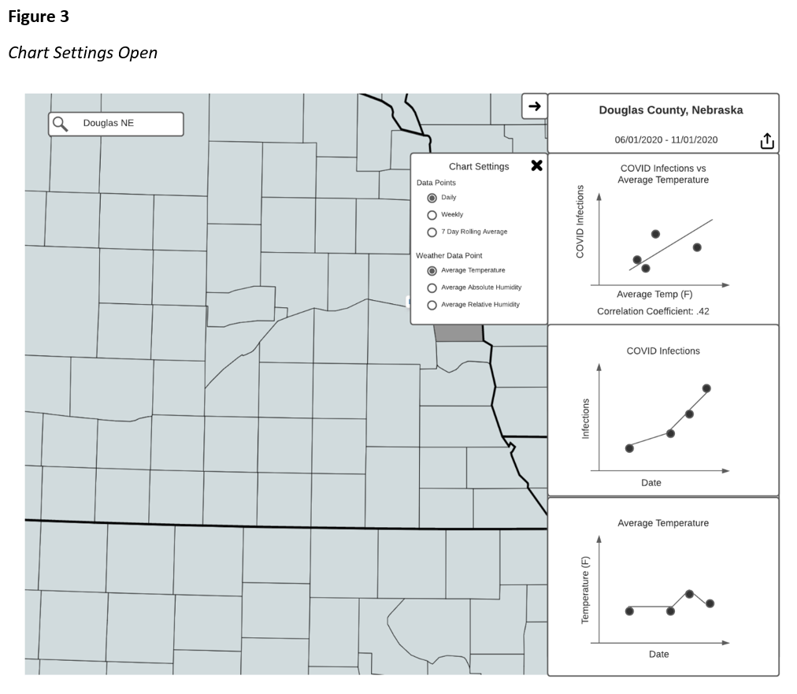
Methods
Notes:
-In this mockup we see the chart settings menu opened up
-This mockup is related to user stories 10 – 12
-These user stories center around the configurability of the visualization

Slide 17
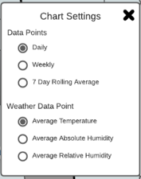
Methods
Notes:
-Here is a better picture of what that chart settings menu looks like
-The top selection that a user can make here is how the data is aggregated
-Users will be able to view the data points as daily data points, weekly averages or 7-day rolling averages
-This was actually something I found in the previous papers that looked at weather and influenza and covid-19
-These papers rolled up their data to weekly averages or 7-day rolling averages in order to smooth out the data
-This becomes more important for the COVID datasets because there are large spikes that can occur due to variations in how many tests were performed in a county day to day
-This feature allows a user to smooth out those spikes
-The other selection here is the weather data point
-Users will be able to select a weather data point from a predefined list
-When a user changes this selection they would see the bottom and top charts update
-So for instance if a user changed the selection from Average Temperature to Average Relative Humidity…

Slide 18
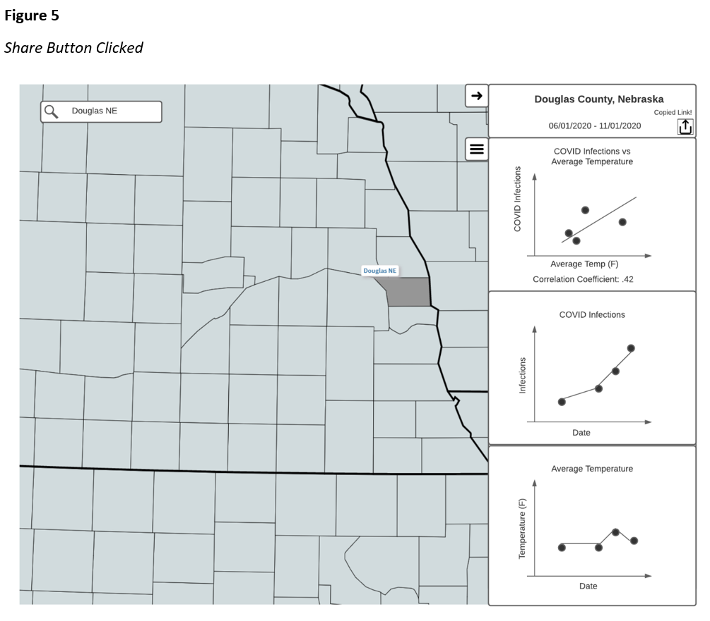
Methods
Notes:
-This last mockup here is related to user story 13 that deals with how a student can gather evidence they can reference for their conclusion

Slide 19

Methods
Notes:
-Here is a better view of what that looks like to the user
-Basically, I plan on encoding the current application state in the URL so that when a student wants to share what they are seeing on their screen with someone else they just need to copy the link
-Then when someone else opens that link they would be taken to the same county with all the same chart settings selected

Slide 20
Methods
Data Sources
COVID: New York Times dataset on GitHub
Weather: WeatherSource API
Notes:
-Now I'm going to talk about how I would go about building this, starting with my data sources
-I evaluated several data sources for both COVID-19 and Weather data.
-For COVID-19 data I decided on the New York Times dataset on GitHub
-Cumulative cases by county by day for all counties in US.
-Weather
-For my weather data I decided on using an API from WeatherSource
-WeatherSource is a technology company that provides a suite of products that help businesses leverage weather and climate data
-On March 16th, 2020 WeatherSource opened up their API for free to any researchers exploring the relationship between weather and the COVID-19 pandemic
-One of their APIs allows you to query many different weather data points by location using latitude and longitude or a zip code along with a date range
-Data can be returned in an hourly or daily format
-For my purposes I will be querying average temperature, average relative humidity and average absolute humidity by lat/long and a date range where the lat/long will be the centroid of the county the user has selected
-Data returned in a daily format

Slide 21
Methods
Data transformation
COVID-19 Cumulative Cases By Day → New COVID-19 Infections By Day
Daily → Weekly Average
Daily → 7-Day Rolling average
Notes:
-The data from those sources will need a little bit of transformation for my purposes
-For the COVID data, I start with cumulative case counts by day for a county
-I need to end up with new infections by day for a county
-For any given day, subtract the cumulative case count for the previous day from the current day and you get new infections on that current day
-This can then be rolled up to a weekly or 7-day rolling average
-For the Weather data, I start with the daily data points I need already
-Then I can convert them to weekly or 7-day rolling averages in the same way as the COVID-19 data

Slide 22
Methods
Resources
Azure
App Service
ASP.NET Core Web App (Angular frontend, API endpoints)
Azure SQL Database
COVID-19 data
Azure Function or WebJob
Recurring update of COVID-19 data
GitHub
GitHub Actions
Notes:
-I plan on building my project in the cloud...no pun intended
-Azure offers a free student account
-Here are the Azure resources I think I will use
-Azure App Service
-To host an ASP.NET Core Web Application that will serve up an Angular frontend and provide API endpoints for serving up the COVID-19 and weather data
-Azure SQL database
-Loaded nightly or weekly with COVID-19 data from the New York Times dataset on Github
-Used by API serving up COVID-19 data
-Azure Function or WebJob inside App Service
-For this nightly load I am currently trying to decide between a WebJob or an Azure Function, any help would be much appreciated
-1.2 million rows of data, ~12 MB
-Leaning towards Function
-Code repository hosted on GitHub with GitHub actions for CI/CD

Slide 23
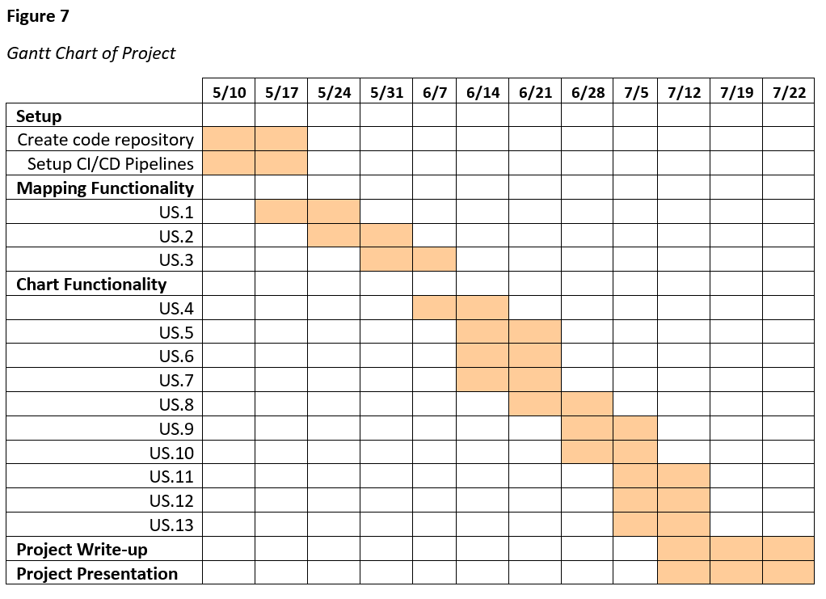
Timeline
Notes:
-Here is a rough timeline for the development tasks that I would need to do for this project
-I will need to have it finished the week of July 22nd because that is when I would need to be doing another presentation with the finished product in order to graduate on time

Slide 24
Summary
Notes:
-In summary, I propose building a visualization tool that would allow a user to investigate weather's role in the pandemic with the goal of engaging students in a real world scientific debate where they would be expected to follow the scientific process and think critically about what they might find.

Slide 25

Questions
Notes:
-Before I open it up to everyone for questions I would actually like to discuss 2 questions I received from Dr Ricks on my graduate committee because they’re really good questions
-'If researchers have found that the relationship between weather and COVID spread is low, what do you think the middle school students will conclude?’
-My project is not really about what a user might find
-The real purpose of building this tool is to enable a classroom activity that engages students by having them follow the scientific process and think critically
-We want the students to think critically about what they are seeing in this tool and more specifically what they are not seeing
-It is very plausible that students could go to a county and see what they think is a strong correlation between weather and COVID-19 infection rates
-We want them to be challenged to think about what else could be causing this? What am I not seeing?
-For instance, what local policies were enacted in this county and when? What's the mobility index for this county across this date range?
-This same learning opportunity actually applies to adults as well
-How many data visualizations do we see in the news or on social media?
-Thinking critically about what those are showing you as well as what they’re not showing you is just as important for us adults as it is middle school students
-So in a way we're pushing a lot of responsibility outside of the tool because it allowed us to scope my project to a limited set of concerns, weather and COVID-19
-It would be nearly impossible to create a tool that truly explained COVID-19 infection rates because there’s an infinite number of variables to consider
-'Do you have any thoughts about how to determine if the project accomplished the goal of student learning?’
-The right way to validate this tool would be through usability studies where we actually create a classroom activity and put it in front of real students in a classroom
-However, for the purposes of my capstone project and due to time constraints that will be out of scope
-My definition of success for this project will be if it is ready for usability testing in a real classroom context

Slide 26
References
Jamshidi, S., Baniasad, M., & Niyogi, D. (2020). Global to USA County Scale Analysis of Weather, Urban Density, Mobility, Homestay, and Mask Use on COVID-19. International Journal of Environmental Research and Public Health, 17(21), 7847. https://doi.org/10.3390/ijerph17217847
Lee, Victor R, and Michelle H Wilkerson. “Data Use by Middle and Secondary Students in the Digital Age: A Status Report and Future Prospects,” n.d., 43.
McClymont, H., & Hu, W. (2021). Weather Variability and COVID-19 Transmission: A Review of Recent Research. International Journal of Environmental Research and Public Health, 18(2), 396. https://doi.org/10.3390/ijerph18020396
Shah, P., & Hoeffner, J. (2002). Review of Graph Comprehension Research: Implications for Instruction. Educational Psychology Review, 14(1), 47–69. https://doi.org/10.1023/A:1013180410169
Roussel, M., Pontier, D., Cohen, J.-M., Lina, B., & Fouchet, D. (2016). Quantifying the role of weather on seasonal influenza. BMC Public Health, 16, 441. https://doi.org/10.1186/s12889-016-3114-x

