Slide 1
COVID-19 and the Weather: A Data Visualization
Nick Palacio
Master’s Capstone Project Proposal

Slide 2



Background
Warmer weather…
Influenza and the weather?
(Roussel et al., 2016)
COVID-19 and the weather
(Jamshidi et al., 2020)
(McClymont & Hu, 2021)

Slide 3

Proposed Project
COVID-19 and Weather Data Visualization…
…for the kids
Students and data
(Lee, et al., 2018)

Slide 4
Related Work
Existing COVID-19 Data Visualizations
John Hopkins
The COVID Tracking Project by The Atlantic
The Institute for Health Metrics and Evaluation (IHME) at the University of Washington

Slide 5
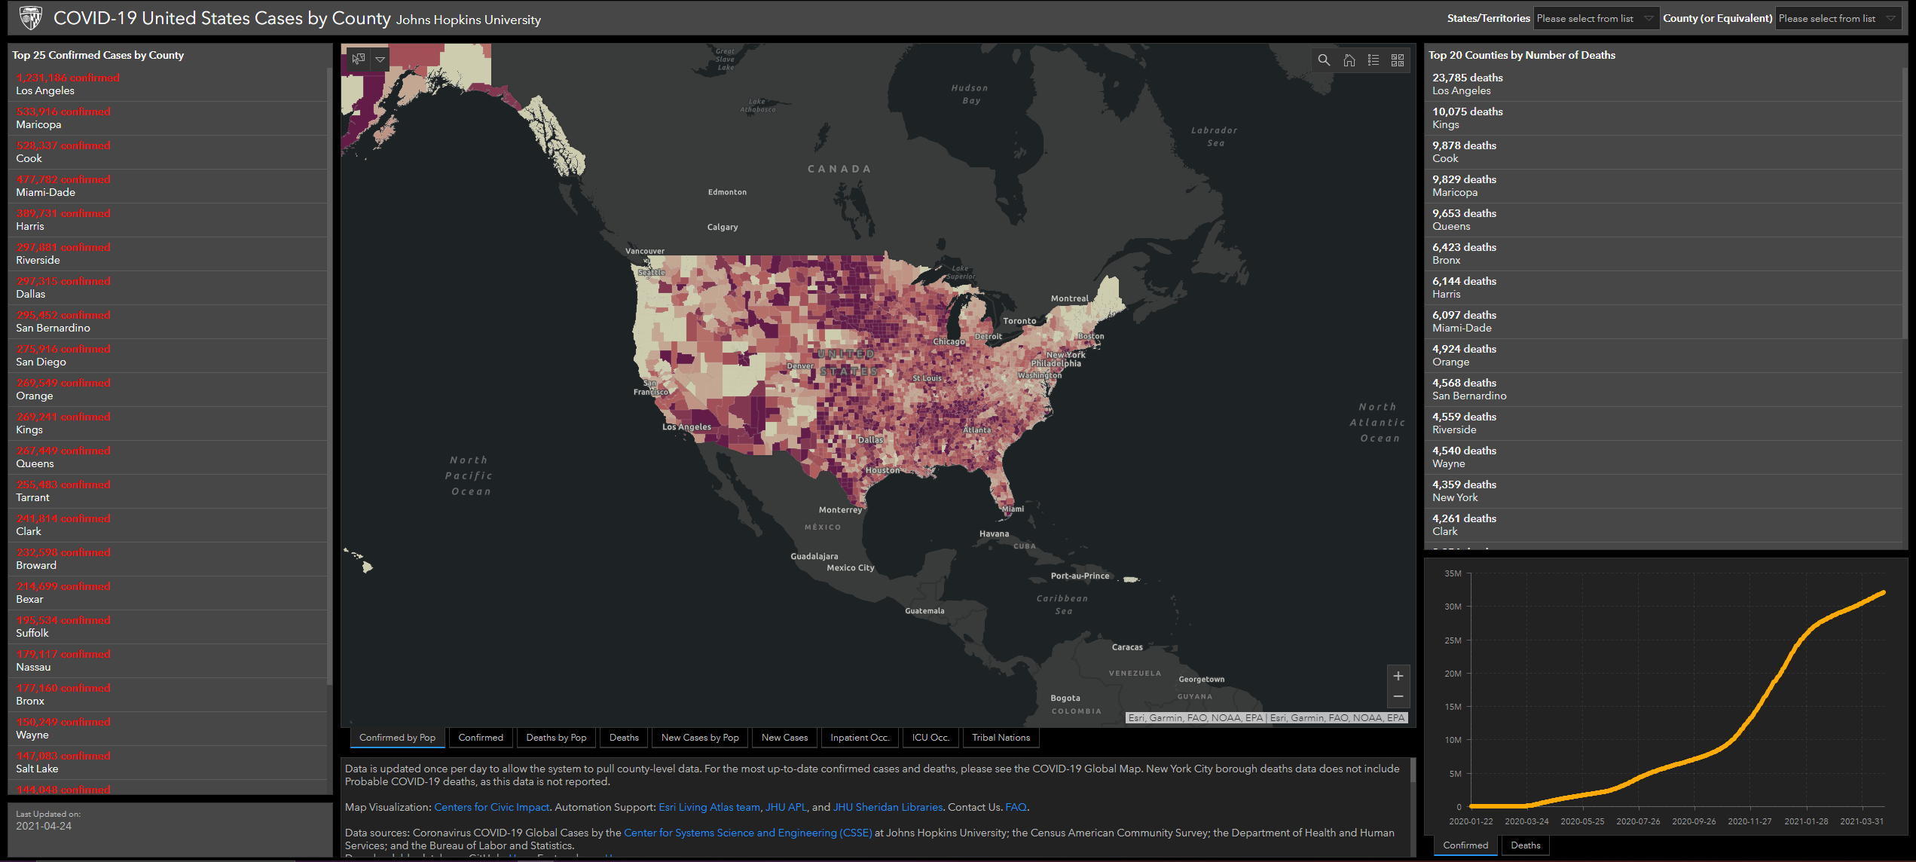
Related Work
John Hopkins

Slide 6
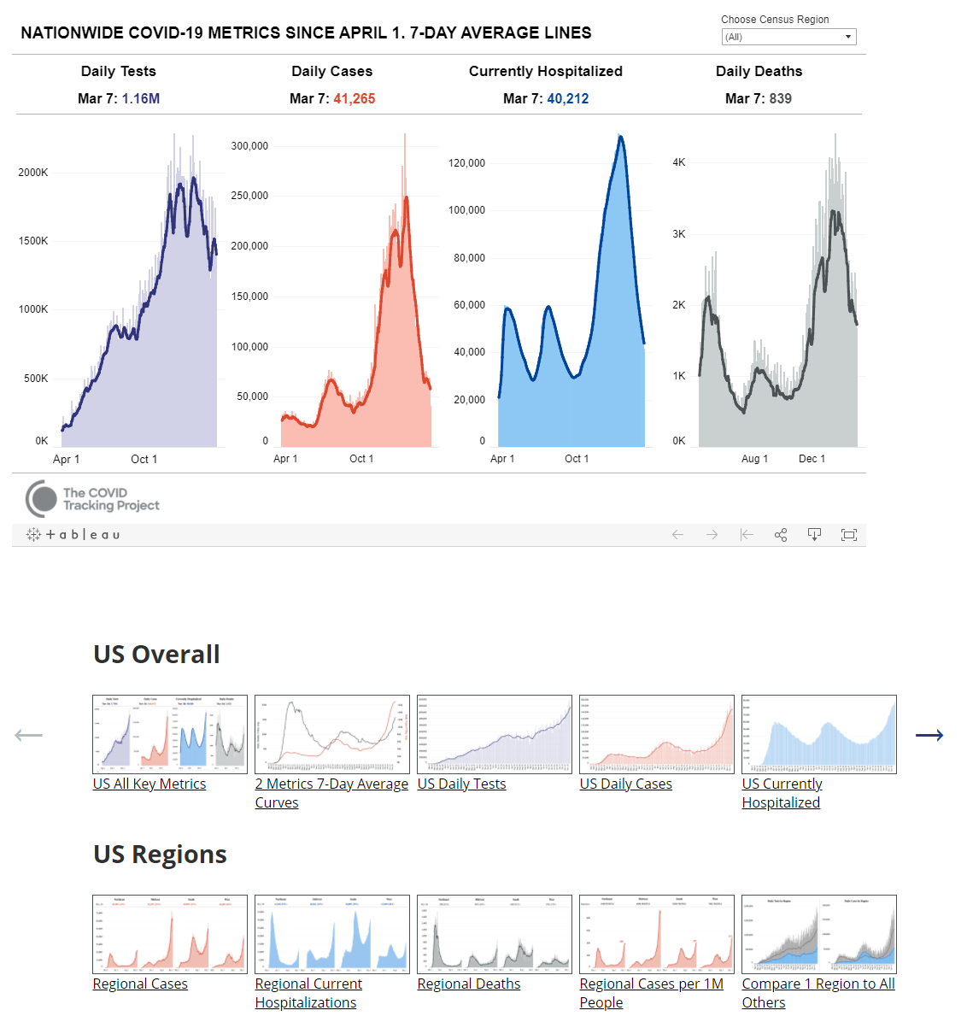
Related Work
The COVID Tracking Project by The Atlantic

Slide 7
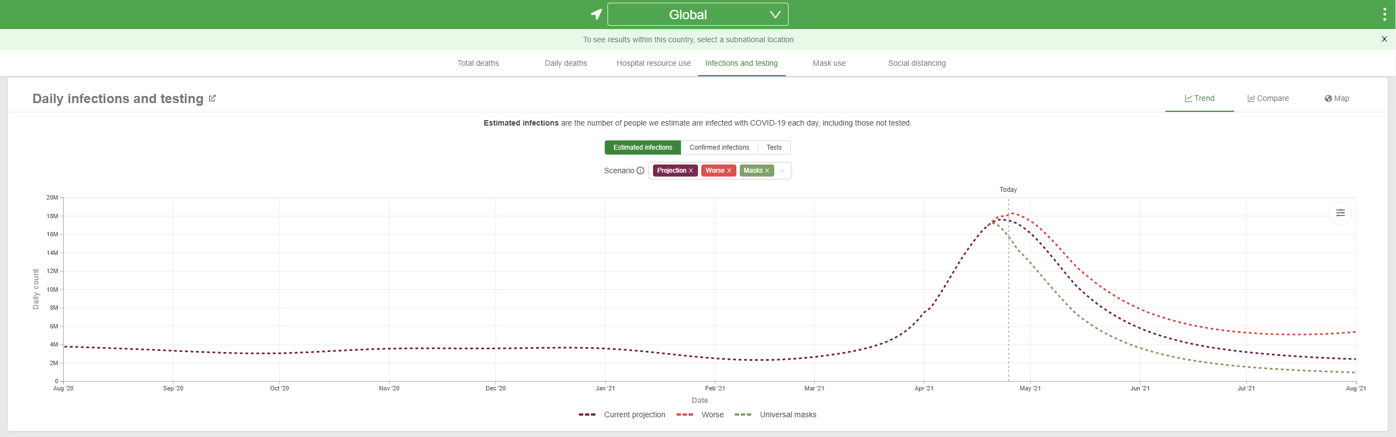
Related Work
(IHME) at the University of Washington

Slide 8
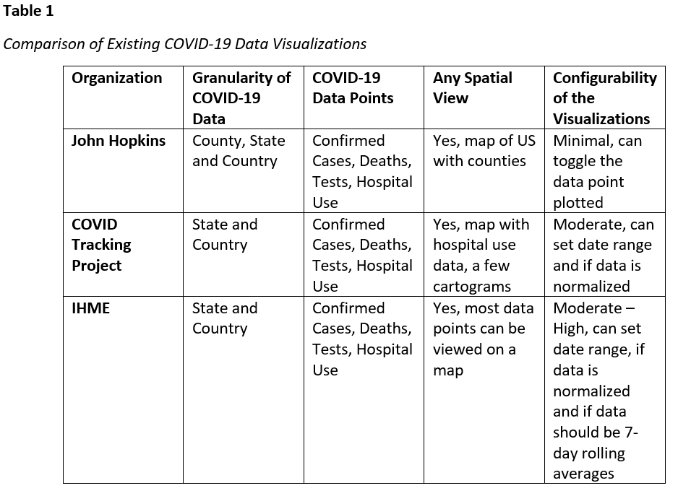
Related Work

Slide 9
Methods
A map based web application

Slide 10
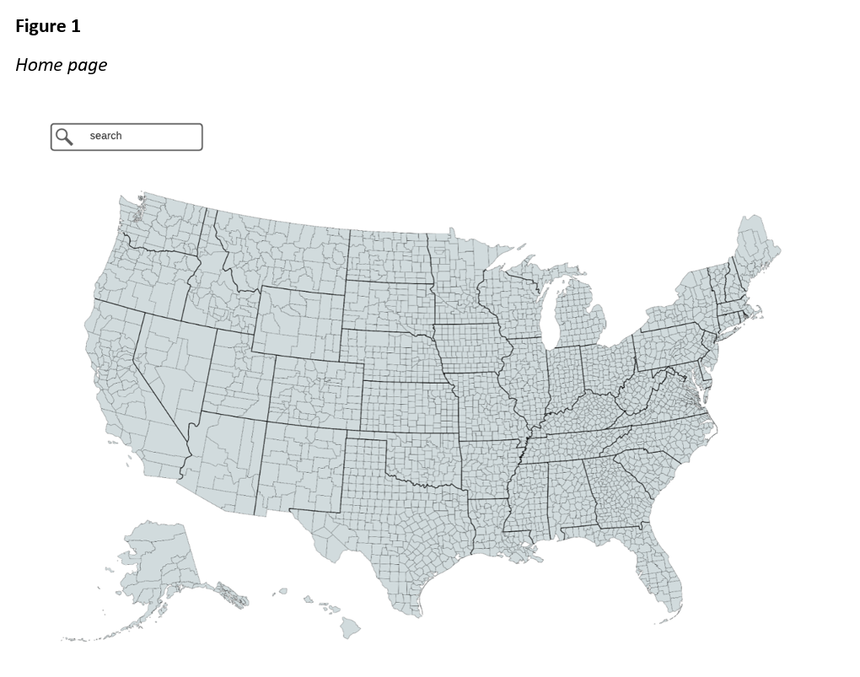
Methods

Slide 11
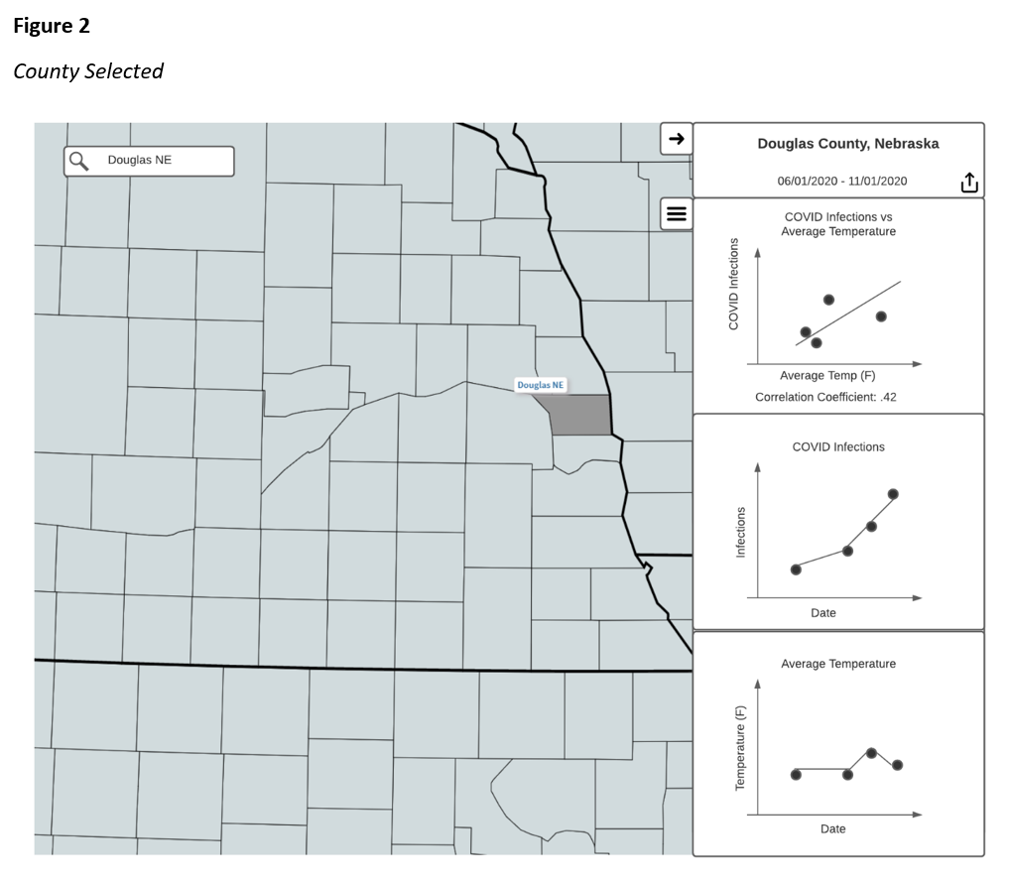
Methods

Slide 12
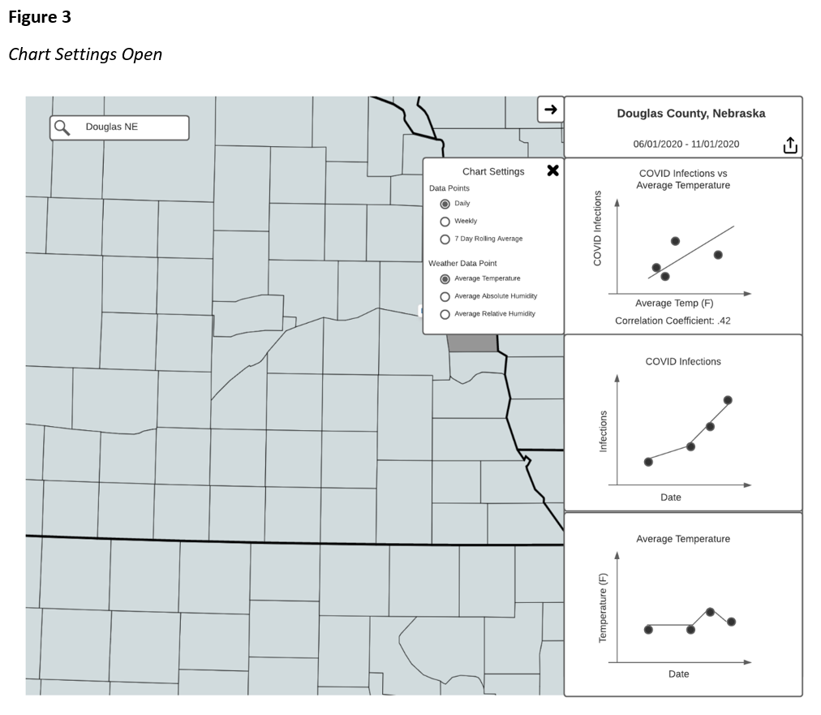
Methods

Slide 13
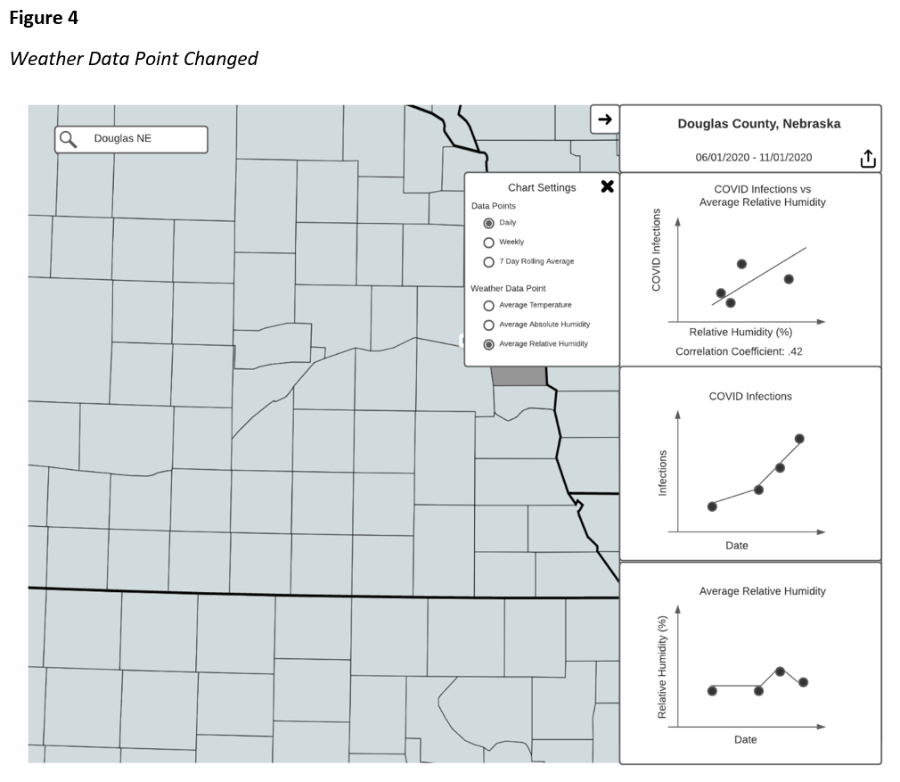
Methods

Slide 14
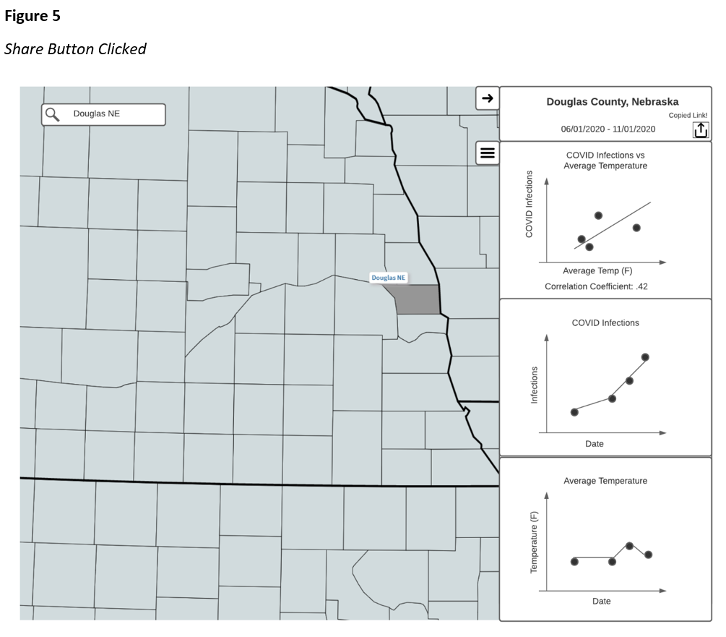
Methods

Slide 15
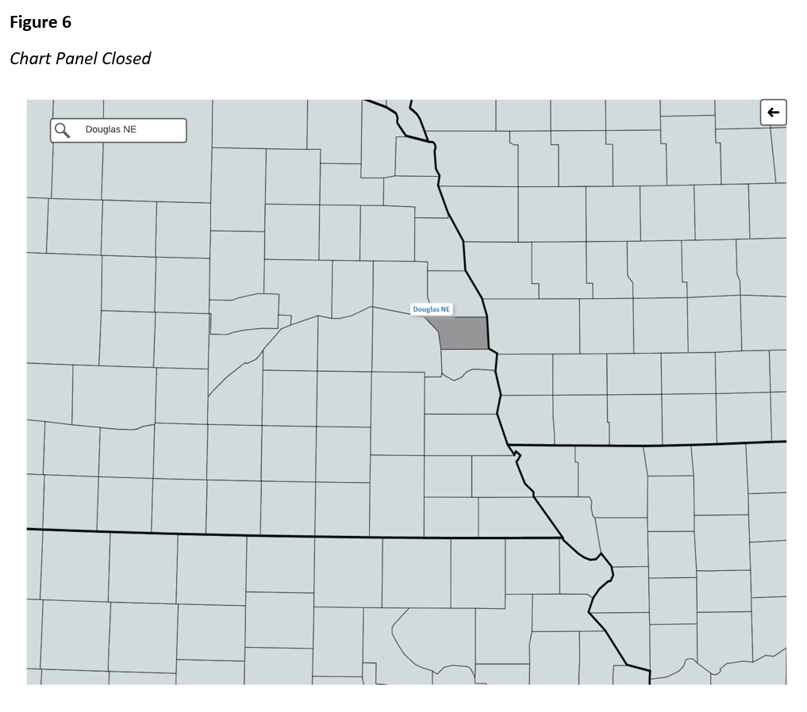
Methods

Slide 16
Methods
Data Sources
COVID: New York Times dataset on GitHub
Weather: WeatherSource API

Slide 17
Methods
Data transformation
COVID-19 Cumulative Cases By Day → New COVID-19 Infections By Day
Daily → Weekly Average
Daily → 7-Day Rolling average

Slide 18
Methods
Resources
Azure
App Service
ASP.NET Core Web App (Angular frontend, API endpoints)
Azure SQL Database
COVID-19 data
Azure Function or WebJob
Recurring update of COVID-19 data
GitHub
GitHub Actions

Slide 19
Summary

Slide 20

Questions

Slide 21
References
Jamshidi, S., Baniasad, M., & Niyogi, D. (2020). Global to USA County Scale Analysis of Weather, Urban Density, Mobility, Homestay, and Mask Use on COVID-19. International Journal of Environmental Research and Public Health, 17(21), 7847. https://doi.org/10.3390/ijerph17217847
Lee, Victor R, and Michelle H Wilkerson. “Data Use by Middle and Secondary Students in the Digital Age: A Status Report and Future Prospects,” n.d., 43.
McClymont, H., & Hu, W. (2021). Weather Variability and COVID-19 Transmission: A Review of Recent Research. International Journal of Environmental Research and Public Health, 18(2), 396. https://doi.org/10.3390/ijerph18020396
Roussel, M., Pontier, D., Cohen, J.-M., Lina, B., & Fouchet, D. (2016). Quantifying the role of weather on seasonal influenza. BMC Public Health, 16, 441. https://doi.org/10.1186/s12889-016-3114-x

