Slide 1
COVID-19 and the Weather: A Data Visualization
Nick Palacio
Master’s Capstone Project
Notes:
-who am I
-Nick Palacio
-Application Developer here at FCSA for a little over 2.5 years
-Been working on my Masters in Computer Science from UNO since 2017, and I completed it this last week
-I'll start this presentation with a refresher on what my project proposal was and why it is important
-You might remember some of the content here from my initial presentation last April
-Then I will do a demo of my finished project to show you what I ended up building
-Next I will get into how I built my project and the resources I used
-I will discuss challenges I faced while implementing my project
-Then I will discuss current limitations and opportunities for future work
-Finally I will wrap things up by summarizing what I accomplished

Slide 2



Background
Warmer weather…
Influenza and the weather?
(Roussel et al., 2016)
COVID-19 and the weather
(Jamshidi et al., 2020)
(McClymont & Hu, 2021)
Notes:
-Some of you might remember when this pandemic began last spring some people said this would all just 'go away' with warmer weather...
-While we know that this did not all just 'go away', people were bringing this up because weather's effect on the season flu is actually well established.
-There was a study done in France in 2016 that looked at weather's role on seasonal influenza spread (Roussel et al., 2016)
-This study found that a couple groups of weather variables had an impact of influenza spread
-The first group was temperature, aboslute humidity and daily variation of aboslute humidity
-The second group was sunshine duration, relative humidity and daily variation of relative humidity
-The impact of these groups of weather variables was found to be between 3% - 6%, so relatively low but still there
-This study mentioned that their results were consistent with similar studies in other parts of the world where a weather impact on influenza spread was found to be a few percent as well
-There have been a few studies this last year looking at weather's role in the COVID-19 pandemic
-Results have been mixed
-One literature review summarized the work of 23 studies that investigated the relationship between COVID-19 transmission and different weather variables (McClymont & Hu, 2021)
-This literature review found that most studies who looked at temperature or humidity found a correlation with COVID-19 transmission\
-However, some reported a positive correlation while others reported a negative correlation
-Another study published in the same journal highlighted an issue with the existing research on COVID-19 and weather (Jamshidi et al., 2020)
-They said that existing research only considers weather variables during analysis
-Instead, this study looked at weather variables alongside other things like population mobility (how much are people moving around) and urban density (how populated is this area)
-They found that weather's impact was small, a few percent, where as things like population mobility and urban density had a much higher impact, 34% and 13%
-One limitation to point out with both of these studies is the data that they had to work with
-One study was submitted for review in September 2020 while the other study was submitted in November 2020 meaning that both of them were missing out on spikes seen in the US around the November - January timeframe

Slide 3

Proposed Project
COVID-19 and Weather Data Visualization…
…for the kids
Students and data
(Lee, et al., 2018)
Notes:
-My proposed project is a visualization tool that would allow a user to look into this relationship between weather variables and COVID-19 transmission
-What we have going on right now is an open scientific debate around weather's role in the pandemic
-This presents a unique opportunity to engage students which is why the target user for my tool would be a middle school scientist
-A tool like this could be used in a classroom activity where students are tasked with the same question of investigating weather's role in the pandemic
-Students would be expected to follow the scientific process of creating their own hypothesis and then gathering evidence to support a conclusion
-My tool would help them gather that evidence
-Students would be expected to think critically about the limitations of what they might see in the tool and what conclusions can or cannot be drawn based on what they find
-In 2018 there was a study done that looked at data use by middle and secondary school students (Lee, et. al., 2018)
-One thing they looked at was how teachers can best support students working with data
-One of their recommendations was that data should be leveraged in the classroom in the context of meaningful scientific pursuits
-My tool falls right in line with this recommendation because students would be asked to participate in this open scientific debate

Slide 4
Demo
Notes:
-My proposed project is a visualization tool that would allow a user to look into this relationship between weather variables and COVID-19 transmission
-What we have going on right now is an open scientific debate around weather's role in the pandemic
-This presents a unique opportunity to engage students which is why the target user for my tool would be a middle school scientist
-A tool like this could be used in a classroom activity where students are tasked with the same question of investigating weather's role in the pandemic
-Students would be expected to follow the scientific process of creating their own hypothesis and then gathering evidence to support a conclusion
-My tool would help them gather that evidence
-Students would be expected to think critically about the limitations of what they might see in the tool and what conclusions can or cannot be drawn based on what they find
-In 2018 there was a study done that looked at data use by middle and secondary school students (Lee, et. al., 2018)
-One thing they looked at was how teachers can best support students working with data
-One of their recommendations was that data should be leveraged in the classroom in the context of meaningful scientific pursuits
-My tool falls right in line with this recommendation because students would be asked to participate in this open scientific debate

Slide 5
Methods
Data Sources
COVID: New York Times dataset on GitHub
Weather: WeatherSource API
Notes:
-Now I'm going to talk about how I ended up building this tool.
-From a high level, I pretty much implemented everything exactly as I had planned it in my initial proposal
-COVID
-For COVID-19 data I decided on the New York Times dataset on GitHub
-Cumulative cases by county by day for all counties in US.
-Weather
-For my weather data I decided on using an API from WeatherSource
-WeatherSource is a technology company that provides a suite of products that help businesses leverage weather and climate data
-On March 16th, 2020 WeatherSource opened up their API for free to any researchers exploring the relationship between weather and the COVID-19 pandemic
-One of their APIs allows you to query many different weather data points by location using latitude and longitude or a zip code along with a date range
-Data can be returned in an hourly or daily format
-For my purposes I am querying average temperature, average relative humidity and average absolute humidity by lat/long and a date range where the lat/long is the centroid of the county the user has selected
-Data returned in a daily format

Slide 6
Methods
Data transformation
COVID-19 Cumulative Cases By Day → New COVID-19 Infections By Day
Daily → Weekly Average
Daily → 7-Day Rolling average
Notes:
-The data from those sources will need a little bit of transformation for my purposes
-For the COVID data, I start with cumulative case counts by day for a county
-I need to end up with new infections by day for a county
-For any given day, subtract the cumulative case count for the previous day from the current day and you get new infections on that current day
-This can then be rolled up to a weekly or 7-day rolling average
-For the Weather data, I start with the daily data points I need already
-Then I can convert them to weekly or 7-day rolling averages in the same way as the COVID-19 data

Slide 7
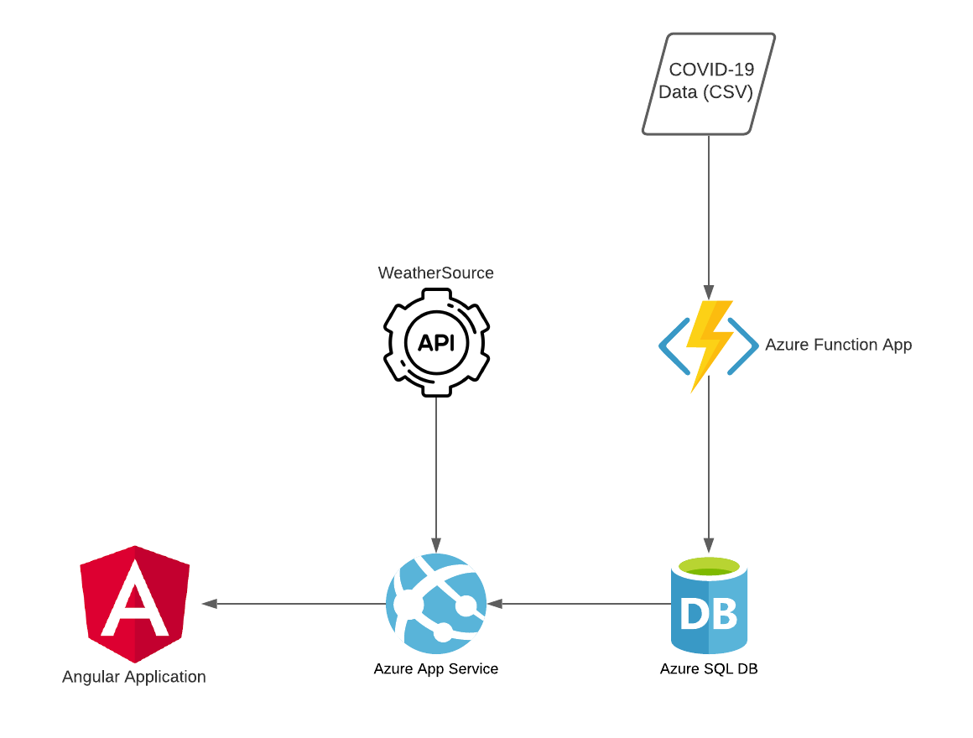
Resources - Azure
Notes:
-My tool is hosted in Azure using a few different Azure resources
-Azure Function
-I am using an Azure Function App for loading the COVID-19 data from the dataset from the New York Times hosted on GitHub. This data is in a CSV format on GitHub.
-Azure SQL database
-I am using an Azure SQL Database for housing the COVID-19 data that I pull from the New York Times dataset.
-Azure App Service
-I am using an Azure App Service for serving up the Angular Application as well as providing several API endpoints for the weather and COVID-19 data.

Slide 8
Resources - GitHub
Source Control
GitHub Actions
GitHub Project Board
https://github.com/npalacio/covid-and-weather-data-visualization
Notes:
- I am leveraging GitHub for a few different things
- I am using it for source control.
- I am using GitHub actions for CI/CD
- I am using a GitHub Project board for tracking user stories and bugs

Slide 9
Future Work
Usability Testing
Continuous/Discrete Weather Data
Spatial Component of Data
Notes:
-Now I am going to talk about some of the limitations in the current implementation and opportunities for future work.
-The next thing that probably needs to be done for this project is to do some usability testing by getting it in front of real students.
-This could be done with a classroom study with a middle school science class where they are given an activity that involves using the tool.
-Some questions that would be good to get answered with usability test include: -Are students able to navigate the interface?
-In what ways are students able to interact with the application in order to select different counties?
-Do students pick up on the meaning of the Pearson correlation coefficient shown?
-An eye tracking study to see how people are reasoning about the data might be useful as well.
-Some questions that would be good to get answered with an eye tracking study include:
-What are users looking at in the application?
-How do users visually parse the page?
-One limitation of the current implementation is that weather data is continuous but I represent it as discrete
-I am using the centroid of each county in order to sample the weather data
-This is a rough approximation and gets less accurate the bigger the county is
-A more accurate representation of this data would be a good opportunity for future work
-Another opportunity for future work is to better capture the spatial component of the data
-Both weather and COVID data have a spatial component
-Currently the application only shows you data from one county at a time
-This makes it difficult to understand how the data might differ by location
-Allowing users to see data from multiple counties would be a good next step

Slide 10
Challenges
Normal Software Development Stuff
Time Constraints
Azure Learning Curve
‘Good Enough’
Notes:
-Now I'd like to talk a little bit about some challenges I ran into while implementing the tool
-for the most part, there were not any major hurdles that popped up. Just normal software development stuff, dealing with random errors and things like that. Things taking a lot longer to implement than I thought.
-That leads me into my next challenge which was finding the time to work on it with my full time job. Often times I would write code all day at work and then come home and write code for a few more hours. This made for some long days and I am very happy to be finished, although this project was enjoyable to work on for the most part.
-Since I had limited experience building things with Azure there was a little bit of a learning curve there while I was getting my services set up
-Azure has pretty good documentation and for a lot of stuff I was able to follow their simple tutorials online
-The toughest challenge for me personally throughout the project was knowing when to call things 'good enough'
-I did not have the time or resources to make everything perfect so I had to make conscious decisions to call my current implementation good enough so I could move onto the other things I needed to implement.

Slide 11
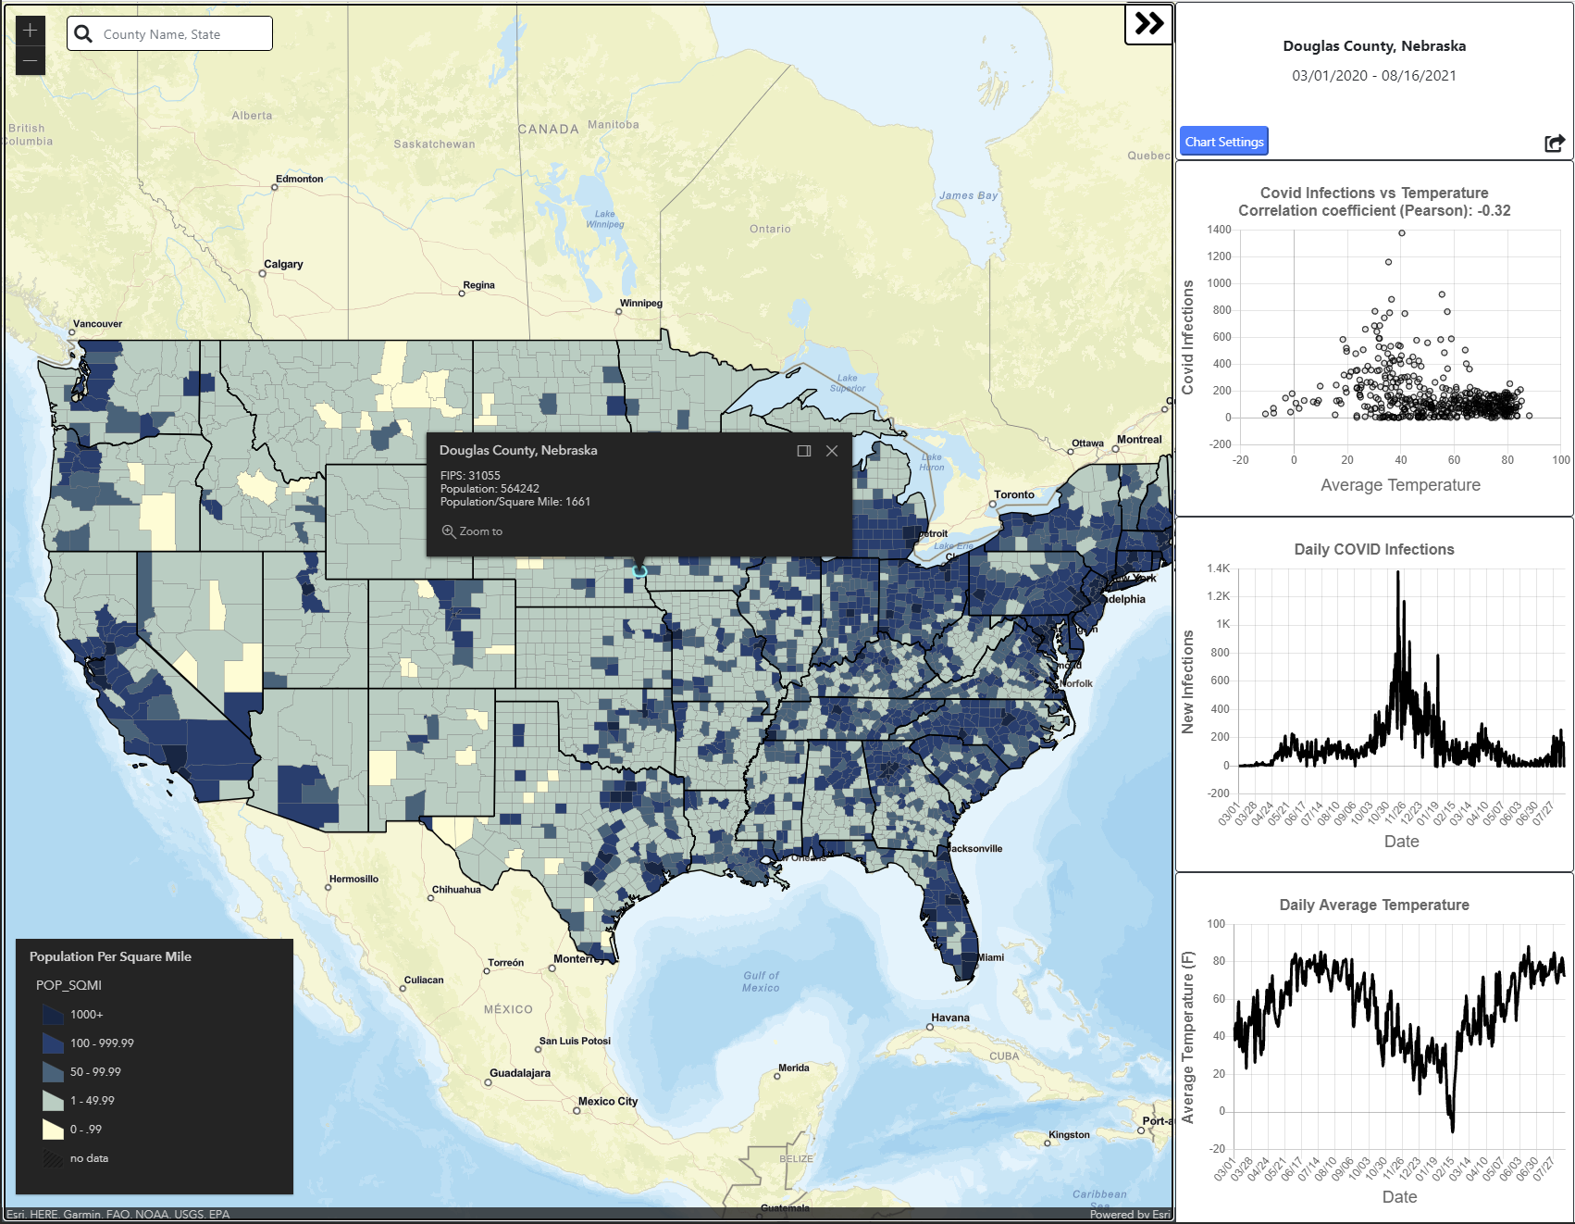
Conclusion
Notes:
-My goal with this project was to build a visualization tool that could be leveraged in a classroom in order to allow students to participate in an open scientific debate related to weather’s role in the COVID-19 pandemic
-I have accomplished this goal
-I implemented all the user stories I had planned in addition to a few others and for the most part my implementation matches the mockups I created.
-Now I would like to open it up to any questions anyone might have

Slide 12

Questions
Notes:
-Before I open it up to everyone for questions I would actually like to discuss 2 questions I received from Dr Ricks on my graduate committee because they’re really good questions
-'If researchers have found that the relationship between weather and COVID spread is low, what do you think the middle school students will conclude?’
-My project is not really about what a user might find
-The real purpose of building this tool is to enable a classroom activity that engages students by having them follow the scientific process and think critically
-We want the students to think critically about what they are seeing in this tool and more specifically what they are not seeing
-It is very plausible that students could go to a county and see what they think is a strong correlation between weather and COVID-19 infection rates
-We want them to be challenged to think about what else could be causing this? What am I not seeing?
-For instance, what local policies were enacted in this county and when? What's the mobility index for this county across this date range?
-This same learning opportunity actually applies to adults as well
-How many data visualizations do we see in the news or on social media?
-Thinking critically about what those are showing you as well as what they’re not showing you is just as important for us adults as it is middle school students
-So in a way we're pushing a lot of responsibility outside of the tool because it allowed us to scope my project to a limited set of concerns, weather and COVID-19
-It would be nearly impossible to create a tool that truly explained COVID-19 infection rates because there’s an infinite number of variables to consider
-'Do you have any thoughts about how to determine if the project accomplished the goal of student learning?’
-The right way to validate this tool would be through usability studies where we actually create a classroom activity and put it in front of real students in a classroom
-However, for the purposes of my capstone project and due to time constraints that will be out of scope
-My definition of success for this project will be if it is ready for usability testing in a real classroom context

Slide 13
References
Jamshidi, S., Baniasad, M., & Niyogi, D. (2020). Global to USA County Scale Analysis of Weather, Urban Density, Mobility, Homestay, and Mask Use on COVID-19. International Journal of Environmental Research and Public Health, 17(21), 7847. https://doi.org/10.3390/ijerph17217847
Lee, Victor R, and Michelle H Wilkerson. “Data Use by Middle and Secondary Students in the Digital Age: A Status Report and Future Prospects,” n.d., 43.
McClymont, H., & Hu, W. (2021). Weather Variability and COVID-19 Transmission: A Review of Recent Research. International Journal of Environmental Research and Public Health, 18(2), 396. https://doi.org/10.3390/ijerph18020396
Shah, P., & Hoeffner, J. (2002). Review of Graph Comprehension Research: Implications for Instruction. Educational Psychology Review, 14(1), 47–69. https://doi.org/10.1023/A:1013180410169
Roussel, M., Pontier, D., Cohen, J.-M., Lina, B., & Fouchet, D. (2016). Quantifying the role of weather on seasonal influenza. BMC Public Health, 16, 441. https://doi.org/10.1186/s12889-016-3114-x

