Slide 1
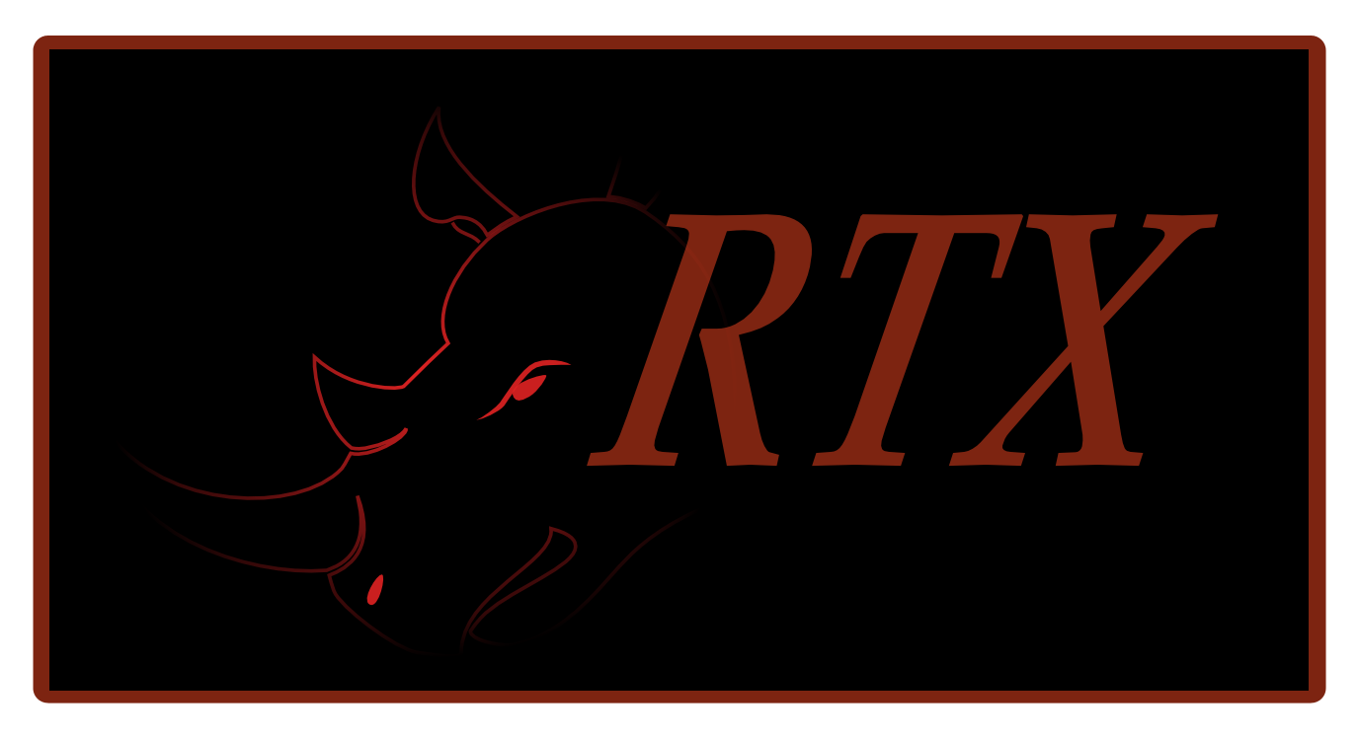
Rathaxes
Notes:
Hi everybody, I’m XXXX from the Rathaxes project.
Today, we are going to talk about something common in the Computer Field.
“Devices Drivers”
There are litteraly millions of computer devices in the world.
Each of these devices requires a driver to work, and each of these drivers has to be written by hand.
Moreover, each of these drivers must be completely rewritten for every OS in the world.
Until Rathaxes.
Rathaxes is an open-source Driver Generator project and will revollutionize the way device drivers are developped.

Slide 2


Today’s specials
Why ?
How is it possible ?
Does it work ?
How does it work ?
How did we get there ?
What’s next ?
Notes:
Todays’ menu will be all that yummy technical sweetness you’ve ever dreamed of, and once we’re done, you’ll be asking for more.
We will explain how this new solution will truly bring a paradigm shift in this domain.
But let’s start with the appetizers : how much is Rathaxes needed ?
(Commentaires : Les parties does it work et how does it work sont fondamentalement
Rathaxes pour les dev de drivers et
Rathaxes pour les dev d’os
Il faudrait juste trouver l’appelation ideale pour ces parties.)

Slide 3
Why Rathaxes?
Driver development is :
7 time more crash prone
Requires a double knowledge
Lengthy training on each OS
Time consuming
Notes:
Drivers tend to be seven times more prone to crashs than regular software.
To be a device driver developer one needs to have at least a double knowledge :
- knowing the hardware
- knowledge of system programmation
And that’s for a developer who won’t have to port his work on several operating several.
Let’s conclude by that, the device driver development is time consuming.

Slide 4
Why Rathaxes?
70 %
FAIL
Of Operating Systems code
Notes:
Since we are talking about device drivers, we should give you a few numbers and facts :
Statistically, 70% of an operating system is composed of device drivers.
Remember earlier when I said that drivers are 7 times more buggy than other piece of software ?
That means that 70% of your system is compose of an unreadable lump of code that
can lead to serious crash because of its inherent nature of being harder to write.
Fun facts, Microsoft published a bug report analysis some time ago :
- 24% of their BSOD on Vista are caused by nVidia drivers.
- Followed closely by ATI with 18%.

Slide 5
Why Rathaxes?
Time consuming
Critical part of a system
Must be cross platform
Needed by the operating system
Notes:
Whether you are a device driver developer or a simple computer user, device drivers are a day to day issue for most people.
It’s even an issue for OS developers.
It’s time consuming , it’s a critical part of a system leading to crashes, it must be ported on several operating system and to develop an OS means having drivers written over and over again.
I hope I’ve managed to make you realize that there is a real need for improvement in this field.
And this is were Rathaxes comes into play by generating device drivers.

Slide 6

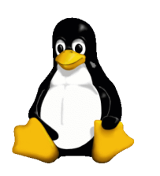
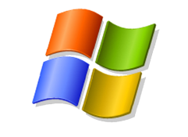
How is it possible?
Generating Drivers : utopia?
Focus on shared concepts
Abstract Operating System differences
?
Notes:
Generating device drivers is certainly not an utopia.
Code generation is a well known solution in the computer field, it means reusability of code and reduction of the development time.
As for driver generation, it’s an approach already thought by previous projects focusing on generating the lowest layers device driver with no consideration for multiplatform.
Even though we are starting from scratch a new solution, Rathaxes plan on generating the whole driver, with cross platform in mind.
In order to attain these objectives, we studied several different OS and focused on the shared concepts instead of the code in itself.
It was important to use that approach because OS are fundamentally different and it was necessary to abstract all the underlying principles
That is why we choose to study three OS, OpenBSD, Windows and Linux for their differences
Hence, Rathaxes will be able to generate drivers for most operating systems.

Slide 7
How is it possible?
Driver Anatomy
DEVICE DEPENDANT
OS DEPENDANT
ALGORITHMS
KERNEL INTERFACES
LIBRARY/BUS
CONFIGURATION
REGISTERS
LKM
Notes:
Our first task in Rathaxes was to understand what was a device driver in order .
If you would follow me, Let’s dive into the anatomy of a driver.
Device drivers purpose is to ensure the communication between a piece of hardware and your system.
Whether you install it on a computer with linux or Windows, this piece of hardware will stay unchanged.
A mouse will always be a mouse and react the same way.
Hence, There are innevitably pieces of code common on all systems.
We concluded that there are two distinct portions inside a device driver : a Device dependent part, and a OS dependant part.
Those two portions offer ways of communicating and handling information.
For the device, its main way of communicating is by registers.
The same way registers won’t change, the logic used with the information obtained will remain the same.
Those two concepts are Device dependant and are inherent to all device drivers.
To be able to interact with the system, the driver offers to the system several means of interaction.
First of all, the driver must declare himself to the system. The concept the most relevant for this is the loadable kernel module.
By doing that, the driver declares a set of « callbacks » and functionnalities that we called kernel interfaces.
Those kernel interfaces are the set of operations the device suports such as read, write or ioctl.
On the other side, the system gives to the driver its configuration , such as it’s type or magic number.
The system also provides acces to bus, or libraries of interaction that the algorithms will use to get information.
Those concepts are specific to the operating system, but are shared by most OS.

Slide 8
How is it possible?
OS Dependant concepts
KERNEL INTERFACES
COMMON INTERFACES
Read
Open
PCI INTERFACES
IoCtl
Write
BUS_SPACES
Close
AsyncRead
…
AsyncWrite
Notes:
One of those concepts we focused on the most is the kernel interfaces abstraction.
Those interfaces are the abstraction layers provided by OSes in order to relay information from userland to the system, and from the system to devices.
As said before, those interfaces are a common mechanism in most OSes, even if they all have a different API.
Whether you use a library to access the device or directly ioports, Rathaxes uses any layer of abstraction provided by the operating system. We won’t reinvent the wheel.

Slide 9
How is it possible ?
Device Dependant concepts
Standard Algorithms
WAIT(Register, value)
SET(Register|variable, Register|variable|value)
COPY(Buffer, Register|Buffer) PRE/POST/INVARIANT {Algoritms}
CONCAT(Buffer, Register|Buffer) PRE/POST/INVARIANT {Algoritms}
Notes:
These algorithms are macroscopic instructions
They are manipulation on registers and buffers.
Dire à l’oral ce que ca fait.
Invariant = DEMANDER A LIONEL

Slide 10
Does it work ?
Notes:
L'interet là est de montré la meme chose que la derniere fois, voir la meme chose que dans la vidéo de presentation qu'on a du faire qui est excelente en rajoutant de la technicité : - Code moche d'un driver actuellement faisable en Rathaxes : Un linux et un windows par exemple -> Vous voyez, c'est effectivement trés different. - Et si on se contentait de juste ecrire cela -> Affichage de code rathaxes - Compilation -> regardez, nous venons de generer les memes codes qu'avant, et oh... c'est quoi ca ? ah ben oui, c'est un troisieme OS ! - Integration au kernel pour montrer la fonctionnalité de ce que l'on a généré
On conclue qu’on a fait des démos en live sur notre stand tout le week end et qu’on en fera encore quelques unes avant de remballer.

Slide 12
How is it working ?
Domain Specific Language
Compiler
Black Library
Notes:
Before explaining how Rathaxes is implemented, we can go further on what it is.
First of all, Rathaxes is a Domain specific Language. As SQL, it is a language used for a specific task.
Rathaxes will be dedicated to the field of Device drivers.
The domain’s underlying concepts we extracted from our studies will be implemented in this language as strong semantics.
This will allow developers to focus on the functionnalities of their device instead of focusing on the syntaxe to write for each OS.
As a complete solution, Rathaxes will also be composed of a Compiler. A Compiler is a program that converts a language into another, like a translator.
This compiler will have a library at is disposition. This Library, that Rathaxes called Black Library, will be composed of many pieces of code usable for the translation.
The Rathaxes compiler will translate our Rathaxes language in C language as it is the language used on most platforms for device drivers development.
Our compiler is made in Codeworker, a descriptive parsing scripting language. This extremely powerful tool saved us months of work.

Slide 13

How is it working ?
Parsing
RDSL
Parsing
BDSL
BackEnd
Files.rtx
.C Files
Windows
OpenBSD
Others
Linux
Black Library
Notes:
Language Parsing : Functionalities
BDSL Parsing : Extensibility, updatability
C Generation : Weaving the parsed code and the templates into a c file. This code will be human readable so it will possible to edit it for optimization, reread it for security certification purposes.
Davestar : met trois fichiers

Slide 14
How is it working ?
Writing Black Library templates
Rathaxes Project
Finalization
.C
Rathaxes Driver Base
C code drivers for your Operating System
Your OS
Windows
OpenBSD
Linux
Existing OS BLTs
.C
OS specific templates written in an easy to learn aspectual DSL
.blt
Every driver ever written in Rathaxes now become available for your Operating System
OS Developer

Slide 15
How is it working ?
BLT language
ADVICE register PART_OF registers
{
struct test_struct
{};
< addElement(« int foo », « test_struct ») >
< addElement(« struct bar », « test_struct ») >
JOINPOINT values IN registers.values;
< addDeclaration(« struct $register.name »)>
< foreach node in register.members>
<addMember(« int $node.name : $node.size », $register.name);>
< foreach >
};
Notes:
ADVICE register PART_OF registers
{
struct test_struct
{};
< addElement(« int foo », « test_struct ») >
< addElement(« struct bar », « test_struct ») >
JOINPOINT values IN registers.values;
< addDeclaration(« struct $register.name »)>
< foreach node in register.members>
<addMember(« int $node.name : $node.size », $register.name);>
< foreach >
};

Slide 16
Conclusion
Rathaxes is for :
Driver Devs
OS devs
language enthusiasts (O.o)
Notes:
Conclusion : La conclusion : - Reprise de la phrase de lancement genre : Effectivement, on rox : - Pour les devs driver - On a abstrait tout leur travail - Qu'on a simplifier dans un langage facile à utiliser - Pour les devs os - On a pensé a eux en cherchant une solution d'integration de nouveau OS - Qu'on a simplifier par un langage bien étudier - Pour les fan de langages : - Implémentation parfaite de ce qu'est un DSL - blabla technique de branleurs : Robsutesse, protabilité, tout ca - Synthese

Slide 17

Our tool :
Opensource Compiler Generator
Free Fast and reliable
www.codeworker.org

Slide 18
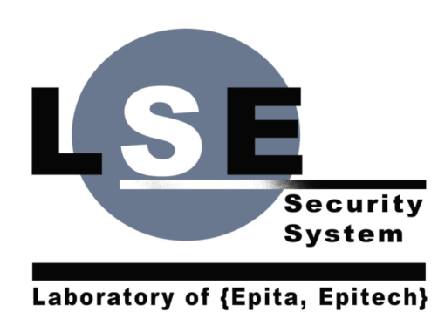


Questions
contact@rathaxes.org
rathaxespublic@googlegroups.com
www.rathaxes.org

