Slide 1
Enterprise GL Data Mart
Universal, audit-ready architecture that prevents regulatory double counting (Y-9C, FR-2590, etc.)
Atomic GL Facts
Metadata Rules
Attribution Bridge (Weights)
BCBS239 Controls
Executive Summary
Lock the GL at an immutable, reconciled grain (period × ledger × legal entity × GL account).
Move all regulatory classification into versioned metadata rulesets (no hard-coded joins).
Generate a GL→Report Attribution Bridge with allocation weights; enforce Σ(weight)=1 per GL row.
Publish reporting marts as SUM-only aggregations over attributed amounts; keep full drill-through lineage.
Notes:
[Sources]
- BCBS 239 (Basel Committee): Principles for effective risk data aggregation and risk reporting (Jan 2013). https://www.bis.org/publ/bcbs239.pdf
[/Sources]

Slide 2
The universal failure mode
Why Y-9C (and other reports) get inflated when mapping changes the grain
What goes wrong
Universal fix
Atomic GL row
Do not attach report lines directly to the GL fact.
Create an Attribution Bridge with allocation weights.
Enforce Σ(weight)=1 per GL row (or Σ(allocated)=GL amount).
Aggregate ONLY after attribution (SUM-only marts).
Key: (Period, Ledger, LE, GL Acct)
Amount: $X
Naïve join to mapping
GL Acct → {Y9C Line A, Y9C Line B, …}
Bridge rows:
Line A weight 0.6 → $0.6X
Line B weight 0.4 → $0.4X
Total = $X
Result: amount multiplied (1×N)
Notes:
[Sources]
- FR Y-9C reporting form overview and instructions downloads (Federal Reserve). https://www.federalreserve.gov/apps/reportingforms/Report/Index/FR_Y-9C
[/Sources]

Slide 3
Target reference architecture
Layered design that scales across all regulatory and management reports
Sources
Core GL, subledgers, lease systems, vendor finance
Bronze
Raw ingest (replayable, traceable)
Silver
Atomic GL fact (reconciled, immutable grain)
Gold – Classification
Derived entity/product flags (effective-dated)
Gold – Rule Engine
Versioned metadata rulesets + approvals
Gold – Attribution Bridge
GL→Report rows with weights (Σw=1)
Never change GL grain
Gold – Report Marts
SUM-only outputs (Y-9C, FR-2590, CCAR)
Notes:
[Sources]
- BCBS 239, Principle 3 (Accuracy & integrity) emphasizes accurate aggregation with reduced manual error (ECB thematic review quoting BCBS239). https://www.bankingsupervision.europa.eu/ecb/pub/pdf/ssm.BCBS_239_report_201805.pdf
[/Sources]

Slide 4
Operational flow (swimlane)
ETL stages, control gates, and UI touchpoints
Data Platform
Ingest
Standardize
Reconcile
Lock
Raw GL journals/balances
Conform codes & keys
Trial balance & control totals
Publish atomic GL fact
Gate: if GL not certified → stop downstream attribution
Reg Engine (CRRT)
Ruleset
Evaluate
Attribute
Approved MAP_RULESET version
Match criteria + precedence
Write bridge rows with weights (Σw=1)
Consumers (CR360)
Aggregate
Review UI
Evidence
SUM-only marts per report
Deltas + drill to GL & rule
Lineage + controls for audit

Slide 5
Canonical data model
Hard separation of GL truth vs classifications vs reporting
Core (Silver)
Reporting (Gold)
FACT_GL_BALANCE (immutable)
Metadata rules
Grain:
• Period
• Ledger
• Legal Entity
• GL Account
(+ Currency)
Measures:
• Signed balance
MAP_RULESET / MAP_RULE / CRITERIA / OUTPUT
• versioned
• effective-dated
• approved
Attribution bridge (prevents inflation)
BRIDGE_GL_REPORT_ATTRIBUTION
• gl_fact_key
• report_line_key
• weight (0..1)
• allocation_amount
• rule_id
Gate: Σ(weight)=1 per gl_fact_key
Rule: no Y-9C / FRN_DOM / LCR / risk buckets in this fact
MART_Y9C / MART_FR2590
SUM-only aggregations over allocation_amount
(full drill-through preserved)

Slide 6
UI & functional pairings
How ERA / CRRT / CR360 map to platform components
ERA – GL Control
CRRT – Regulatory Engine
CR360 – Consumption
Trial balance & certification
GL vs subledger reconciliation
Close/lock atomic GL fact
Exception workflow for source breaks
Author/version rulesets
Approve/effective-date changes
Apply allocation methods
Write attribution bridge with lineage
SUM-only report marts
Review UI: deltas & drill-down
Self-service analytics
Audit/evidence exports

Slide 7
Controls & governance (hard gates)
Automated checks that prevent inflation/leakage and support audit
Required control checks
No inflation
Σ(GL amount) = Σ(allocated amount) by ledger, entity, period
Weight integrity
Per GL key, Σ(weight) = 1.0000 (fail pipeline if breached)
Completeness
≥ 99.9% of GL amount mapped; remainder routed to exception workflow
Version discipline
Only APPROVED rulesets can run production; effective dating enforced
Change impact
Automated delta analysis by report line vs prior version/period
Lineage
Every report row drillable to contributing GL keys + rule_id(s)
Notes:
[Sources]
- BCBS 239 (Basel Committee): Principles for effective risk data aggregation and risk reporting (Jan 2013). https://www.bis.org/publ/bcbs239.pdf
- ECB thematic review quoting BCBS Principle 3 (Accuracy & integrity). https://www.bankingsupervision.europa.eu/ecb/pub/pdf/ssm.BCBS_239_report_201805.pdf
[/Sources]

Slide 8
Implementation roadmap
PoC → enterprise hardening → scale-out to all reports
Phase 1 (PoC)
Phase 2 (Enterprise)
Phase 3 (Scale)
4–6 weeks
8–12 weeks
Ongoing
Atomic GL fact + reconciliation
Ruleset metadata (Y-9C)
Attribution bridge + Σw=1 gate
SUM-only Y-9C mart + drill-down
Effective dating + approvals workflow
Driver-based allocations
Exception UI + SLA workflow
Automated delta/impact analysis
Add FR-2590 / FR Y-15 / CCAR
Self-service controls dashboard
Evidence pack automation
Performance + partition strategy

Slide 9
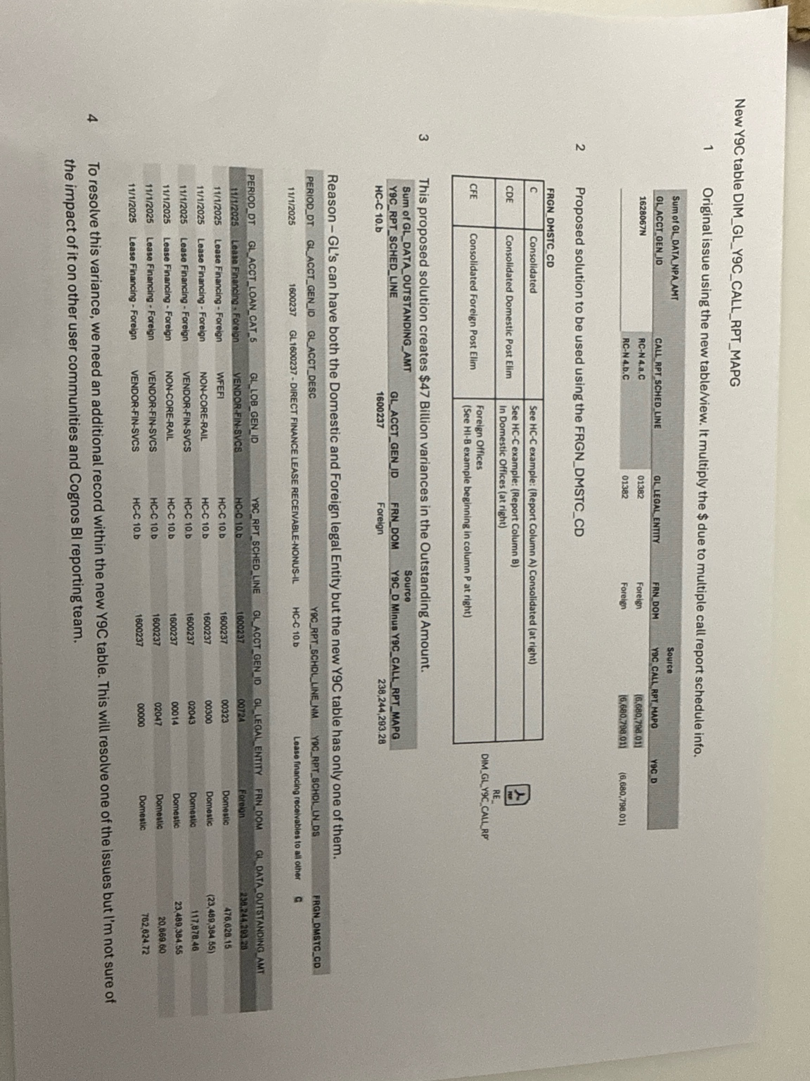
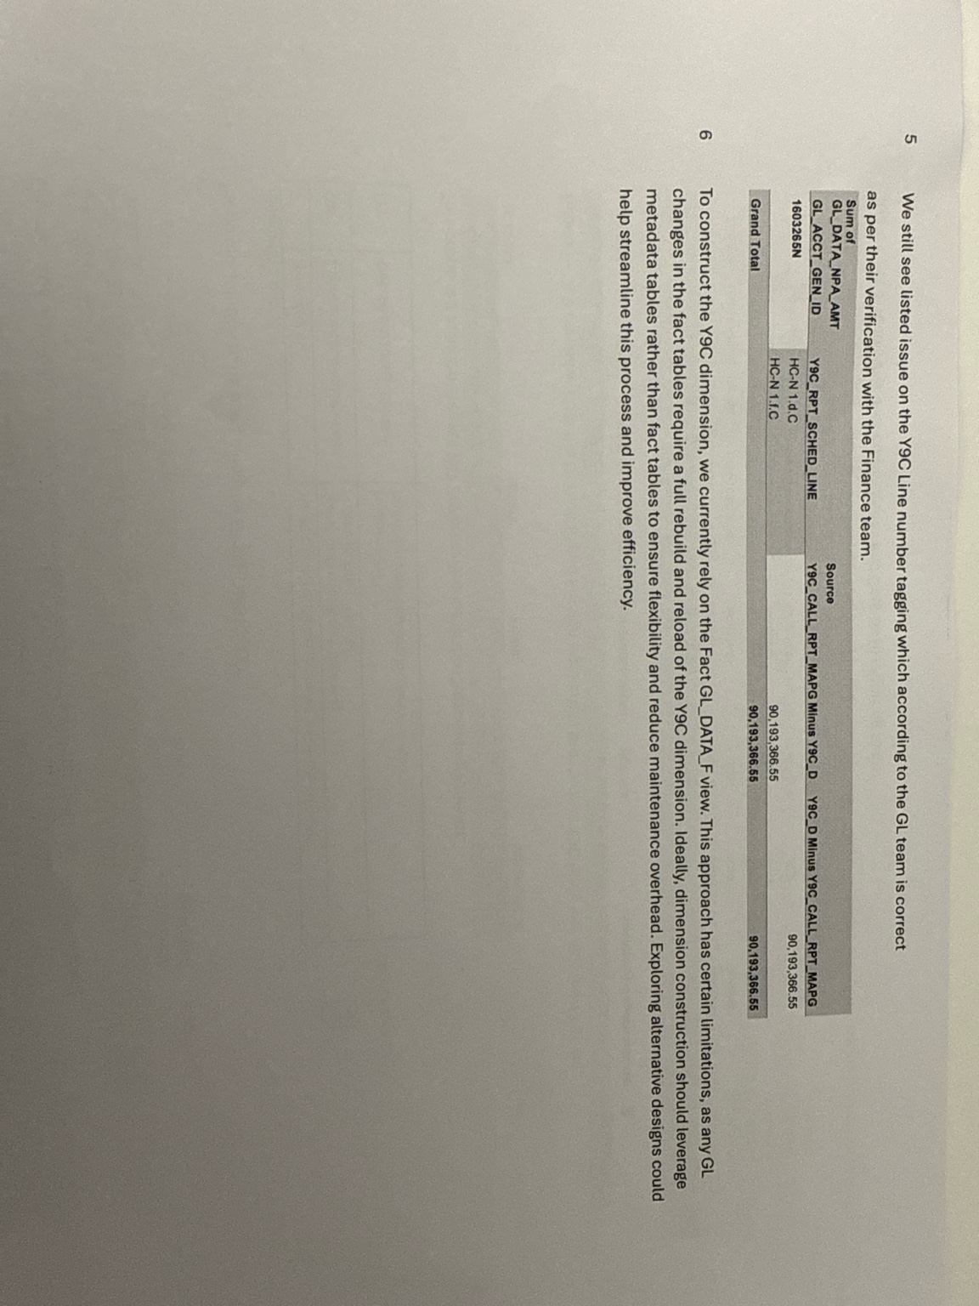
Appendix: issue evidence (from current implementation)
Screenshots provided by stakeholders
Evidence A
Evidence B

Slide 10
Decision ask
What we need approved to proceed
Architecture decisions
Approve immutable Atomic GL Fact as the only source of financial truth (no reporting attributes embedded).
Approve metadata-driven regulatory rulesets with versioning, effective dating, and approvals.
Approve Attribution Bridge pattern with enforced Σ(weight)=1 per GL row (no double counting).
Approve SUM-only report marts + mandatory drill-through lineage to GL and rule IDs.
Approve control gates (no inflation/leakage) as release criteria for any regulatory output.
Notes:
[Sources]
- FR Y-9C reporting form overview (Federal Reserve). https://www.federalreserve.gov/apps/reportingforms/Report/Index/FR_Y-9C
[/Sources]

