Slide 5
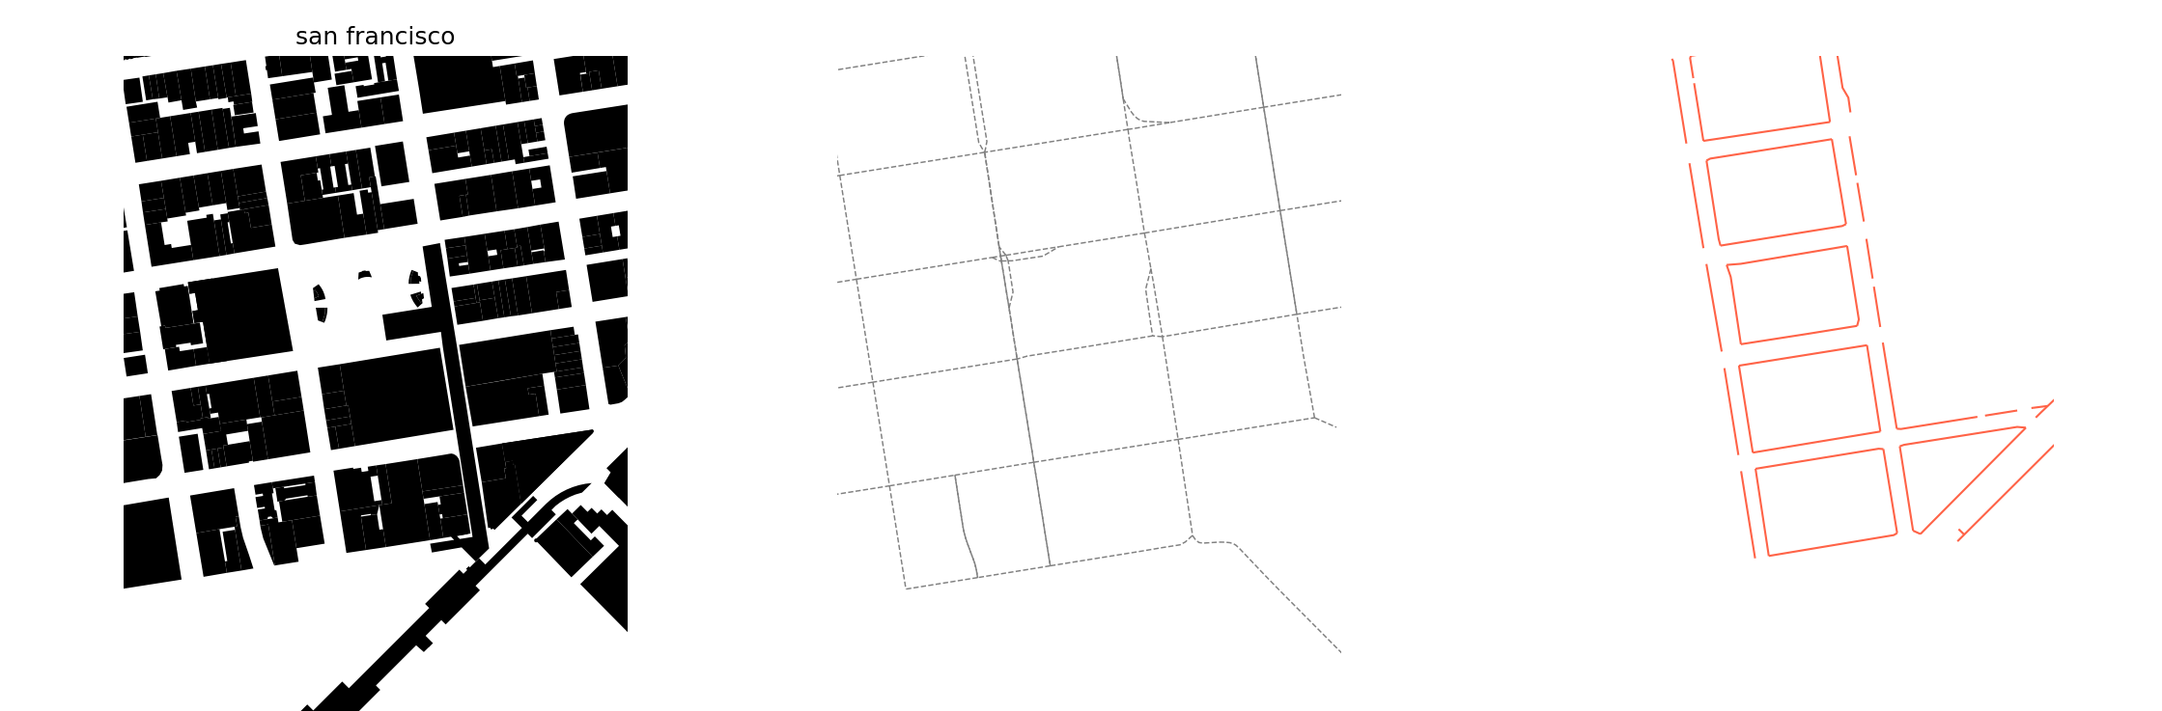
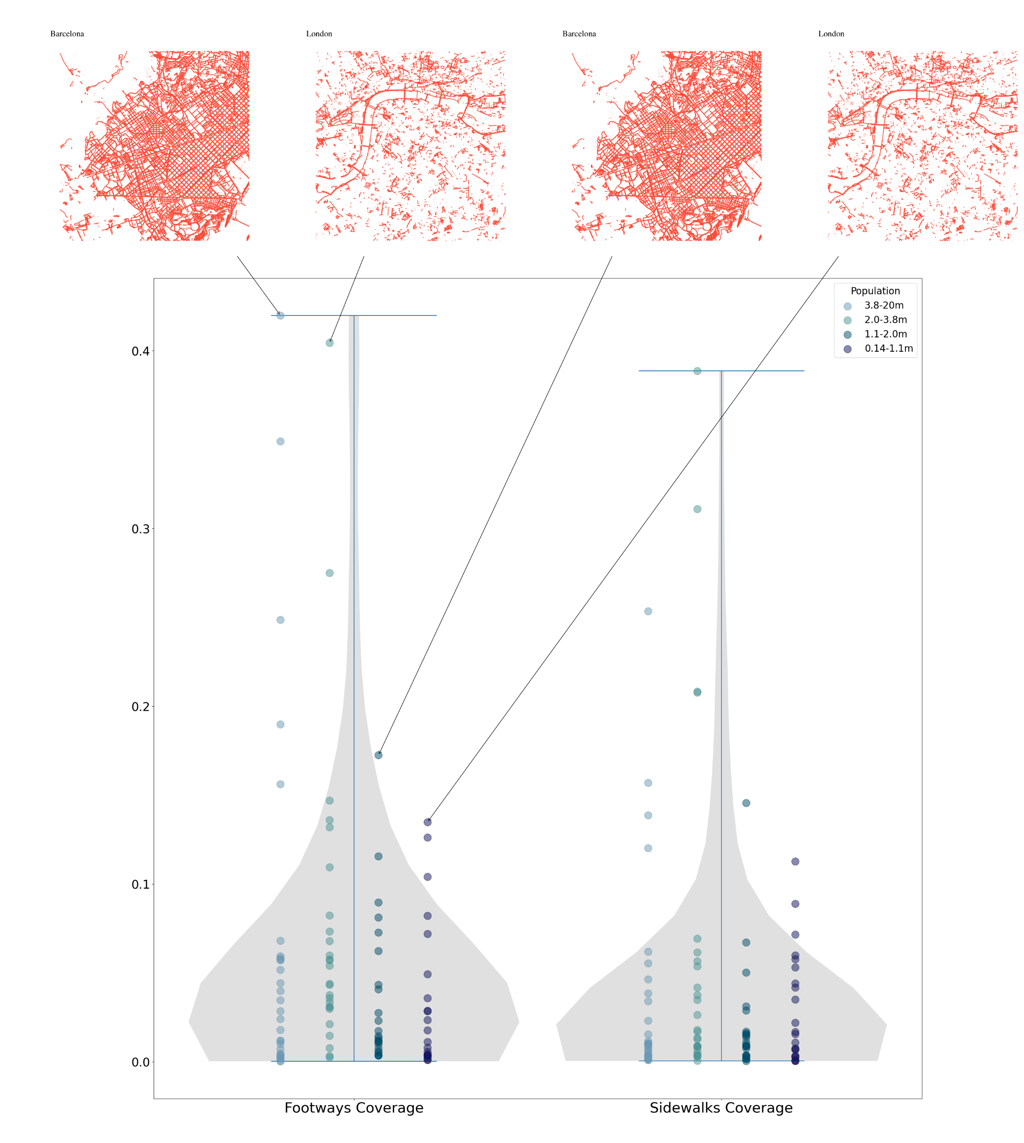
Mapping the space between buildings using Open Street Map
Obi Thompson Sargoni, Hannah Gumble, Nicolas Palominos
The Bartlett Centre for Advanced Spatial Analysis, University College London
Defining Streets
(a manifesto)
In urban areas buildings should be accessible by foot or wheelchair. The spaces between buildings should provide space and infrastructure suitable to these modes. Digital representations of this infrastructure should help indicate the extent to which this objective is met.
Streets and Sustainability
The sustainable mobility paradigm (Banister, 2008) creates demand for spatial information by emphasising the links between land use and transport planning. For example, the link and place function categorisation of urban roads highlights the role of roads as places in themselves (Jones et al, 2007), increasing the need to understand public space design and features of the urban realm encompassed in “the space between buildings” (Gehl, 1987).
Furthermore, emerging transport innovations are increasing the demand for diverse high-resolution geographic information. The introduction of single rider vehicles (micromobility) and increased transport network connectivity through mobility-as-a-services (MaaS) platforms exemplify such innovations. The resulting diversified use of streetspace creates competing demands, motivating the need to measure streetspace.
Streets in Open Street Map
Whilst a road can be represented by a link i.e. a one-dimensional road centre line, understanding a ‘place’ and effective quantitative/ qualitative assessments requires capturing activities across a two-dimensional or three-dimensional space. OSM’s suggested convention for representing pedestrian routes is by tagging line segments which record the pavement centre line (PCL) with ["highway"="footway"] or ["footway"="sidewalk"]. This extends the one-dimensional representation of streets by distinguishing between sides of the road.
We make an initial assessment of the availability of ‘footways’ in OSM using a sample of 117 cities worldwide and compare to the alternative use of ‘sidewalk’ tags. For each city we calculate the coverage of footways and sidewalk tagged geometries by dividing the total length of these geometries by twice the total length of the walkable road network, also downloaded from OSM.

Slide 7
