Slide 4
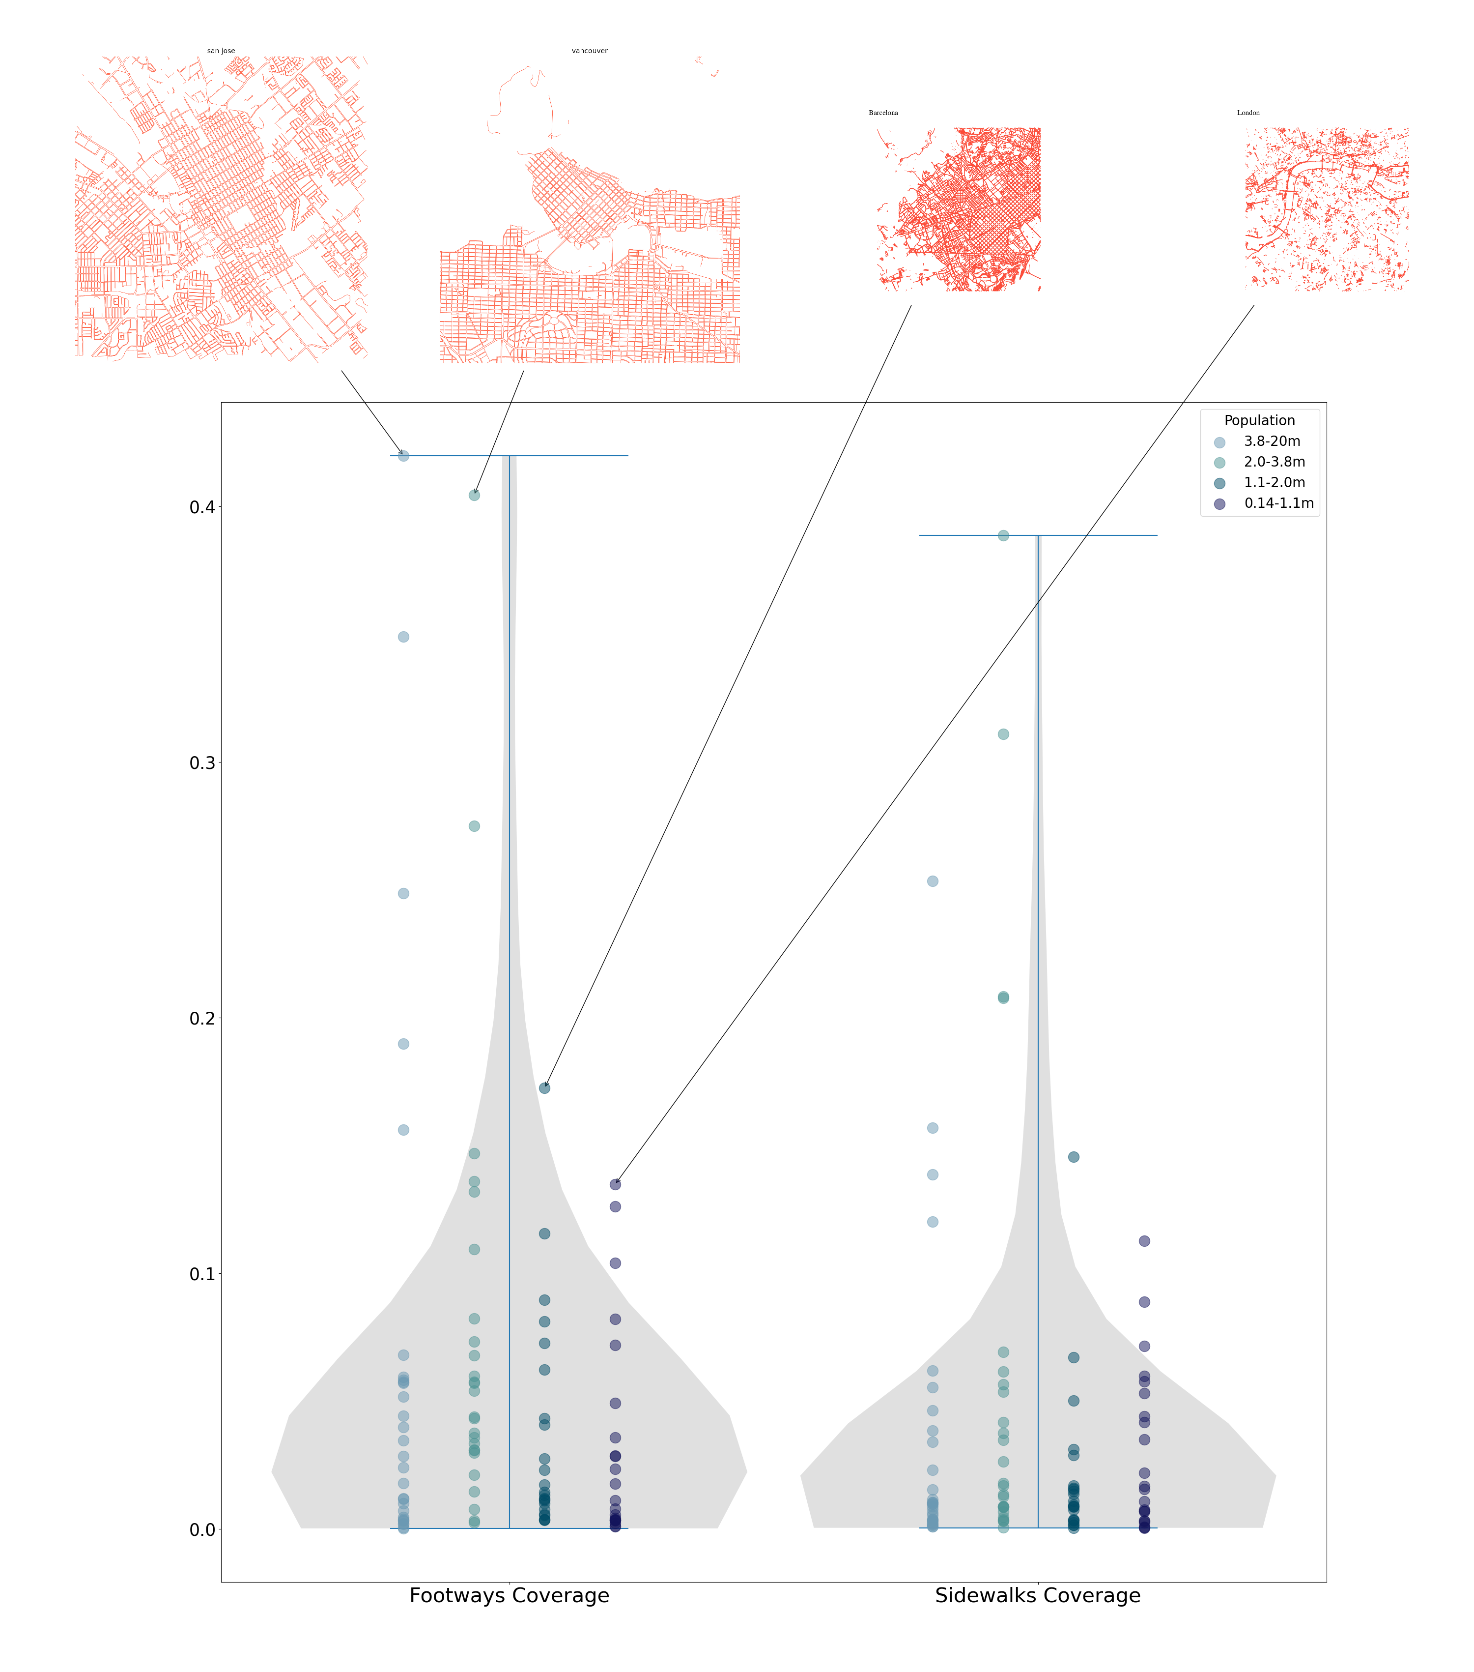
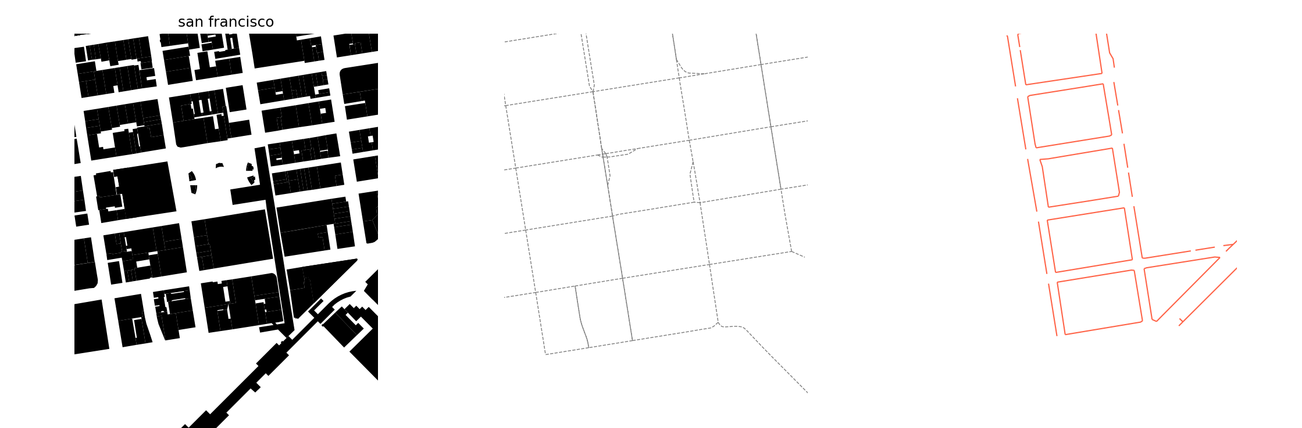
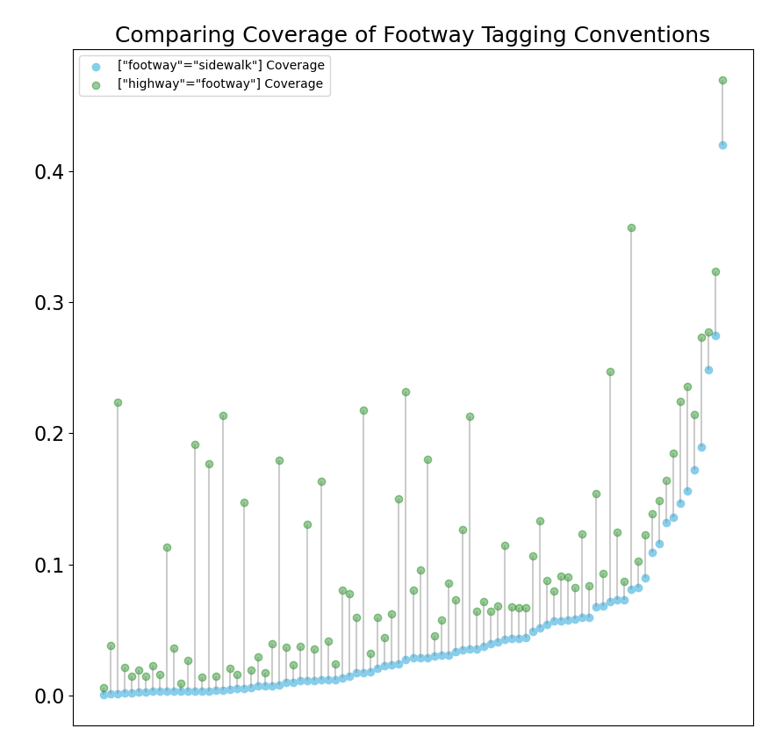
Mapping the space between buildings using Open Street Map
Obi Thompson Sargoni, Hannah Gumble, Nicolas Palominos
The Bartlett Centre for Advanced Spatial Analysis, University College London
Defining Streets (a manifesto)
In urban areas buildings should be accessible by foot or wheelchair. The spaces between buildings should provide space and infrastructure suitable to these modes. Digital representations of this infrastructure should help indicate the extent to which this objective is met.
Streets in Open Street Map
Whilst a street can be represented by a one-dimensional road centre line geometry, understanding a ‘place’ effectively requires capturing activities across two and three dimensions. OSM’s suggested convention for representing pedestrian routes to add geometries representing the pavement centre line and tagging these with ["highway"="footway"] or ["footway"="sidewalk"]. These ‘footways’ extend the one-dimensional representation of streets by distinguishing between sides of the road. Alternatively, road centre line geometries can be assigned the [“sidewalk”= “both|left|right|no”] tags, indicating the availability of pedestrian infrastructure without extending the one-dimensional representation of streets.
We make an initial assessment of the availability of ‘footways’ in OSM using a sample of 117 cities worldwide and compare the alternative use of ‘sidewalk’ tags. For each city we calculate the coverage of footways and sidewalk tagged geometries by dividing the total length of these geometries by twice the total length of the walkable road network, also downloaded from OSM.
Streets and Sustainability
The sustainable mobility paradigm (Banister, 2008) creates demand for spatial information by emphasising the links between land use and transport planning. For example, the link and place function categorisation of urban roads highlights the role of roads as places in themselves (Jones et al, 2007), increasing the need to understand public space design and features of the urban realm encompassed in “the space between buildings” (Gehl, 1987).
Furthermore, emerging transport innovations are increasing the demand for diverse high-resolution geographic information. The introduction of single rider vehicles (micromobility) and increased transport network connectivity through mobility-as-a-services (MaaS) platforms exemplify such innovations. The resulting diversified use of streetspace creates competing demands, motivating the need to measure streetspace.
Walkable Road Centre Line Geometries | Footways | Road Centre Lines with Sidewalks
["highway"]["area"!~"yes"] ["highway"!~"abandoned|bus_guideway|construction| cycleway|motor|planned|platform| proposed|raceway|pedestrian|footway"] [“footway”!~ “sidewalk”] ["foot"!~"no"]["service"!~"private"] | [“footway”=“sidewalk”] | [“sidewalk”= “both|left|right”]
[“highway”=“footway”] vs [“footway”=“sidewalk”]
In this section we explain the distinction between what these why the distinction is important from the

