Slide 1
Lending club case study
Naren Reddy Palupunoori
Rabia Omer

Slide 2
Problem statement
Risks associated with banks lending
Applicant likely not pay back the loan.
Bank’s rejecting applicants and loosing business
Analyze the data
Find the patterns of which costumers are more likely to get charged off.
Find the probability of current customers who might be charged off

Slide 3
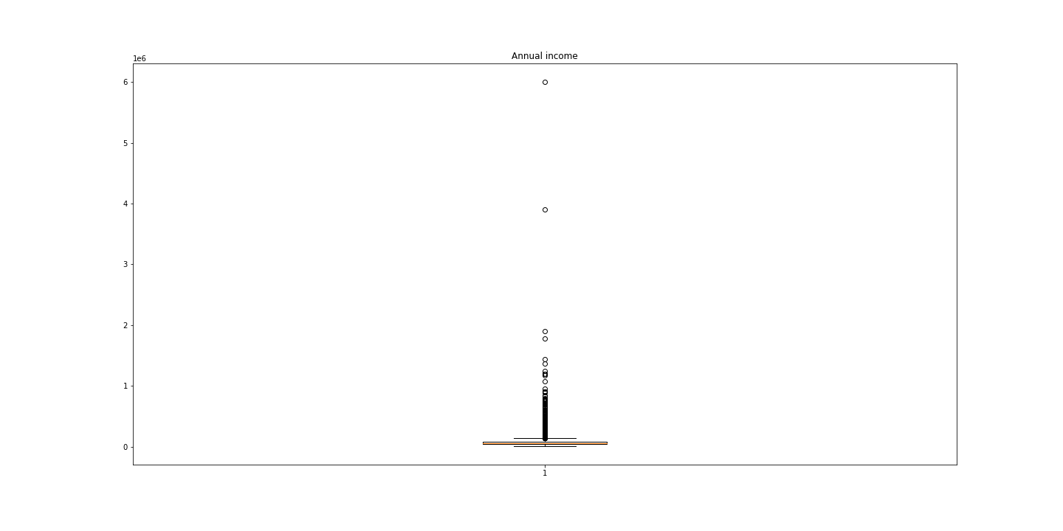
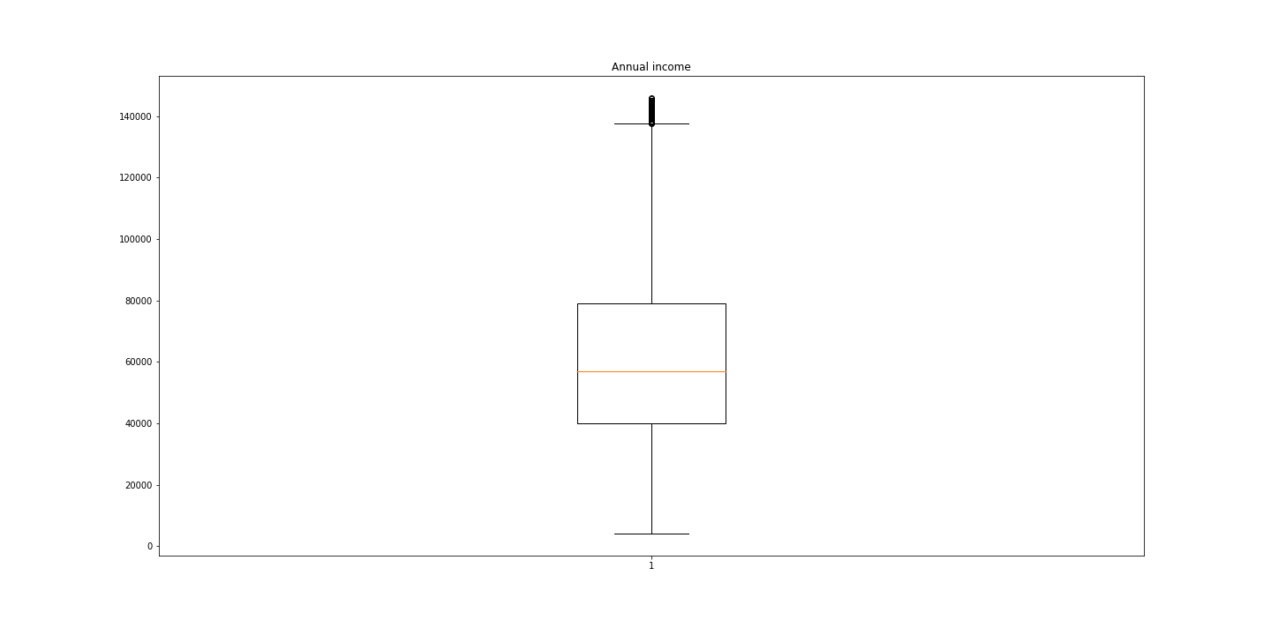
Annual income
Annual income has couple of outliers.
Couple of customers make up 17% of annual income, We want to eliminate them.
New mean income value now for all the customers now is 61000$

Slide 5
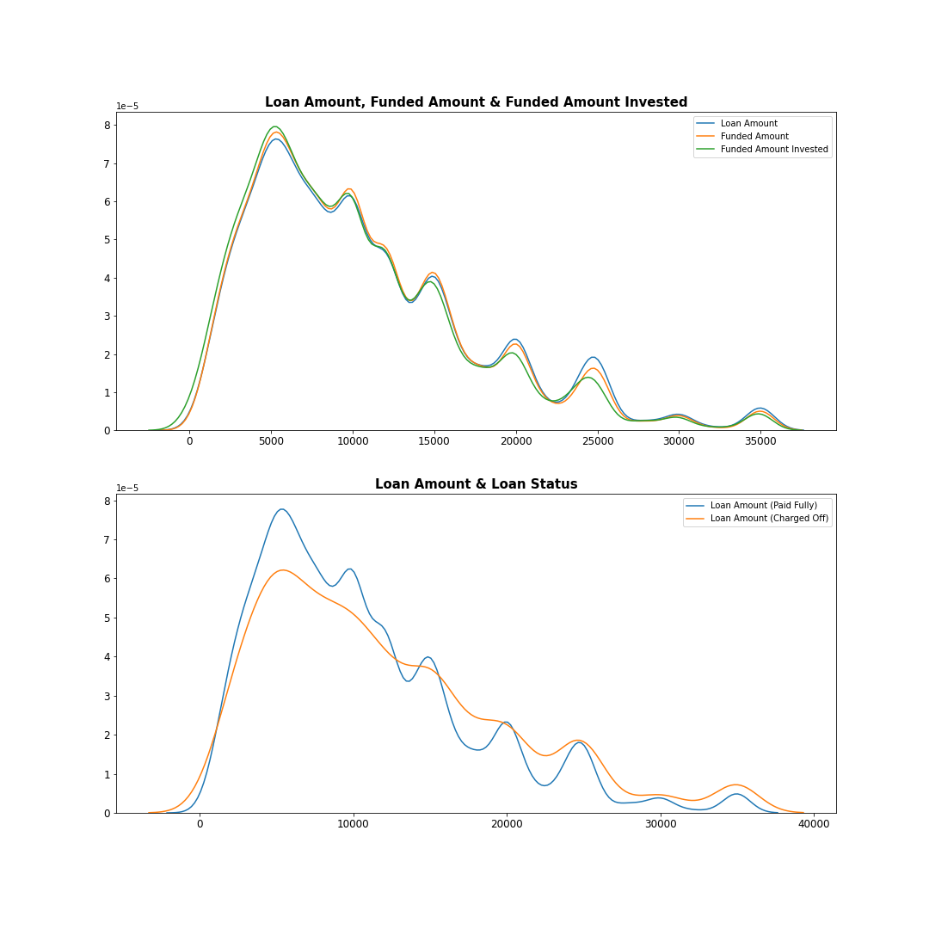
Loan status
Lower loan amounts have higher probability of paying off

