Slide 1
Lending club case study
Naren Reddy Palupunoori
Rabia Omer

Slide 2
Problem statement
Risks associated with banks lending
Applicant likely not pay back the loan.
Bank’s rejecting applicants and loosing business
Analyze the data
Find the patterns of which costumers are more likely to get charged off.
Find the probability of current customers who might be charged off

Slide 3
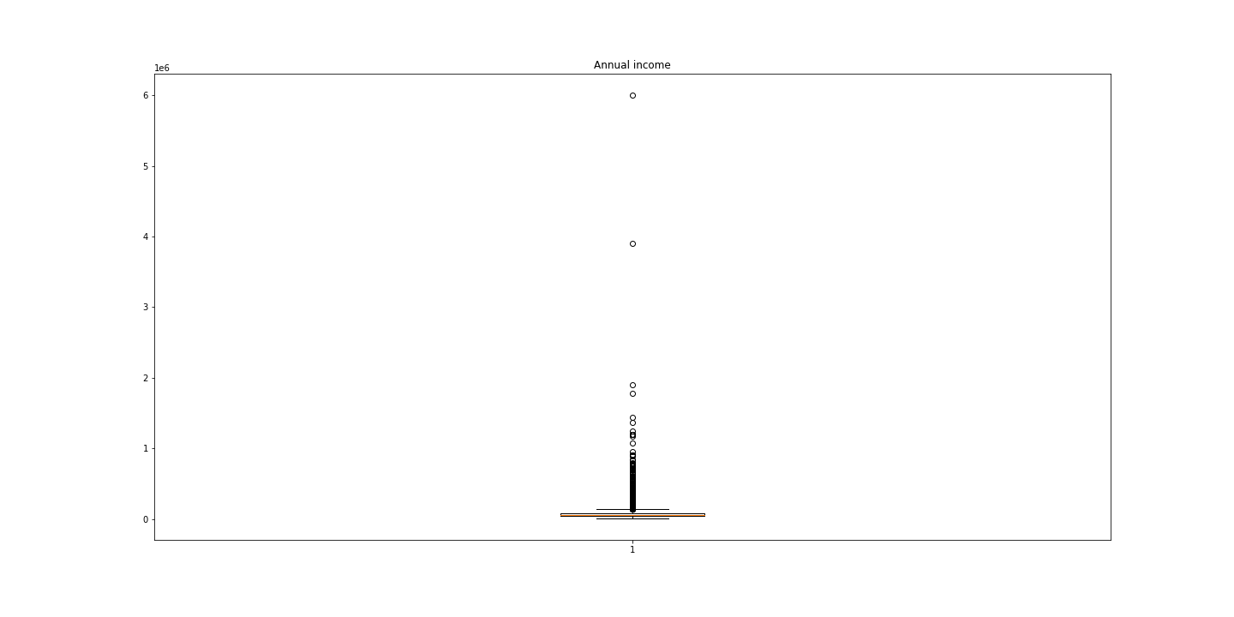
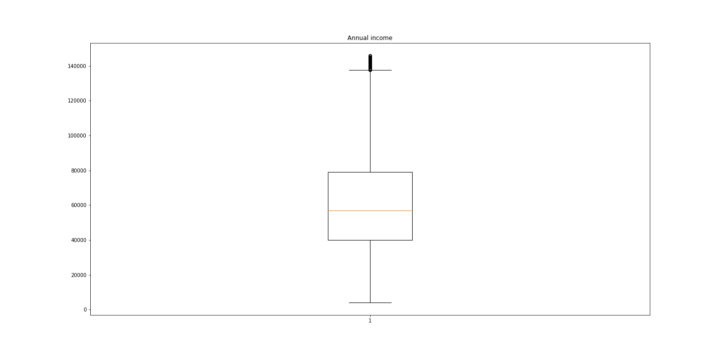
Annual income
Annual income outliers which might biased the analysis.
Customers in the outliners make up 17% of annual income in total, We want to eliminate them.
New mean income value now for all the customers now is 61000$

Slide 4
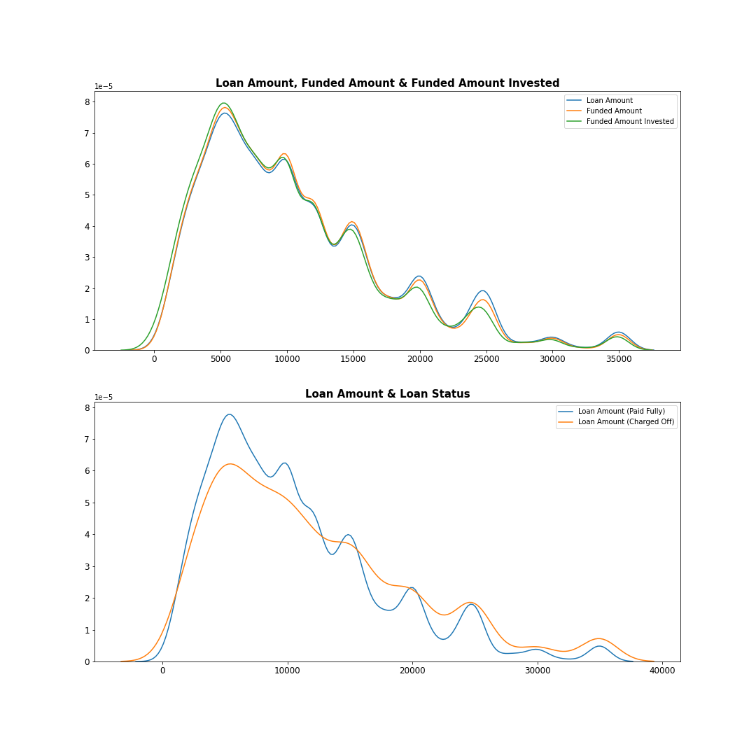
Loan status
Lower loan amounts have higher probability of paying off
Looking closely approx. 28% of the loan amount greater then 30,000$ are expected to charge off.

Slide 5
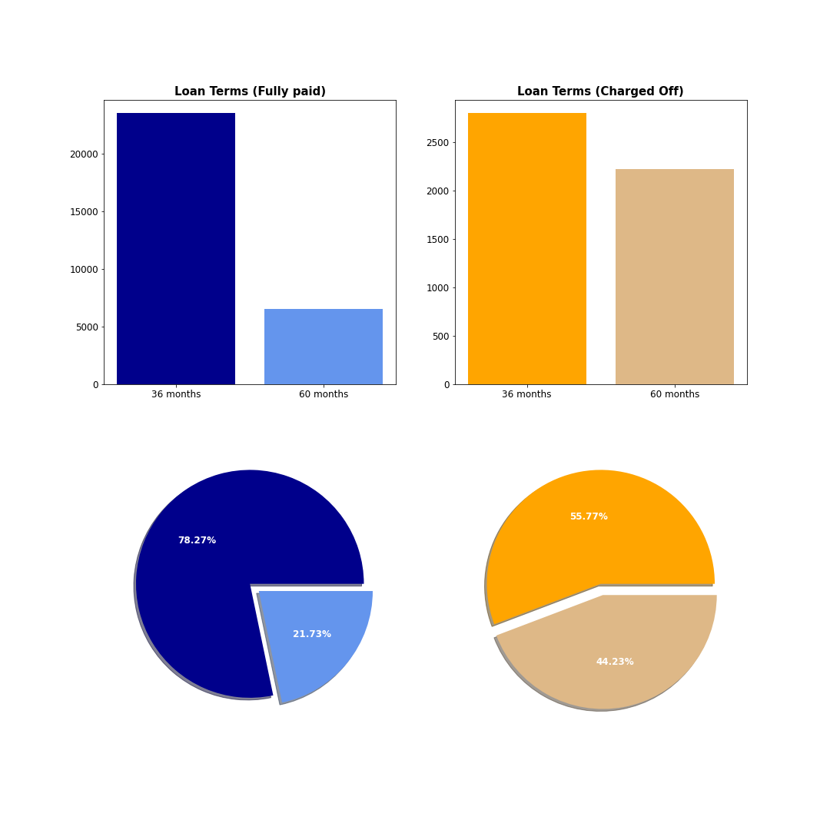
Term analysis
Overall, most of the loan terms are from 36 months, but charged off loans have a larger proportion of 60 months loan compared to fully paid loans.
Almost 45% of the charged off loans is with a 60 months term which means that despite the longer duration of the loans it still can be charged off.
We can see that loans with 60 months term are more likely to be charged off compared to loans with 36 months terms
1 out of 4 loans with 60 months term resulted in charged off loan while only 1 out of 10 loan with 36-month term resulted in charged off loan

Slide 6
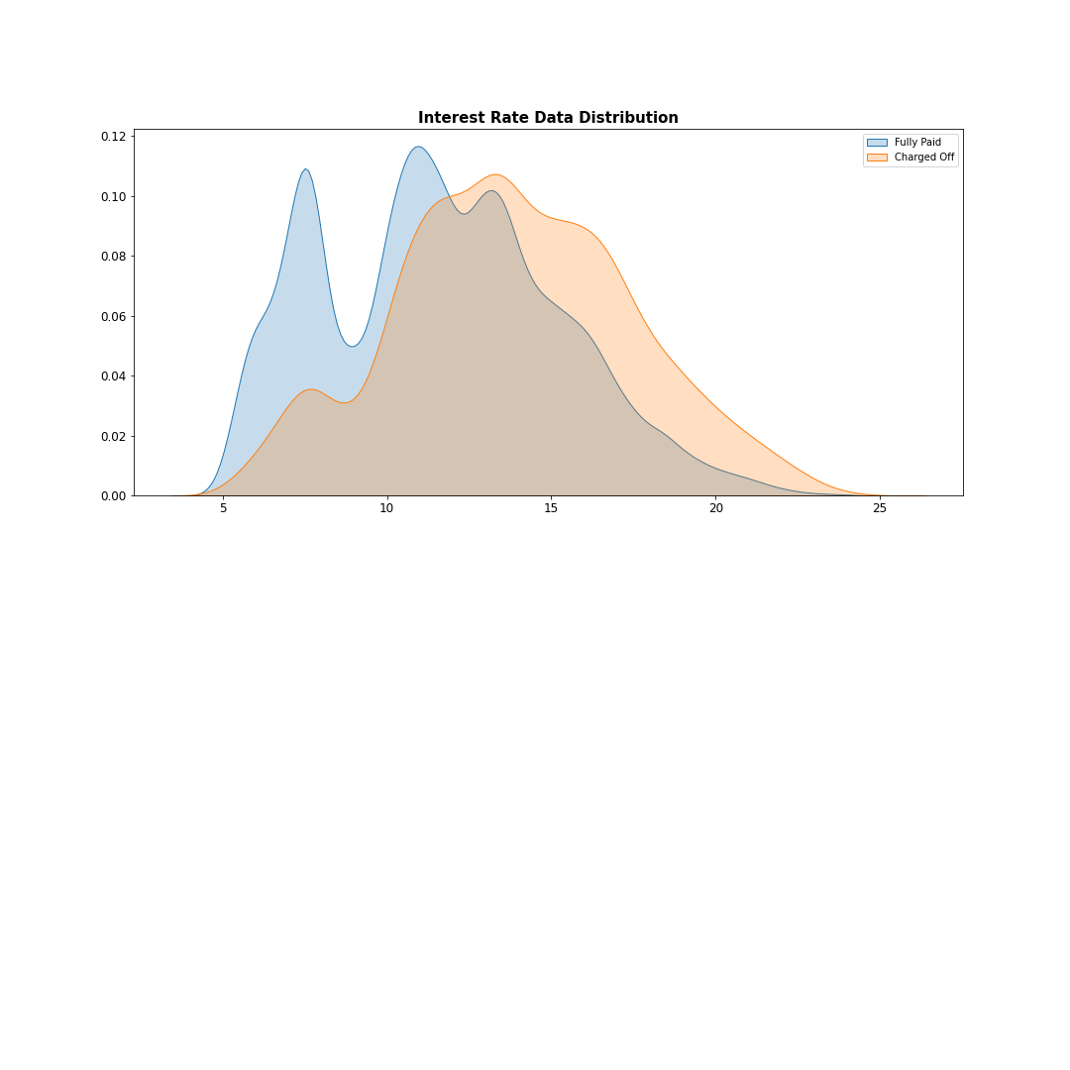
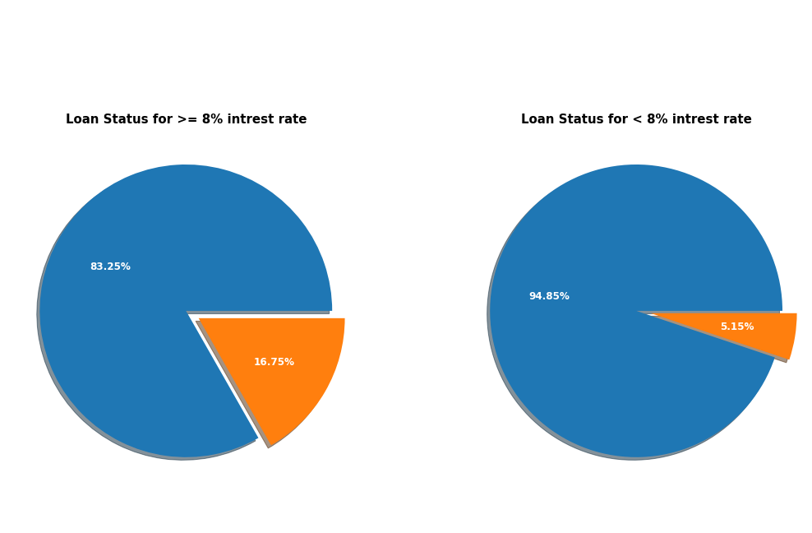
Interest rate
As the interest rate increases percentage of charged off increases.
Once the interest rate goes above 8% charged off increases by approximately 10%

Slide 7
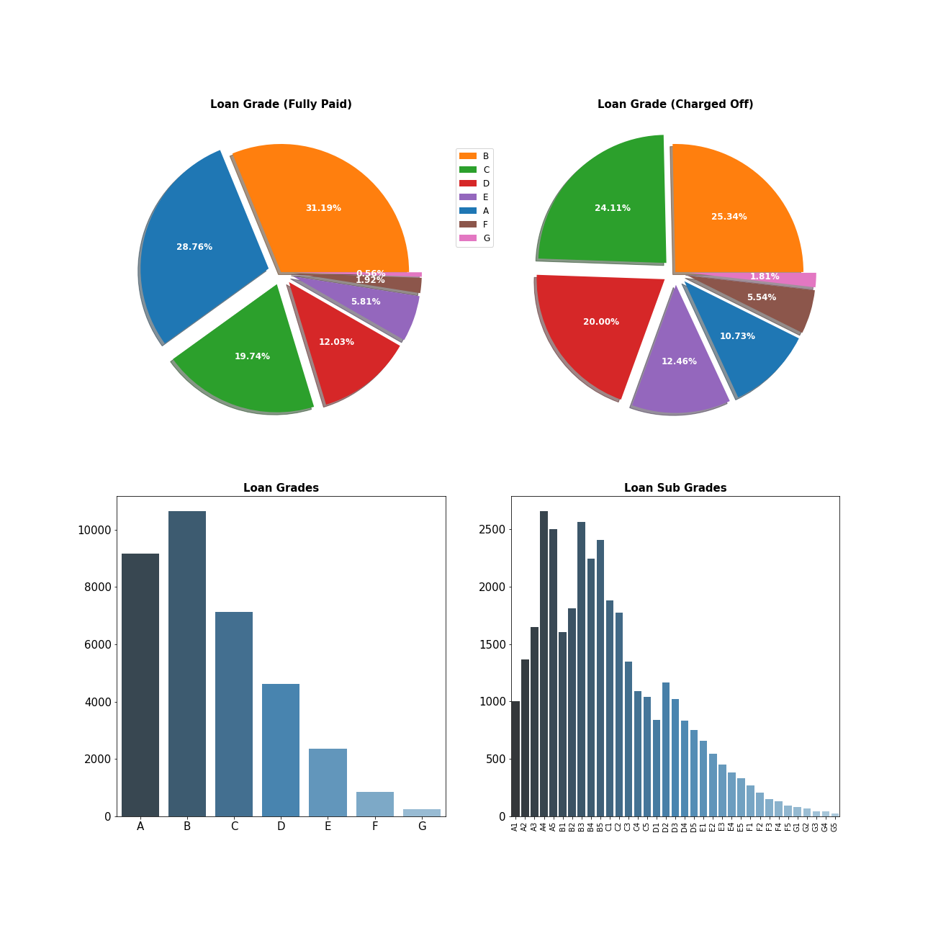
Loan Grade
We can notice that a higher portion of loans A and B are represented in fully paid loans (60%) compared to only (35%) for the charged off loans, for all other loan grades we can see their proportion to the total is less than the fully paid loans.
It looks like loan grade classification is a good indication of rather a loan is likely to be charged off or not.

Slide 8
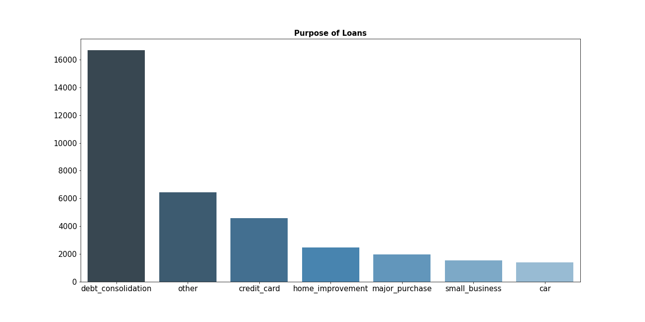
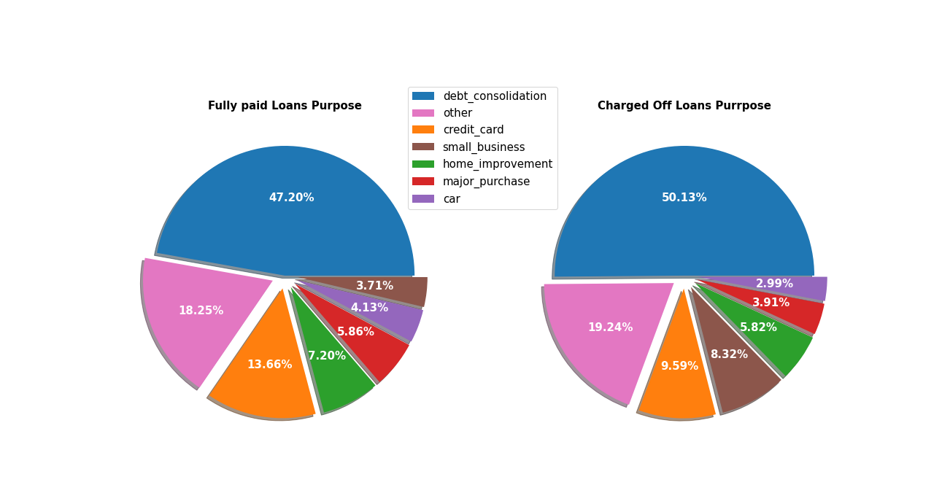
Loan purpose
Debt consolidation is main reason for lending amount here.
Fully paid loans are more for consumable purposes like paying off credit cards, home improvement, major purchases and cars.
Relatively high proportion of charged off loans which is for small business. as you can see almost 1 out of 4 small business loans has charged off which is higher than the overall percentage of charged off loans of (15%)

Slide 9
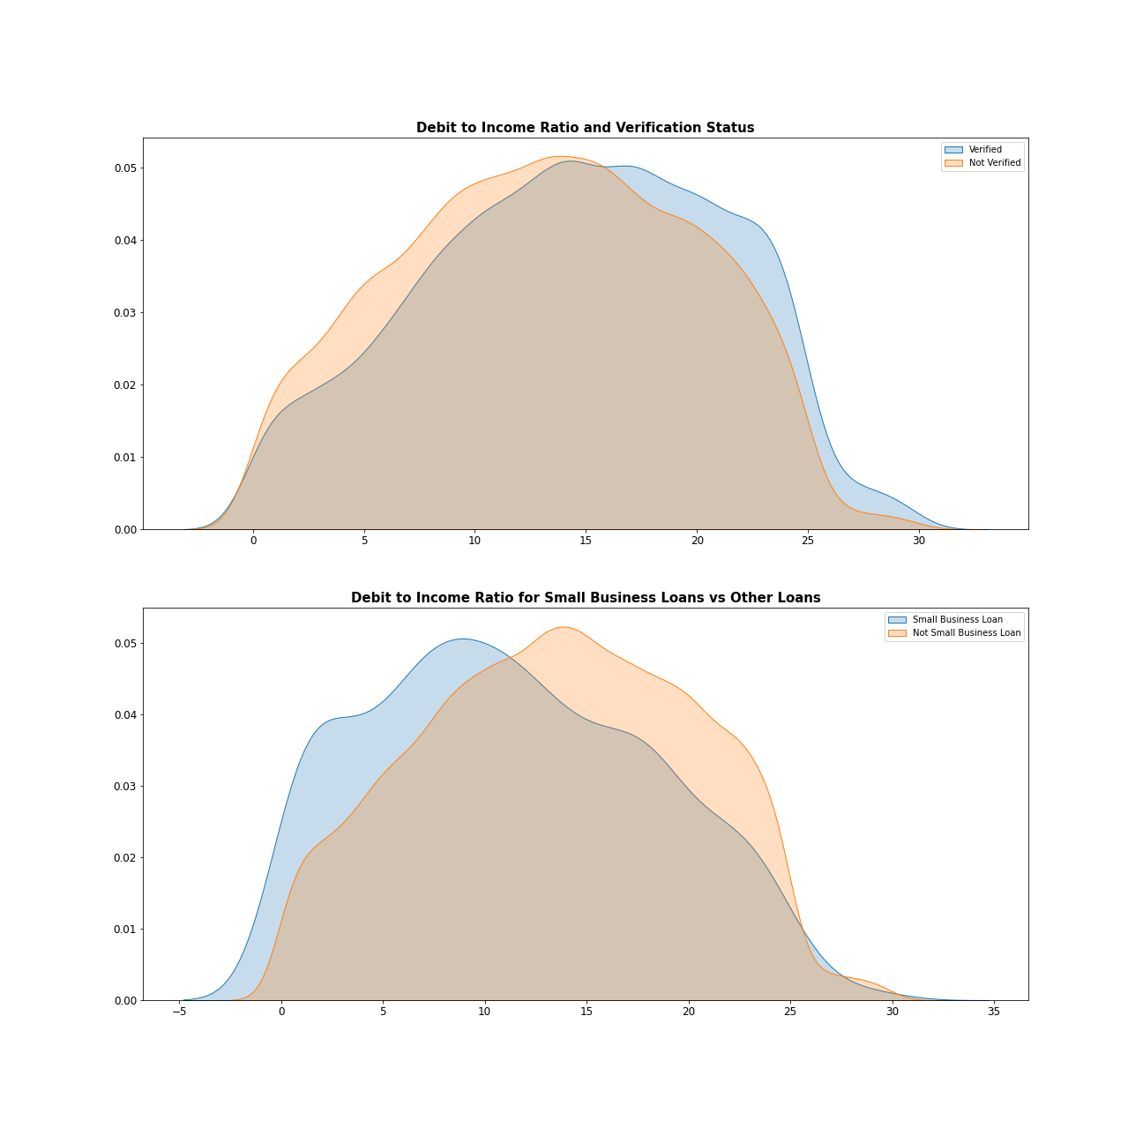
Debit to Income Ratio (DTI)
At around 17 DTI ratio There is higher probability of charged off then at fully paid.
Around the same DTI verification of accounts drops, looks like bank is already doing verification when DTI is high which is a good thing and continue doing that.
For small business DTI ratio with more then 10 looks like high-risk loans. There is steep rise in charged off.

Slide 10
Conclusion
85% of the loans are fully paid. only 15% of them are charged off loans
Higher Loan Amount are more likely to result in Charged off loan. Almost 1 out of 3 loans higher than 45k are charged off loans.
Longer duration long terms are more likelt to result in charged off loan. 44% of charged off loan are with 60 months terms compare to only 21% for fully paid loans. 1 out of 4 loans with 60-month term were charged off.
Loans with higher interest rates (Interest rate higher than 12% are more likely to be charged off. These charged off loans are more likely to collect less interest from them despite the higher interest because they are more likely to charge oof early.
Loan Grad classification shows that only 35% of the charged off loans are A and B loan grades compare to 60% for fully paid loans.
The percentage of charged off loans is high for small business loans (approximately 27%) compared to overall charged off percentage of 15%.
Higher Income borrowers are more likely to pay their loans.
Debit to Income ratio higher than 12% are more likely result in charged off loan, the verification of borrower's income is more occurred with DTI higher than 17%. Small Business loans has lower DTI compared to other purpose loans despite the high proportion of charge
60% of charged off loans received at least 1 inquiry within the last 6 months while this percentage is 50% for fully paid loans. d off loans for these loans.
Higher revolving line utilization (>55%) is more likely lead to charge doff loan.

