Slide 1
Lending club case study
Naren Reddy Palupunoori
Rabia Omer

Slide 2
Problem statement
Risks associated with banks lending
Applicant likely not pay back the loan.
Bank’s rejecting applicants and loosing business
Analyze the data
Find the patterns of which costumers are more likely to get charged off.
Find the probability of current customers who might be charged off

Slide 3
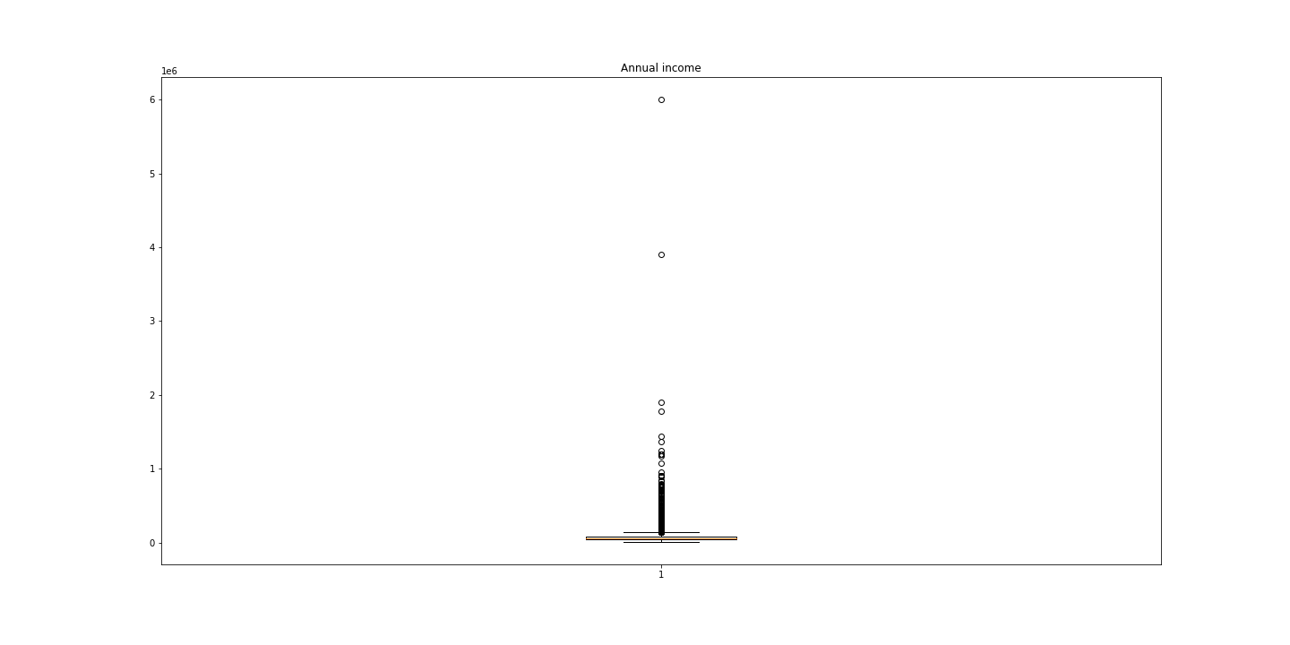
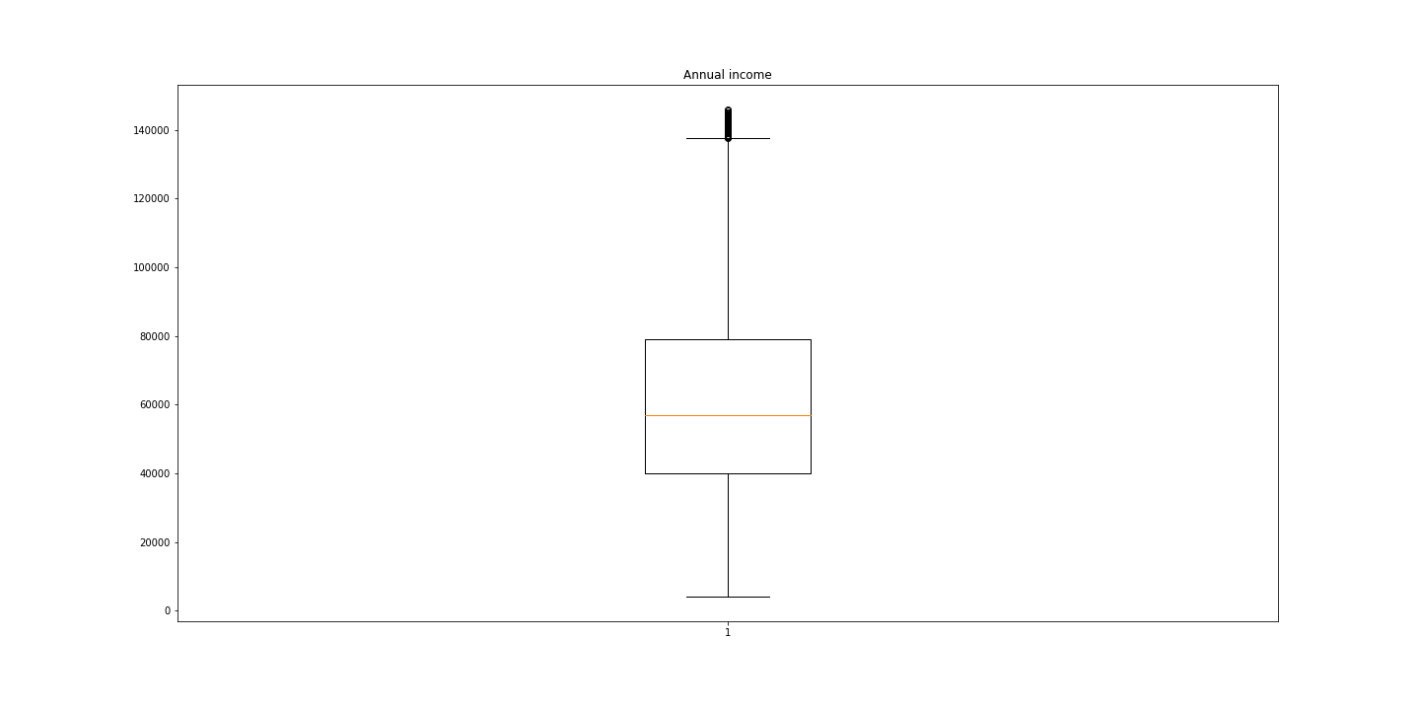
Annual income
Annual income has couple of outliers.
Couple of customers make up 17% of annual income, We want to eliminate them.
New mean income value now for all the customers now is 61000$

Slide 4
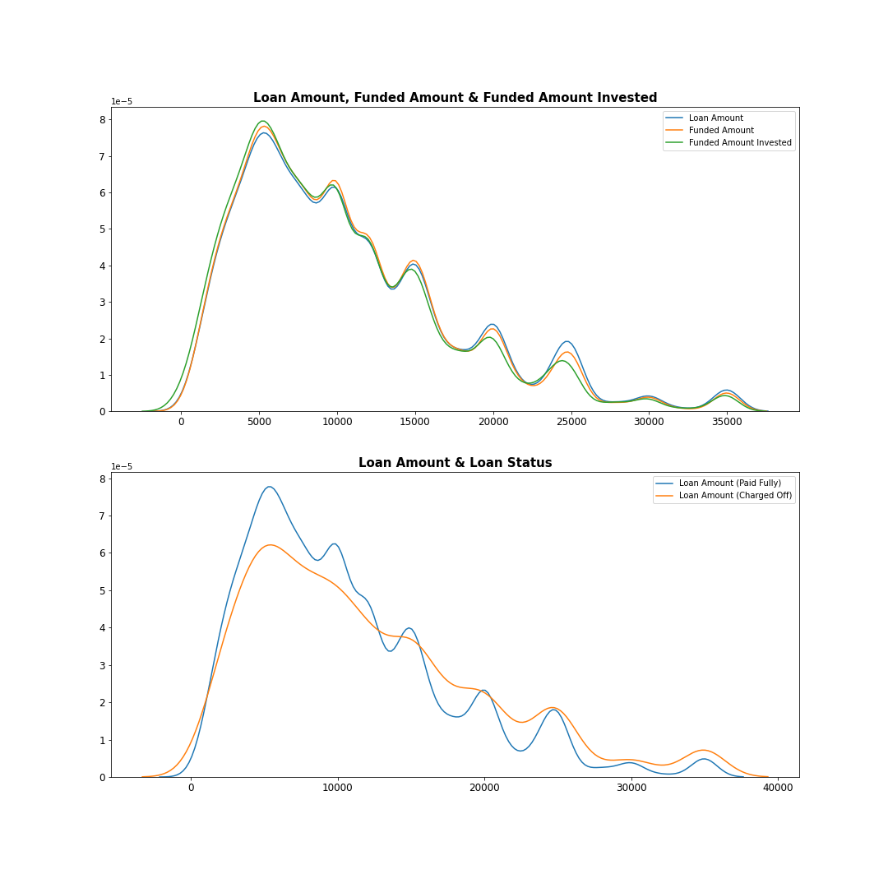
Loan status
Lower loan amounts have higher probability of paying off
Looking closely approx. 28% of the loan amount greater then 30,000$ are expected to charge off.

Slide 5
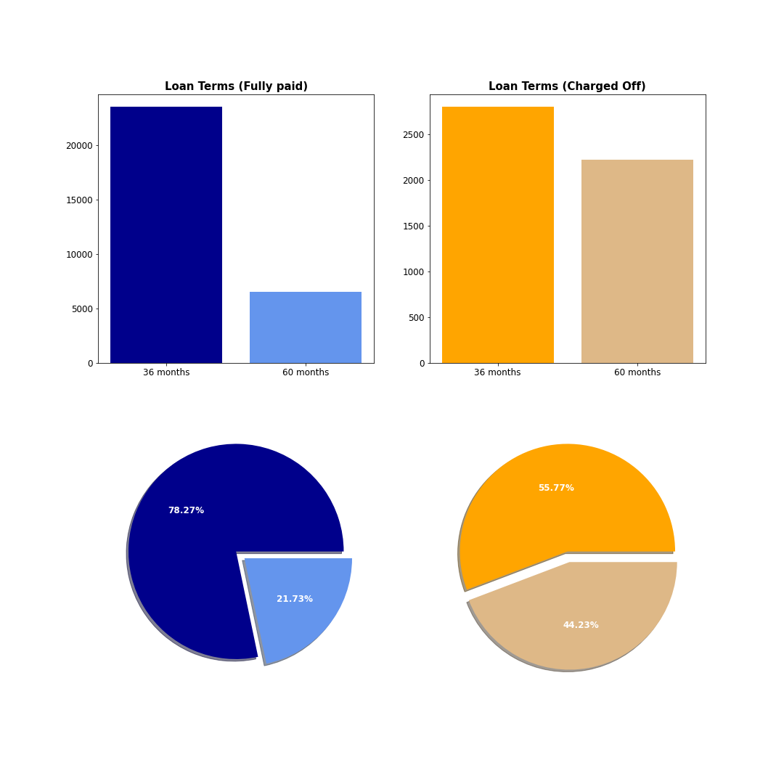
Term analysis
Overall, most of the loan terms are from 36 months, but charged off loans have a larger proportion of 60 months loan compared to fully paid loans.
Almost 45% of the charged off loans is with a 60 months term which means that despite the longer duration of the loans it still can be charged off.
We can see that loans with 60 months term are more likely to be charged off compared to loans with 36 months terms
1 out of 4 loans with 60 months term resulted in charged off loan while only 1 out of 10 loan with 36-month term resulted in charged off loan

Slide 6
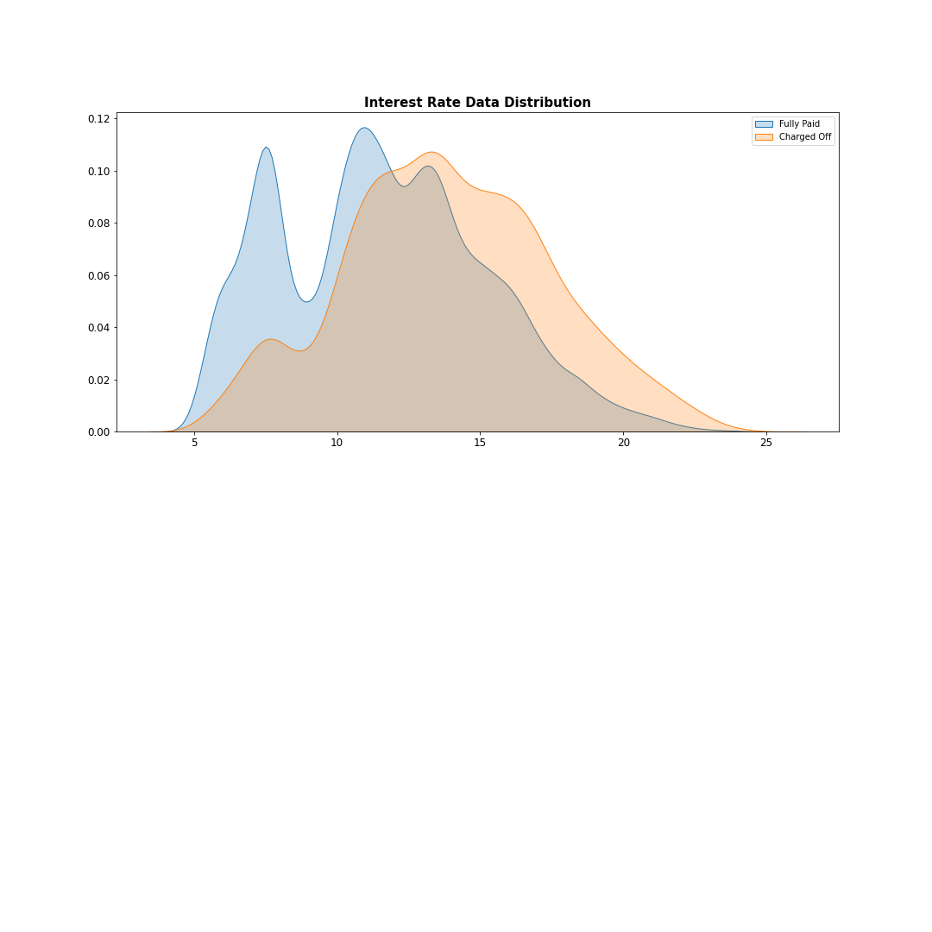
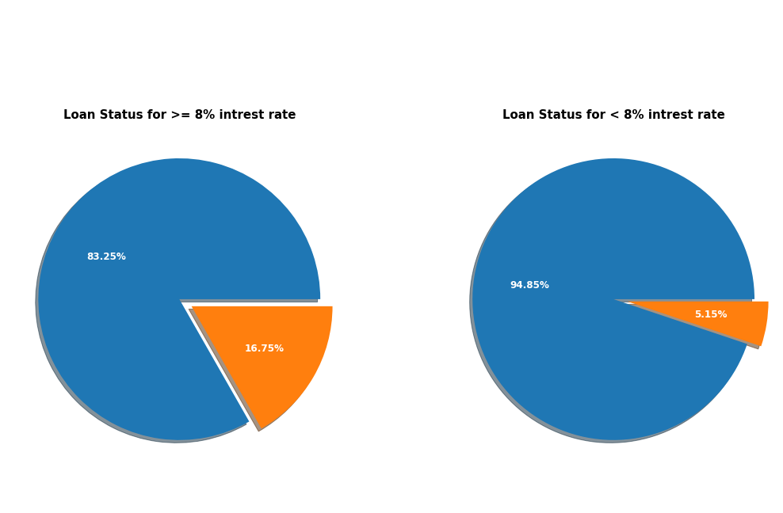
Interest rate
As the interest rate increases percentage of charged off increases.
Once the interest rate goes above 8% charged off increases by approximately 10%

