Slide 1
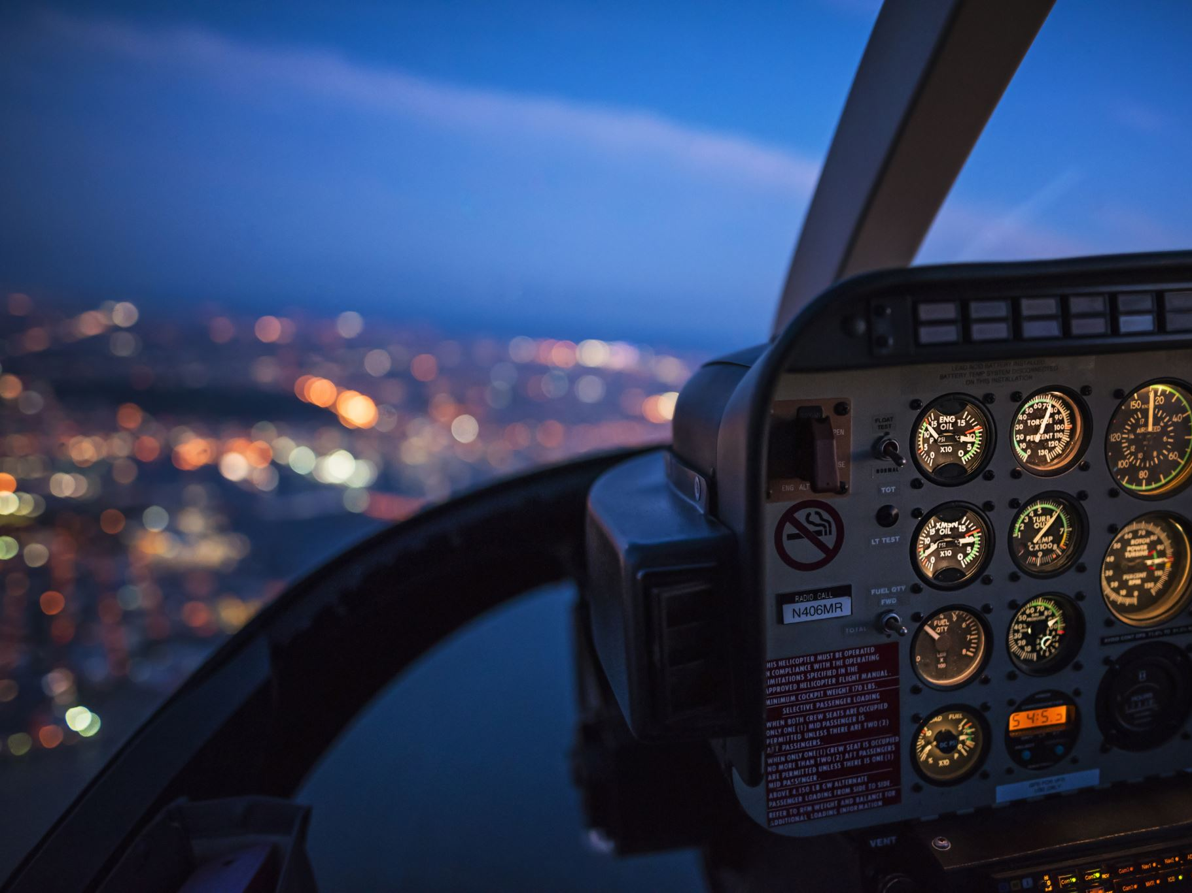
Predicting Airline Tweet Sentiment Using Machine Learning and NLP
Author: Neelam Pandey
Mentor : Himanshu Aggarwal
Data Science Career Track – Capstone 3 Project
January 2026

Slide 2

Introduction
Airlines receive thousands of customer tweets daily.
Real-time sentiment analysis is essential for customer experience, crisis management, and brand monitoring.
Goal: Classify tweets as positive, neutral, or negative.

Slide 3
Problem Statement & Objective
Manual monitoring of social media is impractical.
Teams miss early warning signs of operational issues.
Objective: Build a supervised ML model for accurate sentiment prediction using NLP.

Slide 4
Dataset Overview
Source: Twitter US Airline Sentiment Dataset (cleaned)
~14,000 tweets, labeled sentiment classes
Key columns: text, processed_text, airline_sentiment, negativereason, tweet_created

Slide 5

Data Wrangling
Handled missing values and empty strings
Removed critical rows with missing text
Encoded target variable
Cleaned dataset saved for modeling

Slide 6
Exploratory Data Analysis (EDA)
Sentiment distribution: majority negative tweets (class imbalance)
Most common words in negative tweets: 'delay', 'customer service', 'late'
Tweet volume over time: spikes during disruptions

Slide 7
Preprocessing & Feature Engineering
TF-IDF vectorization (1–2 grams, 5000 features)
Standardized feature magnitude
80/20 train/test split with stratification
Label encoding for sentiment

Slide 8
Modeling Approach
Four models trained: Logistic Regression, Linear SVC, Random Forest, Gradient Boosting
All used the same TF-IDF pipeline for fairness

Slide 9
Model Performance & Selection
Best Model: Linear SVC
Highest accuracy and best metrics for minority classes
Fast training and inference, robust for sparse text data
Model saved as: best_twitter_airline_model_LinearSVC.joblib

Slide 10
Results & Interpretation
High precision in identifying negative sentiment
Enables early detection of dissatisfaction, prioritization of support, and real-time monitoring
Some confusion between neutral and negative due to linguistic ambiguity

Slide 11
Recommendations for Stakeholders
Deploy real-time monitoring dashboard
Use negativereason field for root cause analysis
Integrate model into customer service triage systems

Slide 12
Future Work
Add hyperparameter tuning (GridSearchCV)
Explore deep learning models (BERT, RoBERTa)
Expand dataset to more airlines and international tweets
Add topic modeling for deeper insights

Slide 13
Conclusion
Machine learning can accurately classify airline tweet sentiment
Provides actionable insights for customer experience teams
Linear SVC model is ready for real-world deployment

