Slide 1
Housing Price Prediction Using Machine Learning
Student: Neelam Pandey
Project: Capstone Two – Data Science
Mentor: Himanshu Agarwal
Date: January 2026
GitHub: https://github.com/npandey472/CapstoneTwoProject

Slide 2
Project Overview
• Predict housing prices using ML
• Complete ML workflow
• Multiple regression models
• Random Forest selected

Slide 3
Problem Identification
• Target Variable: SalePrice
• Supervised Learning – Regression
• Real estate price prediction

Slide 4
Dataset Description
• ~2,900 records
• Numerical & categorical features
• Structural & zoning attributes

Slide 5
Feature Engineering
• HouseAge = CurrentYear − YearRemodAdd
• Basement Finished Portion
• Dropped original columns

Slide 6
Handling Missing Values
• Mean imputation for basement feature
• No missing values in target

Slide 7
Encoding & Scaling
• One-Hot Encoding for categorical features
• StandardScaler used for SVR

Slide 8
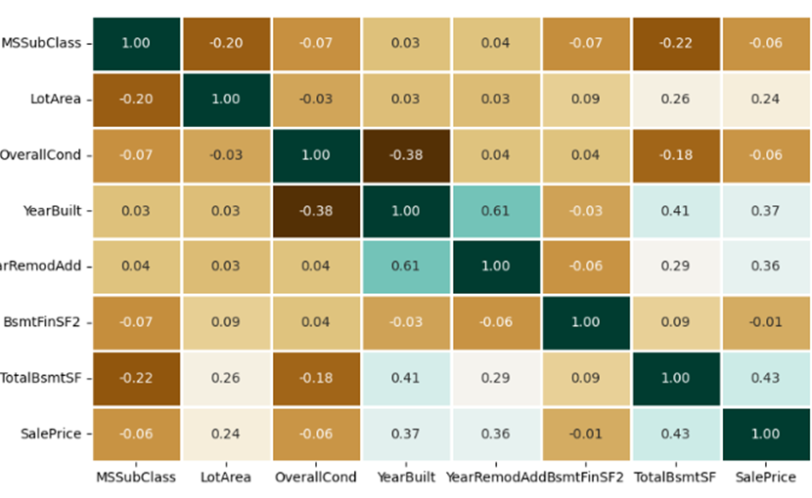
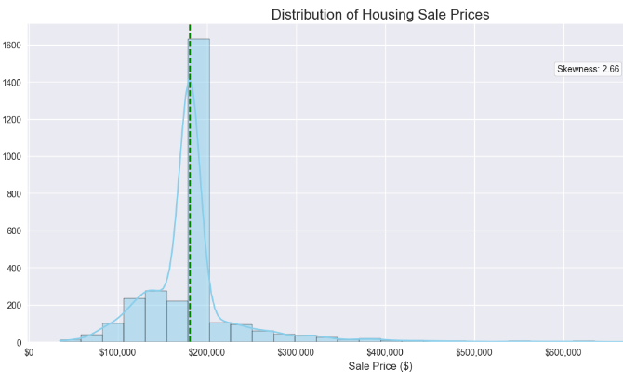
Exploratory Data Analysis
• Right-skewed SalePrice distribution
• Weak linear correlations
• Presence of outliers

Slide 9
Models Implemented
• Linear Regression
• SVR
• Random Forest
• CatBoost

Slide 10
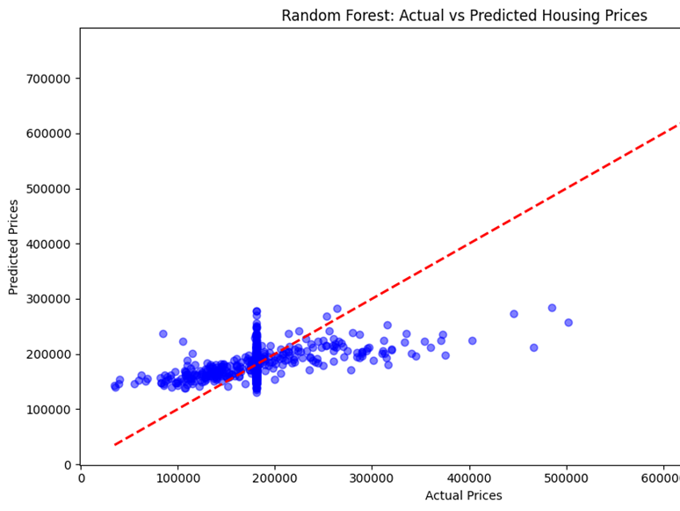
Random Forest Performance

Slide 11
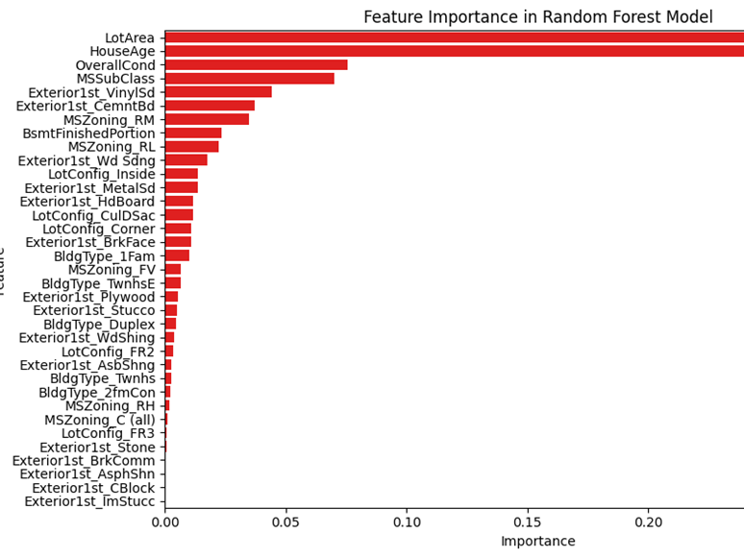
Random Forest Performance

Slide 12
Model Comparison
Model | R² | MAE | MAPE
Linear Regression | — | — | 20.13%
SVR | ~0.00 | ~$28k | ~18%
Random Forest | ~0.30 | ~$33k | ~20%
RF (Log Target) | ~0.26 | ~$33k | ~20%
CatBoost | ~0.23 | ~$35k | ~22%
Random Forest outperformed all other models

Slide 13
Conclusion
• Data quality more important than model complexity
• RF provides best balance

Slide 14
Future Work
• Add neighborhood & living area data
• Try XGBoost
• Deploy as web app

