Slide 1
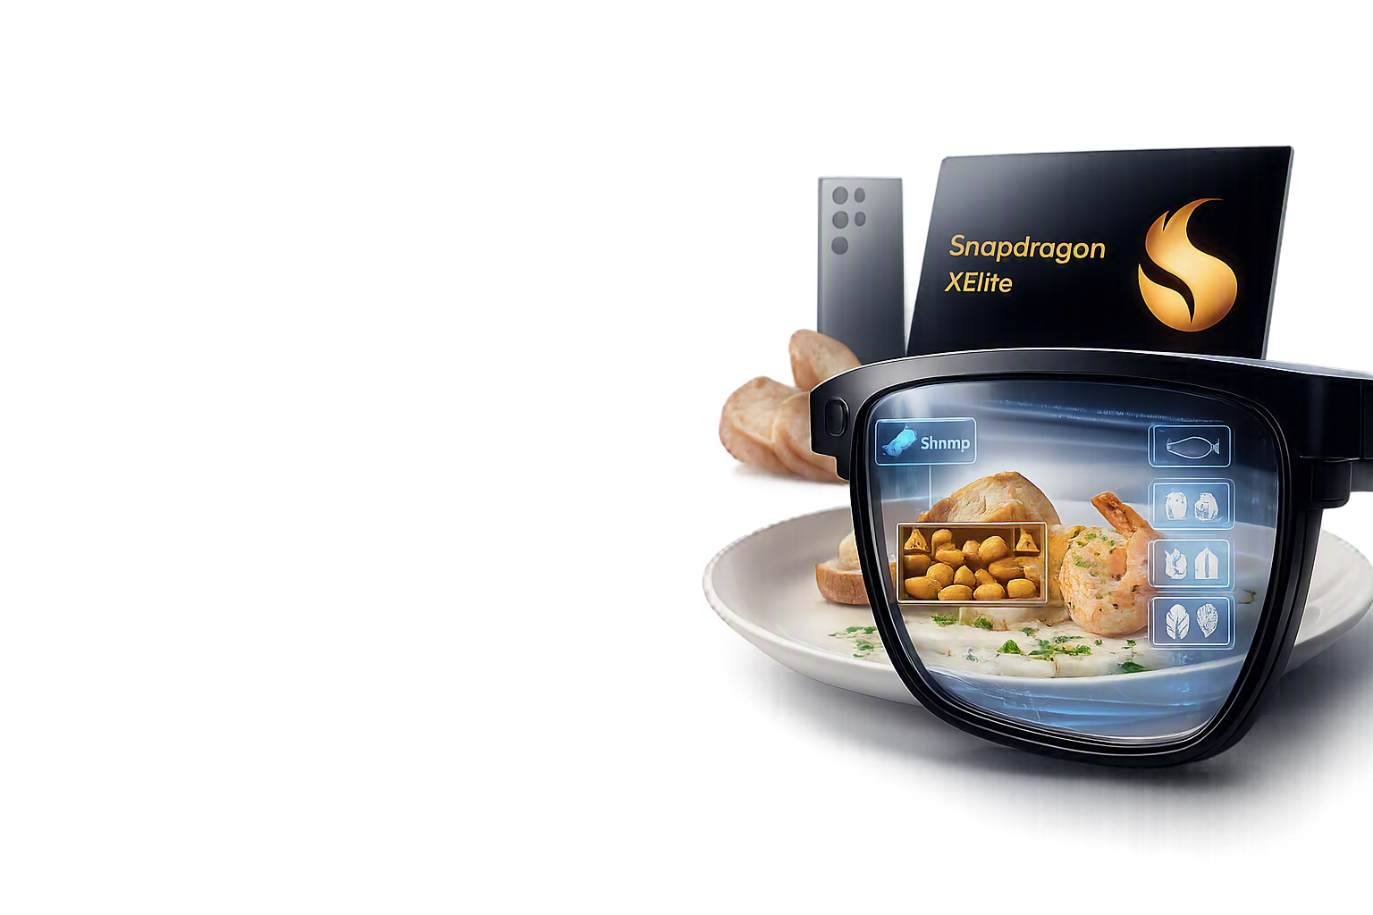
LOCAL WHEN POSSIBLE. CLOUD WHEN NEEDED. SAFETY ALWAYS.
AI-Powered Allergen Detection
AR Glasses · Edge AI · Multipath QUIC
Millions of people can't tell if a meal will hurt them — until it's too late.
A menu doesn't list hidden ingredients. A home-cooked dish has no label. We built glasses that answer, “is this safe?” the moment you look at your food and ask.
AI-Powered Allergen Detection | AR Glasses · Edge AI · Multipath QUIC
1 / 7
Notes:
Food allergies affect millions of people. A menu doesn't list hidden ingredients. A home-cooked dish has no label. We built glasses that answer 'is this safe?' the moment you look at your food and ask. State the theme line once, here, and don't repeat it verbatim again until the close.

Slide 2
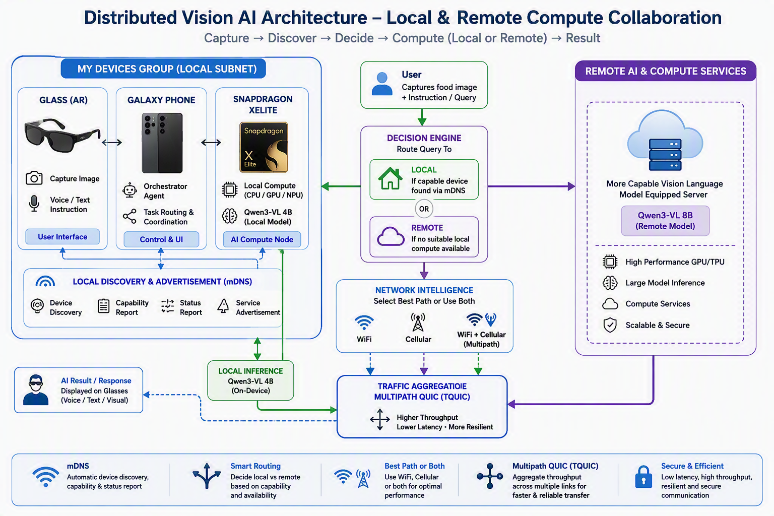
ARCHITECTURE
End-to-End System Architecture
Local first, cloud when needed — same user experience either way. The phone decides, not the person.
AI-Powered Allergen Detection | AR Glasses · Edge AI · Multipath QUIC
2 / 7
Notes:
Collapse the journey and architecture into one breath: RayNeo AR glasses capture the food image and the spoken question, relay to a Samsung Galaxy S25 Ultra, whose on-device agent tries a nearby Snapdragon X Elite PC first via automatic network discovery, and only falls back to AWS cloud if no local host answers. Land: same user experience either way — the phone decides, not the person. Demo callout: none, set up the two paths the demo will exercise.

Slide 3
SOLUTION
One Phone-Based AI Agent, Two Inference Paths
Local first, cloud when needed — same user experience either way. The phone decides, not the person.
RayNeo AR Glasses
Capture image + voice
Samsung S25 Ultra
Orchestration agent decides: local or cloud?
Local · Snapdragon X Elite
AR Response
Safety answer, in view
Cloud · AWS EC2
mDNS discovery on the LAN decides local-vs-cloud automatically — no visible mode switch for the user.
HOW IT WORKS
RayNeo AR glasses capture the food image and spoken question, relay to a Samsung Galaxy S25 Ultra, whose on-device agent tries a nearby Snapdragon X Elite PC first via automatic network discovery, and only falls back to AWS cloud if no local host answers.
AI-Powered Allergen Detection | AR Glasses · Edge AI · Multipath QUIC
3 / 7
Notes:
Collapse the journey and architecture into one breath: RayNeo AR glasses capture the food image and the spoken question, relay to a Samsung Galaxy S25 Ultra, whose on-device agent tries a nearby Snapdragon X Elite PC first via automatic network discovery, and only falls back to AWS cloud if no local host answers. Land: same user experience either way — the phone decides, not the person. Demo callout: none, set up the two paths the demo will exercise.

Slide 4
EDGE AI
Snapdragon X Elite + LM Studio
On-device inference — Qwen3-VL:4B running locally via LM Studio, no cloud round-trip required.
What happens on-device
• Identifies food items in the captured image
• Infers likely ingredients from what it sees
• Flags matches against the 9 allergen categories
• Returns a result without leaving the device or LAN
Benefits
• Privacy — image data never leaves the LAN
• Cost — no per-inference cloud spend
• Speed — sub-second response target
• Offline — works with zero internet connectivity
HONEST NOTE
In the current build, LM Studio on X Elite runs this inference on CPU — NPU/GPU acceleration isn't wired up yet. That's the clear next optimization. The win today is architectural: local-first still means zero image data leaves the LAN, no cloud cost, and full offline operation.
AI-Powered Allergen Detection | AR Glasses · Edge AI · Multipath QUIC
4 / 7
Notes:
The model identifies food items, infers ingredients, flags matches against the nine major allergen categories, and returns a result without ever leaving the device or the LAN. Be accurate if asked: in the current build, LM Studio on X Elite runs this inference on CPU — NPU/GPU acceleration isn't wired up yet, it's the clear next optimization (see appendix). The win today is architectural, not silicon-specific: zero image data leaves the LAN, no per-inference cloud cost, and it keeps working fully offline. Demo callout: flag that the upcoming demo will show a visible latency counter on this exact path.

Slide 5
CLOUD + NETWORKING
Cloud Fallback + Multipath QUIC
When local isn't available, fail over to a bigger model over a link with no single point of failure.
Cloud fallback
• No local host found → route the same request to AWS EC2
• Ollama serves the larger Qwen3-VL:8B model
• A stronger, not weaker, fallback
Multipath QUIC (Wi-Fi + 5G)
• Wi-Fi signal degrades → traffic shifts to cellular automatically
• Phone rides Wi-Fi and 5G to AWS simultaneously
• If one network drops, the connection survives on the other
• No reconnect — the single most distinctive part of the stack
Wi-Fi path
5G path
One Multipath QUIC Connection
minrtt scheduler picks best path
AWS EC2
Ollama · Qwen3-VL:8B
AI-Powered Allergen Detection | AR Glasses · Edge AI · Multipath QUIC
5 / 7
Notes:
If no local host is discovered, the same request routes to AWS EC2, where Ollama serves the larger Qwen3-VL:8B — a stronger, not weaker, fallback. The link to AWS uses Multipath QUIC, riding Wi-Fi and 5G at the same time; if one network drops, the connection survives on the other with no reconnect. This is the single most technically distinctive piece of the stack — say so.

Slide 6
LIVE DEMO
Everything Just Described — Running Now
Two beats, tight timing. Narrate each one — don't go quiet while it runs.
Beat 1 · Local-first success
• Ask the allergen question wearing the glasses
• Local path (X Elite) answers fast
• Call out the path indicator on screen
Beat 2 · Forced cloud fallback
• Disable local host / narrate “now forcing cloud”
• Re-ask — show fallback to AWS
• If time allows: show the Wi-Fi → 5G path switch live
BACKUP PLAN
Have a 60–90s backup video cued in case live networking fails at the venue.
AI-Powered Allergen Detection | AR Glasses · Edge AI · Multipath QUIC
6 / 7
Notes:
Two beats only, tight timing: (1) Ask the allergen question wearing the glasses, local path answers fast — call out the path indicator. (2) Disable the local host (or just narrate 'now forcing cloud') and re-ask — show the fallback to AWS and, if time allows, the Wi-Fi-to-5G path switch on the live stats. Narrate each beat in one sentence — don't go quiet while it runs. This IS the demo slide — have a 60-90s backup video cued in case live networking fails at the venue.

Slide 7
REAL NPU-READY EDGE AI · REAL MULTIPATH NETWORKING · REAL AR GLASSES
Local When Possible.
Cloud When Needed.
Safety Always.
Thank you — happy to take questions.
AI-Powered Allergen Detection | AR Glasses · Edge AI · Multipath QUIC
7 / 7
Notes:
Local when possible. Cloud when needed. Safety always. Thank you — happy to take questions. Keep it to one breath; don't introduce new information here.

Slide 8
APPENDIX · Q&A BACKUP
Why Koog?
KEY MESSAGE
Koog gives the agent memory and model-portability, so it isn't reinvented from scratch.
Why it's in the stack
• Handles conversation history / context summarization across turns
• Lets the agent move sessions between LLM backends — local today, cloud on fallback, or a different model tomorrow — without losing context
• Solves the same problem LangChain / LangGraph solve on the Python side — Koog is that role for this stack
• Without it: every local↔cloud handoff would either drop context or need hand-rolled summarization
Session context
(persists)
Model A → Model B
via Koog
AI-Powered Allergen Detection | AR Glasses · Edge AI · Multipath QUIC
Appendix A
Notes:
Koog handles conversation history/context summarization across turns and lets the agent move sessions between LLM backends (local model today, cloud model on fallback, or a different model entirely tomorrow) without losing context. This is the same problem LangChain/LangGraph solve on the Python side — Koog is that role for this stack. Without it, every local↔cloud handoff would either drop context or require hand-rolled summarization.

Slide 9
APPENDIX · Q&A BACKUP
Why Multipath QUIC (Tencent tquic)?
KEY MESSAGE
Multiple paths exist for two reasons — reliability and aggregate throughput — and a smart scheduler picks the best one in real time instead of just tolerating whichever one you're stuck on.
Single path (the problem)
• Bad Wi-Fi signal? You just suffer through it
• The connection has no idea a better path exists
• One degrading link → one degrading experience
Multipath QUIC (the fix)
• Client holds Wi-Fi and 5G open simultaneously
• minrtt scheduler routes traffic over whichever path currently measures best round-trip time
• Can shift away from a degrading path without dropping the connection
• Not just failover — continuous best-path selection, with the option to aggregate both for higher throughput
AI-Powered Allergen Detection | AR Glasses · Edge AI · Multipath QUIC
Appendix B
Notes:
If you're on a single path, a bad Wi-Fi signal is something you just suffer through — the connection doesn't know a better path exists. With Multipath QUIC, the client holds Wi-Fi and 5G open simultaneously; a scheduler like minrtt actively routes traffic over whichever path currently measures the best round-trip time, and can shift away from a degrading path without dropping the connection. It's not just failover — it's continuous best-path selection, plus the option to aggregate both paths for higher throughput.

Slide 10
APPENDIX · Q&A BACKUP
Why mDNS?
KEY MESSAGE
mDNS lets the phone find nearby AI-capable devices with zero user setup.
Why it's the right tool
• Discovers available devices and services on the LAN — no manual IP entry, no pairing
• Same category of “just works” discovery as finding a nearby printer or Chromecast
• Local-first only works as an experience if discovery is invisible to the user
Phone
silently broadcasts a query
X Elite host
responds — no UI, no user action
AI-Powered Allergen Detection | AR Glasses · Edge AI · Multipath QUIC
Appendix C
Notes:
The goal is discovering available devices and services on the LAN without the user manually entering an IP address or pairing anything — the same category of 'just works' discovery as finding a nearby printer or Chromecast. That's the whole justification: local-first only works as an experience if discovery is invisible.

Slide 11
APPENDIX · Q&A BACKUP
Why AR Glasses as the Companion Use Case?
KEY MESSAGE
Glasses are faster to use than a phone in the exact moment safety matters — and the phone is still there as a fallback.
Glasses already on
• Just ask — one step
• Speed matters right before the first bite
Phone-only fallback
• Unlock → open app → aim camera → ask — four steps
• Still works fully if glasses aren't available or worn
HONEST NOTE (WORTH RAISING PROACTIVELY)
LM Studio on X Elite is CPU-only in this build — no NPU/GPU acceleration yet. Worth stating proactively if a Qualcomm engineer doesn't ask, since it's the clearest immediate next step for this project.
AI-Powered Allergen Detection | AR Glasses · Edge AI · Multipath QUIC
Appendix D
Notes:
If you're already wearing the glasses, asking them is quicker than pulling out and unlocking a phone — and speed matters when the moment to check is right before the first bite. If glasses aren't available or aren't worn, the same question still works by phone alone — the glasses are an accelerant to the experience, not a hard dependency. Pair this with the honest note: LM Studio on X Elite is CPU-only in this build, no NPU/GPU acceleration yet — worth stating proactively if a Qualcomm engineer doesn't ask, since it's the clearest immediate next step for this project.

Slide 12
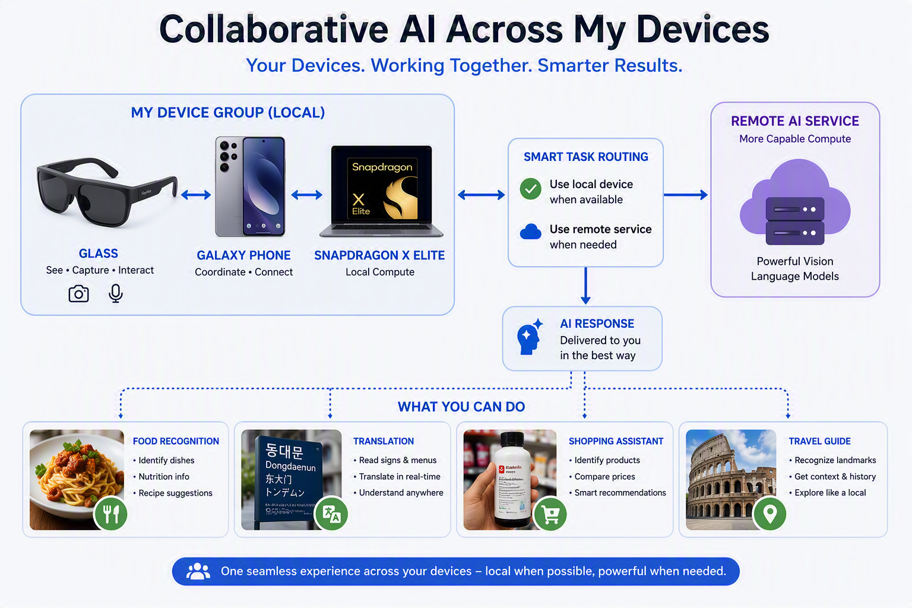
APPENDIX · VISION
Beyond Allergen Detection
The same local-first, cloud-when-needed pattern generalizes to any everyday task.
AI-Powered Allergen Detection | AR Glasses · Edge AI · Multipath QUIC
Appendix E
Notes:
Allergen detection is the demo, but the architecture underneath — local device group, mDNS discovery, smart task routing to local or remote compute — isn't allergen-specific. The same pattern applies to food recognition, translation, shopping, and travel assistance: use the local device when it's capable, reach for more powerful remote compute only when needed.

