Slide 1

IST – 659 Data admin concepts and Database Management
Fashion Week Database Management
Final Project
Presented by :
Nandita P (npathard@syr.edu)
Jenifer F (jferna41@syr.edu)
Kyliah A (kfalmeid@syr.edu)
Spoorthi C (schand05@syr.edu)

Slide 2
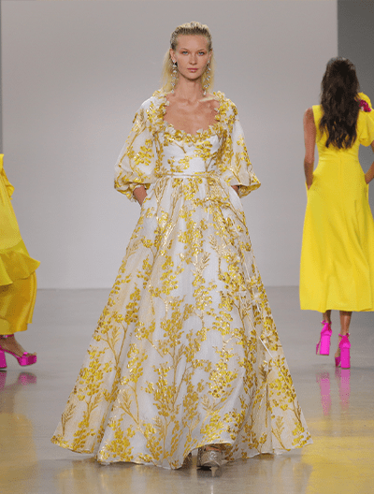
Project Overview
This project focuses on the Fashion Week dataset, which is a database that contains information about fashion events, designers, collections, models, and runways. It provides detailed information about the events, the designers who participate in them, the collections they showcase, and the models who walk the runway. The dataset also includes information on the location and date of each event, as well as the countries and cities in which they are held. This information can be used to analyze trends in the fashion industry, track the success of designers and their collections, and gain insights into the global fashion landscape.

Slide 3
Goals
The main purpose of this database is to provide a platform for managing and organizing various aspects of fashion week events such as designers, models, events, collections, runways, and other related data.
The database allows for efficient storage and retrieval of data, as well as easy
updating and modification of information as needed.
By keeping track of all relevant data in a centralized location,
the database helps to ensure smooth and successful execution of fashion week events.
The database can keep track of important details such as the dates, locations,
and themes of different fashion week events. It can also store information about the
designers who will be showcasing their collections, the models who will be walking
on the runway, and the media outlets that will be covering the event.
By having all this information in one place, it becomes easier for event
organizers to coordinate with various stakeholders and ensure that everything runs smoothly.

Slide 4
Specifications
Entity Relationship Data Requirements/Business Rules
Conceptual Data Model
Logical Data Model
SQL/Up/Down Script to create/drop tables, keys constraints*
User Stories
External data model satisfying user stories
Triggers/Procedures
User Interface Design
*submitted as sql file

Slide 5
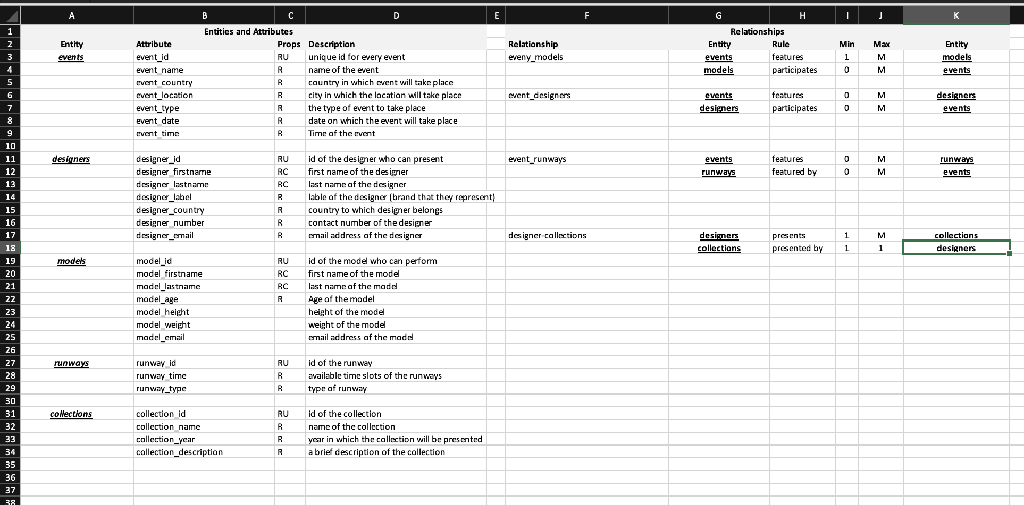
Data Requirements for the project

Slide 6
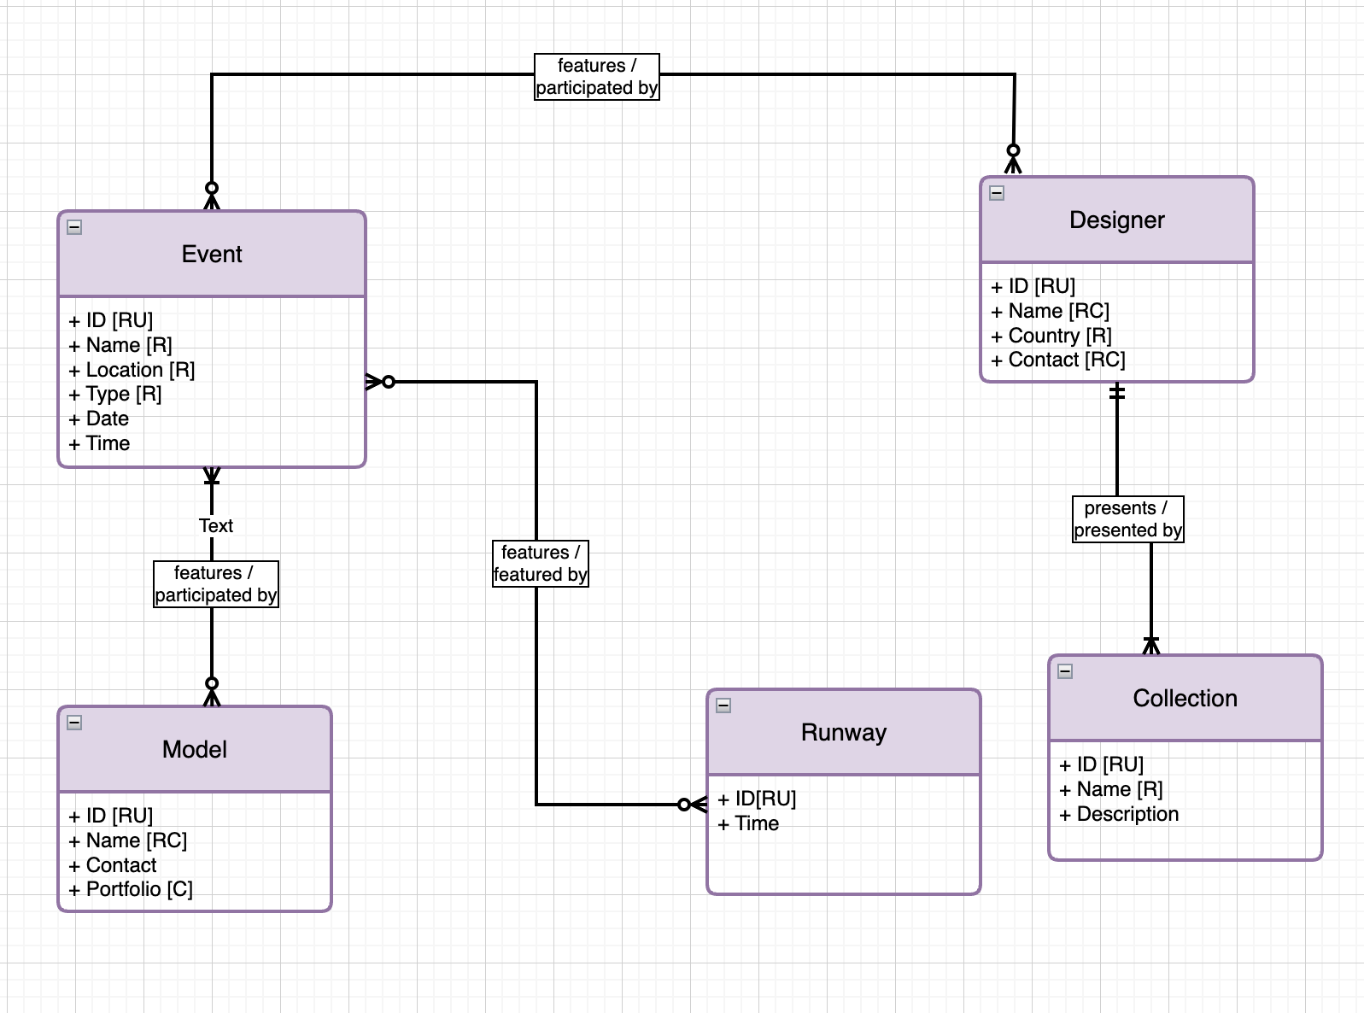
Conceptual Model

Slide 7
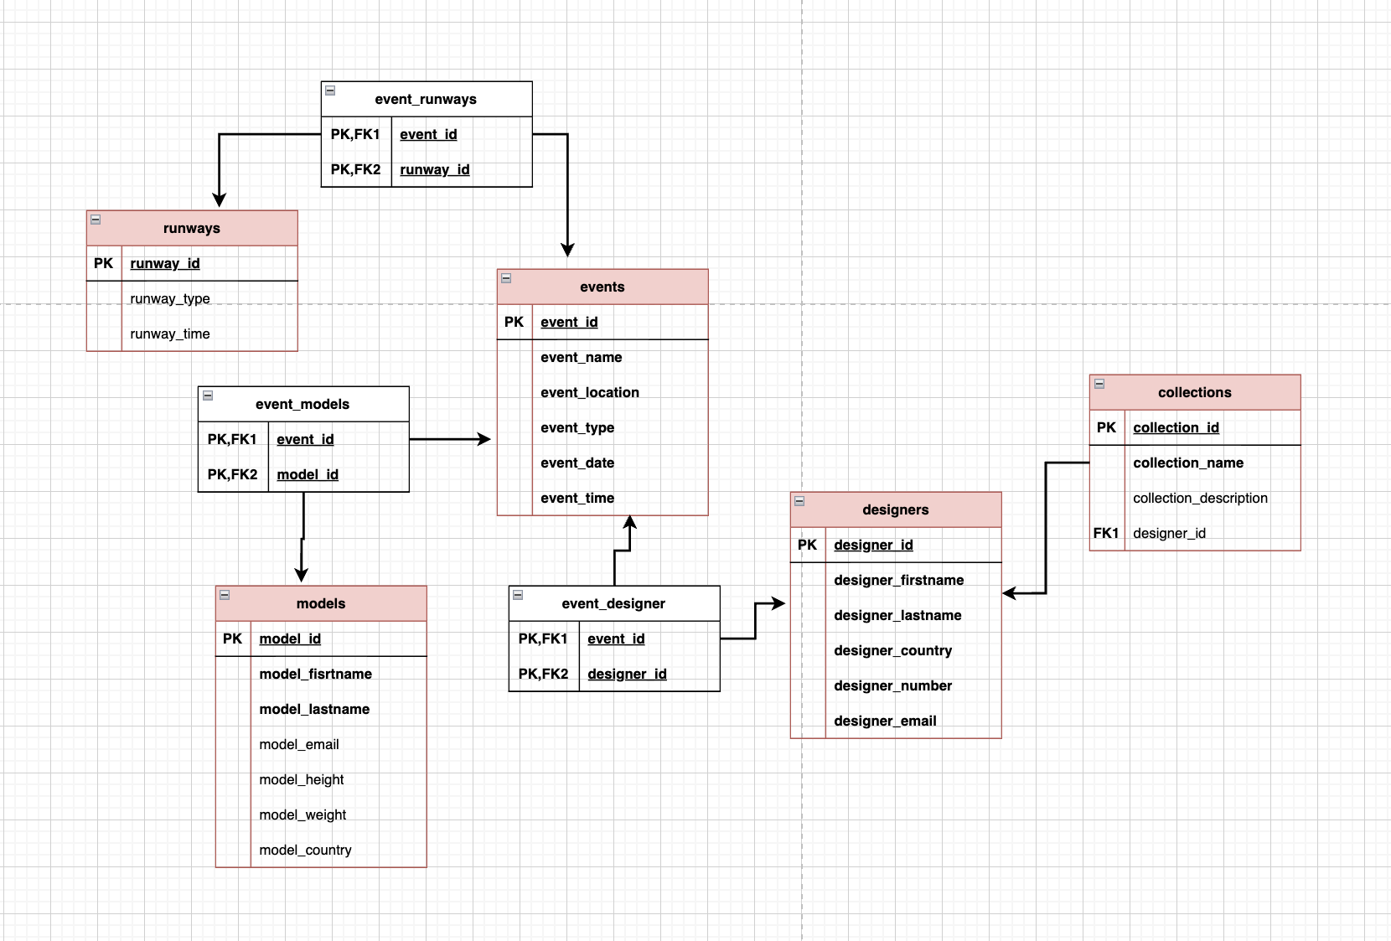
Logical Model

Slide 8
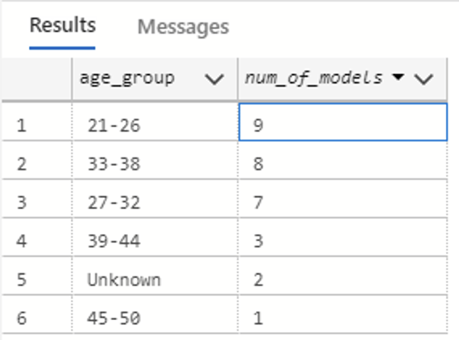
SELECT
CASE
WHEN model_age >= 21 AND model_age < 27 THEN '21-26'
WHEN model_age >= 27 AND model_age < 33 THEN '27-32'
WHEN model_age >= 33 AND model_age < 39 THEN '33-38'
WHEN model_age >= 39 AND model_age < 45 THEN '39-44'
WHEN model_age >= 45 AND model_age < 51 THEN '45-50'
ELSE 'Unknown'
END AS age_group,
COUNT(*) AS num_of_models
FROM models
GROUP BY
CASE
WHEN model_age >= 21 AND model_age < 27 THEN '21-26'
WHEN model_age >= 27 AND model_age < 33 THEN '27-32'
WHEN model_age >= 33 AND model_age < 39 THEN '33-38'
WHEN model_age >= 39 AND model_age < 45 THEN '39-44'
WHEN model_age >= 45 AND model_age < 51 THEN '45-50'
ELSE 'Unknown'
END
ORDER BY age_group;
As a user, I would like to see the most popular age group of models performing based on a determined age group criteria

Slide 9
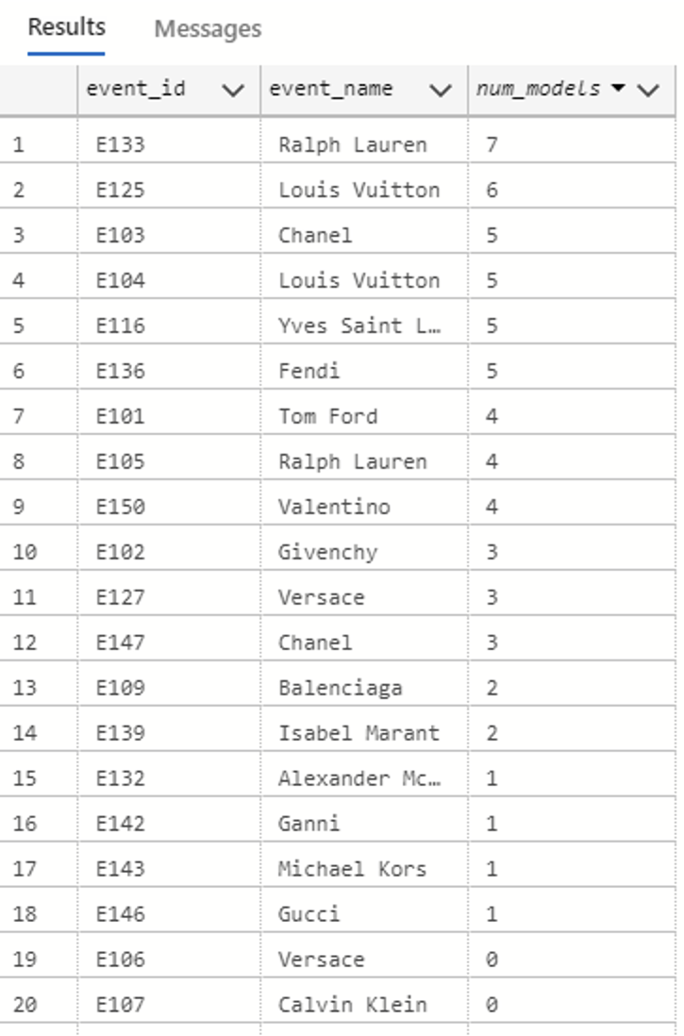
As a user, I would like to see the most popular events in which the models would be performing
SELECT e.event_id, e.event_name, COUNT(em.model_id) AS num_models
FROM events e
LEFT JOIN event_models em ON e.event_id = em.event_id
GROUP BY e.event_id, e.event_name;

Slide 10
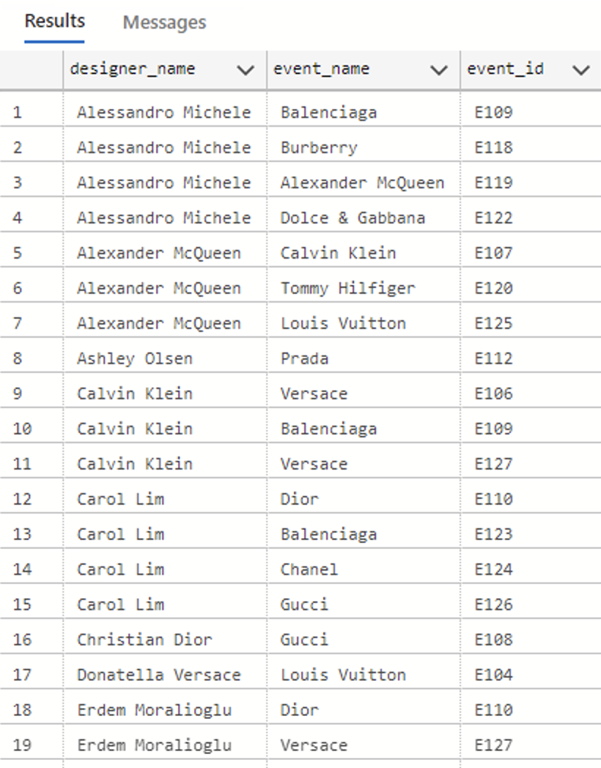
As a user, I want to know which designers are performing in for which event host
SELECT DISTINCT CONCAT(d.designer_firstname, ' ', d.designer_lastname)
AS designer_name, e.event_name, ed.event_id
FROM designers d
JOIN event_designers ed
ON d.designer_id = ed.designer_id
JOIN events e
ON e.event_id = ed.event_id;

Slide 11
As an admin, I want to update a designer’s details in the database
CREATE PROCEDURE UpdateDesigner
@id NVARCHAR(10),
@first_name NVARCHAR(50),
@last_name NVARCHAR(50),
@label NVARCHAR(50),
@country NVARCHAR(50),
@number NVARCHAR(20),
@email NVARCHAR(50)
AS
BEGIN
UPDATE designers
SET
designer_firstname = @first_name,
designer_lastname = @last_name,
designer_label = @label,
designer_country = @country,
designer_number = @number,
designer_email = @email
WHERE
designer_id = @id
END
select * from designers where designer_id = 'D130'
EXEC UpdateDesigner 'D130', 'John', 'Doe', 'JD Fashion', 'USA', 5555555555, 'johndoe@email.com'
select * from designers where designer_firstname='John'

Slide 12
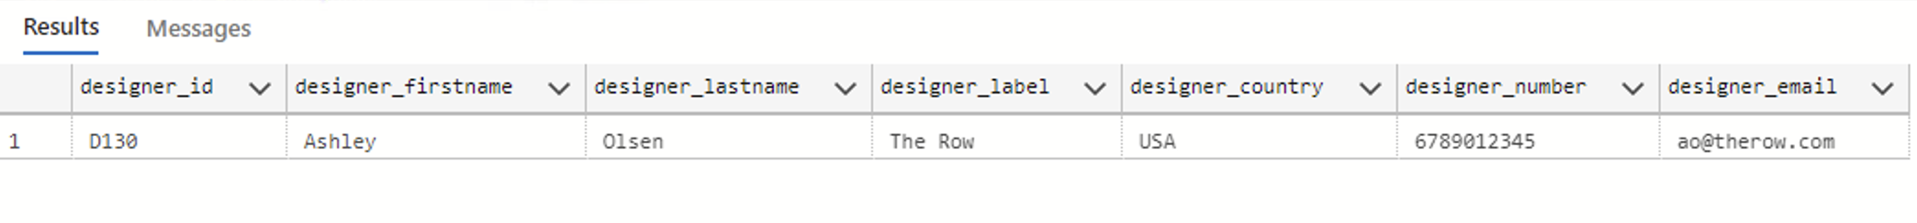
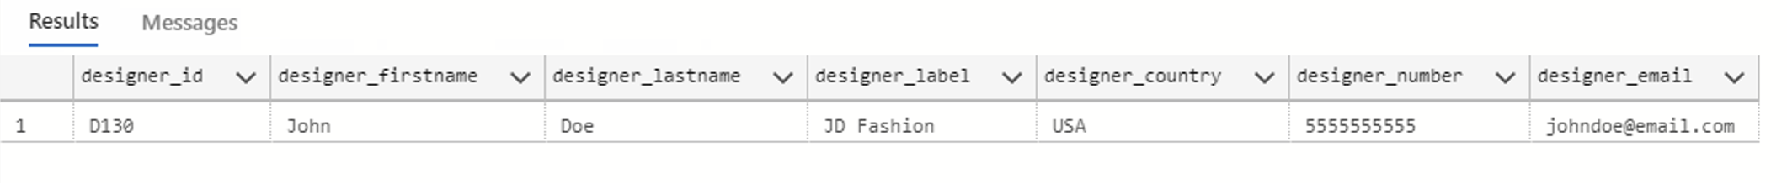
BEFORE
AFTER

Slide 13
As an admin I want to delete details of the designers and have it removed from my database
CREATE TRIGGER trg_DeleteDesigner
ON designers
FOR DELETE
AS
BEGIN
DELETE FROM event_designers
WHERE designer_id IN (SELECT designer_id FROM deleted);
END
select * from event_designers where designer_id='D118'
DELETE FROM collections
WHERE designer_id = 'D118';
ALTER TABLE event_designers
DROP CONSTRAINT FK_event_designers_designer_id;
ALTER TABLE event_designers
ADD CONSTRAINT FK_event_designers_designer_id
FOREIGN KEY (designer_id)
REFERENCES designers(designer_id)
ON DELETE CASCADE;
DELETE FROM designers WHERE designer_id = 'D118';
select * from event_designers where designer_id='D118'

Slide 14
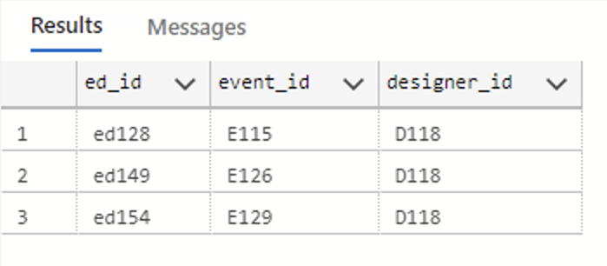
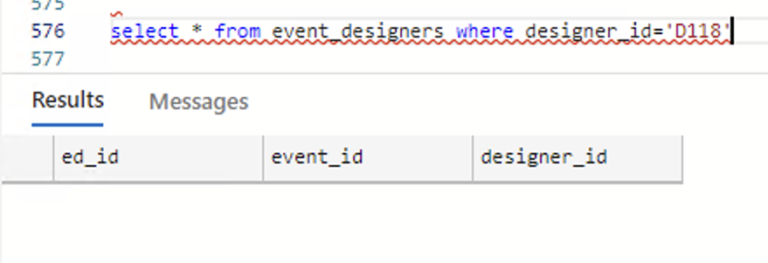
BEFORE
AFTER

Slide 15

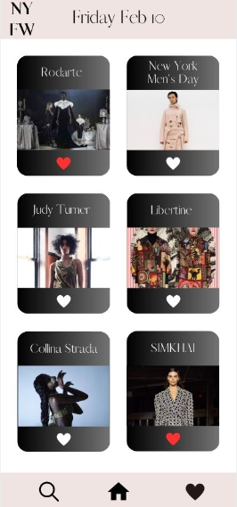
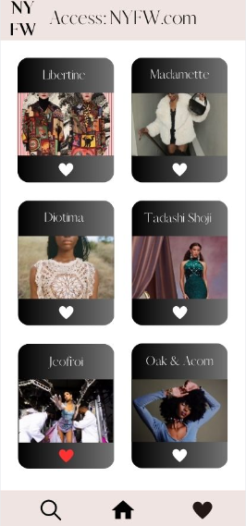
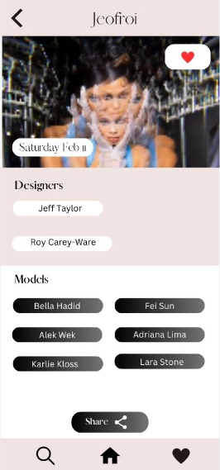
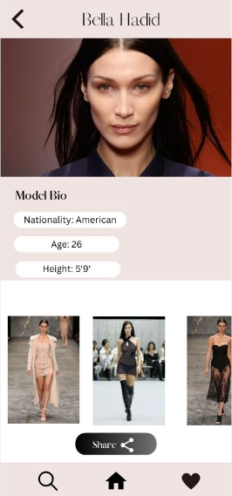
NYFW App UI

Slide 16
THANK YOU ☺

