Slide 1
BIOMETRIC BASED ELECTRONIC VOTING MACHINE
Project II (EC4902D)
Rushikesh Bute (161060014)
Nishad Patne (161060028)
Lalit Jadhav (161060042)
Saurabh Gurbhele (161060063)

Slide 2
ABSTRACT
The aim of the project is to develop a Biometric based Electronic Voting Machine that can be used to distant voting, better authentication.
The key motivation lies in simplifying the complex electoral process of India. Biometric EVM also tries to find out new methodologies to address verification of voters specially thumb impression of voter in this project. The technology also provides a secured confirmation to voters about their registered vote and addresses a issues of security and tampering of traditional EVMs The technology encourages fast counting of votes provide quick result of elections.
The project uses a Raspberry Pi as a microprocessor of the technology. It uses fingerprint scanner for the verification of voters and single national database system of voters with SQL for database management.

Slide 3
INTRODUCTION
India is largest democracy in the world with 910 million voters and election as a complex and time consuming exercise. To simplify this excerise the project develops the Biometric based Electronic Voting Machine which uses thumb impression for voter identification. The technology allows distance voting by directing the voter as per his registered constituency. The EVM also notifies voter about his registered vote with a message of confirmation on a registered mobile number. This model also enables fast election results by on time updation of vote counts of all constituencies.
The project addresses some of the key challenges in electoral system of India and tries to simplify it for the citizens using simple technology.

Slide 4
PROBLEM
STATEMENT
Context:
There are several instances where bogus voting trends in the news during elections. The credibility of traditional EVMs is always questioned by opposition due to complex voting procedures and insufficient verification of votes. This project suggests some efficient model to resolve the issues.
Relevance:
Low voter turnout has been shown to have negative associations with social cohesion and civic engagement. The free and fair elections can contribute highly to elect honest & wokaholic leaders for development of region. Electoral Process is start of the democracy and glitches in it can have serious impact on the human development addressing this problem we have developed Biometric based Electronic Voting Machine.
Problem Definition:
The malfunctions of electoral system due to bogus voting and less participation of voters.

Slide 5
OBJECTIVE
The Biometric based Electronic Voting Machine intends to:
Centralise single database of all voters in election.
Develop a fingerprint based unique voting system.
Enable the distance voting in elections
Provide SMS based vote verification for voters.
Calculate the election results swiftly and transparently.

Slide 6
PROPOSED METHOD
The proposed method creates a central database of voters which can be accessible from any Biometric based Electronic Voting Machine instead of constituency or ward wise database. The model involves solutions like unique identification based voting for better authentication of voters and avoid bogus voting. The method of distance voting is introduced in model to ensure maximum participation of voters. The SMS based vote verification system is developed to address the credibility issues questioned by political parties. The fast votes counting system is enabled to simplify the work of booth officers and avoid logistical problems faced by Election Commission in elections.

Slide 7
HARDWARE ASSEMBLING

Slide 8
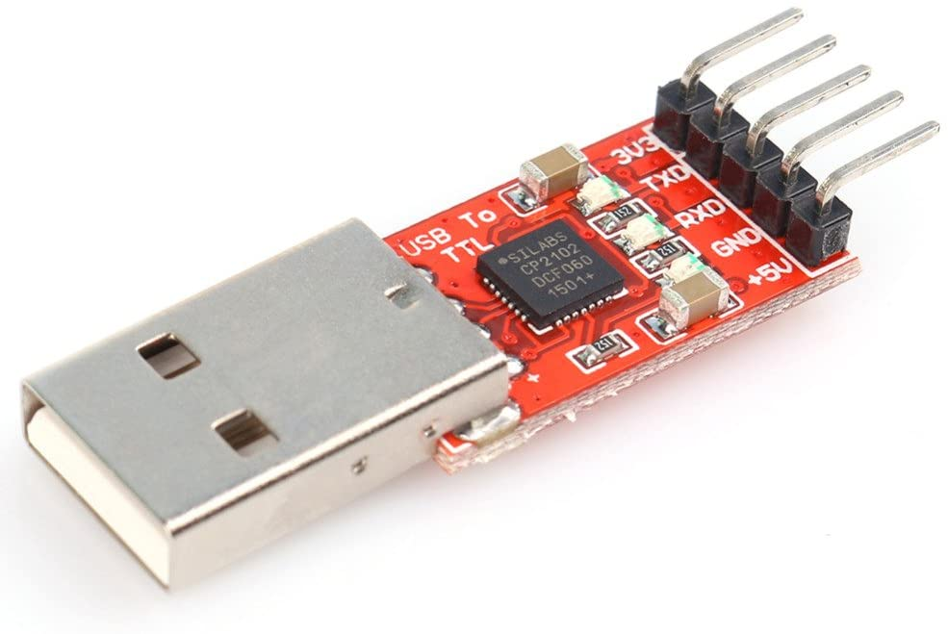
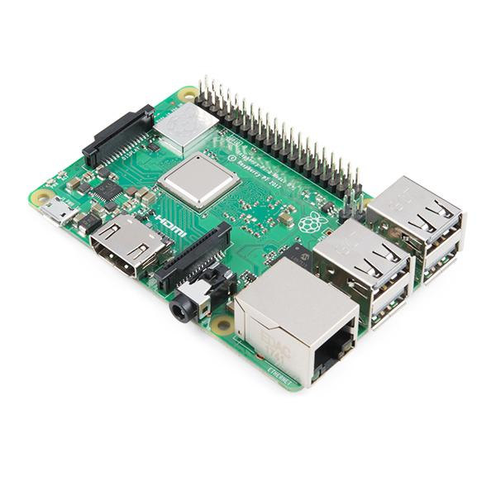
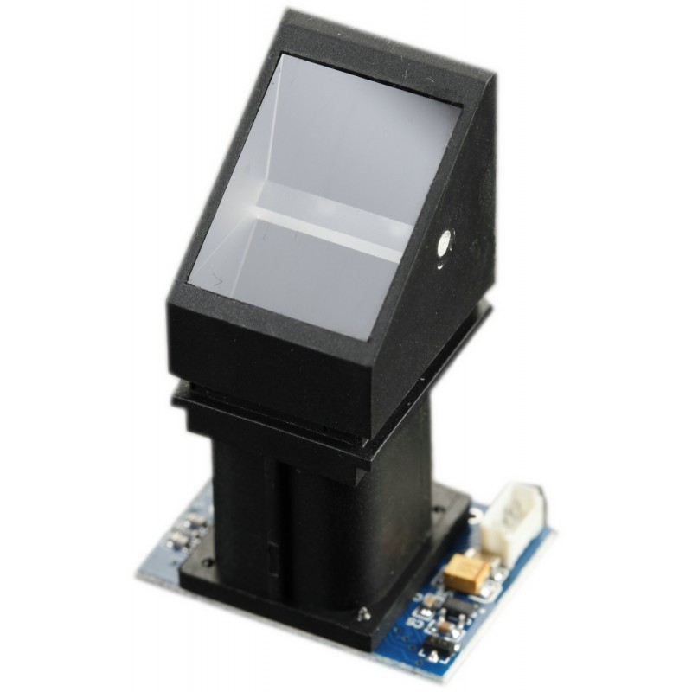
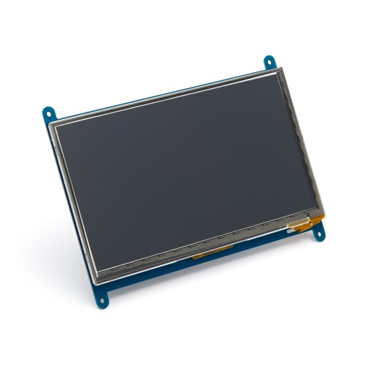
Hardware Components

Slide 9
Hardware Installation
Raspberry Pi installation
Download the Raspbian OS ISO
Prepare the Micro SD Card
Powering up the Raspberry Pi
Initial Configuration of Raspbian OS
Fingerprint Sensor installation
Connection of the Raspberry Pi Fingerprint Sensor
Installation of the Raspberry Pi Fingerprint Library
Test code & example scenario

Slide 10
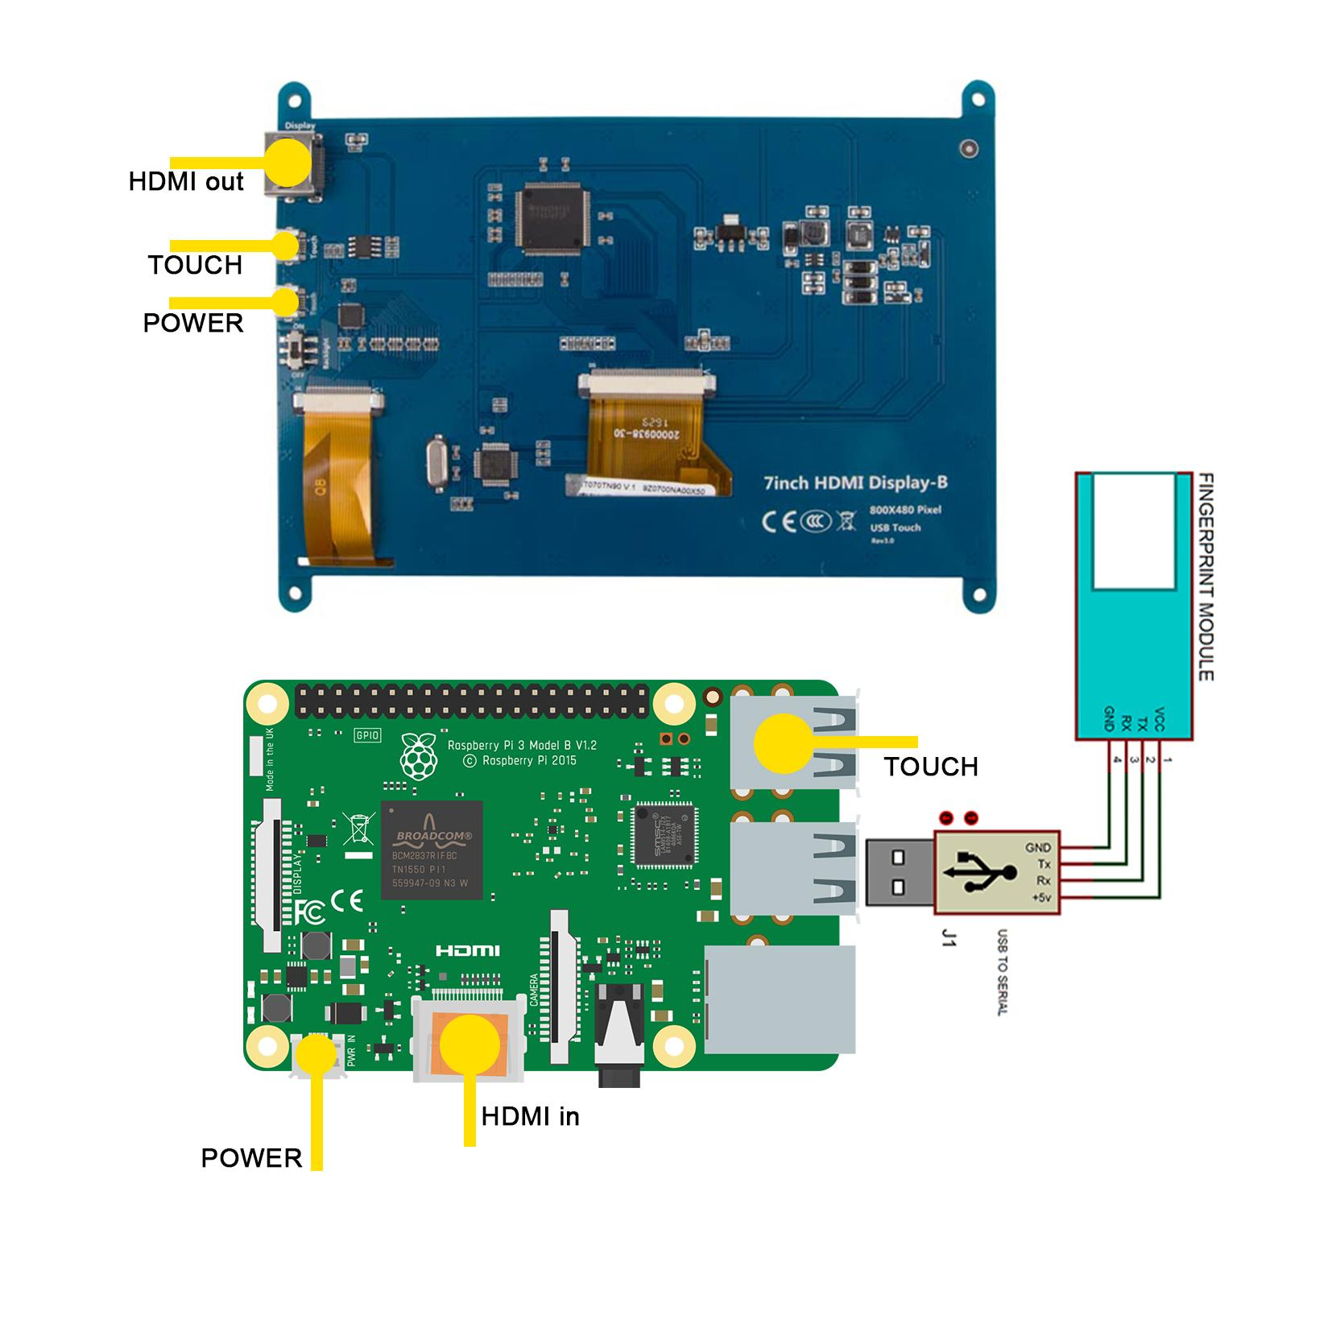
Hardware Setup

Slide 11
DATABASE MANAGEMENT

Slide 12
Software Used
SQLite:
In this biometric based EVM system SQLite acts as one of the most important elements. SQLite provides a platform for this system to manage the heavy database and to update the database from time to time. SQLite is used to compute the results faster and give more insights with the available data. The creation of tables and the data entered in these tables is done on SQLite.
DB Browser for SQLite:
SQLite Database browser is a light GUI editor for SQLite databases, built on top of Qt. The main goal of the project is to allow non-technical users to create, modify and edit SQLite databases using a set of wizards and a spreadsheet-like interface.

Slide 13
Procedures
To manage the data effectively we need 3 database tables
Constituency table..
Constituency table for result.
Voter table.
The first constituency table will be multiple in number as different constituencies will have different tables. These will have details of the constituency. It will have the data of the participating candidates from that constituency in the elections.
Constituency table for the result will consist of data from all constituencies such as winning party, losing party, margin etc.
Voter table will have data of all the voters which will be used for authentication, authorisation and feedback.

Slide 14
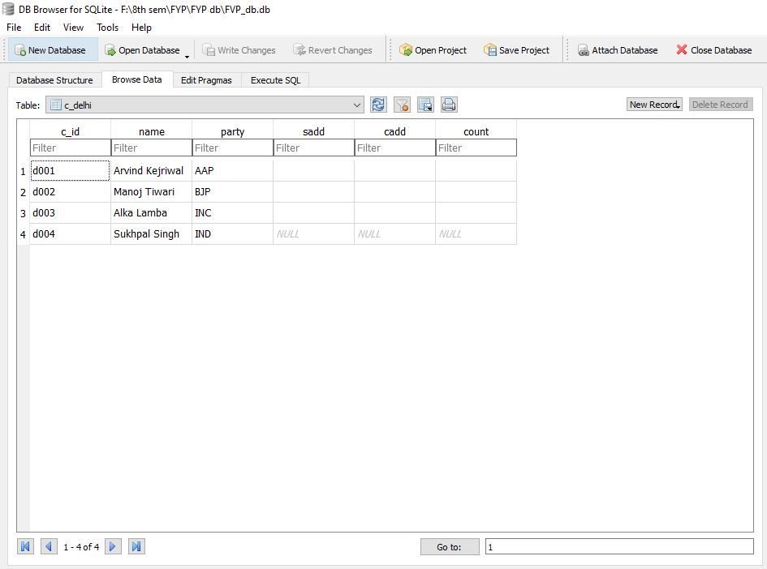
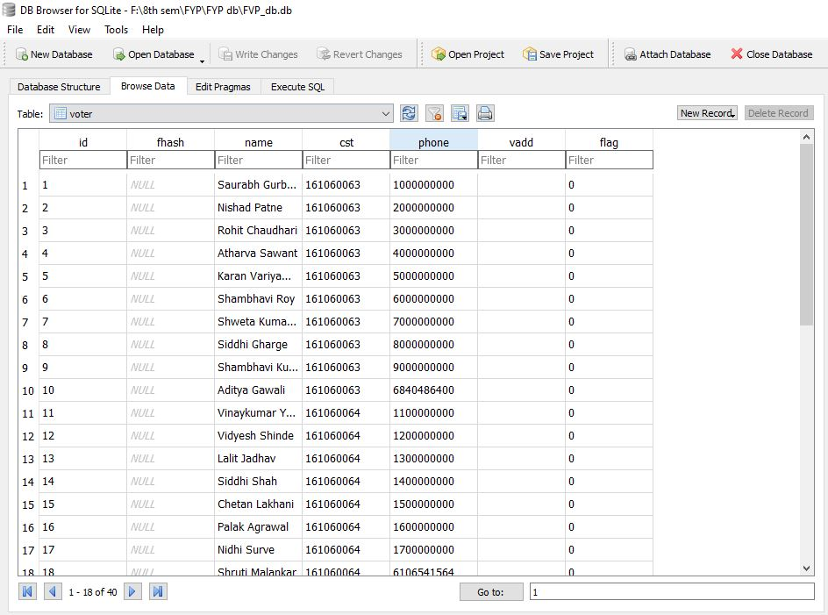
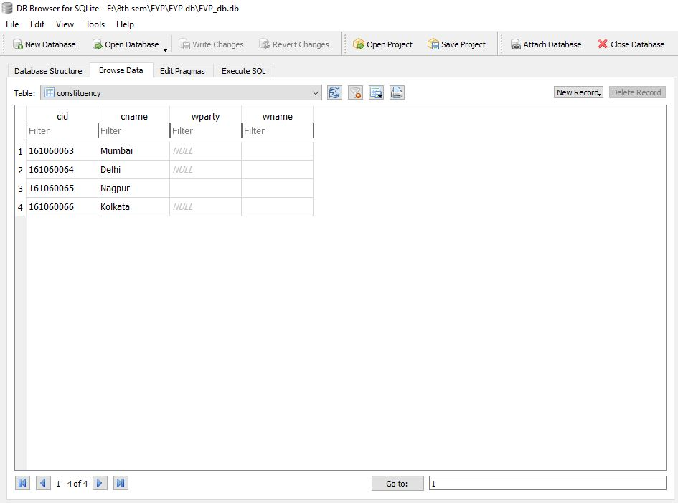
Tables

Slide 15
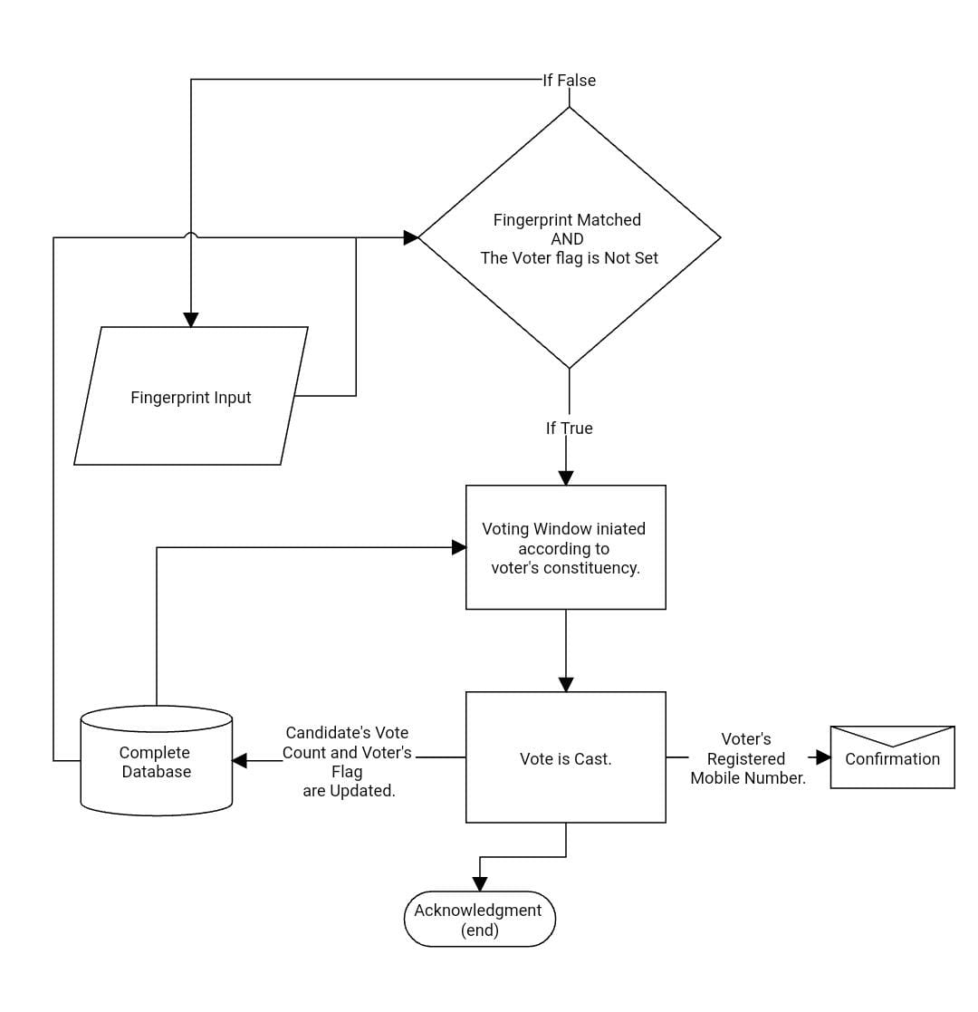
Counting

Slide 16
GRAPHICAL USER INTERFACE

Slide 17

Software
Kivy:
The Kivy software is used for developing an graphic interface of application of Biometric based Electronic Voting Machine. Kivy is a free and open source Python library for developing mobile apps and other multitouch application software with a natural user interface (NUI).

Slide 18
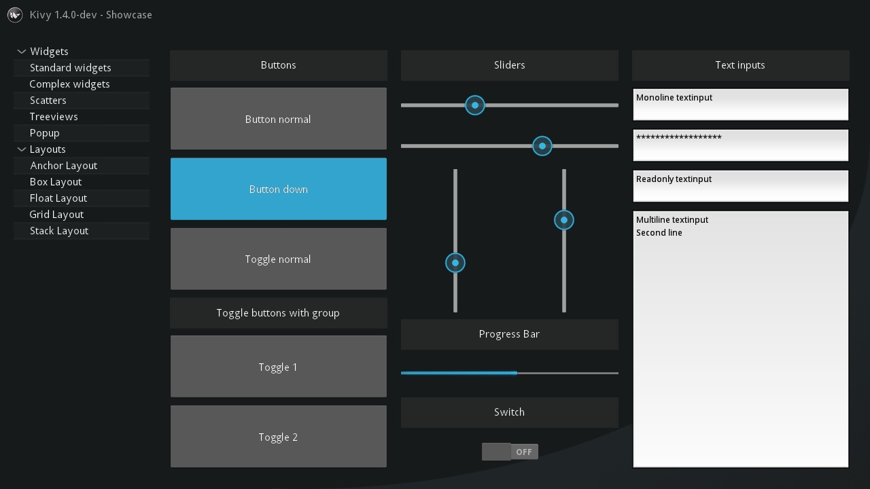
Installation
Kivy Installation:
Install the dependencies
Install pip dependencies:
Install Kivy to Python globally

Slide 19
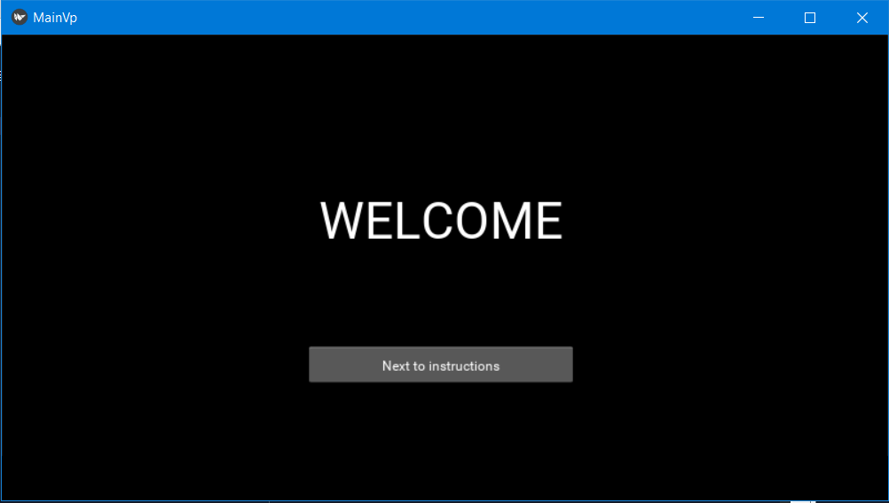
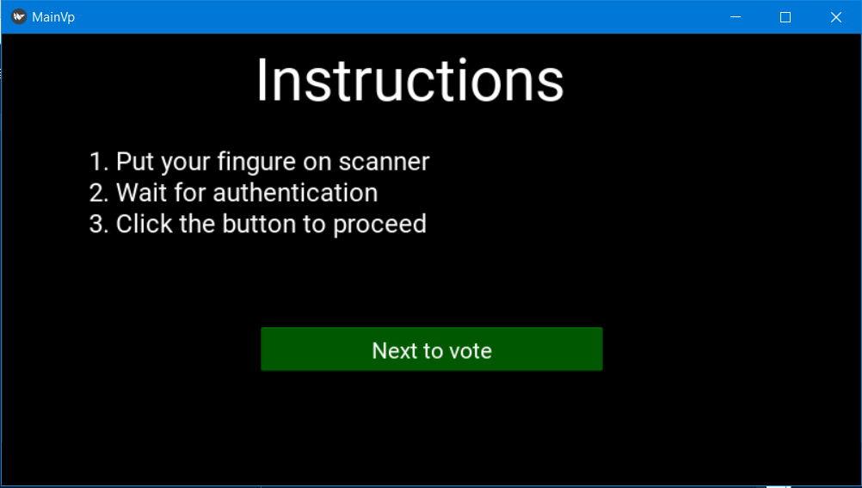
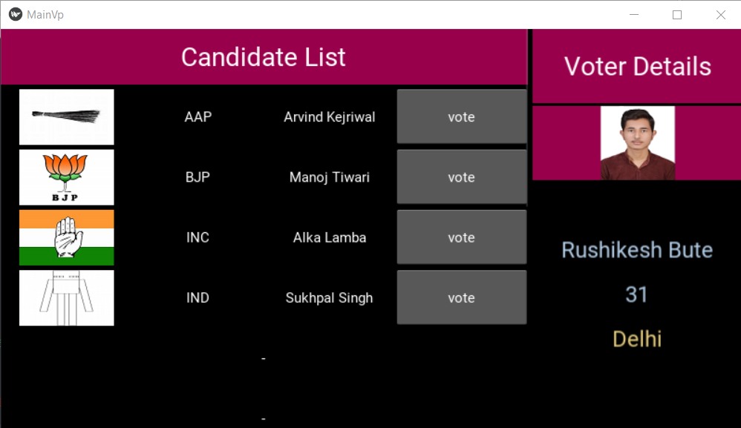
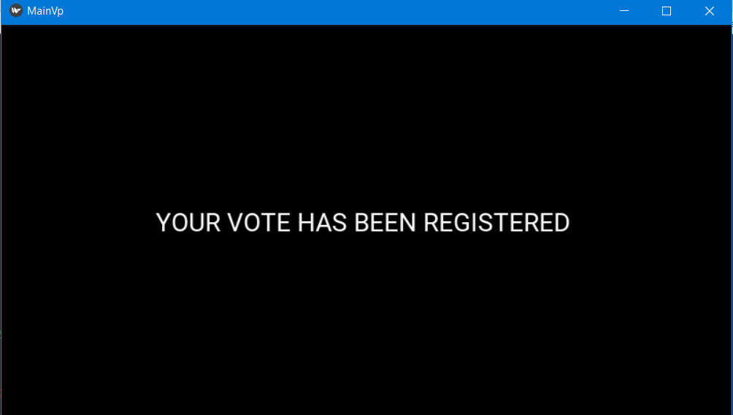
Voting Interface

Slide 20
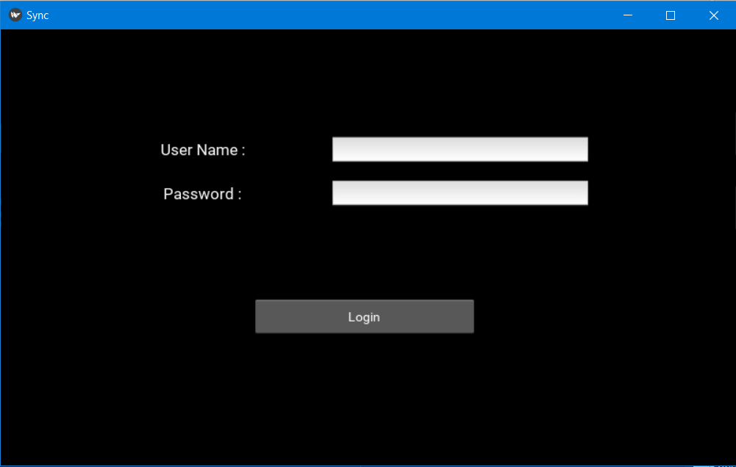
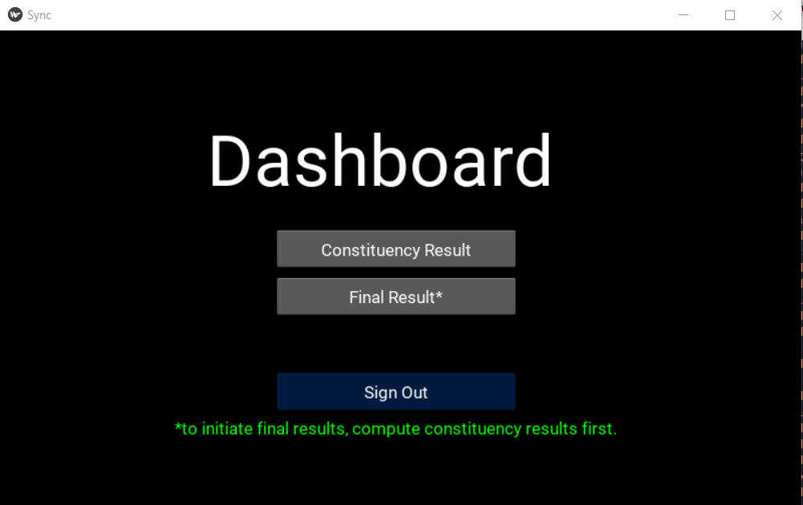
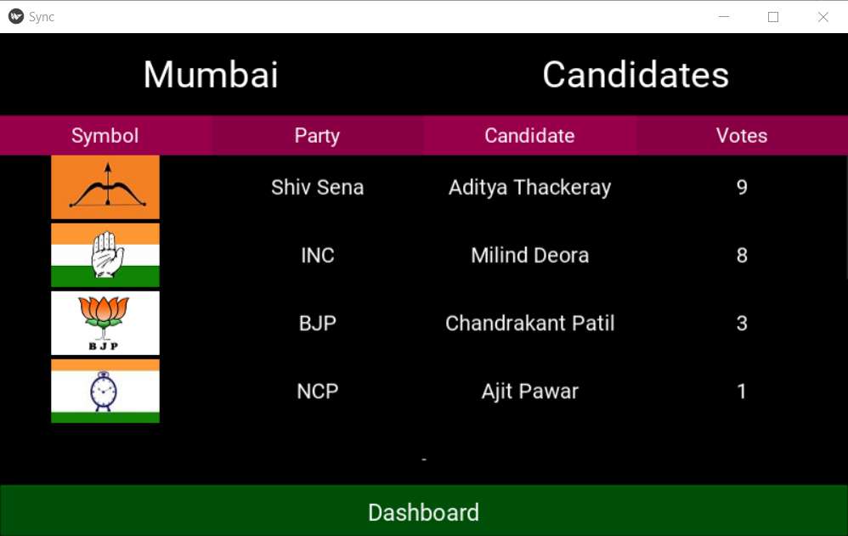
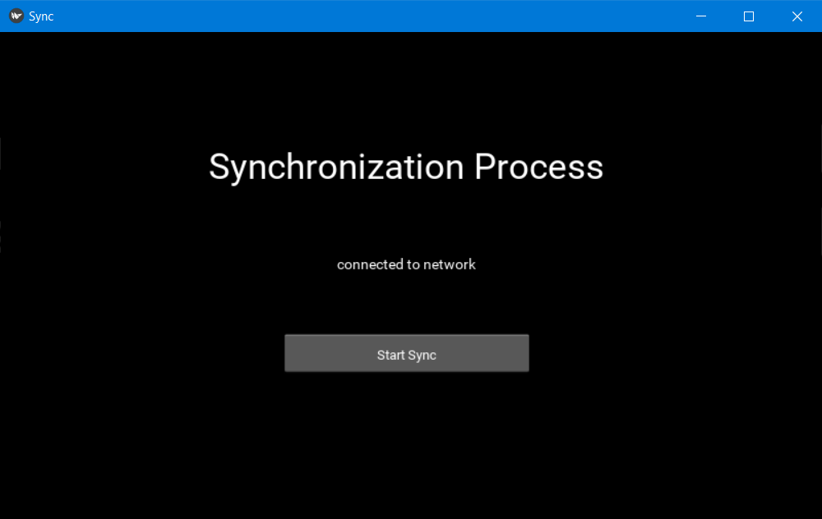
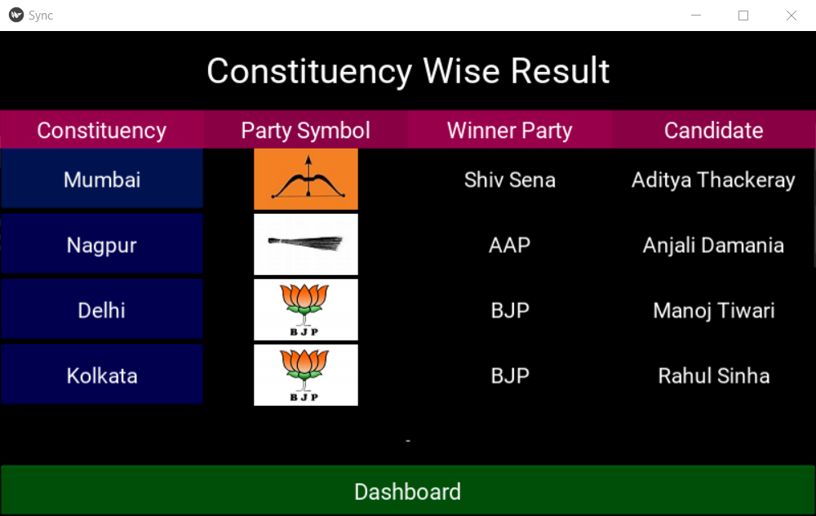
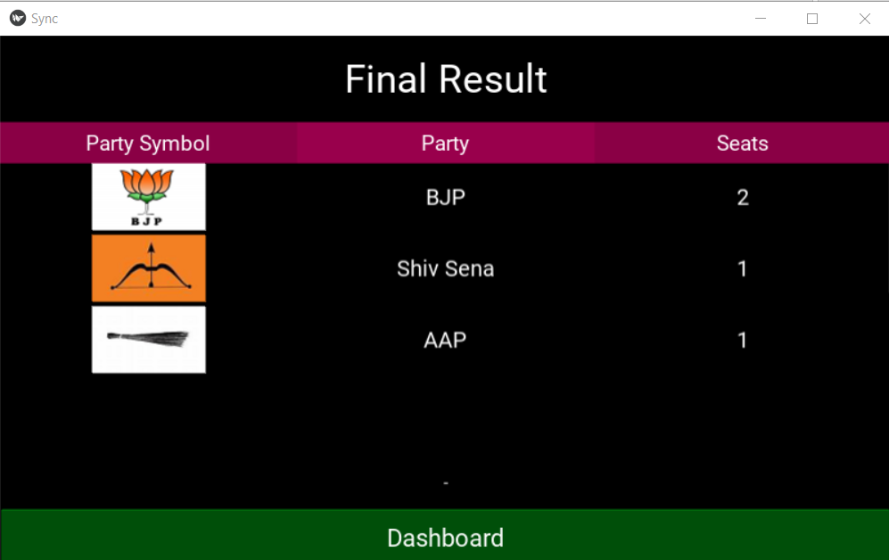
Counting Interface

Slide 21
MISCELLANEOUS

Slide 22
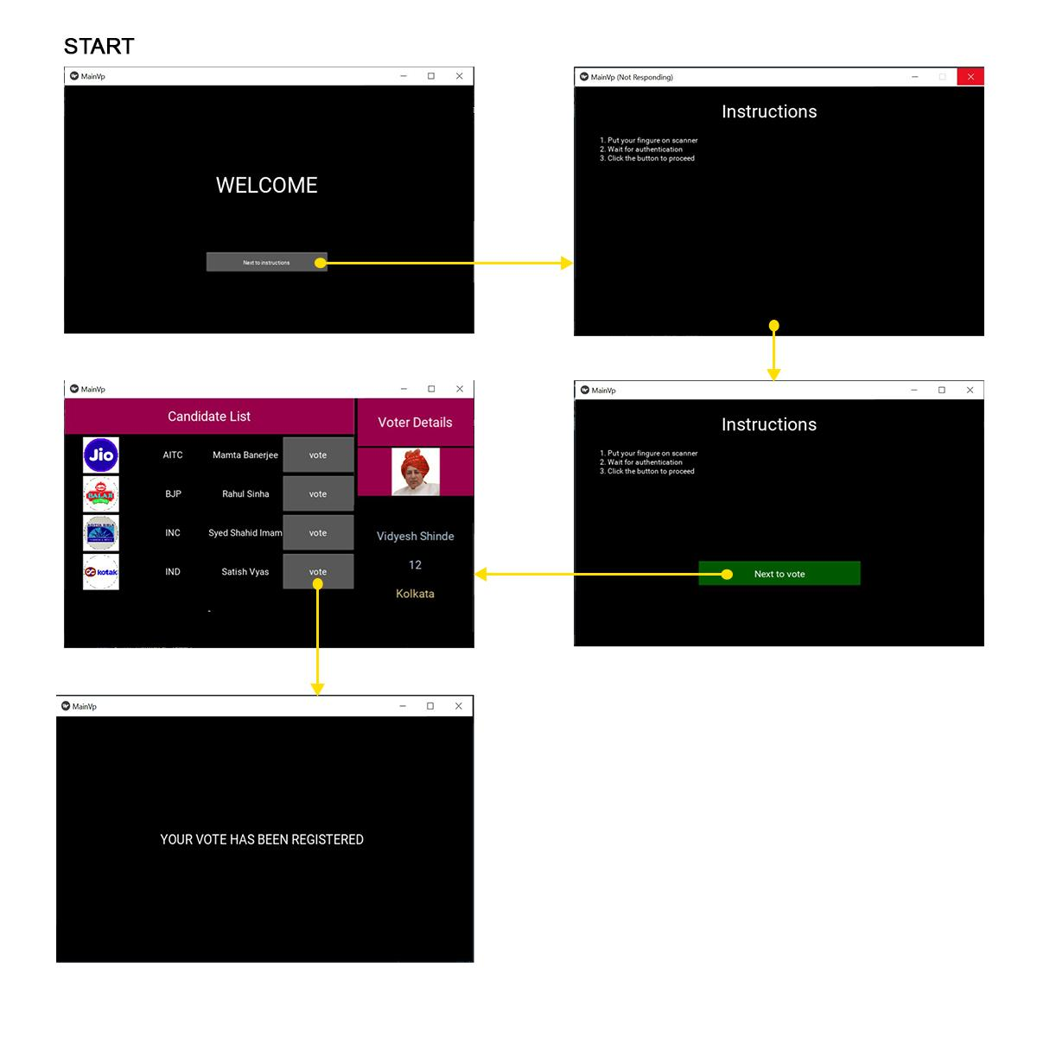
Voting Flowchart

Slide 23
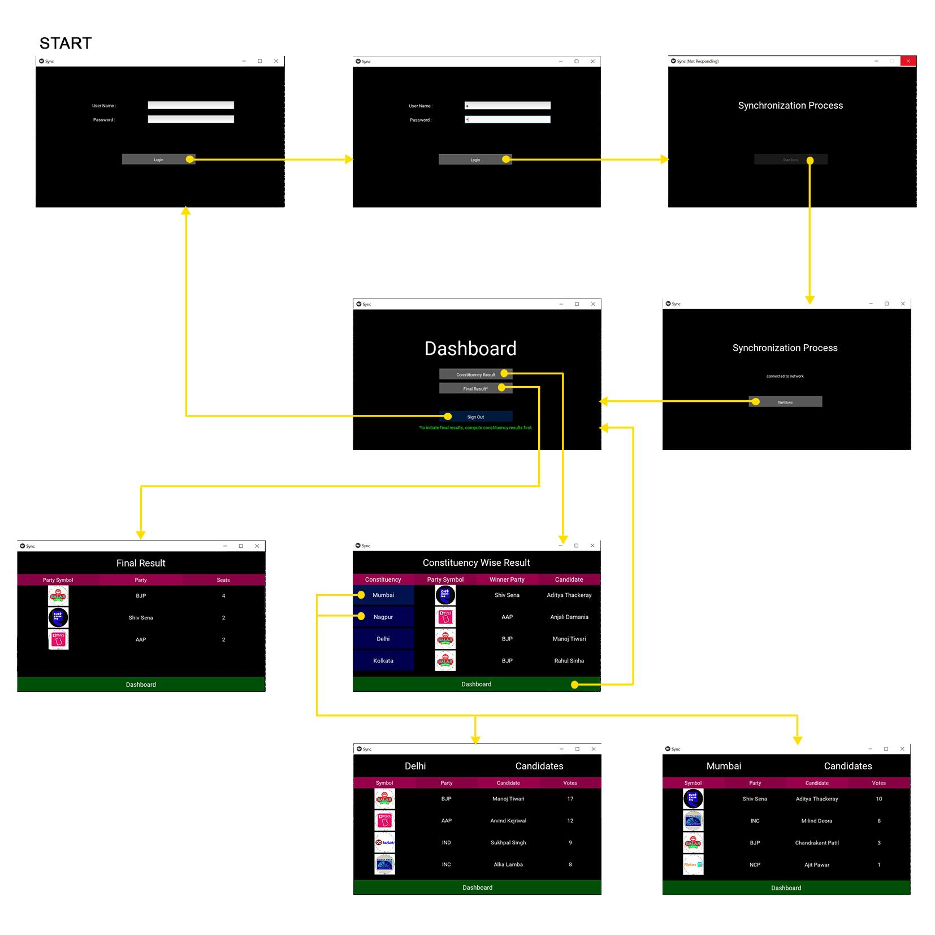
Counting Flowchart

Slide 24
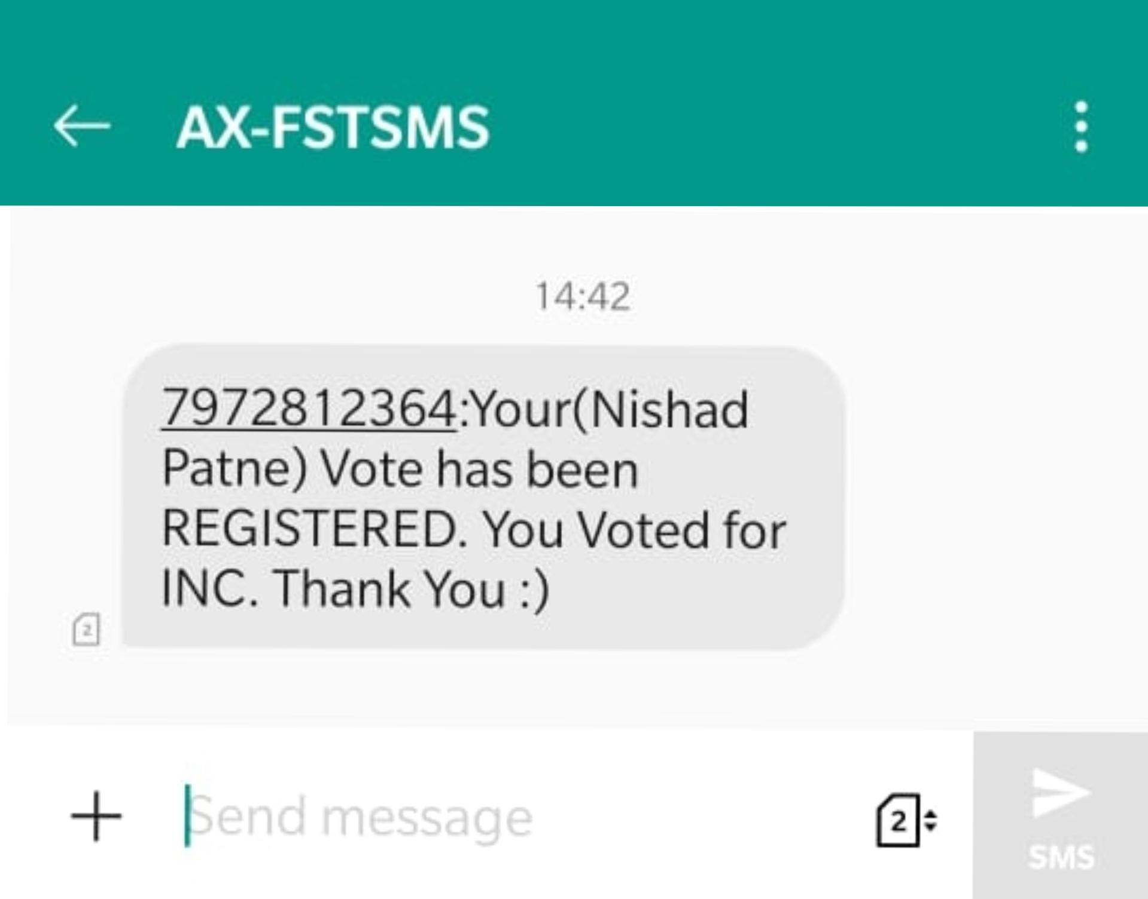

SMS Verification System
The Biometric based Electronic Voting Machine uses a messaging service to inform voters about their vote and party which they voted for. In this project we have used third party system named FAST2SMS to send voter confirmation. The received message on voter's personal mobile phone is as:

Slide 25
RESULT
The Biometric based Electronic Voting Machine was tested successfully at all objectives. The results of the system were positive and reliable. The fingerprint scanning system is providing fast authentication and entry to voting for their respective constituency. The verification message with name and party they have voted for is quickly delivered on the registered mobile number of voter. The machine keeps the count of all votes flawlessly without revealing the secrecy of voters. The counts sync to the server first before entering to calculate results of election. These results provide a silver line to use this system for voting than traditional EVMs.

Slide 26
CONCLUSION
As India is considered as the largest democracy in the world, Safe and accurate elections must take place to protect democracy in India. By using this Biometric based EVM we can ensure the most secure, safe and accurate elections. Biometric authentication makes sure that no fake votes are casted and prevents multiple voting. The centralised database used to cast distance voting and solve the participation problems of migrants in elections. The instant results lower the chances of tampering the EVMs for result and display the nationwide results on each Machine instantly when Election Day ends. This way Biometric based EVM helps to overcome the drawbacks of the current EVM system. As current EVM’s integrity and accuracy is in doubt as a result of various elements in society and officials. Therefore we can say that implementation of Biometric based EVM can provide a transparent, fair, secure and accurate election process in India than traditional EVMs and thus hold strong roots of democracy in our country.

Slide 27
LIMITATIONS
The verification of fingerprints may take some time extra than expected for the centralised database due to huge number of voters for election.
The Biometric authentication of voters can be challenging for physically disabled people.
Performance can be fluctuate to environmental conditions, badly maintained systems, age groups, etc.
The Biometric identifiers of voters cannot be changed, if compromised.
Distance voting can lead to problem of voters management in densely populated areas.
There are chances of breaching the secrecy of mobile phones of voters to learn about their voting patterns.
The reduction in time to vote and count can lead to administering as well as law and order issues.

Slide 28
FUTURE SCOPE
First thing can be done is, the system of authentication with fingerprint scanning can be extended to a multi-biometric system including retina scan, face recognition etc. Second, the UIDAI already has the biometric database of all Indian nationals in the form of AADHAR [5]. The biometric data can be used as a centralise voters database and can be modified from election to elections as per requirement. The already existing data would reduce the the efforts to allot voter id cards to each new voter and can directly recommend him to vote when he/she is qualified to vote by age. Third, the voting process can be shifted to Blockchain Technology for better security of the elections and lowering the chances of tampering.

Slide 29
Thank You!

