Slide 1
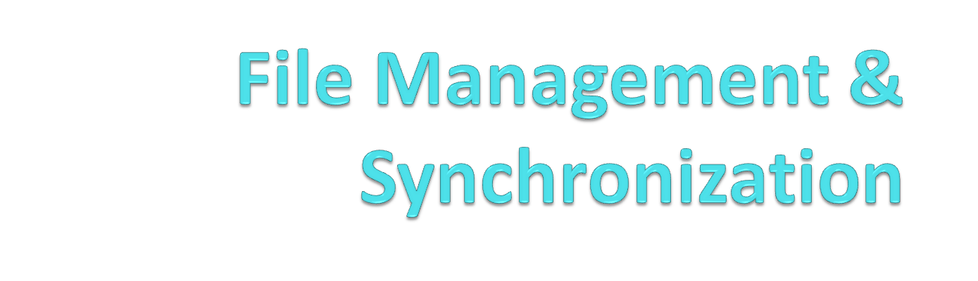
By:
Pratik S. Desai
Nikhil Bendre

Slide 2

Introduction
Android 2.2 App (Implemented in Python using SL4A)
File Management
File Synchronization
Client – Android Mobile Device
Server – Linux Machine

Slide 3
Objectives
Objectives
  To understand and use the Android platform
  To design and write network applications for Android OS
Requirements
  Android SDK 2.2 AVD
  Scripting Layer for Android (SL4A)
  Python

Slide 4
Work Schedule
Milestone 1
  Project Scope
Milestone 2
  Simple Client & Server Model that exchanges character data
Milestone 3
  Listing of Files
  Block Transfer of File
Milestone 4
  Complete File Management
  Folder Synchronization

Slide 5
Server Details
  Server gets the modified timestamps of files present and the timestamps stored in a log file at previous sync
  Client sends contents of his log file
  Compares the two log files
  Files with greatest different in modified and last modified timestamp is considered latest
  File sync based on difference between timestamps

Slide 6
Client Details
Sends contents of its log file to the server
Server sends list of files to be uploaded & downloaded
Recalculates the timestamps
Write it to the log file

Slide 7
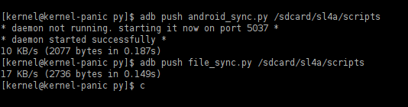
Snapshot
Sending script files to the AVD

Slide 8
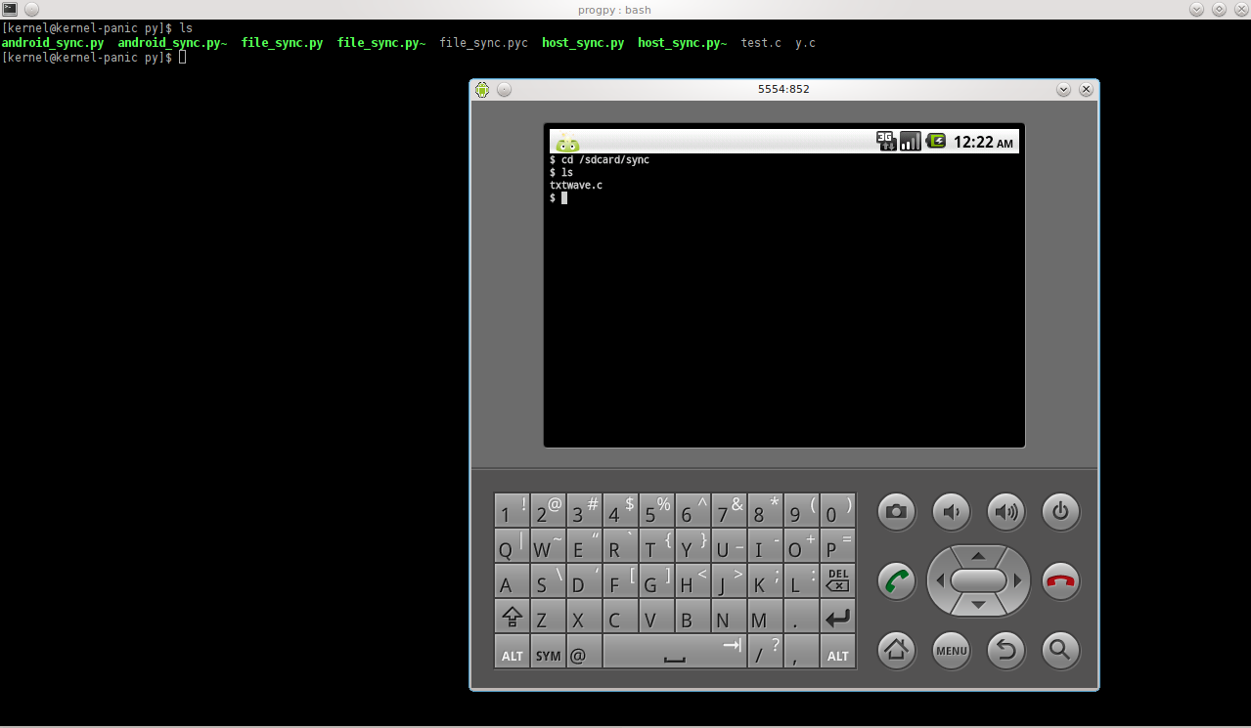
Before Sync

Slide 9
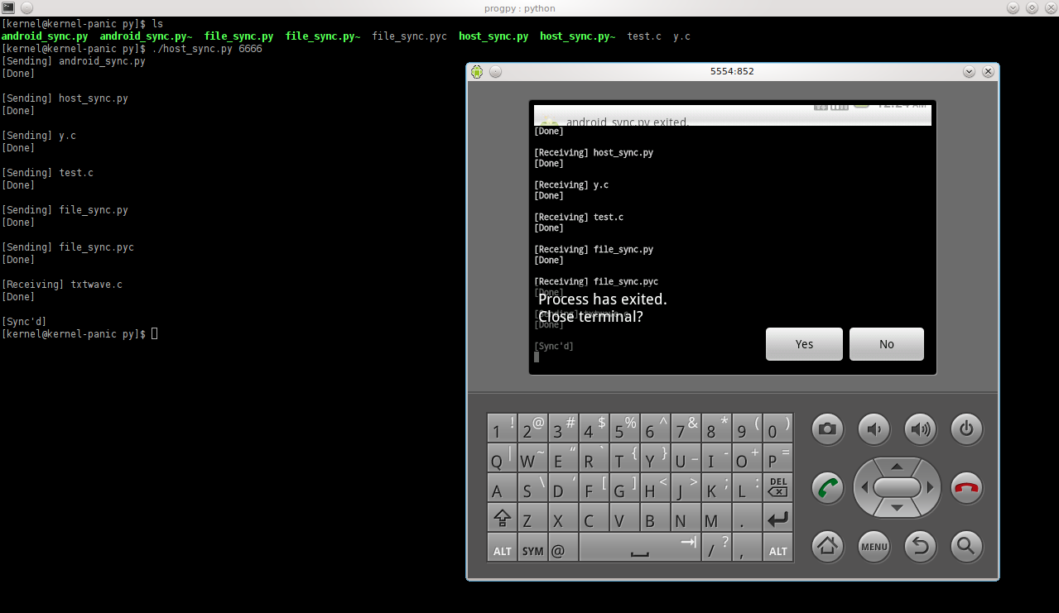
The sync process

Slide 10
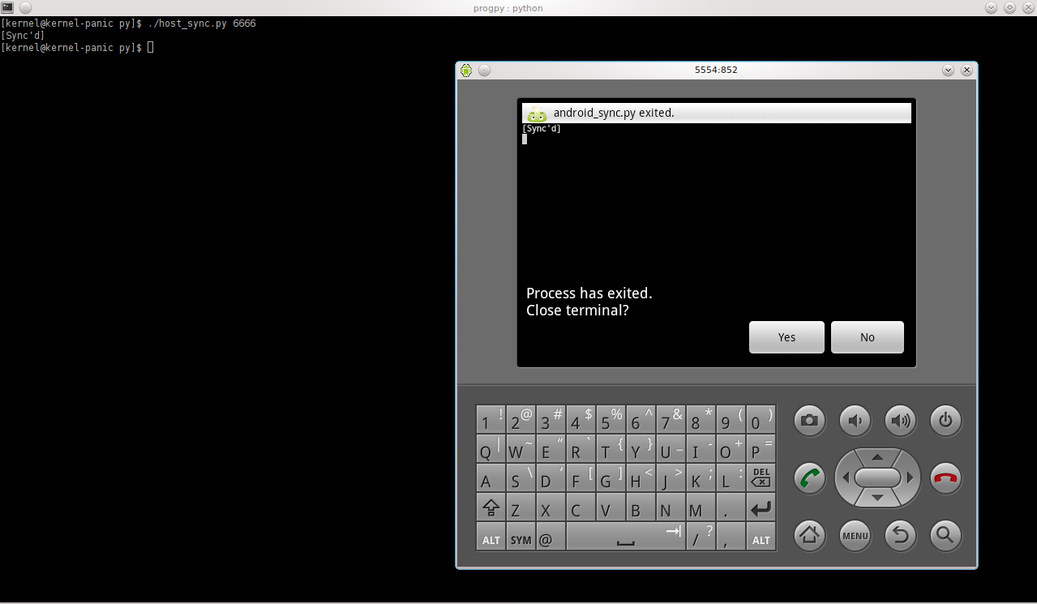
Syncing for the 2nd time

Slide 11
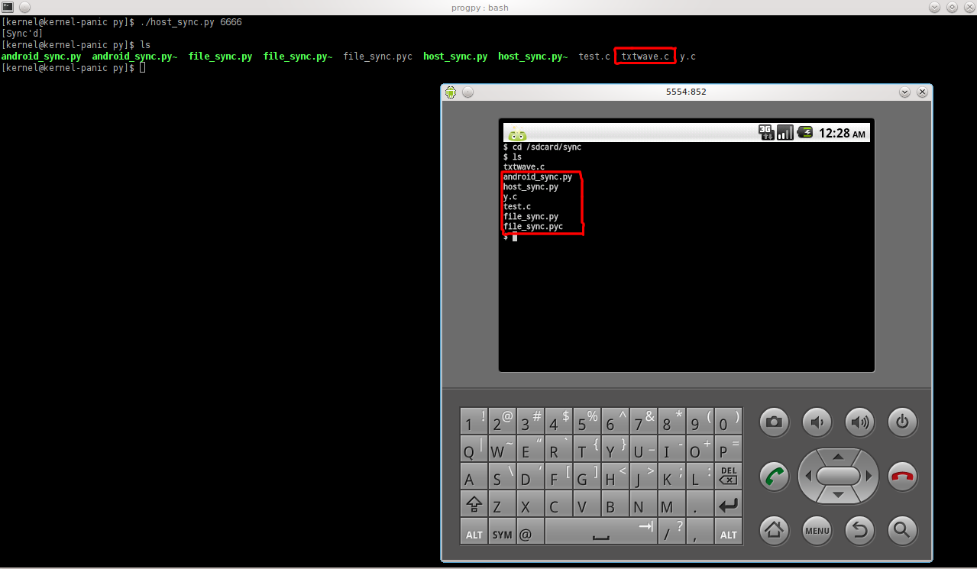
List of files after sync

Slide 12
Improvements
GUI implementation
Sub-folder synchronization
Compatibility with IPv6

Slide 13
Conclusion
We have successfully developed an Android application for File management and synchronization.
Future Work:
To accomplish the specified improvements above

Slide 14
Q & A

