Slide 1

User Click Modeling based on Search Engine Log Data
Nikhil Bendre
Justin Thomas

Slide 2
Outline
Source
Background
Dataset
Methods
Challenges
Results
Performance Benchmarks
Conclusion

Slide 3
Source

Slide 4
KDD Cup 2012 sponsored by Tencent Inc.
Largest real datasets ever released publicly for competitions
User click modeling in advertising

Slide 5
Background

Slide 6
Search Advertising
Economic model behind it
  Rank Ads
  Price Clicks
  pCTR
  Session logs from Soso.com

Slide 7
Dataset

Slide 8
Multiple data files derived from a search session
Primary Data File
  Training (9.87GB)
Additional Data files
  UserID Profile

Slide 9
Training Data File

Slide 10
Click
Impression
DisplayURL
AdID
AdvertiserID
Depth

Slide 11
Position
QueryID
KeywordID
TitleID
DescriptionID
UserID

Slide 12
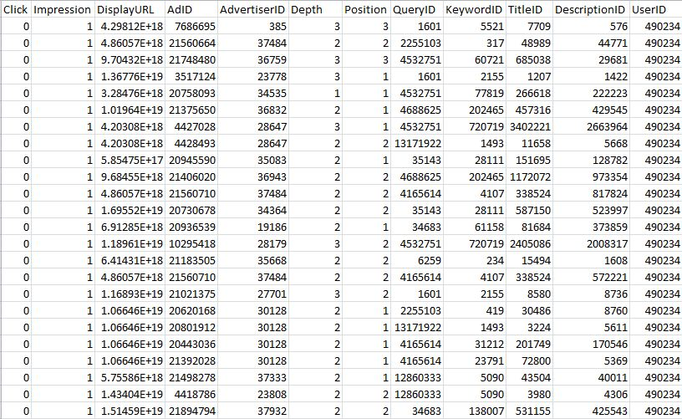

Slide 13
UserID Profile Data File

Slide 14
UserID
Gender
  '1' for male, '2' for female, and '0' for unknown
Age
  '1' for (0, 12], '2' for (12, 18], '3' for (18, 24], '4' for (24, 30], '5' for (30, 40], and '6' for greater than 40

Slide 15
Methods

Slide 16
Python using Hadoop Streaming
R - Bigmemory package
doMC package
Serial Run to verify results

Slide 17
Each Node Configurations were:
  256 gb RAM : 8 cores
  16 gb RAM : 8 cores
Created a new VM and deployed it on each specific node
Install R and packages, mount hard drives

Slide 18
Challenges

Slide 19
Brief Documentation on bigmemory
Merge operation in bigmemory
Use of proper technique/package to perform Linear Regression
Ran out of working memory on small machines

Slide 20
Results

Slide 21
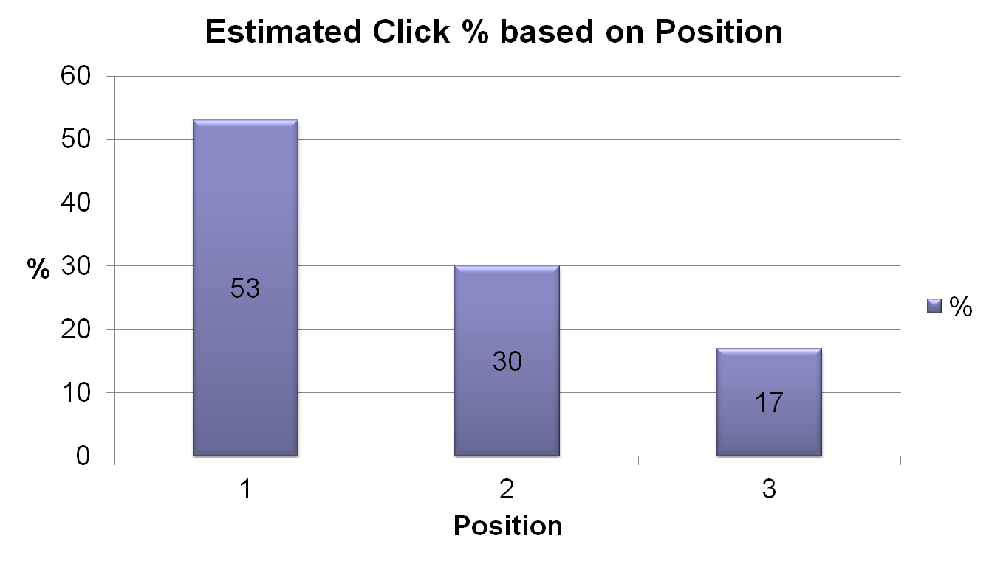

Slide 22
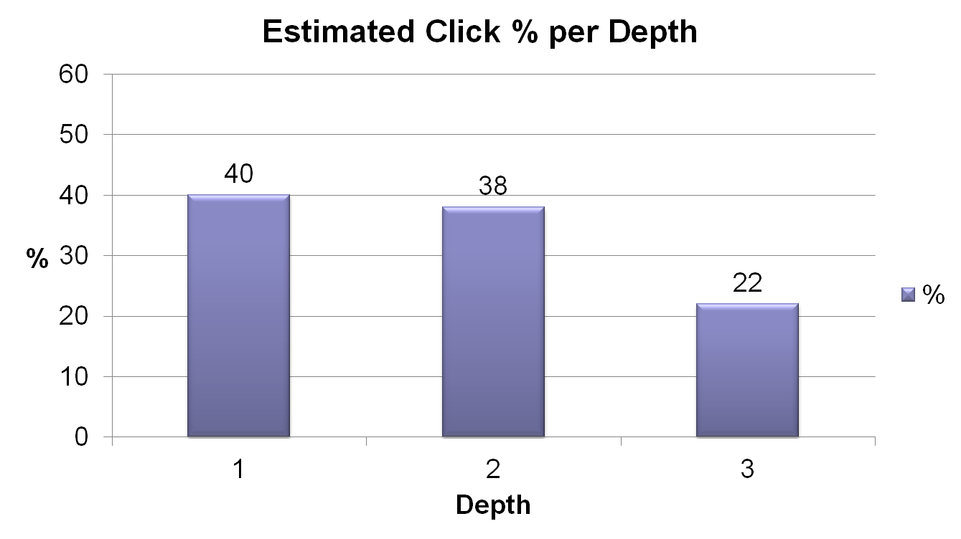

Slide 23
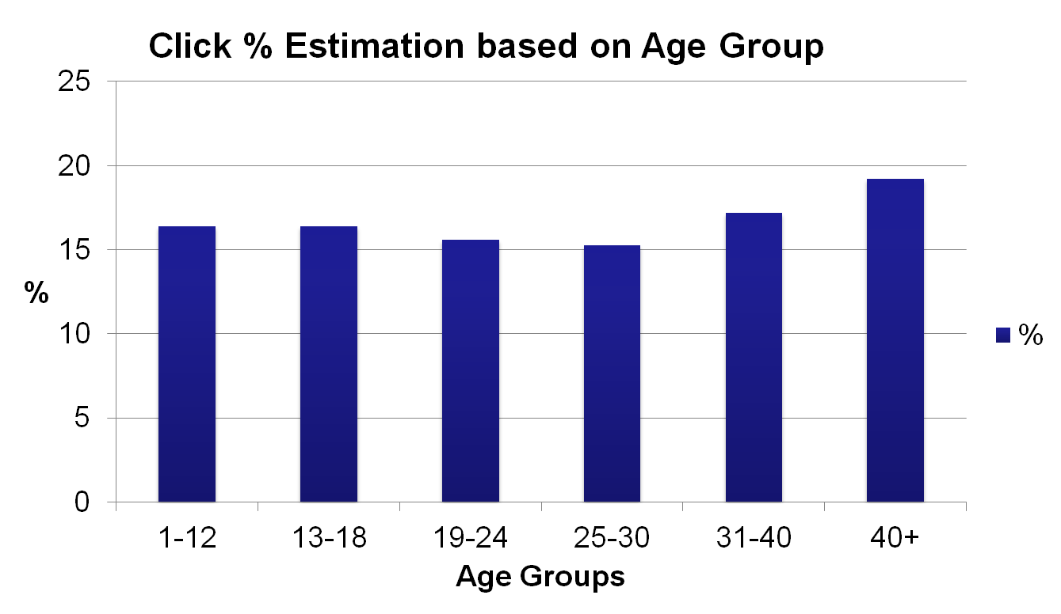

Slide 24
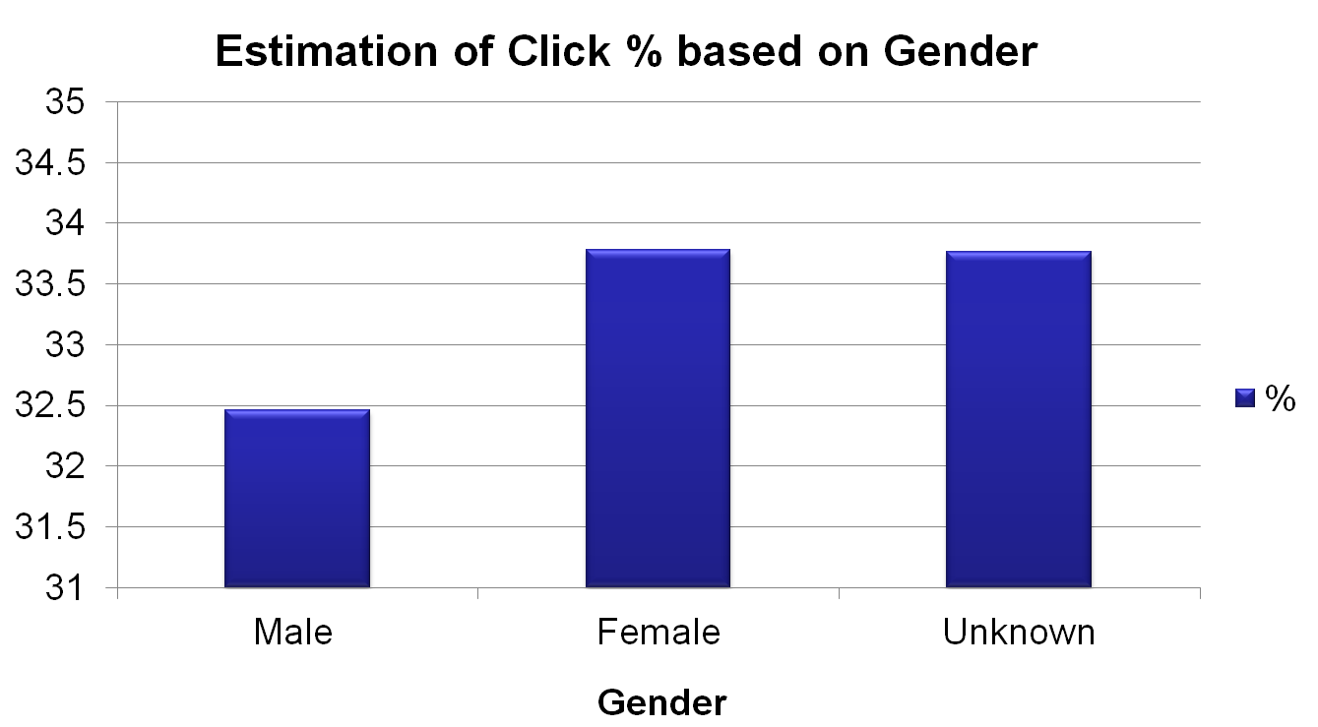

Slide 25
Linear Regression
Sample size = 149,639,105 = 149 million records
 | Coef | 95% | CI | P
(Intercept) | 0.0988 | 0.0959 | 0.1016 | 0.0000
Depth | -0.0003 | -0.0019 | 0.0013 | 0.7191
Position | -0.0291 | -0.0308 | -0.0273 | 0.0000

Slide 26
Performance Benchmarks

Slide 27
Compute Node Hardware Specifications
Node | Processor | Cores | Memory
Node 1188 | Intel Xeon L5420 @2.5GHz | 8 | 16 gb
Nodelm03 | Intel Xeon 7542 @ 2.66 GHz | 8 | 256 gb

Slide 28
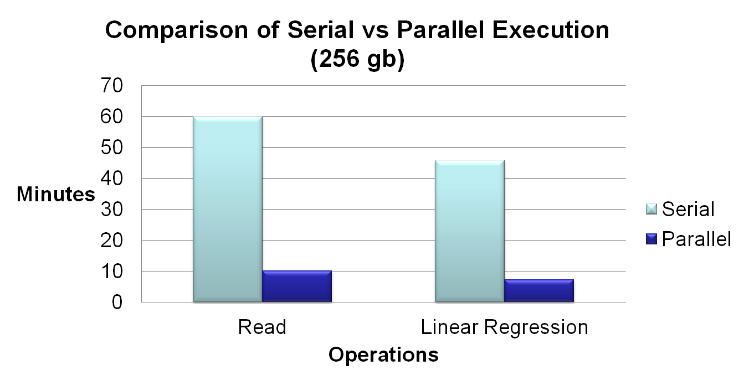

Slide 29
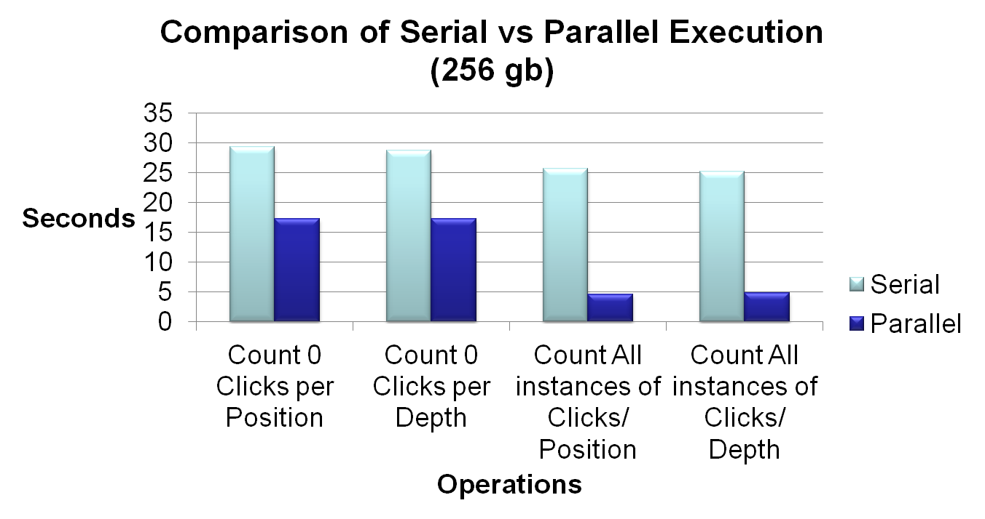

Slide 30
 | Serial | Parallel | Parallel
Operation | ( 256 gb) | (256 gb) | (16 gb)
Read | 59.88 mins | 10.18 mins | 14.70 mins
Count 0 Clicks/ Position | 29.30 secs | 17.30 secs | 25.20 secs
Count 0 Clicks / Depth | 28.75 secs | 17.30 secs | 27.80 secs
Count All Instances/ Position | 25.67 secs | 4.6 secs | 14.30 secs
Count All Instances / Depth | 25.23 secs | 4.9 secs | 10.80 secs
Linear Regression | 45.80 mins | 7.30 mins

Slide 31
Questions?

