Slide 2

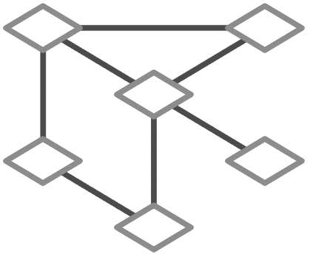

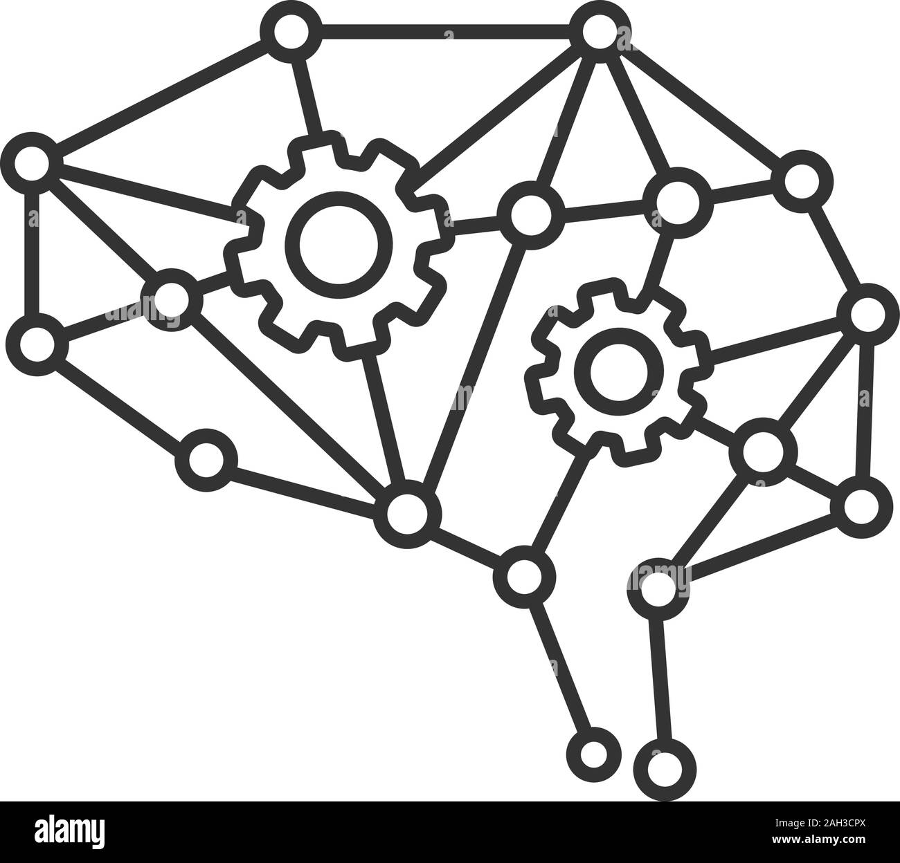

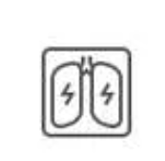
Blood test results and other numerical metrics
Pre-processing layer
Patient
Detailed Text summary of inference
Pre-processing layer
Deep-learning model
Medical scans such are MRI, CT, ECG etc..

Slide 3
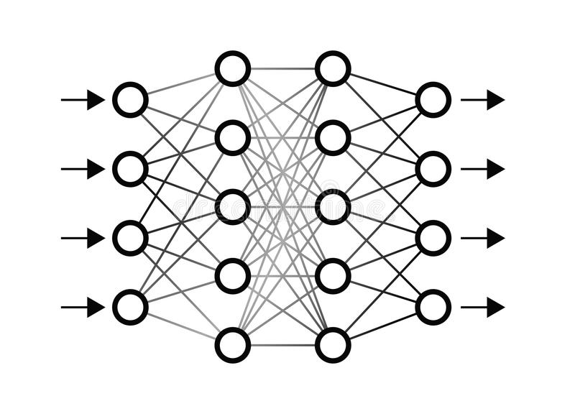
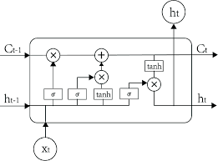
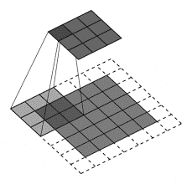
Inference can be directly made
Pre-processing Layer
(Feature scaling,
de-noising, normalizing)
Numerical and categorical data
Fully connected dense + dropouts
Detailed Text summary of inference
Pre-trained NLG layer
(BERT)
Pre-processing Filters
(Noise removal and edge detection)
Scan Image data
CNNs + Maxpool + Dense with ReLu
Inference can be directly made

