Slide 1
UMKC Hackathon - 2016
Twitter Analysis using Heron
By
CrazyCoders
(Priyadarsini N, Sri Harsha Ch, Tej Kumar Y)

Slide 2
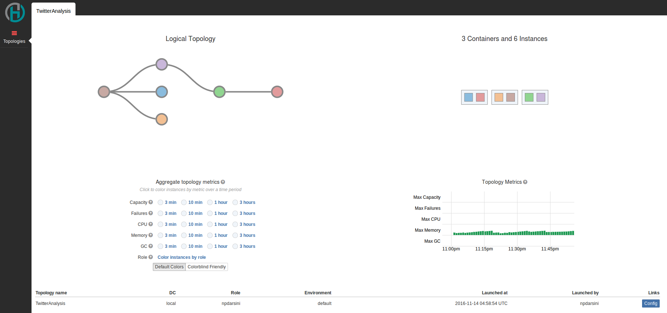
Topology

Slide 3
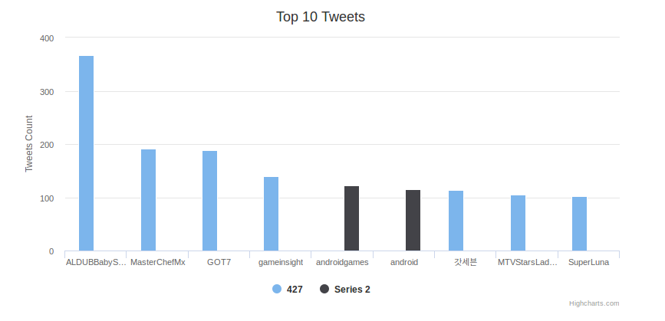

Visualization

Slide 4
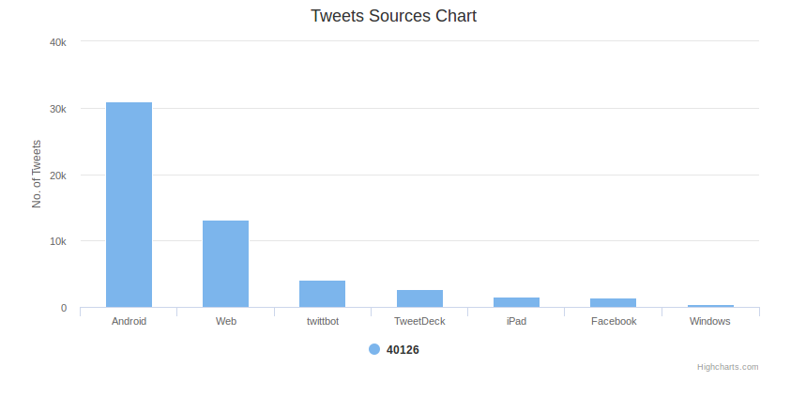
Visualizations (Contd.,)

Slide 5
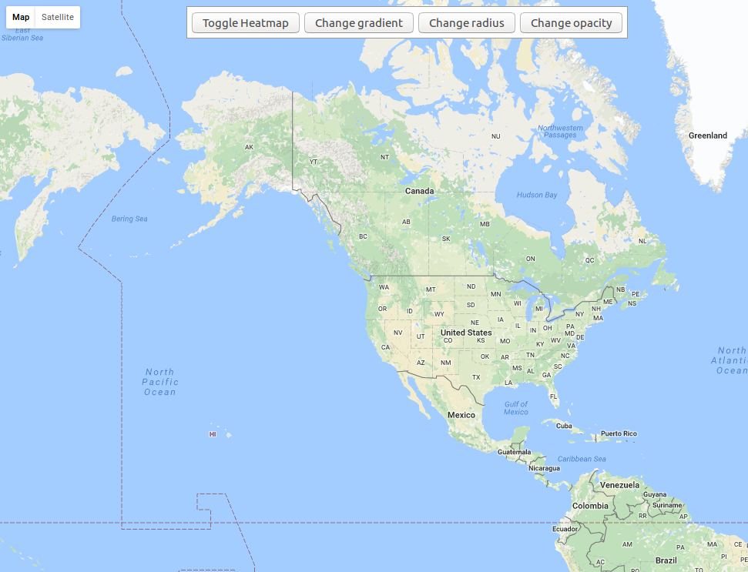
Visualizations (Contd.,)

Slide 6
Thank You

