Slide 1
Intrinsic Detective System
Sri Harsha (4), Priyadarsini (16), Tej Kumar (27), Chaitanya Sai (14)

Slide 2
Introduction
Our application main goal is to recognize the suspects in a stream of video and alert the security personnel.
The tools that we used are:
OpenIMAJ Framework – to record and process the video, to extract features
Kafka Messaging System – to transfer the features reliably from client to Spark or Storm
Apache Spark MLLib – to generate a Decision Tree based model for the features dataset
Apache Storm – to process the received data streams in real-time
Mongo DB – to store the model and predictions
nodeJS & GCM – to develop a REST application to serve the messages to android devices

Slide 3
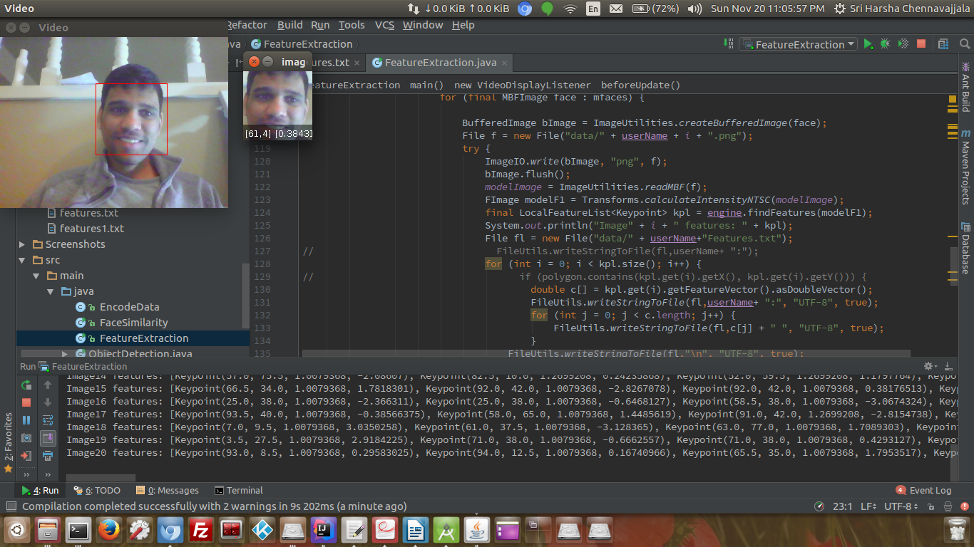
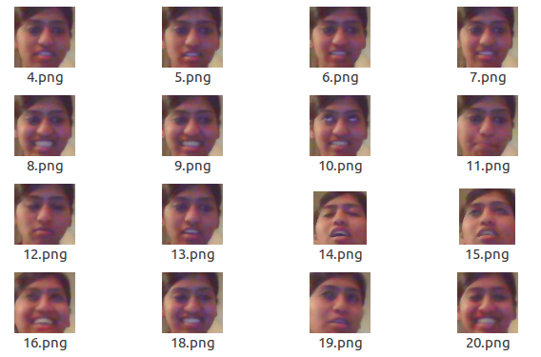
ROI and Feature Extraction

Slide 4







Architecture
Save Model to mongoDB
Features for Model building
Extracted Features
Retrieve Model from mongoDB
Retrieve latest records
Extracted Features
Features for Model validation
Save predictions to mongoDB
Send alerts to mobile

Slide 5
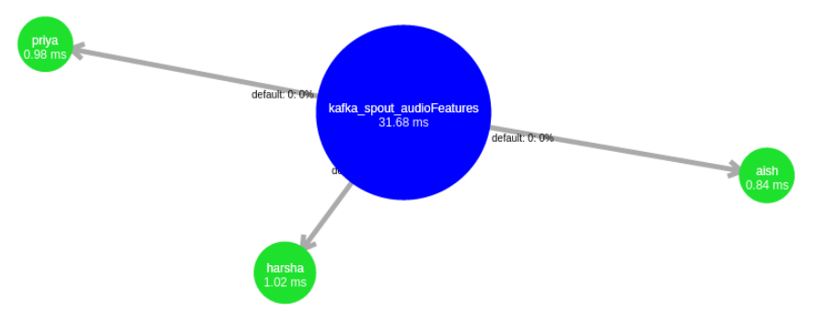
Storm Topology

Slide 6
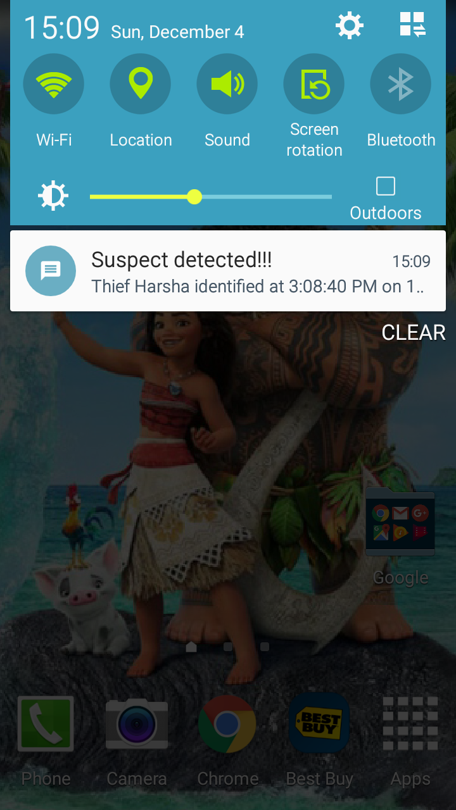
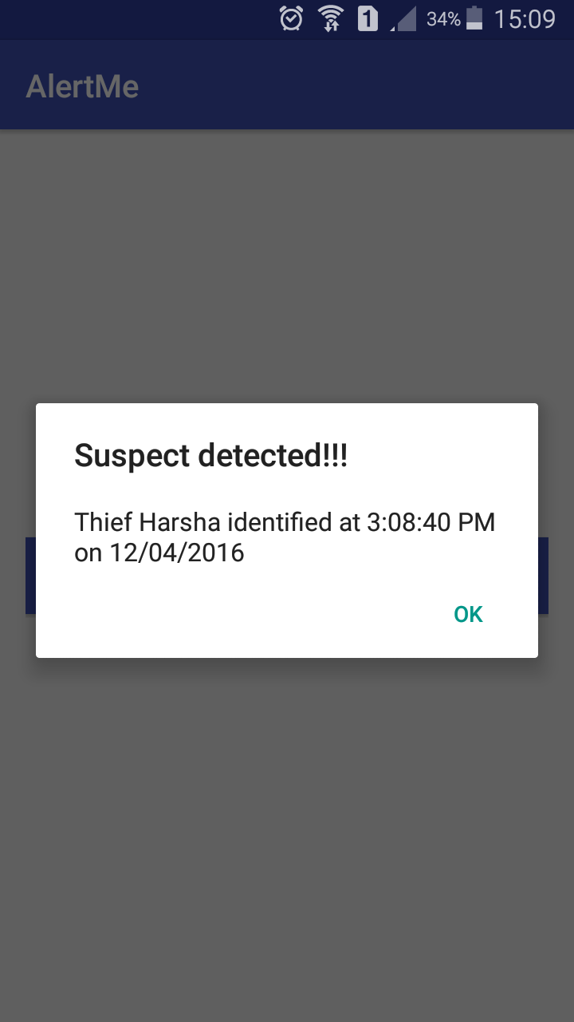
Android device alerts

Slide 7
Results
Confusion Matrix |  | Predicted
 |  | Harsha | ~Harsha
Actual | Harsha | 996 | 250
 | ~Harsha | 173 | 375

Slide 8
Thank You

