Slide 1

Analysis Of Google Play store Apps
By
Niharika Perapalla

Slide 2
Google play store apps dataset
App
comment
App id
Genre
Price
Content Rating
Offered by
Size
Rating
Reviews
Installs
App id
Comment
Stars
Helpfuls

Slide 3
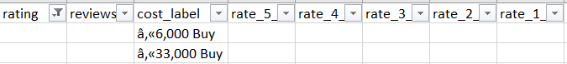
Data Cleaning
Dropped the Rows with all empty rating values.
cost column-
Ex:- ₫‚«46,000Buy or Was ₫‚«98,000, now reduced to â‚«61,000 Buy.
Size column has both in kb & Mb values.
Removed + from installs & ‘total’ from reviews column using regex.
Added column ‘type’(free/paid) based on cost
Merged some of the genres like Education & Educational by creating category column drilled down from 48 genres to 36 categories.
.

Slide 4
Modules Used
Pandas
Numpy
Regex
Word cloud
Sklearn
Matplotlib
Seaborn, plotly

Slide 5

Exploratory Data Analysis

Slide 6
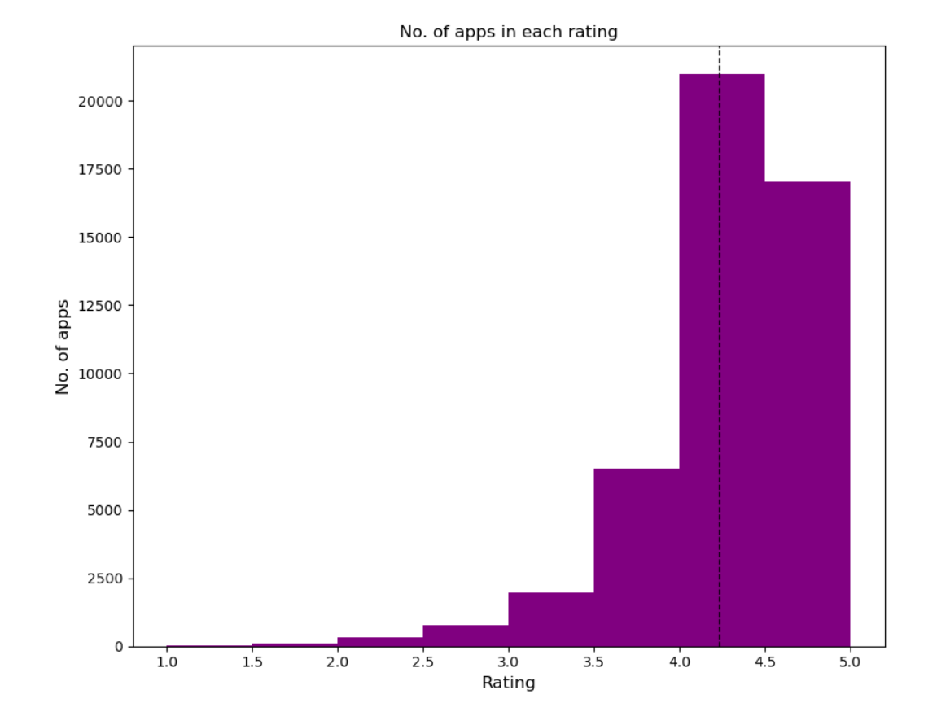

Slide 7
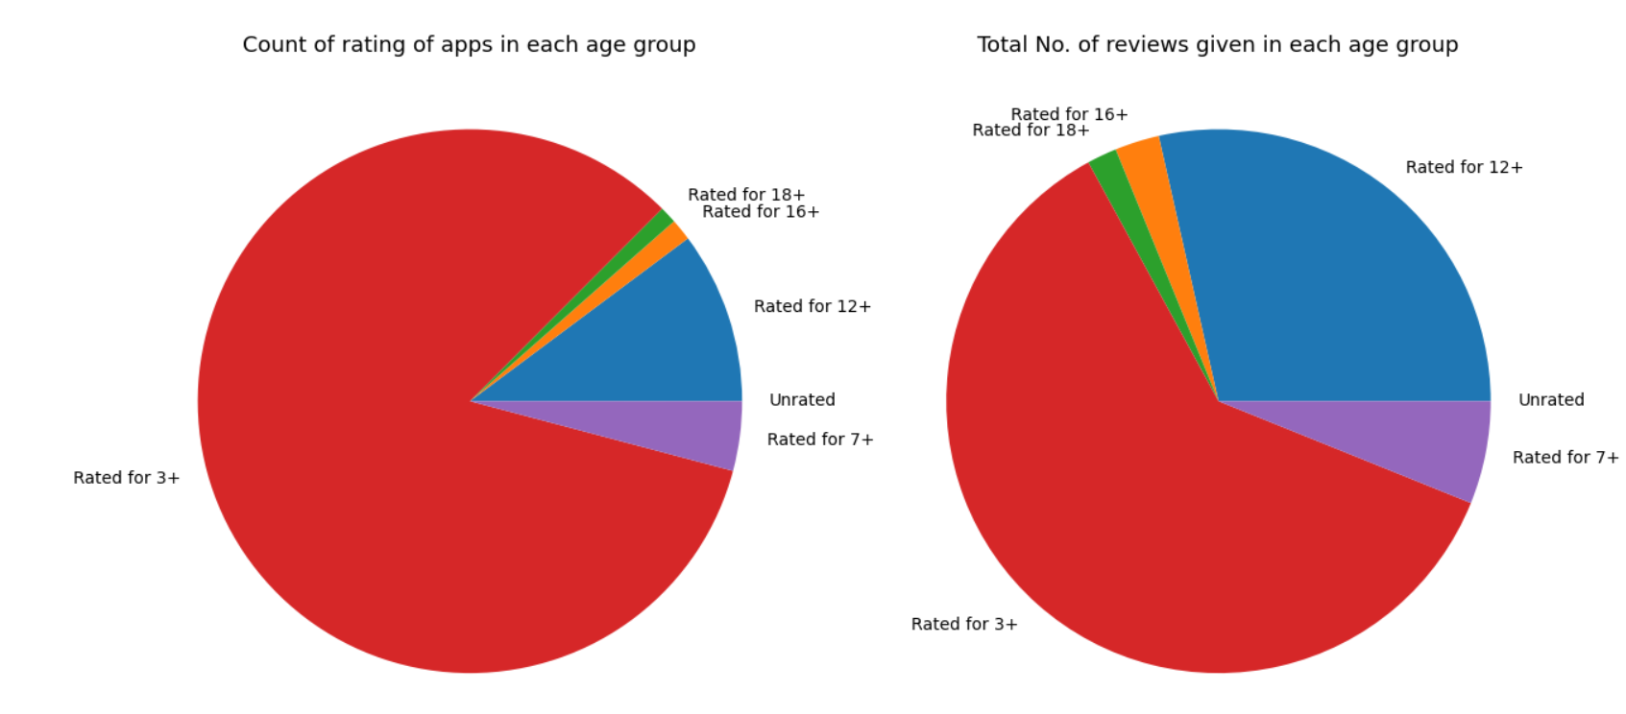

Slide 8
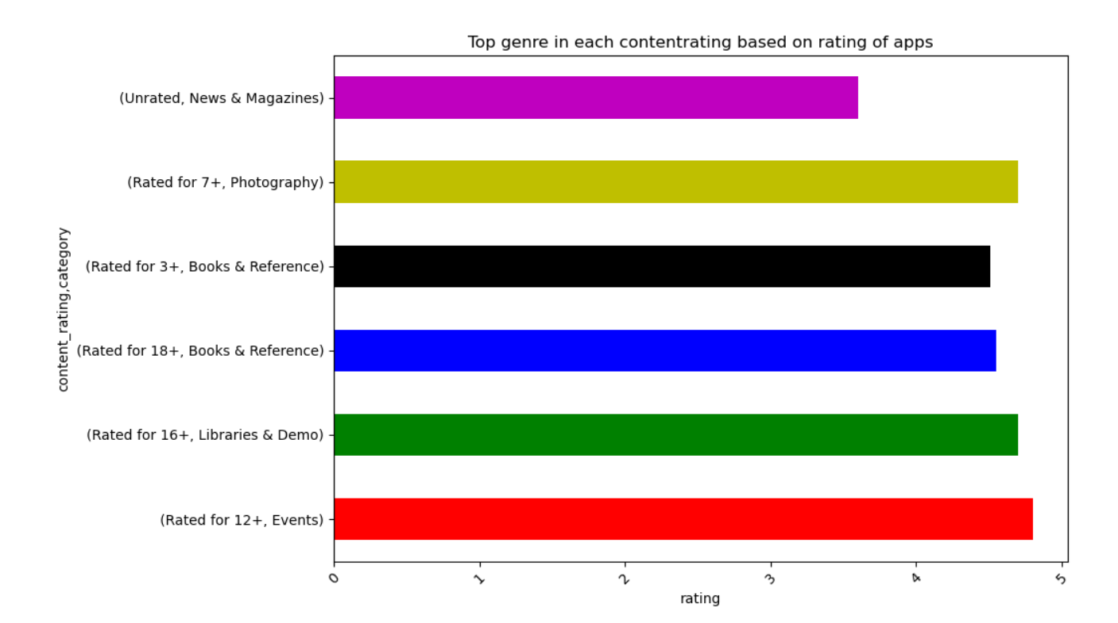

Slide 9
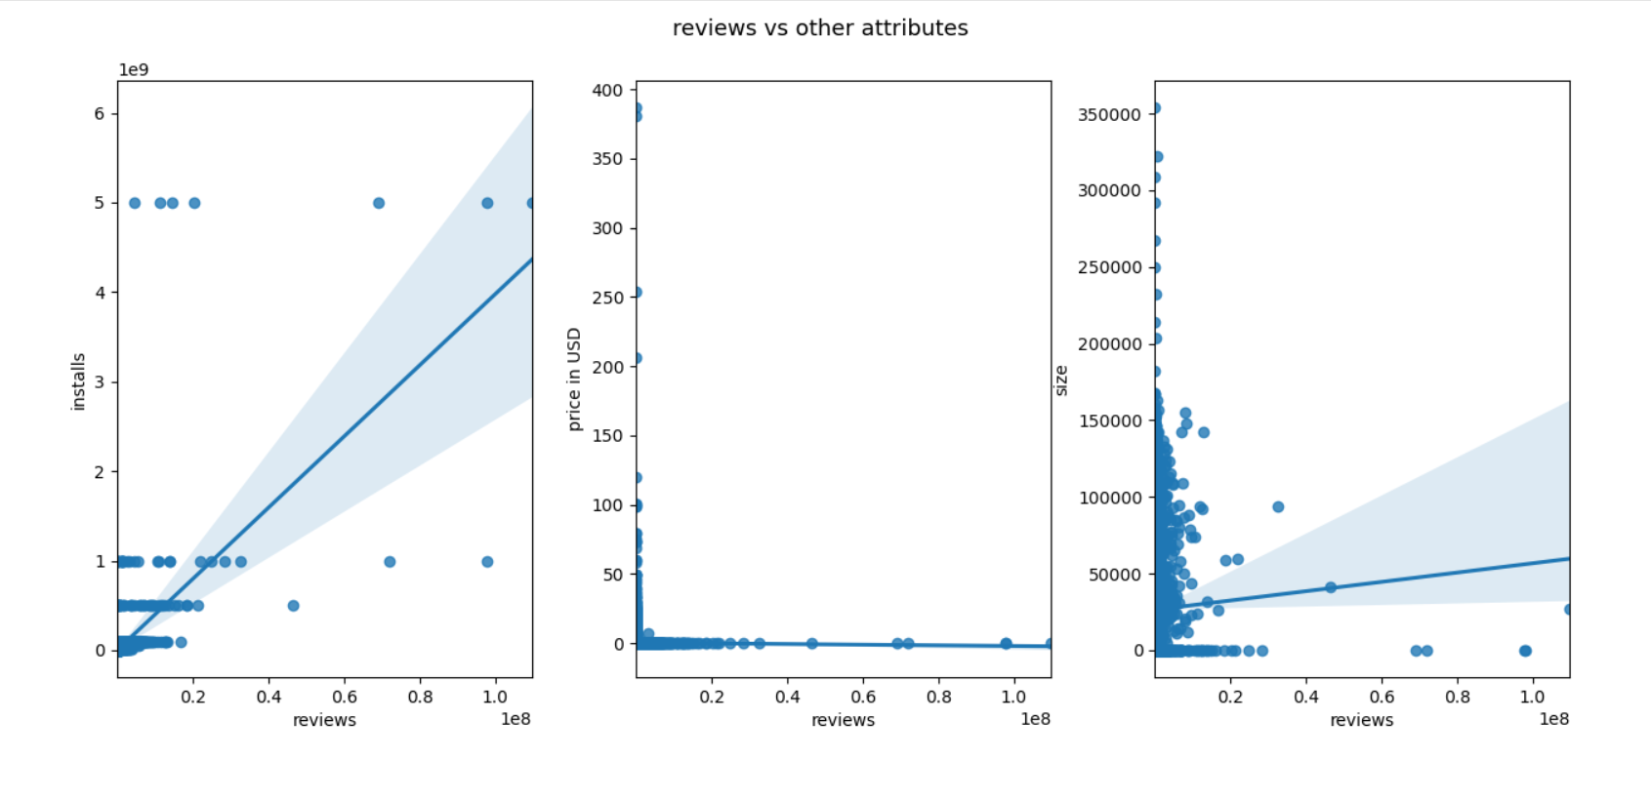

Slide 10
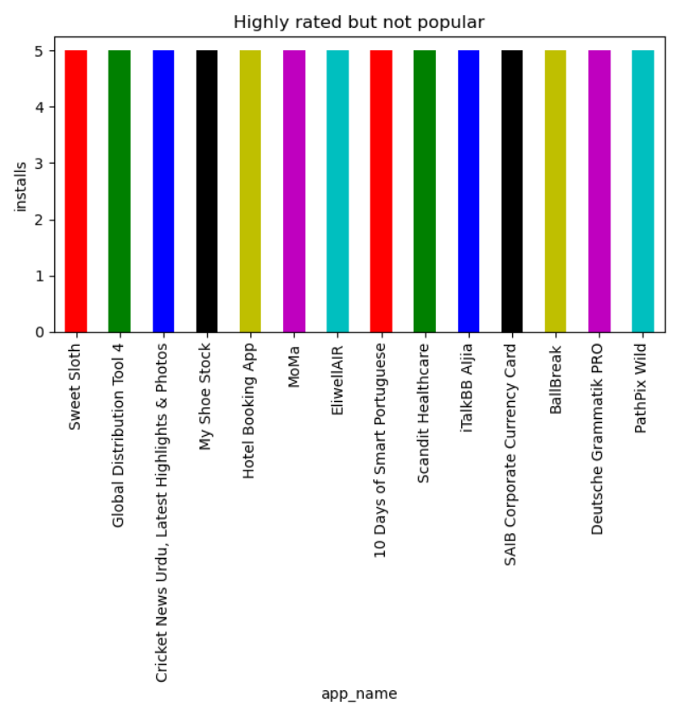

Slide 11
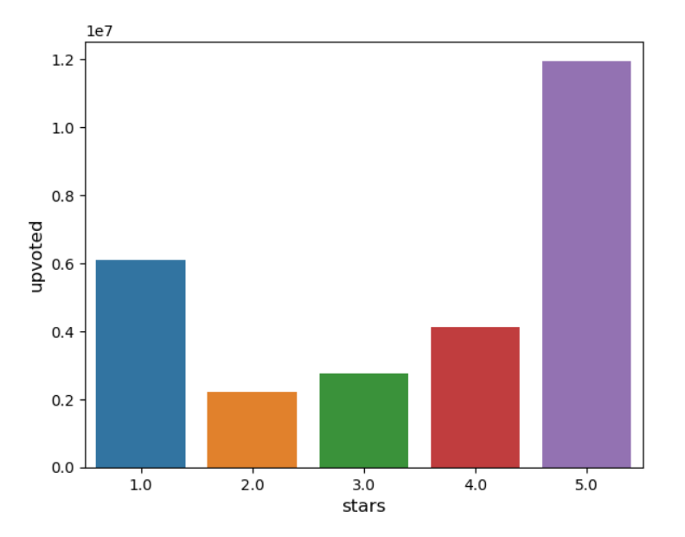
Which Star comments are upvoted by people?

Slide 12
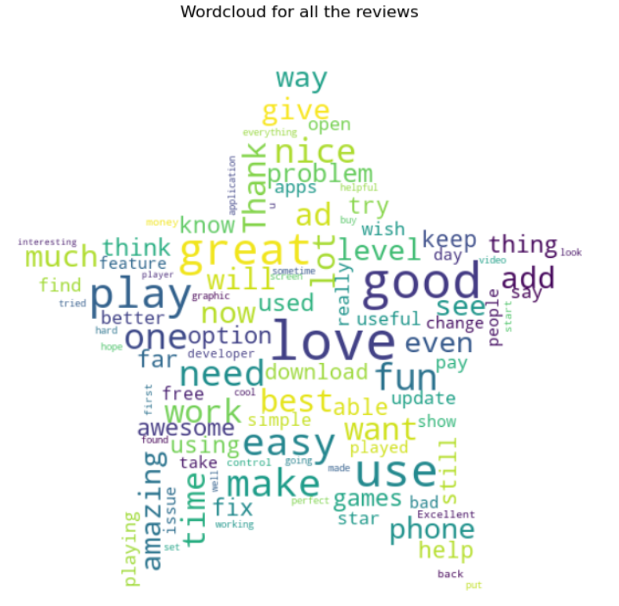

Slide 13
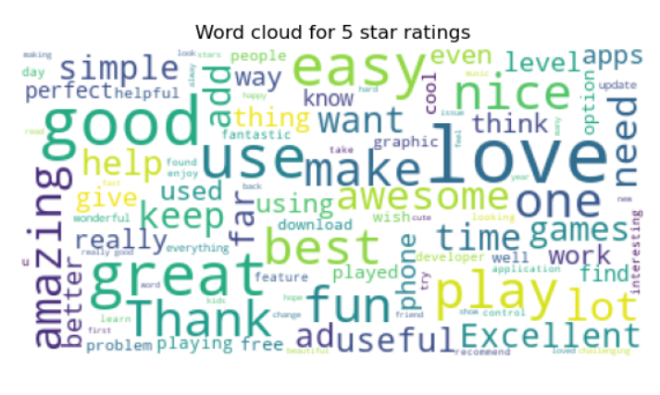
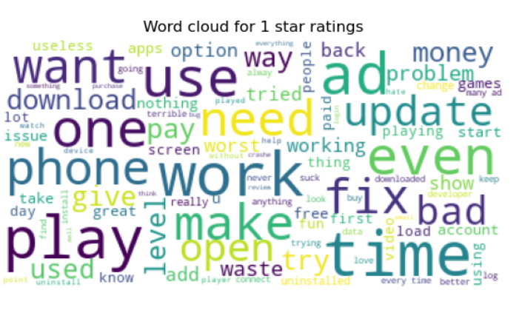

Slide 14
Inferences
Most of the apps in dataset are having high ratings & are free apps.
Apps which are rated for 3+ age group were given more no. of reviews.
Books & Reference is the top category for all age groups.
Reviews & installs are somewhat correlated than other attributes.
Most people consider comments with 1 & 5 stars while choosing an app.

Slide 15
Goals:
Trends of the apps updated in top categories year wise & month wise.
How rating is affected by other attributes?
Top 50 apps & any similar attributes among them.
Top companies producing apps in more than 1 category.
Predicting the rating of applications using ML.

Slide 16
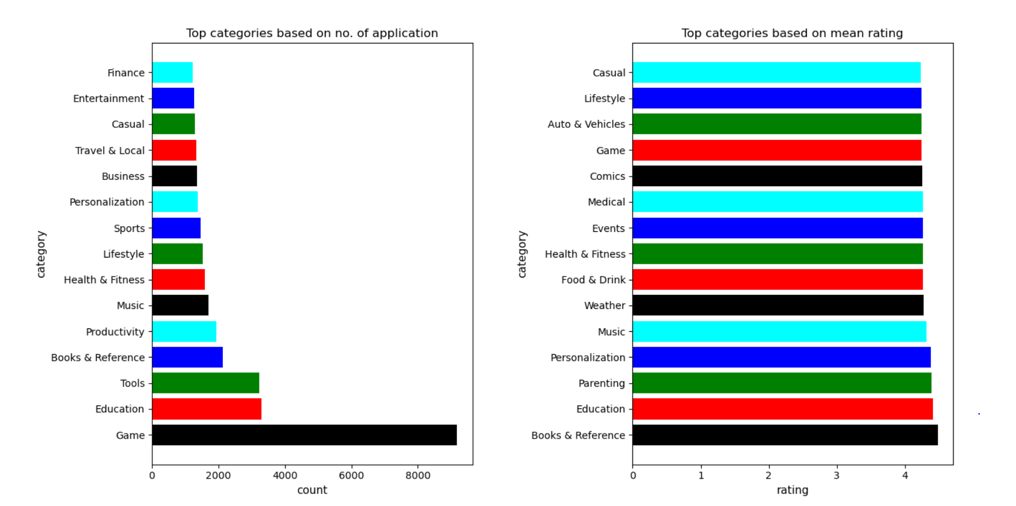

Slide 17
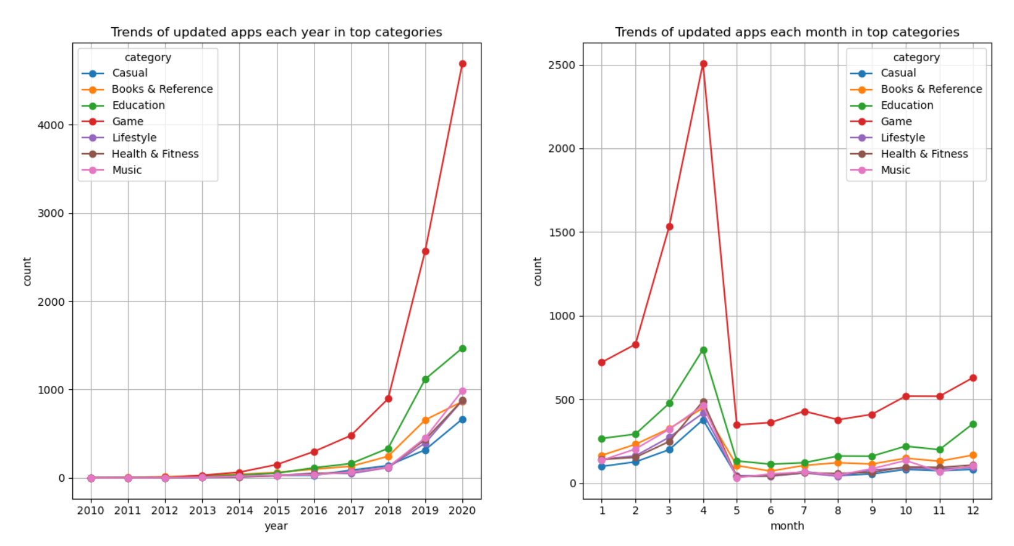
Trends of Top categories

Slide 18
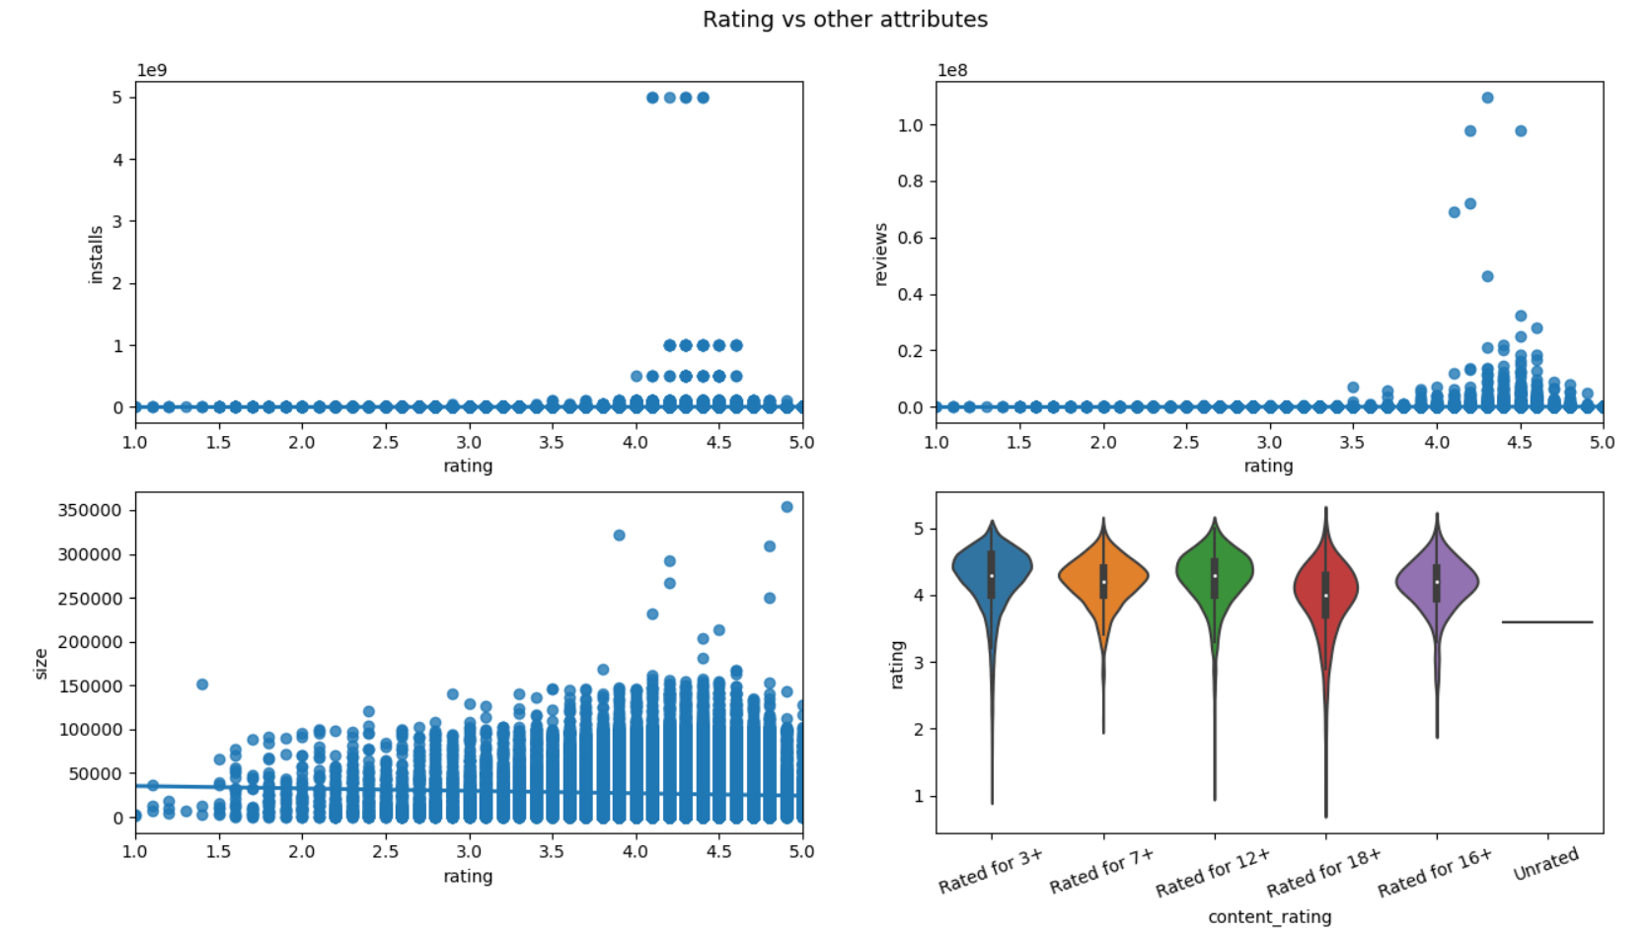

Slide 19
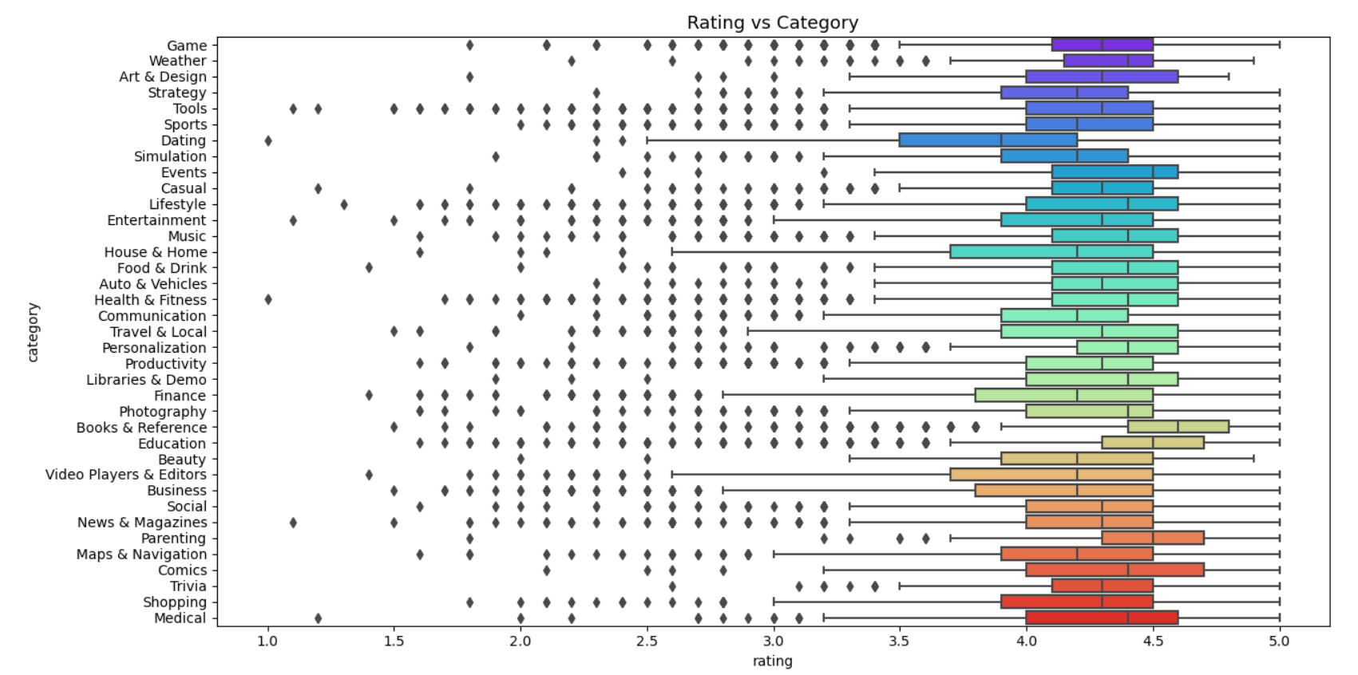

Slide 20
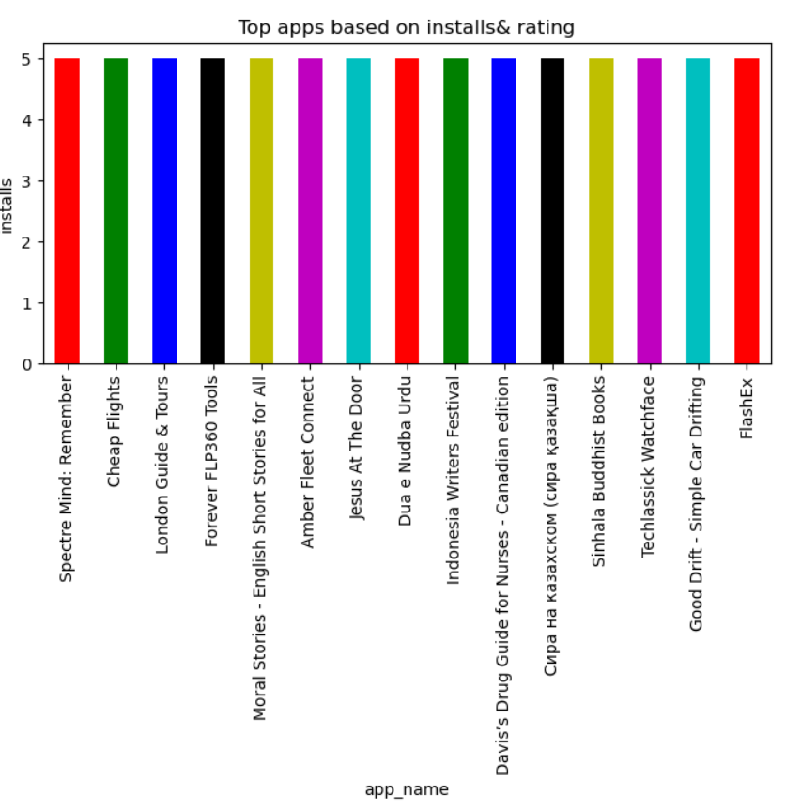
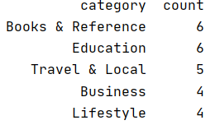
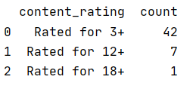

Top Apps & Similar Attributes

Slide 21
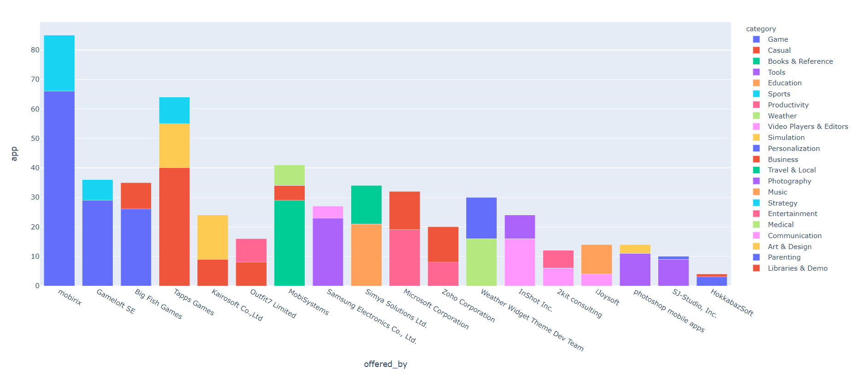
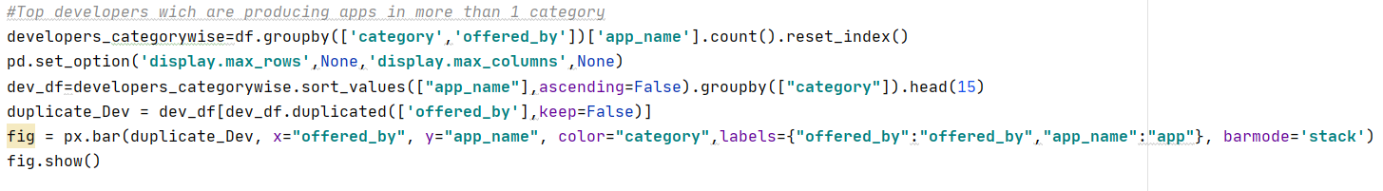
Top companies producing apps in more than one category

Slide 22
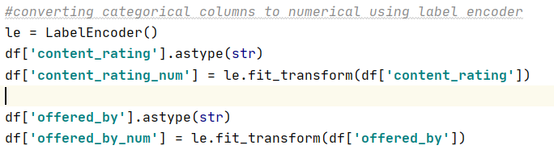
Label Encoder
This used for converting categorical columns to numerical columns.

Slide 23
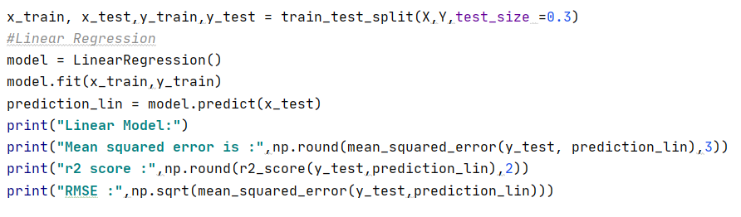
Regression Models
Model | MSE | r2_score | RMSE
Linear Model Regressor | 0.034 | 0.85 | 0.184
Decision Tree Regressor | 0.028 | 0.87 | 0.168
Xgboost Regressor | 0.025 | 0.89 | 0.157

Slide 24
Conclusion:
With the growing years more number of apps are updated.
Applications which are in Rated for 3+, Books & Education category are the top applications.
Samsung & Microsoft are some of the well known companies producing apps in more than 1 category
Xgboost regression model is more appropriate for my dataset.

Slide 25

References
https://stackoverflow.com/questions/48393336/pandas-groupby-sort-within-groups-retaining-multiple-aggregates
https://datatofish.com/replace-values-pandas-dataframe/
https://www.geeksforgeeks.org/python-pandas-to_numeric-method/
https://towardsdatascience.com/all-machine-learning-models-explained-in-6-minutes-9fe30ff6776a
https://medium.com/data-science-bootcamp

Slide 26

Thank You

