Slide 1
Superstore_dashboard
File created on: 10/5/2025 2:54:07 PM

Slide 2
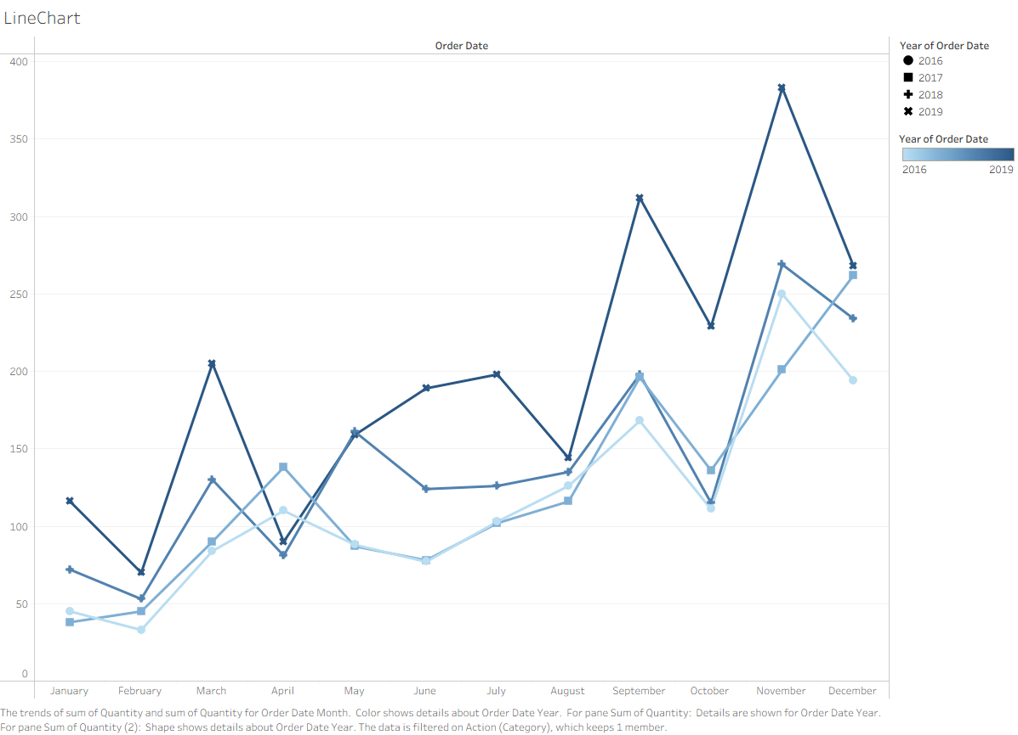

Slide 3
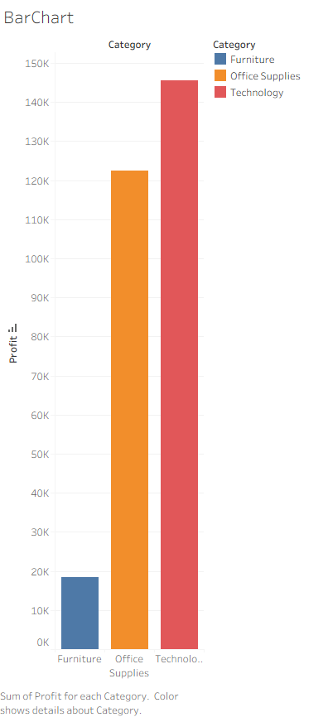

Slide 4
