Slide 1
NEURONS REAL AND IMAGINED
Nicholas Petela
Advisor- Dr. Bozer
Tarleton State University

Slide 2
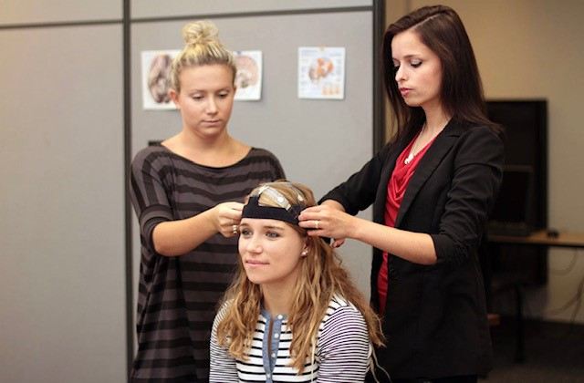
Procedure
Brain activity generates postsynaptic potential
This can penetrate tissue
EEG picks it up at the scalp
Then comes the fun part: analysis!

Slide 3
Convoluting Factors
Data doesn't come out nice and pretty
Overhead lights influence the signal
Every blink is visible on the EEG
Heartbeats show up
Line noise (sweating)

Slide 4

Old Pipeline
iMotions moves data from EEG to computer
Lots of manual cleaning with EEGLab

Slide 5

Enter: MNE
Implemented in Python to replace tools like EEGLab for analysis and cleaning.
Any paper we can understand, we can implement (modularity)
FREE (Explainable/shareable science! Yay!)

Slide 6
The Easy Stuff
Pandas- Coercing EEG data out of iMotions format, coercing montage data out of native .els
Bandpass Filter- Removes noise from the lights (high frequency) and baseline drift (low frequency)
Building out the analysis pipeline.

Slide 7
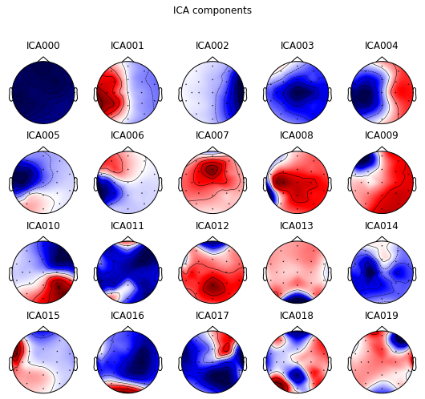
Independent Components Analysis

Slide 8
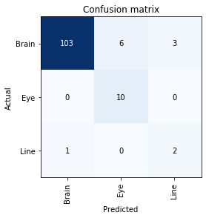
Initial Results
After applying Resnet, things look promising!

Slide 9
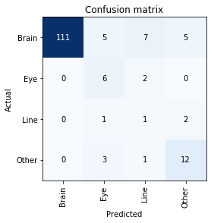
Refined Results
However, after spotting an error in our validation process, accuracy suffered.
We divided nonartifactual components into two classes, “Brain” and “Other” and received better accuracy.

Slide 10
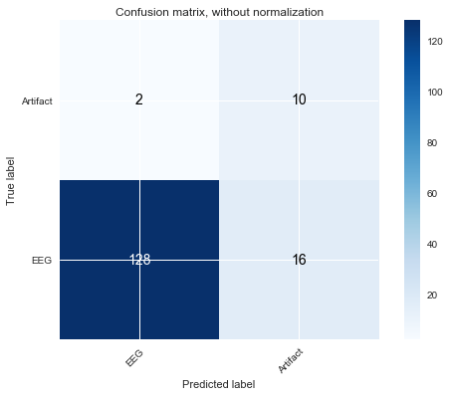
Refined Results
We're not concerned with fine-grained classification, we need artifacts vs. non-artifacts
Currently 88% accurate, favors the under-represented class (better safe than sorry)

Slide 11
Further Direction
Expand to account for temporal data after we can get a better data set, using recurrent neural net (RNN) hybrid architecture
Qualitative Validation
Build out semi-supervised pipeline for refining the model as new data comes in.

Slide 12
Thank You. Questions?
Thank you to Tarleton Behavioral Neuroscience and Psychophysiology Research Group for data
Thank you to Tarleton Math Department for teaching me what to do with it.
Photo Credit: Kurt Mogony
Nicholas.petela@go.tarleton.edu

