Slide 1

Working with Probability Distributions

Slide 2
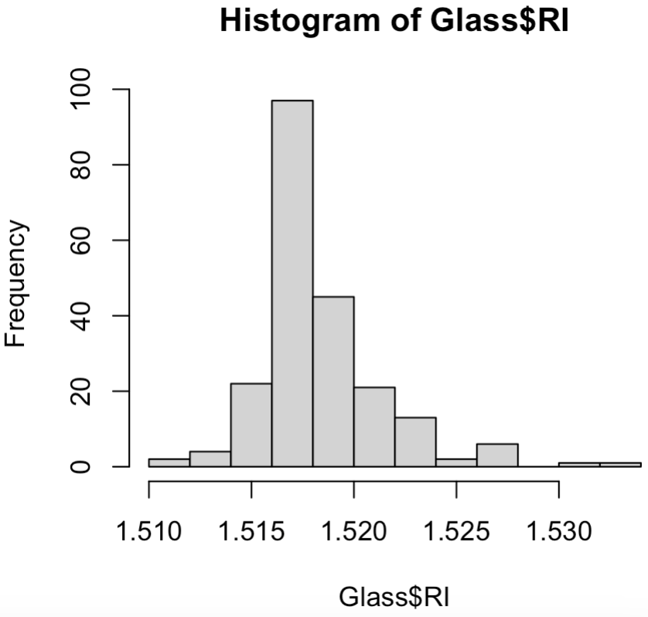
Probability Density Function
When plotted, discrete data is “binned” and continuous data can be treated as if its discrete and “binned”.
Result is a histogram, also called a probability mass function (PMF)
A bar height represents the # of datapoints in the bin.
library(mlbench)
data("Glass")
hist(Glass$RI)

Slide 3
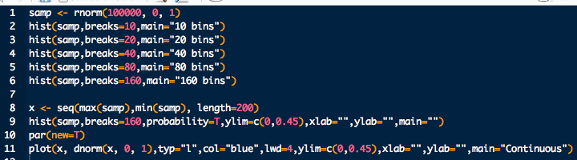
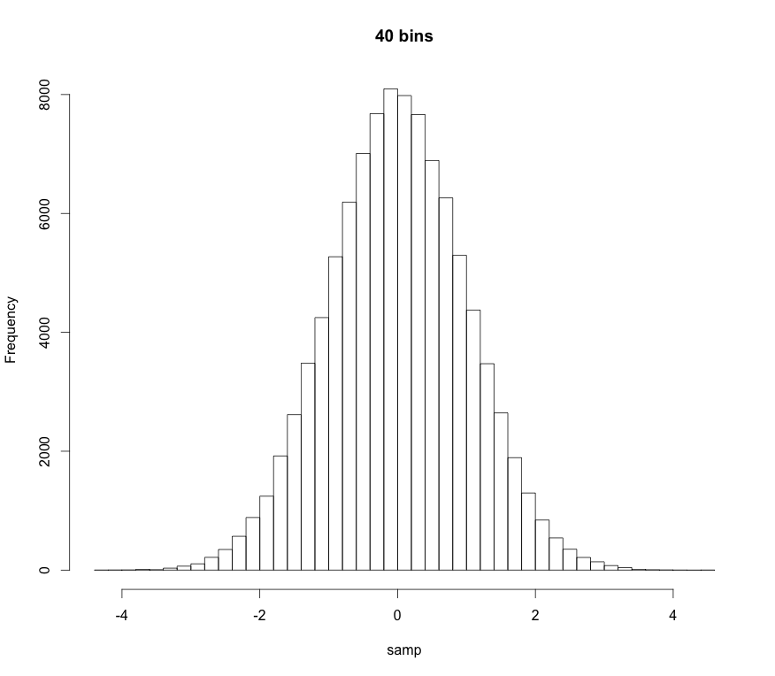
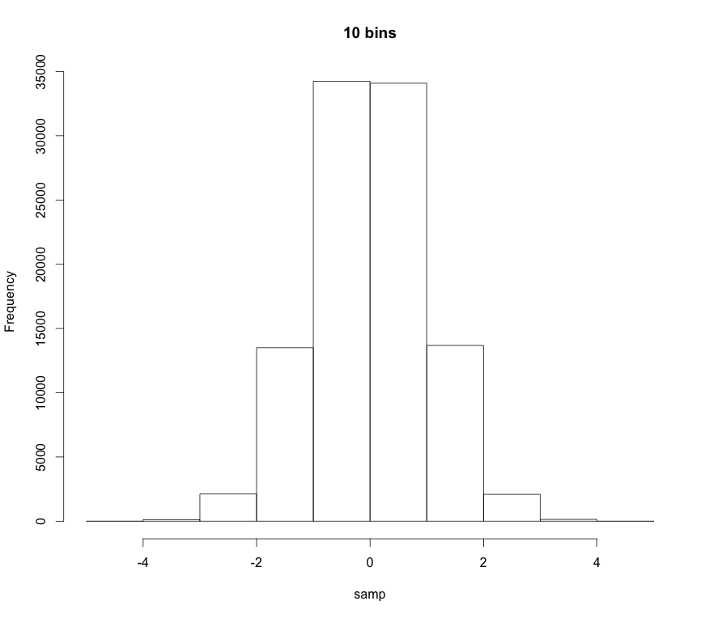
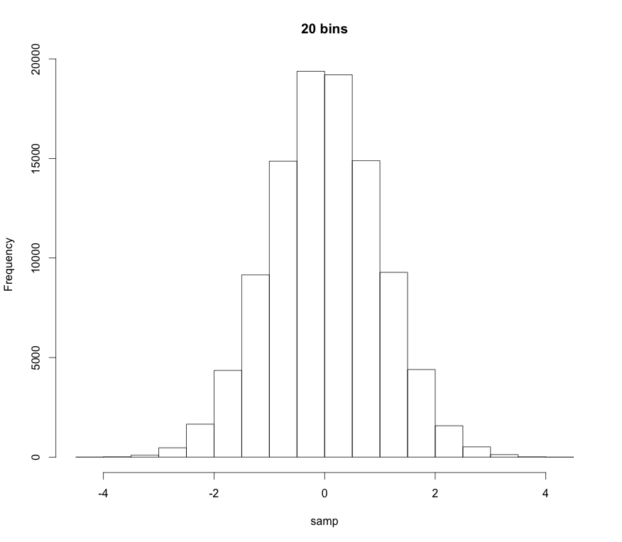
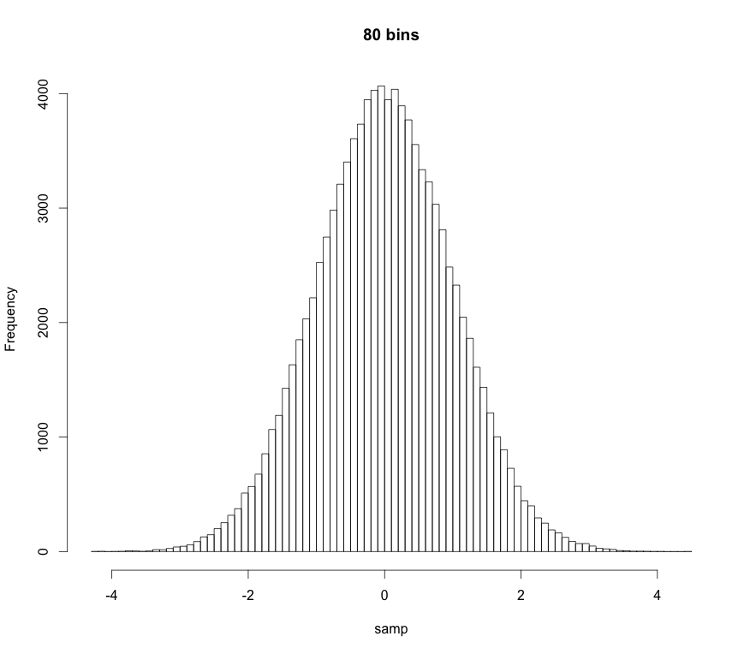
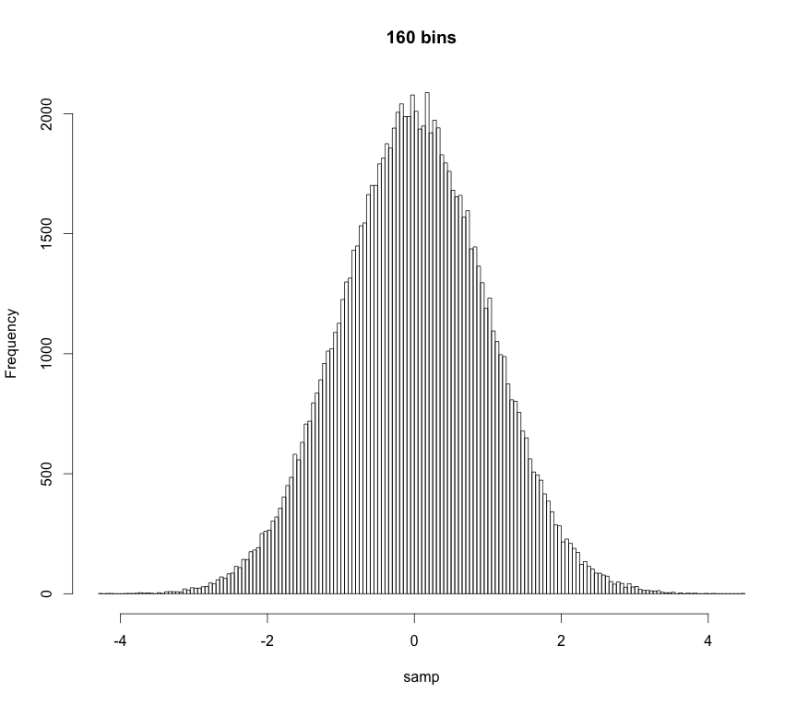
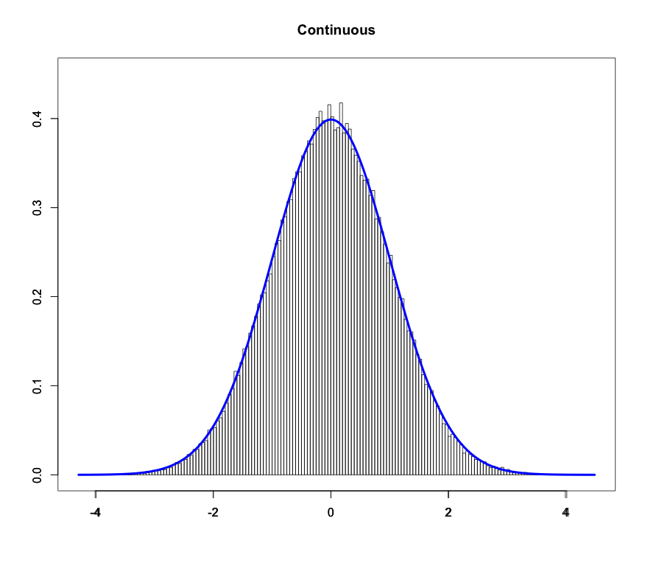
Probability Density Function
As we increase the number of “bins” the “bars” get thinner and thinner
If there are an infinite number of bins the bars get infinitesimally thin:
Probability Density Function (PDF)

Slide 4
Probability Density Function
Technical definition:
A random variate X is continuous if:
The probability that X lies between a and b
p(x): probability density function (pdf)
Note:
Proper pdfs should be normalized
“All space” for an r.v. is it’s domain. Also called its support
“All space” for us is usually 0 to ∞ or -∞ to ∞

Slide 5
Probability Density Function
Technical definition:
A random variate X is continuous if:
The probability that X lies between a and b
p(x): probability density function (pdf)
Note also:
The probability of obtaining a particular r.v. is 0
p(x) ≥ 0
The pdf is always greater than or equal to 0

Slide 6
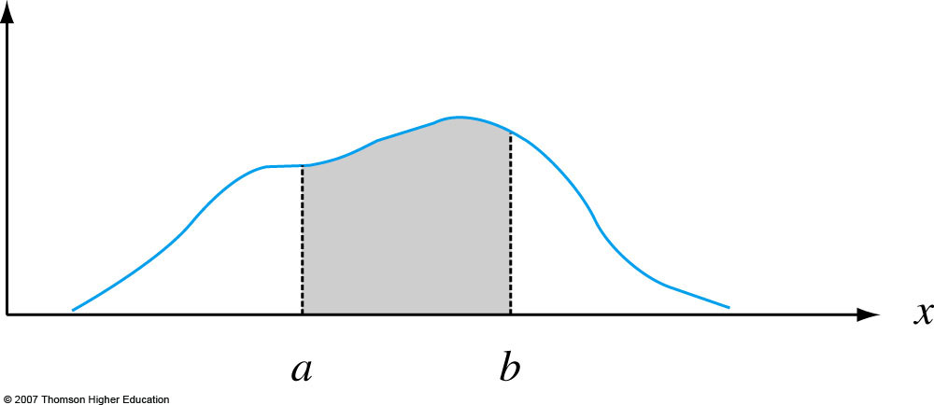
Probability Density Function
Graphically:
p(x)
Notes:
Figure 4.2
P (a ≤ X ≤ b) = the area under the density curve between a and b.

Slide 7
Moments and Expectation Values
Moments are numerical values that control a PDF’s location and shape properties.
m^{th}-order moments are found by taking the expectation value or average-value of an RV raised to the m^{th}-power:
Most of the time we only care about first-order and second-order-central moments.

Slide 8
Moments and Expectation Values
1st-order moment for X, i.e. the expectation value of X:
location descriptor
mean
Take-home message: Expectations are “average values”
Sample mean
This is the formula we usually use

Slide 9
Moments and Expectation Values
Important 2nd-order moments:
Second order central moment.
It can be shown that
Population standard deviation
spread descriptor
Sample standard deviation
This is the formula we usually use

Slide 10
Uniform Distribution
Uniform PDF: Same “likelihood” for all x
Parameters:
a left bound
b right bound

Slide 11
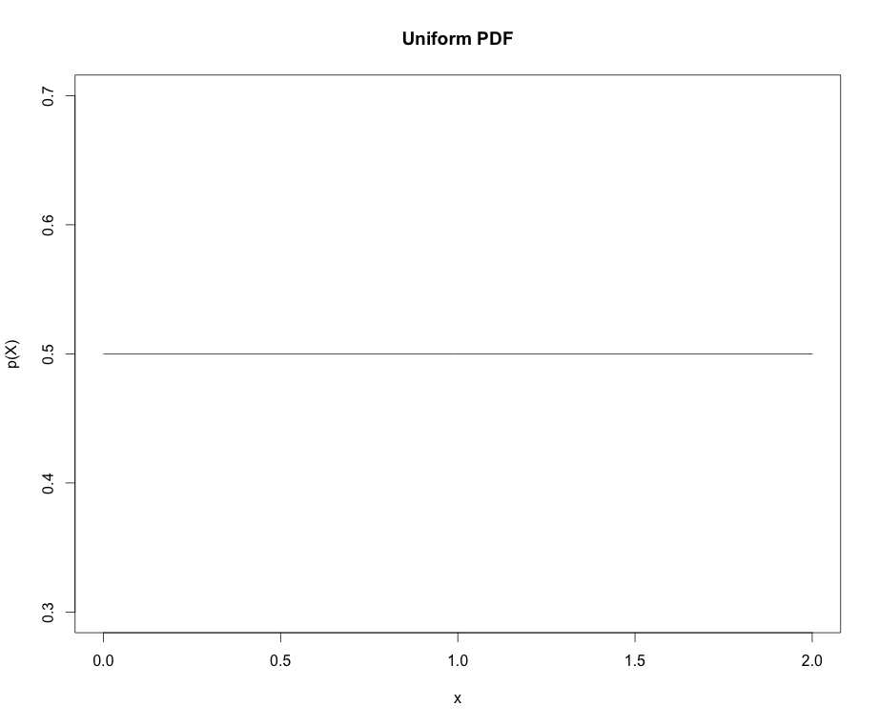
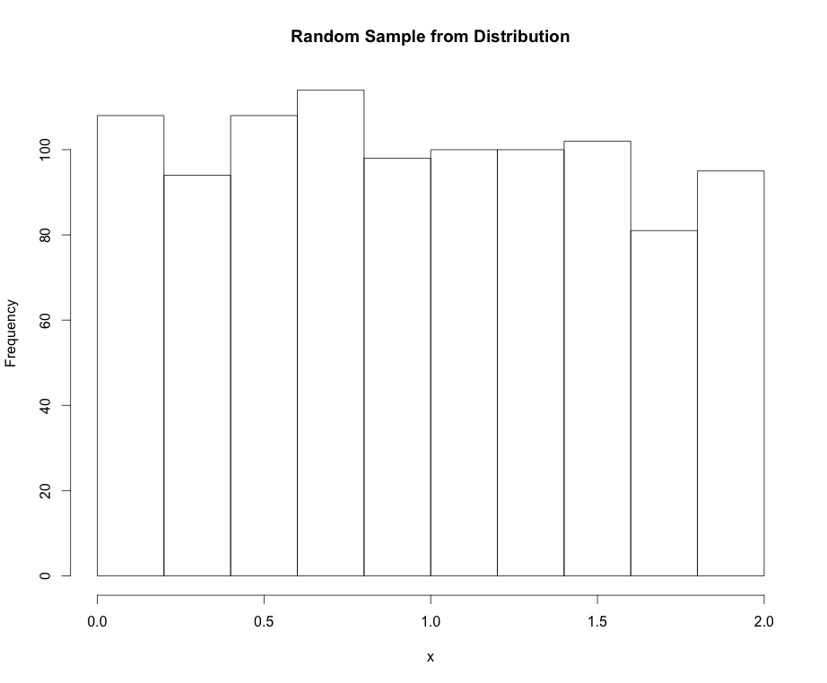
Uniform Distribution
Mean:
Variance:

Slide 12
Normal Distribution
Normal PDF: The “bell cure”. Also called Gaussian dist.
Parameters:
μ mean
σ standard deviation

Slide 13
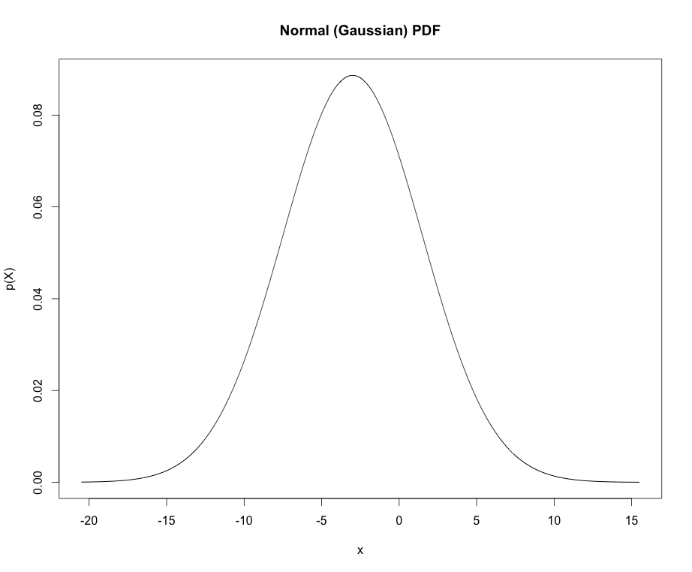
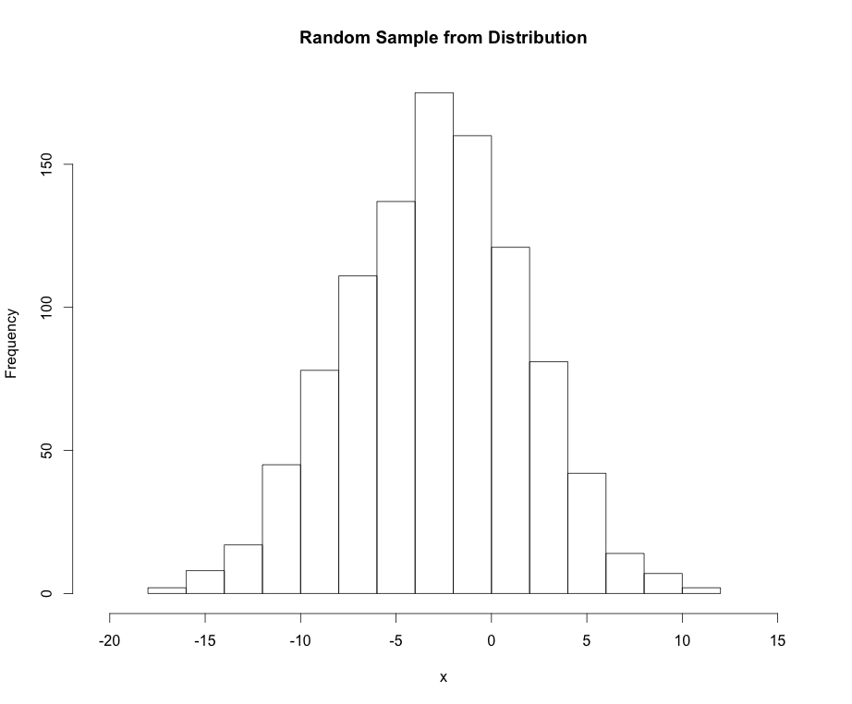
Normal Distribution
Mean: μ_{X} = μ
Variance: σ²_{X} = σ²

Slide 14
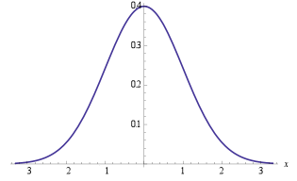
Normal Distribution
Points of interest for the Normal distribution:
If X ~ N(μ, σ) we can “standardize” (transform) to the z-scale:
Standard normal distribution
Handy equation
~ 68%
±1σ
~ 95%
±2σ
~ 99%
±3σ

Slide 15
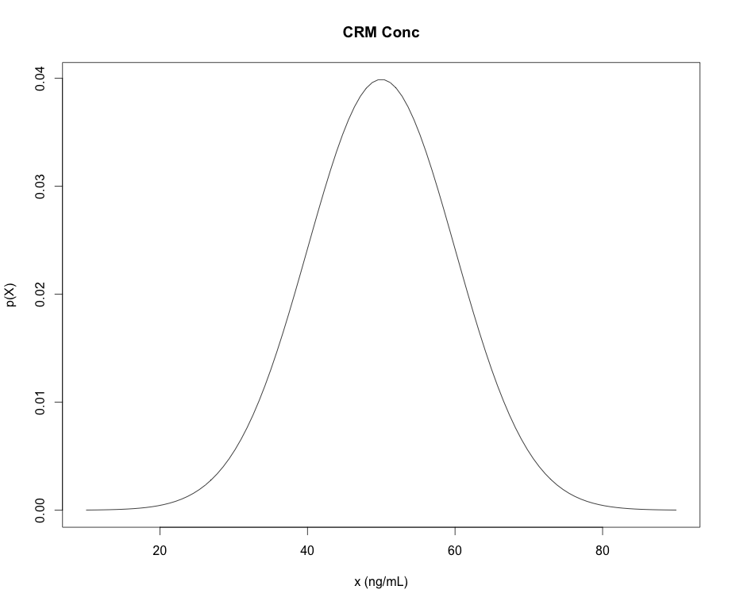
Cumulative Distribution Functions
A function that gives the probability that a random variable is less than or equal to a specified value is a cumulative distribution function (CDF):
x

Slide 16
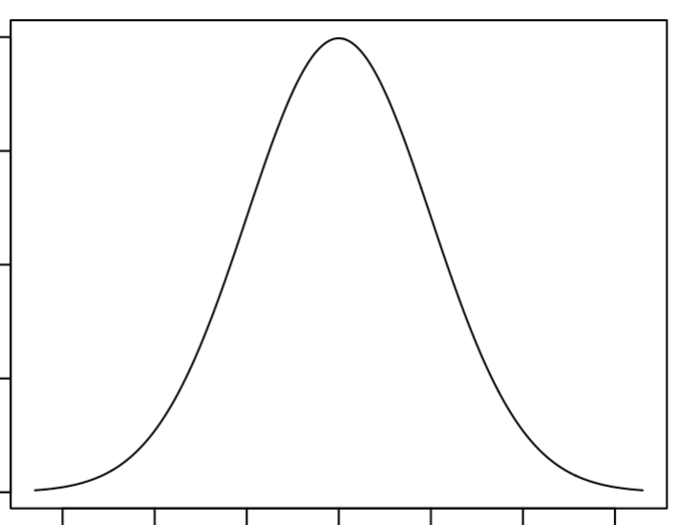
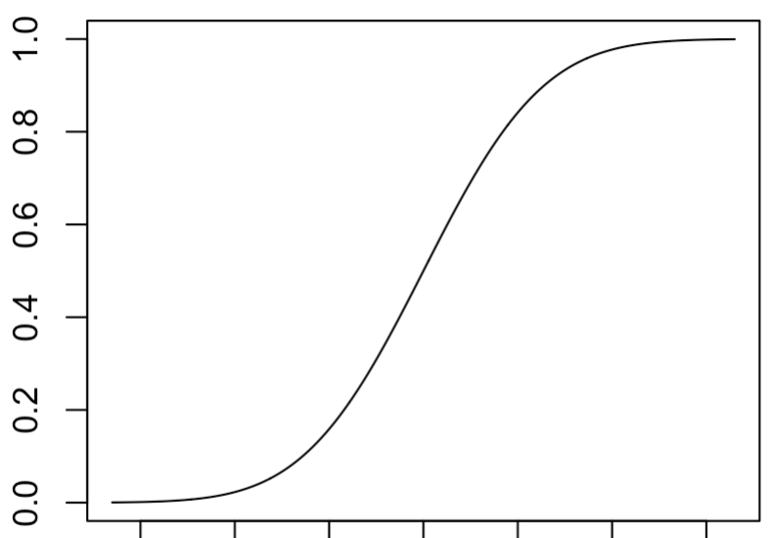
Cumulative Distribution Functions
In general:
PDF:
CDF:
x
x

Slide 17
Some R Commands for PDFs and CDFs
dnorm “d-function” in R is the density (mass) of the distribution (PDF)
pnorm “p-function” in R is the CDFs of the distribution (CDF)
qnorm “q-function” in R give the quantiles of the distribution (x-values) for a given cumulative probability (p-value)
rnorm “r-functions” in R gives a random sample from the distribution
*NOTE: “p-functions” and “q-functions” are inverses of each other
pnorm(q=47,mean=50,sd=10)=
0.42
0.42
“input quantity”
qnorm(p=0.42,mean=50,sd=10)=
47
47

Slide 18
Cumulative Distribution Functions
CDFs are important because they allow us to calculate the probability integrals easily:

Slide 19
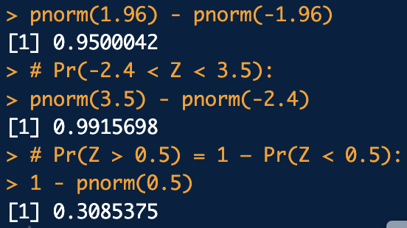
An abstractly worded example
Consider a standard normal random variate:
# a. Pr(-1.96 < Z < 1.96):
pnorm(1.96) - pnorm(-1.96)
# b. Pr(-2.4 < Z < 3.5):
pnorm(3.5) - pnorm(-2.4)
# c. Pr(Z > 0.5) = 1 – Pr(Z < 0.5):
1 - pnorm(0.5)
a. Compute:
b. Compute:
normal_ex1.R
c. Compute:
How would the code change for a uniform random variate between -4 and 4?

Slide 20
Example: quantiles/percentiles by integration
A sample of methamphetamine in blood certified reference material (CRM) is obtained as a standard for calibration of methodology in a tox lab.
The concentration of the CRM is certified to follow a normal distribution with mean concentration of 50 ng/mL and standard deviation of 10 ng/mL.

Slide 21
Example: quantiles/percentiles by integration
What is the probability of that the CRM’s concentration will be measured to be between 30 ng/mL and 70 ng/mL?
30 ng/mL
70 ng/mL
What would the code look like if we wanted Pr(X > 70ng/mL)?
# The "measurands" (parameters):
mu <- 50
sigma <- 10
# Pr(30 < X < 70):
pnorm(70, mean=mu, sd=sigma) - pnorm(30, mean=mu, sd=sigma)
normal_ex2.R

Slide 22

Example: quantiles/percentiles by integration
What is the upper concentration can we expect for 90% of the samples we may measure?
Another way to phrase: What measured sample concentration (quantile) should correspond to the 90th percentile with respect to the CRM?
# Quantile for the 90th percentile:
qnorm(0.9, mean=mu, sd=sigma)
0.9
normal_ex2.R
x?

Slide 23
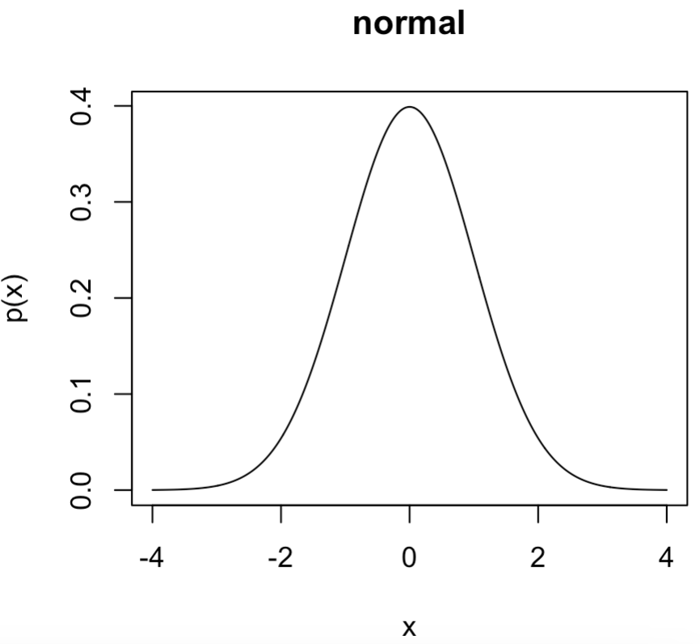
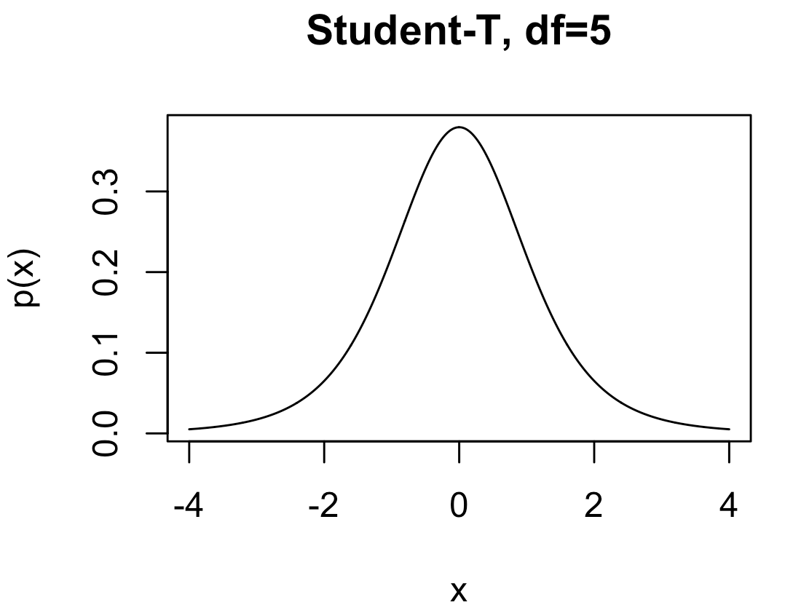
Distributions We’ll Encounter
Normal: Common in science. Also called Gaussian distribution. A standard normal distribution has mean = 0 and sd = 1.
dnorm, qnorm, pnorm, rnorm
Parameters:
mean: μ mean
sd: σ standard deviation
Student-t: Like a standard normal distribution but fatter tails. Used a lot for confidence intervals and hypothesis testing.
Parameters:
dt, qt, pt, rt
df: degrees of freedom

Slide 24
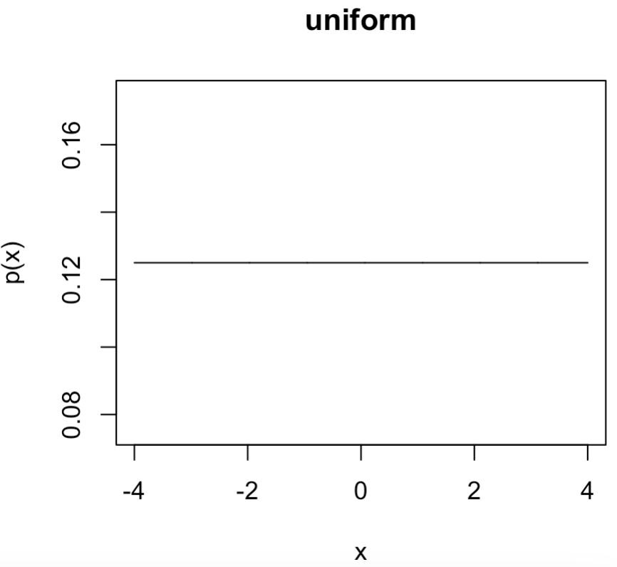
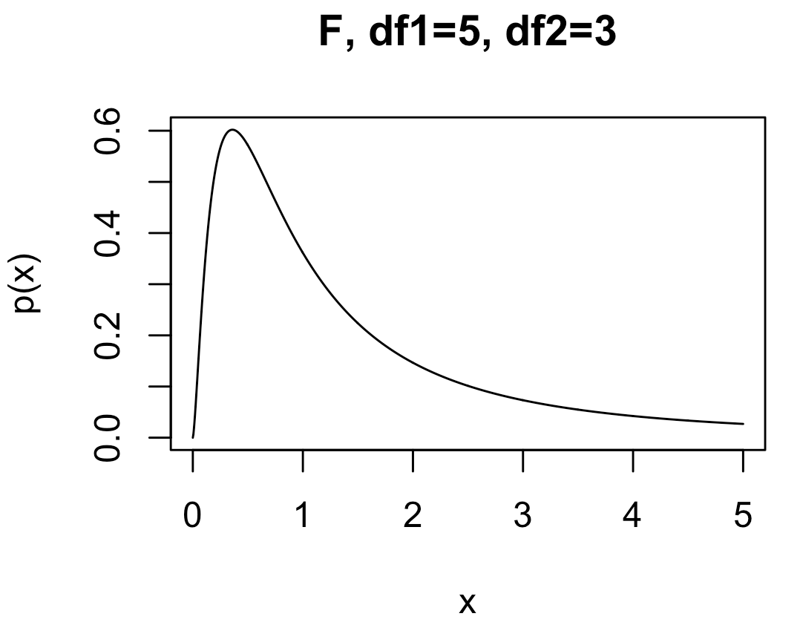
Distributions We’ll Encounter
Uniform: A flat distribution. Usually used to express ambivalence on an outcome between a lower and upper bound.
dunif, qunif, pinif, runif
Parameters:
min: lower bound
max: upper bound
F : Handy especially for comparing outcomes in three or more experiments with different conditions.
Parameters:
df, qf, pf, rf
df1: degrees of freedom 1
df2: degrees of freedom 2

Slide 25
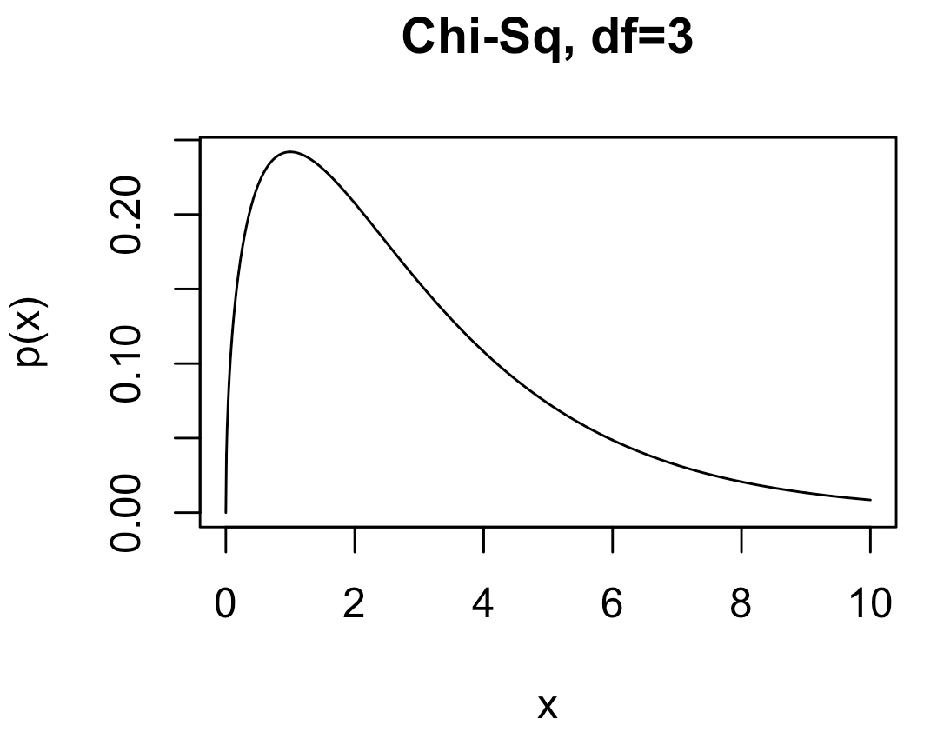
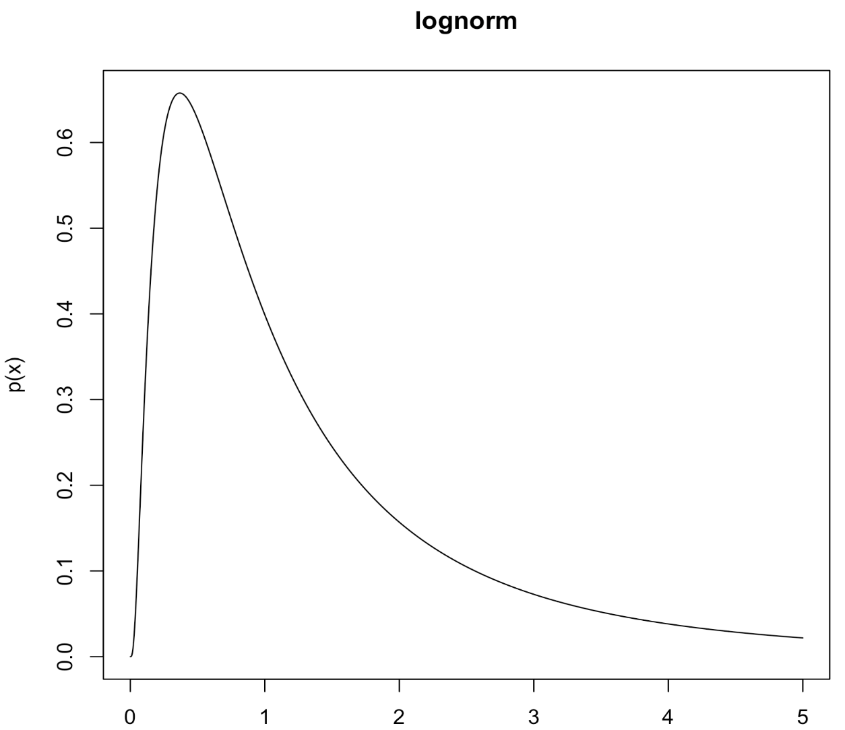
Distributions We’ll Encounter
Chi-squared (χ²): Handy especially for comparing raw set of counts. Also, it’s proportional to the likelihood of sample variance for normal IID data.
dchisq, qchisq, pchisq, rchisq
Parameters:
df: degrees of freedom
Lognormal: When the logarithm of data, X, is normally distributed:
dlnorm, qlnorm, plnorm, rlnorm
Parameters:
meanlog: mean on the log scale
sdlog: sd on the log scale

Slide 26
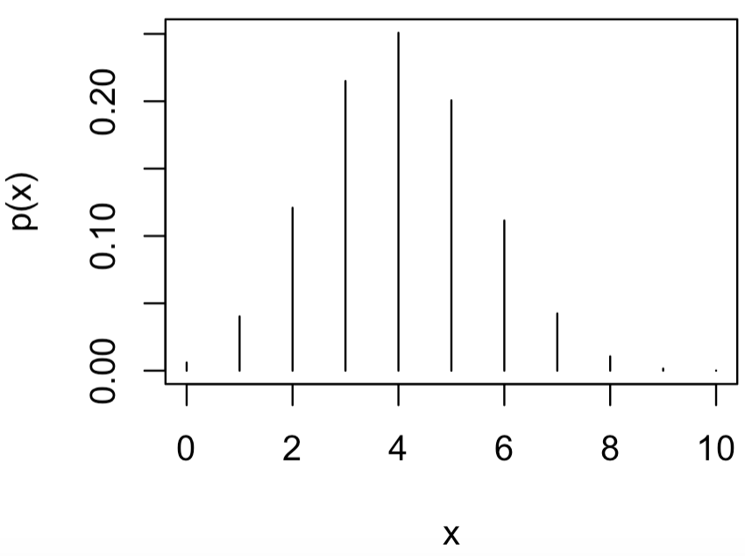
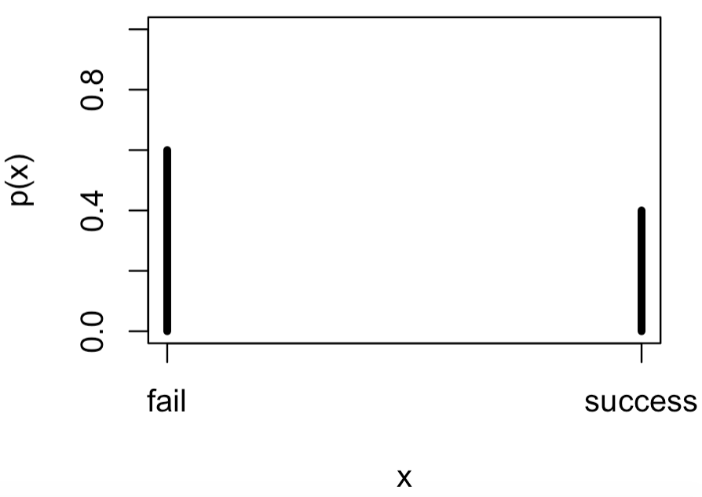
Distributions We’ll Encounter
Binomial: Good modeling the likelihood of x “successes” out of n tries.
dbinom, qbinom, pbinom, rbinom
Parameters:
size (n): number of trials
prob (π): probability of a “success”
Bernoulli: Same as binomial except for only n=1 trials. Good likelihood model for experiments with only two outcomes.
Parameters:
size=1: number of trials
prob: probability of a “success”

Slide 27
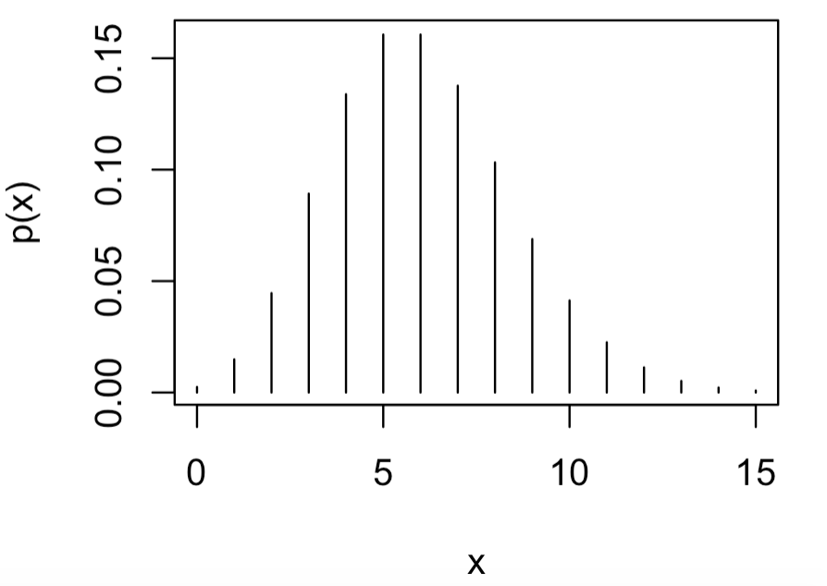
Distributions We’ll Encounter
Poisson: Good likelihood model likelihood of x “successes” with the rate of “success” = lambda.
Parameters:
lambda: rate of “success”
distributions.R

Slide 28
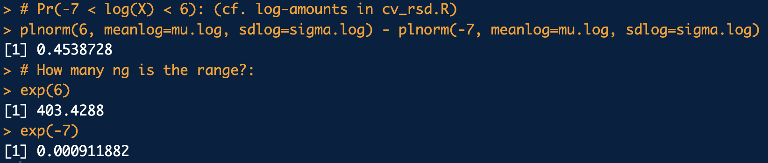
Example: Lognormal Data
A study found that amount of touch DNA collected on a certain surface follows a lognormal distribution with μ_{log}= 5.5 log-ng and σ_{log}= 32 log-ng. Compute the probability of recovering between -7 log-ng and 6 log-ng. (How many ng is the range?)
mu.log <- 5.5
sigma.log <- 32
# Pr(-7 < log(X) < 6): (cf. log-amounts in cv_rsd.R)
plnorm(6, meanlog=mu.log, sdlog=sigma.log) - plnorm(-7, meanlog=mu.log, sdlog=sigma.log)
# How many ng is the range?:
exp(6)
exp(-7)
lognormal_ex.R

Slide 29
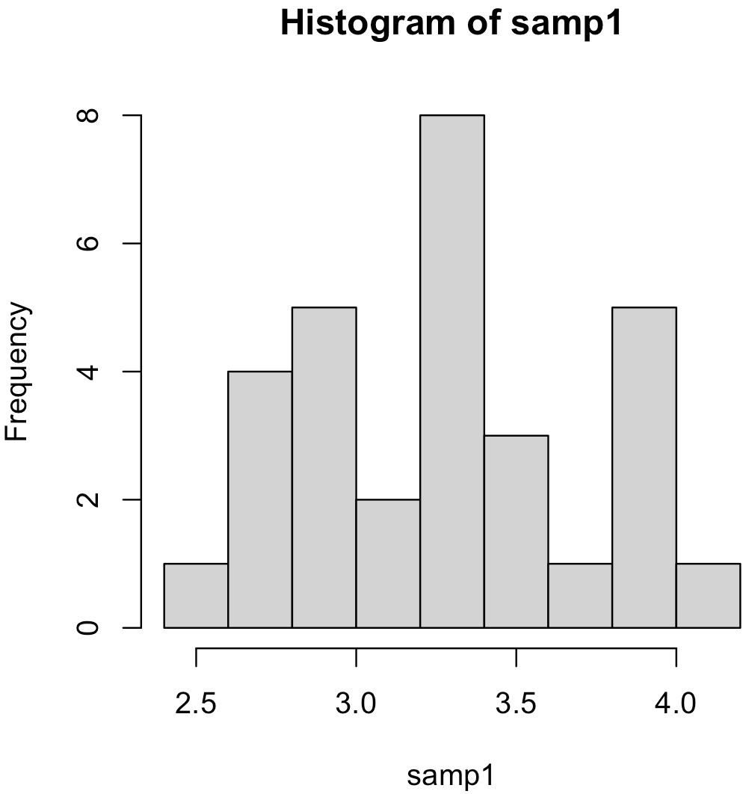
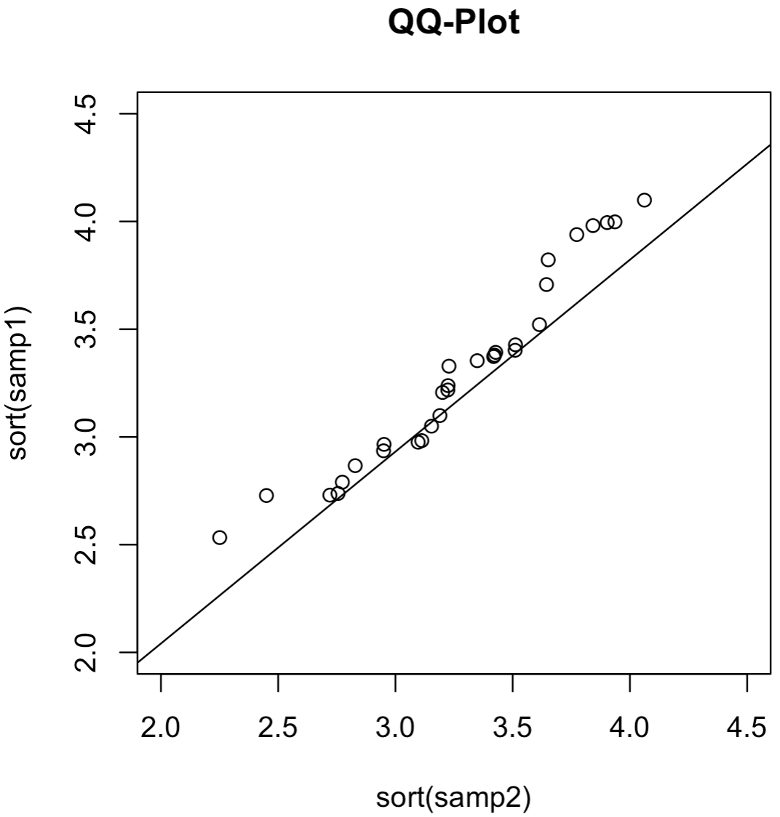
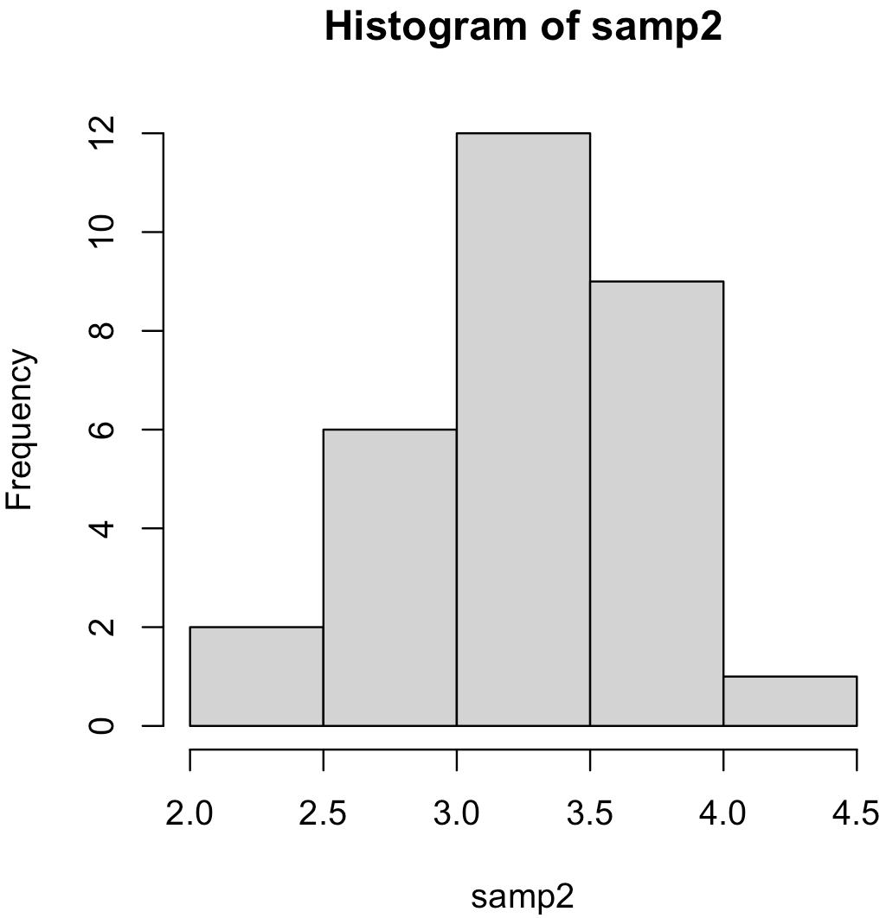
Quantile-Quantile Plots
Since we’re on the topic of probability distributions, lets now discuss a useful graphical tool to compare samples from arbitrary probability distributions. We’ll use a lot later as a diagnostic tool.
Quantile-quantile plot (qq-plot): A plot of two sets of ordered samples against each other.
If the two samples come from the same distribution, then their ordering should share similar percentiles and they should form a straight line.

Slide 30
Example
Check to see how well unidentified C4-akyl benzene data from the gasoline data set below follows follows a standard normal distribution using a qq-plot:
0.29569050, 0.20648248, 0.26693348, 0.21223481, 0.25198974, 0.23751277, 0.25585990, 0.20096679, 0.19726276,
0.15425261, 0.16483406, 0.18912258, 0.15739817, 0.15009366, 0.10737274, 0.11019686, 0.12513466, 0.09524371,
0.11218649, 0.11831685, 0.08995212, 0.15960698, 0.18276274, 0.18421865, 0.18959053, 0.17426713, 0.16382262,
0.17599096, 0.28697780, 0.28860089, 0.29051508, 0.25595839, 0.34949305, 0.29253407, 0.23217603, 0.10844975,
0.10404332, 0.09618116, 0.11909941, 0.09788748, 0.10919293, 0.09880065, 0.22318522, 0.21620975, 0.19462144,
0.19739592, 0.18673440, 0.19269031, 0.18278502, 0.09439924, 0.06428694, 0.07324709, 0.08058238, 0.06419378,
0.09414924, 0.07600200, 0.32917529, 0.32886336, 0.37166893, 0.17086414, 0.14853369, 0.13197682, 0.20217787,
0.20856402, 0.22020857, 0.28396187, 0.30769551, 0.31123136, 0.38733964, 0.40322122, 0.40450410, 0.23592761,
0.21981379, 0.23742448, 0.16887720, 0.16218831, 0.15824930, 0.14710371, 0.13743570, 0.14051266, 0.21783285,
0.21272617, 0.23454162, 0.17563793, 0.16575187, 0.17353579, 0.15081576, 0.12968366, 0.13749965, 0.13056509,
0.13839749, 0.12118398

Slide 31
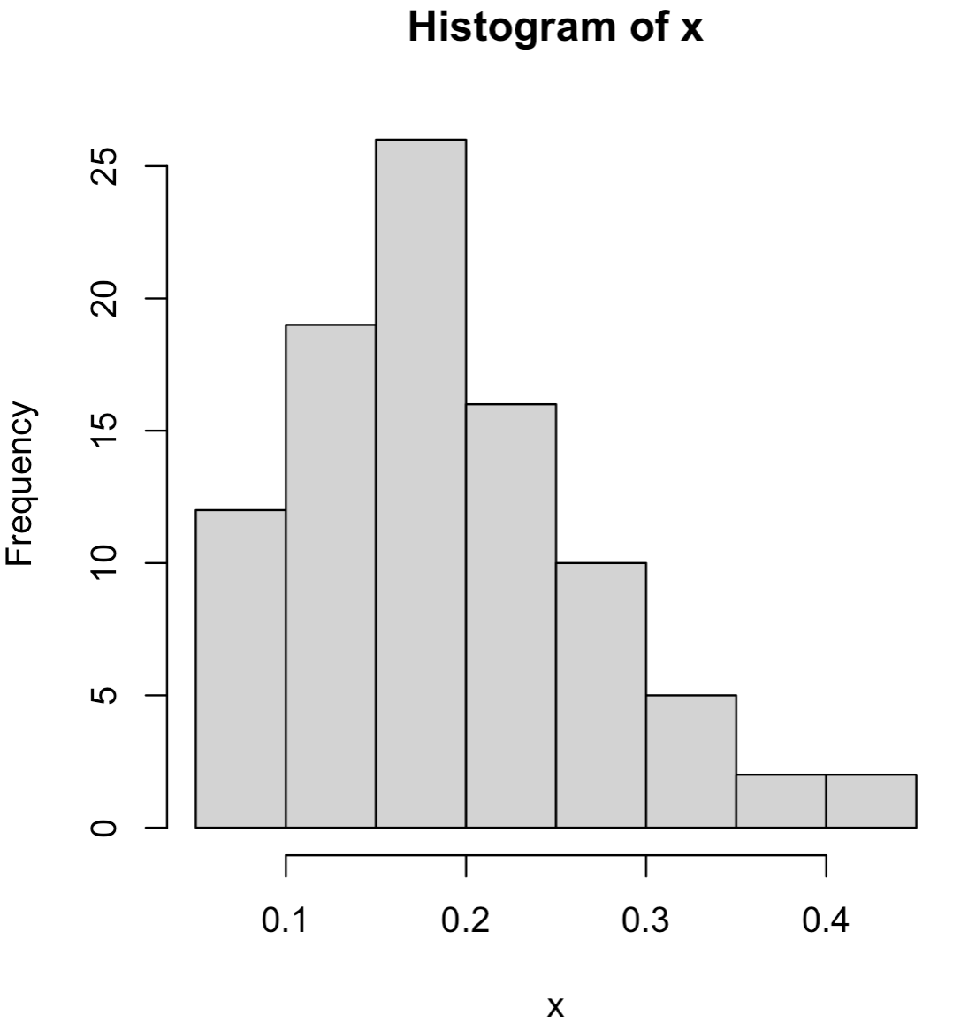
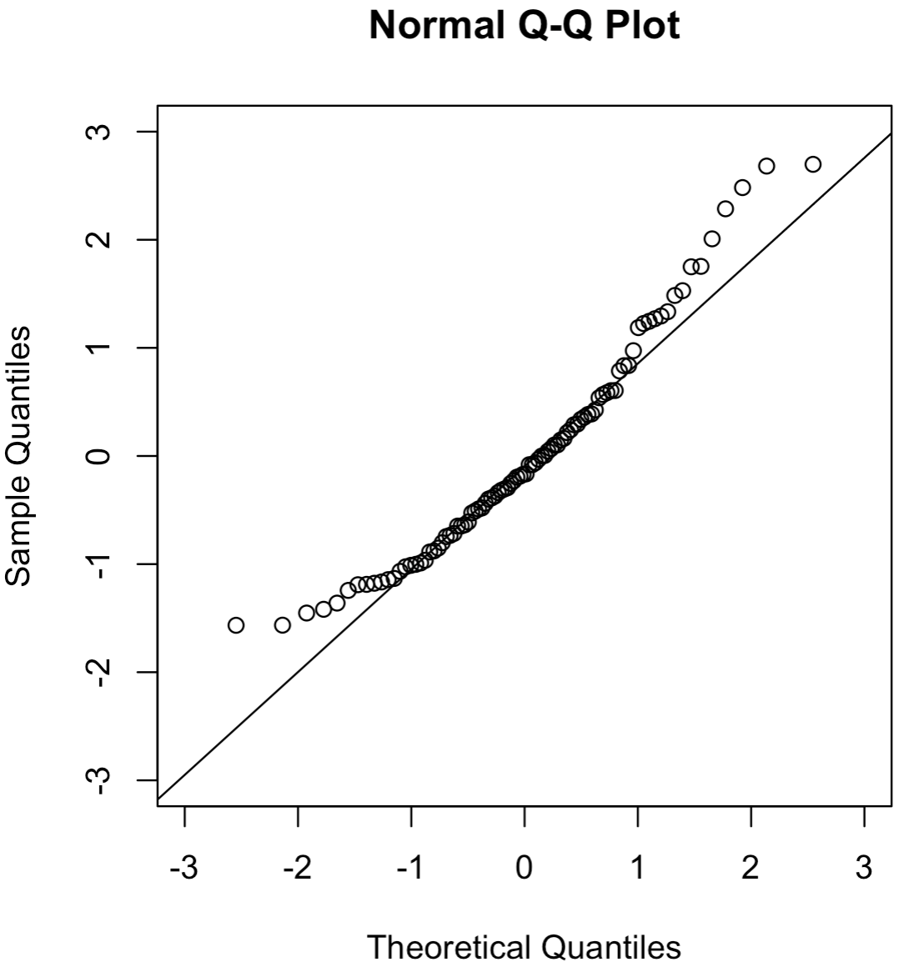
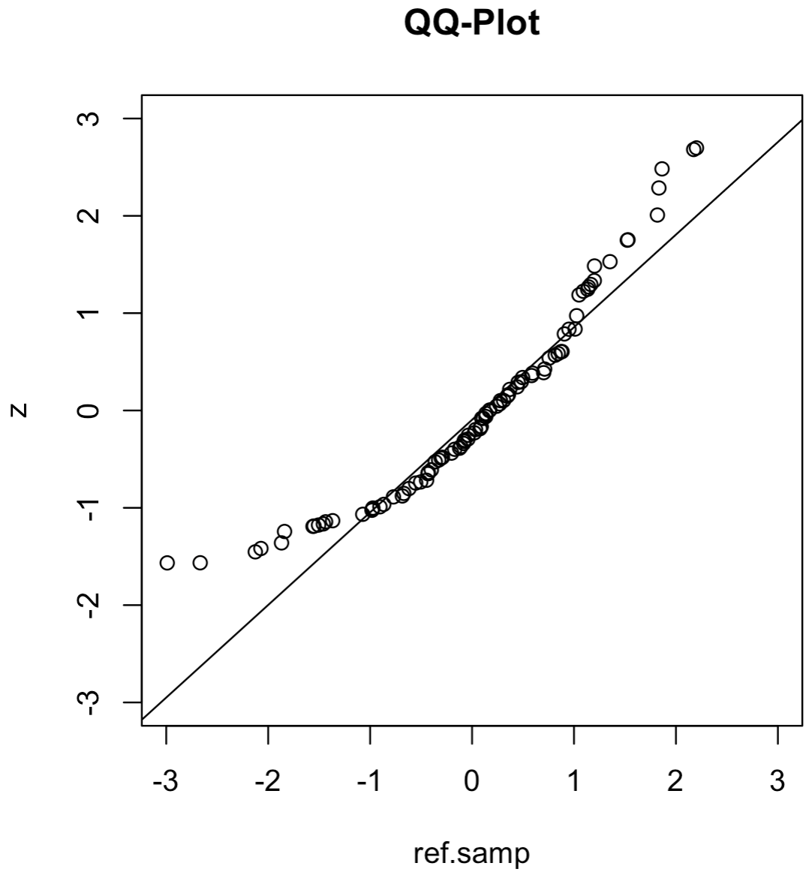
library(frequtils)
data(gas)
x <- gas$C4.alkylbenzene.unid.5
hist(x)
# Standardize the data
z <- (x-mean(x))/sd(x)
# QQ-plot wrt/ standard normal distribution:
qqnorm(z, xlim=c(-3,3), ylim=c(-3,3))
qqline(z)
# A more general way to make a QQ-plot:
ref.samp <- rnorm(length(x), mean = 0, sd = 1)
qqplot(ref.samp, z, main="QQ-Plot", xlim=c(-3,3), ylim=c(-3,3))
qqline(z, distribution = function(p){qnorm(p, mean = 0, sd = 1)})
qqplot_ex.R

