Slide 1

Interval Estimation
Credit: It’s a Wonderful Life

Slide 2
Interval Estimation
We are interested in methods that produce an interval:
Given the assumptions of the methods are satisfied, the interval covers the true value of the parameter with (approximate) probability at least 1 – α.
Common interval methods for:
Confidence intervals
Prediction intervals
Tolerance intervals
Probability/Credibility intervals (Bayesian)

Slide 3
Confidence Intervals
Say we are interested in a range of plausible values for a parameter θ
Consider experiments that will collect a samples of data and give us estimate for and :
BEFORE we collect the data, we can devise procedure such that:
level of significance
Estimates we will get from the sample we have yet to collect
level of confidence

Slide 4
Confidence Intervals
AFTER we collect the data, the outcomes of the experiments are:
Under the frequentist definition, probabilities (other than 0 or 1) only exist for outcomes of experiments that haven’t happened yet.
Take a sample.
Compute a CI.
Graphical representation of
90% CIs is for a parameter:
Here 90% of the CIs contain the true value of the parameter
…we just don’t know which!
true value
of parameter θ

Slide 5
Confidence Intervals
Construction of a CI for a mean depends on:
Sample size n
Standard error for the mean
Level of confidence 1-α
α is significance level
Use α to compute t_{c}-value
Two-sided (1-α)×100% CI for population mean using a sample average and standard error is:

Slide 6
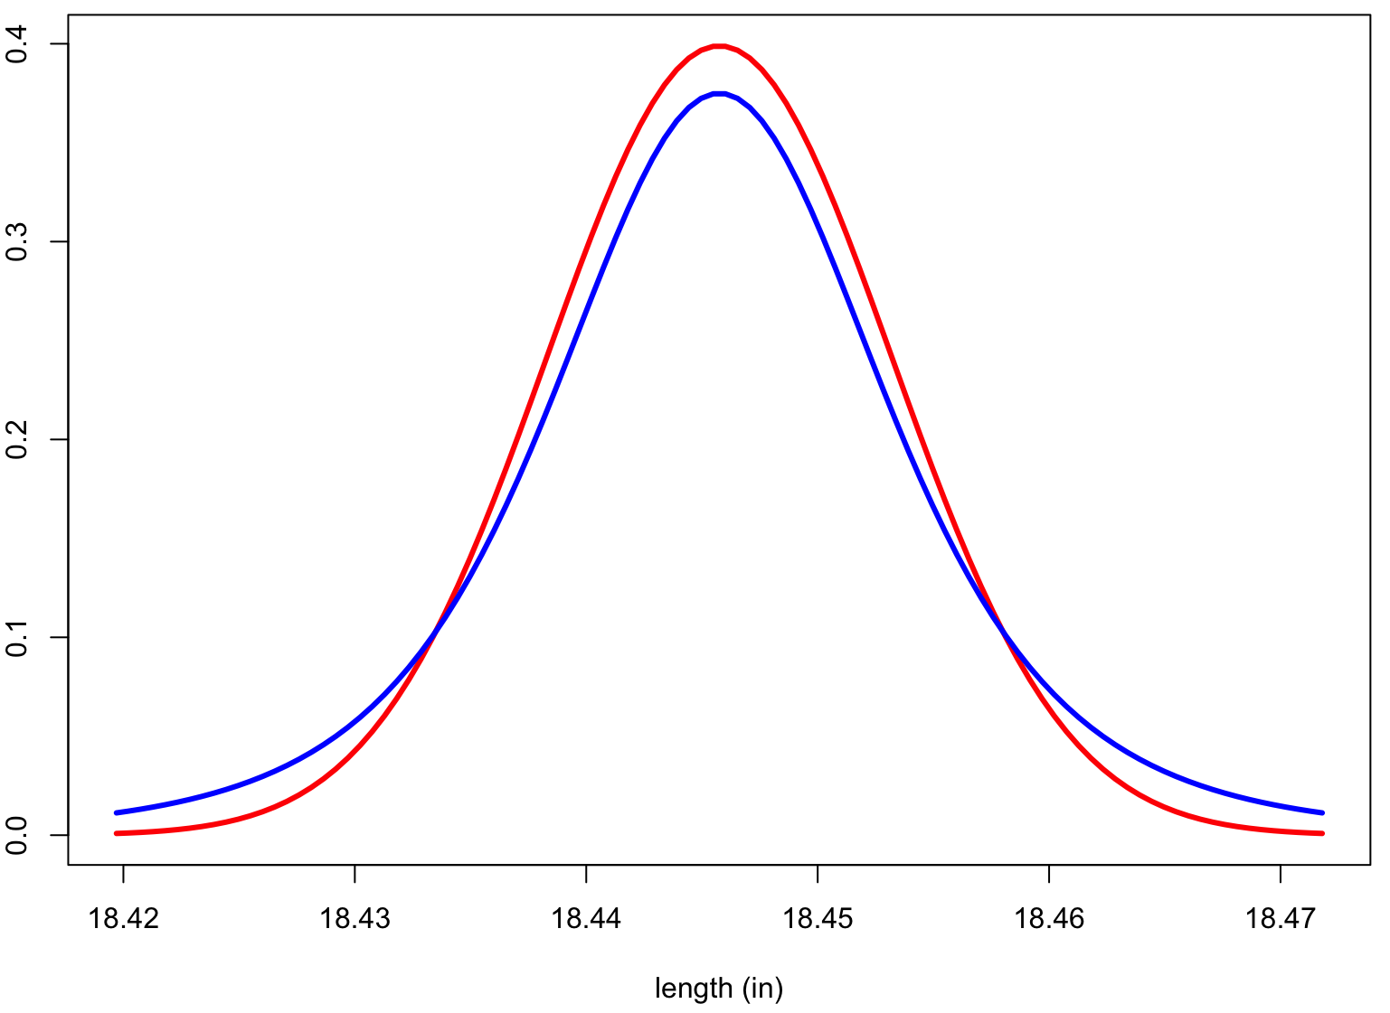
Intuition: Student-t and t_{c}
Mean’s (barrel length) approximate sampling distribution
Normal distribution
Student-t distribution
Fatter in the tails

Slide 7
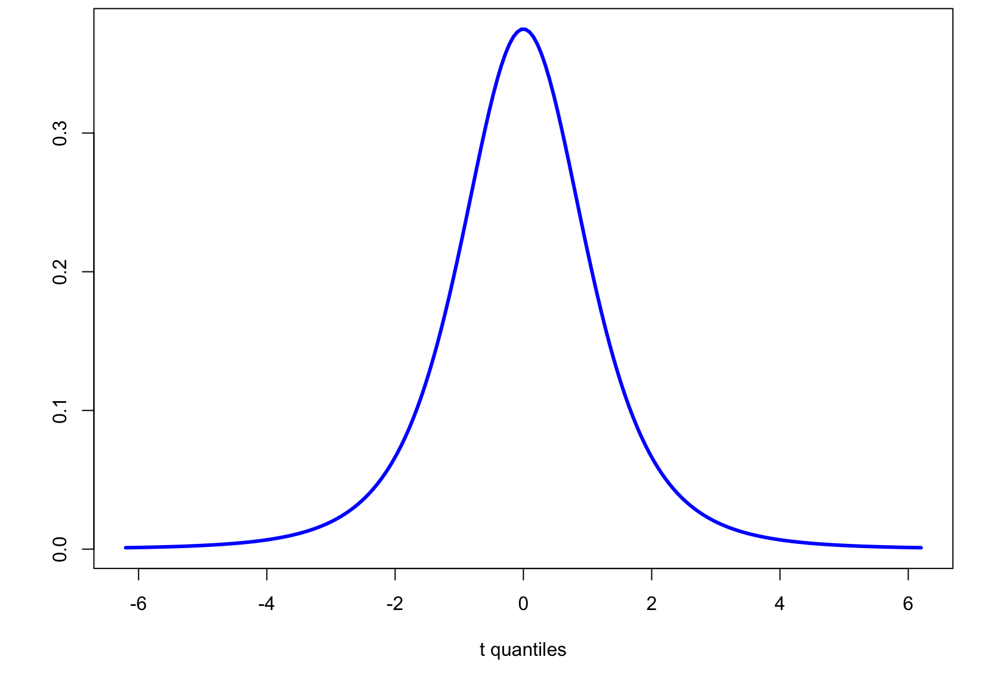
Intuition: Student-t and t_{c}
Student-t PDF, d.f. = 3
Area =
0.99
Area =
0.95
-5.84
5.84
-3.18
3.18
t_{c} = 3.18 for (two-sided) 95% confidence
t_{c} = 5.84 for (two-sided) 99% confidence

Slide 8
Example: Confidence Intervals
Compute a 99% two sided confidence interval for the the RI of a glass shard using this sample set:
Fragment # | Fragment nD
1 | 1.52005
2 | 1.52003
3 | 1.52001
4 | 1.52004
5 | 1.52000
6 | 1.52001
7 | 1.52008
8 | 1.52011
9 | 1.52008
10 | 1.52008
11 | 1.52008
?

Slide 9
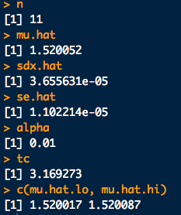
Example: Confidence Intervals
# Data
x <- c(1.52005,1.52003,1.52001,1.52004,1.52000,1.52001,1.52008,1.52011,1.52008,
1.52008,1.52008)
n <- length(x)
# Estimate of mean:
mu.hat <- mean(x)
# Standard deviation
sdx.hat <- sd(x)
# Standard error
se.hat <- sd(x)/sqrt(n)
# Compute tc for given sample size and chosen confidence level
conf <- 0.99
alpha <- 1-conf
tc <- qt(1 - alpha/2, df = n-1)
# Put the CI together:
mu.hat.lo <- mu.hat - tc*se.hat
mu.hat.hi <- mu.hat + tc*se.hat
c(mu.hat.lo, mu.hat.hi)
ci_twosided_ex.R

Slide 10
Example: Confidence Intervals
Compute a 99% two sided confidence interval for the the RI of a glass shard using this sample set:
Fragment # | Fragment nD
1 | 1.52005
2 | 1.52003
3 | 1.52001
4 | 1.52004
5 | 1.52000
6 | 1.52001
7 | 1.52008
8 | 1.52011
9 | 1.52008
10 | 1.52008
11 | 1.52008
Putting this together:
[1.520052 - (3.17)(0.00001), 1.520052 + (3.17)(0.00001)]
99% CI for sample = [1.52002, 1.52009]

Slide 11
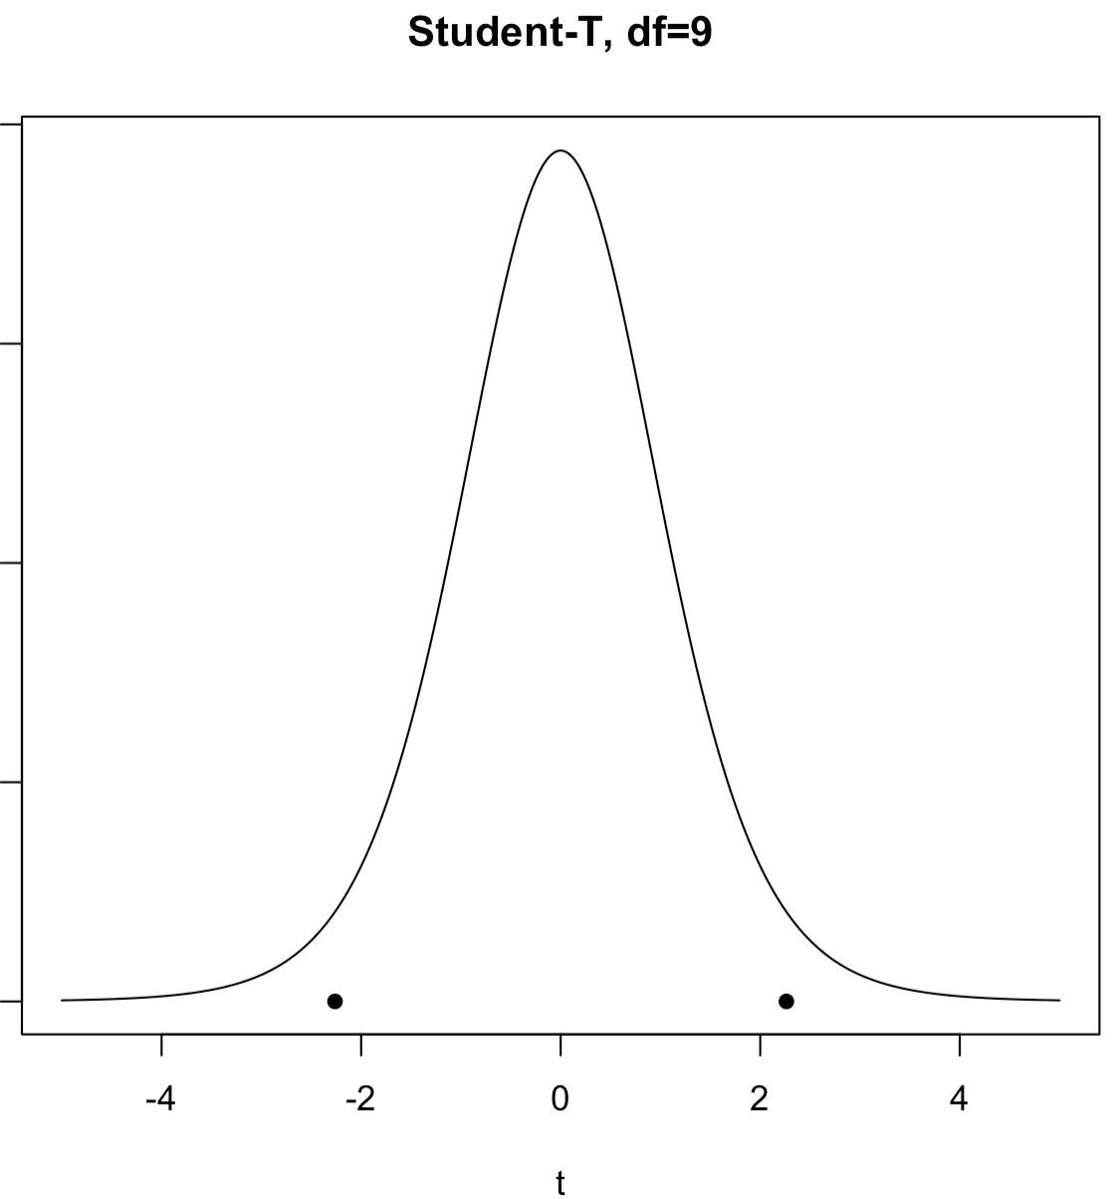
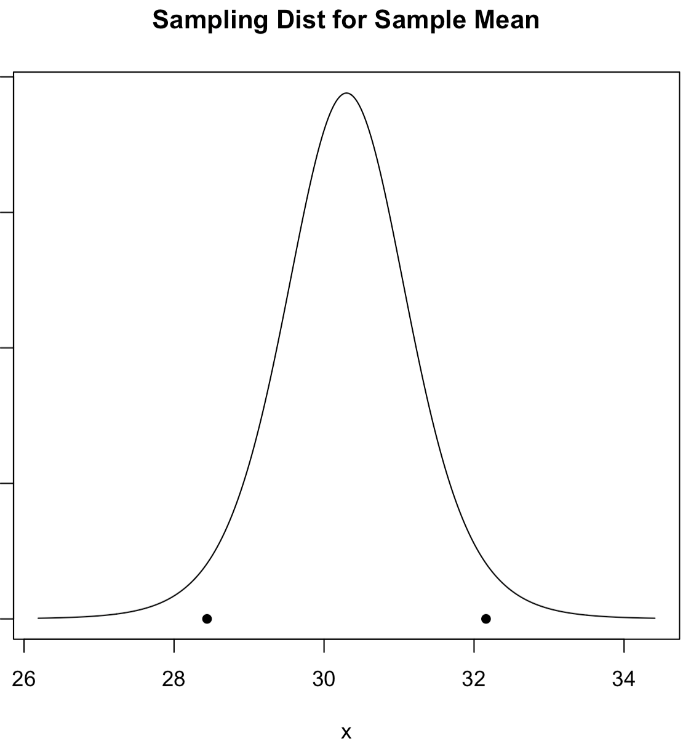
Two vs. One-Sided Intervals
(say 0.95)
(say 0.95)
Two-Sided CI:

Slide 12
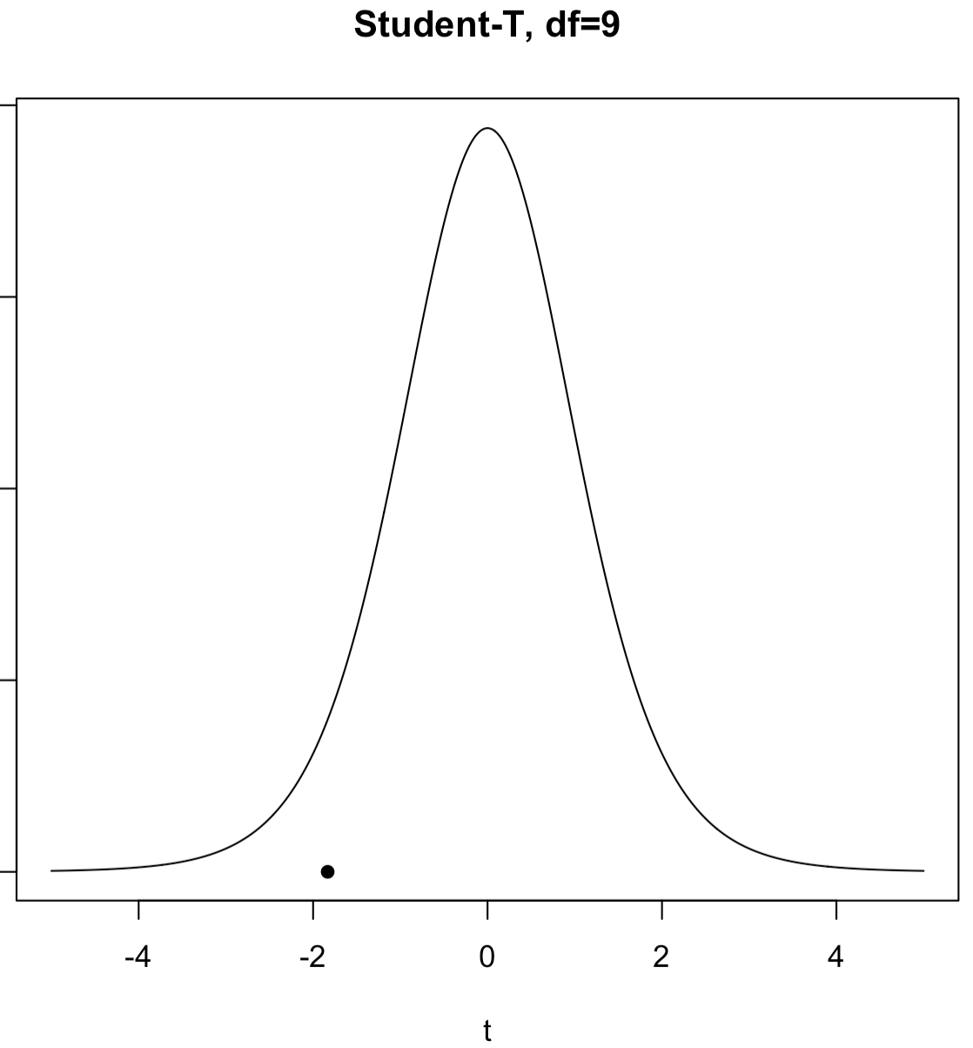

Two vs. One-Sided Intervals
(say 0.95)
(say 0.95)
One-Sided Lower CI:

Slide 13
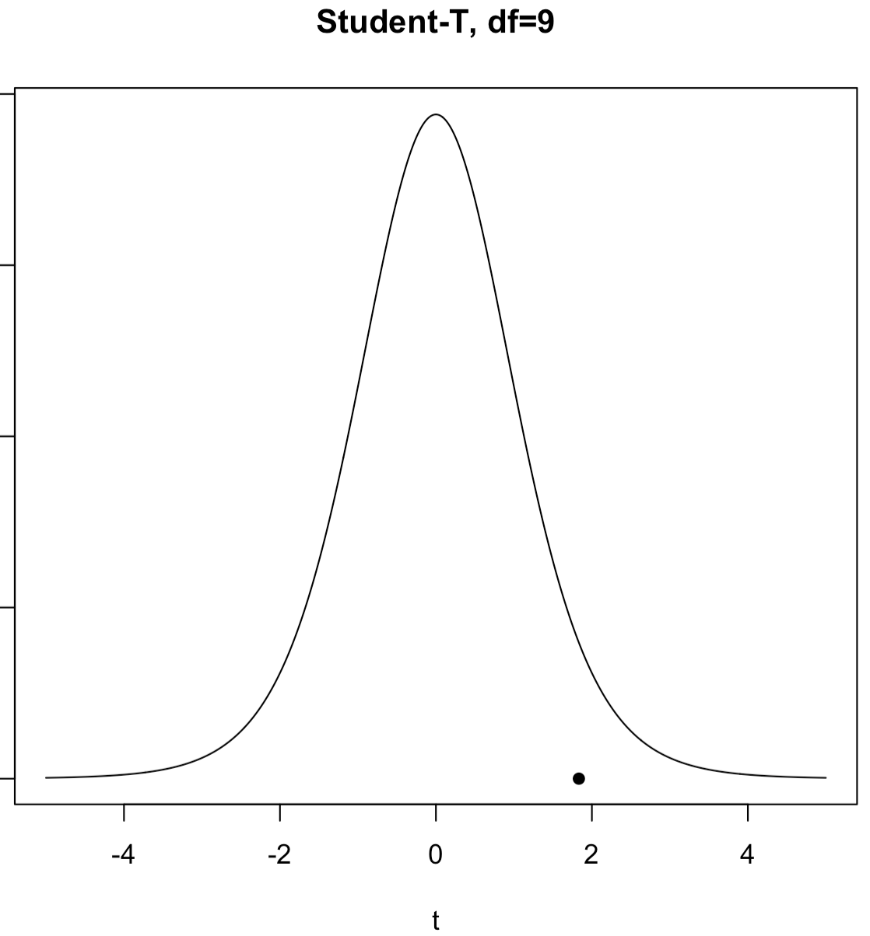

Two vs. One-Sided Intervals
(say 0.95)
(say 0.95)
One-Sided Upper CI:

Slide 14
Another Exercise
A suspect, one Mr. B. Mayhew is captured by law enforcement officials in possession of many mini-Ziploc baggies containing what is determined to be very pure, dry methamphetamine. The forensic lab’s analytical balances are reliable to 4-decimal places. The baggies are emptied and collected into one mass of crystals. 10 mass measurements are taken (units g):
49.9996, 49.9994, 49.9993, 49.9996, 49.9995, 49.9995, 49.9995, 49.9994, 49.9995, 49.9994
Compute the one-sided 95% CI for the lower bound on the mean mass
Compute the one-sided 95% CI for the upper bound on the mean mass
Sketch pictures of where these CIs would appear on the approximate sampling distribution for the meth’s mass

Slide 15
# Data for some of Mr. Mayhew's seizure:
x <- c(49.9996,49.9994,49.9993,49.9996,49.9995,
49.9995,49.9995,49.9994,49.9995,49.9994)
n <- length(x)
# a. **One-sided lower bound. The assumed "upper limit" is Infinity
# Estimate of the mean:
mu.hat <- mean(x)
# Standard deviation of the data:
sdx.hat <- sd(x)
# Standard error of the mean estimate:
se.hat <- sd(x)/sqrt(n)
# Compute tc for given sample size and chosen confidence level:
conf <- 0.95
alpha <- 1-conf
tc <- qt(1 - alpha, df = n-1) # **This is the big change.
# Now we don't split the alpha between the tails.
# For the lower bound we put all the alpha on
# the lower tail. Therefore -tc!
# Put the One-sided lower bound CI together:
mu.hat.lo <- mu.hat - tc*se.hat
c(mu.hat.lo, Inf)
# b. **One-sided upper bound. The assumed "lower limit" is -Infinity
# Everything is the same except now we put all the alpha in the upper tail.
mu.hat.hi <- mu.hat + tc*se.hat
c(-Inf, mu.hat.hi)
ci_onesided_ex.R

Slide 16
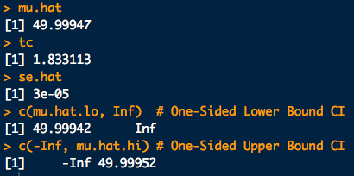
Another Exercise

Slide 17
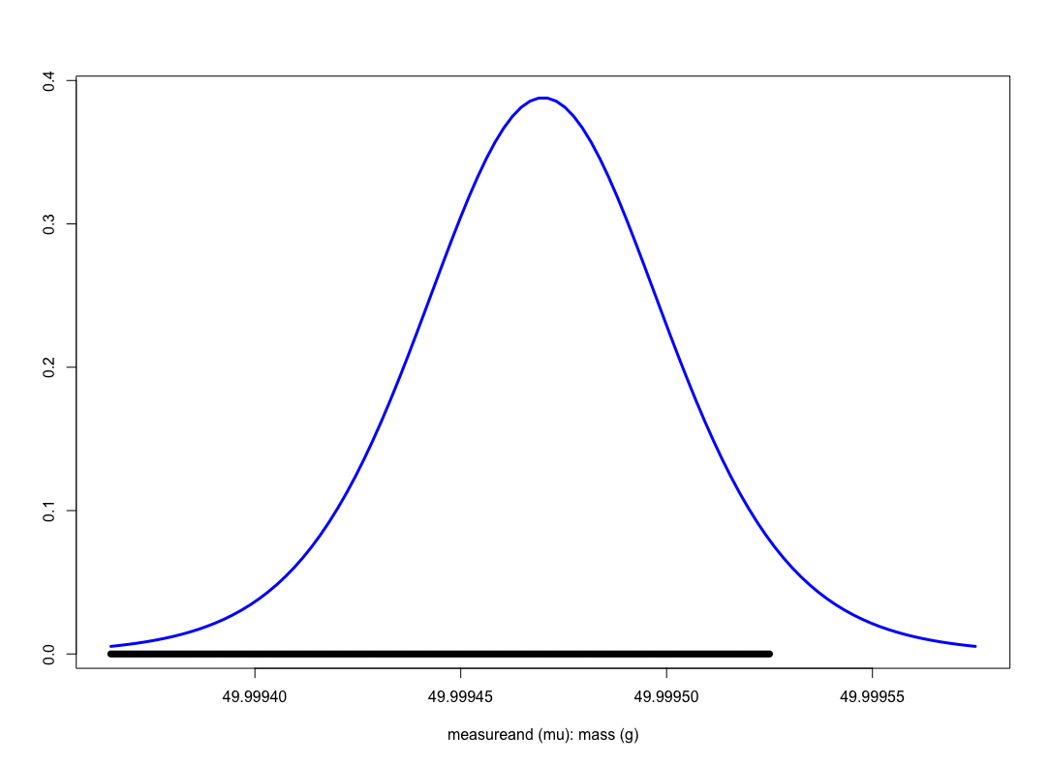
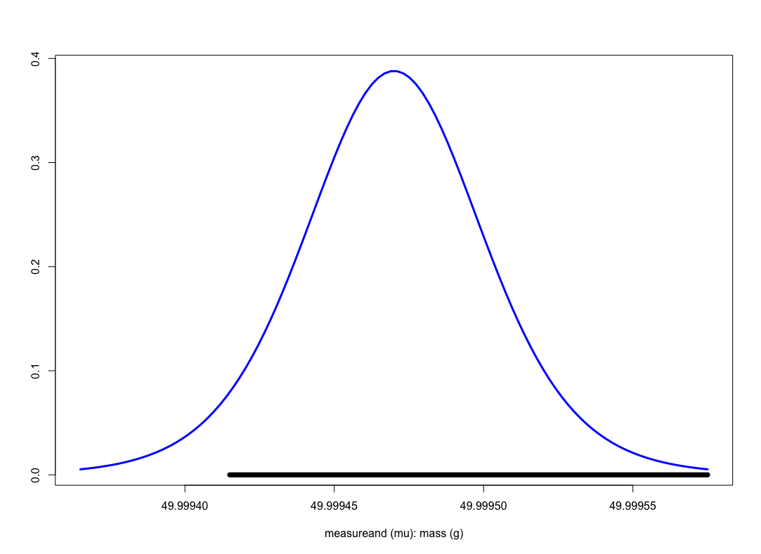
Another Exercise
One sided, upper bound
One sided, lower bound

Slide 18
Bootstrap Confidence Intervals
So how do we compute a (1 − α)×100% confidence interval given a set of data??
For any parameter, you can try to obtain bootstrap based CIs
For a sample of size n:
Obtain a bootstrap sampling distribution for θ : boot.reps
Find the (1 − α)×100% empirical percentiles:
quantile(boot.reps, probs=c(a/2, 1-a/2))
Two sided
quantile(boot.reps, probs=c(a))
One sided, lower bound
quantile(boot.reps, probs=c(1-a))
One sided, upper bound

Slide 19
Example: Bootstrap Confidence Intervals
Consider again the case of Mr. B. Mayhew with seizure mass measurements of:
49.9996, 49.9994, 49.9993, 49.9996, 49.9995, 49.9995, 49.9995, 49.9994, 49.9995, 49.9994
Compute the mean mass estimate via the bootstrap.
What is your bootstrap standard error estimate for the estimated mean?
Compute the two-sided 99% CI for the mean mass via the non-parametric bootstrap.
Compute the one-sided lower bound 99% CI for the mean mass via the non-parametric bootstrap.
Compute the one-sided upper bound 99% CI for the mean mass via the non-parametric bootstrap.

Slide 20
Example: Bootstrap Confidence Intervals
# The data:
x <- c(49.9996,49.9994,49.9993,49.9996,49.9995,49.9995,49.9995,49.9994,49.9995,49.9994)
n <- length(x) # Sample size
# Approximate sampling distribution of the mean via the bootstrap:
B <- 2000
boot.samp <- sapply(1:B, function(xx){mean(sample(x, size = n, replace = T))})
hist(boot.samp)
# a. Boostrap estimate of the mean:
mean(boot.samp)
# b. Bootstrap estimate of the standard error of the mean
sd(boot.samp)
# c. Two-sided 99% CI for the mean mass via the bootstrap:
conf <- 0.99
a <- 1 - conf
quantile(boot.samp, probs=c(a/2, 1-a/2))
# One-sided lower bound 99% CI for the mean mass via the bootstrap.
conf <- 0.99
a <- 1 - conf
quantile(boot.samp, probs=c(a))
# One-sided lower bound 99% CI for the mean mass via the bootstrap.
conf <- 0.99
a <- 1 - conf
quantile(boot.samp, probs=c(1 - a))
ci_bootstrap_ex.R

Slide 21
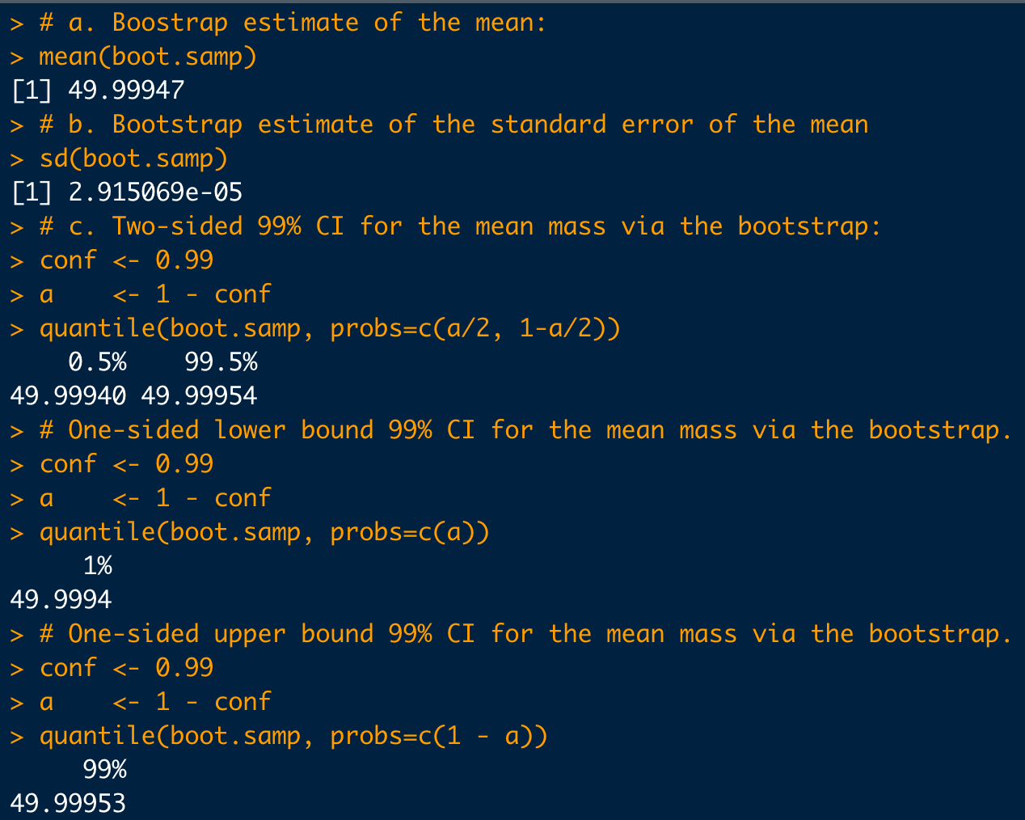
Example: Bootstrap Confidence Intervals

Slide 22
Bayesian Probability Intervals
Now let’s go through the basics of “Bayesian” analysis of the measurement process. In a nutshell:
Prior Knowledge × Data =
Updated Knowledge
Prior × Data = Posterior
If you have the posterior pdf you can get anything else you need

Slide 23
Bayesian Probability Intervals
This analysis can get complicated quick!
Again, in forensic science we are mostly interested in the parameters mean: μ and the standard deviation σ_{X}, of the data
A fairly general Bayesian version of the (very relevant) problem for μ can be worked out with pencil-and-paper
Note: most Bayesian analysis cannot be done without a computer
We need two new symbols, but we’ve used them before
is the sample average (was previous to this in frequentist analysis)
s is the sample standard deviation (was previous to this in frequentist analysis)

Slide 24
Bayesian Probability Intervals
Likelihood (data model):
Prior belief about the mean:
Prior belief about the variance:

Slide 25
Bayesian Probability Intervals
Putting these ingredients into Bayes’ theorem we get the updated (posterior) beliefs about μ, informed by the data:
posterior mean
Exactly the same result as in frequentist analysis.
We just interpret probability differently, i.e. as “belief”

Slide 26
Bayesian Probability Intervals
A Bayesian probability interval (PI) for a mean:
(1-α)×100% PI
Construction depends on:
Sample size n
Sample standard deviation s
Sample average
Level of “credibility” (i.e. belief or probability) 1-α
α is still significance level
Use α to compute t_{c}-value
Bayeisan PI’s are also called Credibility Intervals

Slide 27
Revisit Example: Credibility (Probability) Intervals
Compute a 99% two sided PI for the the RI of a glass shard using this sample set:
Fragment # | Fragment nD
1 | 1.52005
2 | 1.52003
3 | 1.52001
4 | 1.52004
5 | 1.52000
6 | 1.52001
7 | 1.52008
8 | 1.52011
9 | 1.52008
10 | 1.52008
11 | 1.52008
Putting this together:
[1.520052 - (3.17)(0.00001), 1.520052 + (3.17)(0.00001)]
Given the data and our prior assumptions we believe with
99% probability that the measurand (RI) is [1.52002, 1.52009]

Slide 28
Other types of intervals

Slide 29
Prediction Intervals
What if we’re not interested in a range of plausible parameter values for a distribution, but a range actual future measurements?
Prediction Interval: Intervals produced by a method which takes a sample of n measurements and covers the n^{th} + 1 measurement (1 − α)×100% of the time:
Note: prediction is with respect to data and NOT parameters

Slide 30
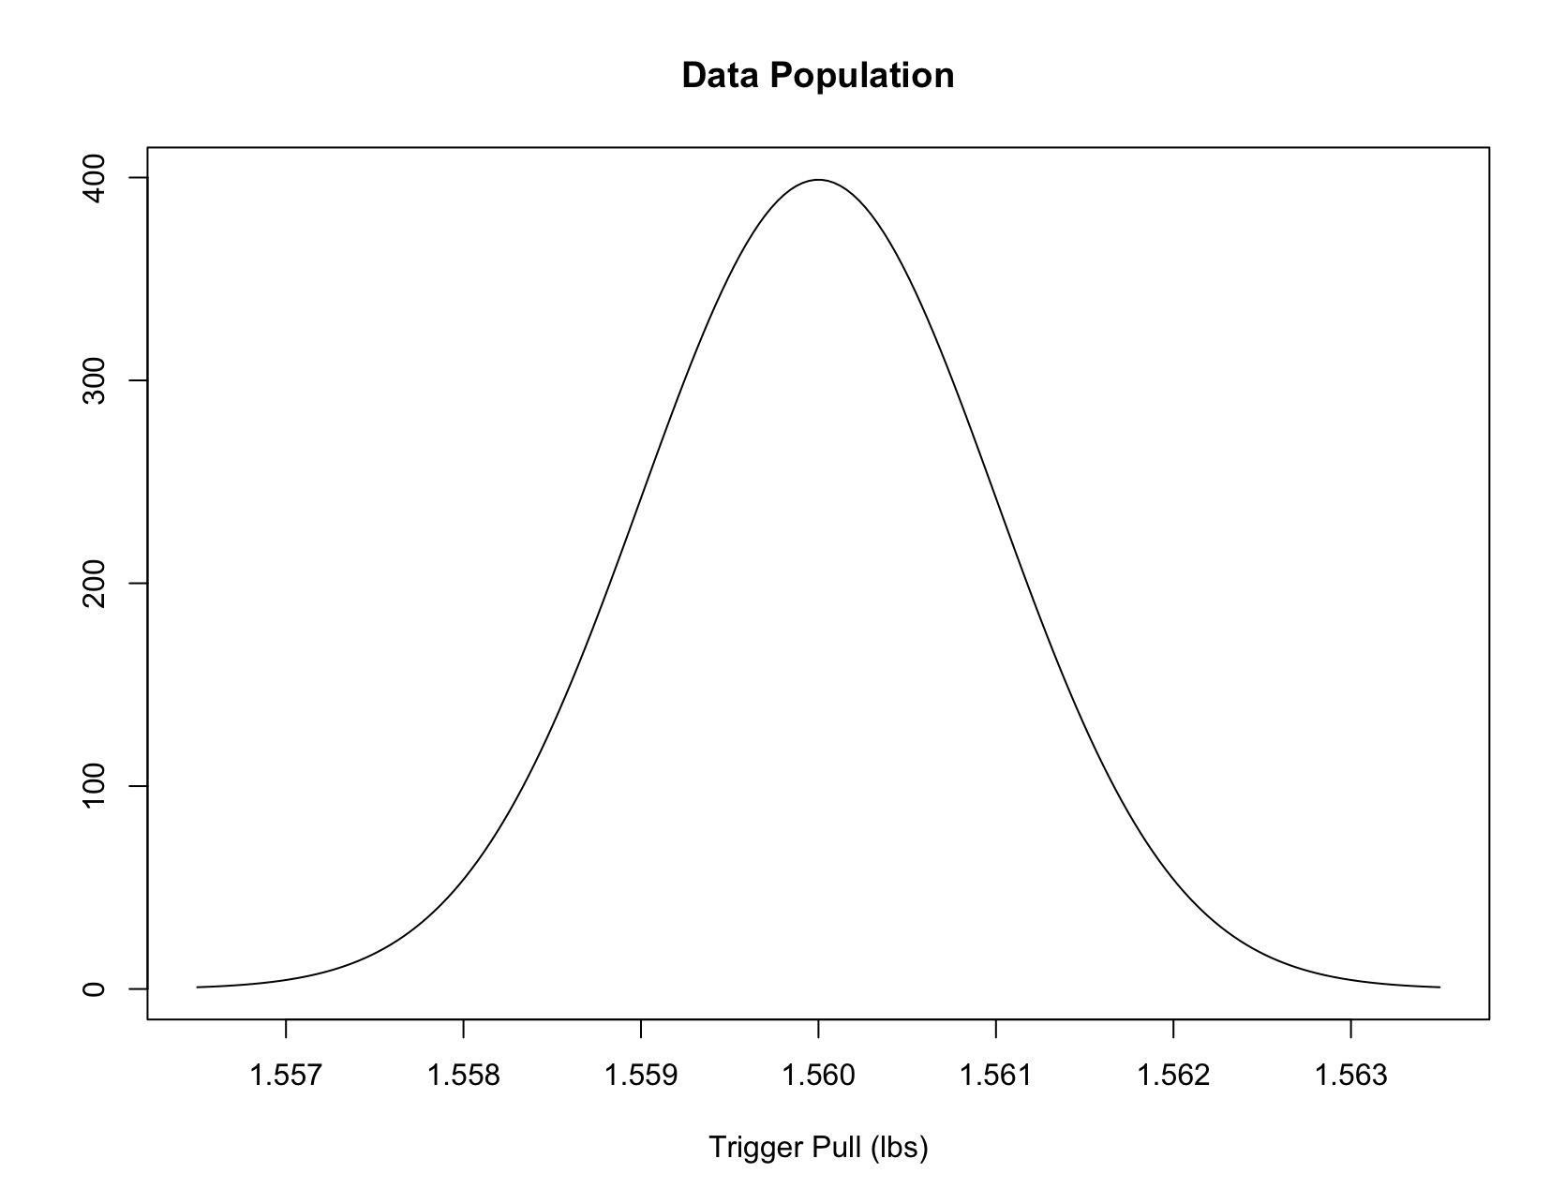
Prediction Intervals
Meaning of a 90% (frequentist) Prediction Interval:
Measure n pulls:
Hit
Measure n pulls:
Hit
Measure n pulls:
Hit
Measure n pulls:
Hit
Measure n pulls:
Hit
Measure n pulls:
Hit
Measure n pulls:
Miss
Measure n pulls:
Hit
Measure n pulls:
Hit
Dots are for the n+1th measurement.
Measure n pulls:
Hit
90% of these things will cover the n+1th measurement (“Hit”) in the long run

Slide 31
Tolerance Intervals
Tolerance Interval (frequentist): Intervals produced by a method which takes a sample of n measurements and produces an interval that covers p×100% of the population of possible measurements (1 − α)×100% of the time:
population PDF for the data
Note again: interval is with respect to data and NOT parameters

Slide 32
Tolerance Intervals
Meaning of a p=85%, at 90% confidence (frequentist) Tolerance Interval:
p=92.1%
Measure n pulls:
Covers ≥ 85%
Measure n pulls:
p=89.4%
Covers ≥ 85%
Measure n pulls:
p=87.6%
Covers ≥ 85%
Measure n pulls:
p=97.2%
Covers ≥ 85%
Measure n pulls:
p=89.8%
Covers ≥ 85%
p=93.6%
Covers ≥ 85%
Measure n pulls:
Measure n pulls:
p=83.7%
Covers < 85%
p=95.4%
Measure n pulls:
Covers ≥ 85%
Measure n pulls:
p=95.5%
Covers ≥ 85%
Measure n pulls:
p=96.7%
Covers ≥ 85%
90% of these things will cover at least 85% of the measurement population in the long run

Slide 33
Tolerance Intervals
If the data follows a normal distribution:
Given a random sample of measurement data, x, then with confidence (1 − α), the proportion of possible measurements, p, are*:
Between x_{lo} and x_{hi} (two-sided):
normtol.int(x, alpha = alpha, P = p, side = 2)
No larger than x_{hi} (one-sided upper):
At least as large as x_{lo} (one-sided lower):
normtol.int(x, alpha = alpha, P = p, side = 1)
*We’ll use the tolerance package

Slide 34
Example
A laboratory is conducting a QC assessment of its blood alcohol content (BAC) assay. In order to determine if it’s procedure is “in conformance” and a sample of CRM blood is assayed for its alcohol content (BAC, 0.08% ± 0.001%). The following BAC values are determined from six trials:
0.081%, 0.078%, 0.079%, 0.076%, 0.082%, 0.077%
Assuming the the BAC data follows a normal distribution, compute the two-sided tolerance interval which could cover 83% or more of the population of measurements with 95% confidence.
How does this interval compare to the 95% two-sided confidence interval for the mean?
Under the same assumptions, compute the one-sided, c=99%/p=90%, lower tolerance limit. Why is this more interesting from a practical perspective?

Slide 35
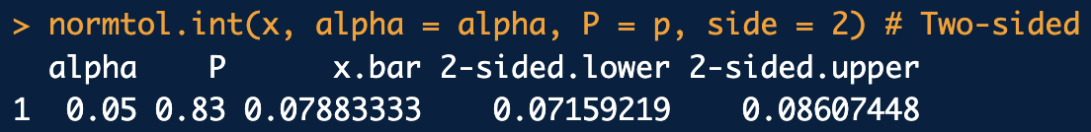

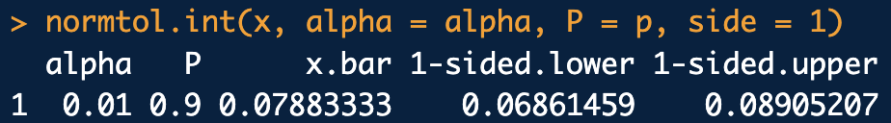
Example
library(tolerance)
# BAC QC data
x <- c(0.081, 0.078, 0.079, 0.076, 0.082, 0.077)
# a. Two-sided tolerance interval:
conf <- 0.95
p <- 0.83
alpha <- 1-conf
normtol.int(x, alpha = alpha, P = p, side = 2)
# b. Two-sided confidence interval for mean:
t.test(x, alternative = "two.sided", mu = 0.08, conf.level = conf)
# c. One-sided lower limit tolerance:
conf <- 0.99
p <- 0.9
alpha <- 1-conf
normtol.int(x, alpha = alpha, P = p, side = 1)
normtol_ex.R

Slide 36
Bayesian Prediction/Tolerance
This is NOTHING like frequentist tolerance intervals in (purist) Bayesian statistics
But, … we can make an analogy using an entity called the posterior predictive distribution.
Posterior predictive distribution (PPD): Measurement data we could plausibly observe, given “updated” beliefs about parameters in the problem.
PPD like an “inferred” data population distribution:
Prior beliefs about
parameters
(e.g. μ^{prior} and σ^{prior})
Updated beliefs about parameters
(e.g. μ^{posterior} and σ^{posterior})
“Inferred” measurement data population
×
Data
Bayes’ Theorem
Posterior distribution
Posterior predictive distribution

Slide 37
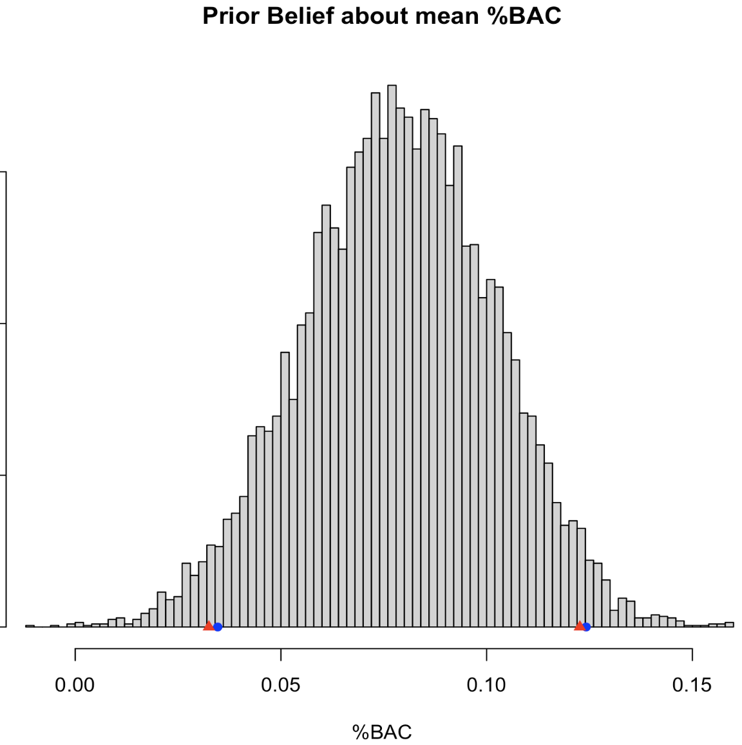
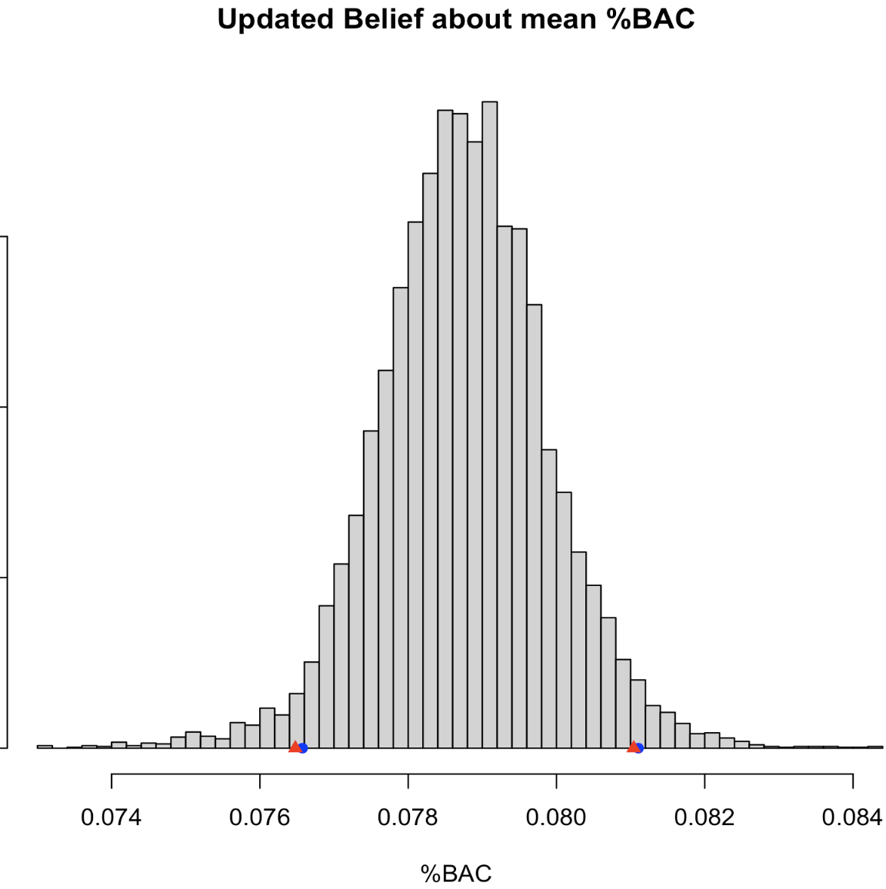
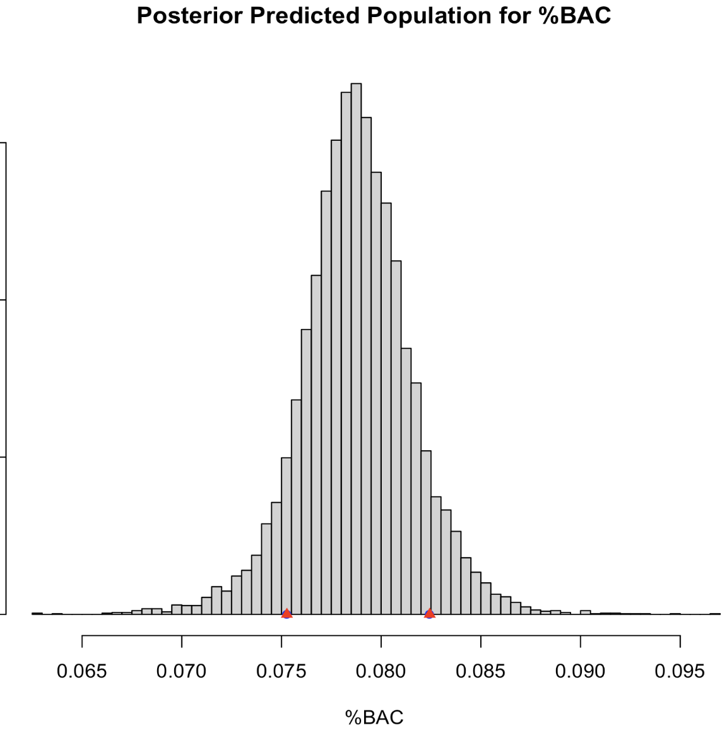

Slide 38
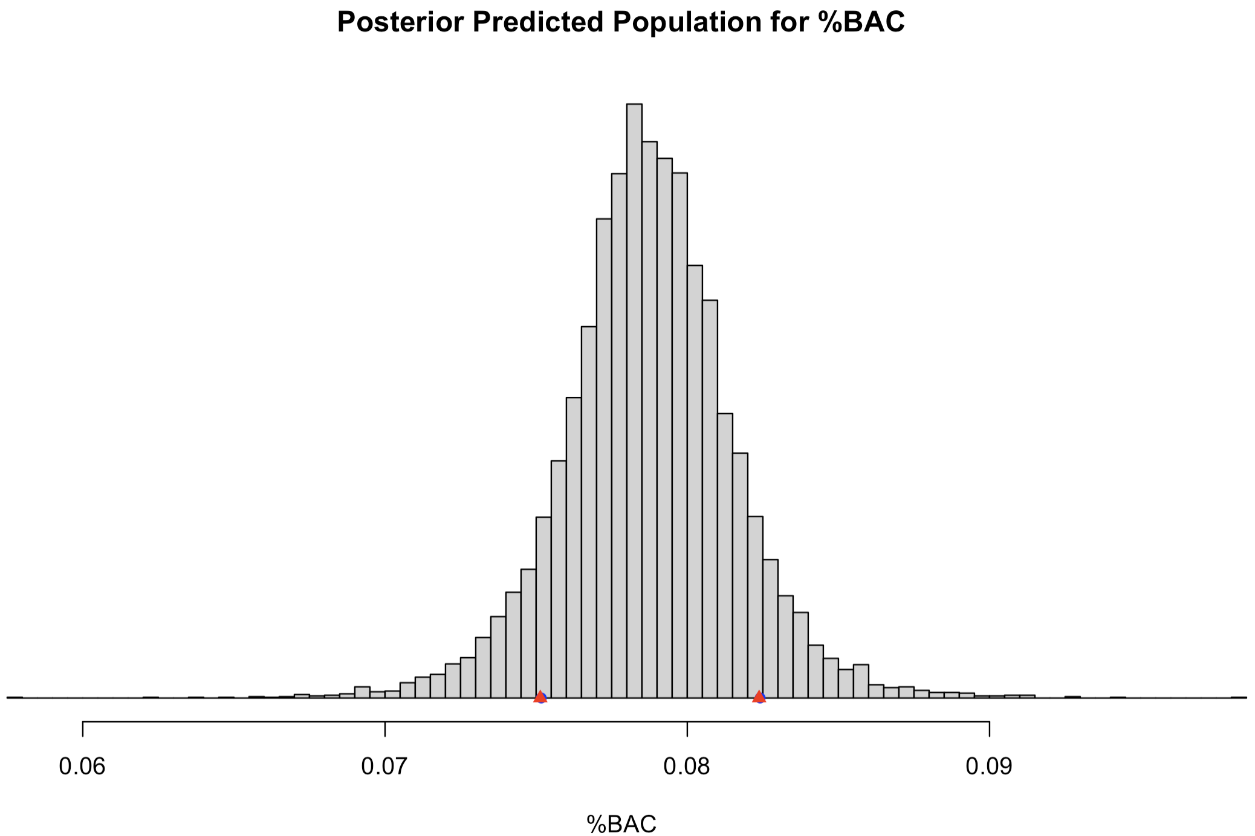
Bayesian Prediction/Tolerance
Example posterior predictive distribution inferred from %BAC data:
For comparison:
We believe the 83% most likely possible measurements we can make will fall between these.

