Slide 1

Introduction
Osborn

Slide 2
“Legal” Science
Daubert is a benchmark!!!:
Daubert (1993)- Judges are the “gatekeepers” of scientific evidence.
Must determine if the science is reliable
Has empirical testing been done?
Falsifiability
Has the science been subject to peer review?
Are there known error rates?
Is there general acceptance?
Frye Standard (1928) essentially
Federal Government and 26(-ish) States are “Daubert States”

Slide 3
Statistics for DNA in a Nutshell
Statistics justify DNA profiling
Probability that unrelated people have the same DNA profile is so remote as to be considered a practical impossibility
Overview of how it works:
Measure the frequency of different alleles at 13 designated loci in a “representative random sample” of a population

Slide 4
Aside: Statistics for DNA in a Nutshell
Nature seems to obey Hardy-Weinberg and linkage equilibria
These Laws of inheritance state that allele frequencies are statistically independent
Multiply frequencies of alleles to get frequencies of genotypes at the chosen 13 loci
Multiply frequencies of 13 genotypes to get frequency of profiles in the population

Slide 5
Aside: A Simple Model
Say there are only two alleles for each locus, A and a
Also say they all he the population frequencies
A = 70%
a = 30%
All genotypes AA
All genotypes aa
Probability of Profile
AA × 2Aa × aa × 2Aa × AA × AA × aa × 2Aa × 2Aa × 2Aa × aa × 2Aa
Genotypes a mix of AA, Aa and aa
All genotypes Aa
Number of Loci

Slide 6
DNA Profiling is a Bad Analogy
for other forms of Physical Evidence!!!
Alleles are like subclass characteristics (R. Nichols)
Subclass characteristics: A subset of characteristics common to some but not all objects of the same class
Not all categories of physical evidence (most?!) have:
Well defined subclass characteristics
Finite number of subclass characteristics
Makes computation of “frequencies” difficult if not impossible

Slide 7
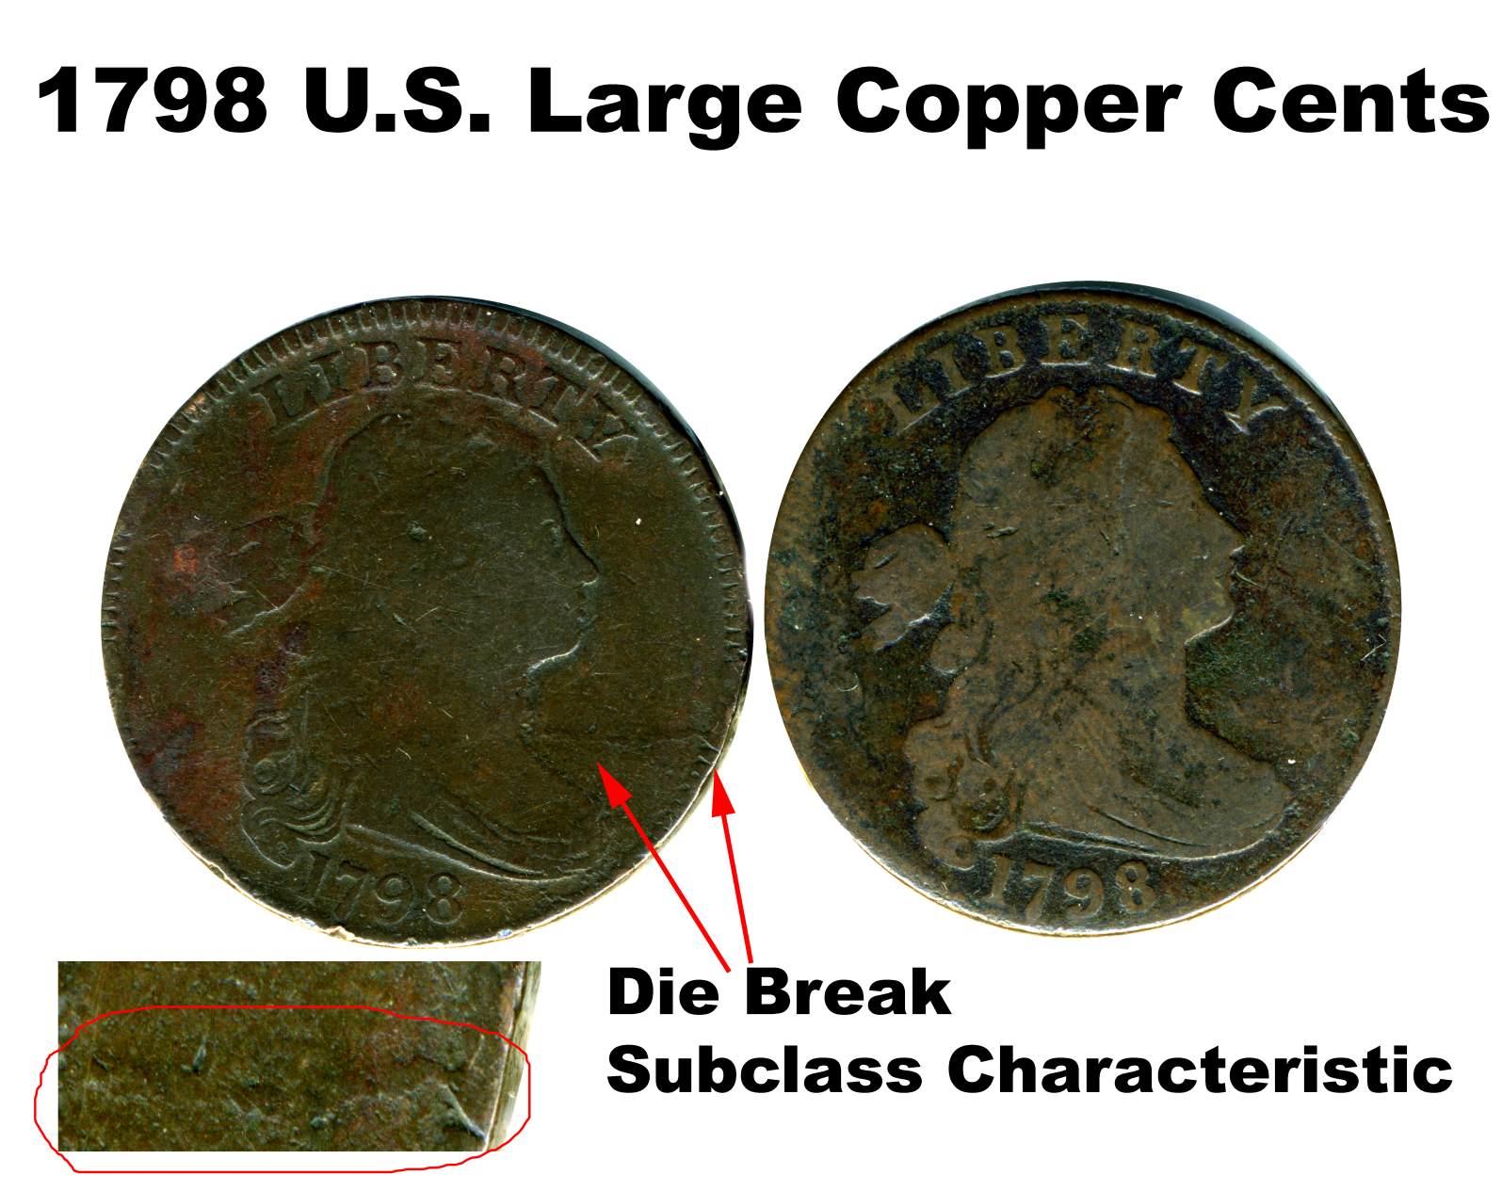
Tool marks, footwear, tires can have subclass characteristics, but they are notoriously difficult to ID

Slide 8
DNA Profiling is a Bad Analogy
for other forms of Physical Evidence!!!
Individual characteristics more common
Difficult to characterize them and measure their frequencies of occurrence!
Features of physical evidence can be mutable over time
Allelic frequencies are assumed not to change!
Statistical independence for the frequencies of the selected physical evidence features may be difficult or impossible to prove.
Combining of individual probabilities into a product “profile” would not be justified.

Slide 9
So What Can We Do?
Practitioners and data/metrology experts work together to quantify their problems
Note: some problems are not quantifiable, but it needs to be clearly articulated why.
The process of data analysis is a craft
Carefully consider the problem and choose appropriate methods.
The are usually many approaches…
Write up analysis as an S.O.P. if it makes sense
Forensic science is messy. Much analysis may remain bespoke to the case and not “S.O.P.-able”
Science by the numbers isn’t always possible, … and boring.

