Slide 1
Outlier Analysis

Slide 2
Outlier Analysis
Outliers are extreme observations that may or may not be legitimate data.
Outliers can be due to:
Just bad data/measurements/technique
The data is good BUT something about the data’s probability distribution has changed
e.g. the mean has changed
The data is good, BUT something about the data’s generating process is different
e.g. outside the linear response region
The data is good, AND something scientifically interesting happened
e.g. rejected the null hypothesis

Slide 3
Outlier Analysis
Judgement of “outlier status” can be handled both qualitatively and quantitatively:
Qualitative assessment is subjective but scientific experience can help identify outliers that fool quantitative methods
Quantitative methods attempt to assess the probability that data belongs to the statistical distribution of the true observations, but they rely on many assumptions

Slide 4

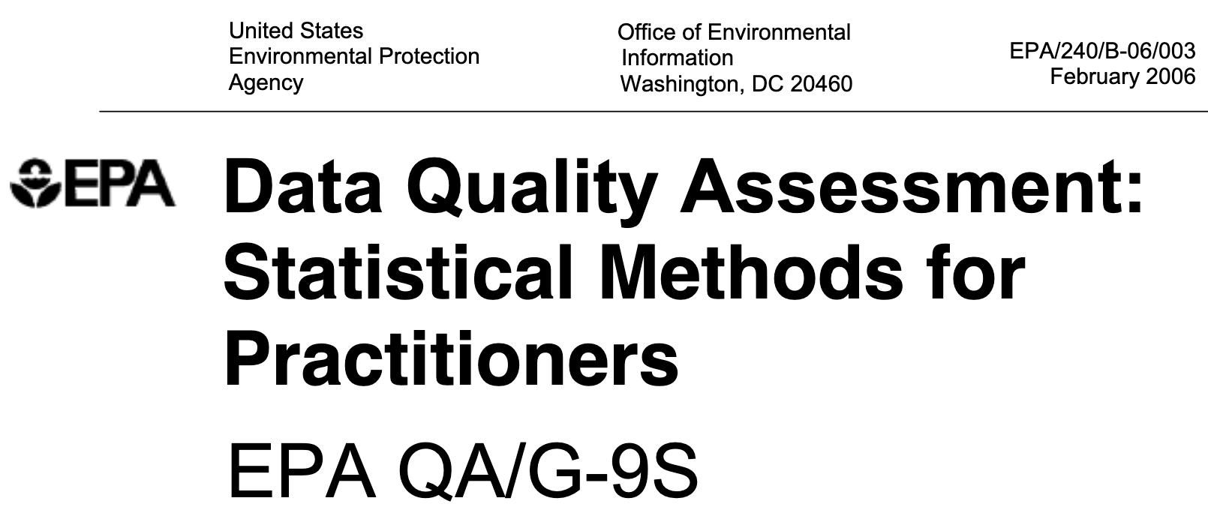
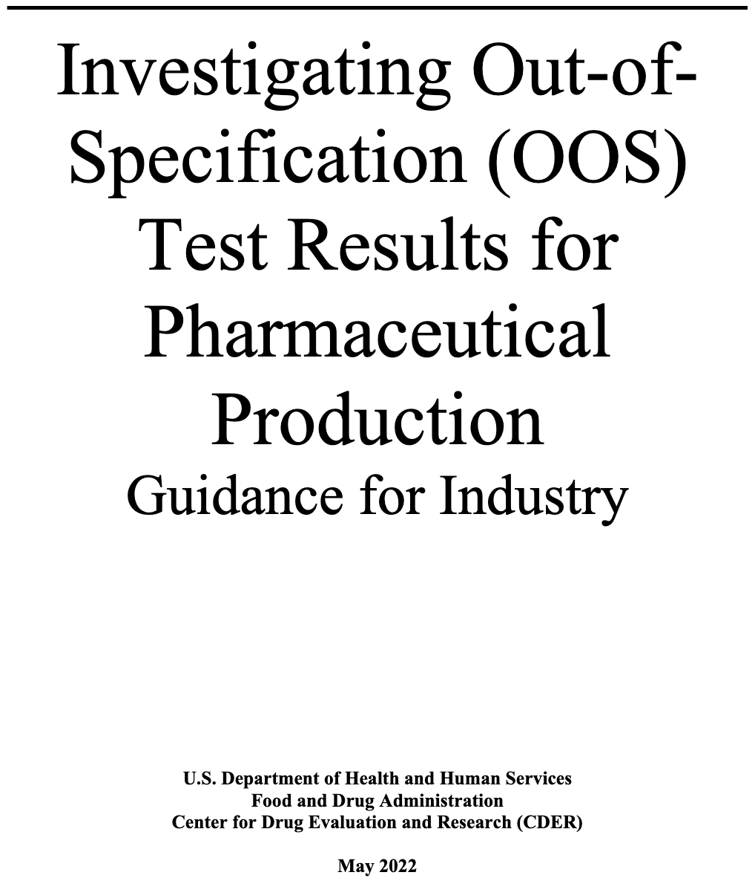
National and International Guidance/Guidelines
NIST Handbook: Detection of Outliers (2012)
EPA: Data Quality Assessment (2006)
FDA: Investigating Out of Specification Test Results (2022)

Slide 5
Standard Dev. and MAD Rules of Thumb
As rules of thumb:
Data past 3 standard deviations from the sample mean can be suspect outliers:
Data past 3 standard deviations from the sample median can be suspect outliers:
Data past 3 mad’s from the sample median can be suspect outliers:

Slide 6
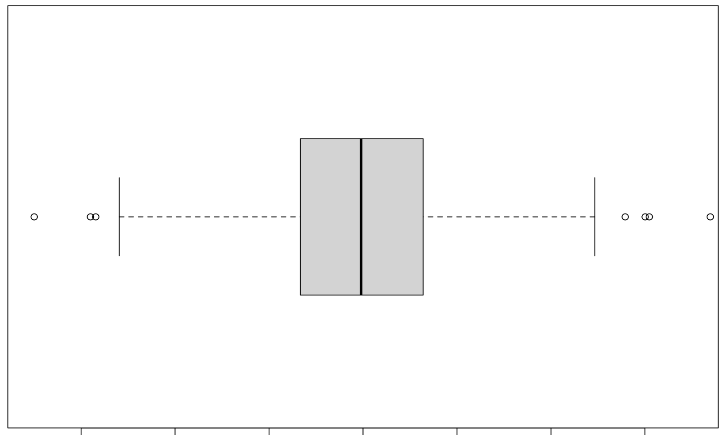
Interquartile Range Outliers
The interquartile range (IQR) is the difference between the 3rd-quartile (75%-tile) and the 1st-quartile (25%-percentile)
IQR = middle 50% of data
1st-quartile (Q1)
3rd-quartile (Q3)
IQR is considered a robust measure of data spread (scale) because it’s not strongly influenced by outliers

Slide 7
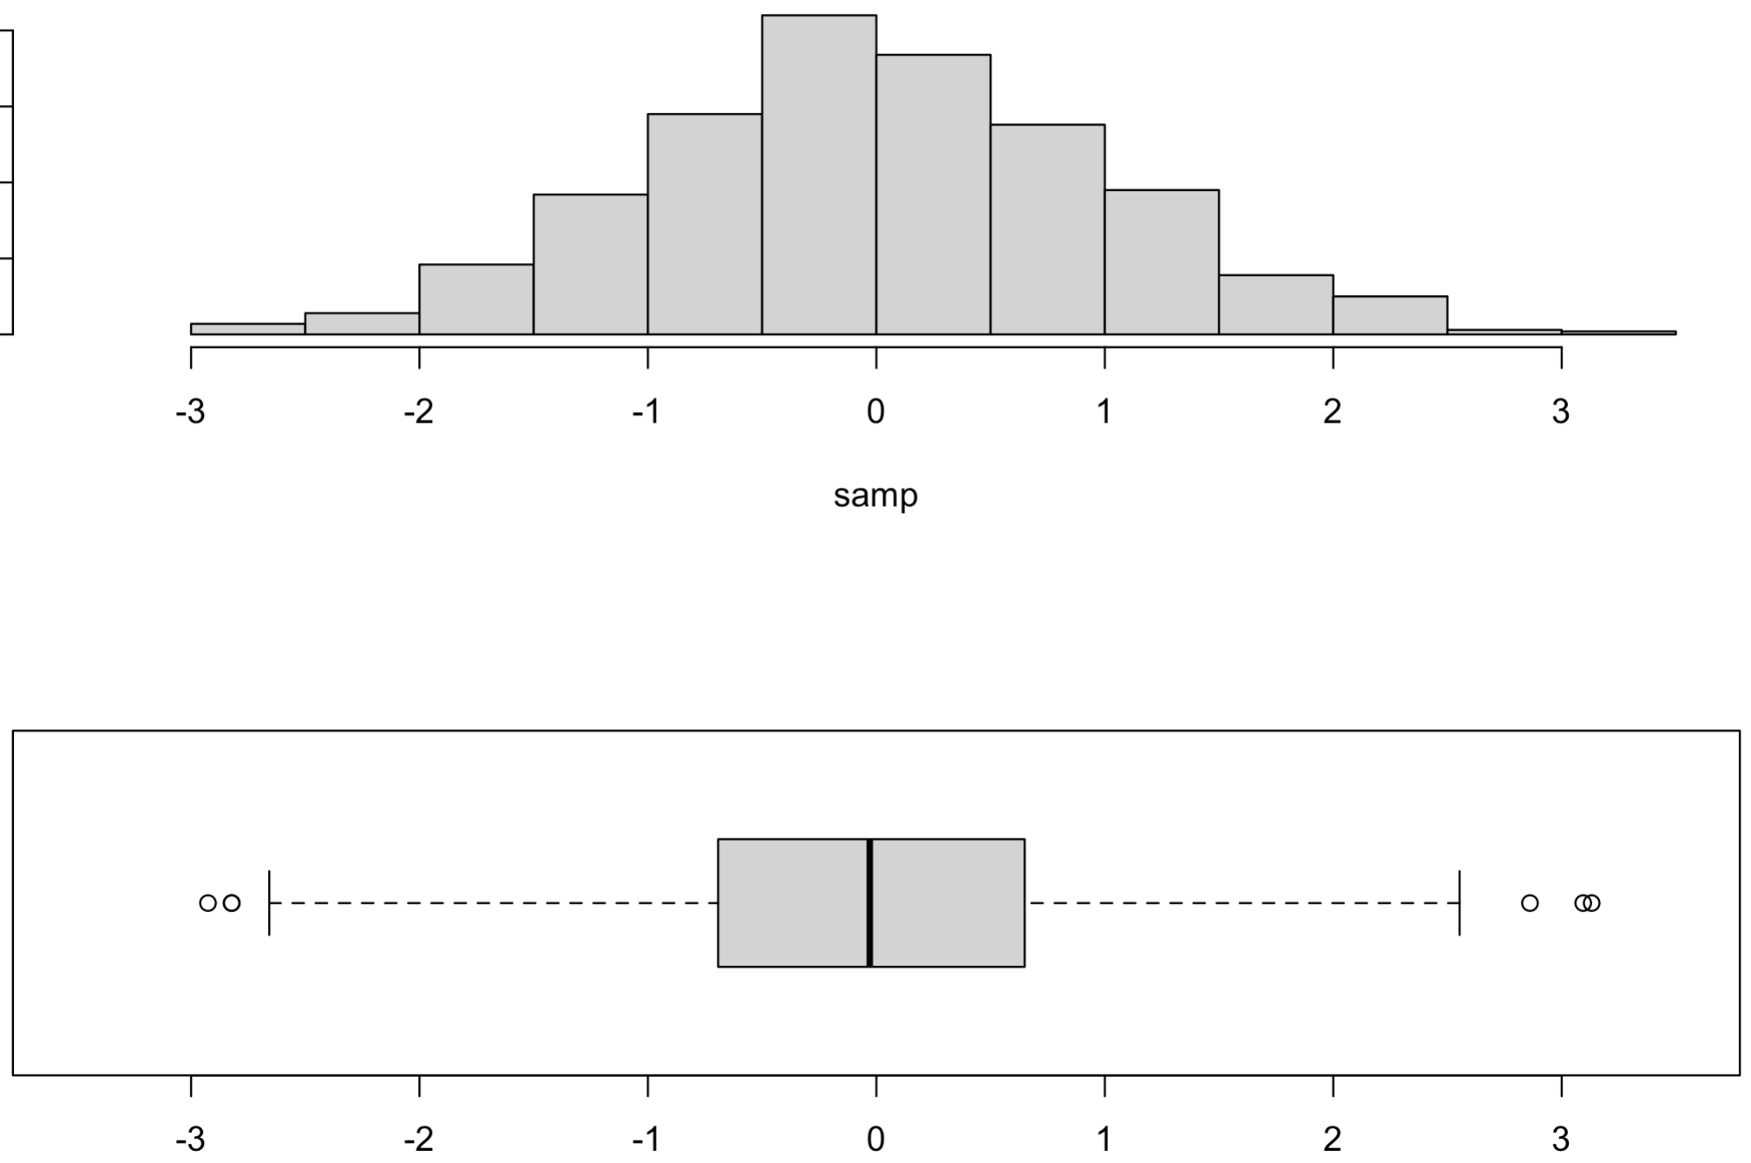
Interquartile Range Outliers
If data follows a normal distribution, then
IQR outlier rule:
possible outliers
IQR
possible outliers
Q1 – 1.5×IQR
Q3 + 1.5×IQR

Slide 8
Example
Examine the measured color intensities of wine in the wine2 data set in the frequtils library for possible outliers using:
Visually (i.e. choose some graphs)
mean-standard dev rule of thumb
median-standard dev rule of thumb
median-mad rule of thumb
interquartile rule

Slide 9
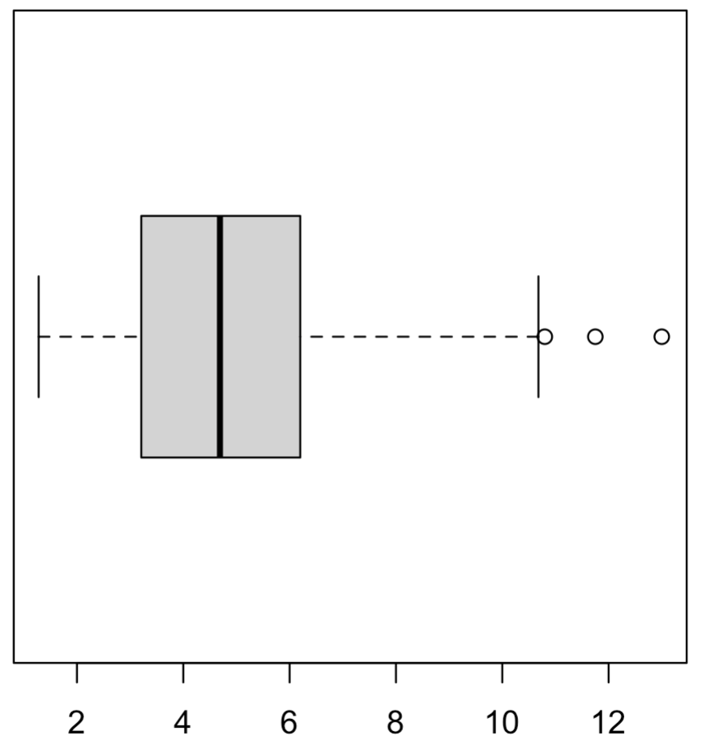
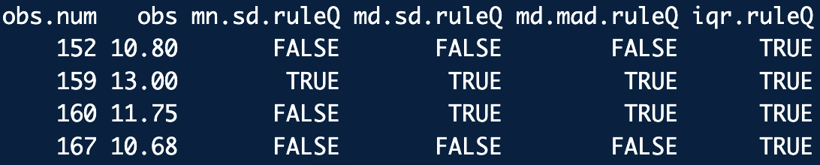
Example
library(frequtils)
data(wine2)
x <- wine2$Color.intensity
hist(x)
boxplot(x, horizontal = T)
summary(x)
Q <- quantile(x, probs = c(0.25, 0.5, 0.75))
mu.hat <- mean(x)
sigx.hat <- sd(x)
# RULE: 3 standard deviations from the sample mean cutoffs:
mu.hat + 3*sigx.hat
mu.hat - 3*sigx.hat
# RULE: 3 standard deviations from the sample median cutoffs:
Q[2] + 3*sigx.hat
Q[2] - 3*sigx.hat
# RULE: 3 mad’s from the sample median cutoffs:
Q[2] + 3*mad(x)
Q[2] - 3*mad(x)
# Interquartile range:
IQR(x)
# RULE: Interquartile outlier cutoffs:
Q[3] + 1.5*IQR(x)
Q[1] - 1.5*IQR(x)
rule.of.thumb.outliers(x, plotQ = T)
rules_of_thumb.R

Slide 10
Grubbs Test for Outliers
A more formal way to test for outliers is (two-sided) Grubbs test statistic:
H₀: There are no outliers in the data set
H_{a}: There is exactly one outlier in the data set
If the sampling distribution for G is (messy but) known
If the data’s distribution is not normal or you don’t want to assume it is, the sampling distribution for G can be approximated with a bootstrap (keep in mind the caveats)

Slide 11
Grubbs Test for Outliers
Typically, Grubbs is used to detect a single outlier in a data set
Grubbs can be “iterated” to pick out multiple suspect outliers
Delete detected outlier and run the Grubb test again. Repeat until no outliers are detected.
Be cognizant of possible masking issues!
Masking: the presence of multiple close outliers can inflate scale measures (usually the sd) and hide their presence

Slide 12
Example Grubbs Test
Consider the total laboratory cholesterol (TC) readings from 20 subjects with hypercholesterolemia:
266, 273, 273, 274, 275, 276, 276, 276, 277, 277, 278, 278, 278, 279, 279, 280, 281, 282, 282, 284
Assuming the data is drawn form a normal distribution (check!), perform a Grubbs test to check for an outlier.

Slide 13
Example Grubbs Test
library(outliers)
x <- c(266, 273, 273, 274, 275, 276, 276, 276, 277, 277,
278, 278, 278, 279, 279, 280, 281, 282, 282, 284)
# Check data's normality visually:
hist(x)
boxplot(x)
qqnorm(x)
qqline(x)
zx <- (x-mean(x))/sd(x) # Standardize scale
qqnorm(zx, ylim = c(-3,3))
qqline(zx)
# Grubbs test(s): Clunky.....
grubbs.test(x, type = 10) # Ha: low val outlier
grubbs.test(x, type = 10, opposite = T) # Ha: high val outlier
grubbs.test(x, type = 11) # Ha: ends outliers
grubbs.test(x, type = 20) # Ha: lowest two outliers
grubbs_ex.R

Slide 14
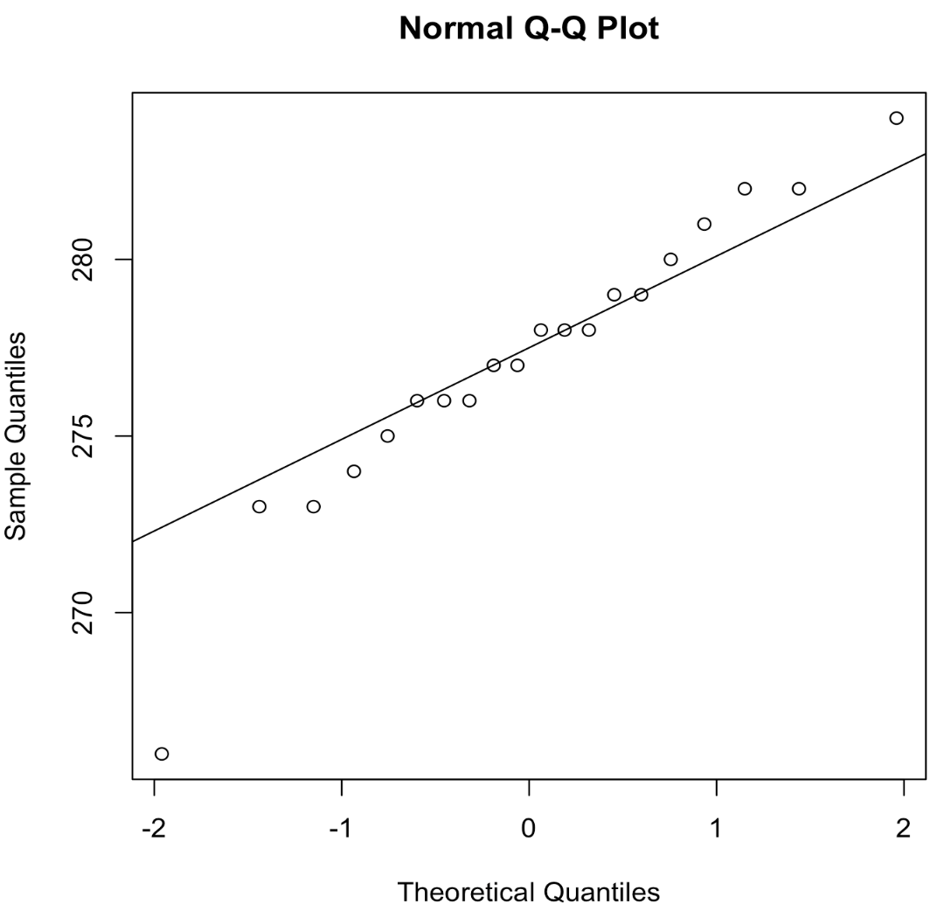
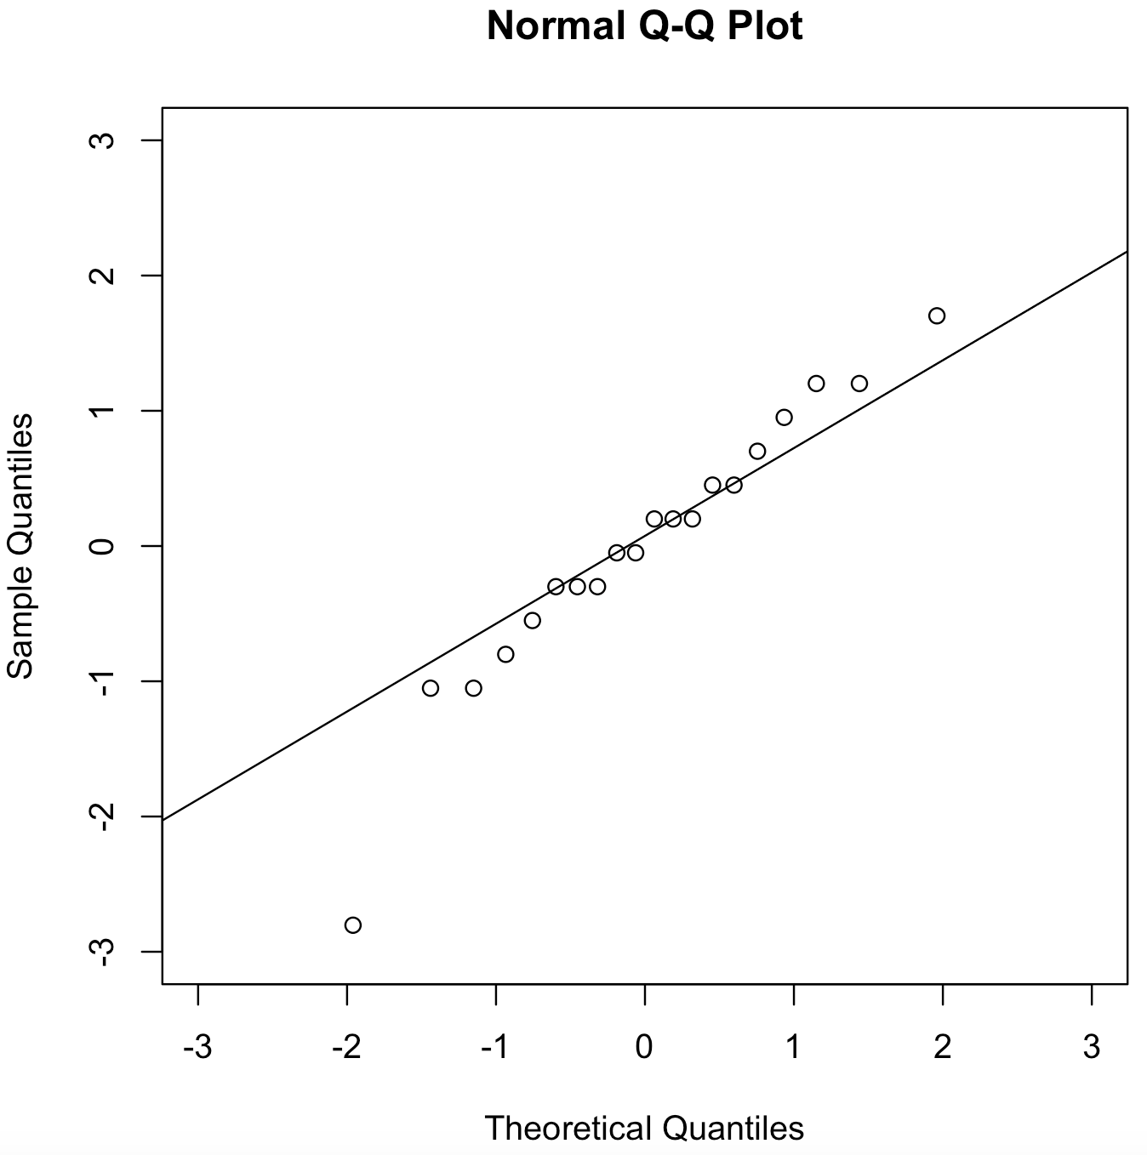
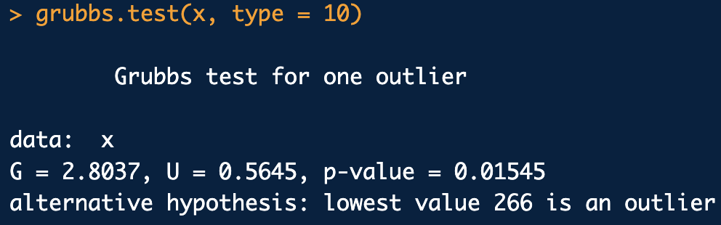

Slide 15
Bootstrap Grubbs Test
We can also do a Grubbs test with a parametric bootstrap:
The nice thing about the bootstrap is that we don’t have to assume the data is normal.
We can also use a non-parametric bootstrap, but then we may be bootstrapping outliers as legit data, so caution should be taken.
For the Grubbs test with a bootstrap:
Choose a distribution model* for the data to generate bootstrap samples
Obtain an approximate sampling distribution of the Grubbs statistic using the bootstrap samples.
Compute the achieved significance level (bootstrap “p-value”) of the original sample’s Grubbs statistic

Slide 16
Example Parametric Bootstrap Grubbs Test
Consider again the total laboratory cholesterol (TC) readings from 20 subjects with hypercholesterolemia:
266, 273, 273, 274, 275, 276, 276, 276, 277, 277, 278, 278, 278, 279, 279, 280, 281, 282, 282, 284
Perform a parametric bootstrap Grubbs test to check for an outlier assuming:
The data is drawn form student-T distribution with n − 1 = 19 dof
The sample mean replaced by the sample median
Sample standard deviation replaced by the sample MAD

Slide 17
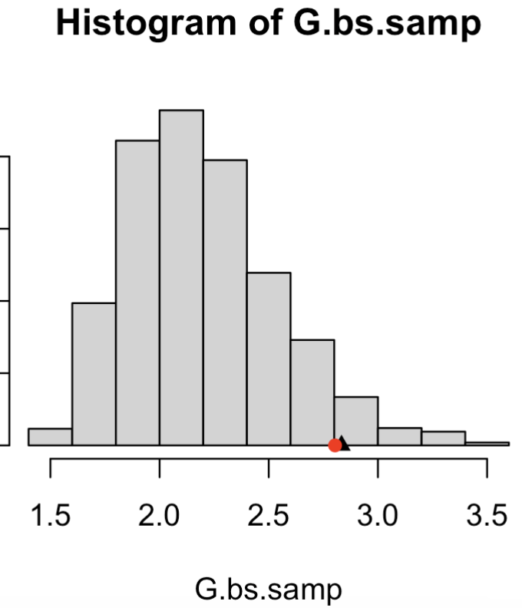
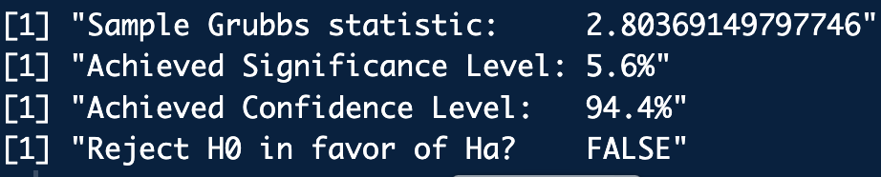
Bootstrap Grubbs Test
library(frequtils)
library(extraDistr)
x <- c(266, 273, 273, 274, 275, 276, 276, 276, 277, 277,
278, 278, 278, 279, 279, 280, 281, 282, 282, 284)
x.md <- median(x)
x.s <- mad(x)
n <- length(x)
grubbs.parametric.bs.test(
xdat = x,
rdist.func = rlst, # Data’s dist
rdist.args.list = list(n = n, df=n-1, mu = x.md, sigma = x.s), # dist’d params
num.B x= 2000)
grubbs_bs.R

Slide 18
Tietjen-Moore Test
Assuming the data is normal, a test for exactly k outliers is the Tietjen-Moore test.
Assume again
Guess number of outliers, k
The test statistic is then:
H₀: There are no outliers in the data set
H_{a}: There are exactly k outliers in the data set
R_{i} are the absolute residuals sorted in increasing order and is the sample mean residual with the largest k residuals removed.

Slide 19
Tietjen-Moore Test
Consider RI’s of glass type 6 in the mlbench library:
1.51905, 1.51937, 1.51829, 1.51852,
1.51299, 1.51888, 1.51916, 1.51969,
1.51115
Visualize the data and speculate about the number of possible outliers
Standardize the data and check its fit against the standard normal distribution
Perform a parametric bootstrap Tietjen-Moore test to check for outliers assuming the standardized data follows a standard normal distribution

Slide 20
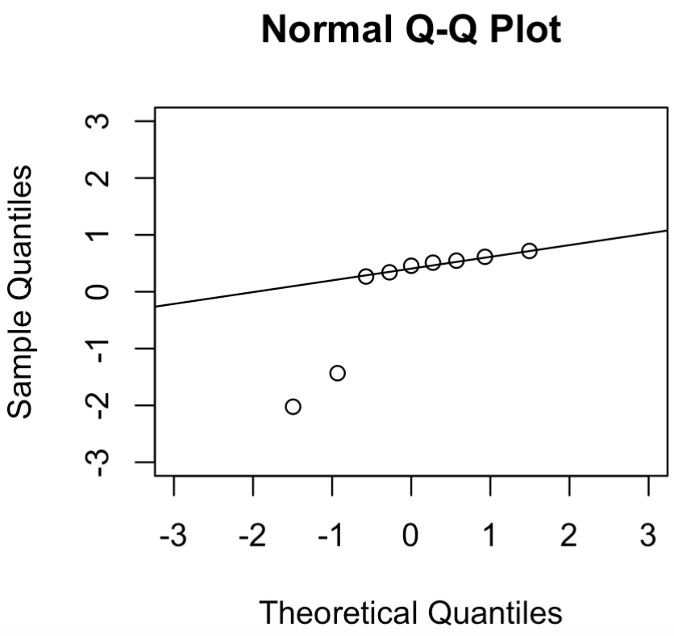
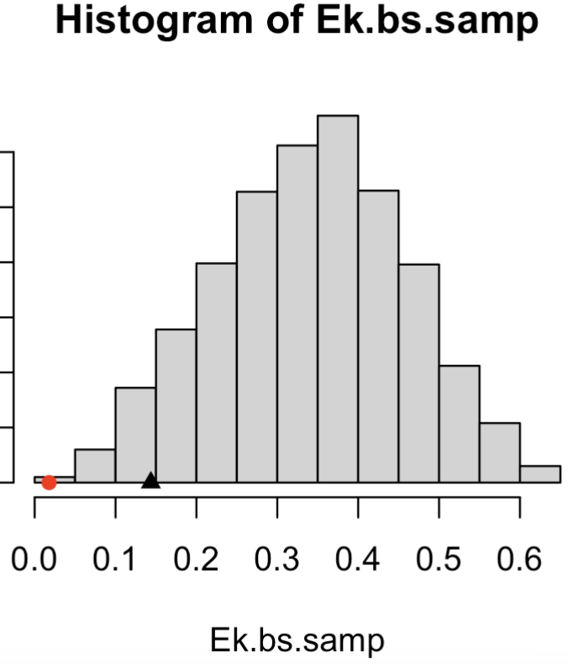
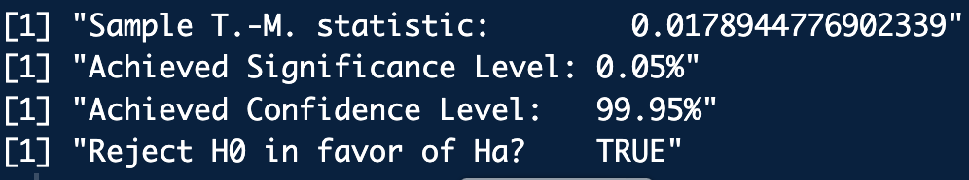
Tietjen-Moore Test
library(frequtils)
library(mlbench)
data(Glass)
boxplot(Glass$RI ~ Glass$Type)
glass.type <- "6"
idx <- which(Glass$Type == glass.type)
dat <- Glass[idx, ]
x <- dat$RI
x.std <- (x-mean(x))/sd(x) # Standardize the data
boxplot(x.std, horizontal = T)
# Check for fit to standard normal
qqnorm(x.std, xlim=c(-3,3), ylim=c(-3,3))
qqline(x.std)
# Tietjen-Moore test:
k <- 2 # assume two outliers
tm.parametric.bs.test(xdat = x, k = k,
confidence.level = 0.95)
tm_test_ex.R

Slide 21
Rosner Test
Assuming the data is normal, detecting at most k outliers is the Rosner test.
Assume again
Guess an upper bound on the number of outliers, k
The test statistics are computed as:
Compute residuals:
Determine “Studentized” max residual:
Drop the data value responsible for the max residual and repeat this process k − 1 more times.
The sampling distribution for the Rosner test statistics is approximately known.
For i ∈{1, …, k} and confidence level 1-α, the critical values are given as:
student-T quantile with:
degrees of freedom
probability

Slide 22
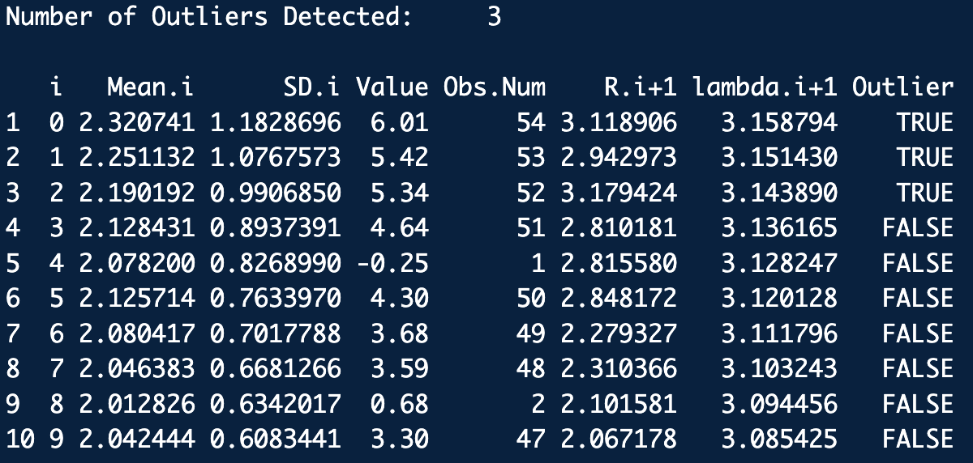
Rosner Test
Compare the k R_{i}’s to their corresponding critical values
The effective number of outliers is the i for which the test statistic is greater than the critical value
Luckily, there is an R-package (EnvStats) that will do these messy calculations for us:
library(EnvStats)
# Some data from Rosner's 1983 paper:
x <- c(-0.25, 0.68, 0.94, 1.15, 1.20, 1.26, 1.26, 1.34, 1.38, 1.43, 1.49, 1.49, 1.55, 1.56,
1.58, 1.65, 1.69, 1.70, 1.76, 1.77, 1.81, 1.91, 1.94, 1.96, 1.99, 2.06, 2.09, 2.10,
2.14, 2.15, 2.23, 2.24, 2.26, 2.35, 2.37, 2.40, 2.47, 2.54, 2.62, 2.64, 2.90, 2.92,
2.92, 2.93, 3.21, 3.26, 3.30, 3.59, 3.68, 4.30, 4.64, 5.34, 5.42, 6.01)
hist(x)
boxplot(x, horizontal = T)
# Check data normality:
x.std <- (x-mean(x))/sd(x)
qqnorm(x)
qqnorm(x.std)
qqline(x.std)
k <- 10 # Speculate there are up to 10 outliers
rosnerTest(x, k = k, alpha = 0.05, warn = TRUE)
rosner_test_ex.R

Slide 23
Dixon Q Test
The Dixon Q statistic tests for single outliers in small data sets:
H₀
There are no outliers in the data set
The minimum value is an outlier –or–
The maximum value is an outlier –or–
Either the minimum or maximum value is an outlier
H_{a}
The Dixon Q test, again, assumes data:
But its performance is known to be robust to data sets that depart from normality.

Slide 24
Dixon Q Test
Dixon Q test is based on comparing the distance of questioned observation from its neighbor with the range of distances between all the other observations.
The other tests we’ve examined are based on the number of standard deviations from the mean of the extreme observations.
For an ordered sample: compute the ratio:
The first/second subscript on the Q indicates the number of outliers that are suspected at the upper/lower end of the data set (0 or 1)

Slide 25
Dixon Q Test
If the data is normal, the sampling distribution for the Null (no outliers) Q-statistic is known:
Its pretty messy
It depends on the sample size (should have n < 30)
It depends on the particular alternative hypothesis H_{a}
Luckily Dixon Q tests are in the R packages dixonTest and outliers so we don’t have to program this from scratch:

Slide 26
Example Dixon Q Test
Consider the repeated measurements of metabolite concentration in a questioned sample of urine:
39.96, 40.12, 40.16, 40.18, 40.18, 40.20
Visualize the data and speculate about the number of possible outliers
Standardize the data and check its fit against the standard normal distribution
Perform a Dixon Q test and discuss the possibility that this data set has an outlier

Slide 27
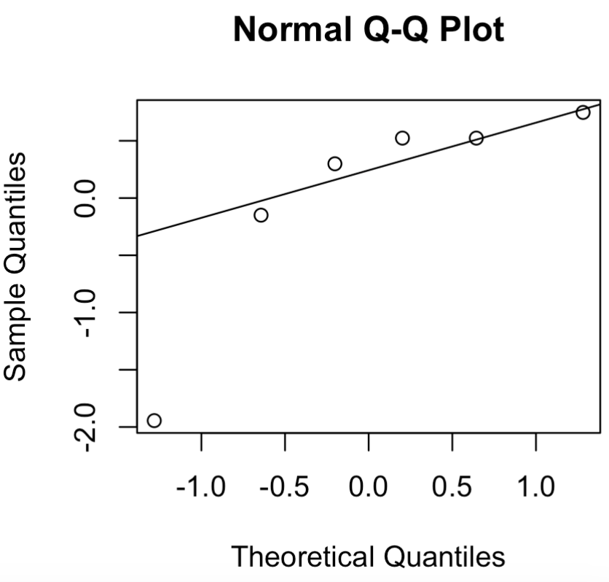
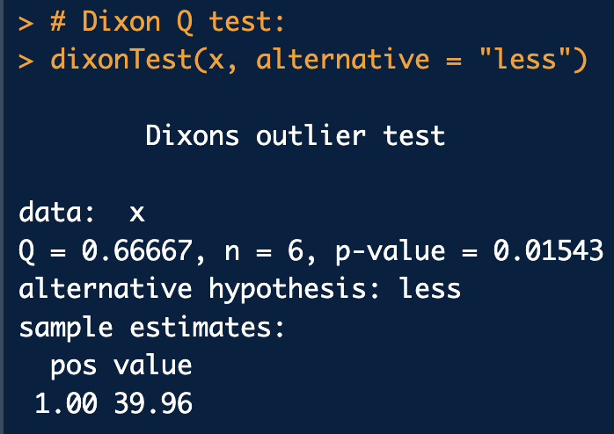
Example Dixon Q Test
library(dixonTest)
# Dixon 1951 example
x <- c(39.96, 40.12, 40.16, 40.18, 40.18, 40.20)
hist(x)
boxplot(x, horizontal = T)
# Check for normality
qqnorm(x)
qqline(x)
x.std <- (x - mean(x))/sd(x)
qqnorm(x.std)
qqline(x.std)
# Dixon Q test:
dixonTest(x, alternative = "less")
dixonTest(x, alternative = "two.sided")
library(outliers)
dixon.test(x, type = 10)
dixon_test_ex.R

Slide 28
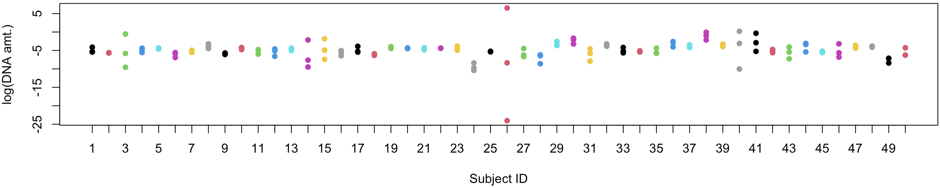
Another Example Dixon Q Test
Examine the touch DNA shedder dataset in frequtil. Choose the LW location and test each subject for outliers in the log(DNA amt) of DNA collected.
library(frequtils)
library(data.table)
data("shedder")
# View the data in stripchart form:
unique(shedder$location)
loc <- "LU"
dat2 <- shedder[shedder$location==loc, c(1,3,4,5)]
num.subjects <- nrow(dat2)
# Re-shape the data from "wide" format to "long" format
dat3 <- melt(dat2, id.vars=c("subjectID"))
dat3 <- cbind(dat3, log(dat3$value))
colnames(dat3) <- c("subjectID", "variable", "value", "log.value")
stripchart(log.value ~ as.numeric(subjectID), group.names = 1:num.subjects, data=dat3,
xlab="Subject ID", ylab="log(DNA amt.)", vertical=T, pch=16, col = 1:num.subjects)

Slide 29
Another Example Dixon Q Test
library(frequtils)
library(dixonTest)
data("shedder")
loc <- "LU"
dat <- shedder[shedder$location==loc, c(3,4,5)]
conf <- 0.95
alpha <- 1 - conf
dinfo <- array(0, c(nrow(dat), 3))
for(i in 1:nrow(dat)) {
x <- log(as.numeric(dat[i,]))
tinfo <- dixonTest(x, alternative = "two.sided", refined = T)
outliersQ <- (tinfo$p.value < alpha)
dinfo[i, ] <- c(tinfo$statistic, tinfo$p.value, outliersQ)
}
colnames(dinfo) <- c("Q-statistic", "p-value", "Poss. Outliers?")
dinfo
dixon_test_ex2.R

Slide 30
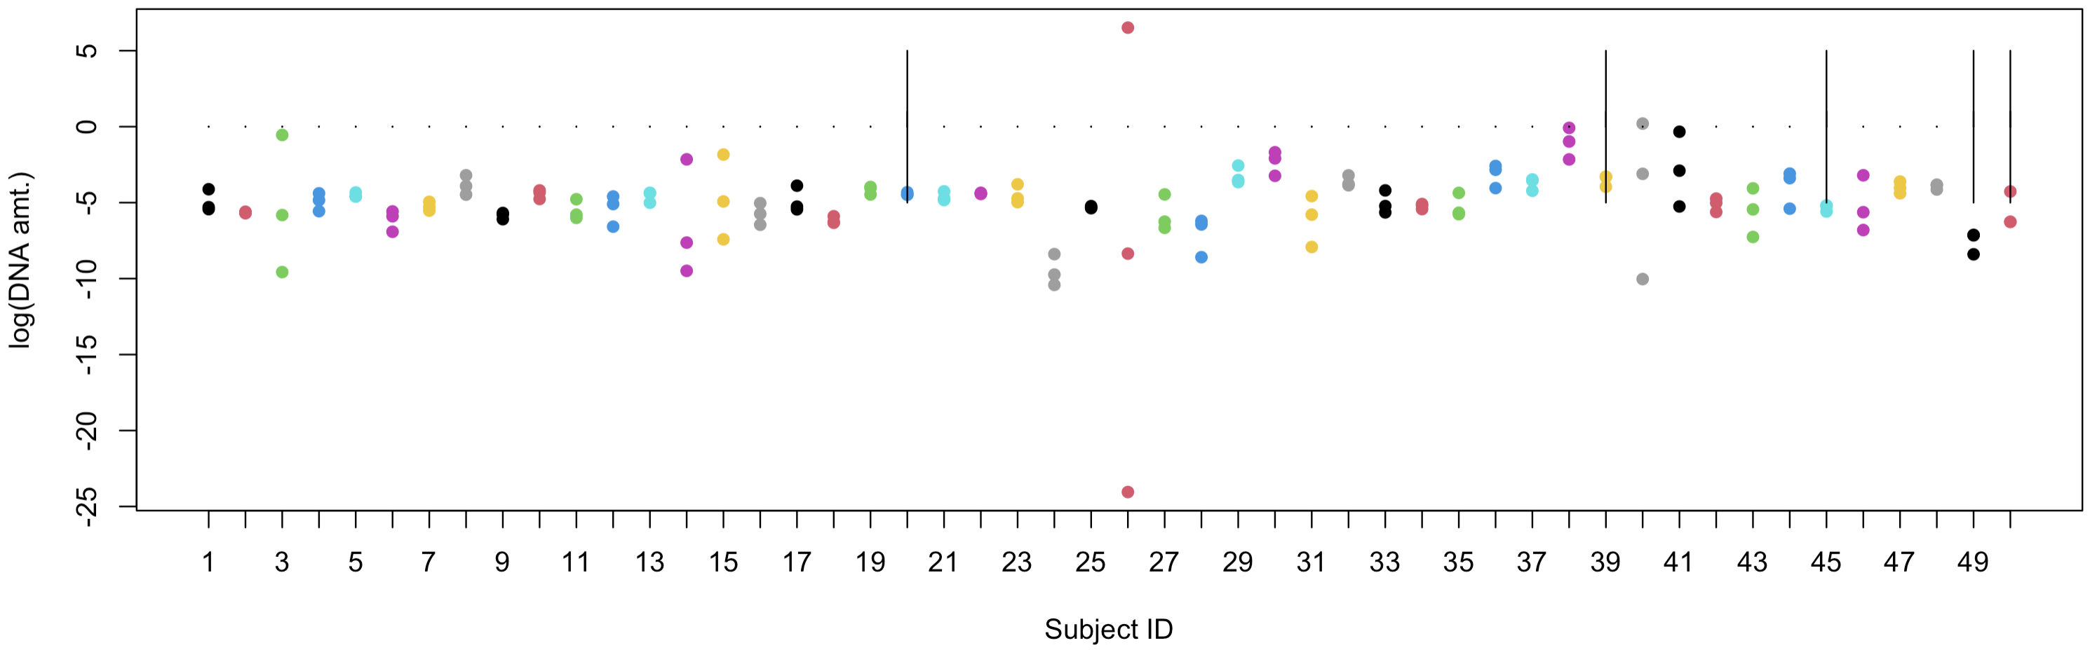
Another Example Dixon Q Test
I was surprised by this result…
Results were also the same using the Grubbs tests
Outliers with this dataset, … hard to tell
Only three replicates
Had to take log DNA amounts
DO PRELIMINARY EXPERIMENTS SO YOU KNOW WHAT TO EXPECT!

