Slide 1

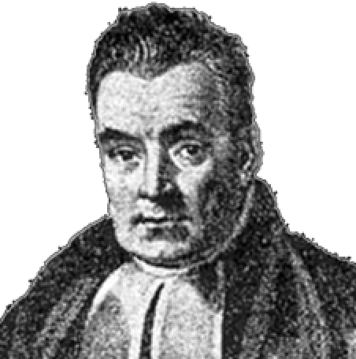
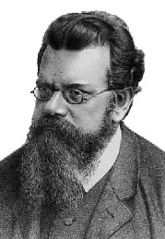
Weights of Evidence and Their Relationship to Statistical Methods

Slide 2
Background
In 2009 a report was released by the National Academy of Science which outlined “challenges facing the forensic science community” and outlined pathways for advancement
One suggestion that arose in several areas was the application of more statistical analyses to the subdisciplines of forensic science.
A copious literature existed at that point (starting from about 1977) which advocated for computing the statistical “weight of evidence” in case work
Dubbed “the Bayesian Framework” or later “the Logical Framework”
This approach has a deep connection to statistical physics

Slide 3
The “Logical (Bayesian) Framework” in F.S.
Notation now common in forensic science ^{Aitken, Taroni}:
H_{p} = the prosecution’s hypothesis
H_{d} = the defences’ hypothesis
E = any evidence (we’ll use D for data later)
I = any background information
Odd’s form of Bayes’ Rule:
Posterior odds in favour of
prosecution’s hypothesis
Likelihood Ratio
Prior odds in favour of
prosecution’s hypothesis

Slide 4
The “Logical (Bayesian) Framework” in F.S.
The likelihood ratio has largely come to be the main quantity of interest in their literature:
A measure of how much “weight” or “support” the “evidence” gives to one hypothesis relative to the other
Here, H_{p} relative to H_{d}
Major Players: Evett, Aitken, Taroni, Champod, Buckelton
Influenced by Dennis Lindley

Slide 5
The “Logical (Bayesian) Framework” in F.S.
Likelihood ratio ranges from 0 to infinity
Points of interest on the LR scale:
LR = 0 means evidence TOTALLY DOES NOT SUPPORT H_{p} in favour of H_{d}
LR = 1 means evidence does not support either hypothesis more strongly
LR = ∞ means evidence TOTALLY SUPPORTS H_{p} in favour of H_{d}

Slide 6
The “Logical (Bayesian) Framework” in F.S.
A standard verbal scale of LR “weight of evidence” IS IN NO WAY, SHAPE OR FORM, SETTLED IN THE STATISTICS LITERATURE!
A popular verbal scale is due to Jefferys, pp.432 (in here too) but there are others
READ British R v. T footwear case!, Ref. 1, Ref. 2

Slide 7
Preliminaries
In science, hypotheses are formed to explain data.
A formal relationship between data (D) and a hypothesis (H) that (potentially) explains the data can be formulated through Bayes’ Theorem:

Slide 8
Preliminaries
Let’s say we have two competing hypotheses (H_{p}, H_{d}) that can explain some observed data:

Slide 9
Preliminaries
Which hypothesis is more probable given the observed data?
To answer this, take the ratio of the two Bayes’ theorems:
Weight of evidence: A measure of how much “weight” or “support” observed data (i.e. “evidence”) gives to one hypothesis relative to the other^{Jeffereys, Turing, Good}

Slide 10
Hypothesis Models of Data
p(D|H_{p}) and p(D|H_{d}) are clearly important.
So how do we get them??!!
In practice, H_{p} and H_{d} are probabilistic models seeking to explain observed data D (the “evidence”)
Probabilistic models are formulated in terms of probability functions (e.g. Pr’s, pmf’s, pdf’s etc.) which have parameters, θ

Slide 11
Hypothesis Models of Data
Model parameters are also obtained from Bayes’ theorem:
This is our quantity of interest
Now that we’ve gotten into some detail, we see what p(D|H_{i}) really is, and it’s a problem…

Slide 12
Marginal Likelihood and Sums over States
The denominator of (any) Bayes’ theorem can be found from the law of total probability:
with
In our specific case/notation, it’s written:
A sum of values over a defined partition − ger. Zustandssumme
Colloquially called a “sum over states”
In probability theory, this specific zustandssumme is called marginalization
p(D|H_{i}) is called (among other thing) a marginal likelihood

Slide 13
Marginal Likelihood and Sums over States
Summary so far:
Marginal likelihood: likelihood of observing the data given the hypothesis (model, theory) is true
expected likelihood
(Bayes) evidence
a zustandssumme (a sum over states), Z_{i}
a Bayes’ theorem normalization constant
Some other names for a marginal likelihood
Each term in the weight of evidence is a marginal likelihood (and thus a sum over states):

Slide 14
Bayes Factors
More trivia:
These integrals (or sums) are often intractable (impossible or nearly impossible to evaluate)
Intractability comes from the high dimensionality of the integral or a gigantic number of terms in the sums (combinatorial explosion)
If we can evaluate these integrals, the weight of evidence is called a Bayes factor (BF)
No uncertainty other than that from estimating the integral by numerical/monte carlo methods
BFs can be very model dependent however, especially due to the prior terms p(θ_{i}|H_{i})
Computing marginal likelihood and BFs routinely is still an active area of research

Slide 15
Likelihood Ratios
More trivia:
Usually, the integrals are replaced with formulas/parameter point estimates, in which case the weight of evidence is called a likelihood ratio
or
LRs are subject to sampling uncertainty when parameters are estimated
LRs are subject to modelling uncertainty
LRs are by far the most common weight of evidence computed but issues of appropriateness, modelling, meaning and uncertainty are hotly debated^{Lund and Iyer}

Slide 16
Properly Evaluating Marginal Likelihoods
Properly computing marginal likelihoods are exceptionally difficult to compute
Known in physics for over a hundred years (cf. Boltzmann papers)
Most techniques to compute these originally came from physics and made their way into general statistics:
Umbrella Sampling
Annealed importance sampling
Bridge sampling
Thermodynamic integration
Nested sampling
Wang-Landau sampling
Belief propagation*
Some modern methods for approximating marginal likelihoods
Most based on fancy random sampling
None are easy to implement for production (i.e. not black box buttons)
None universally applicable

Slide 17
Actually Computing Bayes Factors
and Likelihood Ratios…
Regardless of philosophies about BFs/LRs:
…try to compute and work with them for practical situations of interest.
Do they deliver any value to you; helping to get closer to the “truth” or discern a clearer “scientific story”?
Note: Always be cognizant and “up-front” about the assumptions, strengths and weaknesses of your calculations.
Until recently (~1995, early 2000s??) BFs are almost all impossible to compute for realistic models of practical interest
This is probably the reason why they are not actually applied widely in the Bayesian community despite their pedigree as “logical”
LRs are typically easier to compute than BFs but are far more arbitrary/uncertain for assorted reasons…(cf. Lund and Iyer, arXiv ver.)

Slide 18
Actually Computing Bayes Factors
and Likelihood Ratios…
There are different “practical” approaches to dealing with p(D|H_{i}) and thus BFs/LRs:
Parametric
MCMC (Markov-Chain Monte Carlo)
BUGS (Bayesian Using Gibbs Sampling)
Andrew Gelman (Columbia)
David Speigelhalter (Cambridge)
Bayes Nets
Graphical Models
Steffan Lauritzen (Oxford)
Judea Pearl (UCLA)
Postulate
Make up equations
non-parametric/fit histograms
plug-ins
etc…
Empirical Bayes
Data-driven
Brad Efron (Stanford)
Notes:
Depending on the problem to be solved and the data available there are different approaches for updating beliefs.
This slide shows the major approaches with some of the top developers associated with them.
There is software out there to work with all of these.
Unfortunately, we’d run out of time if we tried to do justice to all three of these.
In this course we will focus on parametric Bayesian calculations.
They force us to build our data analysis models very systematically and make our assumptions concrete.
There are well developed methods to assess and check these types of Bayesian models.
They are most often used in scientific data analyses and often provide a complementary approach to classical frequentist methods.

Slide 19
How good of a “match” is it?
Efron Empirical Bayes’
An I.D. is output for each questioned toolmark
This is a computer “match”
What’s the probability it is truly not a “match”?
Similar problem in genomics for detecting disease from microarray data
They use data and Bayes’ theorem to get an estimate
No disease_{genomics} = Not a true “match”_{toolmarks}

Slide 20
Empirical Bayes’
We use Efron’s machinery for “empirical Bayes’ two-groups model”^{Efron}
Surprisingly simple!
Use binned data to do a Poisson regression
Some notation:
S⁻, truly no association, Null hypothesis
S⁺, truly an association, Non-null hypothesis
z, a score derived from a machine learning task to I.D. an unknown pattern with a group
z is a Gaussian random variate for the Null

Slide 21
Empirical Bayes’
From Bayes’ Theorem we can get^{Efron}:
Estimated probability of not a true “match” given the algorithms' output z-score associated with its “match”
Names: Posterior error probability (PEP)^{Kall}
Local false discovery rate (lfdr)^{Efron}
Suggested interpretation for casework:
We agree with Gelaman and Shalizi^{Gelman}:
“…posterior model probabilities …[are]… useful as tools for prediction and for understanding structure in data, as long as these probabilities are not taken too seriously.”
= Estimated “believability” of machine made association

Slide 22
Empirical Bayes’
Bootstrap procedure to get estimate of the KNM distribution of “Platt-scores”^{Platt,e1071}
Use a “Training” set
Use this to get p-values/z-values on a “Validation” set
Inspired by Storey and Tibshirani’s Null estimation method^{Storey}
Use SVM to get KM and KNM “Platt-score” distributions
Use a “Validation” set
From fit histogram by Efron’s method get:
“mixture” density
z-density given KNM => Should be Gaussian
Estimate of prior for KNM
What’s the point??
We can test the fits to
and !
z-score

Slide 23
Posterior Association Probability: Believability Curve
12D PCA-SVM locfdr fit for
Glock primer shear patterns
+/- 2 standard errors

Slide 24
Poisson (Efron) on test set
Bayesian Poisson on test set
Bayesian Poisson with intercept on test set
Bayesian over-dispersed Poisson with intercept on test set

Slide 25
Bayes Factors/Likelihood Ratios
Once the “fits” for the Empirical Bayes method are obtained, it is easy to compute the corresponding likelihood ratios.
Using the identity:
the likelihood ratio can be computed as:
posterior odds
prior odds

Slide 26
Bayes Factors/Likelihood Ratios
Using the fit posteriors and priors we can obtain the likelihood ratios^{Tippett, Ramos}
Known match LR values
Known non-match LR values

Slide 27
Empirical Bayes’: Some Things That Bother Me
Need a lot of z-scores
Big data sets in forensic science largely don’t exist
z-scores should be fairly independent
Especially necessary for interval estimates around lfdr^{Efron}
Requires “binning” in arbitrary number of intervals
Also suffers from the “Open-set” problem
Interpretation of the prior probability for this application
Should Pr(S⁻) be 1 or very close to it? How close?

Slide 28
Graphical Models in Brief

Slide 29
Directed Graphs
A
B
Word equivalents:
The outcome of A influences the outcome of B
A influences B
A “causes” B
A effects B
Knowledge of A is relevant for my belief about B
Called a Bayesian Network

Slide 30
PMF Equivalents and Common Graph Motifs
A
The probability of A:
“node”
A node represents a probability table:
 |  | Pr(A)
A: | yes | 0.28
 | maybe | 0.10
 | no | 0.62
A
=
A prior (unconditional) “node”

Slide 31
PMF Equivalents and Common Graph Motifs
A
B
Graph defines two probability tables:
 |  | Pr(A)
A: | yes | 0.28
 | maybe | 0.10
 | no | 0.62
A
=
Pr(B|A) |  | A:
 |  | yes | maybe | no
B: | low | 0.28 | 0.32 | 0
 | medium | 0.3 | 0.18 | 0.76
 | high | 0.42 | 0.50 | 0.24
B
=

Slide 32
PMF Equivalents and Common Graph Motifs
A
B
C
How many table do we need to represent Pr(A, B, C)?

Slide 33
PMF Equivalents and Common Graph Motifs
Note:
A
B
A
B
The “causal” direction is not uniquely defined.
We can choose it to be intuitive or convenient

Slide 34
PMF Equivalents and Common Graph Motifs
A
C
B
B
A
C

Slide 35
PMF Equivalents and Common Graph Motifs
A
B
C
A
B
Cycles NOT ALLOWED!
C

Slide 36
Directed Graphs
Hypothesis: not directly observable or only observable at high cost
Data: information that reveals something about the state of a hypothesis
Hypothesis
Data
Typical
Hypothesis
Hypothesis
Typical
Hypothesis
Data
Not Typical

Slide 37
Directed Graphs
It helps me to remember:
Disease
Symptoms
Typical

Slide 38
Example: Monty Hall Problem
In the “Let’s Make a Deal” game show, a version of the Choose a Door game is (Monty himself pointed out that there are many variations depending on what his mood was):
You are given the choice of three doors:
Behind one door the real prize, a car.
Behind the others, goats or other gag prizes.
You pick a door, say No. 1. The host (who knows what's behind the doors) opens another door, say No. 3, which has a goat. He then says to you, “Do you want to switch to door No. 2?”
Question: Is it to your advantage to switch your choice?

Slide 39
Example: Monty Hall Problem
Nodes:
P = Prize is behind door #
C = Your choice of door #
M = Monty’s choice of door #
Prize is
Behind
Door #
Your Choice
of Door #:
Joint PMF for the scenario:
Monty Hall
Chooses
Door #:
What are the dependencies between the nodes?
Your choice of door affects Monty’s choice of door
The door the prize is behind affects Monty’s choice of door
Your choice of door is not affected by anything in this scenario
The door the prize is behind is not affected by anything in this scenario

Slide 40
Example: Monty Hall Problem
Task: Marginalize nodes
Knowing the probability table of each node, compute all marginal probabilities:
Marginals of prior nodes are just their tables.
Prize is
Behind
Door #
Your Choice
of Door #:
Monty Hall
Chooses
Door #:
Marginals of conditional nodes generally requires software:
Graph theoretic operations
Some form of Pearl’s “Message Passing Algorithm”

Slide 41
Example: Monty Hall Problem
 |  | Pr(P)
Prize is Behind Door #: | door 1 | 0.333
 | door 2 | 0.333
 | door 3 | 0.333
 |  | Pr(C)
Your Choice of Door #: | door 1 | 0.333
 | door 2 | 0.333
 | door 3 | 0.333
Prize is
Behind
Door #
Your Choice
of Door #:
Monty Hall
Chooses
Door #:
Pr(M|P,C) | Prize is Behind Door #: | door 1 | door 1 | door 1 | door 2 | door 2 | door 2 | door 3 | door 3 | door 3
 | Your Choice of Door #: | door 1 | door 2 | door 3 | door 1 | door 2 | door 3 | door 1 | door 2 | door 3
Monty Hall Chooses Door #: | door 1 | 0 | 0 | 0 | 0 | 0.5 | 1 | 0 | 1 | 0.5
 | door 2 | 0.5 | 0 | 1 | 0 | 0 | 0 | 1 | 0 | 0.5
 | door 3 | 0.5 | 1 | 0 | 1 | 0.5 | 0 | 0 | 0 | 0

Slide 42
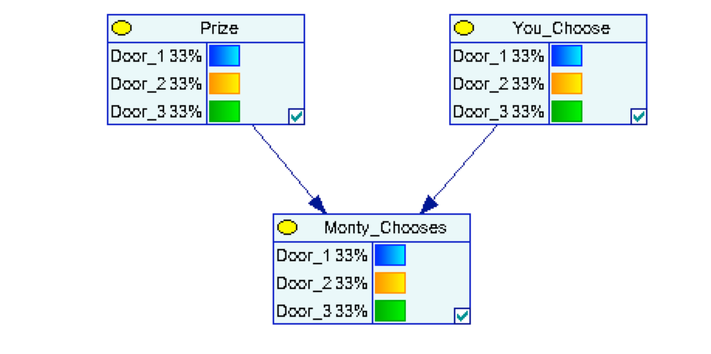
Example: Monty Hall Problem
 |  | Pr(P)
Prize is Behind Door #: | door 1 | 0.333
 | door 2 | 0.333
 | door 3 | 0.333
 |  | Pr(C)
Your Choice of Door #: | door 1 | 0.333
 | door 2 | 0.333
 | door 3 | 0.333
Prize is
Behind
Door #
Your Choice
of Door #:
Monty Hall
Chooses
Door #:
Pr(M|P,C) | Prize is Behind Door #: | door 1 | door 1 | door 1 | door 2 | door 2 | door 2 | door 3 | door 3 | door 3
 | Your Choice of Door #: | door 1 | door 2 | door 3 | door 1 | door 2 | door 3 | door 1 | door 2 | door 3
Monty Hall Chooses Door #: | door 1 | 0 | 0 | 0 | 0 | 0.5 | 1 | 0 | 1 | 0.5
 | door 2 | 0.5 | 0 | 1 | 0 | 0 | 0 | 1 | 0 | 0.5
 | door 3 | 0.5 | 1 | 0 | 1 | 0.5 | 0 | 0 | 0 | 0

Slide 43
Example: Monty Hall Problem
Task: Update marginals of nodes after data is collected
After introducing “evidence” or “observations” how are our beliefs about the states of the other nodes changed?
Prize is
Behind
Door #
Your Choice
of Door #:
door #1
Monty Hall
Chooses
Door #:
door #3

Slide 44
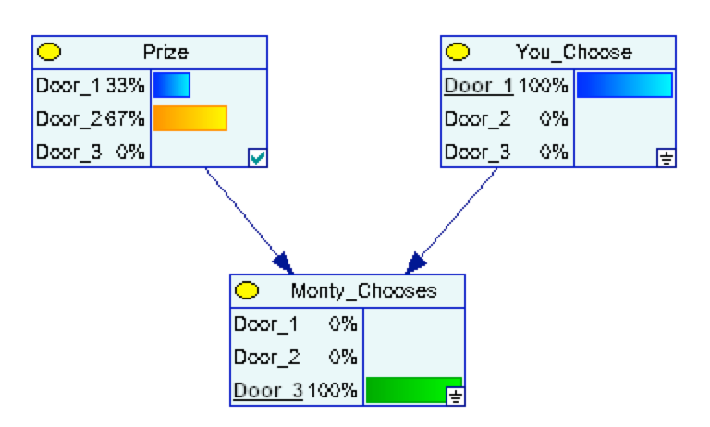
Example: Monty Hall Problem
Updated beliefs about which door to pick
door #1
door #3

Slide 45
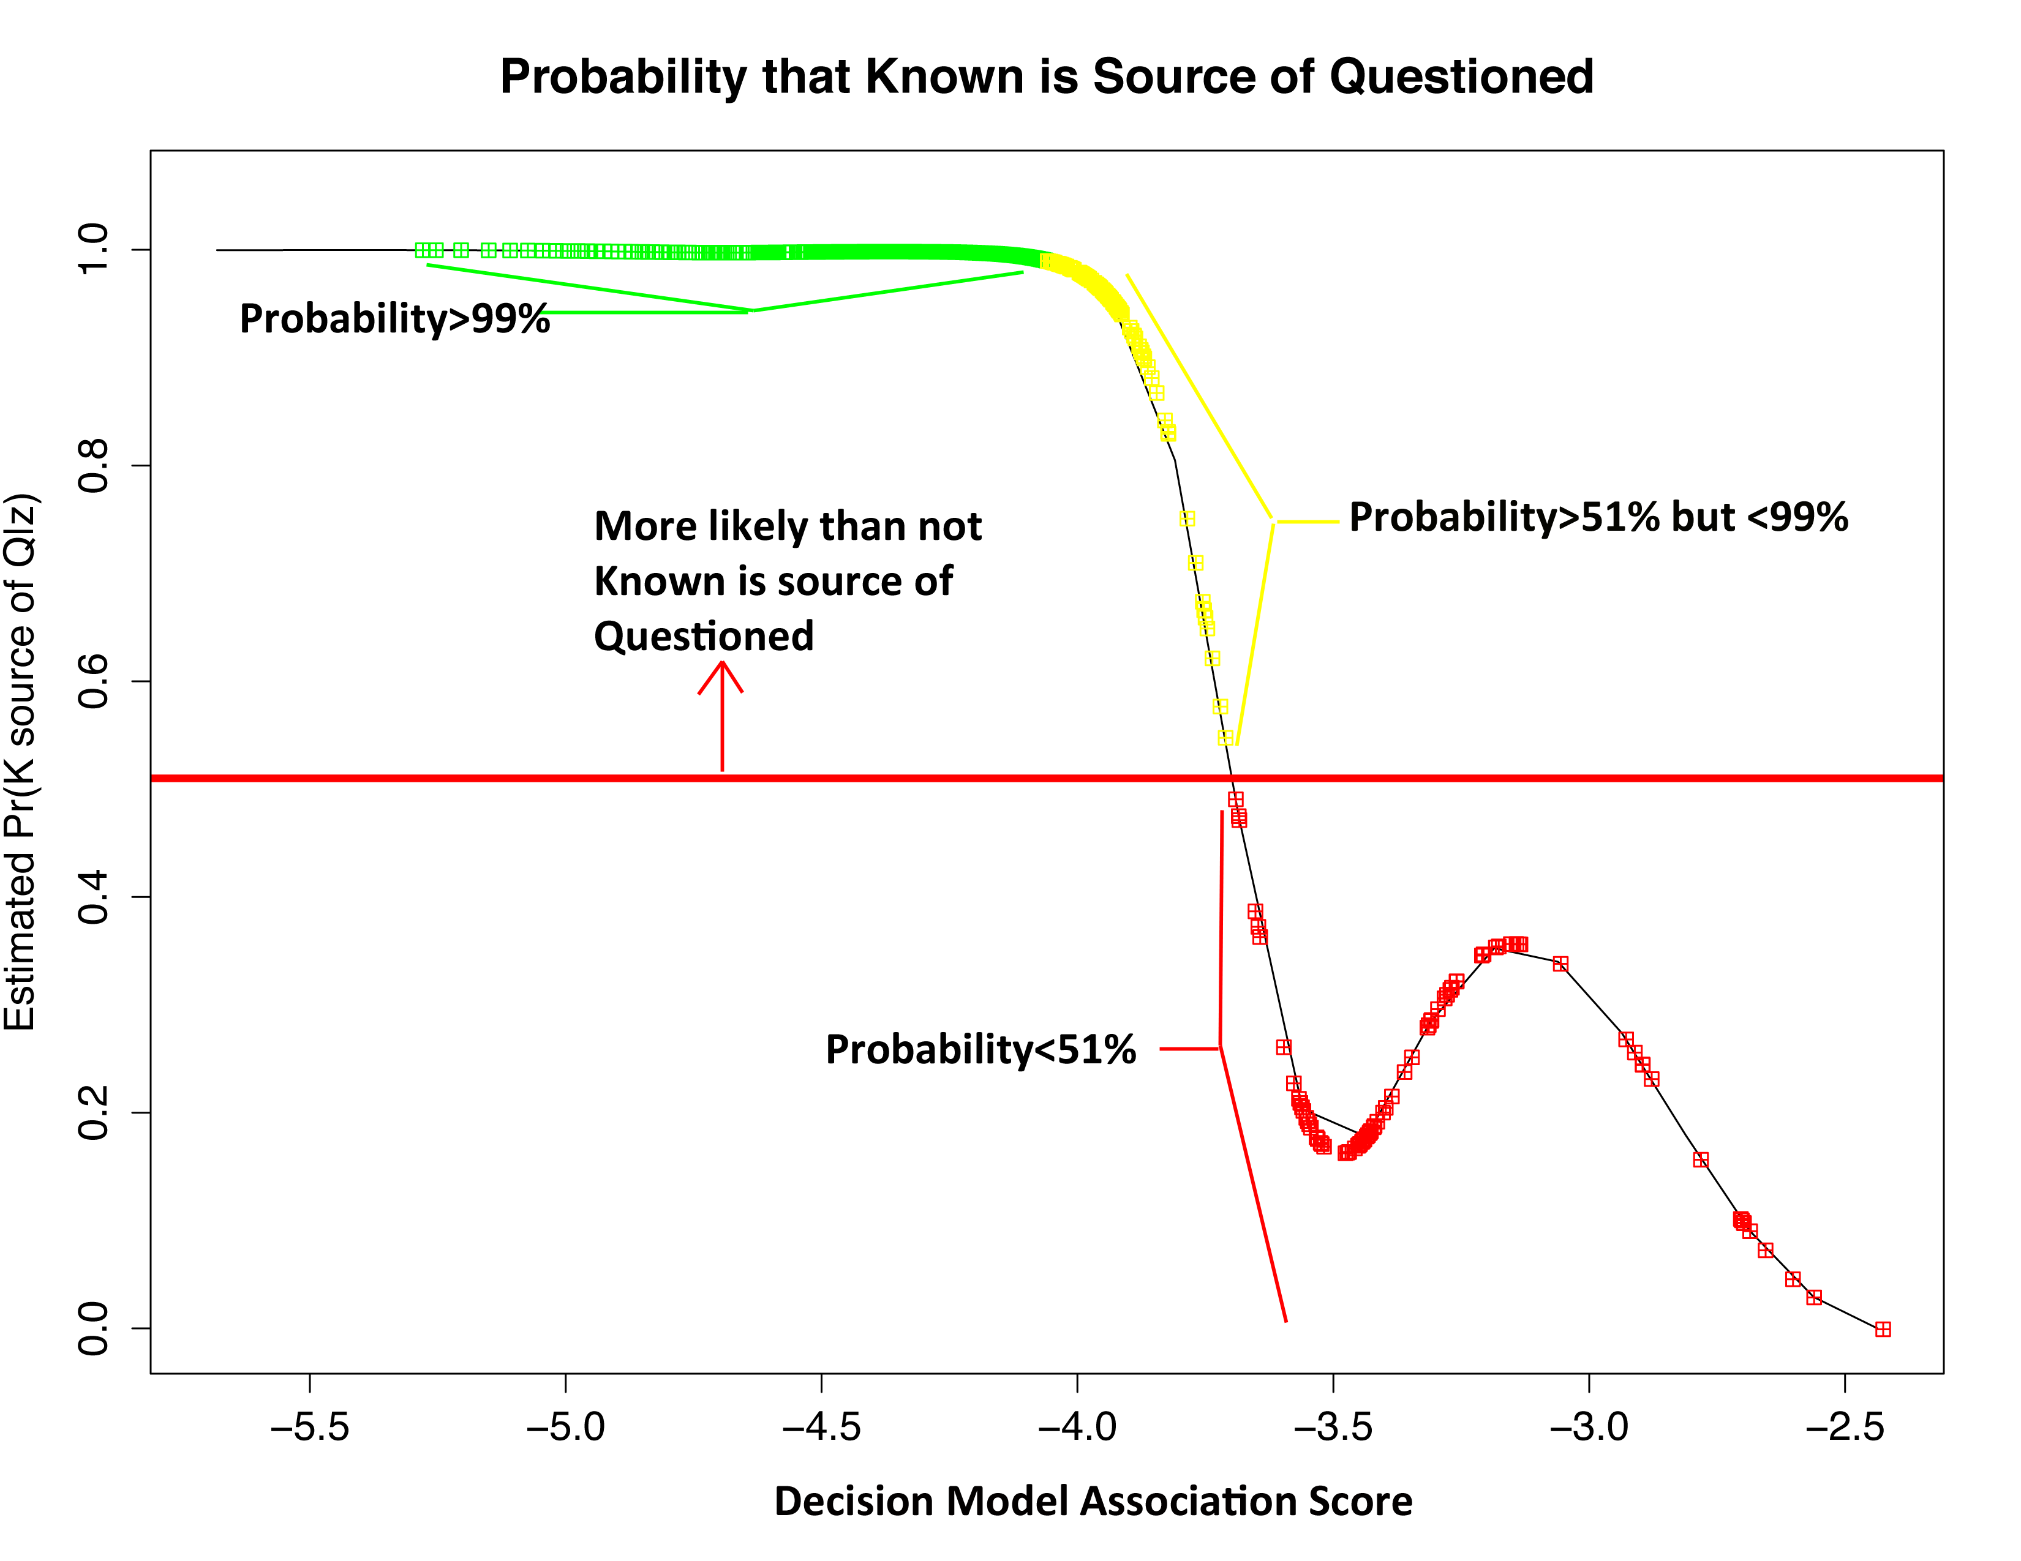
20D PCA-SVM Empirical Bayes Model on Dust Trace Evidence

Slide 46
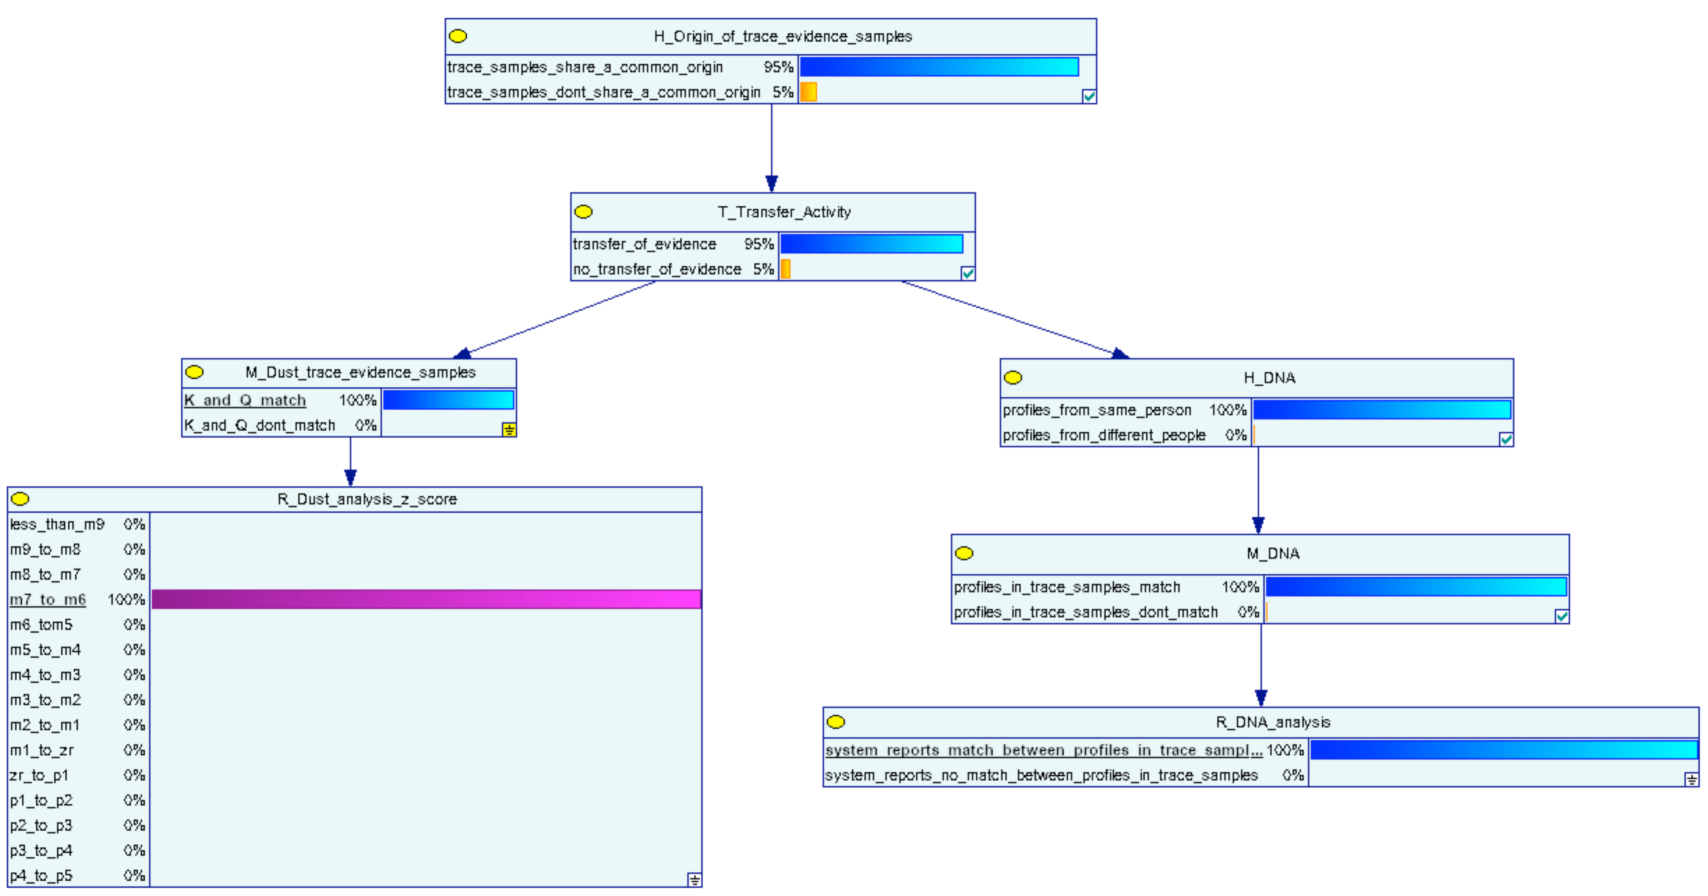
Ballantyne Network
Combine dust ID results (trace) with DNA results:

Slide 47


Slide 48
Bayes Net in Painting Authentication Case

Slide 49
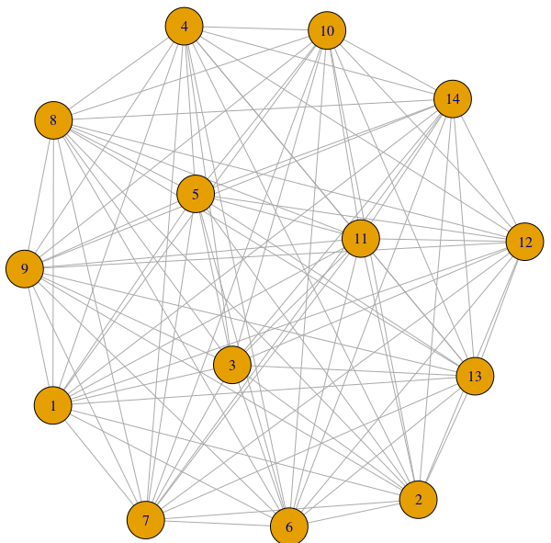
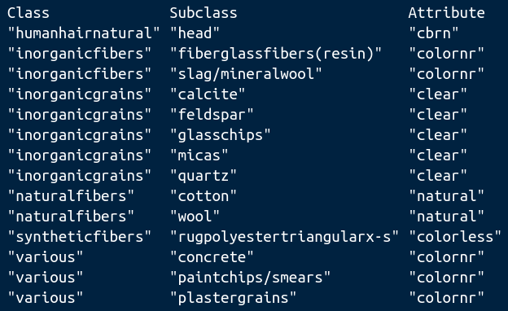
Source Probabilities From Spin Physics
WTC dust (prototype) probability network:
LR: Probability that all these components came together given they are from the WTC vs random chance
~ 1¹⁰
Decisive (Jeffreys)

Slide 50
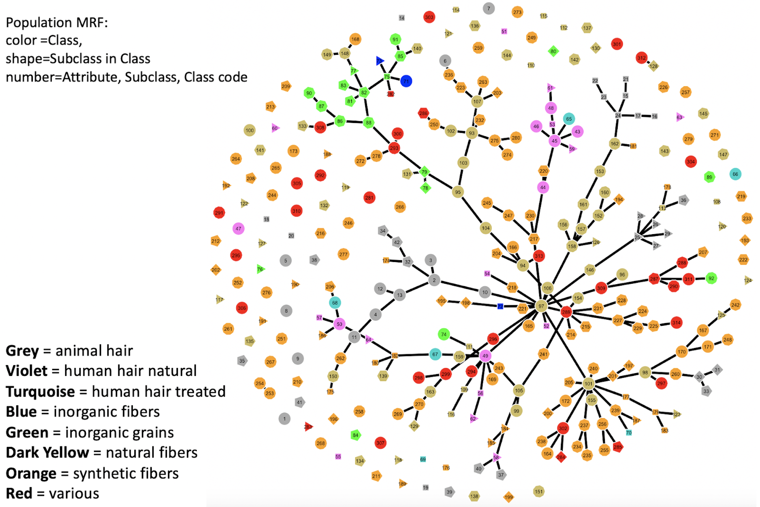
Aggregate Dust Evidence Dependencies

Slide 51
Another Art Project: This Time Using Parametric Methods
To calculate proper Bayes Factors for Artist attribution, use parametric Bayes models for artist did/didn’t make works
hyper-params
hyper-params
λ
BFs > 1000
λ_{i}
s_{i}
s_{i}
i = 1:200+
i = 1:200+
make
not make
not make
not make

