Slide 1
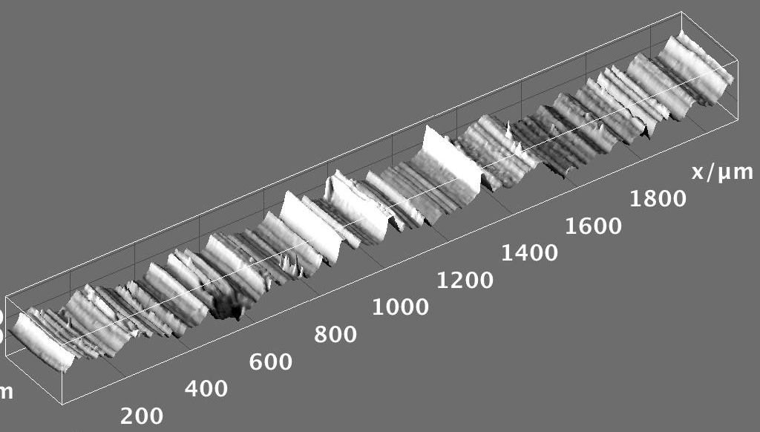


Introduction to Software We’ll Use

Slide 2

Outline
R : A powerful platform for scientific calculation and data analysis
Why bother learning R ?
Data, data, data, I cannot make bricks without clay ^{Copper Beeches}
A tour of RStudio. Basic Input and Output
Getting Help
Visualizing with Plots
Loading your data from Excel spreadsheets
Basic Plotting

Slide 3
Why ?
R is not a black box!
Codes available for review; totally transparent!
R maintained by a professional group of statisticians, and computational scientists
From very simple to state-of-the-art procedures available
Very good graphics for exhibits and papers
R is extensible (it is a full scripting language)
Coding/syntax similar to Python and MATLAB
Easy to link to C/C++ routines

Slide 4
Why ?
Where to get information on R :
R: http://www.r-project.org/
Just need the base
RStudio: http://rstudio.org/
A great IDE for R
Work on all platforms
Sometimes slows down performance…
CRAN: http://cran.r-project.org/
Library repository for R
Click on Search on the left of the website to search for package/info on packages

Slide 5
Finding our way around R/RStudio
Script Window
Command Line

Slide 6
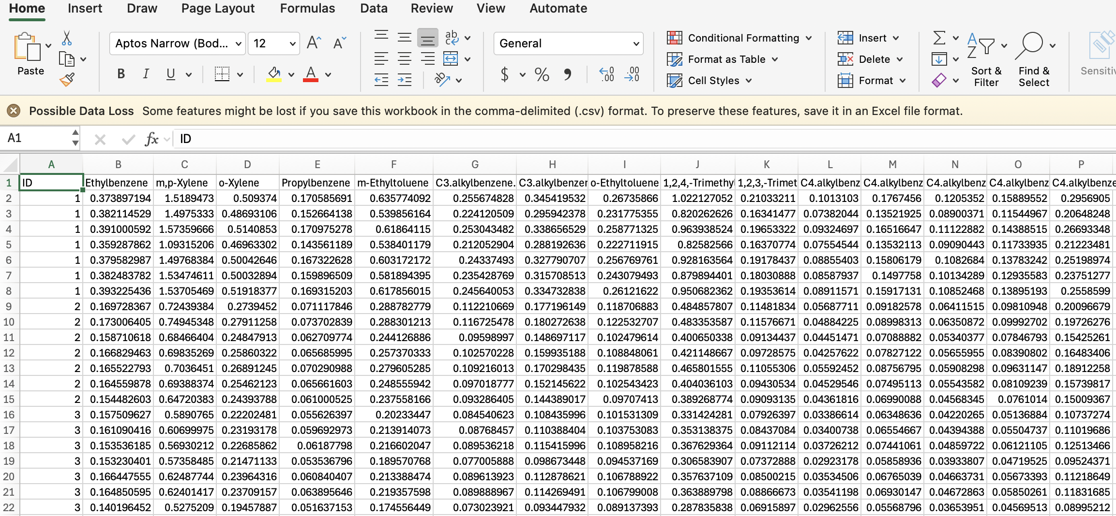

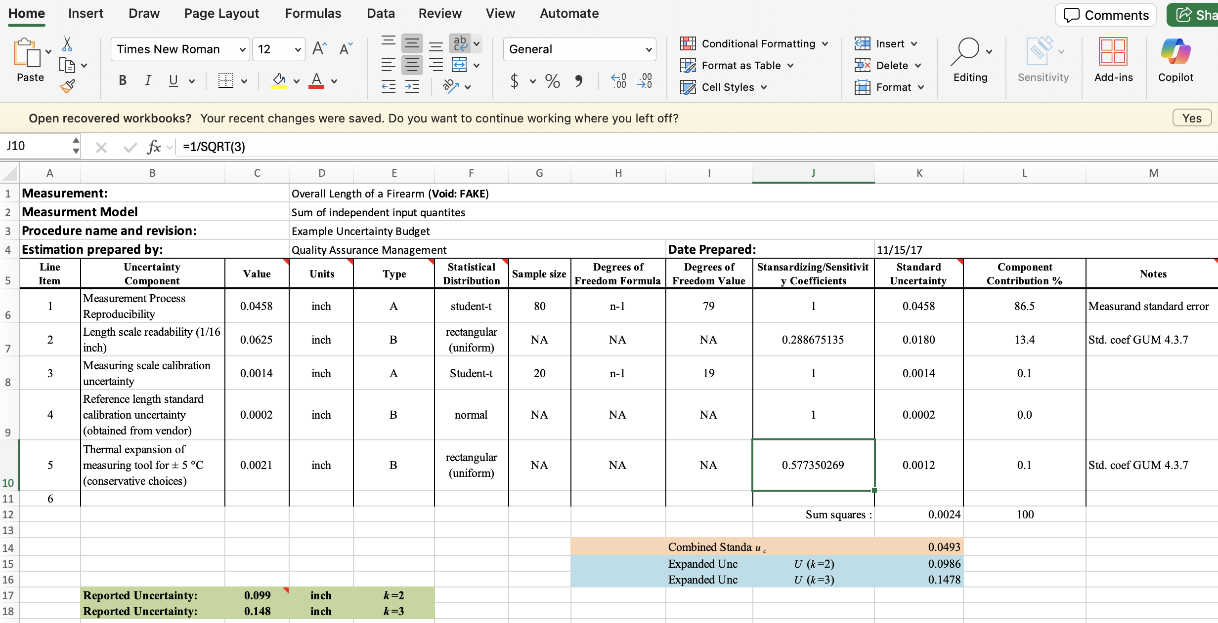
Bet You Never Heard of This One

Slide 7

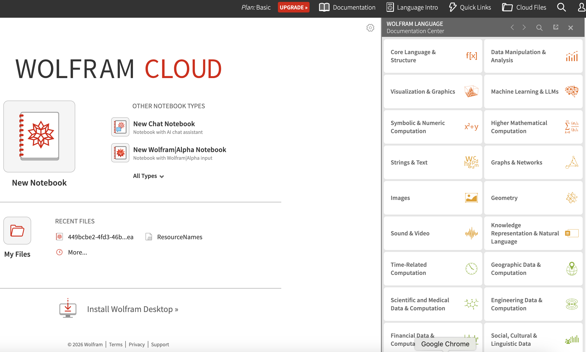
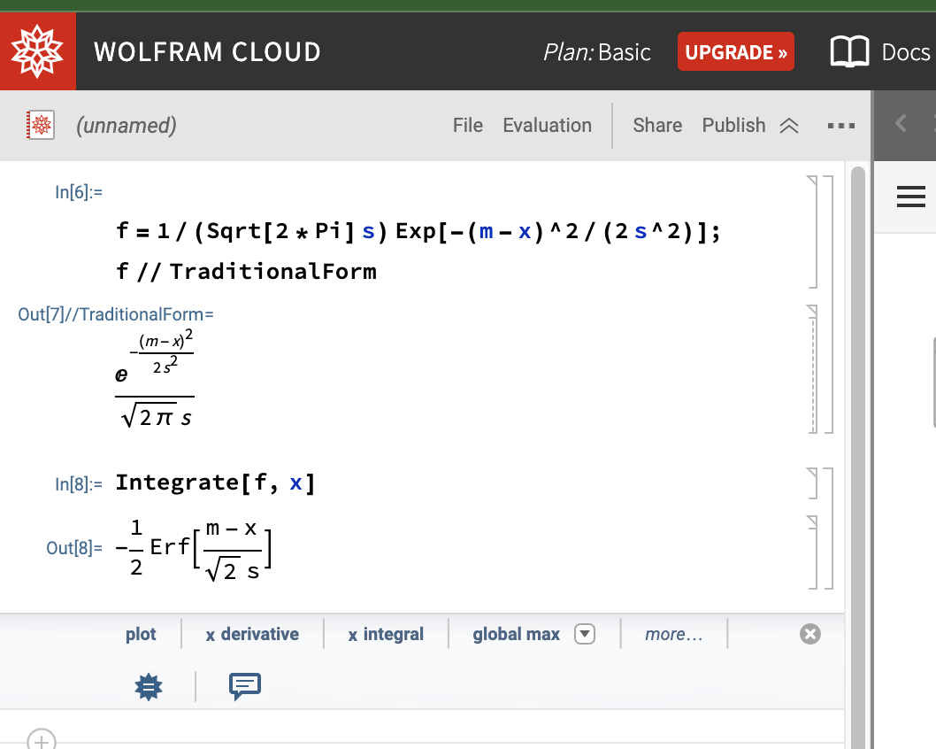
What is Mathematica ?
Primarily a computer program to do symbolic algebra and calculus
Does Plotting, Numerical and Web stuff too.
Free to use on the web at:
https://www.wolframcloud.com/

Slide 8
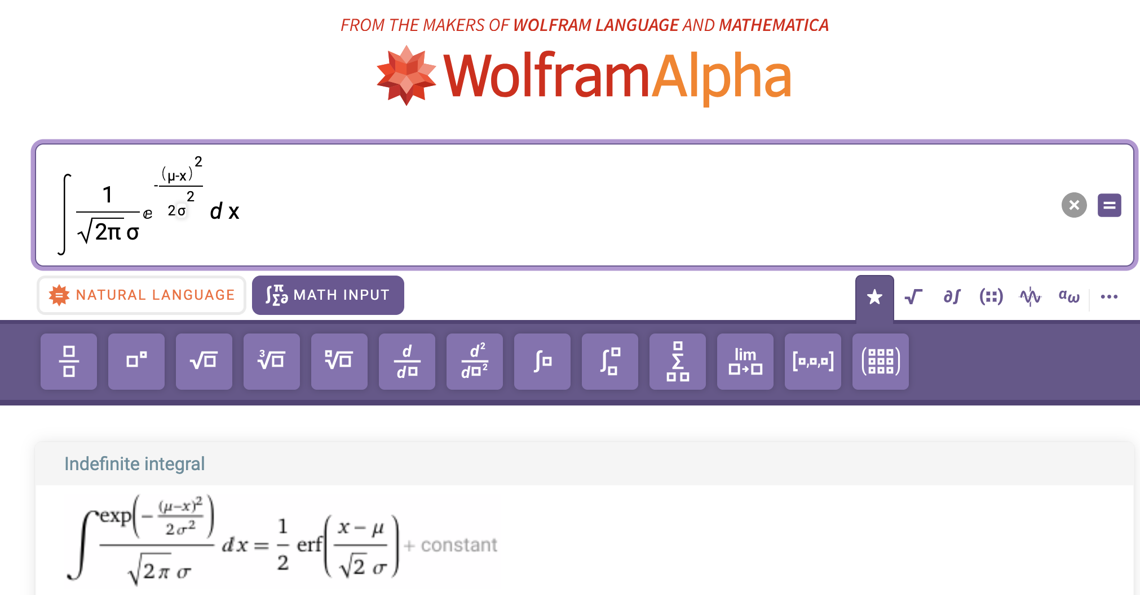
What is Mathematica?
Another web version of Mathematica, with no account needed is:
https://www.wolframalpha.com/

Slide 9

Bayesian Network/Graphical Model Software
Computer programs to deal with certain kinds of probability models that can be represented as special graphs
These graphical models are becoming popular in forensic science
A particular type of graphical model with easy to use software is a Bayesian network:

Slide 10

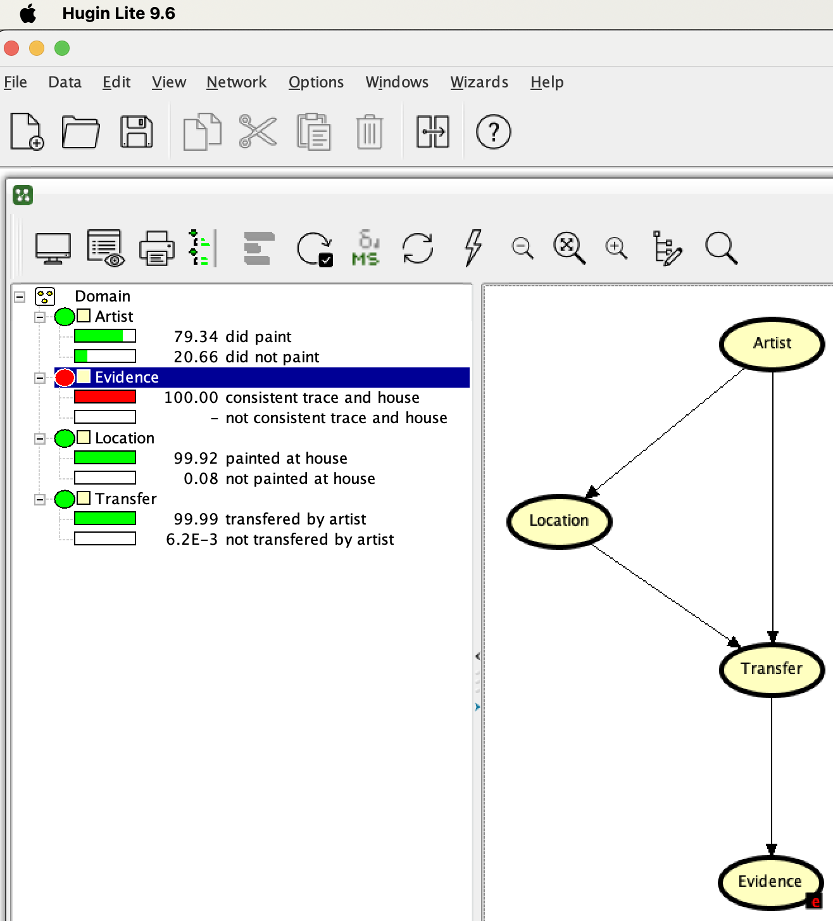
Bayesian Network/Graphical Model Software
A simplified but free version of Hugin Bayesian network software is available at: https://www.hugin.com/hugin-lite/

