Slide 1

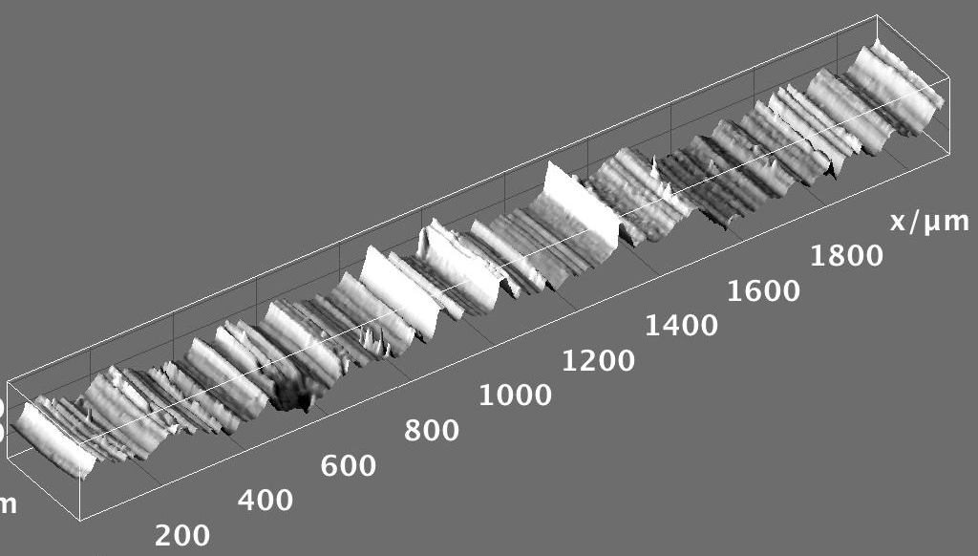


Hands-on Introduction to R

Slide 2
Outline
R : A powerful platform for scientific calculation and data analysis
Why bother learning R ?
Data, data, data, I cannot make bricks without clay ^{Copper Beeches}
A tour of RStudio. Basic Input and Output
Getting Help
Visualizing with Plots
Loading your data from Excel spreadsheets

Slide 3
Why ?
R is not a black box!
Codes available for review; totally transparent!
R maintained by a professional group of statisticians, and computational scientists
From very simple to state-of-the-art procedures available
Very good graphics for exhibits and papers
R is extensible (it is a full scripting language)
Coding/syntax similar to Python and MATLAB
Easy to link to C/C++ routines

Slide 4
Why ?
Where to get information on R :
R: http://www.r-project.org/
Just need the base
RStudio: http://rstudio.org/
A great IDE for R
Work on all platforms
Sometimes slows down performance…
CRAN: http://cran.r-project.org/
Library repository for R
Click on Search on the left of the website to search for package/info on packages

Slide 5
Finding our way around R/RStudio
Script Window
Command Line

Slide 6
Handy Commands:
Basic Input and Output
Numeric input
x <- 4
variables:
store
information
:Assignment operator
x <- "text goes in quotes"
Text (character) input

Slide 7
Handy Commands:
Get help on an R command:
If you know the name: ?command name
?plot brings up html on plot command
If you don’t know the name:
Use Google (my favorite)
??key word

Slide 8
Handy Commands:
R is driven by functions:
func(arguement1, argument2)
function name
input to function goes in parenthesis
function returns something; gets dumped into x
x <- func(arg1, arg2)

Slide 9
Using R functions: Example
Say we have a vector of some data. Let’s enter it into R:
-2π, -1.5π, …, 2π
# Enter in the vector of data:
dat <- c(-2*pi, -1.5*pi, -1*pi, -0.5*pi, 0, 0.5*pi, 1*pi,
1.5*pi, 2*pi)
c() is the “collect” function
Compute the sin() of each of your data points:
# Example of USING a function:
out <- sin(dat)
out

Slide 10
Plots: Look at your data
We will visualize our resuts as much as possible. Let’s make some basic plots!
Plot cosine from -5π to 2.8π, and use 100 data points
Handy R function we’ll use all the time
# seq generates a sequence:
x <- seq(from= -5*pi, to= 2.8*pi, length.out = 100)
y <- cos(x)
plot(x, y, type="l")
Defines “x-axis”
Extra argument to connect the points
Defines “y-axis”

Slide 11
How to Load Spreadsheets of Data:
Input from Excel
Save spreadsheet as a CSV file
A .csv file is just a text version of an Excel file
We’ll use the read.csv function

Slide 12
Re-work below to be current about loading data directly off your computer and the concepts that need to be understood to do that

Slide 13
What You Need to Know
About Your Computer
Data (documents, spread-sheets, music, pictures, etc…) is stored on your hard drive:
Say you transfer a picture from your phone to your laptop.
Magnetic disk or semiconductor chips
Picture file gets saved here.
How do we find the file when we need it again?????

Slide 14
What You Need to Know About Your Computer
The address of any file on your computer is called its file path.
Your file is saved here.
The file path tell you how to navigate through a series of folders (directories) to get to your file.

Slide 15
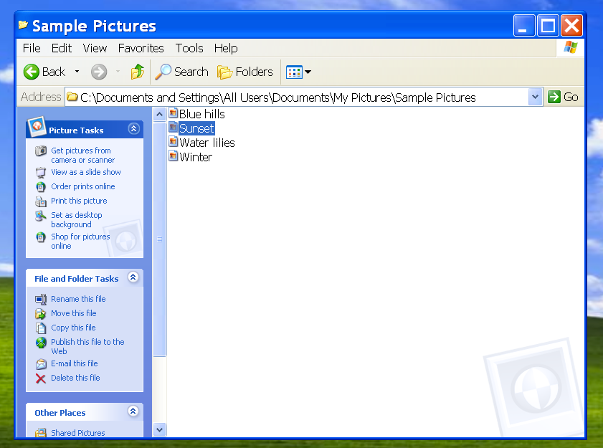
What You Need to Know About Your Computer
Root directory is C:\
File path to Sunset.bmp picture file
Your file is saved here.
Sunset.bmp picture file is in the “Sample Pictures” directory
Sometimes we’ll need to navigate to files or look up file paths to work with data.

Slide 17
How to Load Spreadsheets of Data:
Input from Excel
We can load in a file directly from the internet using its URL address (if we have a working internet connection):
# A file on the internet. Use it’s URL to load:
some.data2 <- read.csv("https://raw.githubusercontent.com/npetraco/CHE302/master/Laboratories/Lab0/bigdata.csv", header = F)

Slide 18
How to Load Spreadsheets of Data:
Input from Excel
Also you can download and save spreadsheet as a CSV file
You’ll need to type in the path to the file in read.csv
Mac e.g.:
"/Users/npetraco/latex/papers/data.csv"
Windows e.g.:
"C:\Users\npetraco\latex\papers\data.csv"
"C:/Users/npetraco/latex/papers/data.csv"
"C:\\Users\\npetraco\\latex\\papers\\data.csv"

Slide 19
How to Load Spreadsheets of Data:
Load a CSV file that is on your (mine actually…) Desktop. The file is called bigdata.csv and I made it in Excel:
This brings up the choose file menu instead
# Load the spreadsheet:
dat <- read.csv("/Users/npetraco/Desktop/bigdata.csv")
# We could also do this:
#dat <- read.csv(file.choose())
# Extract column 1
x <- dat[,1]
# Extract column 2
y <- dat[,2]
# Plot the data:
plot(x,y)

Slide 20
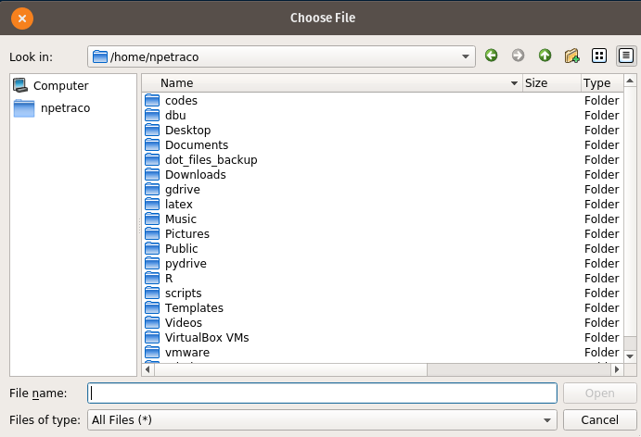
How to Load Spreadsheets of Data:
Input from Excel
An alternative is to use file.choose() function with read.csv:
# file.choose lets you navigate to file you want and gets
# its path:
apath <- file.choose()
some.data <- read.csv(apath)

Slide 21
More Handy Commands:
Matrices: X
X[,1] returns column 1 of matrix X
X[3,] returns row 3 of matrix X
Handy functions for data frames and matrices:
dim, nrow, ncol, rbind, cbind
User defined functions syntax:
func.name <- function(arguements) {
do something
return(output)
}
To use it: func.name(values)

Slide 22
More Handy R Commands:
# Enter some data in a Matrix:
X <- rbind(
c(0.99, 0.92, 0.84, 0.39, 0.36),
c(0.87, 0.73, 0.80, 0.76, 0.87),
c(0.50, 0.11, 0.14, 0.43, 0.62),
c(0.08, 0.41, 0.68, 0.49, 0.02)
)
# What happens when we execute each of these line?:
X
X[1,3]
X[2,]
X[,1]
X[5,]
X[5]

Slide 23
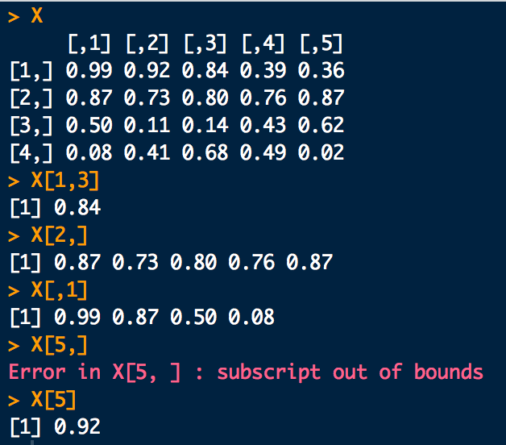
More Handy R Commands:

