Slide 1
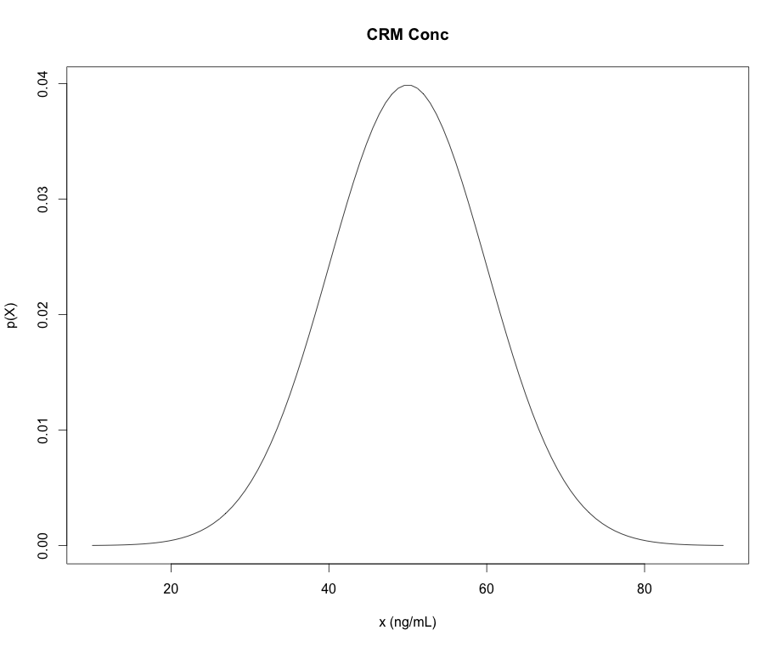
Some R Commands for PDFs and CDFs
dnorm “d-function” in R is the density (mass) of the distribution (PDF)
pnorm “p-function” in R is the CDFs of the distribution (CDF)
qnorm “q-function” in R give the quantiles of the distribution (x-values) for a given cumulative probability (p-value)
rnorm “r-functions” in R gives a random sample from the distribution
*NOTE: “p-functions” and “q-functions” are inverses of each other
pnorm(q=47,mean=50,sd=10)=
0.42
0.42
“input quantity”
qnorm(p=0.42,mean=50,sd=10)=
47
47

Slide 2
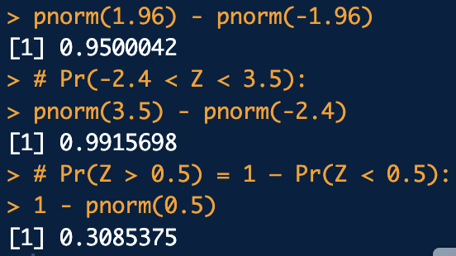
An abstractly worded example
Consider a standard normal random variate:
# a. Pr(-1.96 < Z < 1.96):
pnorm(1.96) - pnorm(-1.96)
# b. Pr(-2.4 < Z < 3.5):
pnorm(3.5) - pnorm(-2.4)
# c. Pr(Z > 0.5) = 1 – Pr(Z < 0.5):
1 - pnorm(0.5)
a. Compute:
b. Compute:
normal_ex1.R
c. Compute:
How would the code change for a uniform random variate between -4 and 4?

Slide 3
Example: quantiles/percentiles by integration
A sample of methamphetamine in blood certified reference material (CRM) is obtained as a standard for calibration of methodology in a tox lab.
The concentration of the CRM is certified to follow a normal distribution with mean concentration of 50 ng/mL and standard deviation of 10 ng/mL.

Slide 4
Example: quantiles/percentiles by integration
What is the probability of that the CRM’s concentration will be measured to be between 30 ng/mL and 70 ng/mL?
30 ng/mL
70 ng/mL
What would the code look like if we wanted Pr(X > 70ng/mL)?
# The "measurands" (parameters):
mu <- 50
sigma <- 10
# Pr(30 < X < 70):
pnorm(70, mean=mu, sd=sigma) - pnorm(30, mean=mu, sd=sigma)
normal_ex2.R

Slide 5

Example: quantiles/percentiles by integration
What is the upper concentration can we expect for 90% of the samples we may measure?
Another way to phrase: What measured sample concentration (quantile) should correspond to the 90th percentile with respect to the CRM?
# Quantile for the 90th percentile:
qnorm(0.9, mean=mu, sd=sigma)
0.9
normal_ex2.R
x?

Slide 6
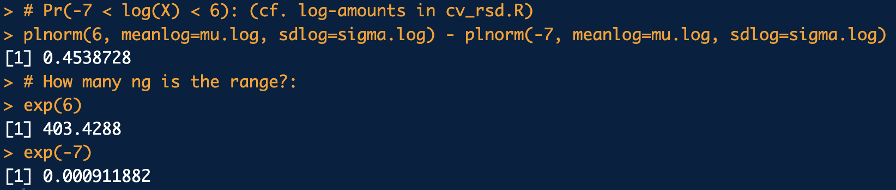
Example: Lognormal Data
A study found that amount of touch DNA collected on a certain surface follows a lognormal distribution with μ_{log}= 5.5 log-ng and σ_{log}= 32 log-ng. Compute the probability of recovering between -7 log-ng and 6 log-ng. (How many ng is the range?)
mu.log <- 5.5
sigma.log <- 32
# Pr(-7 < log(X) < 6): (cf. log-amounts in cv_rsd.R)
plnorm(6, meanlog=mu.log, sdlog=sigma.log) - plnorm(-7, meanlog=mu.log, sdlog=sigma.log)
# How many ng is the range?:
exp(6)
exp(-7)
lognormal_ex.R

Slide 7

Example: Hypergeometric Distribution
What is the probability that a sample of size 90 contains 68 pills positive for Xanax given 70% of a consignment of 500 pills contain Xanax?
k <- 90 # Sample size
x <- 68 # Number of positives in sample
N <- 500 # Consignment size
p <- 0.7 # 70% of pills in consignment contain drug
m <- N*p # number of positives in consignment
n <- N-m # number of negatives in consignment
# Probability of 68 pillis in sample of 90 are positive
dhyper(x = x, m = m, n = n, k = k)
hypergeom_ex1.R

Slide 8
Example
Check to see how well unidentified C4-akyl benzene data from the gasoline data set below follows follows a standard normal distribution using a qq-plot:
0.29569050, 0.20648248, 0.26693348, 0.21223481, 0.25198974, 0.23751277, 0.25585990, 0.20096679, 0.19726276,
0.15425261, 0.16483406, 0.18912258, 0.15739817, 0.15009366, 0.10737274, 0.11019686, 0.12513466, 0.09524371,
0.11218649, 0.11831685, 0.08995212, 0.15960698, 0.18276274, 0.18421865, 0.18959053, 0.17426713, 0.16382262,
0.17599096, 0.28697780, 0.28860089, 0.29051508, 0.25595839, 0.34949305, 0.29253407, 0.23217603, 0.10844975,
0.10404332, 0.09618116, 0.11909941, 0.09788748, 0.10919293, 0.09880065, 0.22318522, 0.21620975, 0.19462144,
0.19739592, 0.18673440, 0.19269031, 0.18278502, 0.09439924, 0.06428694, 0.07324709, 0.08058238, 0.06419378,
0.09414924, 0.07600200, 0.32917529, 0.32886336, 0.37166893, 0.17086414, 0.14853369, 0.13197682, 0.20217787,
0.20856402, 0.22020857, 0.28396187, 0.30769551, 0.31123136, 0.38733964, 0.40322122, 0.40450410, 0.23592761,
0.21981379, 0.23742448, 0.16887720, 0.16218831, 0.15824930, 0.14710371, 0.13743570, 0.14051266, 0.21783285,
0.21272617, 0.23454162, 0.17563793, 0.16575187, 0.17353579, 0.15081576, 0.12968366, 0.13749965, 0.13056509,
0.13839749, 0.12118398

Slide 9
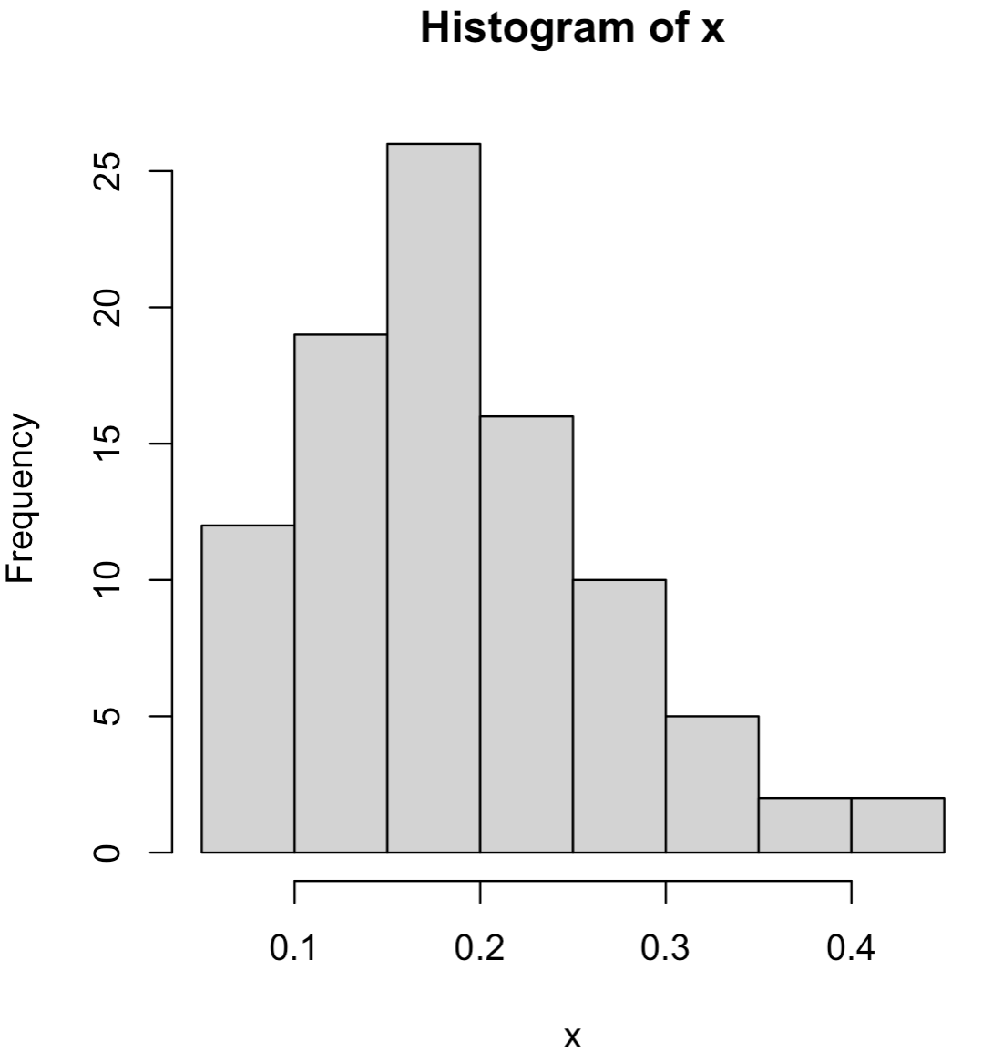
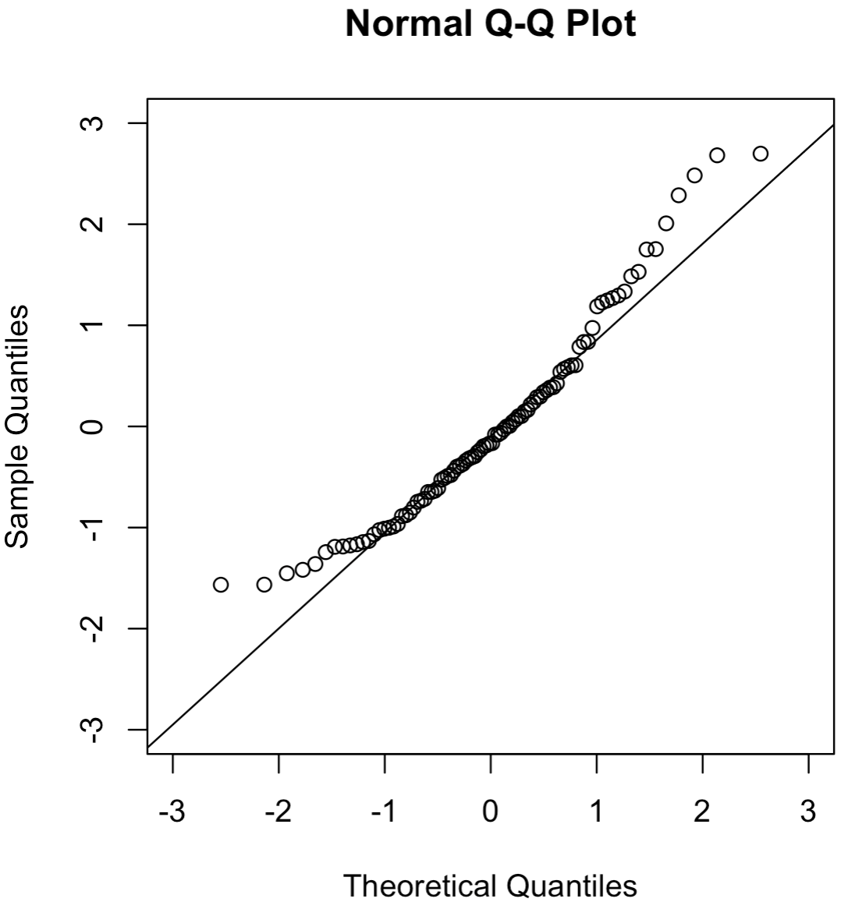
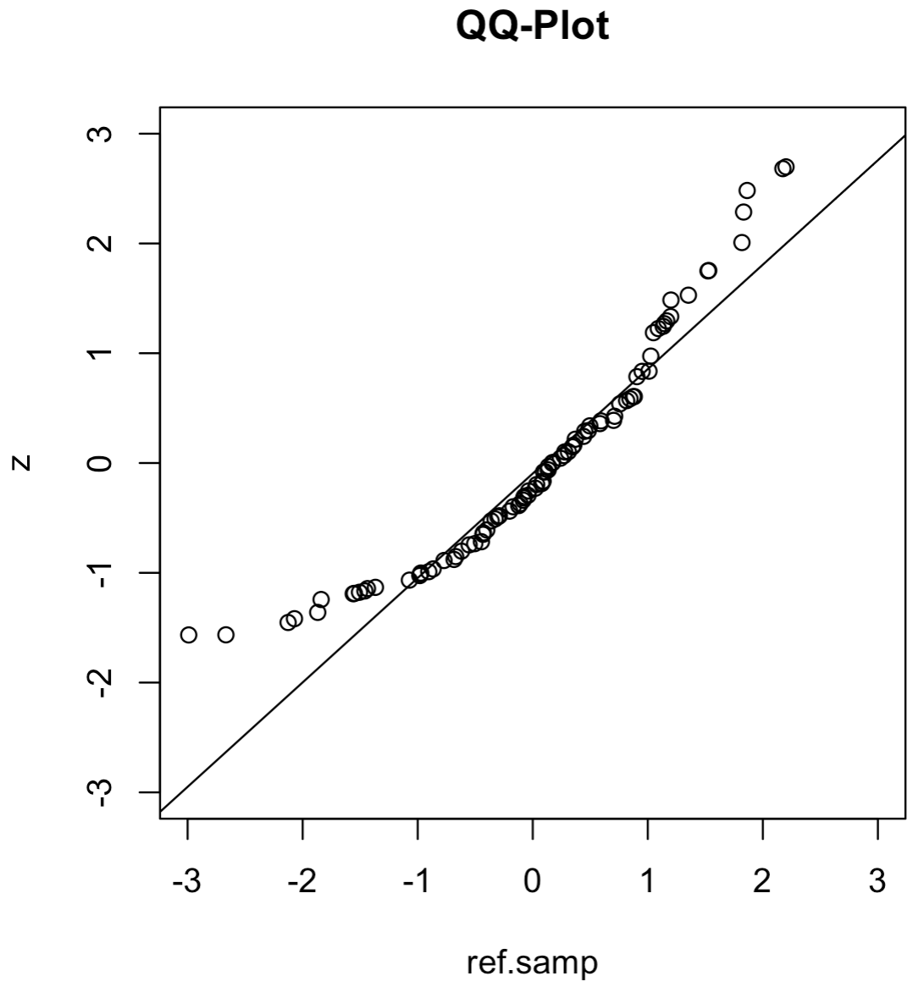
library(frequtils)
data(gas)
x <- gas$C4.alkylbenzene.unid.5
hist(x)
# Standardize the data
z <- (x-mean(x))/sd(x)
# QQ-plot wrt/ standard normal distribution:
qqnorm(z, xlim=c(-3,3), ylim=c(-3,3))
qqline(z)
# A more general way to make a QQ-plot:
ref.samp <- rnorm(length(x), mean = 0, sd = 1)
qqplot(ref.samp, z, main="QQ-Plot", xlim=c(-3,3), ylim=c(-3,3))
qqline(z, distribution = function(p){qnorm(p, mean = 0, sd = 1)})
qqplot_ex.R

Slide 10
Example
Consider the shotgun pellet spread (sqrt.area) vs. distance data in sgr.tsim of frequtils:
Plot the PMFs of the pellet spread at 10ft for the Stevens and Remington guns.
Compare the distributions of the Stevens and Remington datasets at 10ft with a QQ-plot. What are your observations and conclusions about the similarity of the two dataset's distributions?
Plot the eCDFs of the Stevens and Remington datasets at 10ft and overlay them. Do your conclusions change from b.?

Slide 11
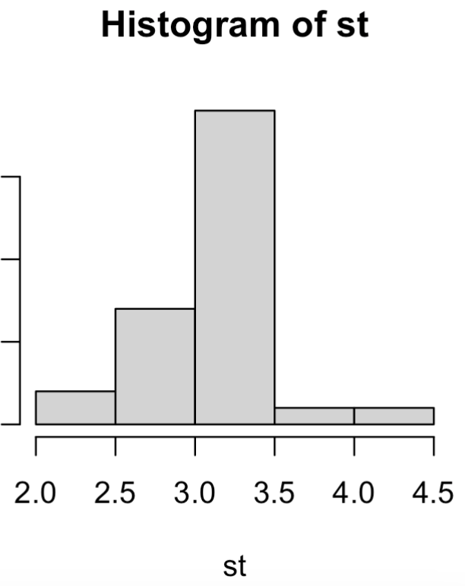
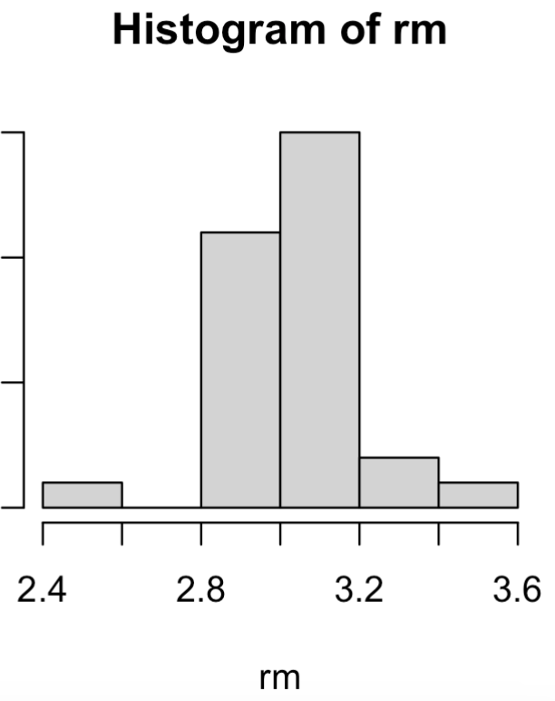
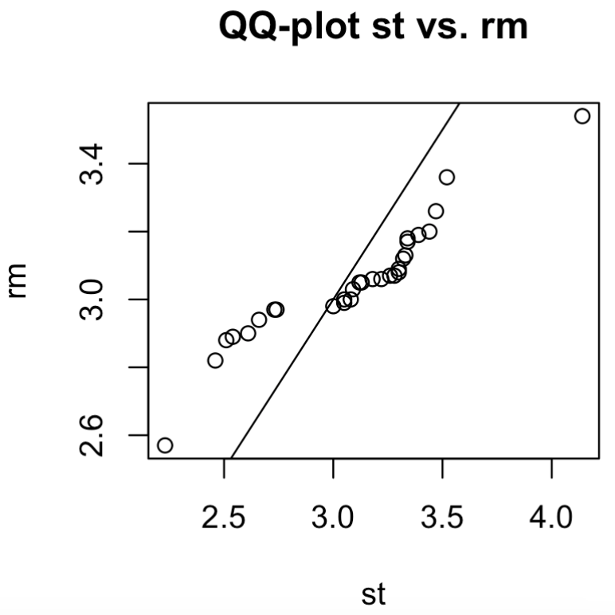
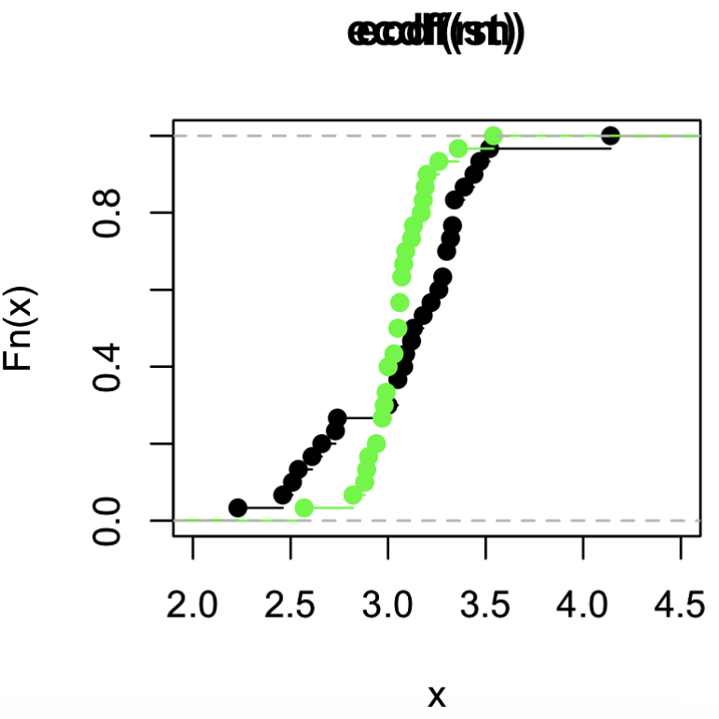
library(frequtils)
data("sgr.tsim")
st.idxs <- which(sgr.tsim$gun.lbl=="Stevens")
rm.idxs <- which(sgr.tsim$gun.lbl=="Remington")
st <- sgr.tsim[st.idxs, 1] # X10.ft data Stevens
rm <- sgr.tsim[rm.idxs, 1] # X10.ft data Remington
# Datasets distributions (PMFs)
hist(st)
hist(rm)
# QQ-plot to compare datasets distributions:
qqplot(st,rm, main="QQ-plot st vs. rm")
abline(a = 0, b = 1)
# Data CDFs:
Fx.st <- ecdf(st)
Fx.rm <- ecdf(rm)
plot(Fx.st)
plot(Fx.rm)
# Overlay to ecdfs compare also:
plot(Fx.st, xlim=c(2,4.5))
par(new=T)
plot(Fx.rm, xlim=c(2,4.5), col="green")
qqplot_ecdf_compare.R

