Slide 1

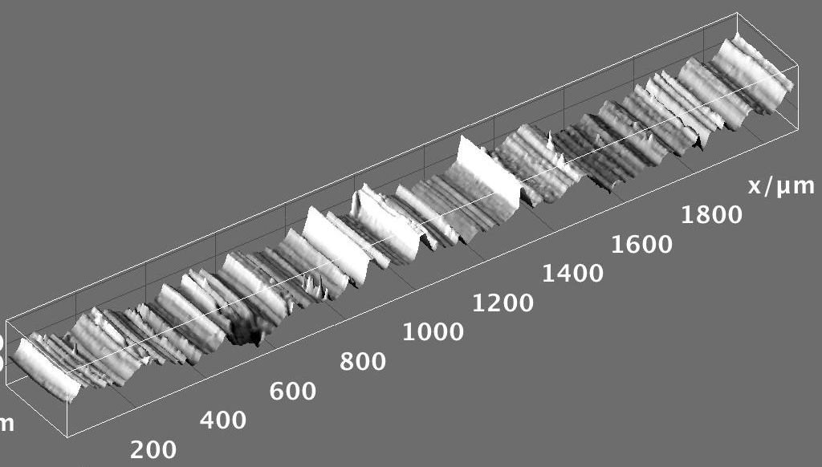


Hands-on Introduction to R

Slide 2
Outline
R : A powerful platform for scientific calculation and data analysis
Why bother learning R ?
Data, data, data, I cannot make bricks without clay ^{Copper Beeches}
A tour of RStudio. Basic Input and Output
Getting Help
Visualizing with Plots
Loading your data from Excel spreadsheets
Basic Plotting

Slide 3
Why ?
R is not a black box!
Codes available for review; totally transparent!
R maintained by a professional group of statisticians, and computational scientists
From very simple to state-of-the-art procedures available
Very good graphics for exhibits and papers
R is extensible (it is a full scripting language)
Coding/syntax similar to Python and MATLAB
Easy to link to C/C++ routines

Slide 4
Why ?
Where to get information on R :
R: http://www.r-project.org/
Just need the base
RStudio: http://rstudio.org/
A great IDE for R
Work on all platforms
Sometimes slows down performance…
CRAN: http://cran.r-project.org/
Library repository for R
Click on Search on the left of the website to search for package/info on packages

Slide 5
Finding our way around R/RStudio
Script Window
Command Line

Slide 6
Handy Commands:
Basic Input and Output
Numeric input
x <- 4
variables:
store
information
:Assignment operator
x <- “text goes in quotes”
Text (character) input

Slide 7
Handy Commands:
Get help on an command:
If you know the name: ?command name
?plot brings up html on plot command
If you don’t know the name:
Use Google (my favorite)
??key word

Slide 8
Handy Commands:
is driven with functions:
func(arguement1, argument2)
function name
input to function goes in parenthesis
function returns something; gets dumped into x
x <- func(arg1, arg2)

Slide 9
Using functions: Example
Say we have a vector of some data. Let’s enter it into R:
-2π, -1.5π, …, 2π
# Enter in the vector of data:
dat <- c(-2*pi, -1.5*pi, -1*pi, -0.5*pi, 0, 0.5*pi, 1*pi,
1.5*pi, 2*pi)
first_examples.R
c() is the “collect” function
Compute the sin() of each of your data points:
# Example of USING a function:
out <- sin(dat)
out

Slide 10
Plots: Look at your data
We will visualize our resuts as much as possible. Let’s make some basic plots!
Plot cosine from -5π to 2.8π, and use 100 data points
Handy R function we’ll use all the time
# seq generates a sequence:
x <- seq(from= -5*pi, to= 2.8*pi, length.out = 100)
y <- cos(x)
plot(x, y, type="l")
Defines “x-axis”
Extra argument to connect the points
Defines “y-axis”
first_examples.R

Slide 11
Slicing and Dicing Data
Data chucks in are called (among other things) data frames, arrays, vectors, or matrices: X
These objects have “indices”:
vectors:
X[4] returns element 4 of vector X
matrices:
X[,1] returns column 1 of matrix X
X[3,] returns row 3 of matrix X
X[c(2,4),] returns rows 2 and 4 of matrix X
Handy functions for data frames and matrices:
dim, nrow, ncol, rbind, cbind

Slide 12
Slicing and Dicing Data
# Enter some data in a Matrix:
X <- rbind(
c(0.99, 0.92, 0.84, 0.39, 0.36),
c(0.87, 0.73, 0.80, 0.76, 0.87),
c(0.50, 0.11, 0.14, 0.43, 0.62),
c(0.08, 0.41, 0.68, 0.49, 0.02)
)
# What happens when we execute each of these line?:
X
X[1,3]
X[2,]
X[,1]
X[5,]
X[5]
first_examples.R

Slide 13
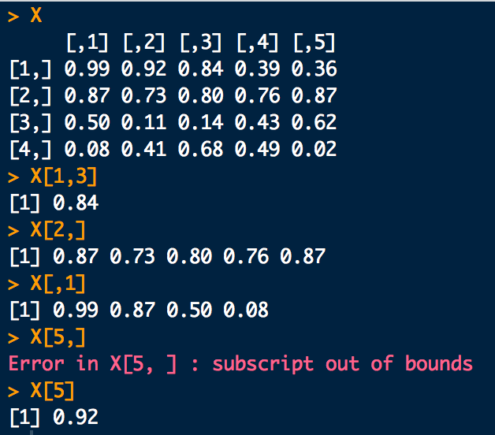
Slicing and Dicing Data

Slide 14
How to Load Spreadsheets of Data:
Input from Excel
Save spreadsheet as a CSV file
A .csv file is just a text version of an Excel file
We’ll use the read.csv function

Slide 15
How to Load Spreadsheets of Data:
Input from Excel
Method easiest for class: We can load in a file directly from the internet using its URL address (if we have a working internet connection):
# A file on the internet. Use it’s URL to load:
dat <- read.csv("https://raw.githubusercontent.com/npetraco/709/refs/heads/main/R/data/ASCLAD_GaugeR%26R_example_data.csv", header = T)
# **check the datatype R thinks it loaded
class(dat)
spreadsheet_load.R

Slide 16
How to Load Spreadsheets of Data:
Input from Excel
Usually however you have a spreadsheet on your computer already as a CSV file
You’ll need to type in the path to the file in read.csv
Mac e.g.:
"/Users/npetraco/latex/papers/data.csv"
Windows e.g.:
"C:\Users\npetraco\latex\papers\data.csv"
"C:/Users/npetraco/latex/papers/data.csv"
"C:\\Users\\npetraco\\latex\\papers\\data.csv"

Slide 17
How to Load Spreadsheets of Data:
Load a CSV file that is on your (mine actually…) Desktop. The file is called bigdata.csv and I made it in Excel:
# Load the spreadsheet:
dat <- read.csv("/Users/npetraco/Desktop/GC_gasoline_peak_data.csv")
# Extract column 1
x <- dat[,1]
# Extract column 2
y <- dat[,2]
# Plot the data:
plot(x,y)
spreadsheet_load.R

Slide 18
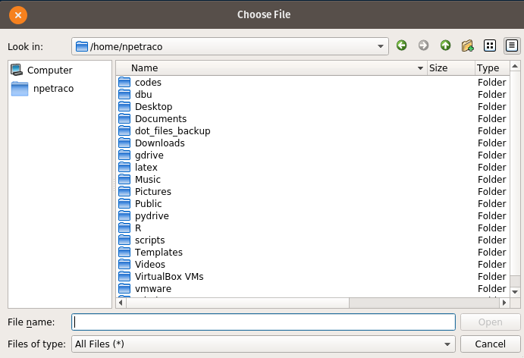
How to Load Spreadsheets of Data:
Input from Excel
An alternative is to use file.choose() function with read.csv:
# file.choose lets you navigate to file you want and gets
# its path:
apath <- file.choose()
some.data <- read.csv(apath)
spreadsheet_load.R

Slide 19
Installing R packages
R has a vast repository of user created specialized code called CRAN
The code is called packages or libraries
To install and use a package from CRAN do the following:
Only need to do this once
package/library name
# Install a package called mlbench:
install.packages("mlbench")
# Turn on the library for use:
library(mlbench)
install_a_package.R
install.packages()
library() turn on package for use

Slide 20
Installing Our Course Package
We will use a custom course package for the course but it’s on GitHub, not CRAN
How to install a package from GitHub:
install.packages("remotes")
library(remotes)
install_github("npetraco/frequtils")
library(frequtils)
data(linton) # Load some built in data as a test
head(linton)
# Optional packages:
#install.packages("rgl")
#install.packages("extraDistr")
#install.packages("tolerance")
#install.packages("mlbench")
#install.packages("dafs")
#install.packages("outliers")
#install.packages("EnvStats")
#install.packages("dixonTest")
#install.packages("effectsize")
install_course_package.R

Slide 21
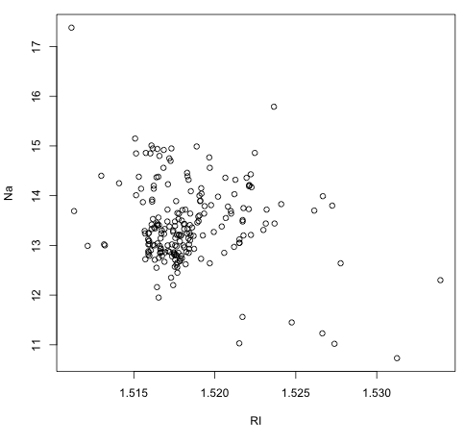
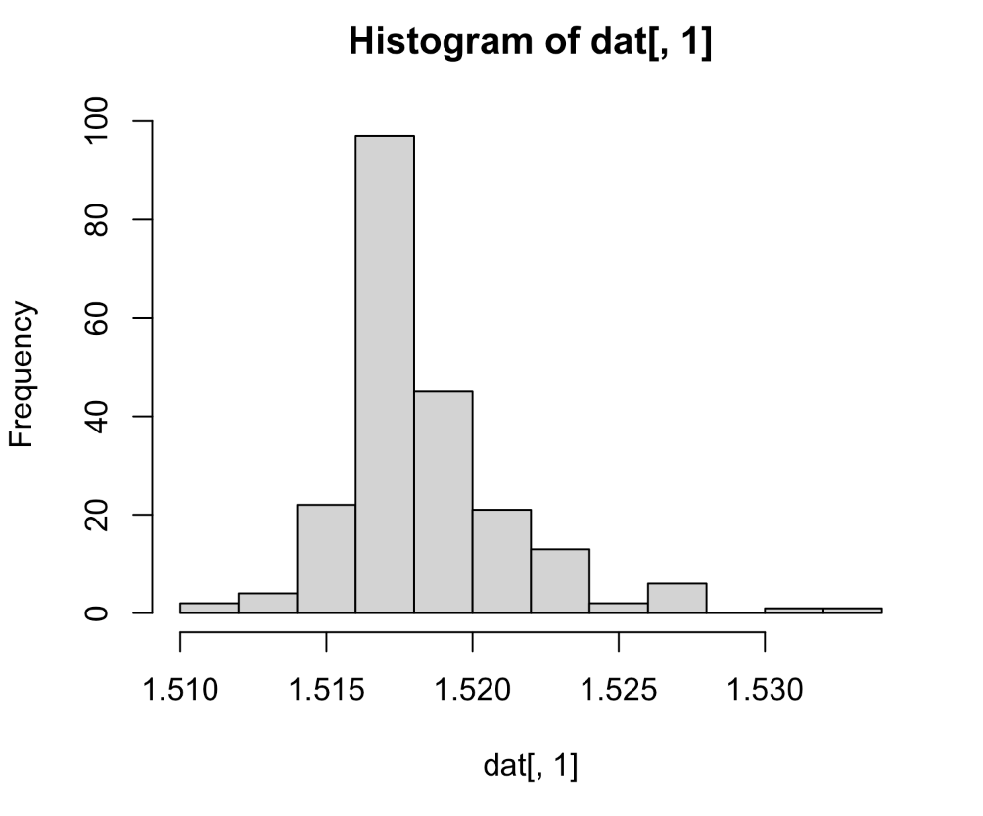
More Plots of your Data
Explore the Glass dataset
Scatter plots: plot any two variables against each other
Histograms: “bin” a variable and plot frequencies

Slide 22
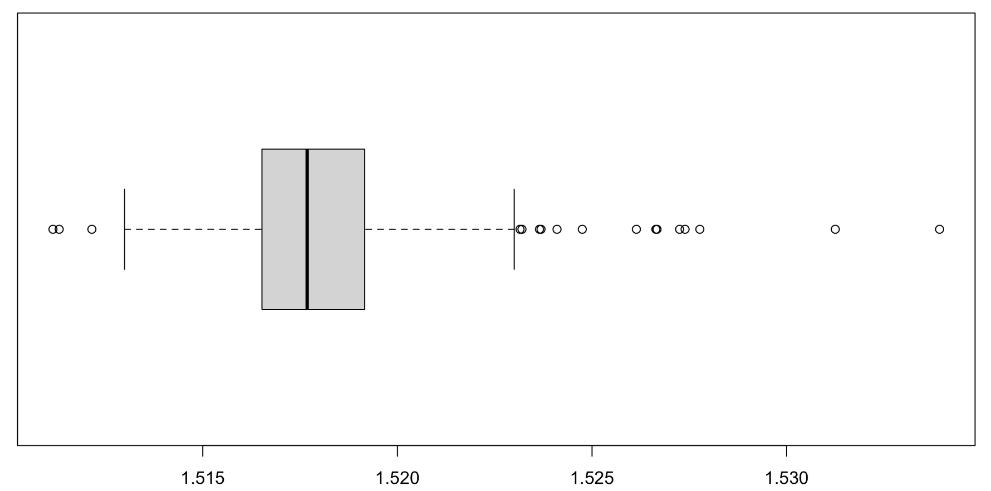
More Plots of your Data
Box and Whiskers plots:
range
possible
outliers
possible
outliers
25th-%tile
1st-quartile
median
50th-%tile
75th-%tile
3rd-quartile
RI

Slide 23
Basic Plotting Commands:
plot() basic 2D plot
hist() basic histogram
boxplot() basic box and whiskers plot
# Load data:
dat <- read.csv(
"https://raw.githubusercontent.com/npetraco/709/refs/heads/main/R/data/Glass.csv")
head(dat)
# Scatter plot:
plot(dat[,1], dat[,2])
# Histogram:
hist(dat[,1])
# Box and whisker plot:
boxplot(dat[,1], horizontal = T)
basic_plotting.R

Slide 24
More Advanced Plots/Syntax:
data() access built in data set
? Bring up help page
$ access named columns or list elements
stripchart()
library(mlbench)
# Load some sample data
data("Glass")
?Glass
# Scatter plots
plot(Glass$RI, Glass$Na)
plot(Glass$Na, Glass$Si)
# Strip chart
stripchart(as.numeric(Type)~Na, data=Glass,xlab="Glass#",
ylab="Na conc.", vertical=F, pch=16)
stripchart.R

Slide 25
More Advanced Plots/Syntax:
library(mlbench)
# Load some sample data
data("Glass")
head(Glass)
ele <- Glass[, 2:8] # Slice out columns of elements
dim(ele)
# **** Looping ****
ele.avgs <- array(-1, c(ncol(ele))) # Allocate space to hold element averages
for(i in 1:ncol(ele)) {
ele.avg <- mean(ele[,i]) # compute average of element
ele.avgs[i] <- ele.avg # store average
}
names(ele.avgs) <- colnames(ele) # Optional: label the elements
ele.avgs
pie(ele.avgs) # Make a pie chart
loops_and_pie.R

Slide 26
More Advanced Plots/Syntax:
library(mlbench)
# Load some sample data
data("Glass")
# Compute average element abundance for each glass type:
ele <- Glass[, 2:8] # Slice out columns of elements
lbl <- Glass[, 10] # Slice out the glass type, a set of labels
lbl.typ <- levels(lbl)
# **** Nested Looping ****
num.typ <- length(lbl.typ) # Number of unique glass type labels
num.ele <- ncol(ele) # Number of elements
ele.typ.avg <- array(-1, c(num.ele, num.typ)) # Allocate storage for each element-glasstype average
for(i in 1:num.ele) {
ele.col <- ele[,i] # Slice out an element column
for(j in 1:num.typ) {
# Now slice out the element abundances for each glass type:
ele.typ.idxs <- which(lbl == lbl.typ[j])
# Take the average element abundance for each glass type and store it
ele.typ.avg[i,j] <- mean(ele.col[ele.typ.idxs])
}
}
# Label the rows and columns of the element-glass type averages:
element.names <- colnames(ele)
glass.typ.names <- c("bldg.flot","bldg.nflot","veh.flot","contnr","tabwre","headlgt")
rownames(ele.typ.avg) <- element.names
colnames(ele.typ.avg) <- glass.typ.names
# Stacked bar plots:
barplot(ele.typ.avg ~ element.names, main="Elements in Glass Type", col=rainbow(6))
legend("topright", legend = glass.typ.names, fill = rainbow(6), cex=0.75)
barplot(t(ele.typ.avg) ~ glass.typ.names, main="Elements in Glass Type", col=rainbow(8))
legend("topright", legend = element.names, fill = rainbow(8), cex=0.5)
nested_loops_and_stackedbar_plots.R

