Slide 1

Estimation 2, Intro to Simulation and
The Bootstrap

Slide 2
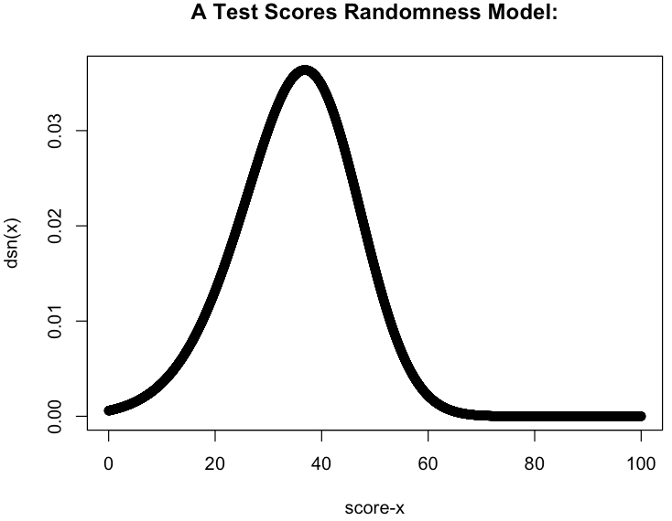
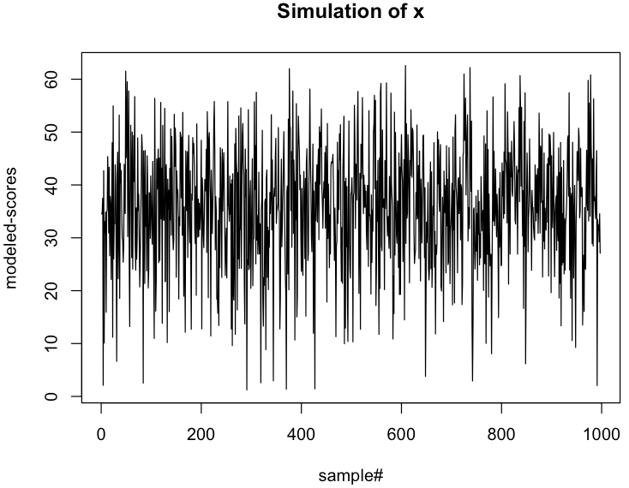
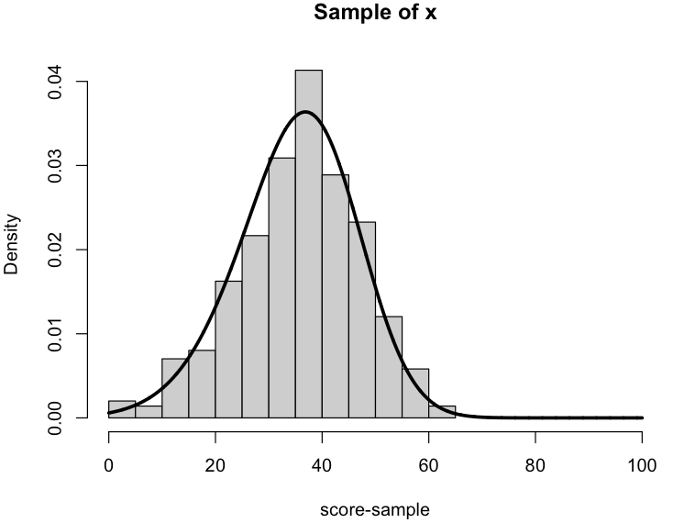
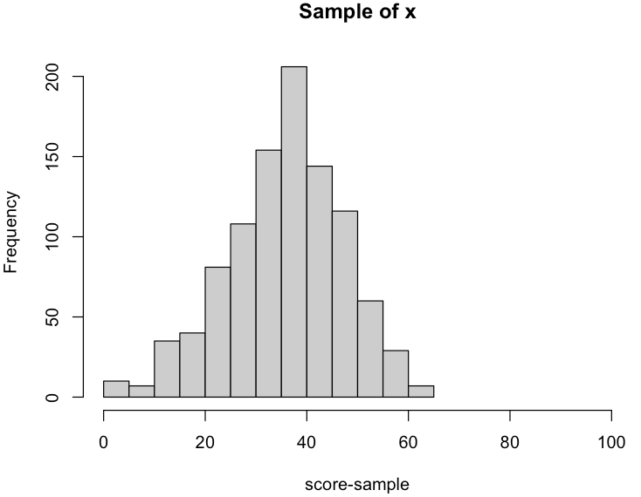
Random Sampling and Simulation
Bridge theory and real data: turn probabilistic models into numerical results.
Solve concrete problems by modeling uncertainty with “randomness models” and using calculations + visualization.
Simulation is running models to generate “new” data.
Simulation from a model is also called sampling.
Simulations are repetitive and tedious: a perfect job for computers:
simulation_ex.R

Slide 3
The Bootstrap
Reality in lab work:
Sample sizes are often small
Parameters we may want estimates for don’t have a known or convenient sampling distribution
Reality in the 21st century:
Computers are powerful, cheap and plentiful!
The bootstrap is a computer based simulation method that can be used to estimate virtually any parameter along with a measure of its uncertainty^{Efron}
Assumes nothing about the underlying data except that it is IID
Tends to give good estimates even for small sample sizes
Both handy properties for forensic applications

Slide 4
The Non-Parametric Bootstrap
Non-parametric Bootstrapping starts with a sample of data x of size n:
and re-samples (“bootstraps”) it many times, B
For each “bootstrap sample”, x*, compute your statistic of interest θ*
The collection of B θ*’s is the “non-parametric bootstrap approximation” for the sampling distribution of θ.

Slide 5
The Parametric Bootstrap
The parametric bootstrap generates bootstrap samples of data by assuming the data’s distribution and performing simulation:
Start with an assumed parametric probability distribution model for the data X:
Use a sample of data x of size n and/or expert judgement to assign parameters θ for the assumed data.
Draw B “bootstrap random samples”, x* of size n and compute B bootstrapped statistics of interest θ* just as with the non-parametric bootstrap.
The collection of B θ*’s is the “parametric bootstrap approximation” for the sampling distribution of θ.

Slide 6
Example
Consider the measurements of the length of a gun barrel (in):
18.449, 18.468, 18.431, 18.390, 18.450,
18.426, 18.401, 18.438, 18.431, 18.417
Find the non-parametric bootstrap approximation for the sampling distribution of the mean
Find the non-parametric bootstrap approximation for the sampling distribution of the median
Find the non-parametric bootstrap approximation for the sampling distribution of the measurement standard deviation
Repeat a., b. and c. assuming the data follows a normal distribution (i.e. use a parametric bootstrap).

Slide 7
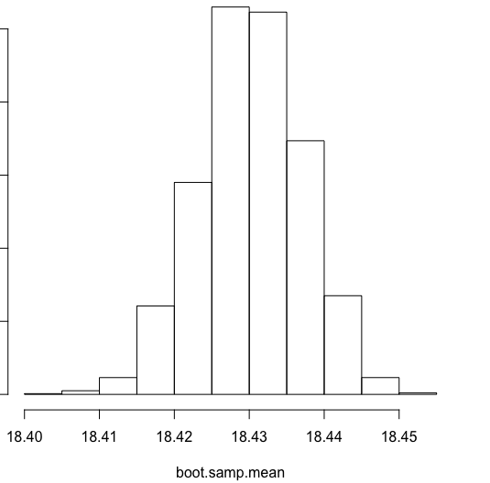
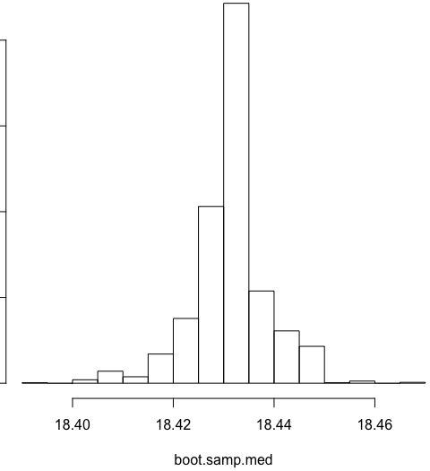
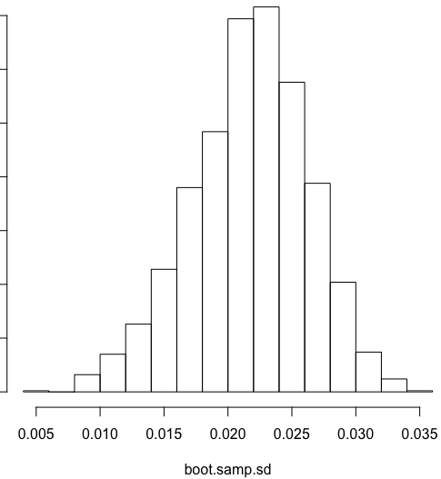
Non-Parametric BS Example
# Length measurements (in):
x <- c(18.449, 18.468, 18.431, 18.390, 18.450,
18.426, 18.401, 18.438, 18.431, 18.417)
n <- length(x)
B <- 2000 # Do this many bootstrap iterations
boot.samp.mean <- sapply(1:B, function(xx){mean(sample(x, size = n, replace = T))})
hist(boot.samp.mean)
boot.samp.med <- sapply(1:B, function(xx){median(sample(x, size = n, replace = T))})
hist(boot.samp.med)
boot.samp.sd <- sapply(1:B, function(xx){sd(sample(x, size = n, replace = T))})
hist(boot.samp.sd)
nonparametric_bs_ex1.R

Slide 8
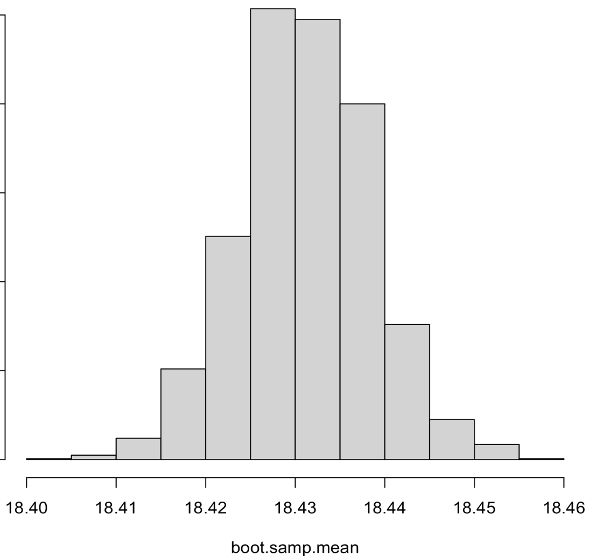
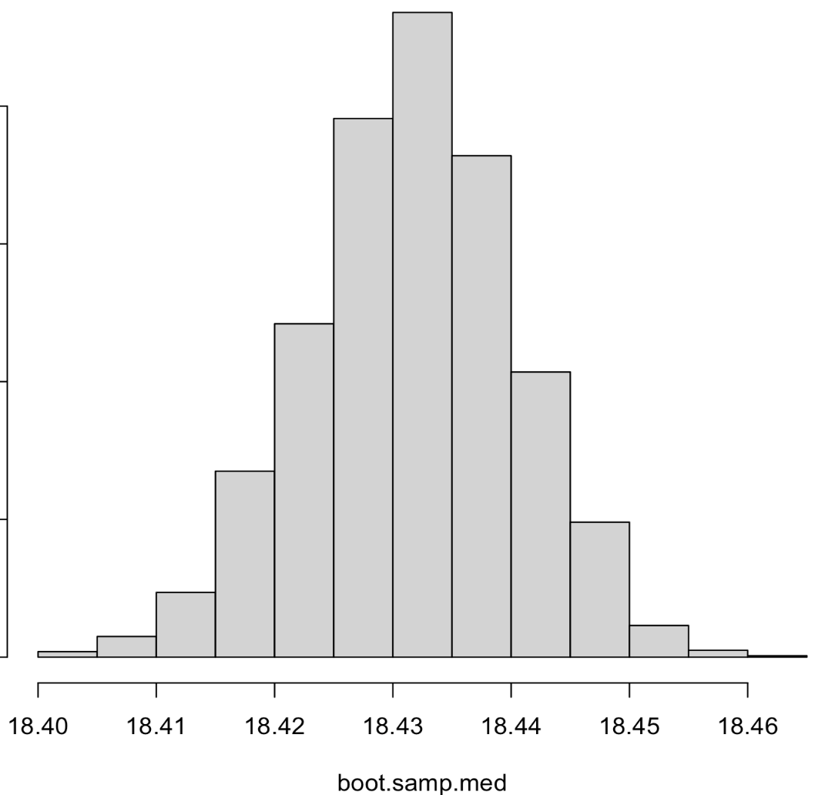
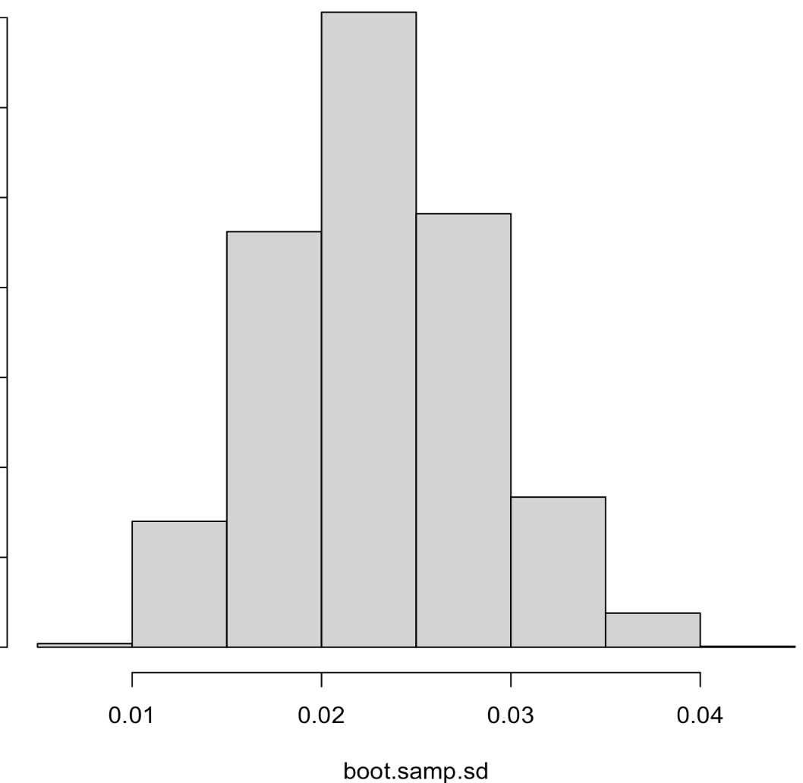
Parametric BS Example
# Length measurements (in):
x <- c(18.449, 18.468, 18.431, 18.390, 18.450,
18.426, 18.401, 18.438, 18.431, 18.417)
# Assume X is normally distributed and use say median and mad for the mean and sd model prameters
boot.samp.mean <- sapply(1:B, function(xx){mean(rnorm(n = n, mean = median(x), sd = mad(x)))})
hist(boot.samp.mean)
boot.samp.med <- sapply(1:B, function(xx){median(rnorm(n = n, mean = median(x), sd = mad(x)))})
hist(boot.samp.med)
boot.samp.sd <- sapply(1:B, function(xx){sd(rnorm(n = n, mean = median(x), sd = mad(x)))})
hist(boot.samp.sd)
parametric_bs_ex1.R

Slide 9
The Bootstrap
The set of B bootstrap replications is an approximate sampling distribution for so:
Average all the together to get the bootstrap based point estimate for θ :
Compute the unbiased s.d. over all the to get the bootstrap based standard error estimate for :

Slide 10
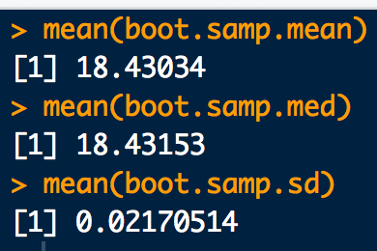
Example (con’t)
# Bootstrap estimate and se for the mean
mean(boot.samp.mean)
sd(boot.samp.mean)
# Bootstrap estimate and se for the median
mean(boot.samp.med)
sd(boot.samp.med)
# Bootstrap estimate and se for the standard deviation
mean(boot.samp.sd)
sd(boot.samp.sd)
nonparametric_bs_ex1.R
parametric_bs_ex1.R

Slide 11
Example: Bootstrapping Fail
How would our last bootstrap algorithm be different for estimating the standard error of a sample max over a uniform distribution?
We will simulate some fake data from a uniform distribution with known min = 1 and known max = 3. The sample size will be n = 15.
1.891304, 2.909405, 1.417487, 1.386373, 1.070313, 1.031299, 2.010315, 2.537558, 1.424424, 2.286100, 1.385528, 1.608154, 1.102906, 2.753568, 1.010469

Slide 12
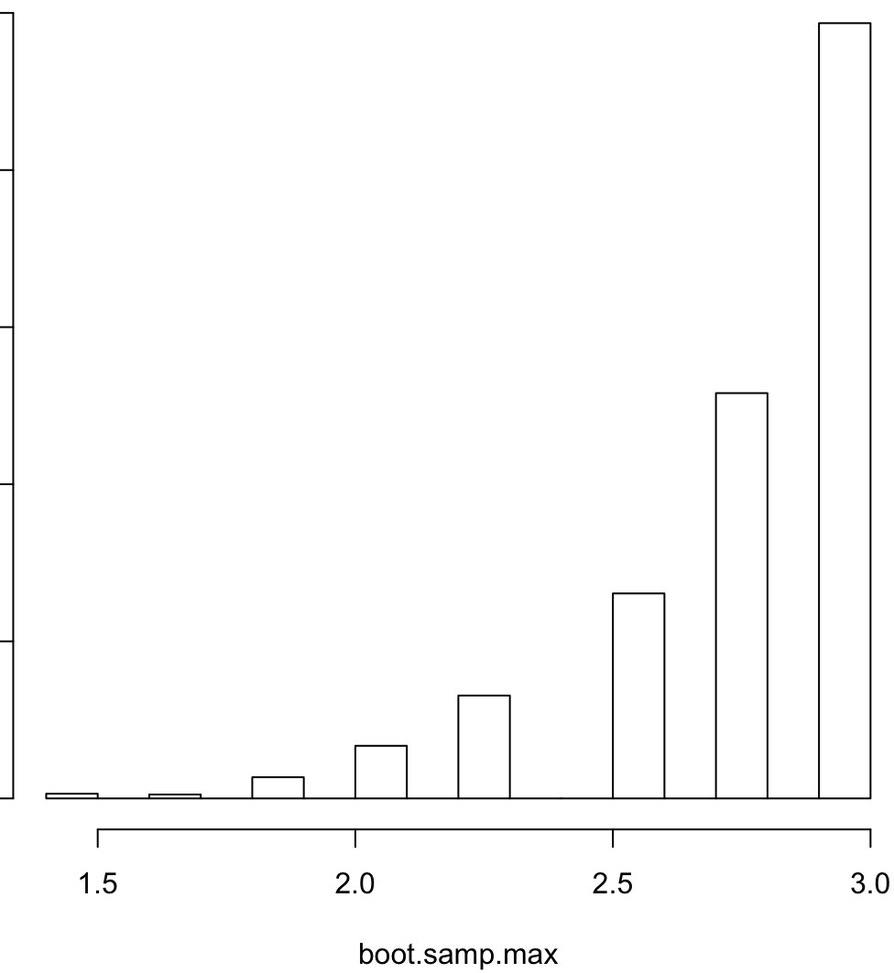

Example: Bootstrapping Fail
# Bootstrap fail:
# A sample from a uniform distribution with min=1 and max=3:
x <- c(1.891304, 2.909405, 1.417487, 1.386373, 1.070313, 1.031299, 2.010315,
2.537558, 1.424424, 2.286100, 1.385528, 1.608154, 1.102906, 2.753568,
1.010469)
boot.samp.max <- sapply(1:B, function(i){max(sample(x, size = n, replace = T))})
hist(boot.samp.max)
bs_fail.R
If the histogram of bootstrap replications looks like this, the bootstrap didn’t work! Don’t use it!!

Slide 13
The Bootstrap Bias Correction
Bias is also an measure of estimator accuracy that typically comes up when comparing data produced by a methodology to a reference standard:
Mean of the sampling dist. For the estimator of θ.
If we have a reference standard (i.e. a CRM) we can plug it in here
If the bootstrap must be used to estimate θ (e.g. the sampling dist. of is unknown), and θ is available then just plug in for
θ known!

Slide 14
Example: Bias with the bootstrap and θ known
A CRM solution of 150ng/mL Oxycodone in blood is used to assess the bias of a Laboratory’s SOP for concentration determination. 15 assay runs are conducted under the same conditions with the following data recorded (ng/mL):
117.7, 97.6, 147.4, 139.6, 135.5, 130.8, 141.0, 137.6, 115.0, 134.0, 122.3, 148.0, 121.6, 132.5, 119.8
Compute the MLE, unbiased and bootstrap estimates for:
average concentration
s.d. concentration
s.e. of the average concentration
bias

Slide 15
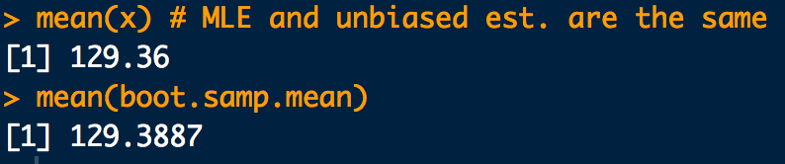
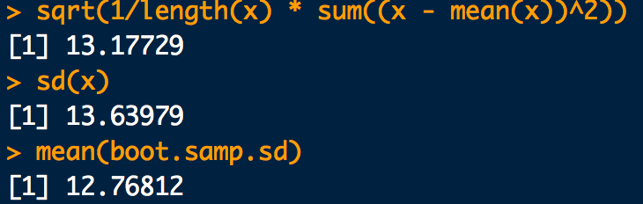
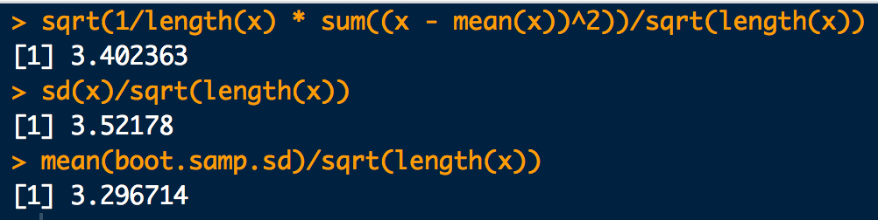

Example: Bias with the bootstrap and θ known
x <- c(117.7, 97.6, 147.4, 139.6, 135.5, 130.8, 141.0,
137.6, 115.0, 134.0, 122.3, 148.0, 121.6, 132.5, 119.8)
#a. MLE, unbiased and bootstrap estimates for average concentration
mean(x) # MLE and unbiased est. are the same
boot.samp.mean <- sapply(1:B, function(i){mean(sample(x, size = n, replace = T))})
mean(boot.samp.mean)
#b. MLE, unbiased and bootstrap estimates for s.d. concentration
sqrt(1/length(x) * sum((x - mean(x))^2))
sd(x)
B <- 2000
boot.samp.sd <- sapply(1:B, function(i){sd(sample(x, size = n, replace = T))})
mean(boot.samp.sd)
#c. MLE, unbiased and bootstrap estimates for s.e. of the average concentration
sqrt(1/length(x) * sum((x - mean(x))^2))/sqrt(length(x))
sd(x)/sqrt(length(x))
mean(boot.samp.sd)/sqrt(length(x))
#d. Bootstrap estimates for bias
mean(boot.samp.mean) - 150
bs_bias_ex.R

