Slide 1

Estimation 2, Sampling Distributions

Slide 2
Estimation and Sampling Distributions
Measurands (PDF and PMF parameters) tell us tell us how our measurements will behave statistically
They define the probability distribution of the data
If we know them, we can make very precise and meaningful statements about:
the uncertainty in our analysis
draw inferences taking into account the uncertainty
Problem!: We don’t know what the parameters are…
We don’t know the true values of our measurands…ever!
So what can we do??

Slide 3
Estimation and Sampling Distributions
In the absence of complete knowledge of the measurement process’s parameters (measurands), we can take two routes:
We get a sample of data and:
We can do Type A^{GUM} assessment of measurement uncertainty
Assume measurand has a “true value”, we just don’t know it
Use sample(s) to estimate the measurand along with uncertainty
If we have justifiable beliefs as to about what our measurands may be, we can also do Type B^{GUM} assessment of measurement uncertainty
Assume measurand itself has a PDF/PMF, prior belief
Combine sample(s) with prior belief to “update” our belief about the measurand’s value, posterior belief

Slide 4
Type A Measurement Uncertainty
Let’s start with the basics of classical Type A “frequentist” analysis of the measurement process
So, assume one or more parameters (measurands^{GUM}) θ is fixed but unknown.
An estimate for θ from data is denoted with a hat:
The most important parameter for measurement in forensic science is (arguably) the mean: μ
Also, we are usually interested in the population standard deviation of input quantities^{GUM} (data): σ_{X}

Slide 5
Type A Measurement Uncertainty
With a sample of data with n replicate measurements we can estimate mean and standard deviation
Estimate for the mean μ, estimate of the measurand^{GUM}, or measured quantity value^{GUM}:
The sample average
Estimate for the standard deviation σ_{X}, standard measurement uncertainty^{GUM}:
The sample standard deviation

Slide 6
Type A Measurement Uncertainty
Estimate for the coefficient of variation, i.e. relative standard measurement uncertainty^{GUM}:
The relative standard deviation
Estimates for bias^{GUM}:

Slide 7
Example
A CRM solution of 150ng/mL Oxycodone in blood is used to assess the bias of a Laboratory’s SOP for concentration determination. 15 assay runs are conducted under the same conditions with the following data recorded (units: ng):
117.7, 97.6, 147.4, 139.6, 135.5, 130.8, 141.0, 137.6,115.0, 134.0, 122.3, 148.0, 121.6, 132.5, 119.8
Compute:
Average concentration
Sample s.d. concentration
Bias, %Bias
Relative s.d.

Slide 8
Example
# Data and CRM reference
CRM <- 150
x <- c(117.7, 97.6, 147.4, 139.6, 135.5, 130.8, 141.0, 137.6,
115.0, 134.0, 122.3, 148.0, 121.6, 132.5, 119.8)
# a. Sample average:
mu.hat <- mean(x)
# b. Sample SD:
sdx.hat <- sd(x)
# c. Bias and %Bias:
bias <- mu.hat - CRM
percent.bias <- bias/CRM * 100
#d. Relative SD:
rel.sdx <- sdx.hat/mu.hat * 100
crm_ex1.R

Slide 9
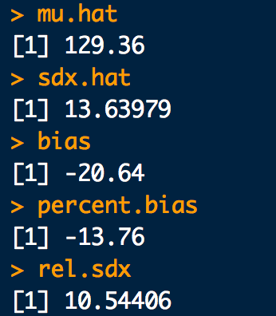
Example

Slide 10
Sampling Distributions
Because estimators of measurands are based on random samples, they are random variates just like data!
Estimators have distributions called sampling distributions
Say are interested in mean Mn mass contained in bullets manufactured at a particular factory
Let’s use the average mass of Mn in a sample (of size n) to estimate the population mean mass:
What might the distribution of
look like if we take 25000 samples of
size 10 over the course of a year?

Slide 11
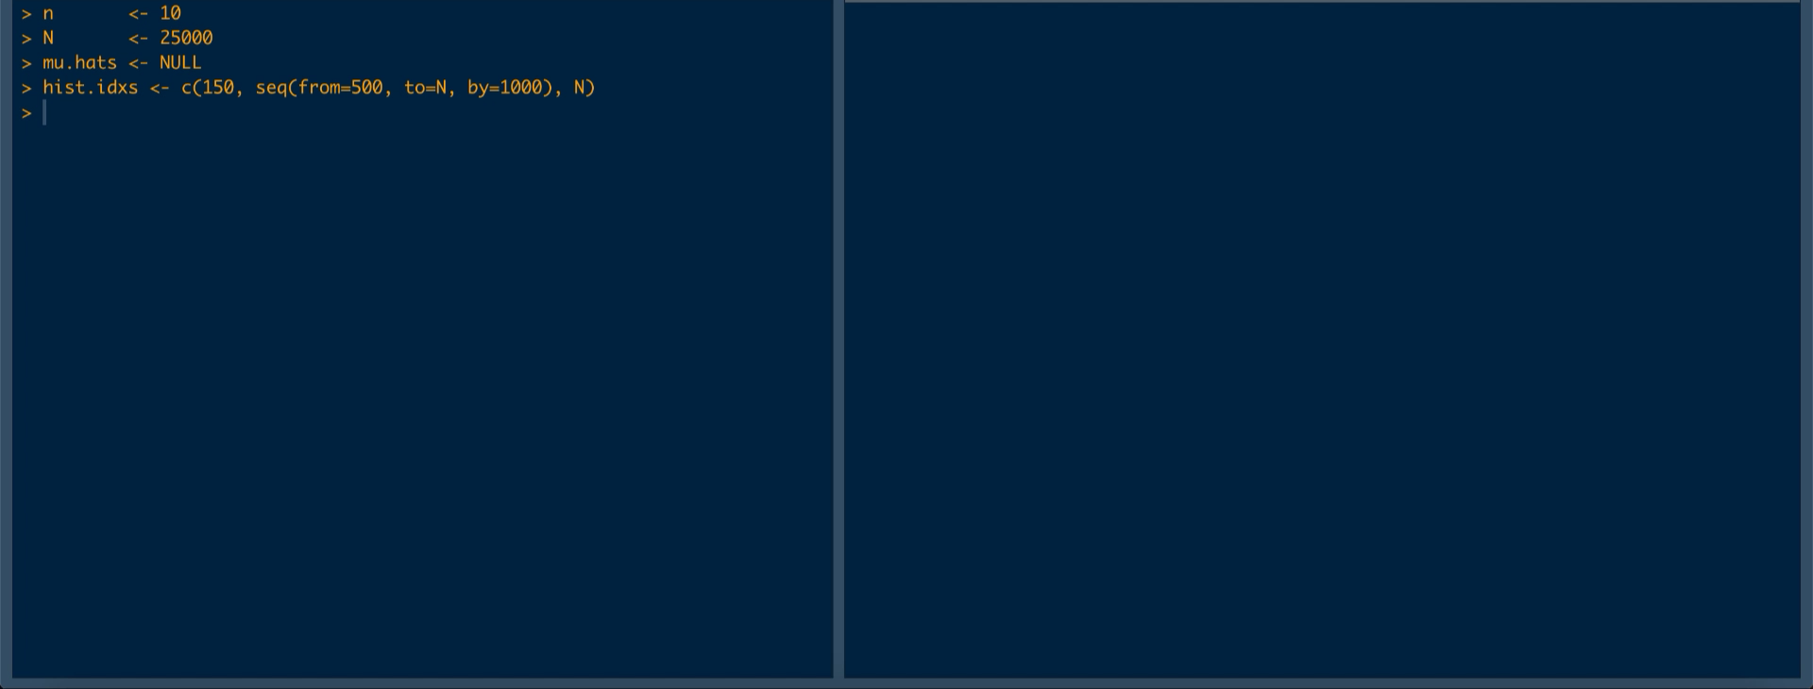
Sampling Distributions
Sample 10 bullets, measure mass, take average and repeat 25000 times:

Slide 12
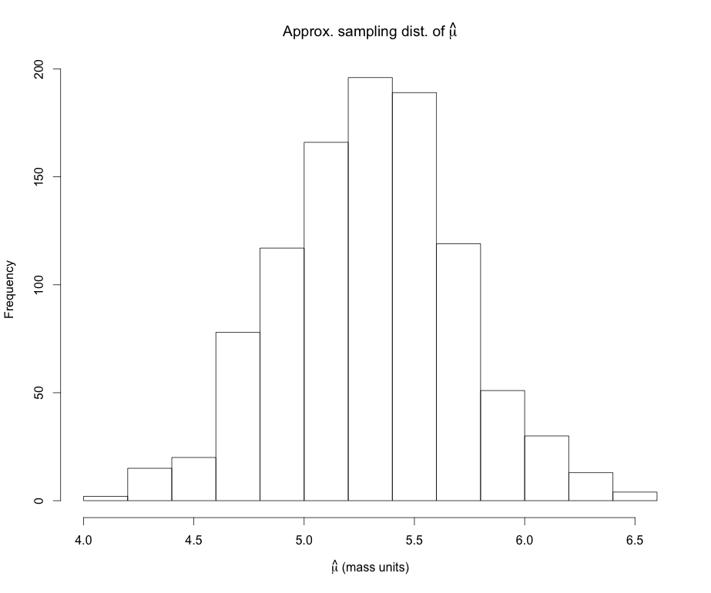
Sampling Distributions
Important features of an estimator’s sampling distribution:
(Approximate) sampling distribution of
Sampling dist mean:
Sample size, n = 10 bullets
Number of samples = 25000
Sampling dist s.d.:

Slide 13
Standard Error
Uncertainty in an estimate can be represented as standard deviation for the sampling distribution:
is called the standard error of the estimator
Also called the standard error of the measurand^{GUM} and standard uncertainty^{GUM}
Applies to ANY parameter estimate/measureand
is called the estimated standard error

Slide 14
Sampling Distribution of the Mean
Important Case:
The are good reasons to believe* that many typical laboratory measurements, X (e.g. mass) are approximately normally distributed with mean μ and s.d. σ
Then the average measurement in a sample of size n, is also normally distributed, with mean μ but s.d.
Sampling distribution of an IID sample average

Slide 15
Standard Error of the Mean
The uncertainty (standard error) in the estimated mean is:
This is important because a lot of what we do in science is take an average of measurements we make in the lab!
Since we usually don’t know σ_{X}, we estimate the standard error of the mean by plugging in

Slide 16
Example
The length of a shotgun barrel is measured with a ruler four times (units: in):
18.438, 18.440, 18.468, 18.437
Compute:
What is the measurand?
The sample mean:
The sample sd:
The estimated standard error of the mean:
Estimate the %relative standard measurement uncertainty^{GUM}
Sketch and label the approximate sampling distribution with the with the measureand’s estimate and standard uncertainty.

Slide 17
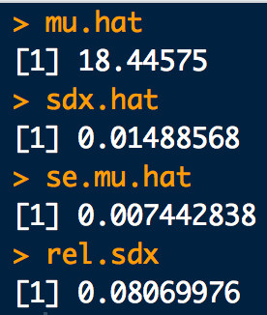
Example
# Data(Input values^GUM):
x <- c(18.438, 18.440, 18.468, 18.437)
# b. Sample average (measurand estimate^GUM):
mu.hat <- mean(x)
# c. Sample SD (standard measurement uncertainty^GUM):
sdx.hat <- sd(x)
# d. SE of sample average (measurand standard uncertainty^GUM):
se.mu.hat <- sd(x)/sqrt(4)
#e. %Relative SD (%Relative standard measurement uncertainty^GUM):
rel.sdx <- sdx.hat/mu.hat * 100
barrel_ex1.R

Slide 18
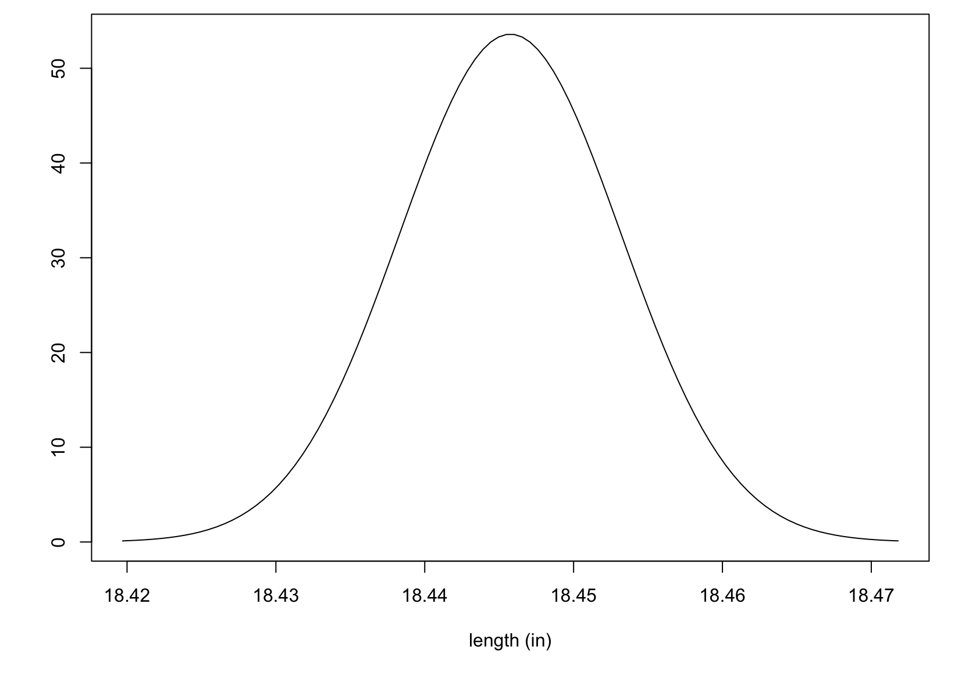
Example
Measurand’s (barrel length) approximate sampling distribution
f.
= 18.446 in
= ±0.007 in

Slide 19
More Type A Measurement Uncertainty
With a sample of data with n replicate measurements we can estimate proportion and it’s uncertainty
Estimate for a proportion π (it is also a mean and thus an estimate of a measurand^{GUM}, or measured quantity value^{GUM}):
The sample proportion
Estimate for the standard deviation of the sample proportion^{GUM} , or standard error of the proportion^{GUM}:
The sample proportion standard error

Slide 20
More Type A Measurement Uncertainty
With a sample of data within n defined time periods or experimental units, we can estimate a rate and its uncertainty
Estimate for a rate λ (it’s also a mean and thus an estimate of a measurand^{GUM}, or measured quantity value^{GUM}):
The sample rate
Estimate for the standard deviation of the sample rate^{GUM} , or standard error of the rate^{GUM}:
The sample rate standard error

Slide 21
Example
A study* of 201 Chicago PD controlled surfaces (e.g. squad card, table surfaces, restraining bars) was studied to examine the potential for secondary GSR transfer/contamination persons of interest in shooting investigations. The study revealed the following (fake) counts of GSR particles on the 201 surfaces examined:
0, 0, 0, 0, 0, 1, 0, 0, 0, 0, 0, 0, 0, 0, 0, 0, 0, 1, 0, 0, 0, 0, 0, 0, 2, 0, 0, 0, 0, 0, 0, 1, 0, 0, 0, 0, 0, 0, 2, 0,
0, 1, 0, 0, 0, 1, 0, 1, 0, 0, 0, 1, 1, 0, 0, 0, 0, 0, 1, 1, 0, 0, 0, 0, 0, 0, 0, 0, 0, 0, 0, 0, 0, 0, 0, 0, 0, 1, 0, 0,
0, 1, 0, 0, 0, 0, 0, 2, 0, 1, 1, 0, 0, 0, 1, 0, 0, 0, 0, 1, 1, 1, 0, 0, 0, 0, 1, 0, 0, 0, 0, 0, 0, 0, 0, 0, 0, 0, 0, 1,
0, 0, 0, 0, 0, 0, 0, 0, 1, 0, 0, 0, 0, 0, 0, 0, 0, 0, 0, 0, 0, 0, 0, 0, 0, 0, 0, 0, 0, 1, 0, 0, 0, 1, 0, 0, 2, 0, 0, 0,
0, 0, 1, 0, 0, 0, 0, 0, 0, 1, 0, 0, 0, 0, 0, 0, 0, 0, 0, 0, 0, 0, 1, 1, 0, 0, 0, 1, 0, 0, 1, 0, 1, 0, 1, 0, 0, 0, 0, 0,
0
Compute:
The sample rate:
The sample sd:
The estimated standard uncertainty of the rate:
Assuming the GSR particle counts follow a Poisson distribution, sketch the data’s distribution.
*Fake data based on findings in RE Berk, SA Rochowicz, M Wong, MA Kopina, "Gunshot Residue in Chicago Police Vehicles and Facilities: An Empirical Study", J Forensic Sci 52(4) 838-841 (2007).

Slide 22
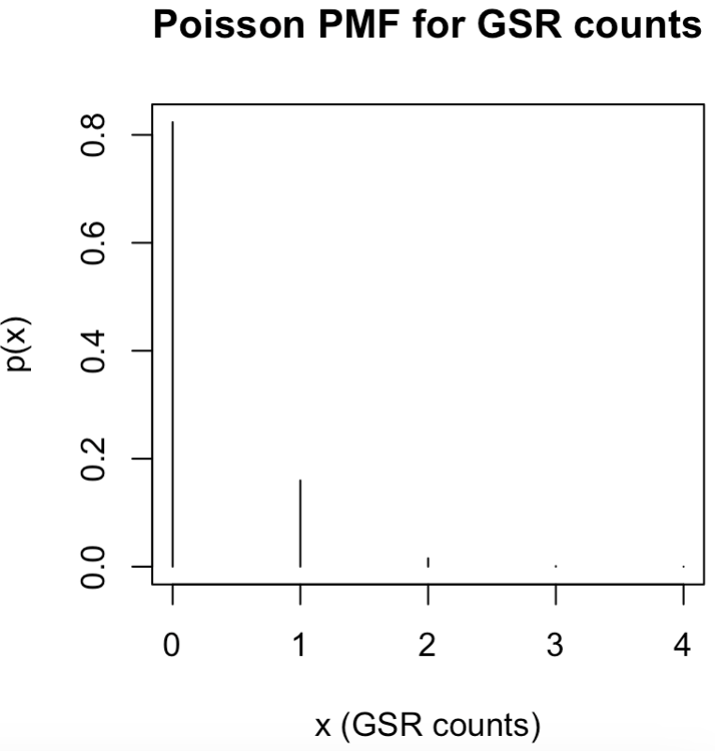
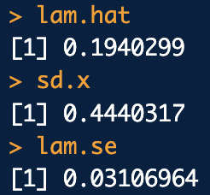
Example
# Data(Input values^GUM):
counts <- c(
0, 0, 0, 0, 0, 1, 0, 0, 0, 0, 0, 0, 0, 0, 0, 0, 0, 1, 0, 0, 0, 0, 0, 0, 2, 0, 0, 0, 0, 0, 0, 1, 0, 0, 0, 0, 0, 0, 2, 0,
0, 1, 0, 0, 0, 1, 0, 1, 0, 0, 0, 1, 1, 0, 0, 0, 0, 0, 1, 1, 0, 0, 0, 0, 0, 0, 0, 0, 0, 0, 0, 0, 0, 0, 0, 0, 0, 1, 0, 0,
0, 1, 0, 0, 0, 0, 0, 2, 0, 1, 1, 0, 0, 0, 1, 0, 0, 0, 0, 1, 1, 1, 0, 0, 0, 0, 1, 0, 0, 0, 0, 0, 0, 0, 0, 0, 0, 0, 0, 1,
0, 0, 0, 0, 0, 0, 0, 0, 1, 0, 0, 0, 0, 0, 0, 0, 0, 0, 0, 0, 0, 0, 0, 0, 0, 0, 0, 0, 0, 1, 0, 0, 0, 1, 0, 0, 2, 0, 0, 0,
0, 0, 1, 0, 0, 0, 0, 0, 0, 1, 0, 0, 0, 0, 0, 0, 0, 0, 0, 0, 0, 0, 1, 1, 0, 0, 0, 1, 0, 0, 1, 0, 1, 0, 1, 0, 0, 0, 0, 0,
0
)
n <- length(counts)
# Rate estimate:
lambda.hat <- 1/n*sum(counts)
lambda.hat
# SE rate:
lambda.se <- sqrt(lambda.hat/n)
lambda.se
# Corresponding data PMF for GSR counts
x <- seq(from=0, to=4)
y <- dpois(x, lambda.hat)
plot(x, y, typ="h", xlab="x (GSR counts)", ylab="p(x)", main="Poisson PMF for GSR counts")
gsr_ex1.R

Slide 23
Another Example
In the course of an evidence admissibility hearing, a defense attorney questions the error rate of a firearms and toolmark analysis unit at a local crime lab. They request data on the unit’s last competency test. The prosecution objects, but the judge rules the data be made available to the defense.
The unit consists of 5 practitioners including one trainee. The test consists of 50 independent comparisons of simulated casework toolmarks for same source match. The results for the five practitioners are as follows:
0 errors, 0 errors, 20 errors, 0 errors, 1 error
The relevant question to the court is:
“what is the firearms unit’s error rate?”
Pool the test results and estimate the lab error rate
Estimate the standard error of the error rate
Assuming the data follows a binomial distribution, sketch the data’s distribution.
What issues do you see in this analyses?

Slide 24
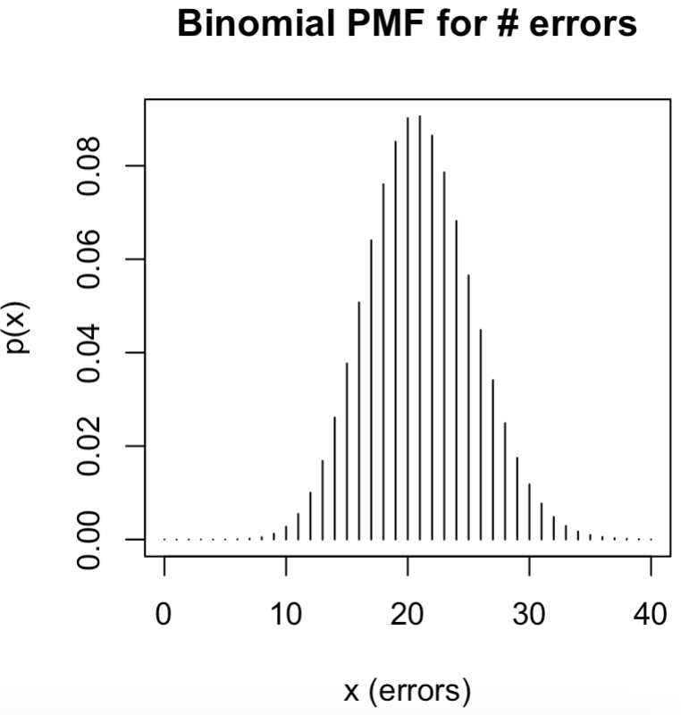
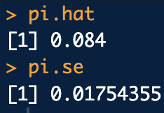
Another Example
# Data: Errors
errs <- c(0,0,20,0,1)
# Pool data. Assume one big test of 250 questions:
n <- 50*5
# Error rate estimate:
pi.hat <- sum(errs)/n
pi.hat
# SE of error rate:
pi.se <- sqrt((pi.hat * (1 - pi.hat)) / n)
pi.se
# Plot:
x <- seq(from=0, to=40)
y <- dbinom(x, size = n, prob = pi.hat)
plot(x,y, typ="h", xlab="x (errors)", ylab="p(x)", main="Binomial PMF for # errors")
admis_err_ex1.R

