Slide 1
Estimation I
Common Data Descriptive Statistics

Slide 2
Measures of Central Tendency
Given a sample from some population:
What is a good “summary” value which well describes the sample?
We will look at:
Average (arithmetic mean)
Median
Mode
For reference see (available on-line):
“The Dynamic Character of Disguised Behaviour for Text-based, Mixed and Stylized Signatures”
LA Mohammed, B Found, M Caligiuri and D Rogers
J Forensic Sci 56(1),S136-S141 (2011)

Slide 3
Histogram Points of Interest
Velocity for the first segment of genuine signatures in Mohammed et al. study.
What is a good summary number?
“Central Tendency”
How spread out is the data?

Slide 4
Measures of Central Tendency
Example:
Absolute Average Velocity for Genuine Signatures across all writers in the LAM study:
92 subjects × 10 measurements/subject = 920 velocity measurements
Average Absolute Average Velocity:

Slide 5
Measures of Central Tendency
Sample median:
Ordering the n pieces of data from smallest value to largest value, the median is the “middle value”:
If n is odd, median is largest data point.
If n is even, median is average of and largest data points.

Slide 6
Measures of Central Tendency
Example:
Median of Average Absolute Velocity for Genuine Signatures, LAM:
Avg

Slide 7
Measures of Central Tendency
Sample mode:
Needs careful definition but basically:
The data value that occurs the most
mode
≈ 9.25
central_tend.R
library(frequtils)
# Slice out the data of interest:
row.idxs <- which(linton$Condition == "GEN" &
linton$Segment == 1)
dat <- linton[row.idxs, ]
head(dat)
vel <- dat$AverageAbsoluteVelocity
# Histogram, sample mean and median:
hist(vel)
mean(vel)
median(vel)
Med
Avg

Slide 8
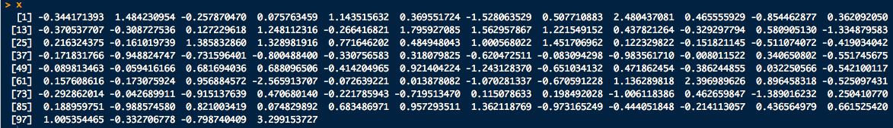
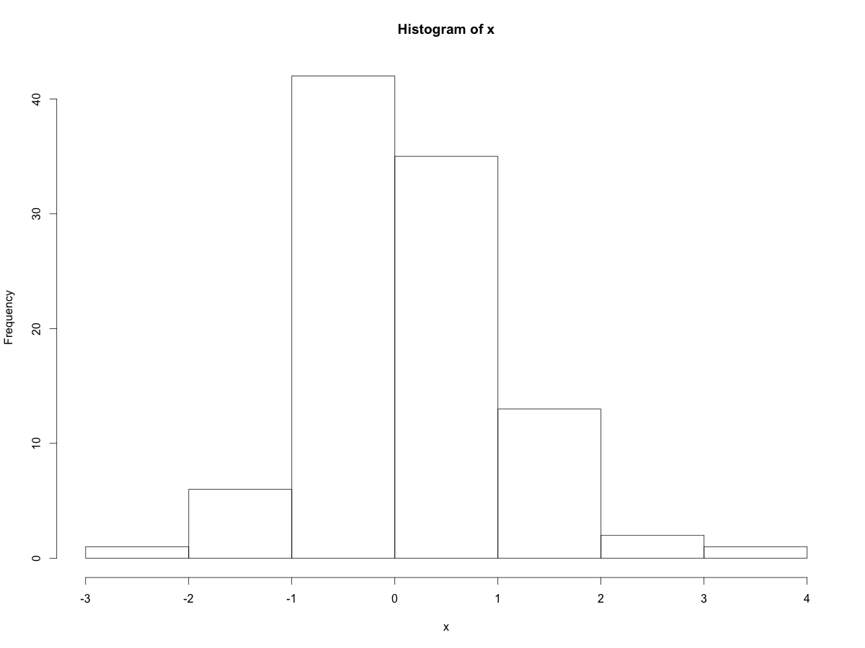
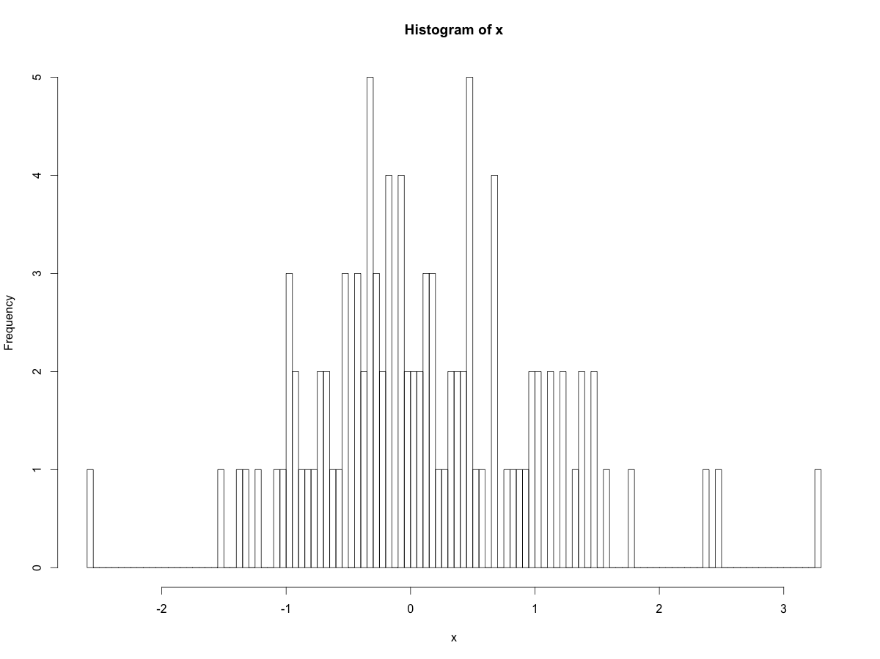
Measures of Central Tendency
Sample mode: Issues…..
What’s the mode here?
Sample:

Slide 9
Measures of Central Tendency
Other issues:
Modes
Mean
Nice and symmetric:
Mean = Median = Mode

Slide 10
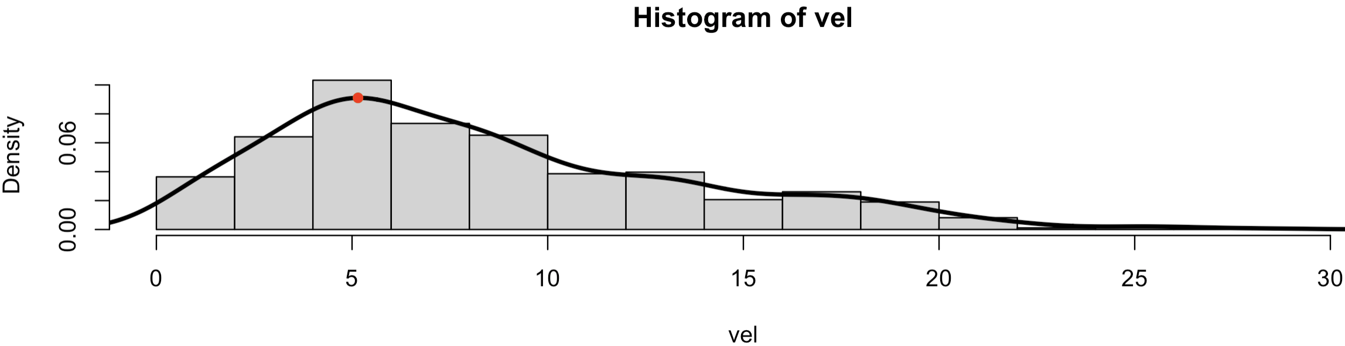
But I Really Want A Mode!!
What can I do?
library(frequtils)
# Slice out the data of interest:
row.idxs <- which(linton$Condition == "GEN" &
linton$Segment == 1)
dat <- linton[row.idxs, ]
vel <- dat$AverageAbsoluteVelocity
# This usually doesn't work for decimal data!
table(vel)
# Histogram, with quick and dirty KED around it:
hist(vel, probability = T)
dk <- density(vel) # The KDE
lines(dk$x, dk$y, lwd=3) # Plot it over hist
max.idx <- which.max(dk$y)
dk$x[max.idx] # Approx mode (max)
# Plot the mode on the KDE:
points(dk$x[max.idx], dk$y[max.idx],
pch=16, col="red")
Use your eyes
Imprecise
Can be very subjective
Only practical for 1 random variate (1D histogram)
Use table() (usually bad):
Fit curve around histogram (kernel density estimate)
Find max of curve
Pedantic and sensitive to sample
kde_mode.R

Slide 11
Measures of Data Spread
Sample variance:
(Almost) the average of squared deviations from the sample mean.
there are n data points
sample mean
data point i
Sample standard deviation is
The sample average and standard dev. are the most common measures of central tendency and spread
Sample average and standard dev have the same units

Slide 12
Measures of Data Spread
Standard deviation is “instructive” to do by hand a few times:
Compute the standard deviation of the following blood alcohol volumes assayed in 10 samples of 10 μL of blood drawn from a drunk driving suspect (units: nL):
7.97, 7.80, 7.79, 8.12, 8.12, 8.22, 8.03, 7.97, 7.88, 8.08
sd(c(7.97, 7.80, 7.79, 8.12, 8.12, 8.22, 8.03, 7.97, 7.88, 8.08))
To prevent writers cramp:
spreads.R

Slide 13
Measures of Data Spread
Standard deviation can be very sensitive to outliers.
Median absolute deviation: Tempers standard deviation’s sensitivity to outliers by:
replacing sample mean with sample median
replacing the sum of squares with the median of the absolute deviations from the sample median
Sometimes include a scale factor k for “consistency”
sample standard deviation
sample median absolute deviation
mad(c(7.97, 7.80, 7.79, 8.12, 8.12, 8.22, 8.03, 7.97, 7.88, 8.08))
?mad
spreads.R

Slide 14
Measures of Data Spread
Sample range:
The difference between the largest and smallest value in the sample
Very sensitive to outliers (extreme observations)
Percentiles:
The p^{th} percentile data value, x, means that p-percent of the data are smaller than or equal to x.
Median = 50th percentile

Slide 15
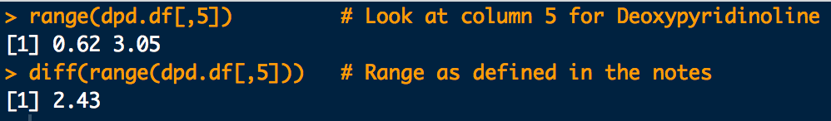
Measures of Data Spread
What is the sample range of deoxypyridinoline conc?
0.62, 0.64, 1.14, 1.04, 1.07, 1.83, 1.32, 1.19, 1.28, 0.85, 1.36, 1.16, 1.00, 1.69, 1.62, 1.25, 1.49, 1.45, 1.14, 2.40, 3.05, 2.81
# Dr. James Curran's dafs (http://www.stat.auckland.ac.nz/~curran)
library(dafs)
data(dpd.df) # Deoxypyridinoline data
range(dpd.df[,5]) # Look at column 5 for Deoxypyridinoline
# concentration and get its range
diff(range(dpd.df[,5])) # Range as defined in the notes
spreads.R

Slide 16
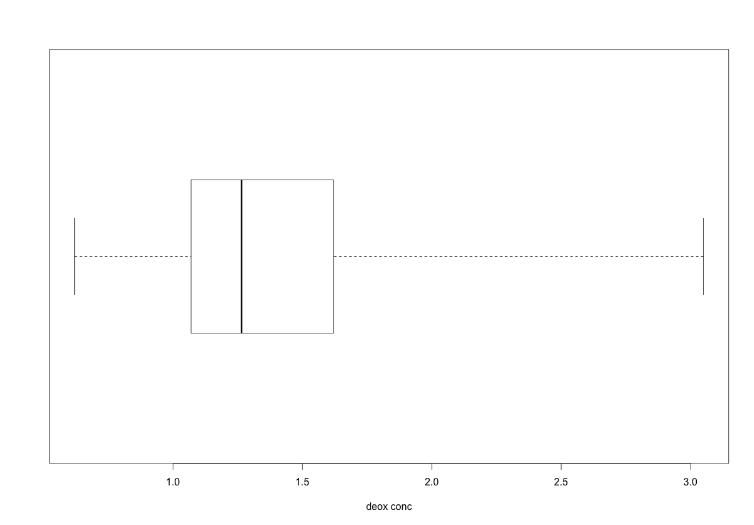
Range Example
Box-and-whisker plot again for reference
Deoxypyridinoline conc?
0.62, 0.64, 1.14, 1.04, 1.07, 1.83, 1.32, 1.19, 1.28, 0.85, 1.36, 1.16, 1.00, 1.69, 1.62, 1.25, 1.49, 1.45, 1.14, 2.40, 3.05, 2.81
range
25th-%tile
1st-quartile
median
50th-%tile
75th-%tile
3rd-quartile
spreads.R
# Box and whiskers plots:
boxplot(dpd.df[,5], horizontal = T, range = 0, xlab = "Deoxypyridinoline conc.")
summary(dpd.df[,5]) # Common summary statistics

Slide 17
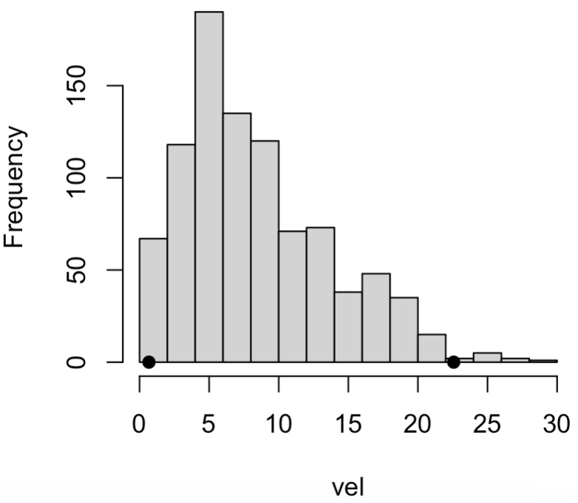
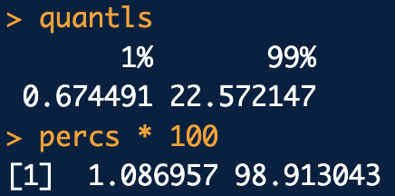
Percentiles Example
library(frequtils)
# Slice out the data of interest:
row.idxs <- which(linton$Condition == "GEN" &
linton$Segment == 1)
dat <- linton[row.idxs, ]
vel <- dat$AverageAbsoluteVelocity
# Percentiles, Quantiles and Histogram
quantls <- quantile(vel, probs = c(0.01, 0.99))
quantls
hist(vel)
points(quantls, c(0,0), pch=16)
# Inverse of the quantile function:
percs <- percentiles(vel,
quantiles = c(0.674491, 22.572147))
percs * 100
Mohammed et al.: Velocity for the first segment of genuine signatures
quantiles_percentiles.R
1st-%tile
99th-%tile
0.67
22.6

Slide 18
Measures of Data Spread
Coefficient of variation (cv)
The ratio of standard deviation to mean
Gives a sense of variation of the data relative to the data’s average
In practice, often written as a percentage
Estimate as sample standard dev to average
Also called the relative standard deviation (rsd)
CVs (RSDs) ≤ 20% − 25% is generally considered “OK”. . .

Slide 19
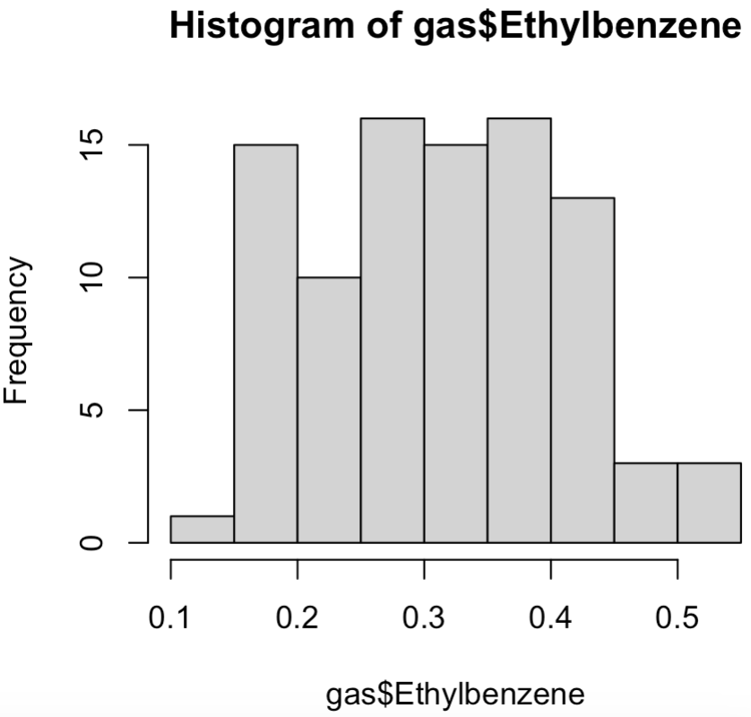
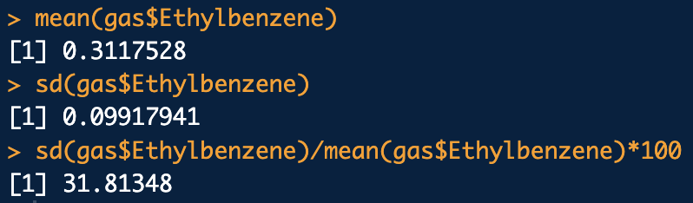
Coefficient of Variation Example
Gil: GC-MS gasoline data
library(frequtils)
# cv% ethylbenzene in gasoline
data(gas)
?gas
hist(gas$Ethylbenzene)
mean(gas$Ethylbenzene)
sd(gas$Ethylbenzene)
cv <- sd(gas$Ethylbenzene)/mean(gas$Ethylbenzene)*100
cv
cv_rsd.R

Slide 20
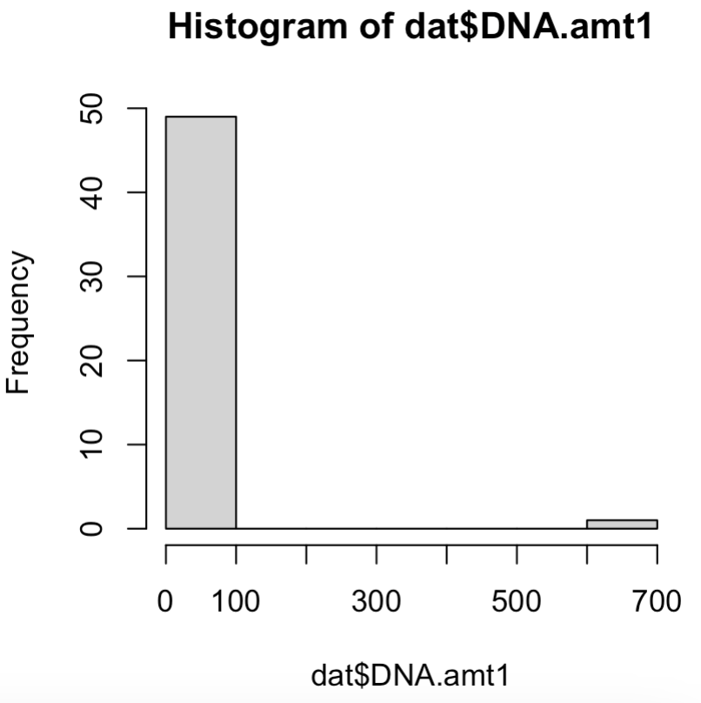
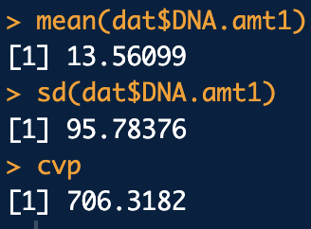
Another Coefficient of Variation Example
Chen (sim): quantity shedder DNA, left upper shoulder (LU)
library(frequtils)
data("shedder")
?shedder
row.idxs <- which(shedder$location=="LU")
dat <- shedder[row.idxs, ]
hist(dat$DNA.amt1)
# cv%:
cvp <- sd(dat$DNA.amt1)/mean(dat$DNA.amt1) * 100
mean(dat$DNA.amt1)
sd(dat$DNA.amt1)
cvp
cv_rsd.R

Slide 21
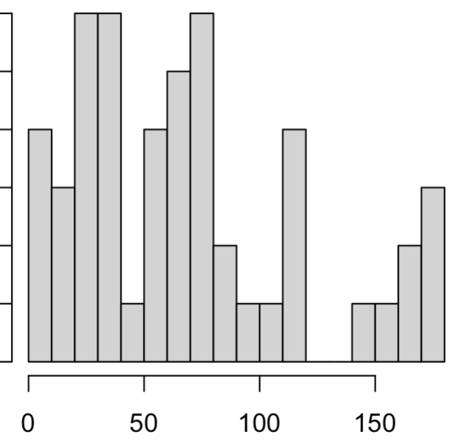
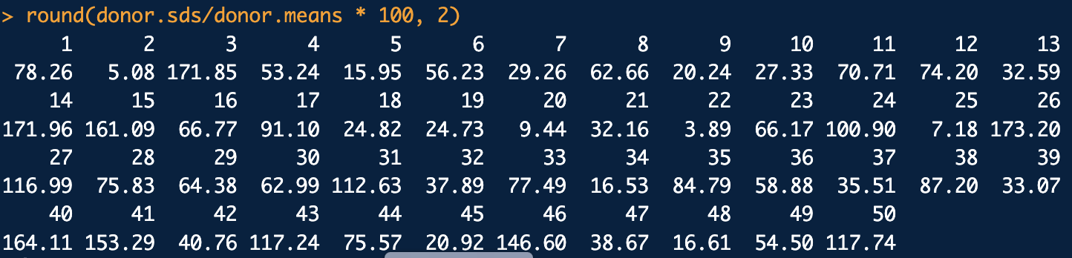
Another Coefficient of Variation Example
DNA shed at LU per Donor: cv%

