Slide 1
Common Graphs
First Thing: Look at your Data

Slide 2
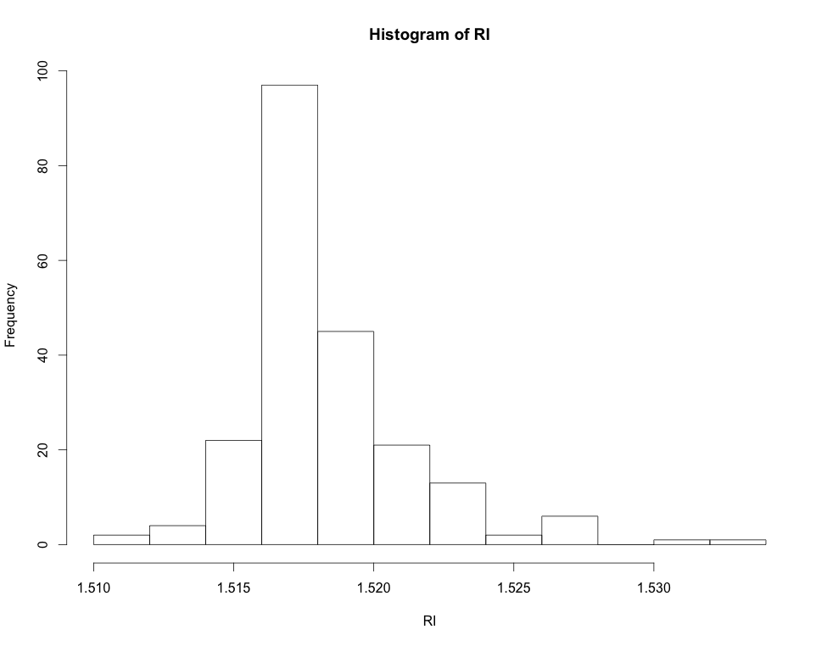
First Thing: Look at your Data
Histograms: “bin” a variable and plot frequencies

Slide 3
First Thing: Look at your Data
Histograms: “bin” a variable and plot frequencies
Each bar is a “bin” that contains a number of data points: counts

Slide 4
First Thing: Look at your Data
Box and Whiskers plots:
range
possible
outliers
possible
outliers
25th-%tile
1st-quartile
median
50th-%tile
75th-%tile
3rd-quartile
RI

Slide 5
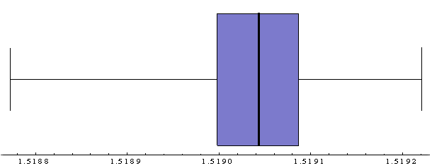
Visualizing Data
Note the relationship:

Slide 6
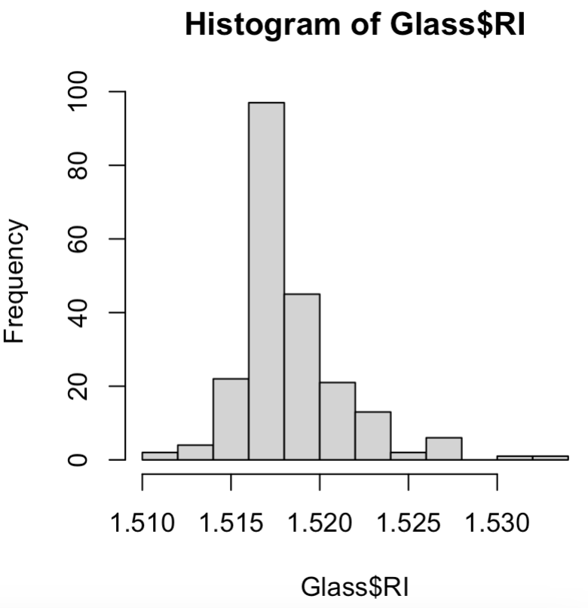
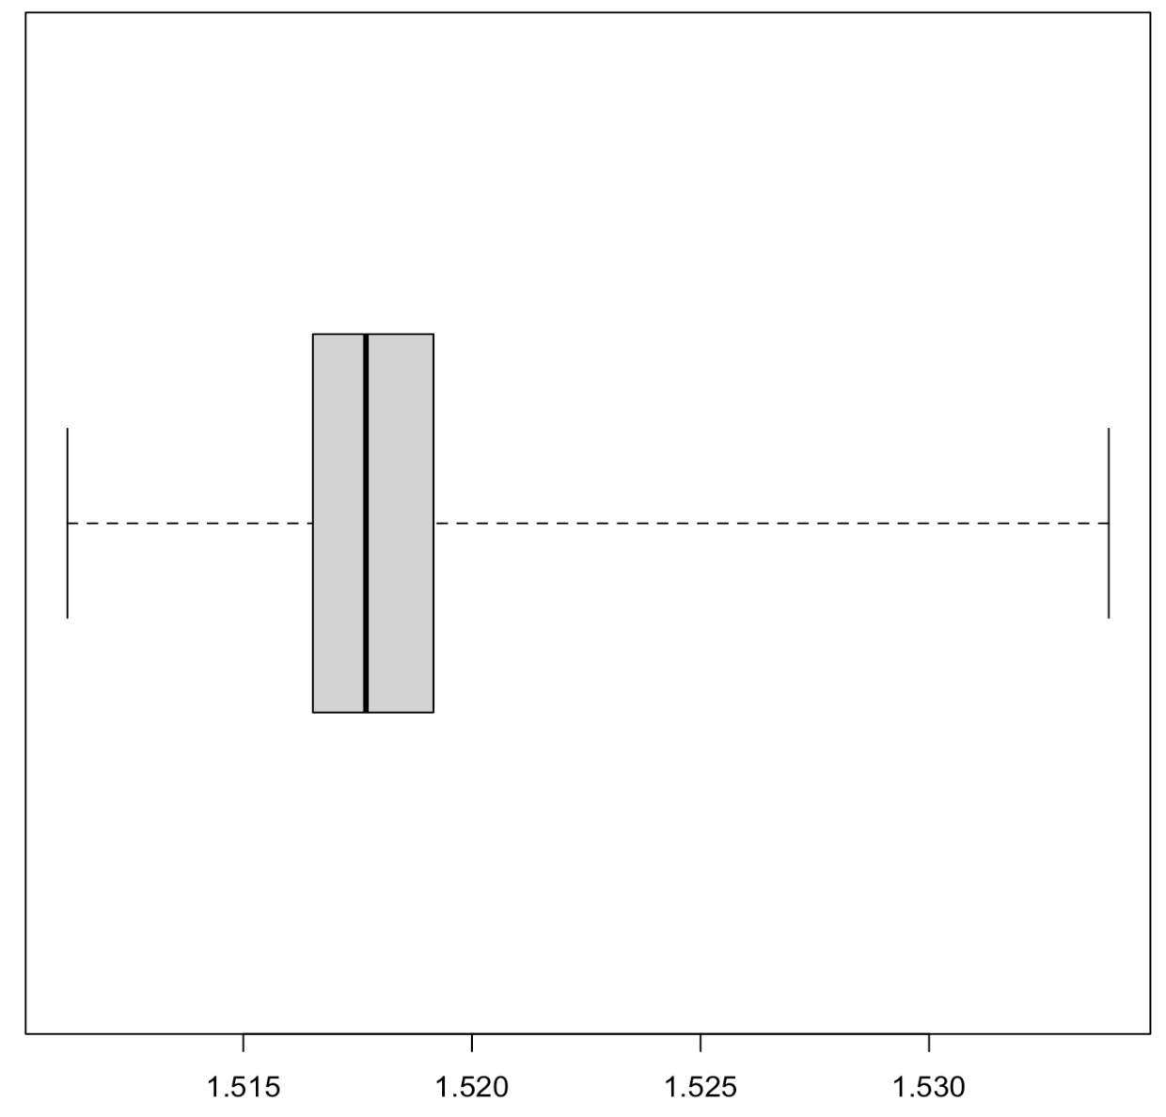
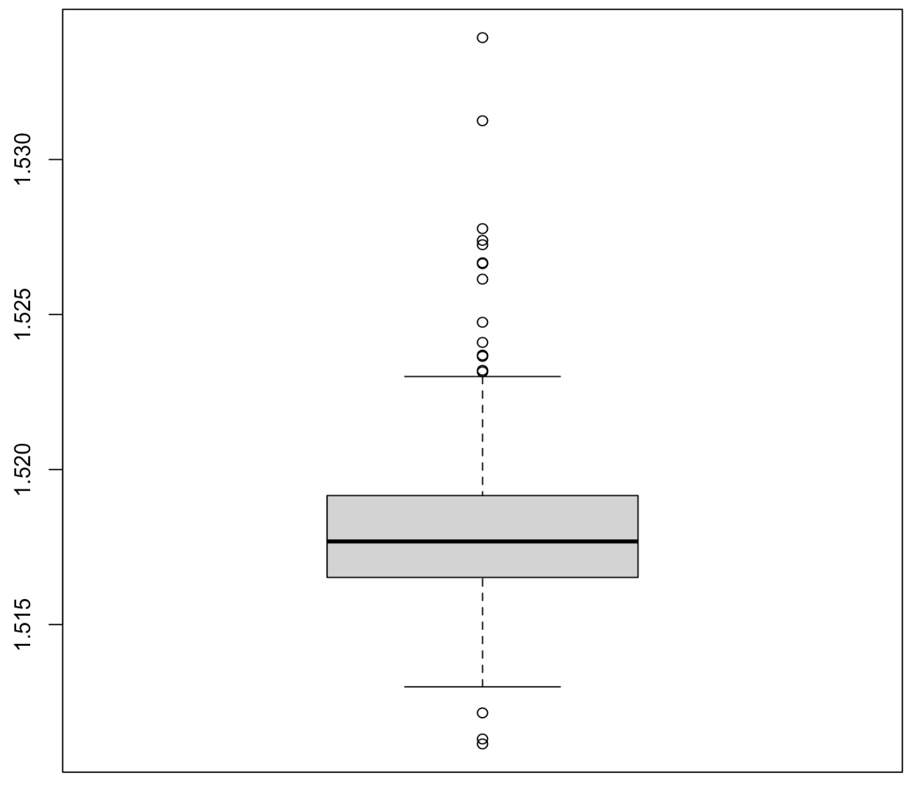
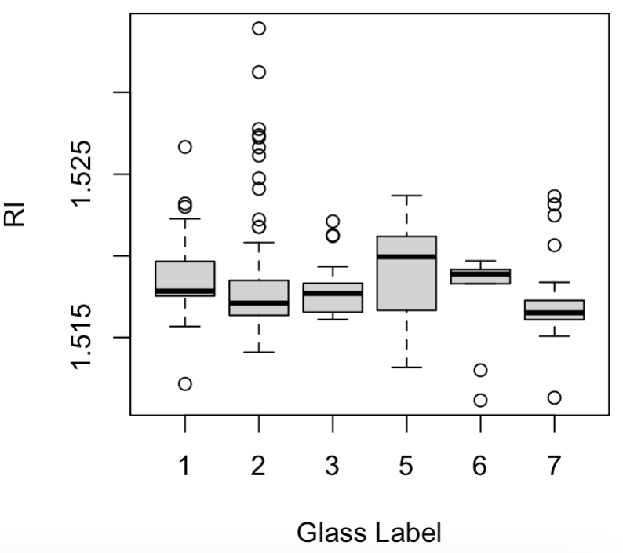
Histogram and BW Examples
library(mlbench)
# Load some sample data
data("Glass")
?Glass
# A histogram of RIs
hist(Glass$RI)
# Corresponding BW plots of RIs
boxplot(Glass$RI)
boxplot(Glass$RI, range=0, horizontal = T)
boxplot(Glass$RI ~ Glass$Type, xlab="Glass Label", ylab="RI")
glass_RI_plots.R

Slide 7
First Thing: Look at your Data
Scatter plots: plot any two variables against each other
Typically, the data for these is continuous variables but can be discrete

Slide 8
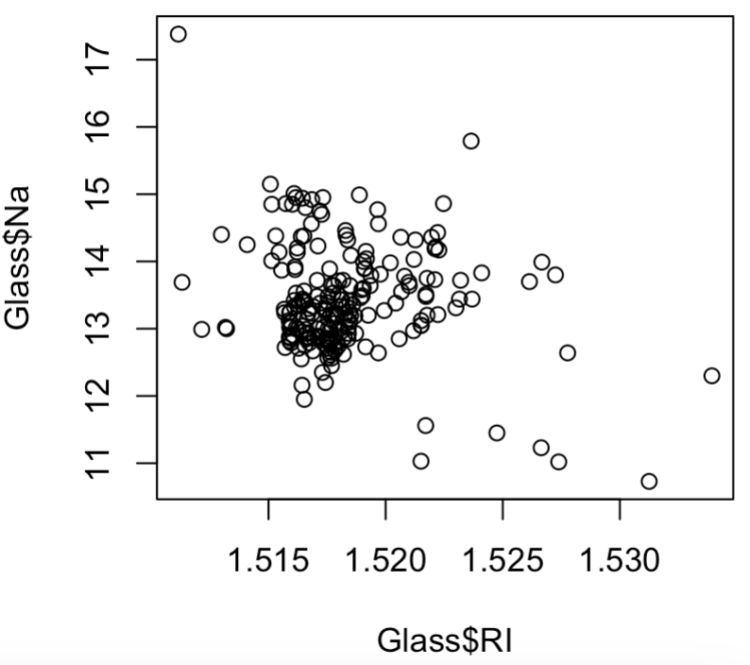
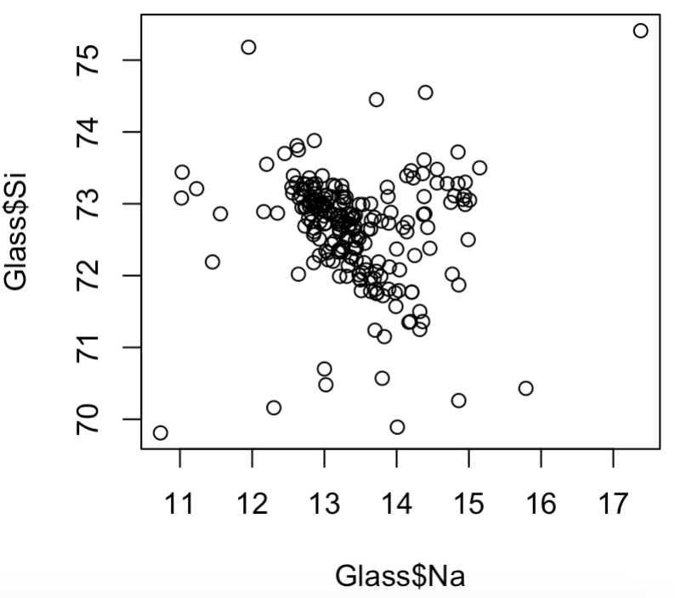
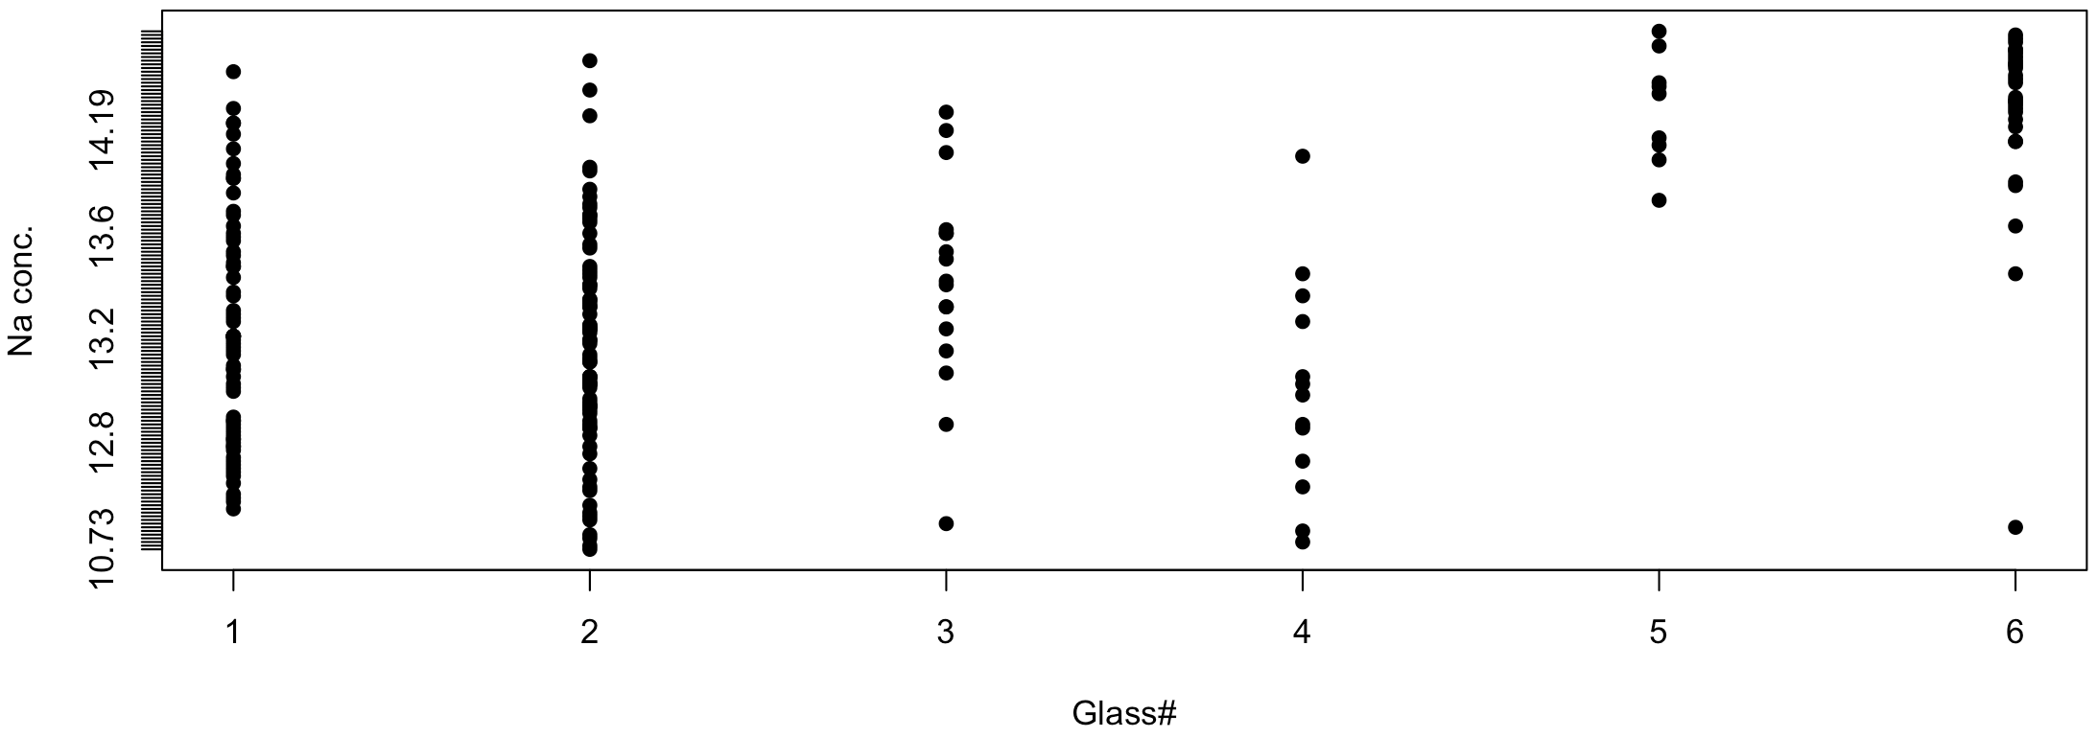
Scatter Plots and Stripcharts
library(mlbench)
# Load some sample data
data("Glass")
?Glass
# Scatter plots
plot(Glass$RI, Glass$Na)
plot(Glass$Na, Glass$Si)
# Strip chart
stripchart(as.numeric(Type)~Na, data=Glass,xlab="Glass#",
ylab="Na conc.", vertical=F, pch=16)
glass_RI_plots.R

Slide 9
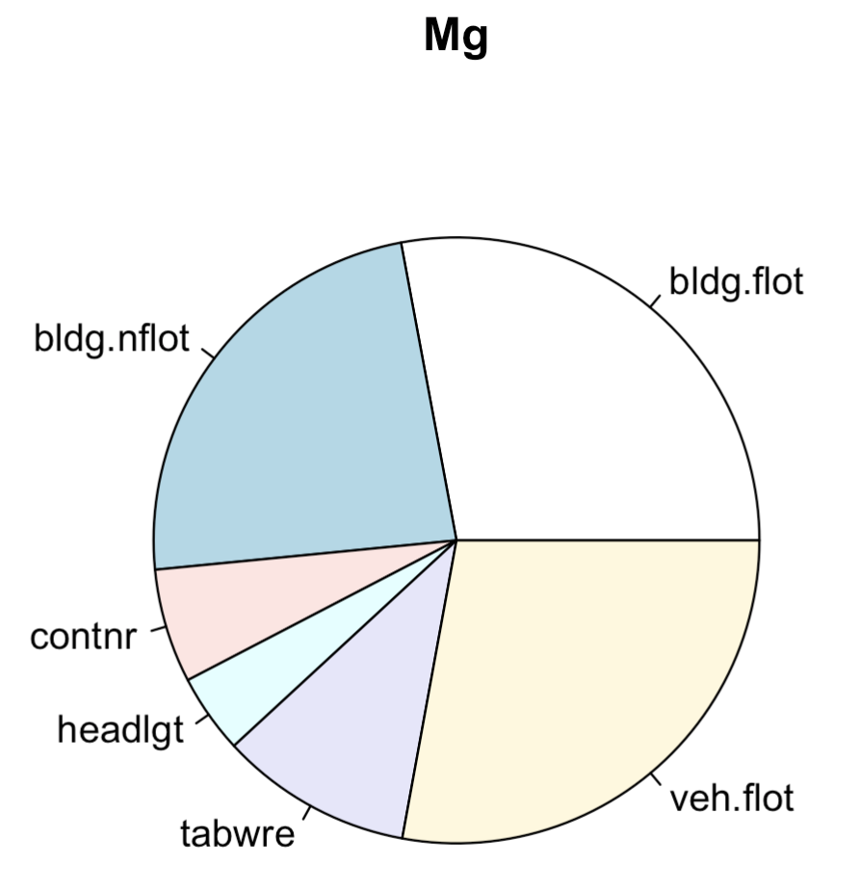
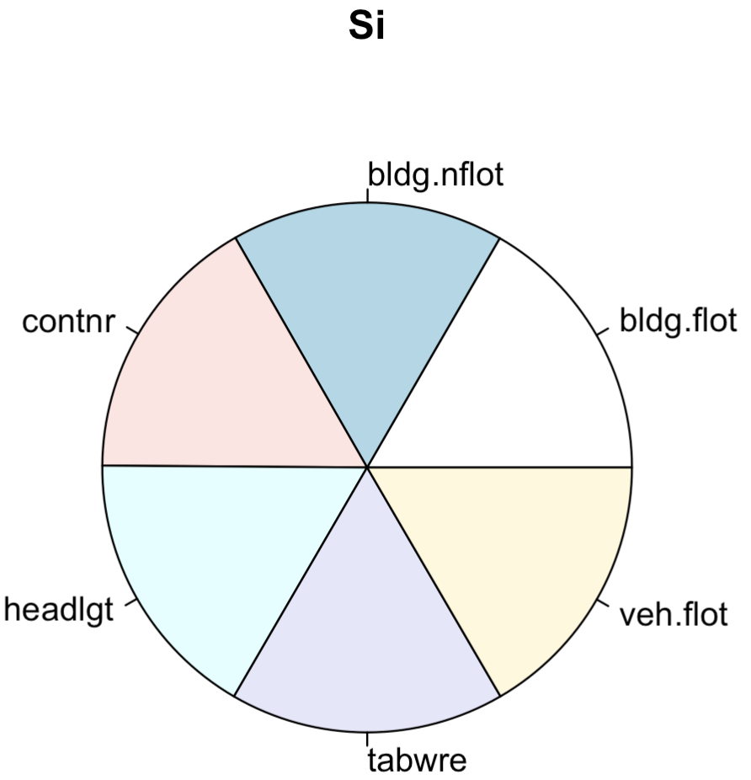
Pie Charts
glass_pie_charts.R
Popular way to depict relative proportions
Shown here are are (average) relative proportions of Mg and Si in a sample of some glass types

Slide 10
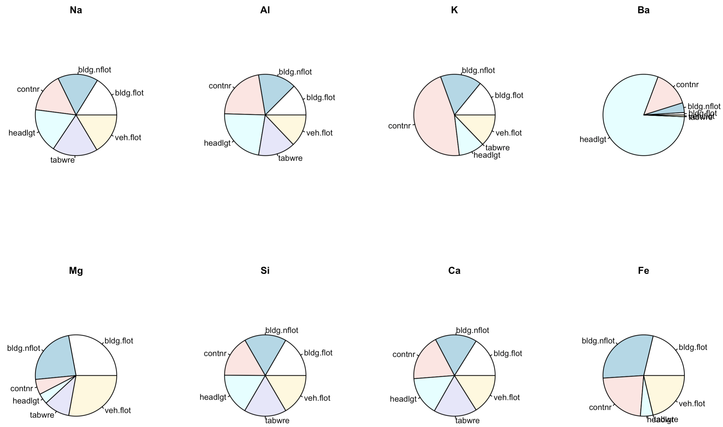
Pie Charts
glass_pie_charts.R

Slide 11
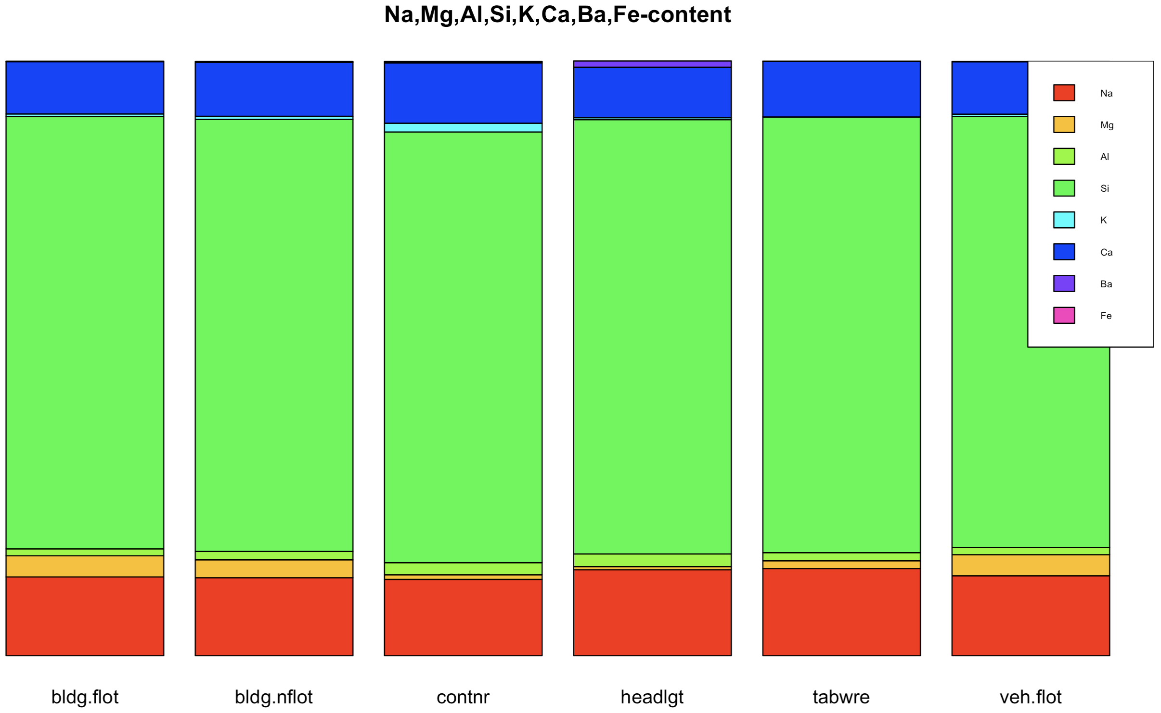
Stacked Bar Plots
Bar heights shows relative proportions
glass_stacked_bar.R

Slide 12
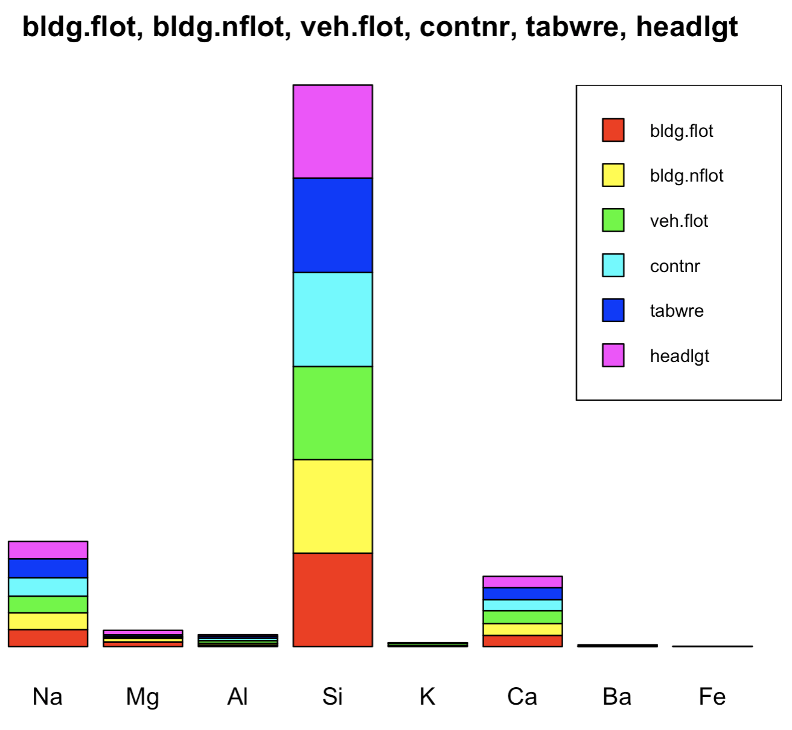
Stacked Bar Plots
glass_stacked_bar.R

Slide 13
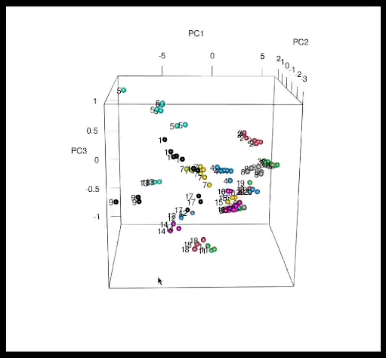
Interactive 3D Scatter Plots
gas_3d_plotting.R

Slide 14
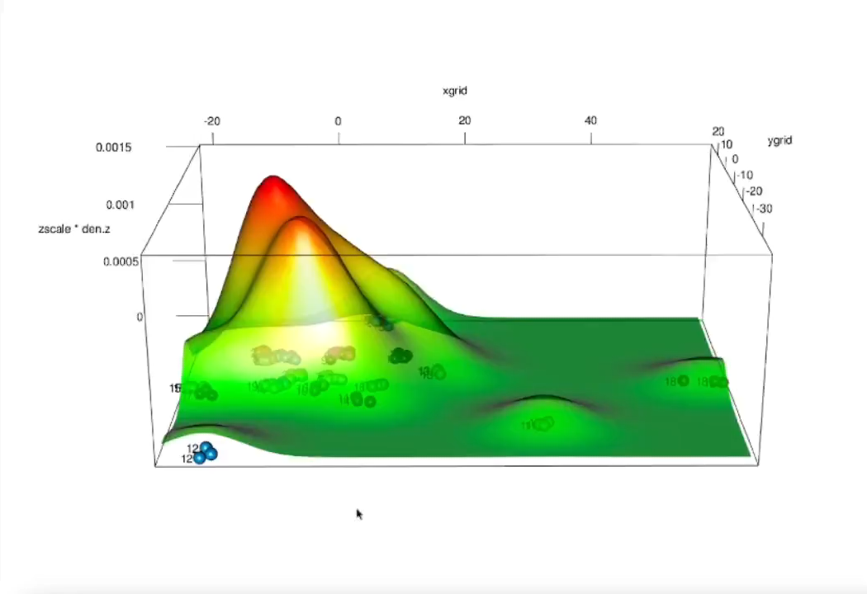
Interactive 3D Surface Plots
gas_3d_plotting.R

