Slide 1

Important Definitions and Resources
Osborn

Slide 2
“Legal” Science
Daubert is a benchmark!!!:
Daubert (1993)- Judges are the “gatekeepers” of scientific evidence.
Must determine if the science is reliable
Has empirical testing been done?
Falsifiability
Has the science been subject to peer review?
Are there known error rates?
Is there general acceptance?
Federal Government and 26(-ish) States are “Daubert States”

Slide 3
Aside: How statistics took off in
Forensic Science
DNA profiling was not only successful, it was a scientific home run!
Lots of testable theory behind it
(Relatively) easy to get simple data
Not to tough to explain to the general public
It was backed by research $$$$ before it made it to forensic science.
So let’s just apply statistics to everything else in forensic science, … right … ????

Slide 4
Aside: Statistics for DNA in a Nutshell
Statistics justify DNA profiling
Probability that unrelated people have the same DNA profile is so remote as to be considered a practical impossibility
Overview of how it works:
Measure the frequency of different alleles at 13 designated loci in a “representative random sample” of a population

Slide 5
Aside: Statistics for DNA in a Nutshell
Nature seems to obey Hardy-Weinberg and linkage equilibria
These Laws of inheritance state that allele frequencies are statistically independent
Multiply frequencies of alleles to get frequencies of genotypes at the chosen 13 loci
Multiply frequencies of 13 genotypes to get frequency of profiles in the population

Slide 6
Aside: A Simple Model
Say there are only two alleles for each locus, A and a
Also say they all he the population frequencies
A = 70%
a = 30%
All genotypes AA
All genotypes aa
Probability of Profile
AA × 2Aa × aa × 2Aa × AA × AA × aa × 2Aa × 2Aa × 2Aa × aa × 2Aa
Genotypes a mix of AA, Aa and aa
All genotypes Aa
Number of Loci

Slide 7
Aside: DNA Profiling is a Bad Analogy
for other forms of Physical Evidence!!!
Alleles are like subclass characteristics (R. Nichols)
Subclass characteristics: A subset of characteristics common to some but not all objects of the same class
Not all categories of physical evidence (most?!) have:
Well defined subclass characteristics
Finite number of subclass characteristics
Makes computation of “frequencies” difficult if not impossible

Slide 8
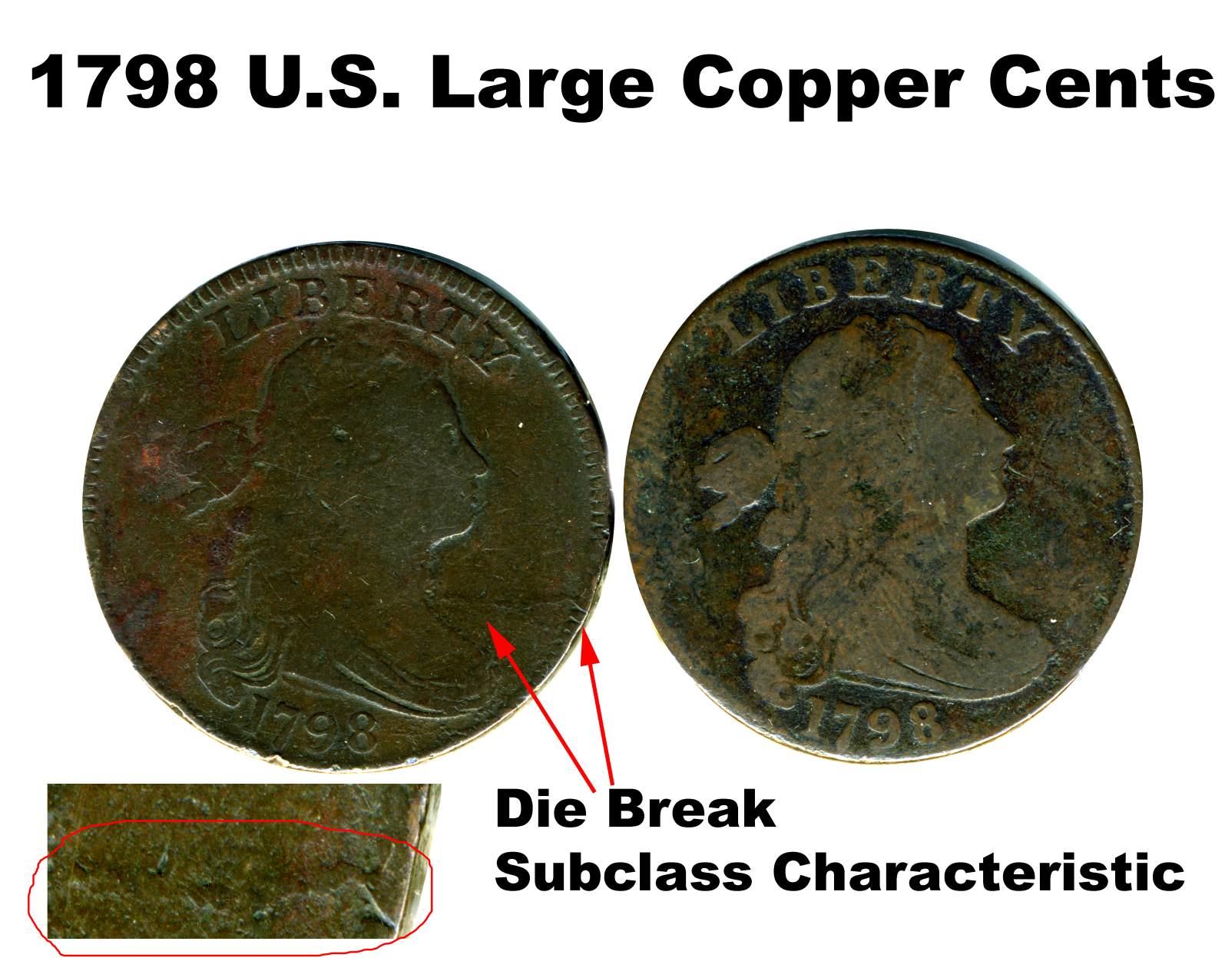
Tool marks, footwear, tires can have subclass characteristics, but they are notoriously difficult to ID

Slide 9
Aside: DNA Profiling is a Bad Analogy
for other forms of Physical Evidence!!!
Individual characteristics more common
Difficult to characterize them and measure their frequencies of occurrence!
Features of physical evidence can be mutable over time
Allelic frequencies are assumed not to change!
Statistical independence for the frequencies of the selected physical evidence features may be difficult or impossible to prove.
Combining of individual probabilities into a product “profile” would not be justified.

Slide 10
So What Can We Do?
Practitioners and data/metrology experts work together to quantify their problems
Note: some problems are not quantifiable, but it needs to be clearly articulated why.
The process of data analysis is a craft
Carefully consider the problem and choose appropriate methods.
The are usually many approaches…
Write up analysis as an S.O.P. if it makes sense
Forensic science is messy. Much analysis may remain bespoke to the case and not “S.O.P.-able”
Science by the numbers isn’t always possible, … and boring.

Slide 11
Measurement and Randomness
Any time an observation is made, one is making a “measurement”
Experimental error is inherent in every measurement
Refers to variation in observations between repetitions of the same experiment.
It is unavoidable and many sources contribute
Error in a statistical context is a technical term^{BHH}

Slide 12
Measurement and Randomness
Experimental error is a form of randomness
Randomness: inherent unpredictability in a process
The the outcomes of the process follow a probability distribution
Statistical tools are used to both:
Describe the randomness
Make inferences taking into account the randomness
Careful!:
Bad data, assumptions and models lead to garbage (GIGO)

Slide 13
What is Statistics??
Study of relationships in data
Descriptive Statistics – techniques to summarize data
E.g. mean, median, mode, range, standard deviation, stem and leaf plots, histograms, box and whiskers plots, etc.
Inferential Statistics – techniques to draw conclusions from a given data set taking into account inherent randomness
E.g. confidence intervals, hypothesis testing, Bayes’ theorem, forecasting, etc.

Slide 14
Why do we use statistical tools?
For the Sciences, we ask:
How precise are our measurements?
How accurate might our measurements be?
Are the differences in measurements characterizing two (or more) objects real or just due to randomness?
Furthermore, for the Forensic Sciences we ask:
Do two pieces of evidence originate from a common source?
For this, we must at least answer the above.

Slide 15
Probability: Frequency
Frequency: ratio of the number of observations of interest (n_{i}) to the total number of observations (N)
Probability (frequentist): frequency of observation i in the limit of a very large number of observations
We will almost always use this definition
It is EMPIRICAL!

Slide 16

Probability: Frequency
Pr( roll a 3 ) = ??

Slide 17
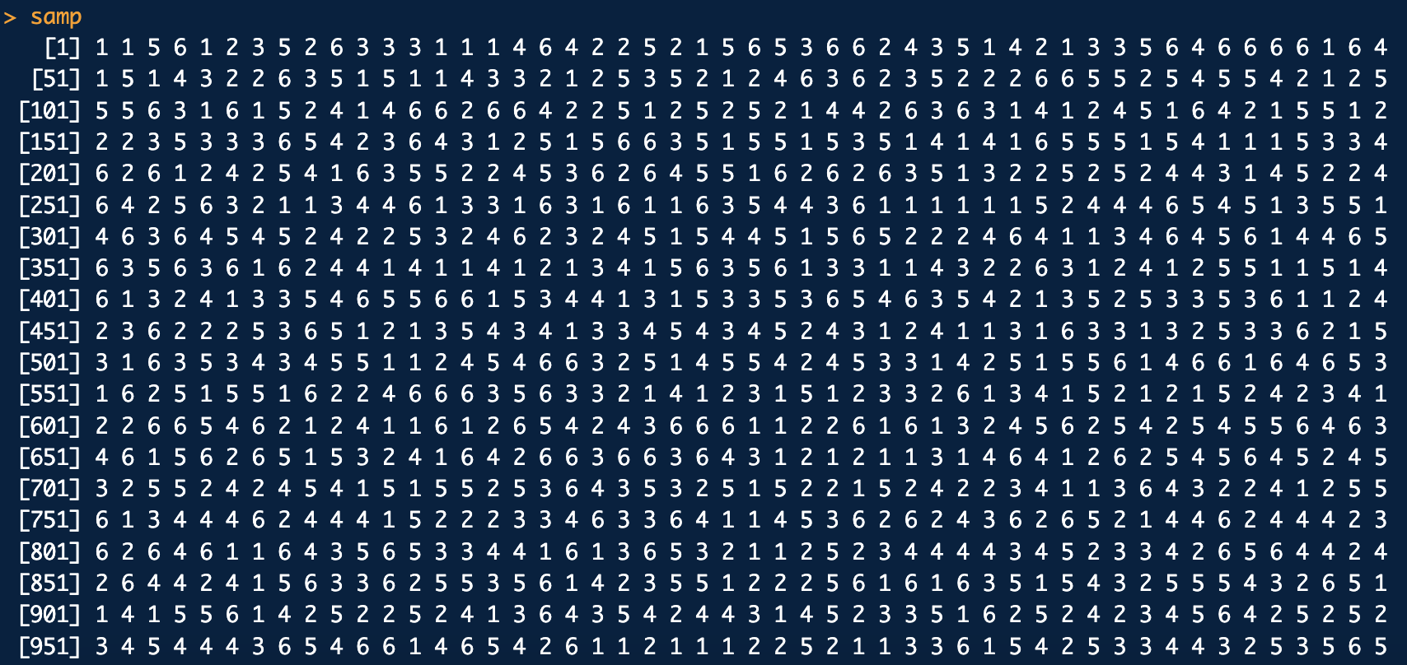
Probability: Frequency
Roll a “fair” die 1000 times (N = 1000). What is the frequency of obtaining 3 (n₃ = ?)?
Let’s do this with simulation (Monte Carlo):
# Sample from 1 through 6, 1000 times:
n <- 1000
samp <- sample(c(1,2,3,4,5,6), size=n, replace=T)
samp
sum(samp==3)/n # Frequency of rolling a 3 in 1000 rolls
In R:
dice6.R
n₃ = 3
Result:
freq₃ = 149/1000 = 0.149

Slide 18
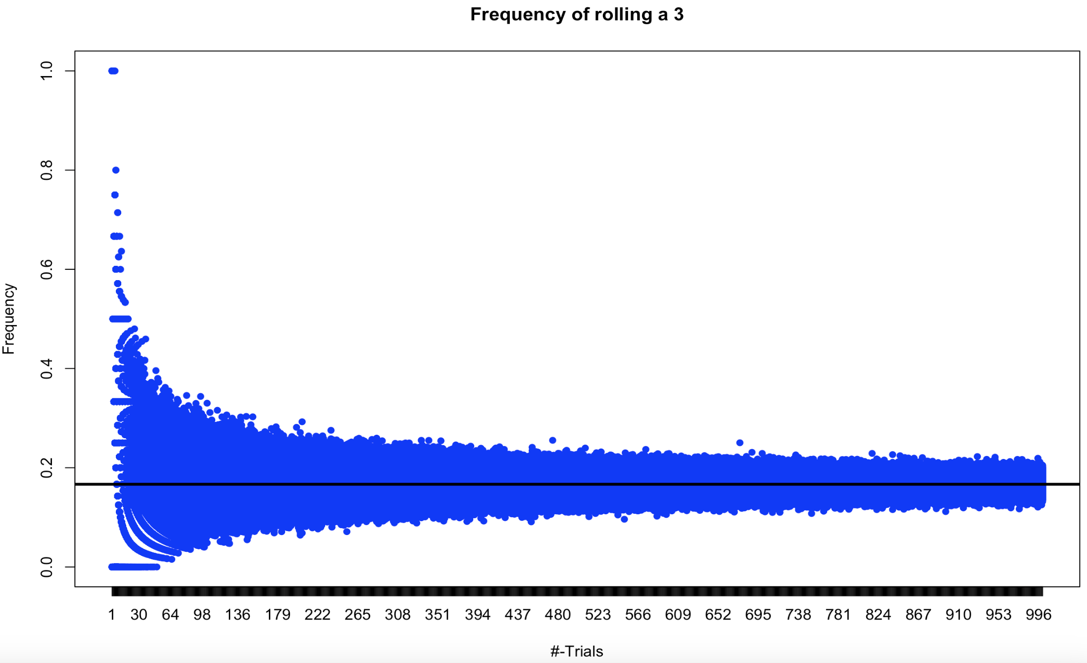
Probability: Frequency
But that was just one run of 1000 trials. What happens if we vary the number of trials and repeat the process many times*?
Frequency approaches 1/6
*Law of large numbers

Slide 19
Probability: Belief
Belief: A “Bayesian’s” interpretation of probability.
Probability is a measure of one’s state of knowlege^{Jaynes}.
Bayesian-probabilities reflect degree of belief and can be assigned to any statement
Beliefs (probabilities) can be updated in light of new evidence (data) via Bayes’ theorem.

Slide 20
Probability: Belief
Pr(Sprinkler)
Pr(Rain)
Other probabilities
are updated given
the observation
You observe
grass is wet.
Pr(Grass Wet)

Slide 21
Probability: Belief
Bayesian network for the provenance of a painting given trace evidence found on that painting

Slide 22
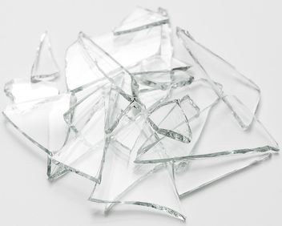
Probability: Belief
What’s our updated beliefs about the mean RI given a probability model for RI’s and the RI data we observe?
Refractive index of glass shards = x
http://wiki.chemprime.chemeddl.org/
posterior sample

Slide 23
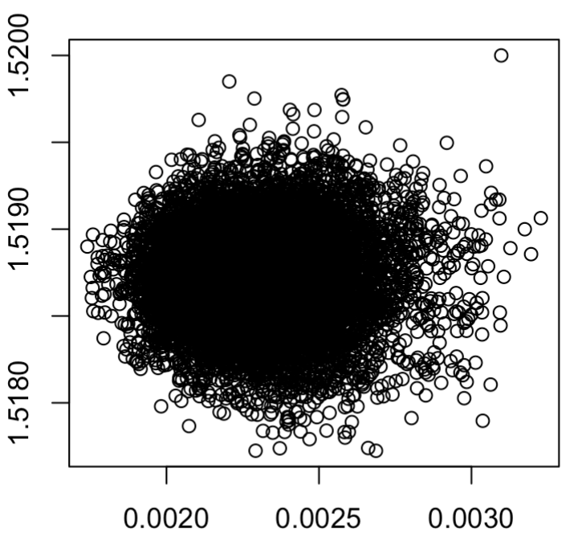
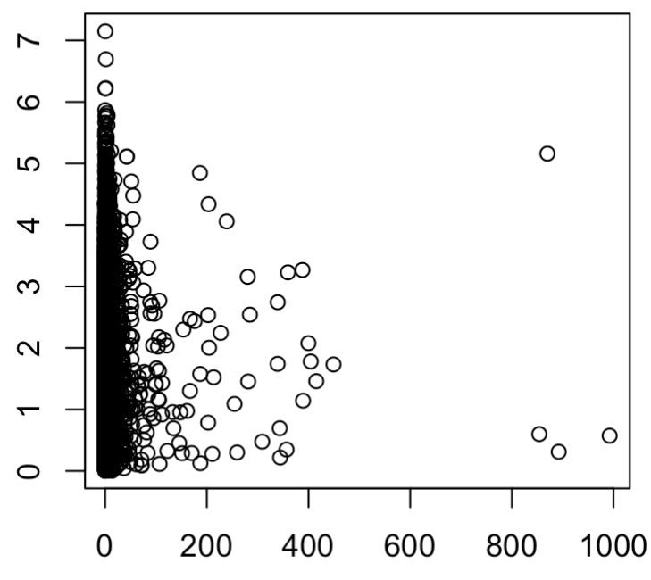
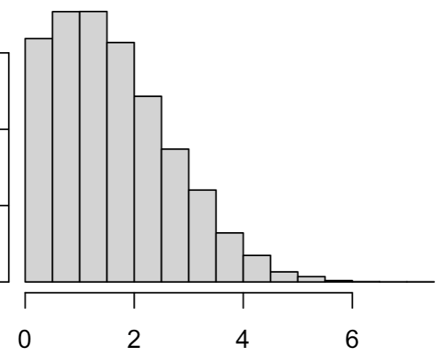
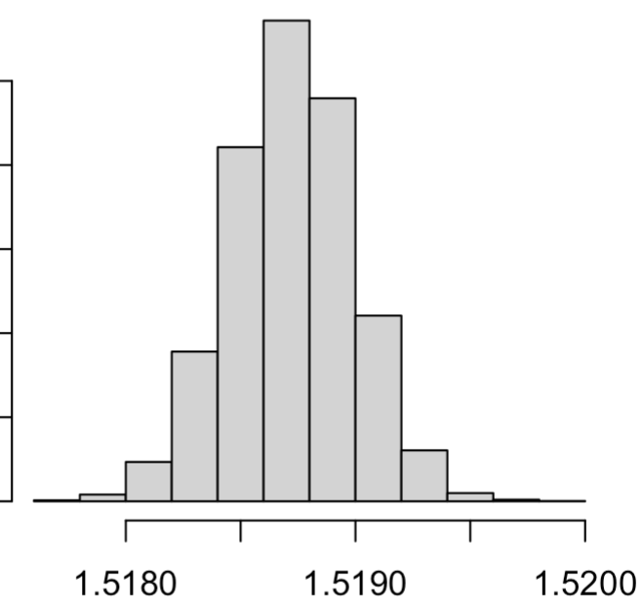
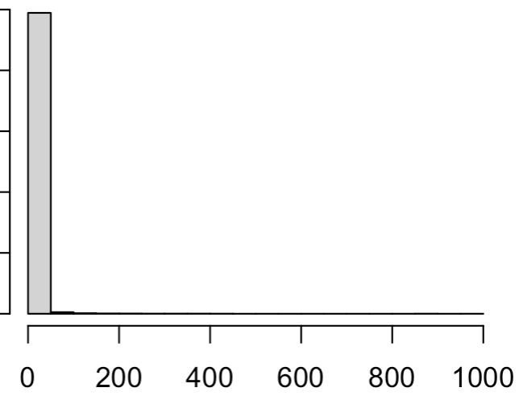
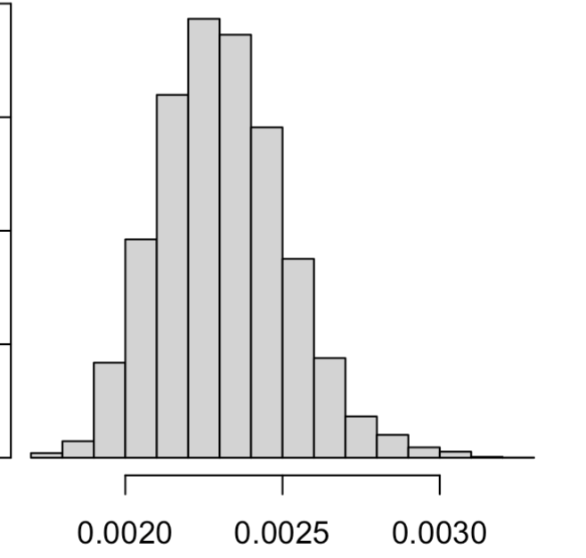
Prior beliefs:
Updated beliefs:

Slide 24
What is Statistics??
Study of relationships in data
Descriptive Statistics – techniques to summarize data
E.g. mean, median, mode, range, standard deviation, stem and leaf plots, histograms, box and whiskers plots, etc.
Inferential Statistics – techniques to draw conclusions from a given data set taking into account inherent randomness
E.g. confidence intervals, hypothesis testing, Bayes’ theorem, forecasting, etc.

Slide 25
Data and Sampling
Population and Sample Representations:
Representative independent random sample:
All observations have an equal chance of being made and no observation affects any other
independent and identically distributed random sample (I.I.D.)
Population
Population
Population
Biased Samples
Sample
Sample

Slide 26
Parameters and Statistics
Parameter: any function of the population
Statistic: any function of a sample from the population
Statistics are used to estimate population parameters
We may construct probability distributions for statistics
Populations have probability distributions for observations
Samples have probability distributions for observations and statistics

Slide 27
Standardized Language: The GUM
The problems of applying statistics to practice and assessing uncertainties are not new or unique to forensic science.
In 1977 the “world’s highest authority in metrology”, Comité International des Poids et Mesures (CIPM) requested an international consensus document for the application of statistics and expression of uncertainty for measurement.
Guide to Uncertainty in Measurement (GUM)

Slide 28
Intro to the GUM
The Bureau International des Poids et Mesures (BIPM) put in charge and convened the Joint Committee on Guides for Metrology (JCGM)
By 1994 CIPM-BIPM-JCGM had something:
“Evaluation of measurement data-Guide to the expression of uncertainty in measurement”: JCGM 100:2008
The GUM
The GUM with supplements is available at this link.
A zip file of all the documents is here.

Slide 29
Intro to the GUM
The GUM is a set of prescriptions to make statements about uncertainty related to measurement
Distilled from the literature on production and quality control
Based also on experience from practitioners around the world:
Engineers
Metrologists
Applied Statisticians
Scientists

Slide 30
Intro to the GUM
The GUM catalogues standard methodologies for uncertainty assessment from both the frequentist (Type A)and Bayesian (Type B) worlds
Very (overly??) general
GUM language is not entirely congruent with textbook statistics language…
“measurand”, “input quantities”, “standard uncertainty”, “conformance”, etc. used by the GUM are more commonly called other things that we’ll discuss.

Slide 31
Intro to the GUM
In a nutshell:
Type A methods rely on the frequentist definition of probability
Require repeatable experiments
“Objective”…in theory
“Push button”; you can look up in any text book
Interpretation is clunky…
Type B methods rely on the Bayesian definition of probability
Can use judgement and/or repeatable experiments
“Subjective”; but not necessarily a bad thing
NOT “push button”. Much harder to carry out in practice usually.
Interpretation is intuitive

Slide 32
Intro to the GUM
Note: There are “gray areas” in the GUM which discuss uncertainty using mixtures of frequentist and Bayesian ideas.
When encountering these “gray areas” we will be explicit about which concepts are more “frequentist” and which are more “Bayesian”

Slide 33
GUM Terminology
Random variables - All measurements have an associated “randomness” component
Randomness –patternless, unstructured, typical, total ignorance
Any experiment/observation recorded is a random variate
GUM calls direct experimental observations input quantities = x
Usually I call this data
Measurand: quantity intended to be measured^{GUM} = y
In this course we’ll usually use μ or θ instead of y

Slide 34
GUM Terminology
Measurands are parameters
Estimates of measurands are statistics
Measured quantity value is an estimate of the measurand^{GUM}
Example:
Most common measurand we’ll be interested in is a mean
Estimate for a mean is an average
An average is a statistic

Slide 35
Basic GUM Terminology
Error: measured quantity value minus a reference value^{GUM}
Systematic Error: error that remains constant or that varies predictably^{GUM}
Related to bias
Random Error error that varies in an “unpredictable” manner^{GUM}

Slide 36
Basic GUM Terminology
Bias: systematic error associated with the measurement process^{GUM}
Uncertainty non-negative parameter characterizing the dispersion of the quantity values being attributed to a measurand^{GUM}
One form or another of standard deviation
There are both type A (frequentist) and B (Bayesian) versions
GUM calls standard deviation, standard uncertainty

Slide 37
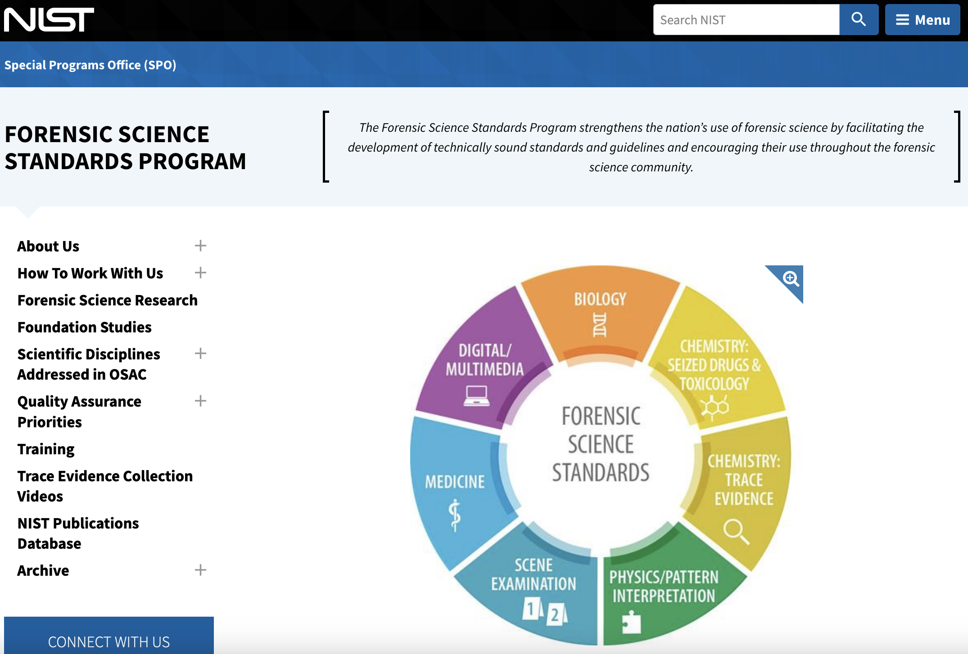

Standards Organizations and Documents
NIST OSAC Info
OSAC Registry
AAFS-ASB

Slide 38
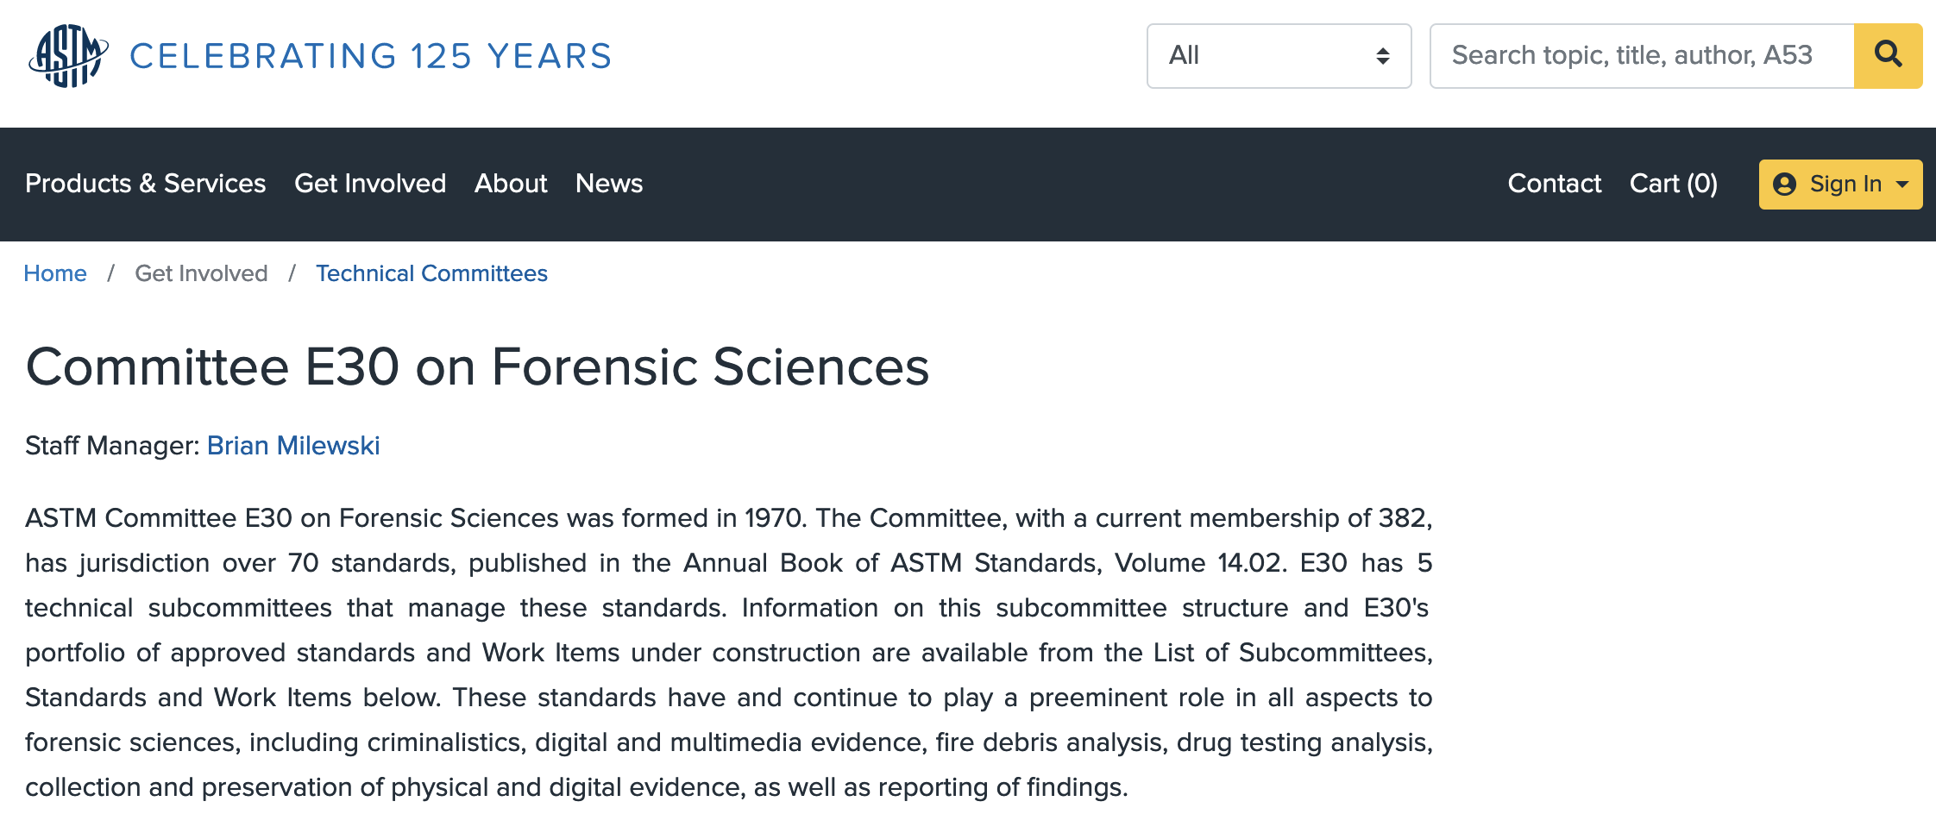
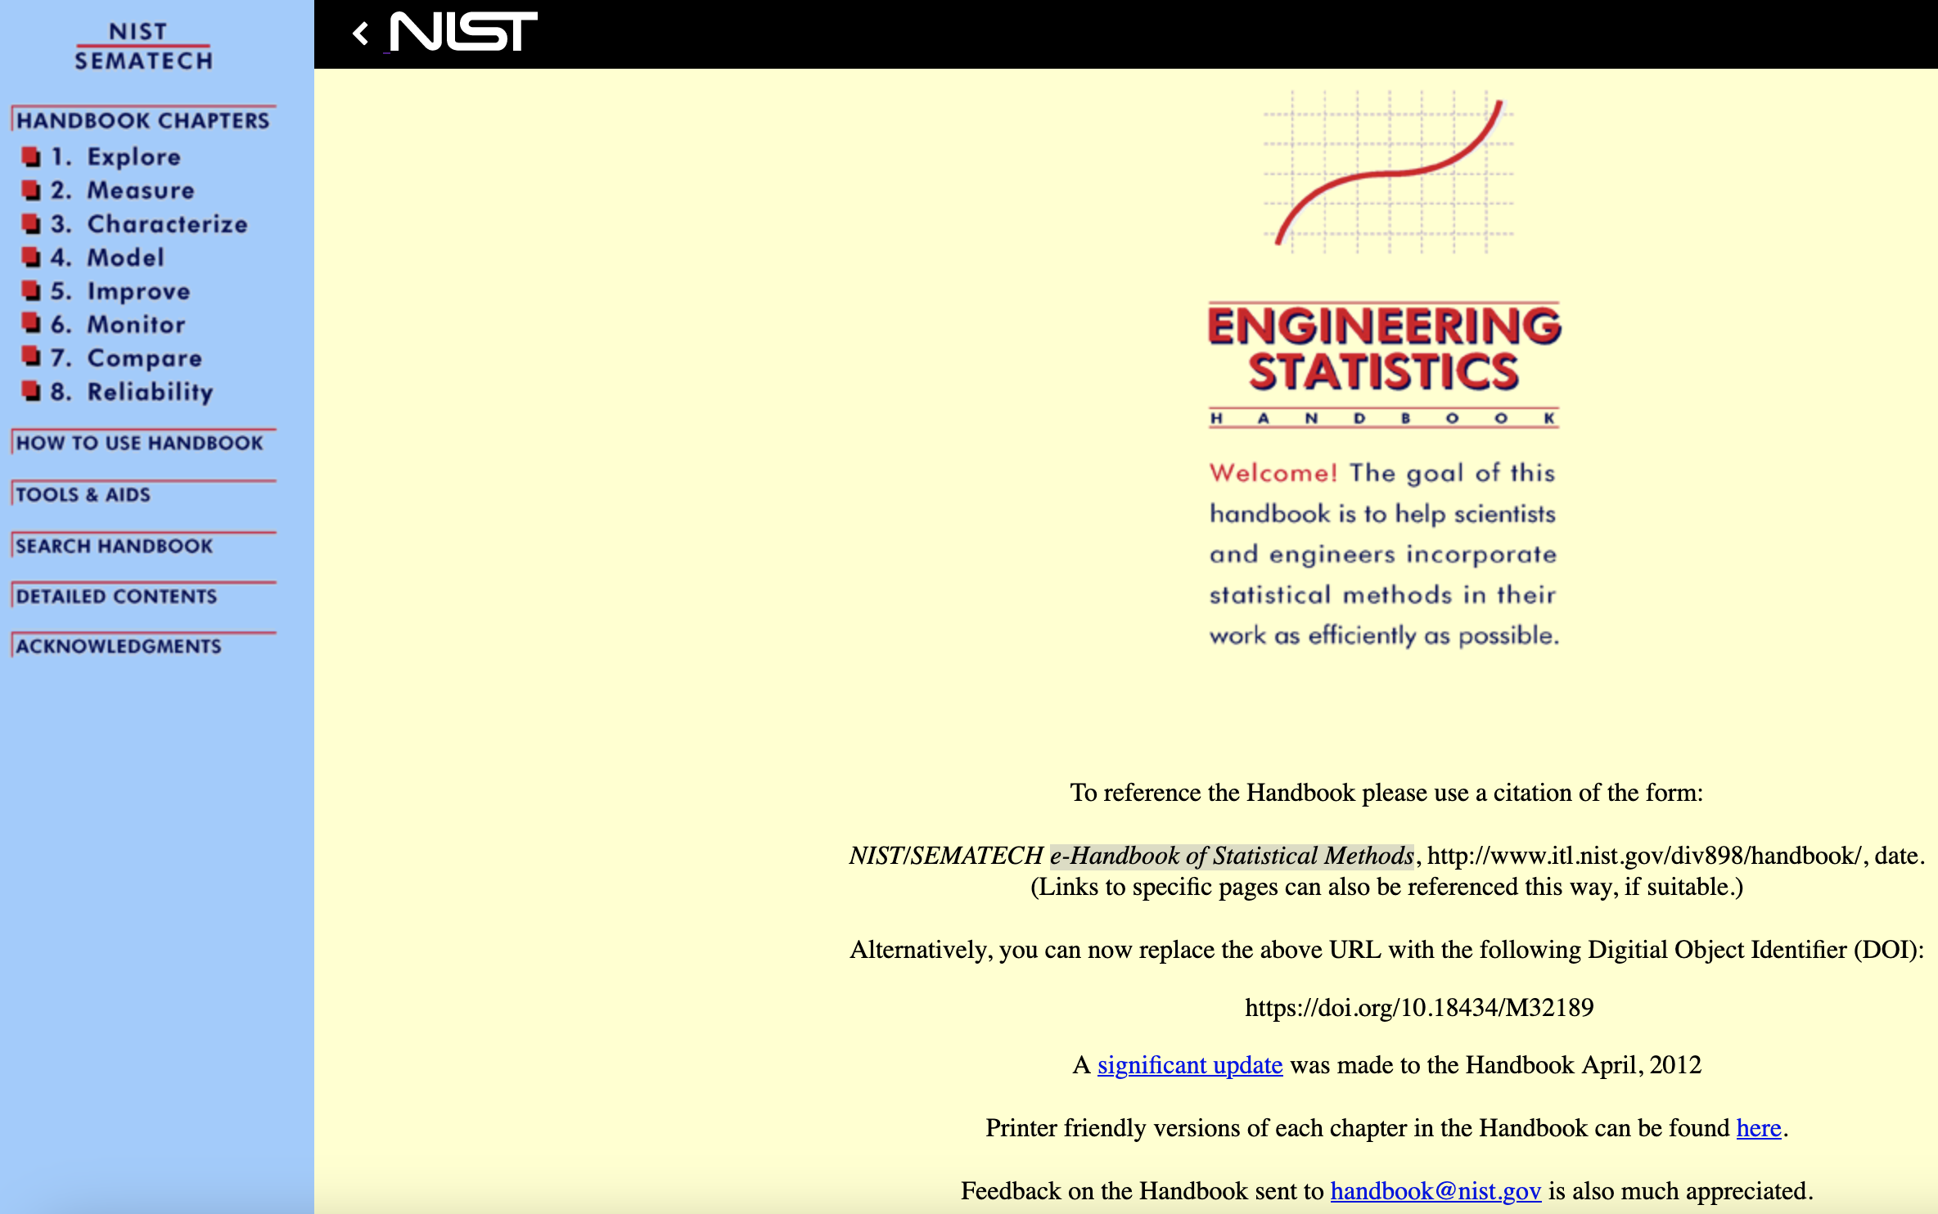
Standards Organizations and Documents
ASTM International
ASTM E30
Committee on Forensic Science
ASTM E30
Subcommittees and Standards
NIST e-Handbook
of Statistical Methods

Slide 39
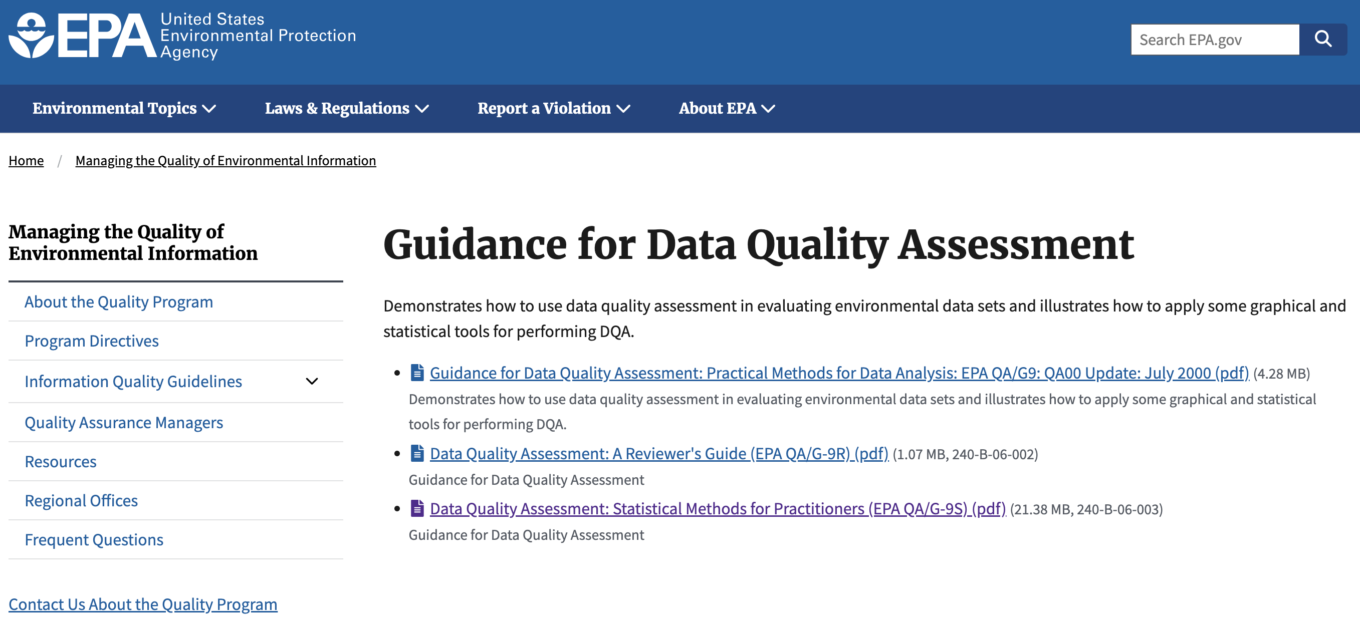
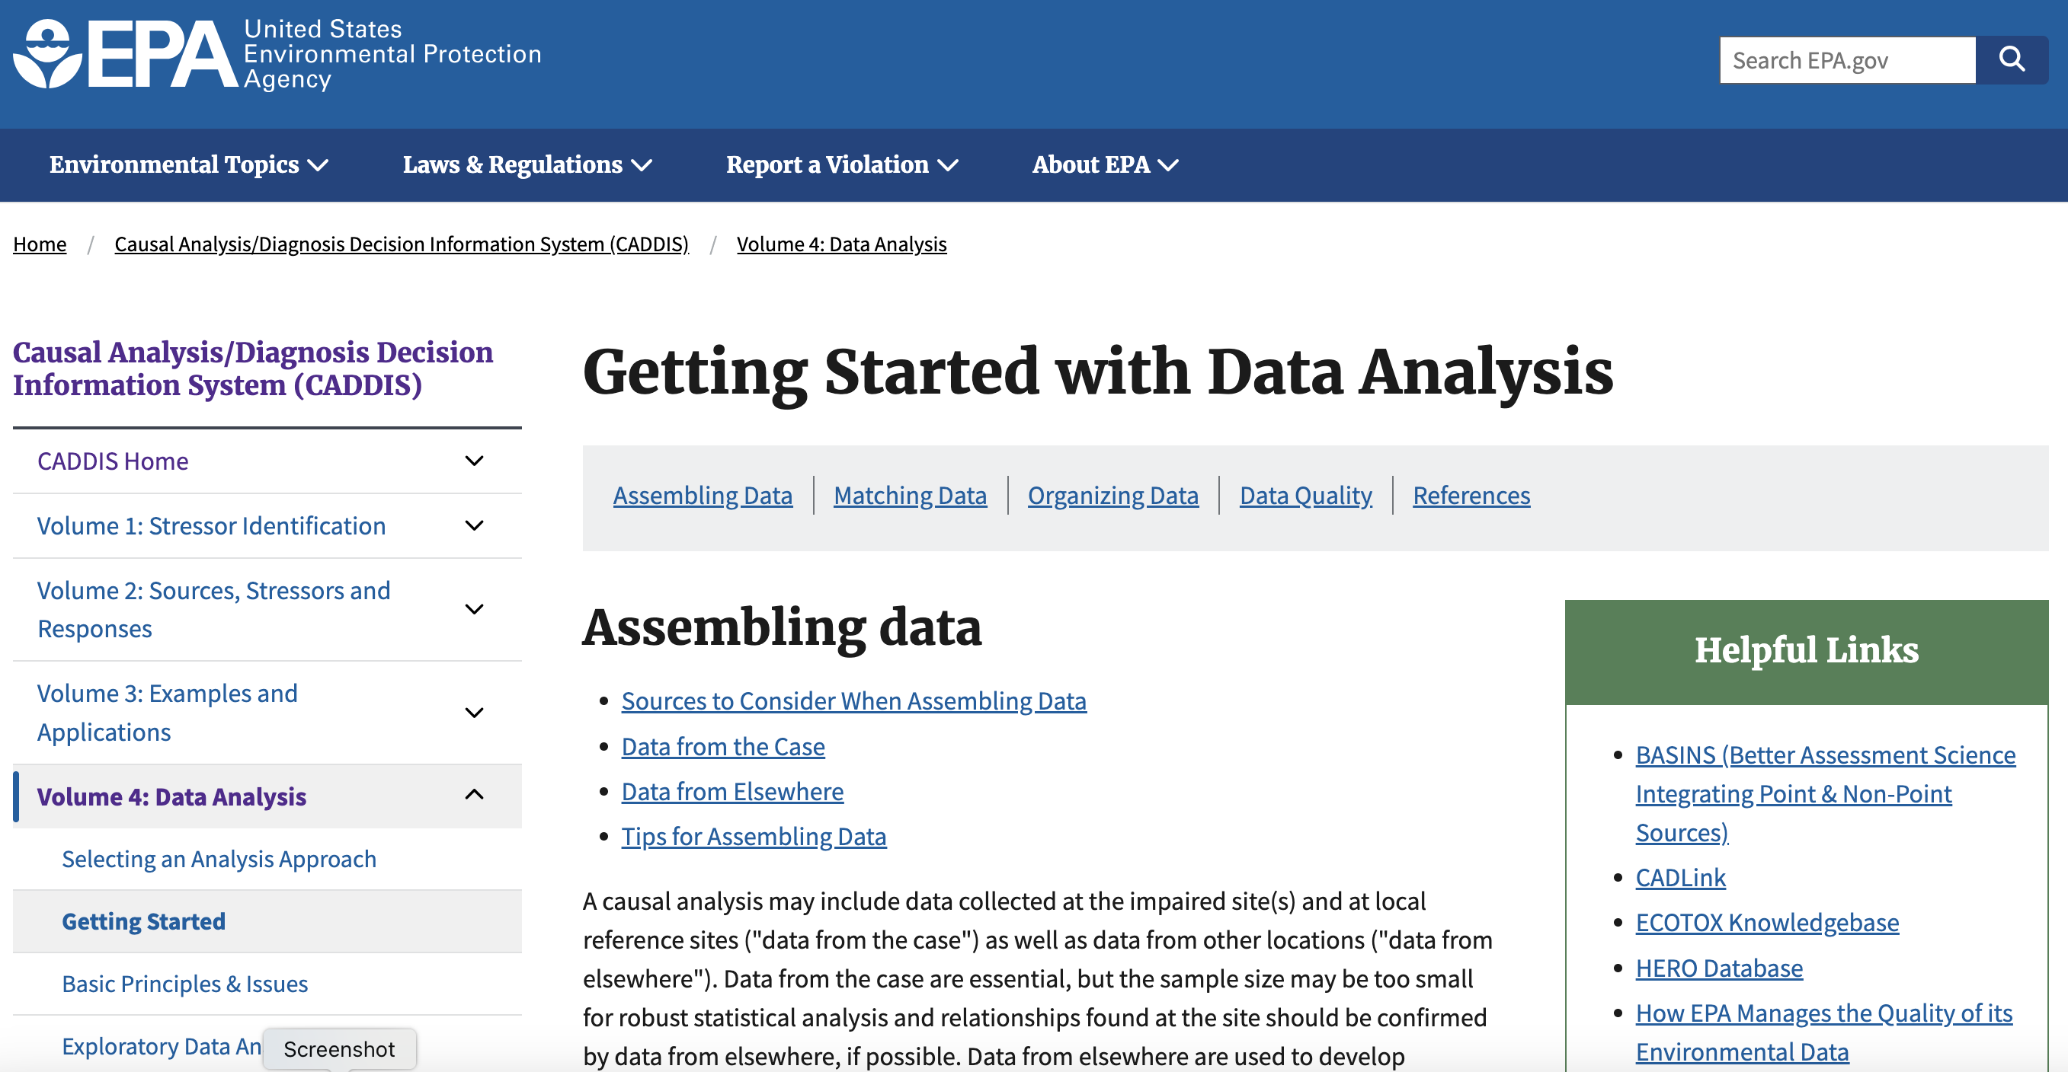
Look to other agencies as well
Look to other agencies that uses statistics in mission critical situations:
EPA 1
EPA 2

Slide 40
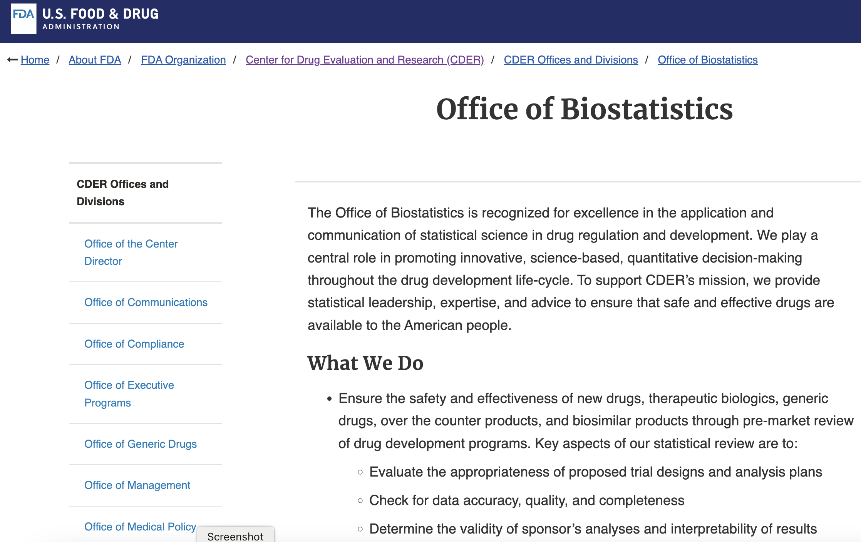
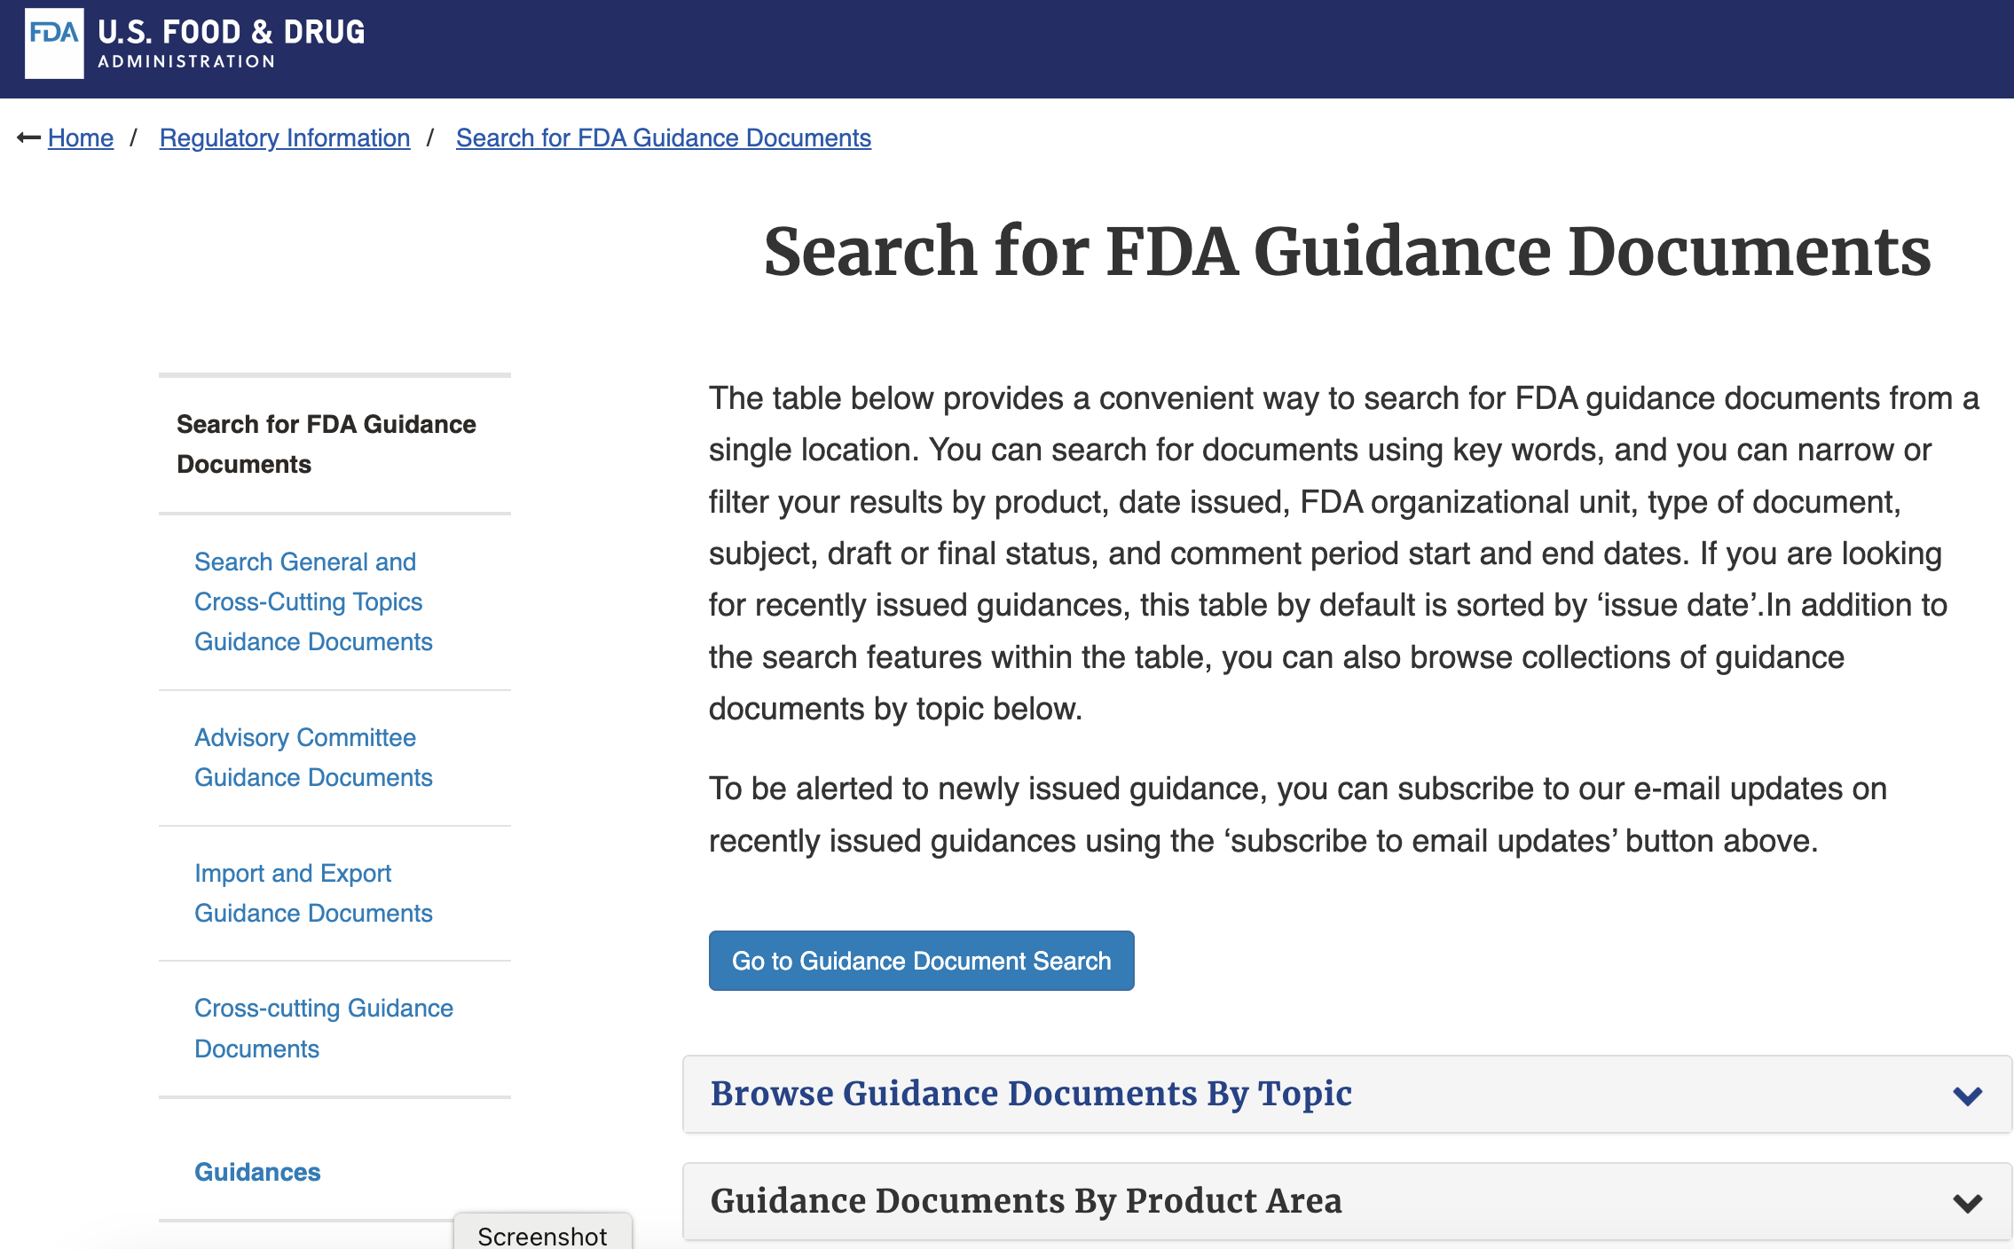
Look to other agencies as well
Look to other agencies that uses statistics in mission critical situations:
FDA 1
FDA 2
cf. FDA/EPA links in syllabus as well

