Slide 1
Introduction to Multivariate Methods

Slide 2
More Complicated Data

Slide 3
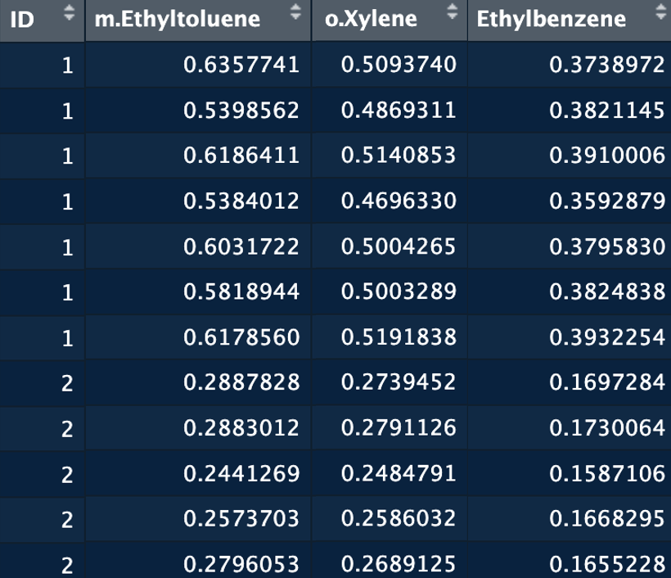
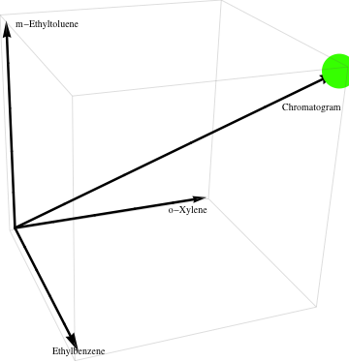
Random Vectors
For an experiment/observation, put many measurements together
Collect p random variables into a random vector, x
Length of x is p:
x also called: observation vectors and feature vectors

Slide 4
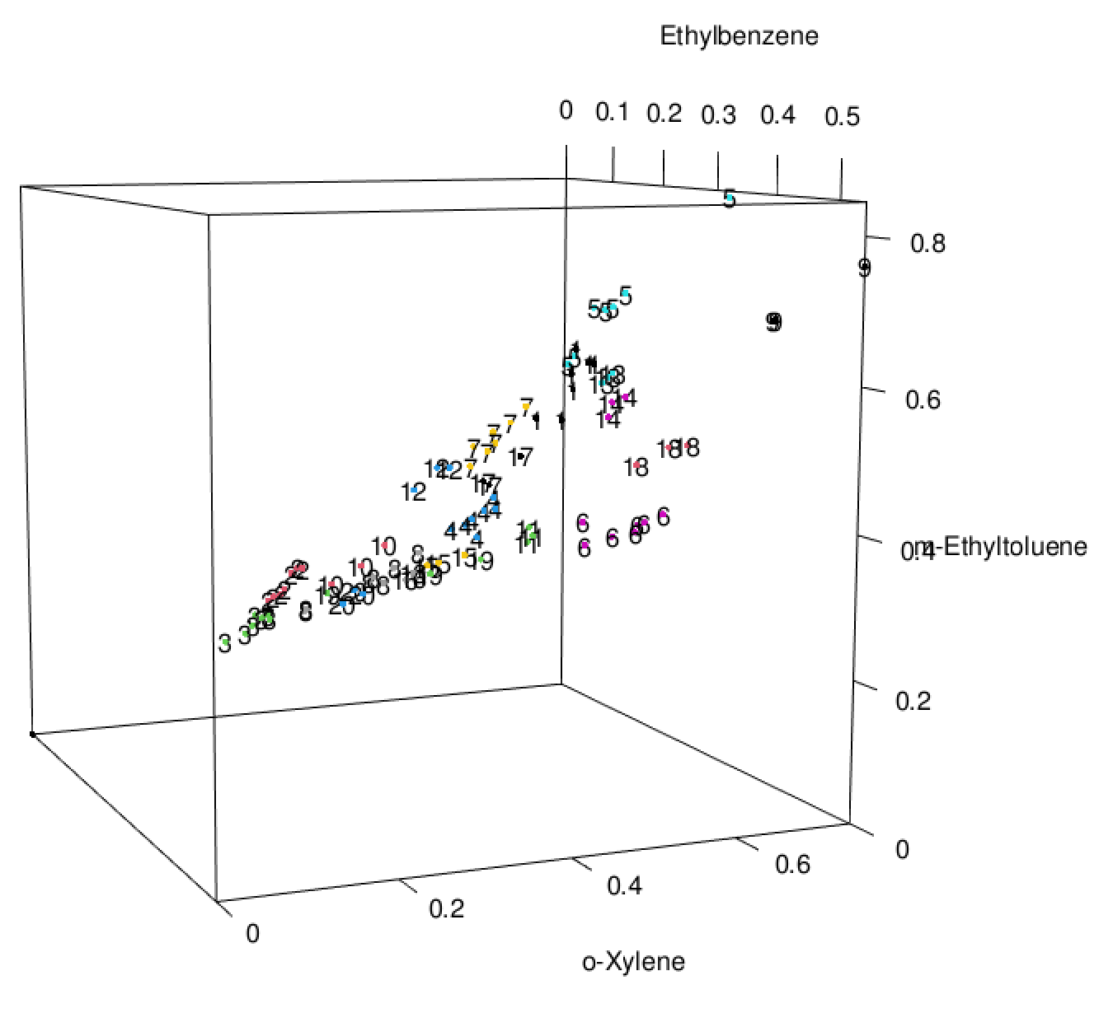
Prep for 3D Plotting in R
Macintosh people only, download and install XQuarz:
https://github.com/XQuartz/XQuartz/releases/download/XQuartz-2.8.5/XQuartz-2.8.5.pkg
library(frequtils)
library(rgl)
data(gas)
x <- gas$Ethylbenzene
y <- gas$o.Xylene
z <- gas$m.Ethyltoluene
lbl <- gas$ID
plot3d(x,y,z, col=lbl)

Slide 5
Basic Data Pre-processing
Mean Centering: Subtract the mean of each column in X
Puts the origin at the data’s “center of mass”
Variance Scaling: Divide each column by its standard deviation
Weights each column (variable) to have the same importance
All variables will have the same variance = 1
Autoscaling: Mean center and variance scale X

Slide 6
Basic Data Pre-processing
Some Gasoline Data:
Raw Peak Areas
Mean Centered

Slide 7
Basic Data Pre-processing
Some Gasoline Data:
Var = 1
Variance Scale
Var = 0.014
Var = 0.002
Raw Peak Areas
Var = 1

Slide 8
Basic Data Pre-processing
Some Gasoline Data:
Var = 1
basic_preprocessing.R
Var = 1
Autoscaled

Slide 9
Some Important Terms
Latent Variable: weighted combination of experimental variables into a new “synthetic” variable
Also called: scores, components or factors, z
The weights are sometimes called loadings* (a_{i} or A)
Most latent variables we will study are linear combinations between experimental variables and weights:
Thes are just dot prods. between obs. vect. and weight vect. gives to get scores:
*Watch out. “Loadings” may refer to a few different things depending on the method and the author

Slide 10
Some Important Terms
We can choose:
How to compute the latent variables:
Principal Component Analysis (PCA)
Canonical Variate Analysis (CVA, LDA)
Partial Least Squares (PLS)
etc.
How many latent variables to retain to represent the data X:
Serves to reduce the dimension of the data
Serves to help pinpoint more important parts of the data
Serves to help separate the data into groups

Slide 11
Covariance Matrix
Covariance: variability of two measured quantities with each other:
obs. #k, var. #i
avg. of var. #i
positive
As one quantity increases the other increases
negative
As one quantity increases the other decreases

Slide 12
Covariance Matrix
Given a n row by p variable data matrix, collect all p² variances/covariances into a p×p table:
For gasoline (15 measurements/chromatogram):
variances
 | 1 | 2 | 3 | 4 | 5 | 6 | 7 | 8 | 9 | 10 | 11 | 12 | 13 | 14 | 15
1 | 0.01 | 0.03 | 0.01 | 0.00 | 0.01 | 0.01 | 0.01 | 0.00 | 0.02 | 0.00 | 0.00 | 0.00 | 0.00 | 0.00 | 0.00
2 | 0.03 | 0.10 | 0.04 | 0.01 | 0.04 | 0.02 | 0.02 | 0.02 | 0.06 | 0.01 | 0.01 | 0.01 | 0.01 | 0.01 | 0.01
3 | 0.01 | 0.04 | 0.01 | 0.00 | 0.02 | 0.01 | 0.01 | 0.01 | 0.02 | 0.01 | 0.00 | 0.00 | 0.00 | 0.00 | 0.01
4 | 0.00 | 0.01 | 0.00 | 0.00 | 0.01 | 0.00 | 0.00 | 0.00 | 0.01 | 0.00 | 0.00 | 0.00 | 0.00 | 0.00 | 0.00
5 | 0.01 | 0.04 | 0.02 | 0.01 | 0.02 | 0.01 | 0.01 | 0.01 | 0.04 | 0.01 | 0.00 | 0.01 | 0.00 | 0.01 | 0.01
6 | 0.01 | 0.02 | 0.01 | 0.00 | 0.01 | 0.00 | 0.01 | 0.00 | 0.01 | 0.00 | 0.00 | 0.00 | 0.00 | 0.00 | 0.00
7 | 0.01 | 0.02 | 0.01 | 0.00 | 0.01 | 0.01 | 0.01 | 0.01 | 0.02 | 0.00 | 0.00 | 0.00 | 0.00 | 0.00 | 0.01
8 | 0.00 | 0.02 | 0.01 | 0.00 | 0.01 | 0.00 | 0.01 | 0.00 | 0.01 | 0.00 | 0.00 | 0.00 | 0.00 | 0.00 | 0.00
9 | 0.02 | 0.06 | 0.02 | 0.01 | 0.04 | 0.01 | 0.02 | 0.01 | 0.05 | 0.01 | 0.01 | 0.01 | 0.01 | 0.01 | 0.01
10 | 0.00 | 0.01 | 0.01 | 0.00 | 0.01 | 0.00 | 0.00 | 0.00 | 0.01 | 0.00 | 0.00 | 0.00 | 0.00 | 0.00 | 0.00
11 | 0.00 | 0.01 | 0.00 | 0.00 | 0.00 | 0.00 | 0.00 | 0.00 | 0.01 | 0.00 | 0.00 | 0.00 | 0.00 | 0.00 | 0.00
12 | 0.00 | 0.01 | 0.00 | 0.00 | 0.01 | 0.00 | 0.00 | 0.00 | 0.01 | 0.00 | 0.00 | 0.00 | 0.00 | 0.00 | 0.00
13 | 0.00 | 0.01 | 0.00 | 0.00 | 0.00 | 0.00 | 0.00 | 0.00 | 0.01 | 0.00 | 0.00 | 0.00 | 0.00 | 0.00 | 0.00
14 | 0.00 | 0.01 | 0.00 | 0.00 | 0.01 | 0.00 | 0.00 | 0.00 | 0.01 | 0.00 | 0.00 | 0.00 | 0.00 | 0.00 | 0.00
15 | 0.00 | 0.01 | 0.01 | 0.00 | 0.01 | 0.00 | 0.01 | 0.00 | 0.01 | 0.00 | 0.00 | 0.00 | 0.00 | 0.00 | 0.01
S =
covariances
WHAAAAAAAAAA??????????

Slide 13
Correlation Matrix
Dividing (co)variances by s.d. of each variable:
Gives correlation coefficients r between all pairs of x_{i}!
Measure linear relationship between variables
For gasoline:
 | 1 | 2 | 3 | 4 | 5 | 6 | 7 | 8 | 9 | 10 | 11 | 12 | 13 | 14 | 15
1 | 1.00 | 0.89 | 0.93 | 0.85 | 0.78 | 0.81 | 0.74 | 0.72 | 0.73 | 0.72 | 0.58 | 0.62 | 0.65 | 0.59 | 0.50
2 | 0.89 | 1.00 | 0.96 | 0.81 | 0.85 | 0.87 | 0.82 | 0.69 | 0.84 | 0.77 | 0.61 | 0.65 | 0.68 | 0.65 | 0.56
3 | 0.93 | 0.96 | 1.00 | 0.90 | 0.89 | 0.92 | 0.87 | 0.79 | 0.87 | 0.85 | 0.68 | 0.74 | 0.77 | 0.73 | 0.62
4 | 0.85 | 0.81 | 0.90 | 1.00 | 0.95 | 0.96 | 0.96 | 0.96 | 0.92 | 0.96 | 0.88 | 0.92 | 0.92 | 0.89 | 0.81
5 | 0.78 | 0.85 | 0.89 | 0.95 | 1.00 | 0.99 | 0.98 | 0.89 | 0.99 | 0.97 | 0.85 | 0.89 | 0.92 | 0.91 | 0.82
6 | 0.81 | 0.87 | 0.92 | 0.96 | 0.99 | 1.00 | 0.98 | 0.90 | 0.98 | 0.97 | 0.85 | 0.89 | 0.92 | 0.90 | 0.81
7 | 0.74 | 0.82 | 0.87 | 0.96 | 0.98 | 0.98 | 1.00 | 0.93 | 0.97 | 0.98 | 0.92 | 0.94 | 0.95 | 0.95 | 0.88
8 | 0.72 | 0.69 | 0.79 | 0.96 | 0.89 | 0.90 | 0.93 | 1.00 | 0.88 | 0.94 | 0.92 | 0.96 | 0.92 | 0.91 | 0.84
9 | 0.73 | 0.84 | 0.87 | 0.92 | 0.99 | 0.98 | 0.97 | 0.88 | 1.00 | 0.96 | 0.85 | 0.89 | 0.92 | 0.91 | 0.82
10 | 0.72 | 0.77 | 0.85 | 0.96 | 0.97 | 0.97 | 0.98 | 0.94 | 0.96 | 1.00 | 0.93 | 0.96 | 0.97 | 0.97 | 0.90
11 | 0.58 | 0.61 | 0.68 | 0.88 | 0.85 | 0.85 | 0.92 | 0.92 | 0.85 | 0.93 | 1.00 | 0.98 | 0.97 | 0.97 | 0.98
12 | 0.62 | 0.65 | 0.74 | 0.92 | 0.89 | 0.89 | 0.94 | 0.96 | 0.89 | 0.96 | 0.98 | 1.00 | 0.98 | 0.97 | 0.94
13 | 0.65 | 0.68 | 0.77 | 0.92 | 0.92 | 0.92 | 0.95 | 0.92 | 0.92 | 0.97 | 0.97 | 0.98 | 1.00 | 0.98 | 0.95
14 | 0.59 | 0.65 | 0.73 | 0.89 | 0.91 | 0.90 | 0.95 | 0.91 | 0.91 | 0.97 | 0.97 | 0.97 | 0.98 | 1.00 | 0.97
15 | 0.50 | 0.56 | 0.62 | 0.81 | 0.82 | 0.81 | 0.88 | 0.84 | 0.82 | 0.90 | 0.98 | 0.94 | 0.95 | 0.97 | 1.00
R =

Slide 14
Principal Component Analysis
Think of variance as “importance”
The the larger the variance, the more the variation, the more “important” it is.
It turns out S or R can be “decomposed” into (principal) components of decreasing variances.
The first component has the most variance. If we project the data against the first component then this “projects out” the part of the data with the most variation.
The same thing happens with the second principal component. The part of the data with the second most variation is projected out.
S or R is “decomposed” into (principal) components using matrix diagonalization.

Slide 15
Principal Component Analysis
PCA is an eigenvalue-problem
Diagonalize some version of S or R to get a PCs
Typically
covariance
matrix
matrix of PC
variances
matrix of PC
“loadings”
For a data frame of p variables, there are p possible PCs.
s ≅ PC importance, dimension reduction
Scores are data projected into space of PCs retained
Scores plots, either 2D or 3D

Slide 16
Principal Component Analysis
PCA:
Is a rotation of reference frame
Gives new PC directions’ relative importance
PC variance

Slide 17
Principal Component Analysis
Keep only those dimensions that contribute to good sample discrimination
3D PCA
PC 3
PC 1
PC 2
2D PCA
PC 2
Raw Data
PC 1

Slide 18
Principal Component Analysis
2D-PCA of gasoline data set with S and R
2D PCA with S (covariance)
2D PCA with R (correlation)
Note: PCA of autoscaled data give the same results with S and R

Slide 19
library(frequtils)
library(rgl)
data(gas)
X <- gas[,2:ncol(gas)]
lbl <- as.factor(gas[,1])
# Scale data if desired:
X <- scale(X,center=T,scale=T)[,]
S <- cov(X)
R <- cor(X)
es <- eigen(S)
pc.vars <- round(es$values/sum(es$values)*100, 2)
pc.vars
cumsum(pc.vars)
#Compute PCA "scores":
Apc <- es$vectors # PCA "loadings" (weights)
Zpc <- X %*% Apc
plot(Zpc[,1], Zpc[,2], col=lbl, pch=16)
text(Zpc[,1], Zpc[,2], labels = lbl, adj = 1)
plot3d(Zpc[,1], Zpc[,2], Zpc[,3], col=lbl, aspect="iso",
xlab="PC1", ylab="PC2", zlab="PC3")
text3d(Zpc[,1], Zpc[,2], Zpc[,3], texts = lbl)
PCA_byhand.R

Slide 20
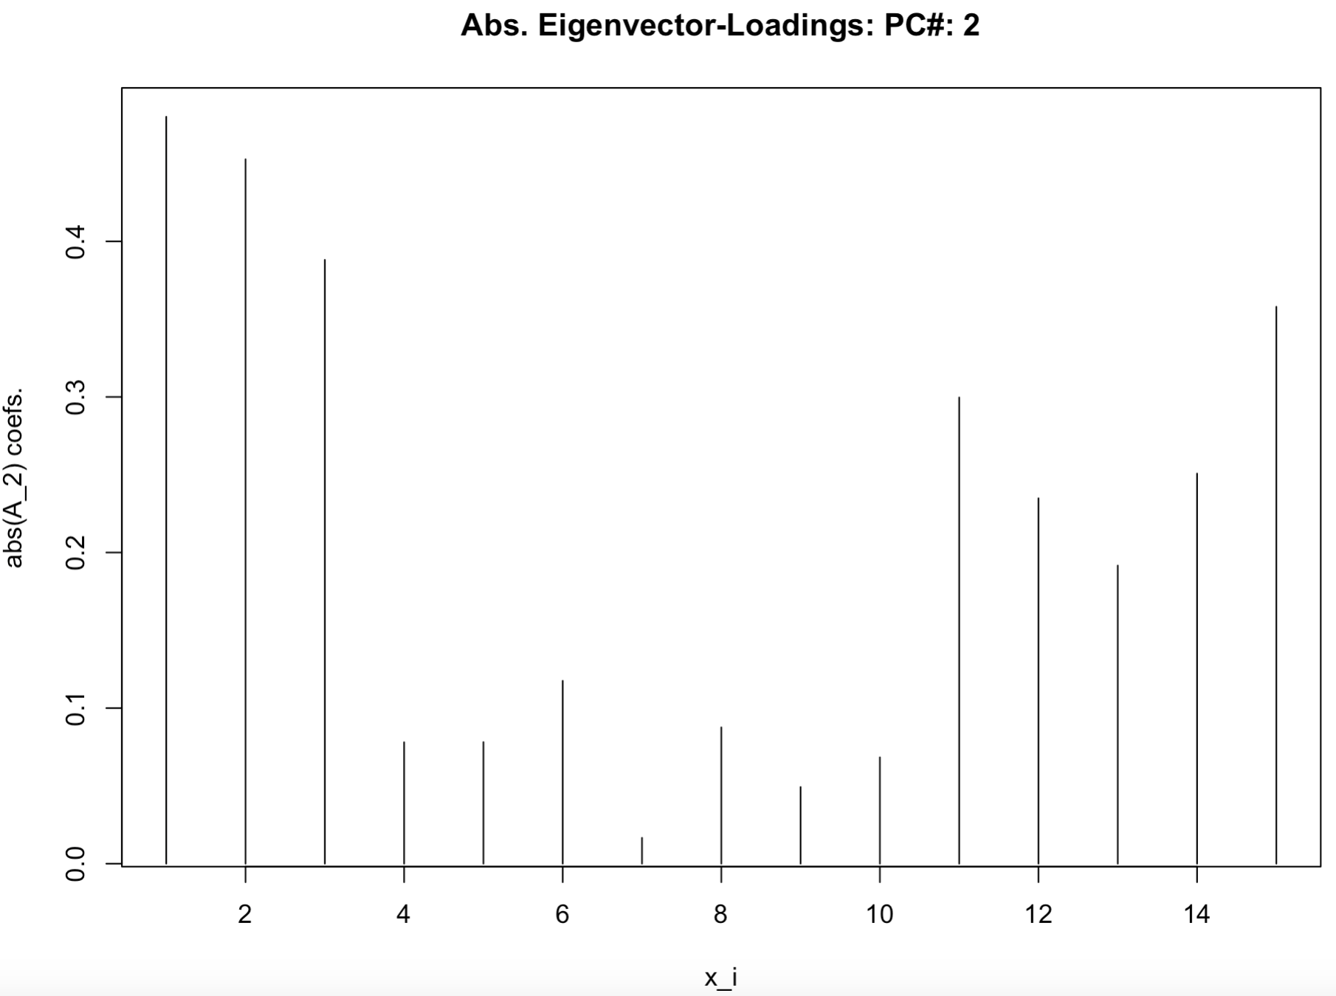
PCA “Loadings”
Loading: “weight” each variable x_{i} contributed to PC_{j}

Slide 21
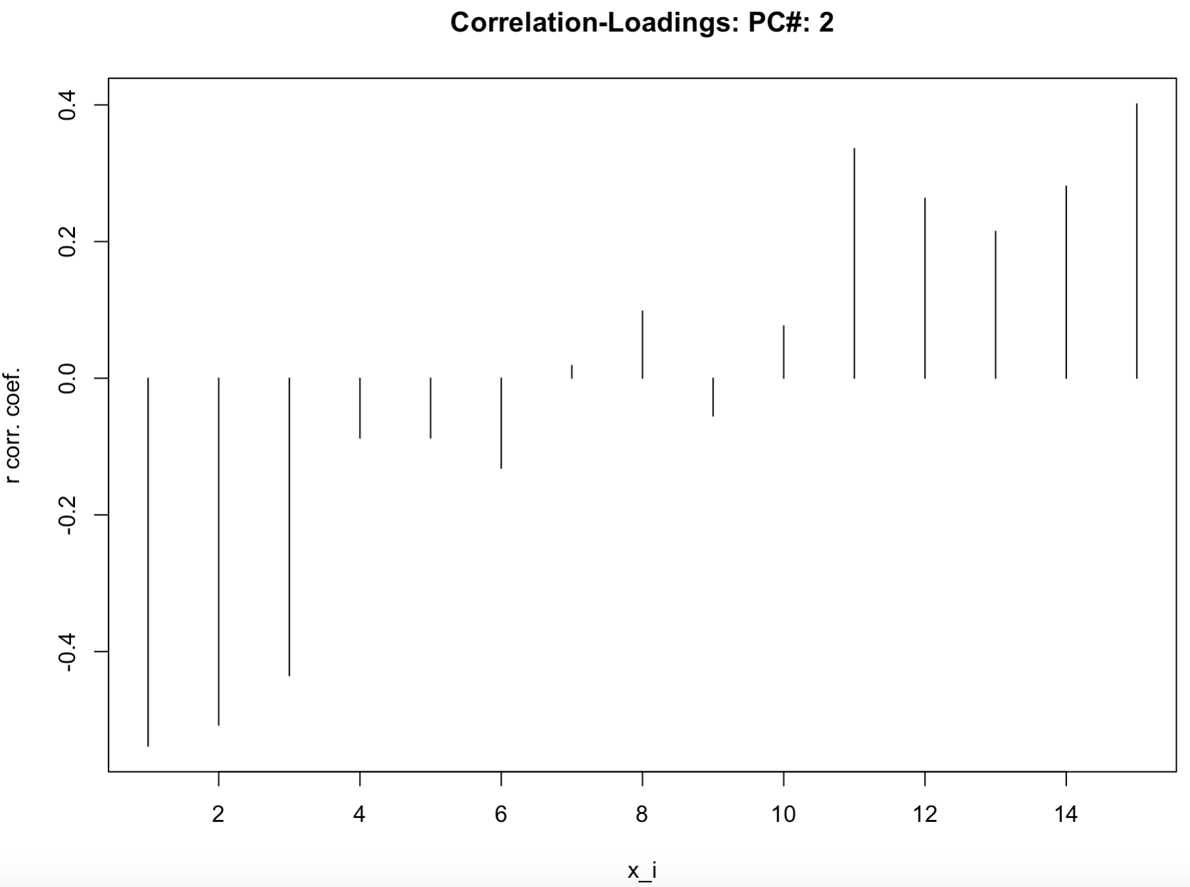
PCA “Loadings”
Loading: “weight” each variable x_{i} contributed to PC_{j}

Slide 22
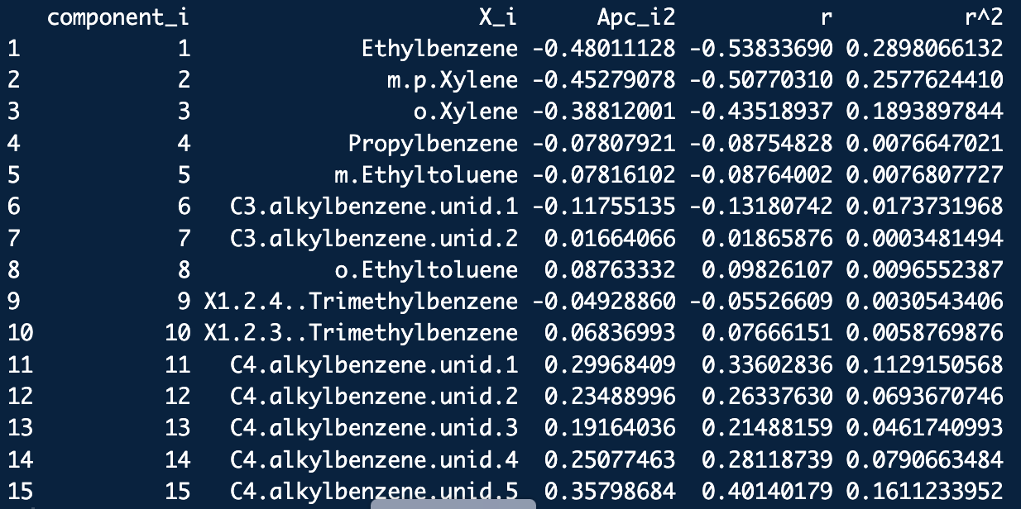
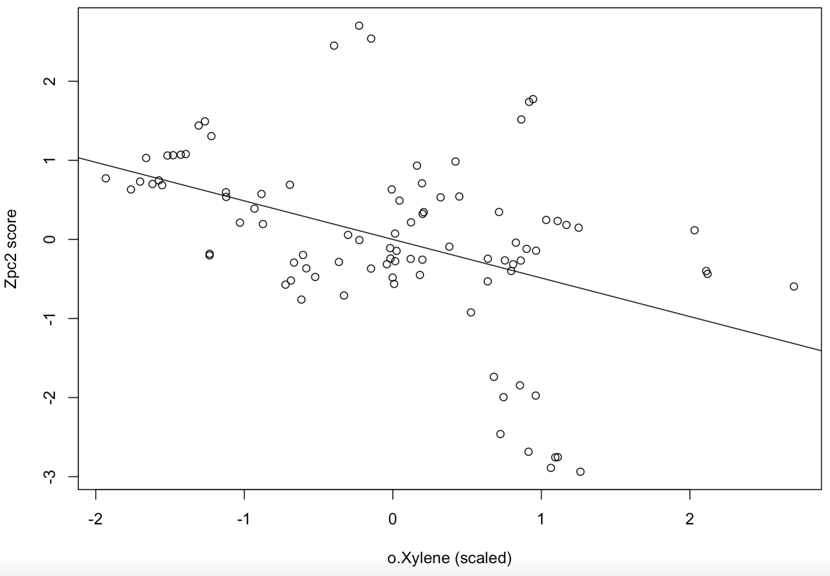
r = -0.4351894
r² = 0.18938978
o.Xylene is negatively correlated with its representation scores on PC2
o.Xylene is pretty important to PC2
r = -0.4351894

Slide 23
Canonical Variate Analysis
This supervised technique is called Linear Discriminant Analysis (LDA) in R
Also called Fisher linear discriminant analysis
CVA is closely related to linear Bayes-Gaussian discriminant analysis
Works on a principle similar to PCA: Look for “interesting directions in data space”
CVA: Find directions in space which best separate groups.
Technically: find directions which maximize ratio of between group to within variation

Slide 24
Canonical Variate Analysis
Project on PC1:
Not necessarily good
group separation!
Project on CV1:
Good group separation!
Note: There are #groups -1 or p CVs
which ever is smaller

Slide 25
Canonical Variate Analysis
Use between-group to within-group covariance matrix, W⁻¹B to find directions of best group separation (CVA loadings, A_{cv}):
CVA can be used for dimension reduction.
Caution! These “dimensions” are not at right angles (i.e. not orthogonal)
CVA plots can thus be distorted from reality
Always check loading angles!
Caution! CVA will not work well with very correlated data

Slide 26
Canonical Variate Analysis
2D CVA of gasoline data set:
2D PCA of gasoline data set:

Slide 27
Canonical Variate Analysis
Distance metric used in CVA to assign group ID of an unknown data point:
Group ID selection rule:
group ID number
If data is Gaussian and group covariance structures are the same then CVA classification is the same as Bayes-Gaussian classification.

Slide 28
Error Rates
Discriminant functions are trained on a finite set of data…
How much fitting should we do?
What should the model’s dimension be?
Model must be used to identify a piece of evidence (data) it was not trained with.
Accurate estimates for error rates of decision model are critical in forensic science applications.
The simplest is apparent error rate:
Error rate on training set
Lousy estimate, but better than nothing

Slide 29
Error Rates
Cross-Validation: systematically hold-out chunks of data set for testing
Most common: Hold-one-out
Omit a data vector from X
Train model,
Classify held out observation
Repeat for all data vectors
Simple but give a good estimate
Lots of literature to back up its efficacy

Slide 30
library(frequtils)
library(MASS) #Library which has LDA/CVA
library(rgl)
data(gas)
X <- as.matrix(gas[,2:ncol(gas)])
lbl <- as.factor(gas[,1])
#Fit an LDA classification model with the PCA-pretreated data
lda.model<-lda(X,lbl)
#"Look at" some of the clustering uncovered (if any) by computing the LDA "scores":
Acv<-lda.model$scaling
Zcv<-X %*% Acv
#Look at three LDA score sets at a time and examin if you see any evidence of clustering:
plot3d(Zcv[,1],Zcv[,2],Zcv[,3],type="s",radius=1,col=as.numeric(lbl),
aspect="iso",xlab="LD1",ylab="LD2",zlab="LD3")
text3d(Zcv[,1],Zcv[,2],Zcv[,3],text=lbl.tool,font=1,adj=1.5) #Group lables
text3d(Zcv[,1],Zcv[,2],Zcv[,3],text=1:50,font=1,adj=1.5) #Observation lables
#-------------------ERROR RATE ESTIMATION-----------------------------------
#OK, now lets use our LDA model to ESTIMATE the error rate that we would get if we had a larger data set:
#The trick is to do the LDA with CV=TRUE (HOO-CV classification):
lda.model<-lda(X,lbl,CV=TRUE)
#HOO-CV predictions of the I.D.s:
cv.lbls<-lda.model$class
#If we got some wrong, which ones were they? (some quick and dirty R):
sameQ <- cv.lbls==lbl
data.frame(1:nrow(X), lbl, cv.lbls, sameQ)
#Compute the error rate estimate (as a percentage):
(1-sum(cv.lbls==lbl)/length(lbl))*100
LDA_ex1.R

