Slide 1

Working with Probability Distributions

Slide 2
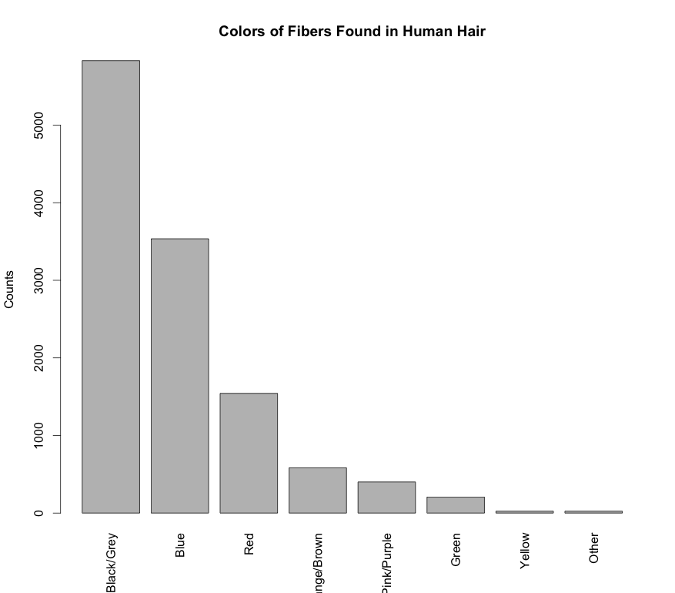
Probability Mass Function
Probability over a discrete set of outcomes is described by a probability mass function (PMF)
A PMF can be represented as a table or displayed as a histogram
Fiber Color* | Probability
Black/Grey | 0.48
Blue | 0.291
Red | 0.127
Orange/Brown | 0.048
Pink/Purple | 0.033
Green | 0.017
Yellow | 0.002
Other | 0.002

Slide 3
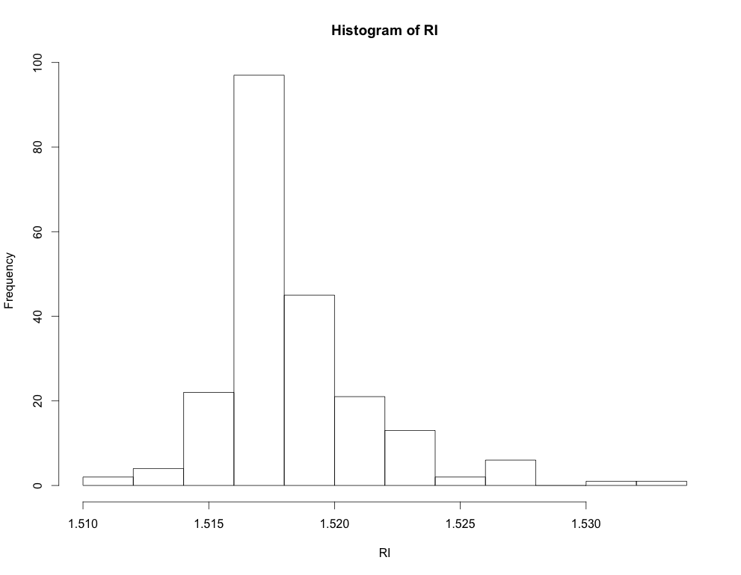
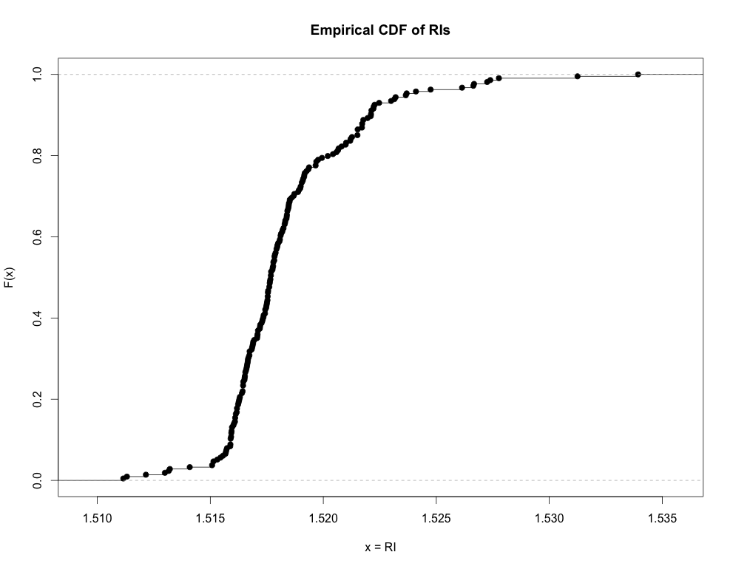
Cumulative Distribution Function
A function that gives the probability that a random variable is less than or equal to a specified value is a cumulative distribution function (CDF):
For discrete data this is:
library(mlbench)
data(Glass)
RI <- Glass[,1]
hist(RI)
plot(ecdf(RI), ylab="F(x)", xlab="x=RI", main="Empirical CDF of RIs")
# What % of the RI data is <= 1.51594?
x <- 1.51594
Fx <- ecdf(RI) # The ECDF
Fx(x) # 1.51594 is >= than about 12% of RIs
Varies between 0 and 1
ecdf.R

Slide 4
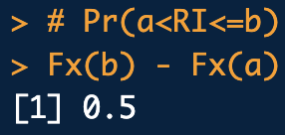
Cumulative Distribution Function
Use the CDF to compute the probability that a RV will lay between two specified values such that:
a <- 1.51593
b <- 1.51820
Fx <- ecdf(RI)
# Pr(a<RI<=b)
Fx(b) - Fx(a)
ecdf.R
F(b)
F(a)
a
b

Slide 5
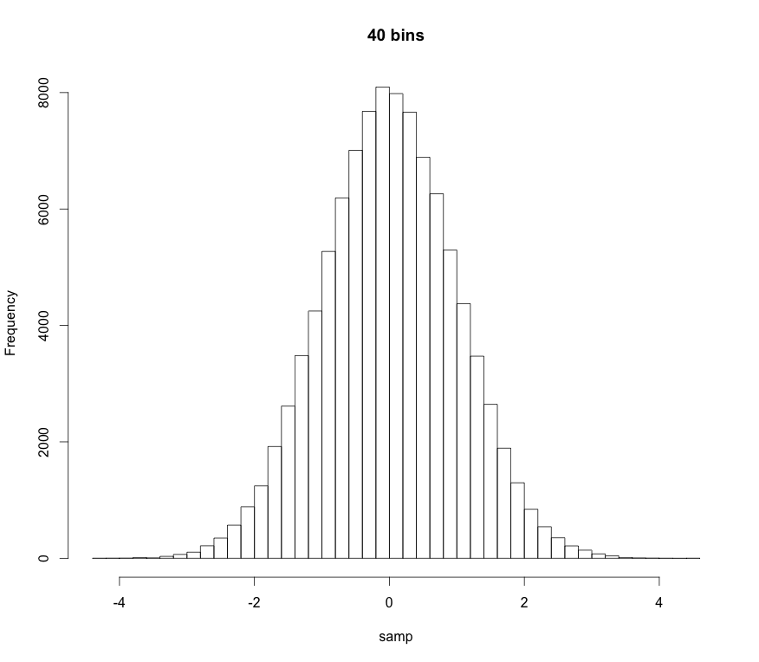
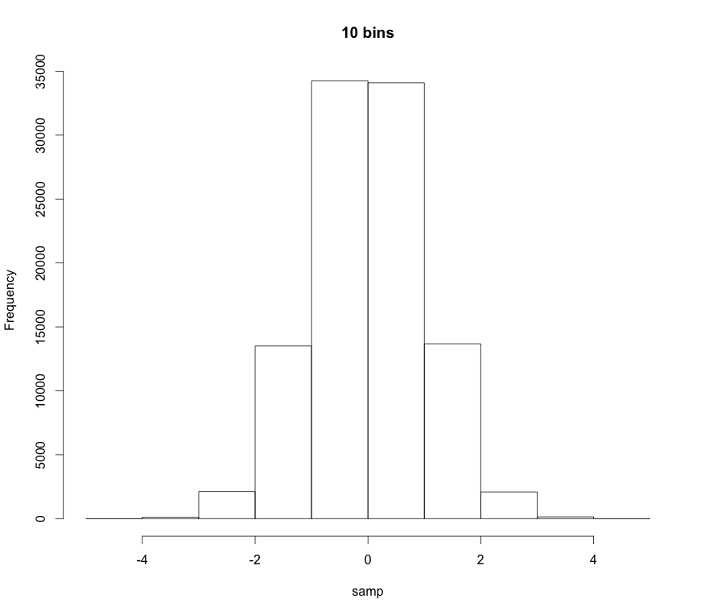
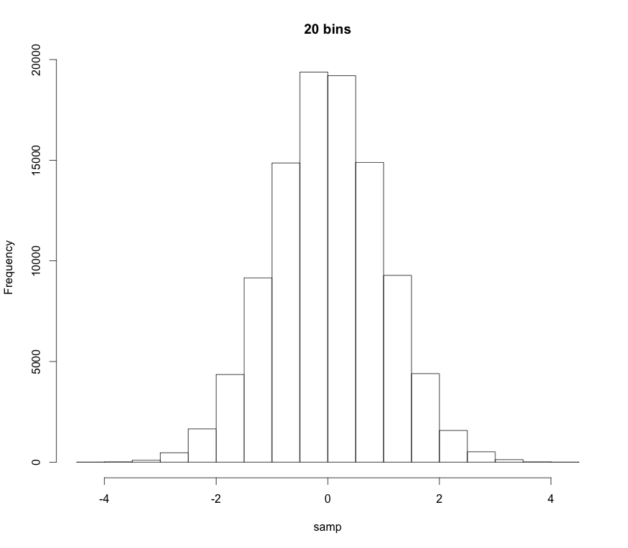
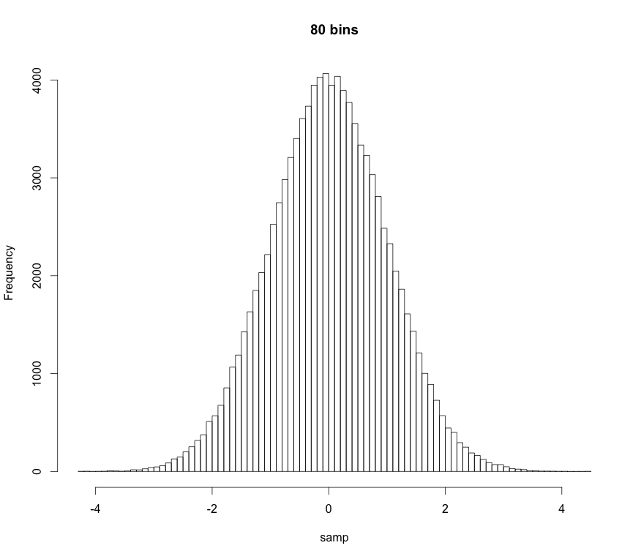
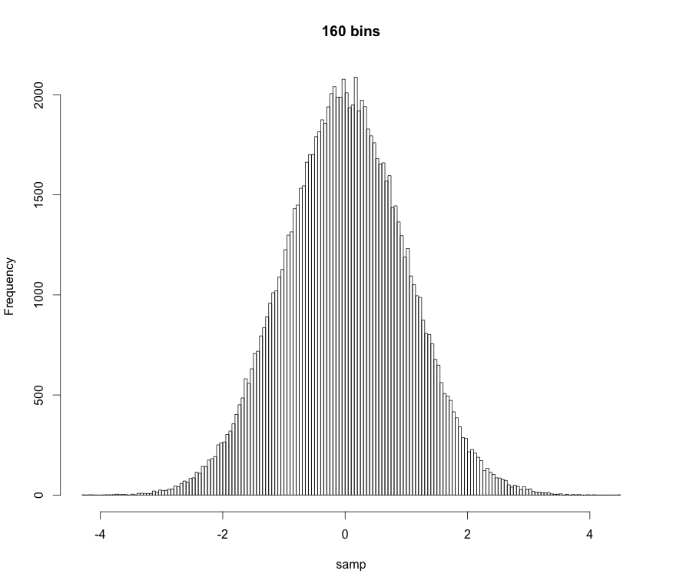
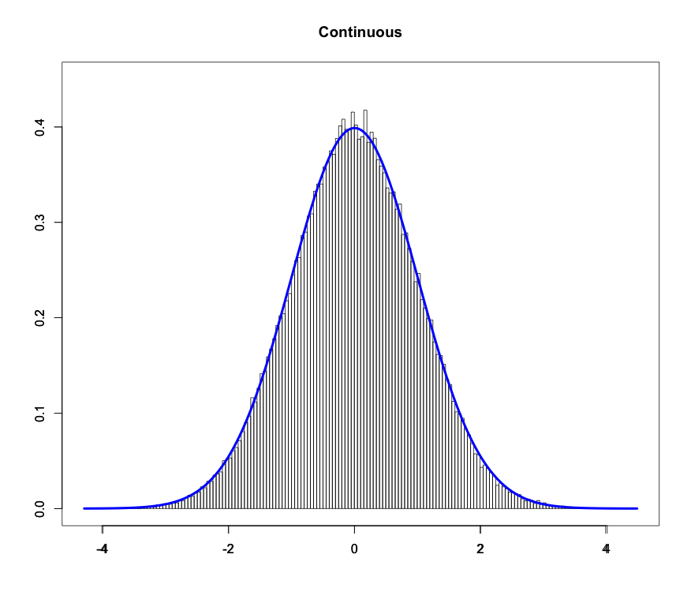
Probability Density Function
As we increase the number of “bins” in the PMF the “bars” get thinner and thinner
If there are an infinite number of bins the bars get infinitesimally thin:
# Simulate a working sample:
n <- 100000
samp <- rnorm(n, mean = 0, sd = 1)
# PMFs of varying bin numbers:
hist(samp, breaks=10, main="10 Bins PMF")
hist(samp, breaks=20, main="20 Bins PMF")
hist(samp, breaks=40, main="40 Bins PMF")
hist(samp, breaks=80, main="80 Bins PMF")
hist(samp, breaks=160, main="160 Bins PMF")
# Overlay PDF on PMF:
z <- seq(from=-4, to=4, length.out=1000)
hist(samp, breaks=160, probability = T,
main="Continuous PDF", xlab="z")
lines(z, dnorm(z), col="red", lwd=3)
pmf2pdf.R
Probability Density Function (PDF)

Slide 6
Probability Density Function
Technical definition:
A random variate X is continuous if:
The probability that X lies between a and b
p(x): probability density function (pdf)
Note:
Proper pdfs should be normalized
“All space” for an r.v. is it’s domain. Also called its support
“All space” for us is usually 0 to ∞ or -∞ to ∞

Slide 7
Probability Density Function
Technical definition:
A random variate X is continuous if:
The probability that X lies between a and b
p(x): probability density function (pdf)
Note also:
The probability of obtaining a particular r.v. is 0
p(x) ≥ 0
The pdf is always greater than or equal to 0

Slide 8
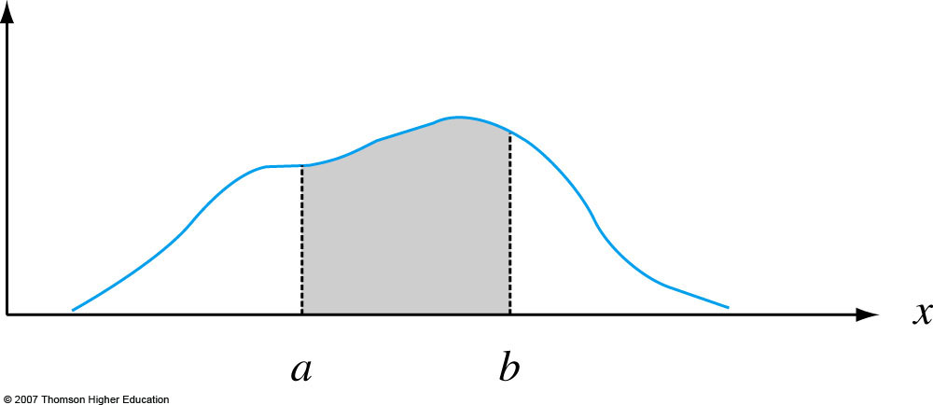
Probability Density Function
Graphically:
p(x)
Notes:
Figure 4.2
P (a ≤ X ≤ b) = the area under the density curve between a and b.

Slide 9
Moments and Expectation Values
Moments are numerical values that control a PDF’s location and shape properties.
m^{th}-order moments are found by taking the expectation value or average-value of an RV raised to the m^{th}-power:
Most of the time we only care about first-order and second-order-central moments.

Slide 10
Moments and Expectation Values
1st-order moment for X, i.e. the expectation value of X:
location descriptor
mean
Take-home message: Expectations are “average values”
Sample mean
This is the formula we usually use

Slide 11
Moments and Expectation Values
Important 2nd-order moments:
Second order central moment.
It can be shown that
Population standard deviation
spread descriptor
Sample standard deviation
This is the formula we usually use

Slide 12
Uniform Distribution
Uniform PDF: Same “likelihood” for all x
Parameters:
a left bound
b right bound

Slide 13
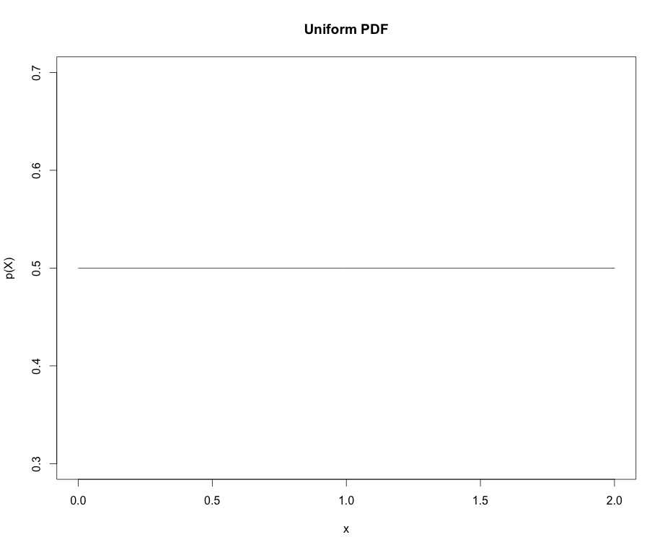
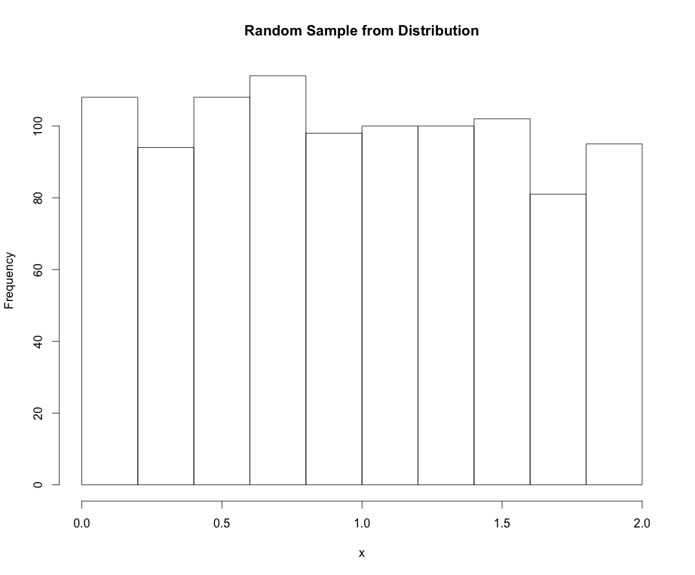
Uniform Distribution
Mean:
Variance:

Slide 14
Normal Distribution
Normal PDF: The “bell cure”. Also called Gaussian dist.
Parameters:
μ mean
σ standard deviation

Slide 15
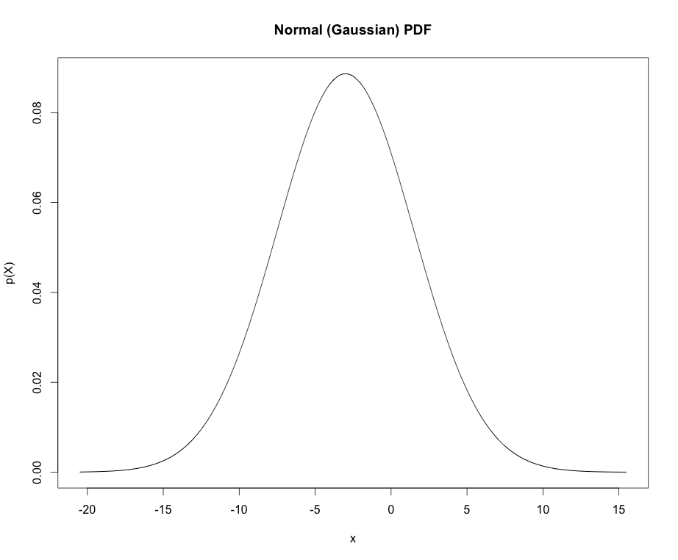
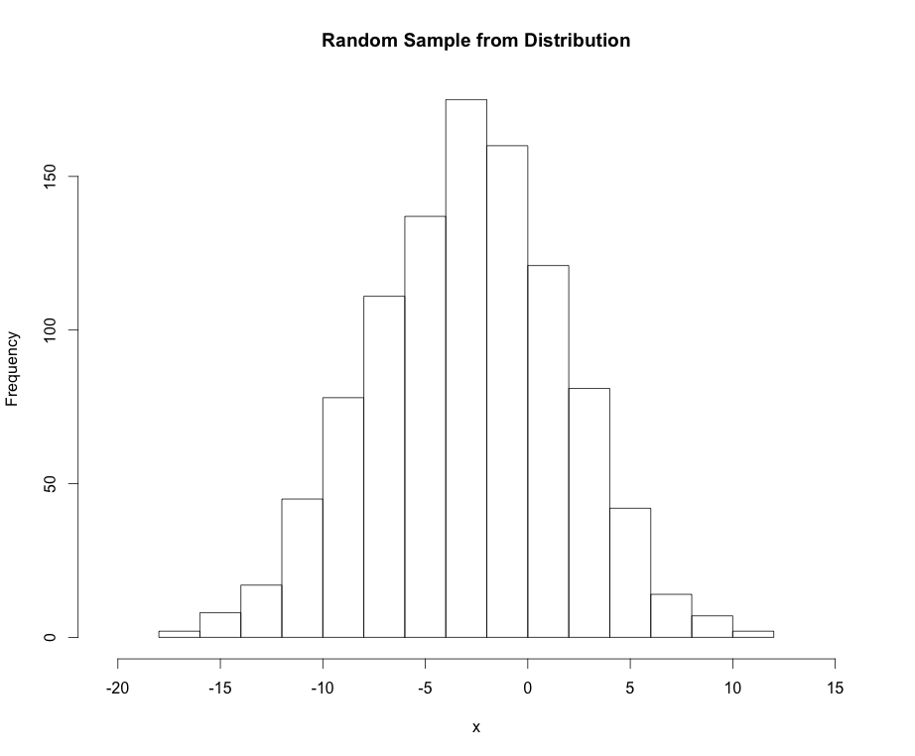
Normal Distribution
Mean: μ_{X} = μ
Variance: σ²_{X} = σ²

Slide 16
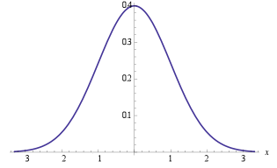
Normal Distribution
Points of interest for the Normal distribution:
If X ~ N(μ, σ) we can “standardize” (transform) to the z-scale:
Standard normal distribution
Handy equation
~ 68%
±1σ
~ 95%
±2σ
~ 99%
±3σ

Slide 17
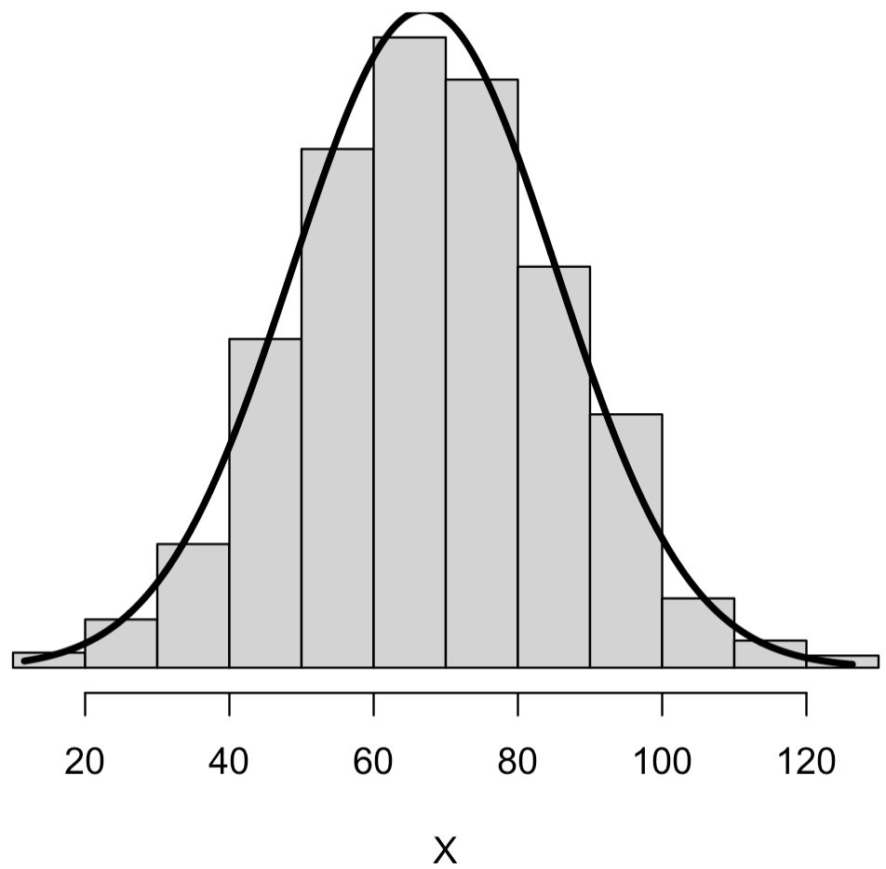
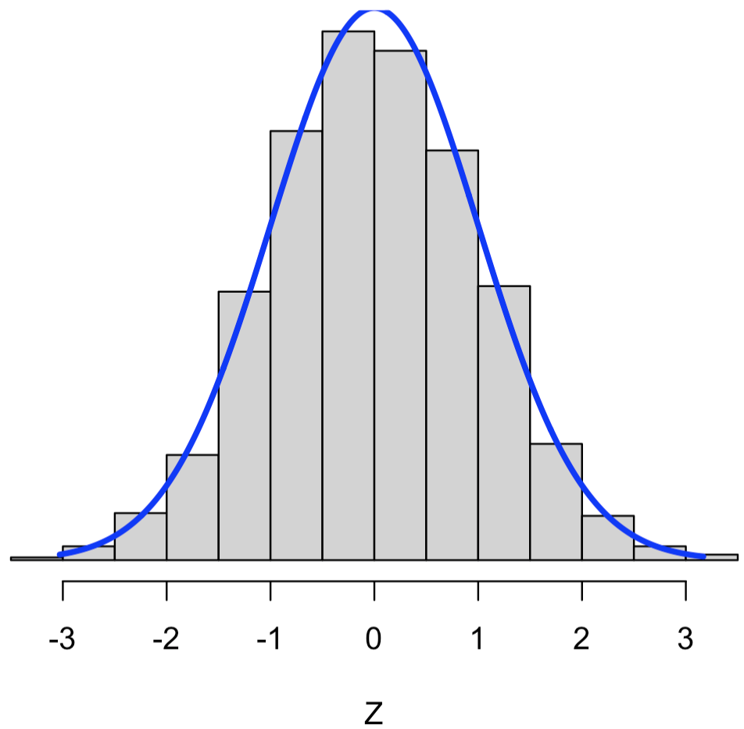
Aside: Standardization
“Standardization” is just a kind of re-scaling, but we do it a lot (for many reasons):
standardize
standardize.R

Slide 18
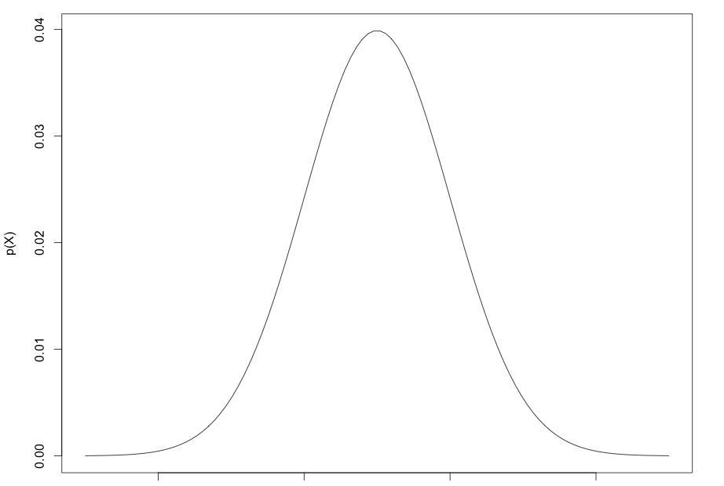
Cumulative Distribution Functions
A function that gives the probability that a random variable is less than or equal to a specified value is a cumulative distribution function (CDF):
x

Slide 19
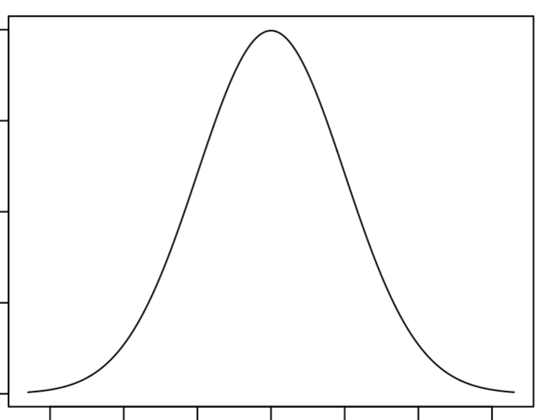
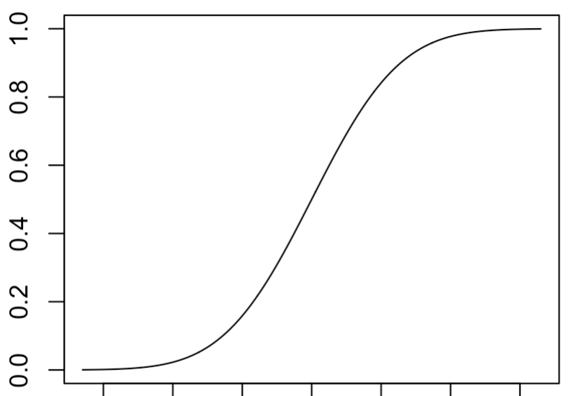
Cumulative Distribution Functions
In general:
PDF:
CDF:
x
x
Note: range is 0-1

Slide 20
Cumulative Distribution Functions
In general:
PDF:
CDF:
0.42
x₀ = 47
x₀ = 47
x
x

Slide 21
Cumulative Distribution Functions
CDFs are important because they allow us to calculate the probability integrals easily:

Slide 22
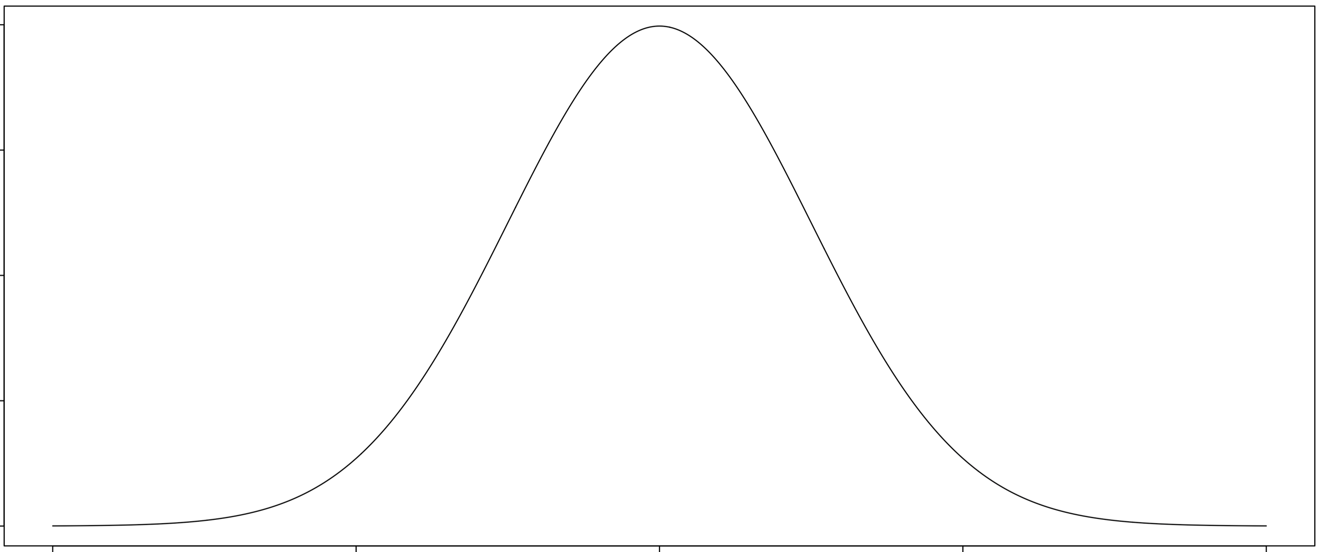
Cumulative Distribution Functions
p(x)
x
a
b

Slide 23
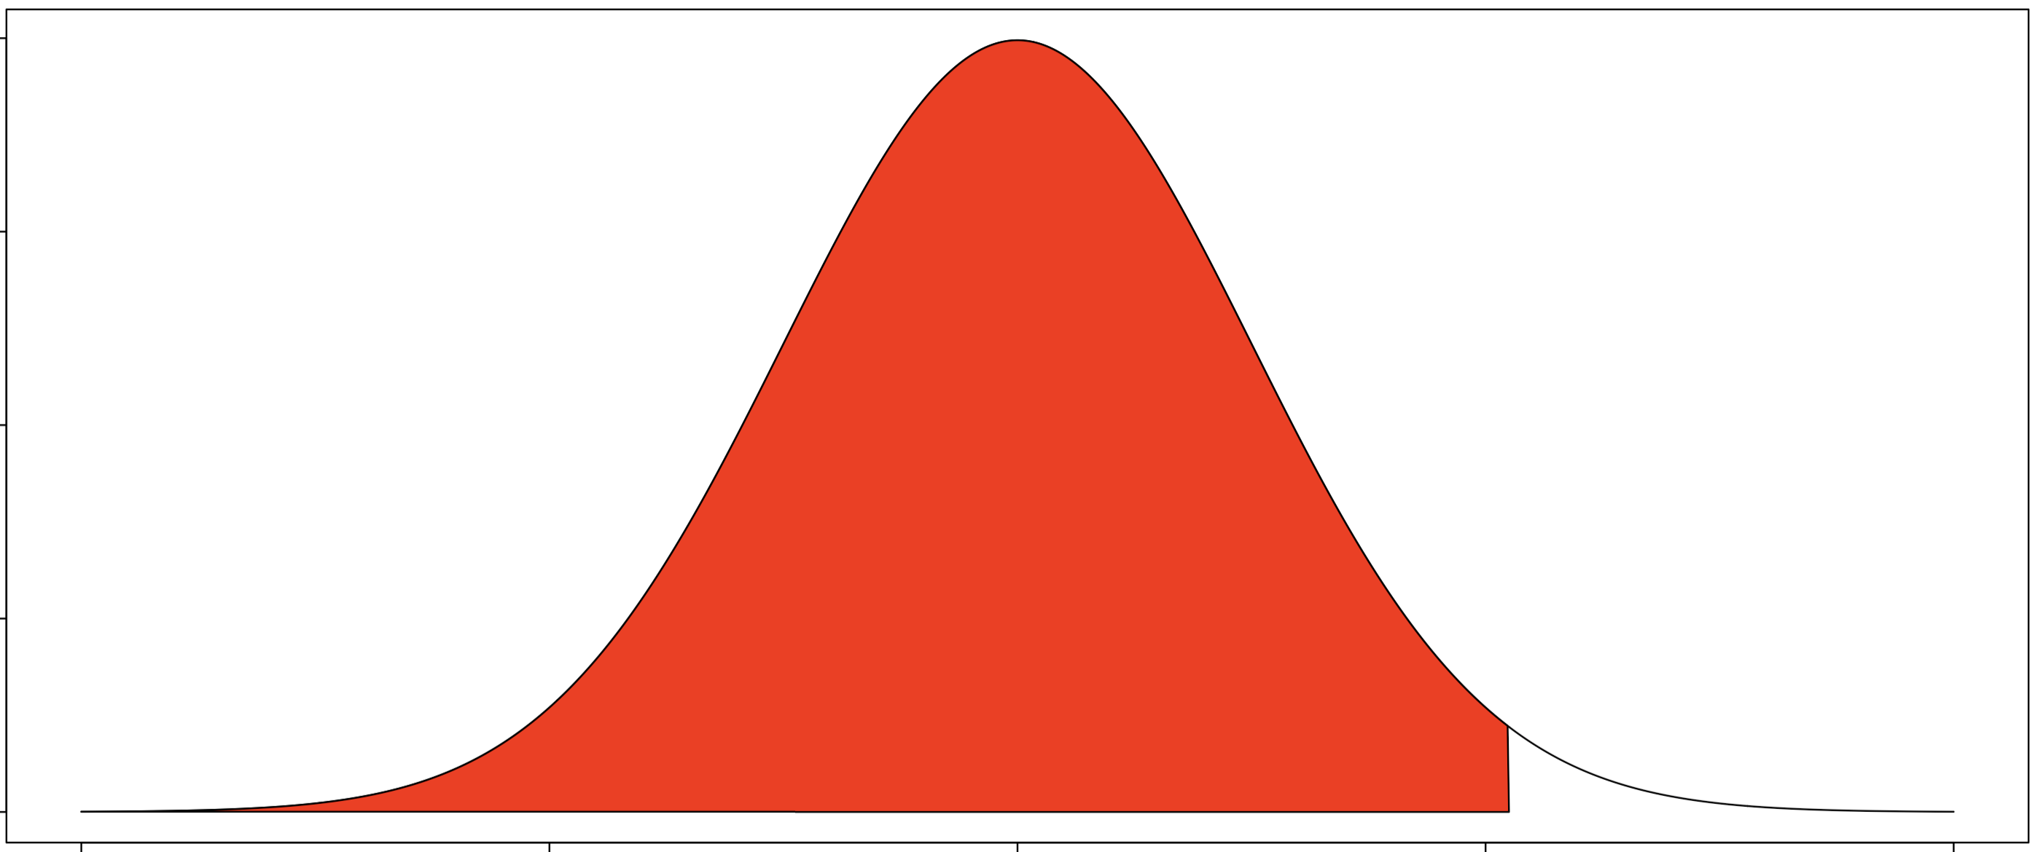
Cumulative Distribution Functions
p(x)
x
b

Slide 24
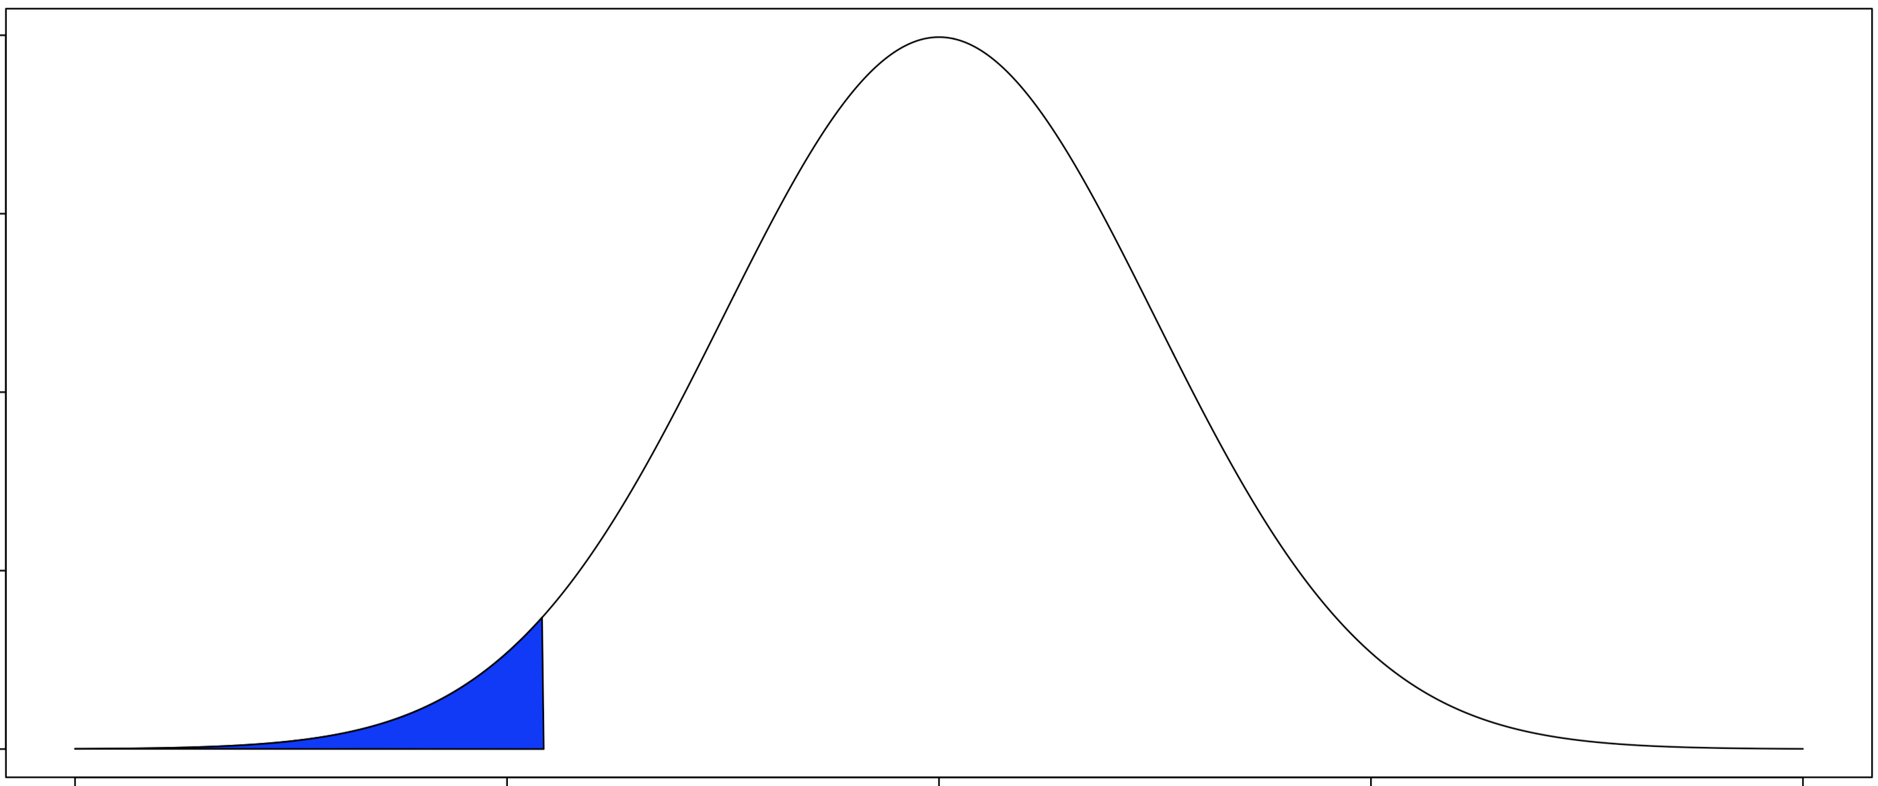
Cumulative Distribution Functions
p(x)
x
a

Slide 25
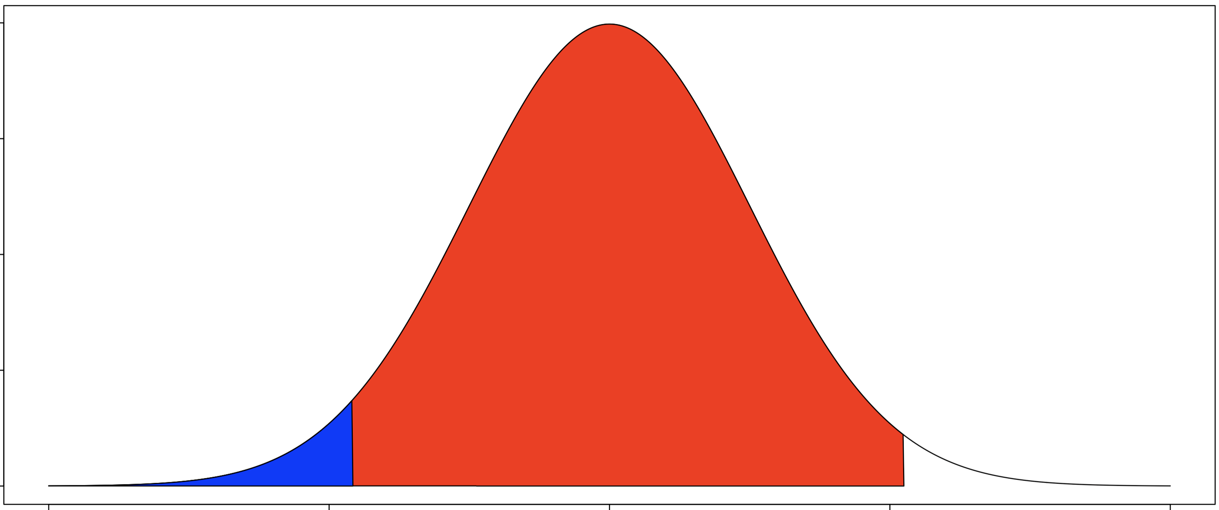
Cumulative Distribution Functions
p(x)
x
a
b

Slide 26
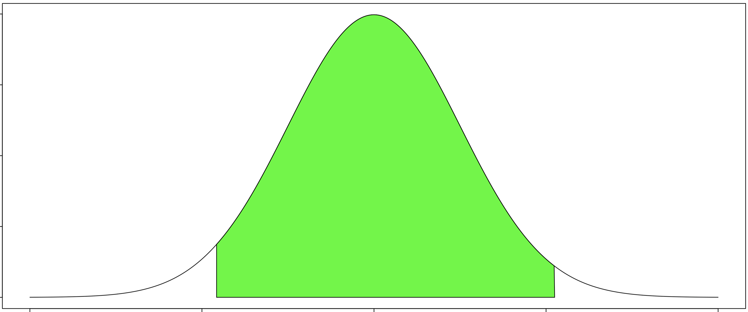
Cumulative Distribution Functions
p(x)
x
a
b

Slide 27
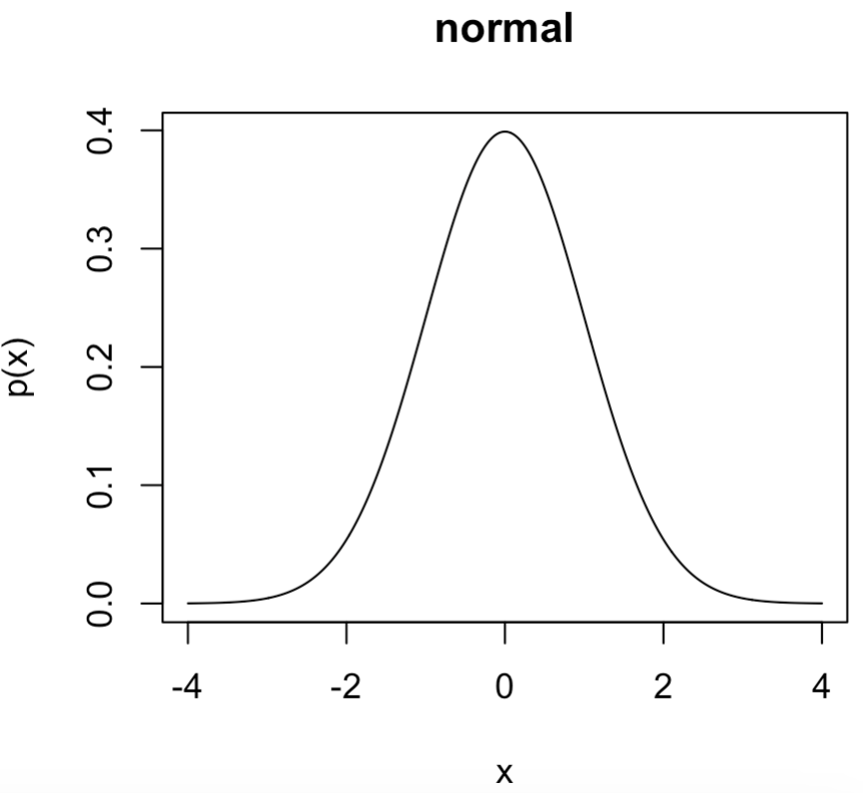
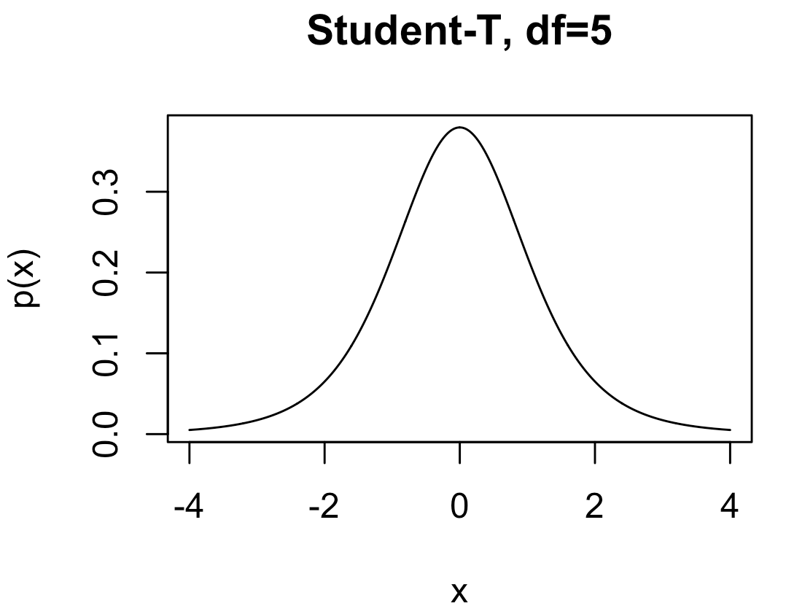
Distributions We’ll Encounter
Normal: Common in science. Also called Gaussian distribution. A standard normal distribution has mean = 0 and sd = 1.
dnorm, qnorm, pnorm, rnorm
Parameters:
mean: μ mean
sd: σ standard deviation
Student-t: Like a standard normal distribution but fatter tails. Used a lot for confidence intervals and hypothesis testing.
Parameters:
dt, qt, pt, rt
df: degrees of freedom

Slide 28
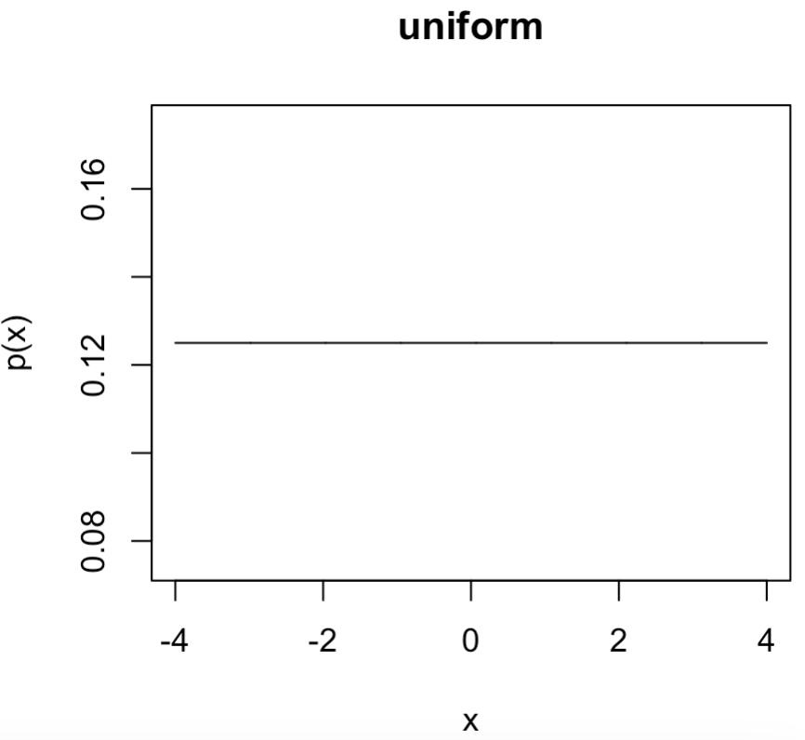
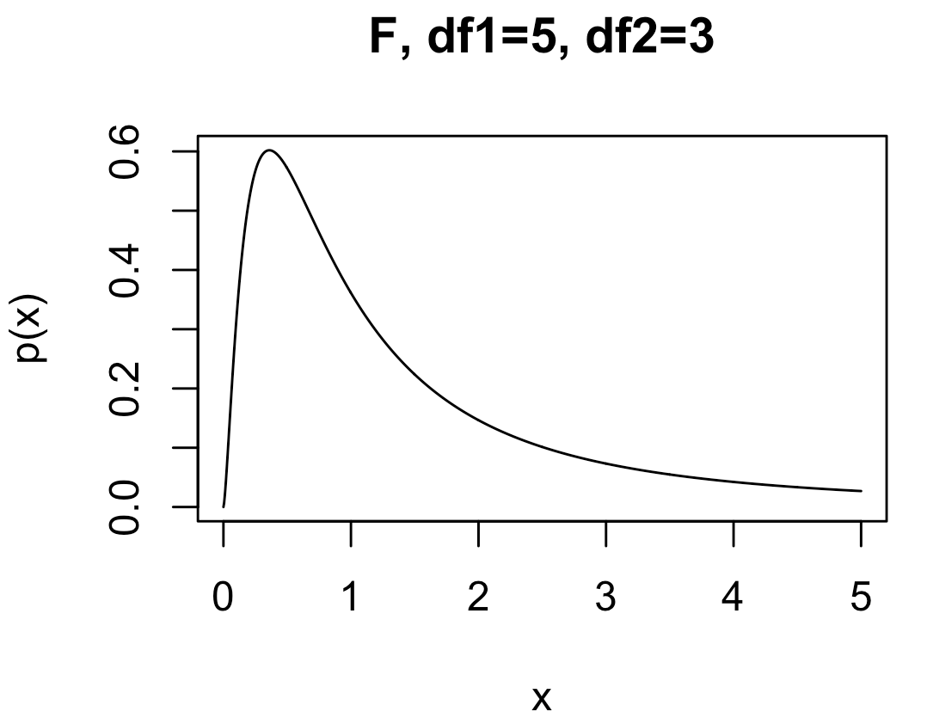
Distributions We’ll Encounter
Uniform: A flat distribution. Usually used to express ambivalence on an outcome between a lower and upper bound.
dunif, qunif, pinif, runif
Parameters:
min: lower bound
max: upper bound
F : Handy especially for comparing outcomes in three or more experiments with different conditions.
Parameters:
df, qf, pf, rf
df1: degrees of freedom 1
df2: degrees of freedom 2

Slide 29
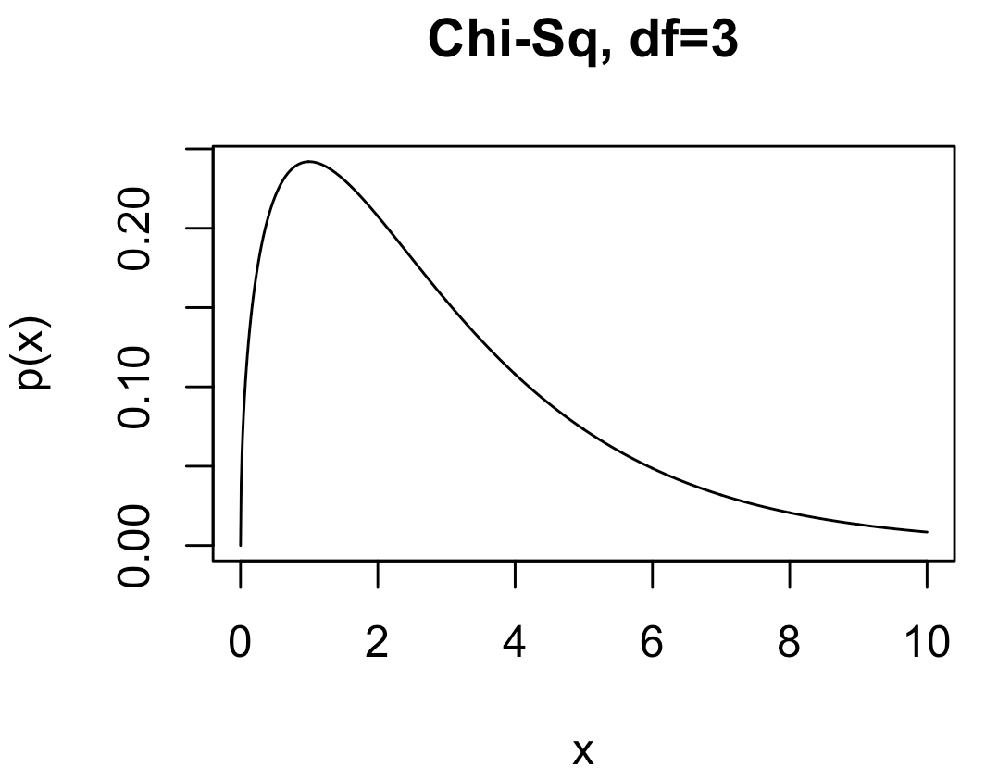
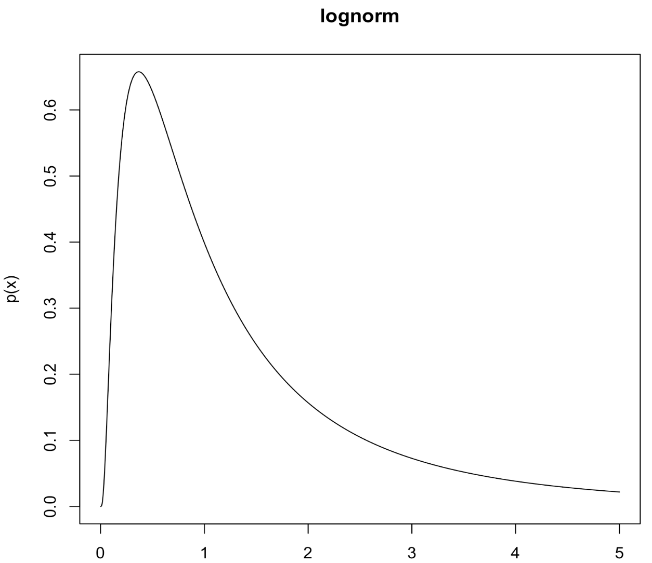
Distributions We’ll Encounter
Chi-squared (χ²): Handy especially for comparing raw set of counts. Also, it’s proportional to the likelihood of sample variance for normal IID data.
dchisq, qchisq, pchisq, rchisq
Parameters:
df: degrees of freedom
Lognormal: When the logarithm of data, X, is normally distributed:
dlnorm, qlnorm, plnorm, rlnorm
Parameters:
meanlog: mean on the log scale
sdlog: sd on the log scale

Slide 30
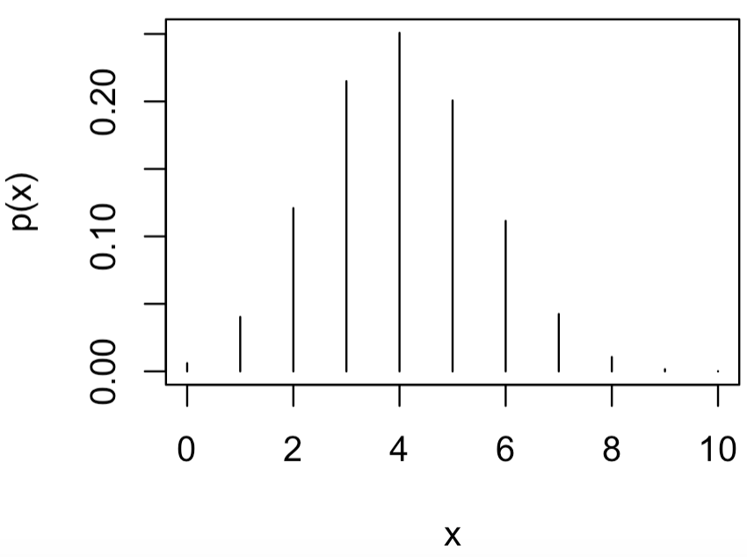
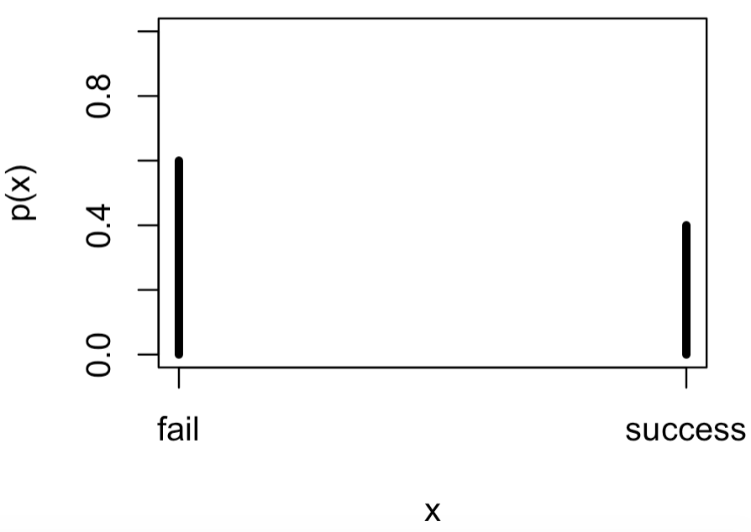
Distributions We’ll Encounter
Binomial: Good modeling the probability of x “successes” out of n tries.
dbinom, qbinom, pbinom, rbinom
Parameters:
size (n): number of trials
prob (π): probability of a “success”
Bernoulli: Same as binomial except for only n=1 trials. Good likelihood model for experiments with only two outcomes.
Parameters:
size=1: number of trials
prob: probability of a “success”

Slide 31
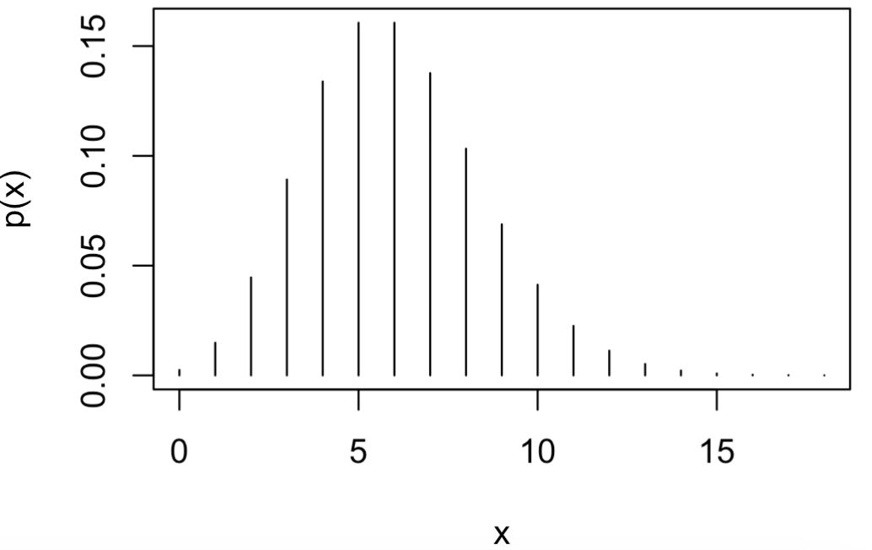
Distributions We’ll Encounter
Poisson: Good likelihood model likelihood of x “successes” with the rate of “success” = lambda.
Parameters:
lambda: rate of “success”

Slide 32
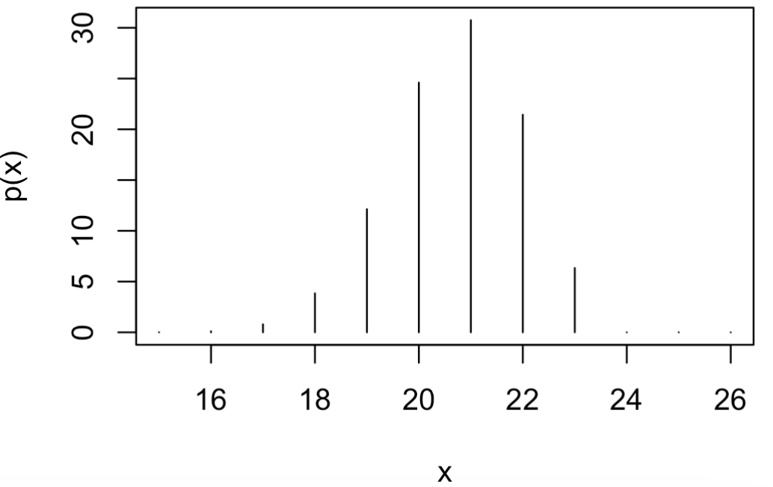
Distributions We’ll Encounter
Hypergeometric Distribution: Used in situations requiring sampling without replacement. Gives the probability for x “successes” in k trials given N total chances for success and probability p for a “success”.
dhyper, qhyper, phyper, rhyper
Parameters:
m: total number of “successes” = N×p
n: total number of “fails” = N - N×p = N – m
k: number of trials; min(k) = 0, max(k) = N
Note:
Famous for use in sampling suspected drug consignments with uncertainty taken into account
distributions.R

Slide 33
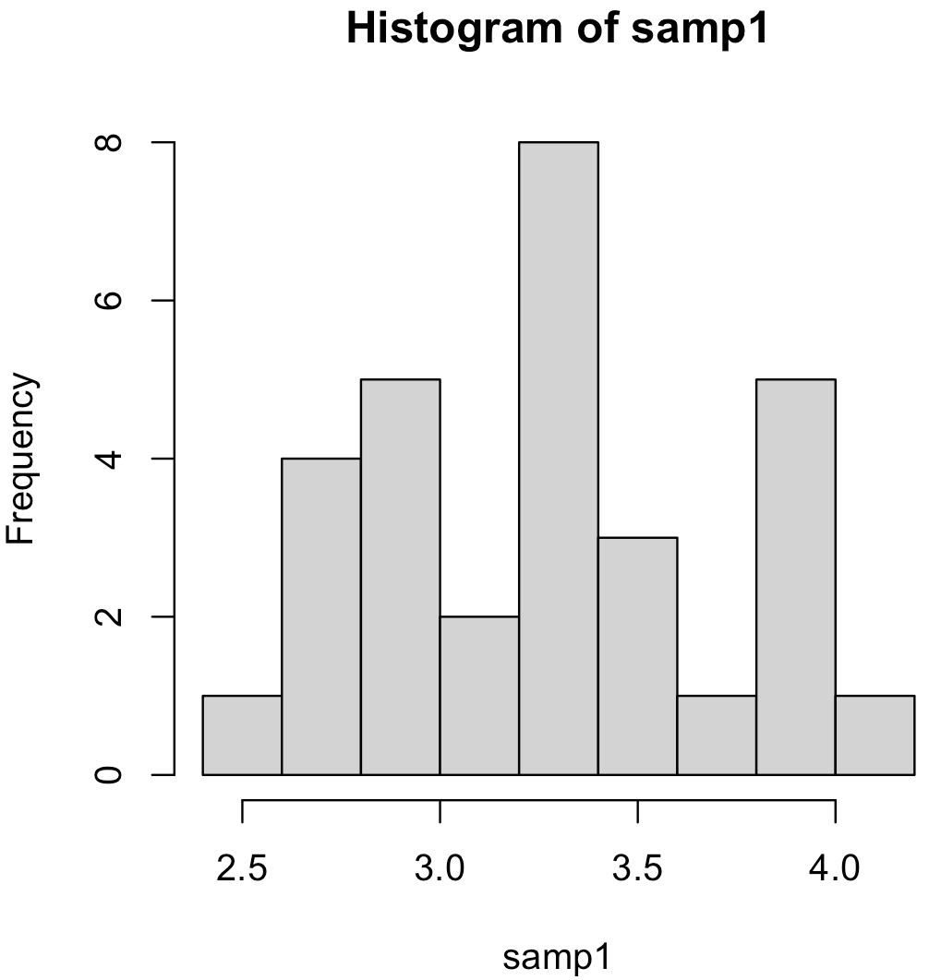
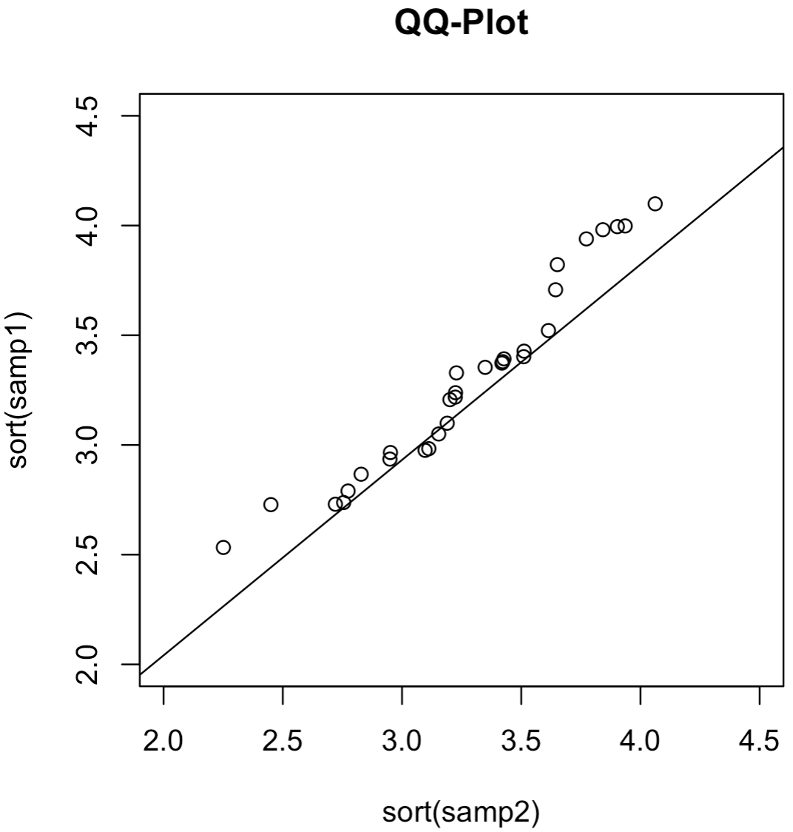
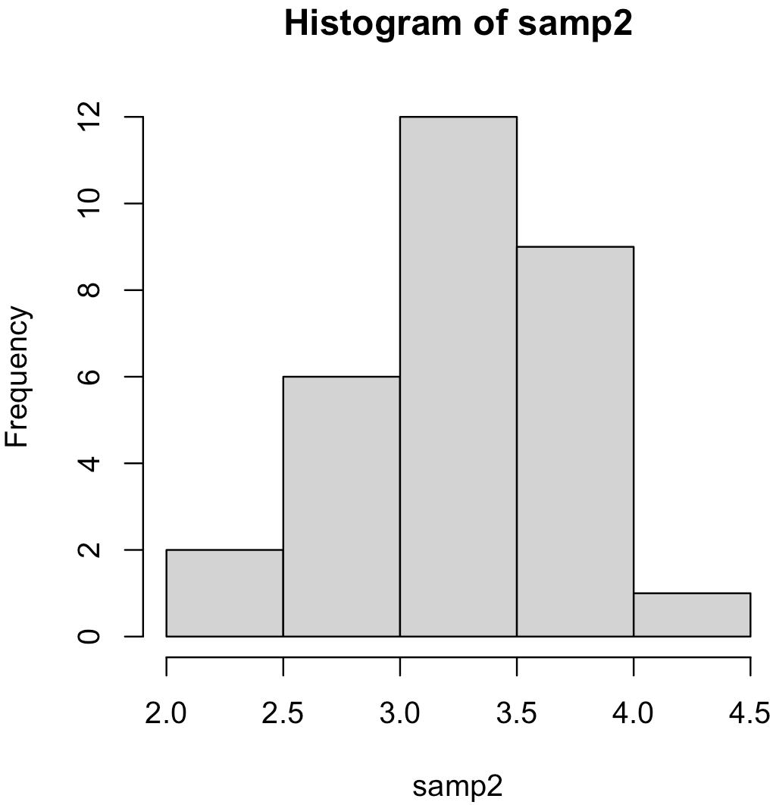
Quantile-Quantile Plots
Since we’re on the topic of probability distributions, lets now discuss a useful graphical tool to compare samples from arbitrary probability distributions. We’ll use these a lot as a diagnostic tool.
Quantile-quantile plot (qq-plot): A plot of two sets of ordered samples against each other.
If the two samples come from the same distribution, then their ordering should share similar percentiles (cumulative probabilities) and they should form a straight line.

Slide 34
Quantile-Quantile Plots
For data set x and/or y of size n:
1. Sort in ascending order
2a. For data set x and/or y with distribution unknown, assign percentiles*:
2b. For x and/or y-axis with distribution known, use p_{i} to compute corresponding quantiles
3. plot x(p_{i}) vs y (p_{i}).
*Do this instead of using data’s empirical CDF.

Slide 35
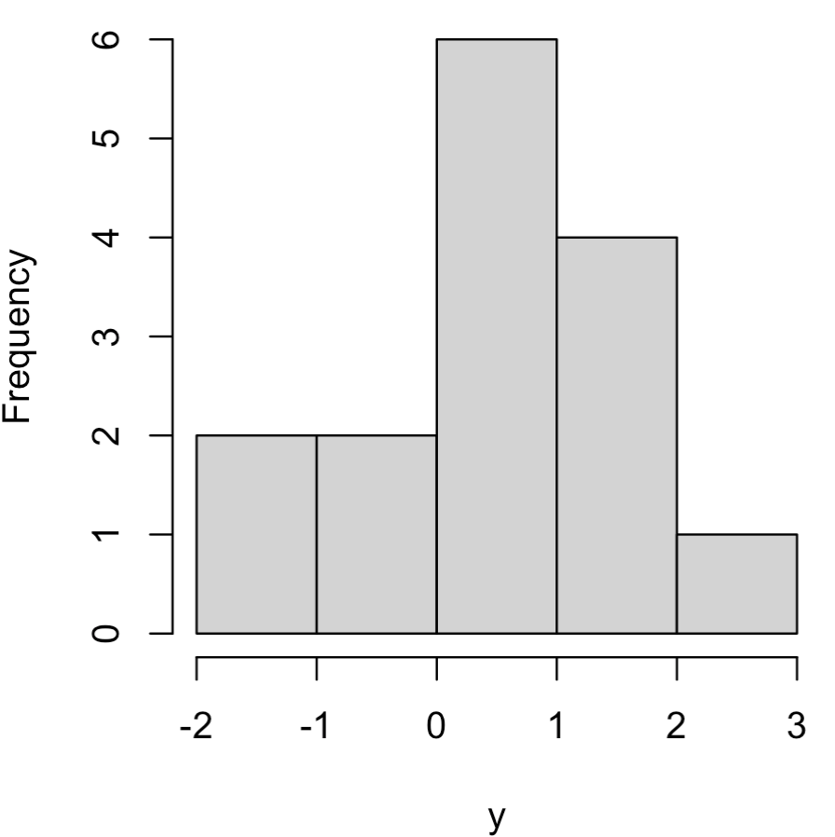
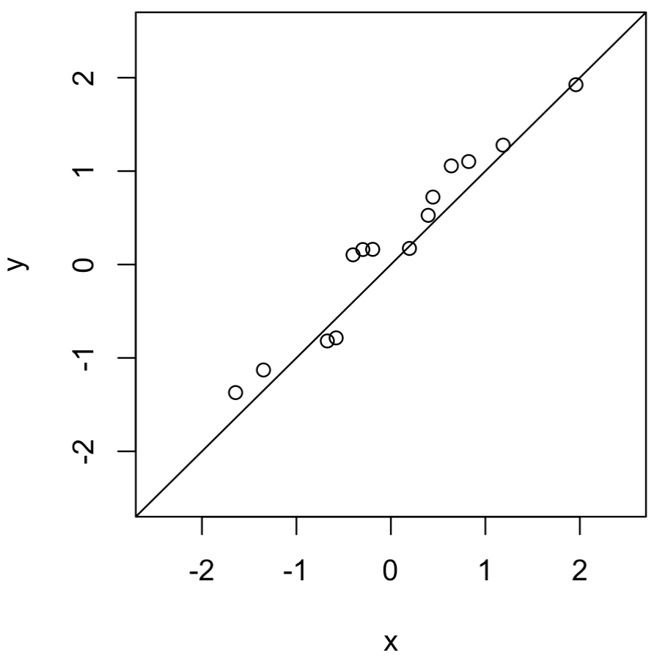
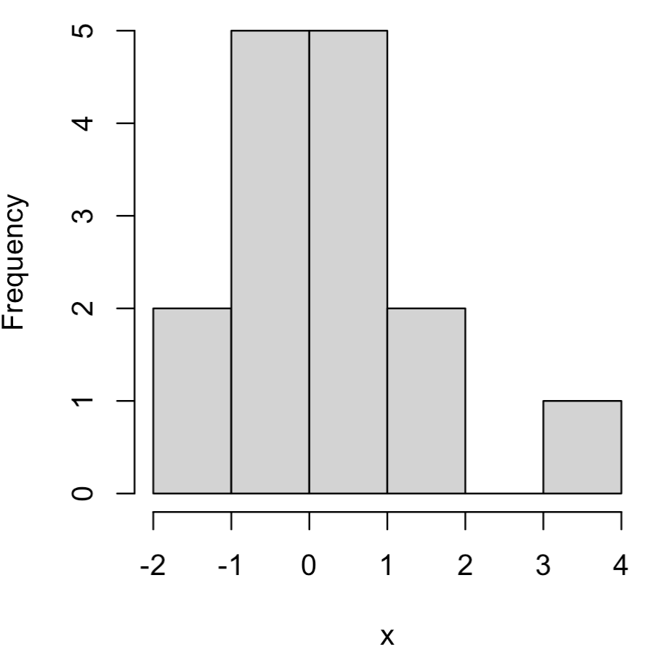
Quantile-Quantile Plots
Comparing empirical dists of two data sets

Slide 36
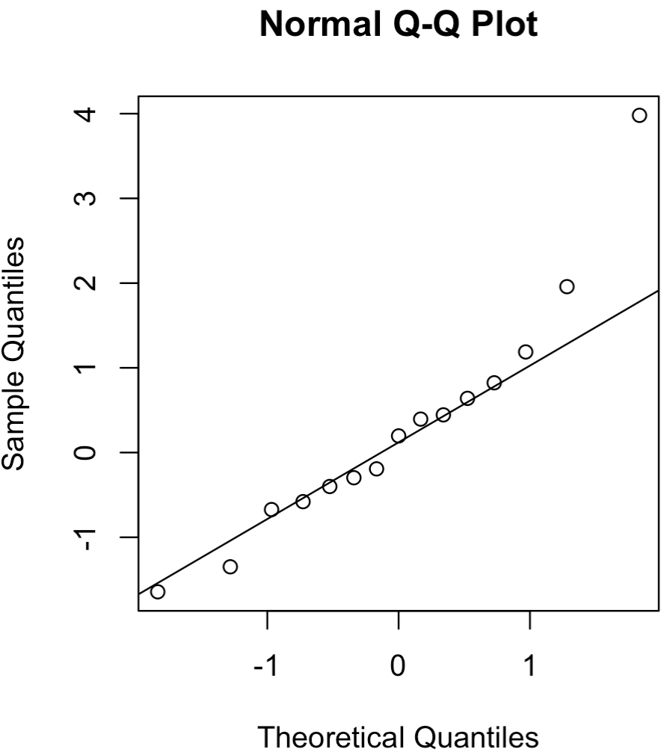
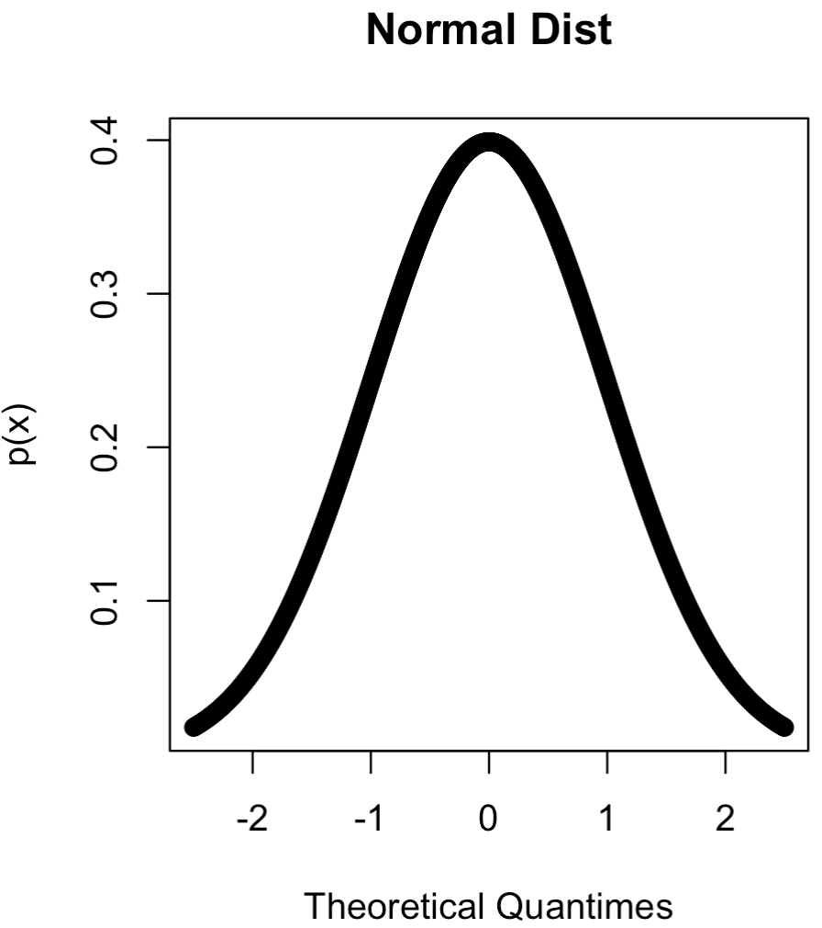
Quantile-Quantile Plots
Comparing data set against a theoretical dist

