Slide 1
Intervals Computational Workshop

Slide 2
Bootstrap Confidence Intervals
So how do we compute a (1 − α)×100% confidence interval given a set of data??
For any parameter, you can try to obtain bootstrap based CIs
For a sample of size n:
Obtain a bootstrap sampling distribution for θ : boot.reps
Find the (1 − α)×100% empirical percentiles:
quantile(boot.reps, probs=c(a/2, 1-a/2))
Two sided
quantile(boot.reps, probs=c(a))
One sided, lower bound
quantile(boot.reps, probs=c(1-a))
One sided, upper bound

Slide 3
Example: Bootstrap Confidence Intervals
Consider again the case of Mr. B. Mayhew with seizure mass measurements of:
49.9996g
49.9994g
49.9993g
49.9996g
49.9995g
49.9995g
49.9995g
49.9994g
49.9995g
49.9994g
Compute the mean mass estimate via the bootstrap.
What is your bootstrap standard error estimate for the estimated mean?
Compute the two-sided 99% CI for the mean mass via the bootstrap.
Compute the one-sided lower bound 99% CI for the mean mass via the bootstrap.
Compute the one-sided upper bound 99% CI for the mean mass via the bootstrap.

Slide 4
Example: Bootstrap Confidence Intervals
# The data:
x <- c(49.9996,49.9994,49.9993,49.9996,49.9995,49.9995,49.9995,49.9994,49.9995,49.9994)
n <- length(x) # Sample size
# Approximate sampling distribution of the mean via the bootstrap:
B <- 2000
boot.samp <- sapply(1:B, function(xx){mean(sample(x, size = n, replace = T))})
hist(boot.samp)
# a. Boostrap estimate of the mean:
mean(boot.samp)
# b. Bootstrap estimate of the standard error of the mean
sd(boot.samp)
# c. Two-sided 99% CI for the mean mass via the bootstrap:
conf <- 0.99
a <- 1 - conf
quantile(boot.samp, probs=c(a/2, 1-a/2))
# One-sided lower bound 99% CI for the mean mass via the bootstrap.
conf <- 0.99
a <- 1 - conf
quantile(boot.samp, probs=c(a))
# One-sided lower bound 99% CI for the mean mass via the bootstrap.
conf <- 0.99
a <- 1 - conf
quantile(boot.samp, probs=c(1 - a))
meanCI_boot_ex1.R

Slide 5
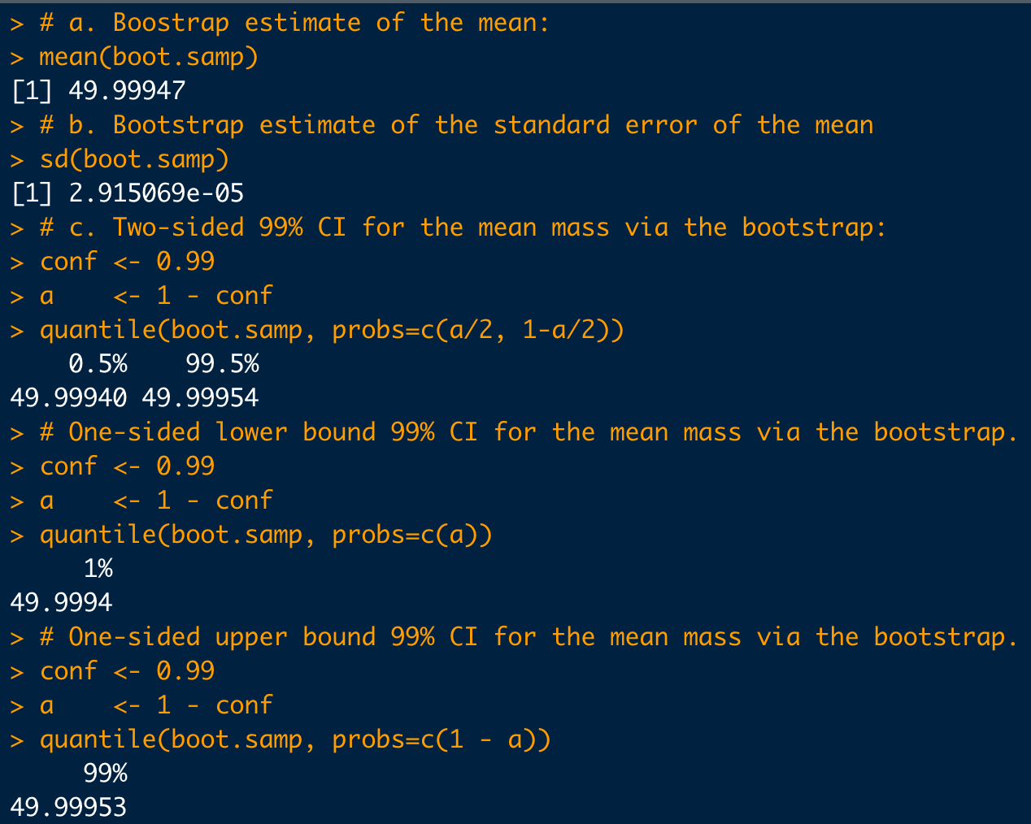
Example: Bootstrap Confidence Intervals

Slide 6
Tolerance Intervals
If the data follows a normal distribution:
Given a random sample of measurement data, x, then with confidence (1 − α), the proportion of possible measurements, p, are:
Between x_{lo} and x_{hi} (two-sided):
normtol.int(x, alpha = alpha, P = p, side = 2)
No larger than x_{hi} (one-sided upper):
At least as large as x_{lo} (one-sided lower):
normtol.int(x, alpha = alpha, P = p, side = 1)

Slide 7
Tolerance Intervals
If the data follows a binomial or a Poisson distribution, tolerance intervals for p×100% of the population with (1 − α)×100% confidence, the procedure to find tolerance limits is multi-step….
We’ll use the R package tolerance for these as well

Slide 8
Tolerance Intervals
If the data follows a binomial distribution:
Given a random sample of n items which may be "positive" or "negative", x items are observed to be "positive".
Take m items to be grouped together at a time.
Then with confidence (1 − α), a proportion p of such groups contains:
Between x_{lo} and x_{hi} "positive" items (two-sided):
bintol.int(x=x, n=n, m=m, alpha=α, P=p, side=2)
No more than x_{hi} "positive" items (one-sided upper):
At least x_{lo} "positive" items (one-sided lower):
bintol.int(x=x, n=n, m=m, alpha=α, P=p, side=1)

Slide 9
Tolerance Intervals
If the data follows a Poisson distribution:
For a sample of n defined time periods (or experimental units), suppose x "events of interest" are observed.
Then with confidence (1 − α), a proportion p of m defined time periods (or experimental units) will have:
Between x_{lo} and x_{hi} "events of interest" (two-sided):
poistol.int(x=x, n=n, m=m, alpha=α, P=p, side=2)
No more than x_{hi} "events of interest" (one-sided upper):
At least x_{lo} "events of interest" (one-sided lower):
poistol.int(x=x, n=n, m=m, alpha=α, P=p, side=1)

Slide 10
Example
A laboratory is conducting a QC assessment of its blood alcohol content (BAC) assay. In order to determine if it’s procedure is “in conformance” and a sample of CRM blood is assayed for its alcohol content (BAC). The following BAC values are determined from six trials:
0.081%, 0.078%, 0.079%, 0.076%, 0.082%, 0.077%
Assuming the the BAC data follows a normal distribution, compute the two-sided tolerance interval which a possible covers 83% of the population of measurements with 95% confidence.
How does this interval compare to the 95% two-sided confidence interval for the mean?
c. Under the same assumptions, compute the one-sided lower (99%/90%) tolerance [(1 – α) /p_{pop})] limit.

Slide 11
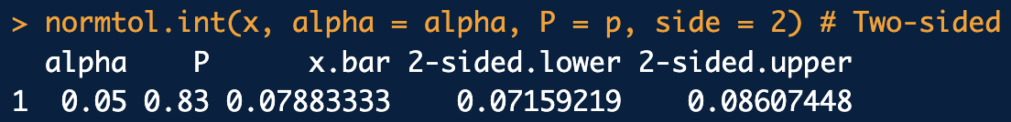

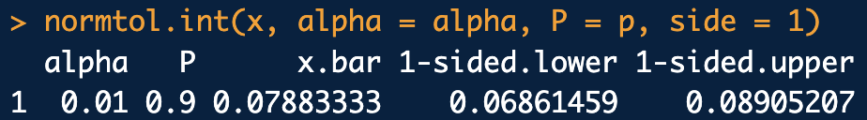
Example
library(tolerance)
# BAC QC data
x <- c(0.081, 0.078, 0.079, 0.076, 0.082, 0.077)
# a. Two-sided tolerance interval:
conf <- 0.95
p <- 0.83
alpha <- 1-conf
normtol.int(x, alpha = alpha, P = p, side = 2)
# b. Two-sided confidence interval for mean:
t.test(x, alternative = "two.sided", mu = 0.08, conf.level = conf)
# c. One-sided lower limit tolerance:
conf <- 0.99
p <- 0.9
alpha <- 1-conf
normtol.int(x, alpha = alpha, P = p, side = 1)
normTI_ex1.R

Slide 12
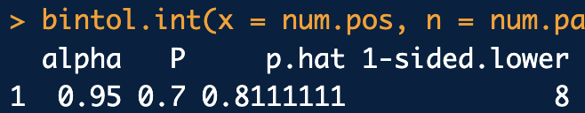
Another Example: Tolerance Intervals
A seizure of 200 blister packs is made. Each pack has m=10 pills. A random sample of 9 blister packs was chosen. It’s found that 73 of the 90 pills in the sample are positive for MDMA.
Assuming the data is binomial, with 95% confidence, what lower tolerance limit can be expected for positive pills per pack for 70% of the blister packs in the seizure?
library(tolerance)
# One-sided lower limit tolerance:
conf <- 0.95
p <- 0.70
alpha <- 1-conf
num.packs <- 9
num.pills.per.pack <- 10
num.pos <- 73
bintol.int(x = num.pos, n = num.packs*num.pills.per.pack, m = num.pills.per.pack,
alpha = conf, P = p, side = 1)
binomTI_ex1.R

Slide 13
Another Example: Tolerance Intervals
Follow up: With 95% confidence, what range of positive pills can we expect for 70% of the remaining seizure?
library(tolerance)
# One-sided lower limit tolerance:
conf <- 0.95
p <- 0.70
alpha <- 1-conf
num.pills.tested <- 90
num.pos <- 73
bintol.int(x = 73, n = 90, m = 2000-90, alpha = conf, P = p, side = 2)
binomTI_ex1.R

Slide 14
Yet Another Example: Tolerance Intervals
Suppose the large laboratory system needs to be 99% confident on the range of the number of lab errors that can be expected to occur across 95% of their system over a period of m=12 months. In the previous n=48 months, there were a total of x=12 documented lab errors.
Compute the 99%/95% Poisson tolerance interval for the range of lab errors that can be expected in the next year.
library(tolerance)
# Two-sided tolerance interval:
poistol.int(x = 12, n = 48, m = 12, alpha = 0.01, P = 0.95, side = 2)
poisTI_ex1.R

