Slide 1

Interval Estimation
Credit: It’s a Wonderful Life

Slide 2
Interval Estimation
We are interested in methods that produce an interval:
Given the assumptions of the methods are satisfied, the interval covers the true value of the parameter with (approximate) probability at least 1 – α.
Common interval methods for:
Confidence intervals
Prediction intervals
Tolerance intervals
Credibility/Probability intervals (Bayesian)
Type A
Type A, B
Type A
Type B

Slide 3
Confidence Intervals
Say we are interested in a range of plausible values for a measurand (parameter) θ
In order to get actual numerical values for and we perform the experiment and plug in the data
The outcomes for this experiment are:
Under the frequentist definition, probabilities (other than 0 or 1) only exist for outcomes of experiments that haven’t happened yet.

Slide 4
Confidence Intervals
Consider an experiment that will collect a sample of data.
Then BEFORE we collect the data, we can devise procedure such that:
level of significance
Estimates we will get from the sample we have yet to collect
level of confidence
Take a sample.
Compute a CI.
Graphical representation of
90% CIs is for a parameter:
Here 90% of the CIs contain the true value of the parameter
…we just don’t know which!
true value
of parameter θ

Slide 5
Confidence Intervals
Construction of a CI for a mean depends on:
Sample size n
Standard error for the mean
Level of confidence 1-α
α is significance level
Use α to compute t_{c}-value
Two-sided (1-α)×100% CI for population mean using a sample average and standard error is:

Slide 6
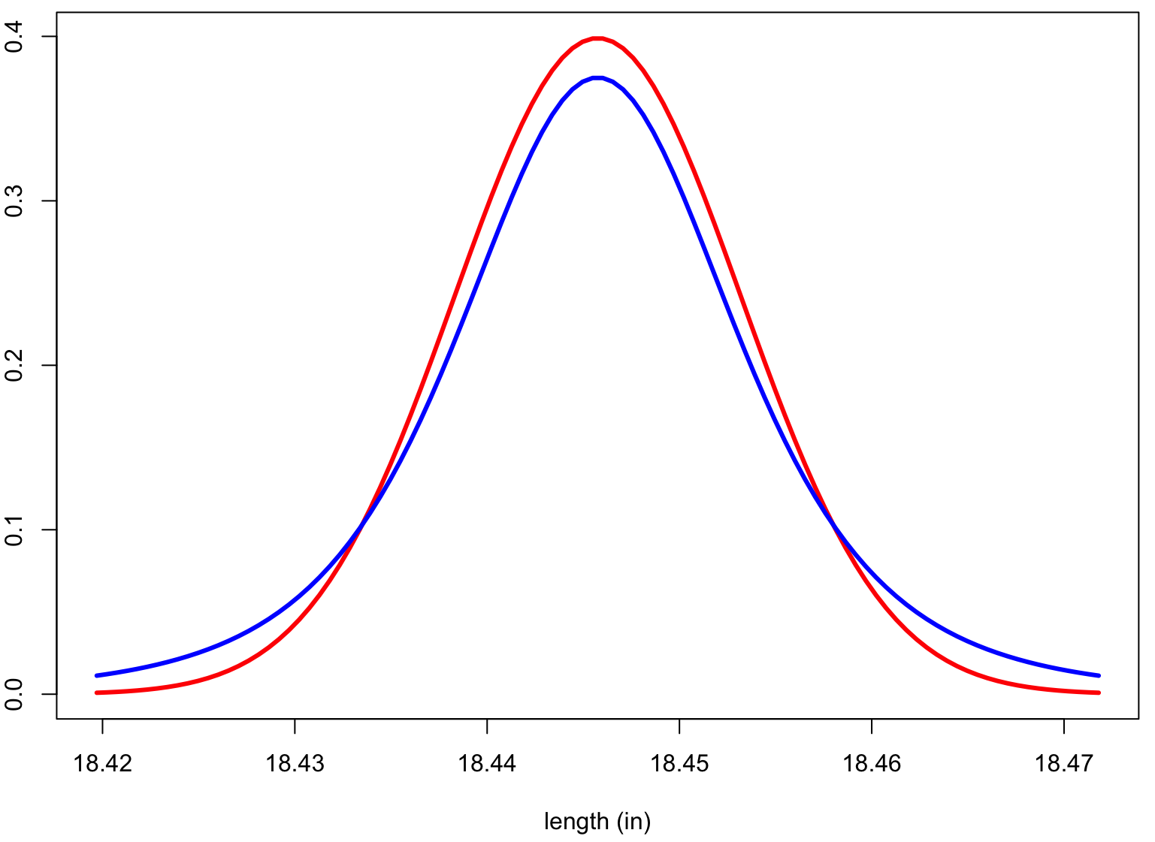
Intuition: Student-t and t_{c}
Measurand’s (barrel length) approximate sampling distribution
Normal distribution
Student-t distribution
Fatter in the tails

Slide 7
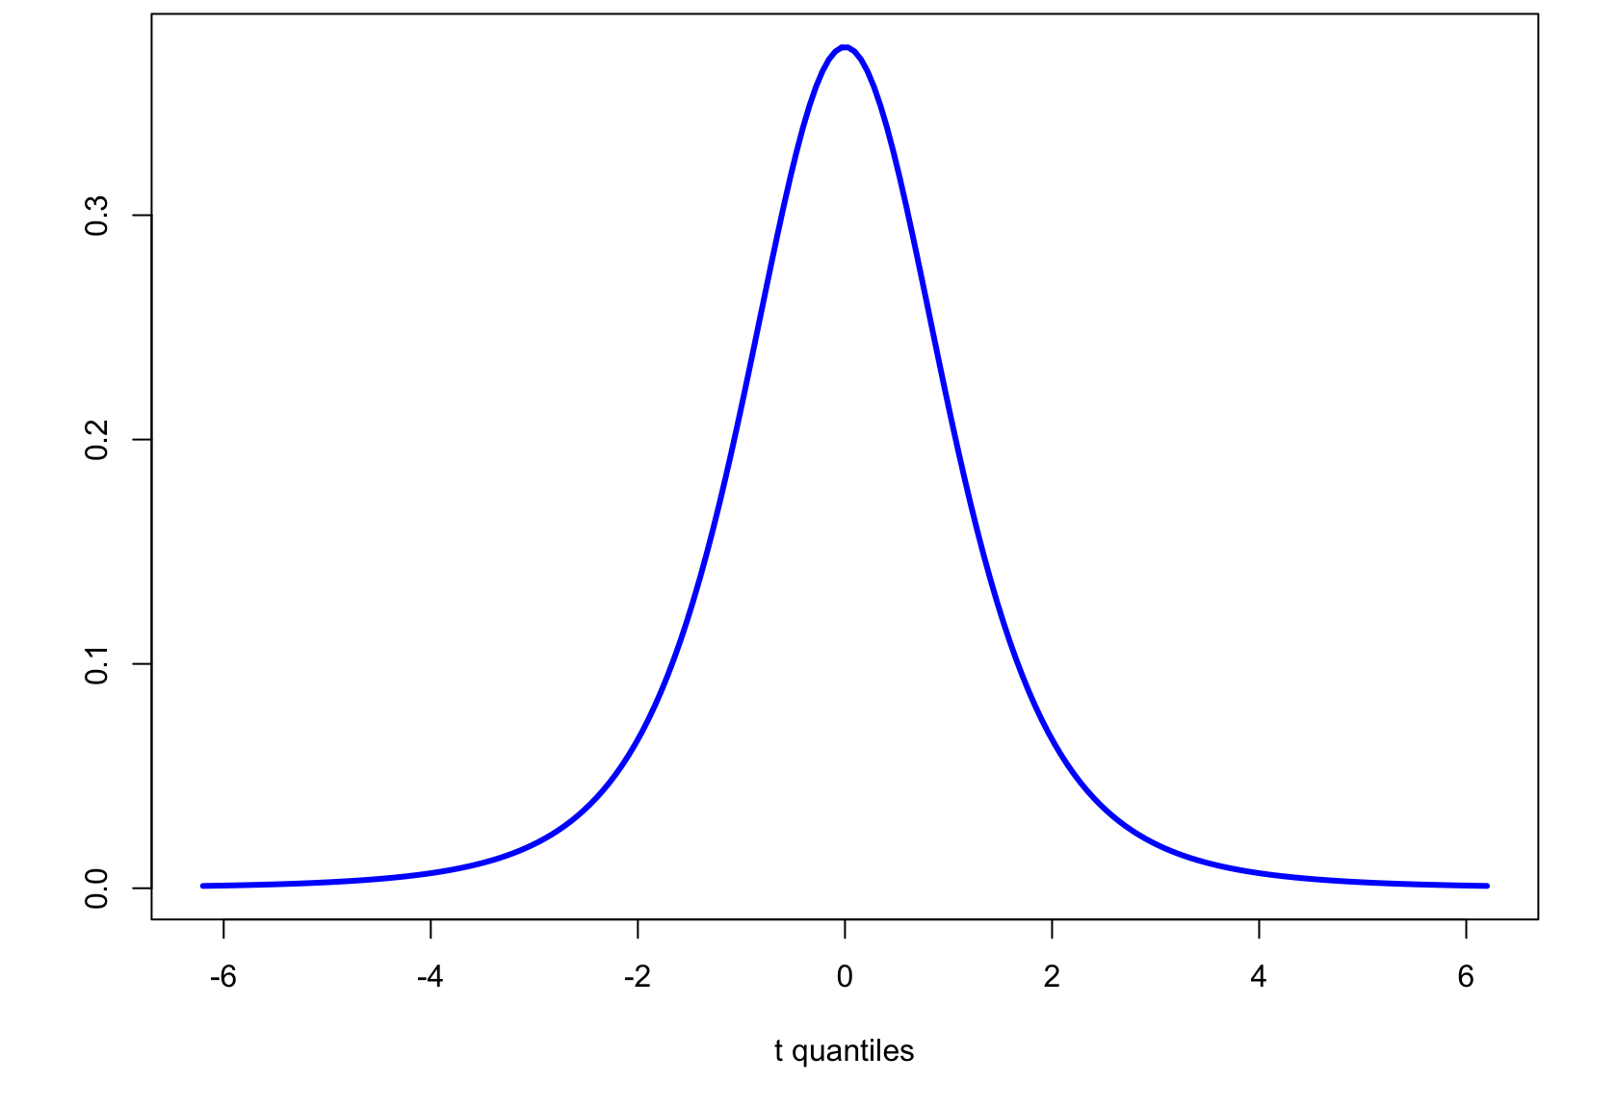
Intuition: Student-t and t_{c}
Student-t PDF, d.f. = 3
Area =
0.99
Area =
0.95
-5.84
5.84
-3.18
3.18
t_{c} = 3.18 for (two-sided) 95% confidence
t_{c} = 5.84 for (two-sided) 99% confidence

Slide 8
Example: Confidence Intervals
Compute a 99% two sided confidence interval for the the RI of a glass shard using this sample set:
Fragment # | Fragment nD
1 | 1.52005
2 | 1.52003
3 | 1.52001
4 | 1.52004
5 | 1.52000
6 | 1.52001
7 | 1.52008
8 | 1.52011
9 | 1.52008
10 | 1.52008
11 | 1.52008
?

Slide 9
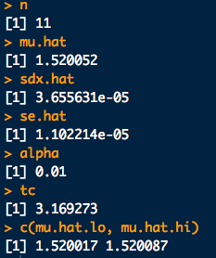
Example: Confidence Intervals
# Data (input quantities^GUM)
x <- c(1.52005,1.52003,1.52001,1.52004,1.52000,1.52001,1.52008,1.52011,1.52008,
1.52008,1.52008)
n <- length(x)
# Estimate of measurand^GUM:
mu.hat <- mean(x)
# Standard uncertainty of the input quantities^GUM
sdx.hat <- sd(x)
# Standard uncertainty of the measurand^GUM
se.hat <- sd(x)/sqrt(n)
# Compute tc for given sample size and chosen confidence level
conf <- 0.99
alpha <- 1-conf
tc <- qt(1 - alpha/2, df = n-1)
# Put the CI together:
mu.hat.lo <- mu.hat - tc*se.hat
mu.hat.hi <- mu.hat + tc*se.hat
c(mu.hat.lo, mu.hat.hi)
meanCI_ex1.R

Slide 10
Example: Confidence Intervals
Compute a 99% two sided confidence interval for the the RI of a glass shard using this sample set:
Fragment # | Fragment nD
1 | 1.52005
2 | 1.52003
3 | 1.52001
4 | 1.52004
5 | 1.52000
6 | 1.52001
7 | 1.52008
8 | 1.52011
9 | 1.52008
10 | 1.52008
11 | 1.52008
Putting this together:
[1.520052 - (3.17)(0.00001), 1.520052 + (3.17)(0.00001)]
99% CI for sample = [1.52002, 1.52009]

Slide 11
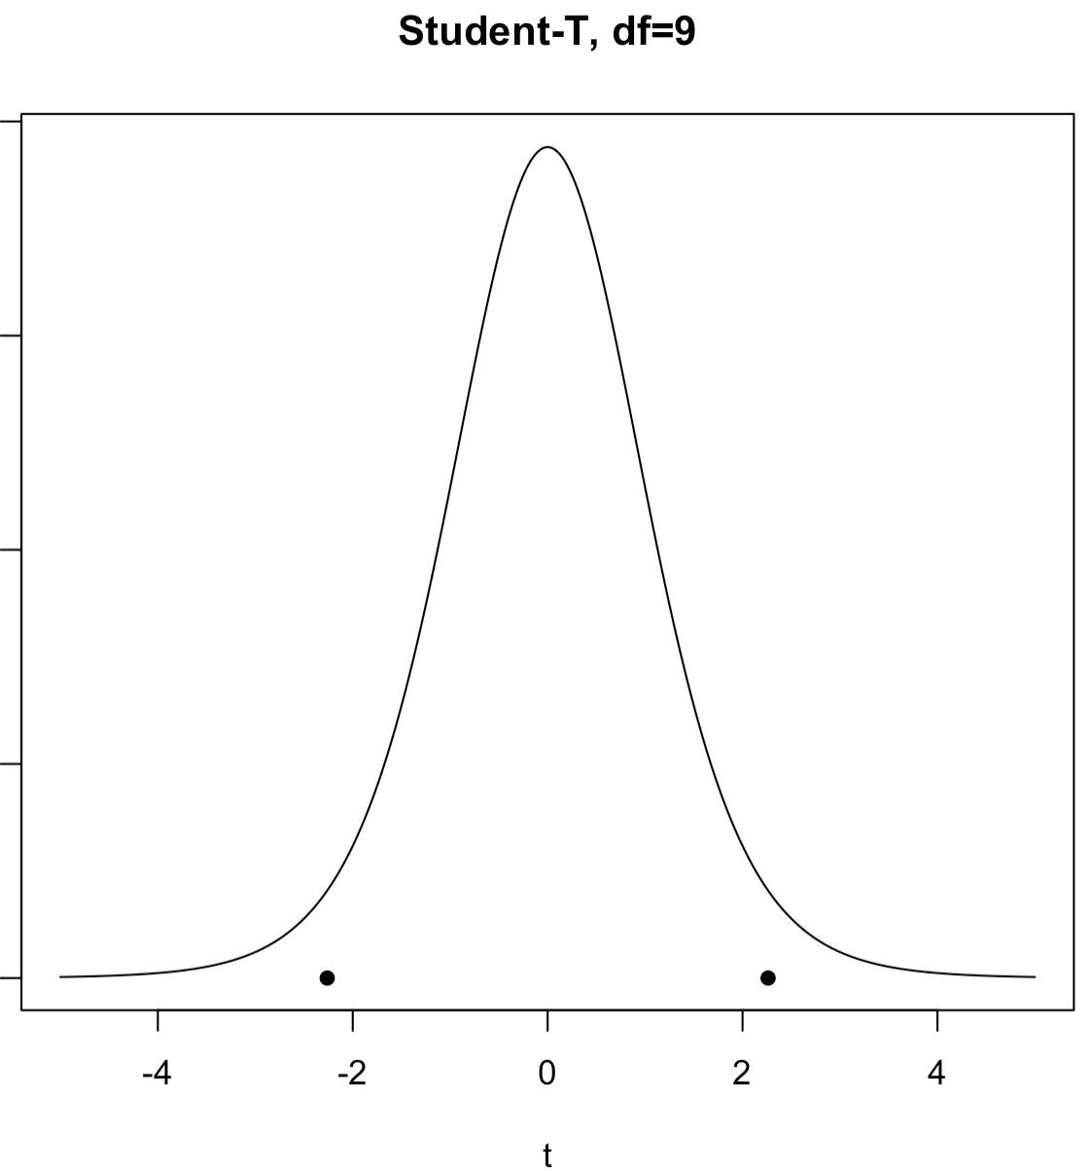
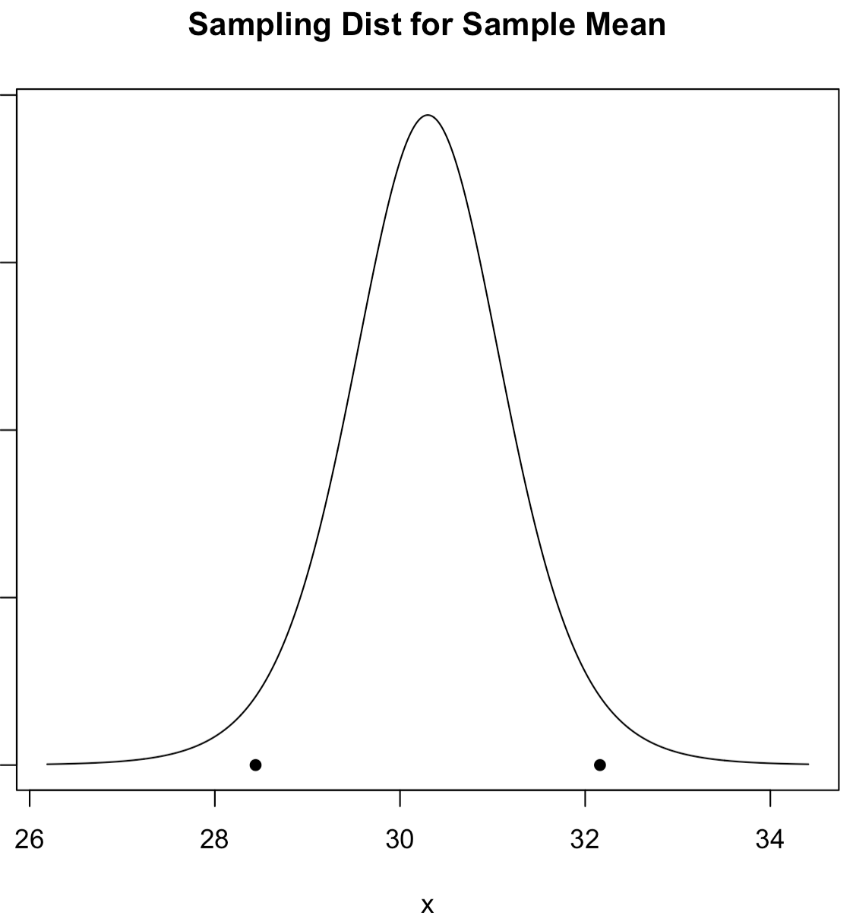
Two vs. One-Sided Intervals
(say 0.95)
(say 0.95)
Two-Sided CI:

Slide 12
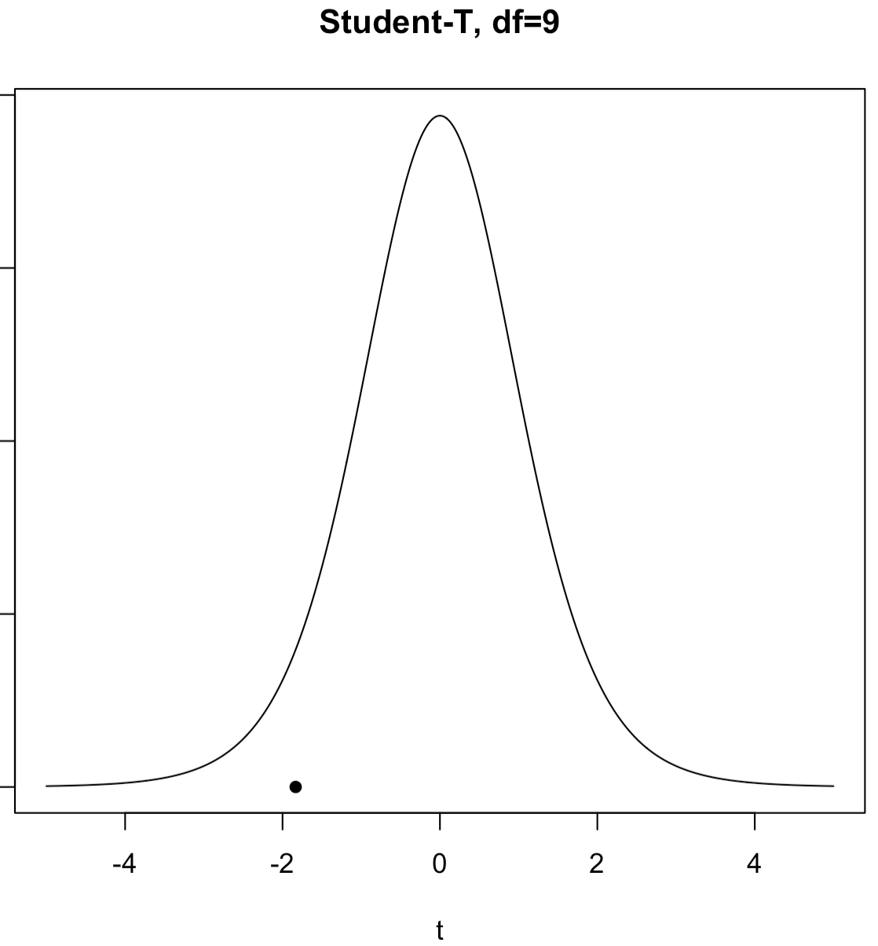

Two vs. One-Sided Intervals
(say 0.95)
(say 0.95)
One-Sided Lower CI:

Slide 13
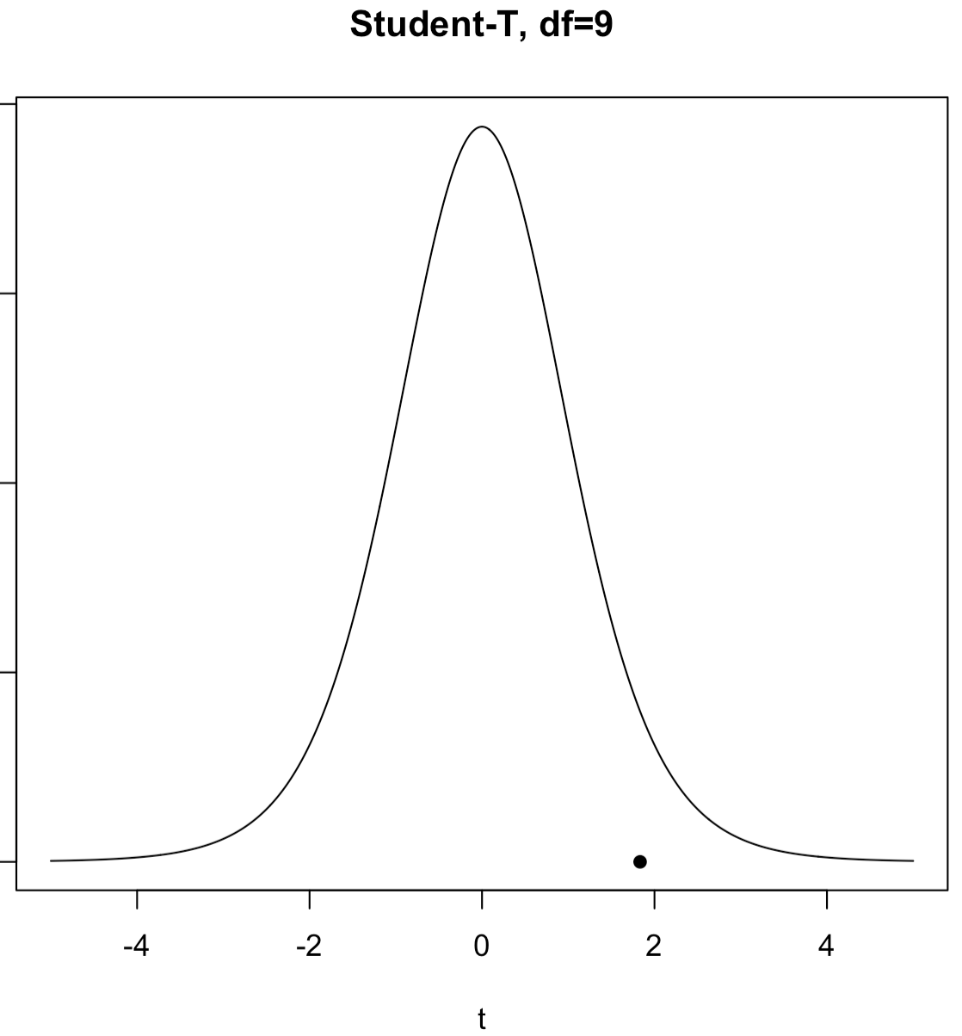

Two vs. One-Sided Intervals
(say 0.95)
(say 0.95)
One-Sided Upper CI:

Slide 14
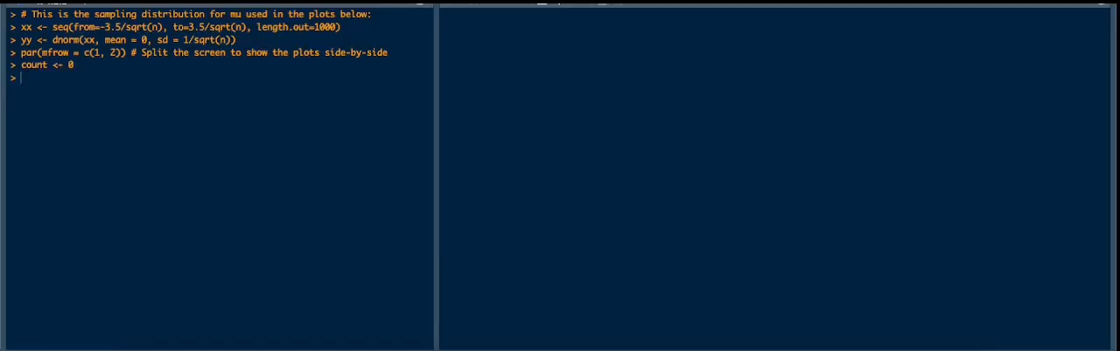
20,000 80% Confidence Intervals For The Mean
Do at least 80% of these cover the mean?? Let’s see:

Slide 15
Type B Measurement Uncertainty
Now let’s go through the basics of “Bayesian” analysis of the measurement process. In a nutshell:
Again we assume one or more parameters (measurands^{GUM}) θ are unknown, but our prior beliefs about them are described by pdfs, p(θ ).
Measurands are RVs like data
No more hats over our parameters…
Measurement data, x is represented by its likelihood given the parameters, p(x|θ).
We update our beliefs about the measurands with Bayes’ theorem:
Posterior (updated) beliefs about measurand now that we’ve seen some data
Prior beliefs about measurand

Slide 16
Type B Measurement Uncertainty
The basic Bayesian philosophy:
Prior Knowledge × Data =
Updated Knowledge
A better understanding of the world
Prior × Data = Posterior
If you have the posterior pdf you can get anything else you need

Slide 17
Type B Measurement Uncertainty
This analysis can get complicated quick!
Again, in forensic science we are mostly interested in the parameters mean: μ and the standard deviation σ_{X}, of the input quantities^{GUM}
A fairly general Bayesian version of the (very relevant) problem for μ can be worked out with pencil-and-paper
Note: most Bayesian analysis cannot be done without a computer
We need two new symbols, but we’ve used them before
is the sample average (was in Type A analysis)
s is the sample standard deviation (was in Type A analysis)
In Bayesian analysis sample statistics are “data” and considered separate entities from parameters. Hence they have different symbols.
In frequentist statistics, sample statistics are estimators for parameters

Slide 18
Type B Unknown Mean and Standard Deviation
Likelihood (data model):
Prior belief about the mean:
Prior belief about the variance:

Slide 19
Type B Unknown Mean and Standard Deviation
Putting these ingredients into Bayes’ theorem we get the updated (posterior) beliefs about μ, informed by the data:
posterior mean
Exactly the same result as in Type A analysis.
We just interpret probability differently, i.e. as “belief”

Slide 20
Type B: Credibility Intervals
Type B probability interval (PI) for a mean:
(1-α)×100% PI
*GUM Suppl. JCGM 106:2012 calls these “tolerance” and “conformity” intervals…
Construction depends on:
Sample size n
Sample standard deviation s
Sample average
Level of “credibility” (i.e. belief or probability) 1-α
α is still significance level
Use α to compute t_{c}-value

Slide 21
Revisit Example: Credibility Intervals
Compute a 99% two sided PI for the the RI of a glass shard using this sample set:
Fragment # | Fragment nD
1 | 1.52005
2 | 1.52003
3 | 1.52001
4 | 1.52004
5 | 1.52000
6 | 1.52001
7 | 1.52008
8 | 1.52011
9 | 1.52008
10 | 1.52008
11 | 1.52008
Putting this together:
[1.520052 - (3.17)(0.00001), 1.520052 + (3.17)(0.00001)]
Given the data and our prior assumptions we believe with
99% probability that the measurand (RI) is [1.52002, 1.52009]

Slide 22
Other types of intervals

Slide 23
Prediction Intervals
What if we’re not interested in a range of plausible parameter values for a distribution, but a range actual future measurements (input quantities^{GUM})?
Prediction Interval (Type A): Intervals produced by a method which takes a sample of n measurements and covers the n^{th} + 1 measurement (1 − α)×100% of the time:
Note: prediction is with respect to data (input quantities^{GUM}) and NOT measurands (parameters)

Slide 24
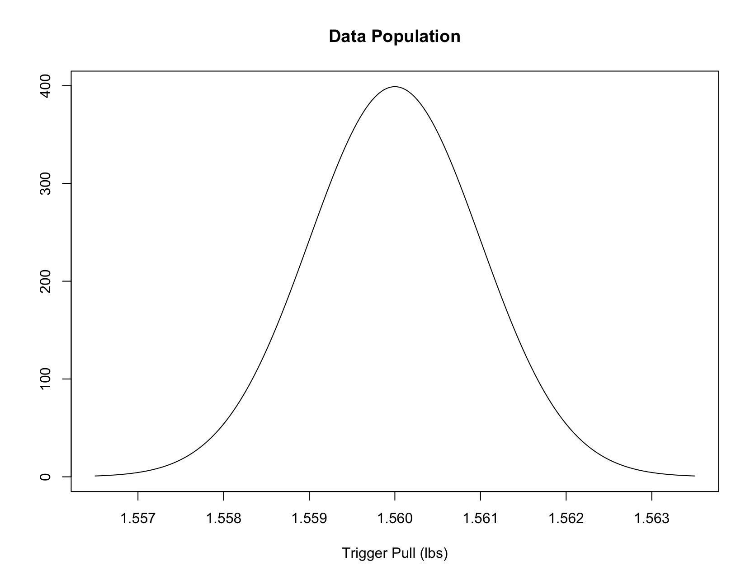
Prediction Intervals
Meaning of a Type A 90% Prediction Interval.
Measure n pulls:
Hit
Measure n pulls:
Hit
Measure n pulls:
Hit
Measure n pulls:
Hit
Measure n pulls:
Hit
Measure n pulls:
Hit
Measure n pulls:
Miss
Measure n pulls:
Hit
Measure n pulls:
Hit
Dots are for the n+1th measurement.
Measure n pulls:
Hit
90% of these things will cover the n+1th measurement (“Hit”) in the long run

Slide 25
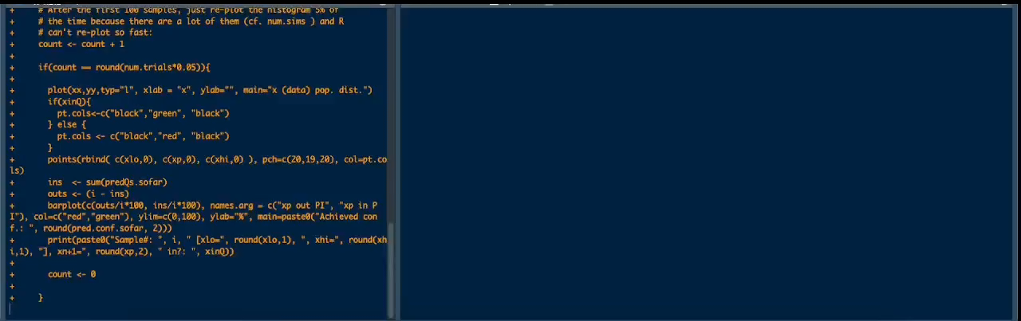
20,000 80% Prediction Intervals For
The Next Data Point
Do at least 80% of these capture the next data point?? Let’s see:

Slide 26
Tolerance Intervals
Tolerance Interval (Type A): Intervals produced by a method which takes a sample of n measurements and covers p×100% of the population of possible measurements (1 − α)×100% of the time:
population PDF for the data
Note again: interval is with respect to data and NOT measurands (parameters)

Slide 27
Tolerance Intervals
Meaning of a Type A p=85%, at 90% confidence Tolerance Interval.
Measure n pulls:
p=92.1%
Covers ≥ 85%
Measure n pulls:
p=89.4%
Covers ≥ 85%
Measure n pulls:
p=87.6%
Covers ≥ 85%
Measure n pulls:
p=97.2%
Covers ≥ 85%
Measure n pulls:
p=89.8%
Covers ≥ 85%
p=93.6%
Covers ≥ 85%
Measure n pulls:
Measure n pulls:
p=83.7%
Covers < 85%
p=95.4%
Measure n pulls:
Covers ≥ 85%
Measure n pulls:
p=95.5%
Covers ≥ 85%
Measure n pulls:
p=96.7%
Covers ≥ 85%
90% of these things will cover at least 85% of the measurement population in the long run

Slide 28
Tolerance Intervals
So how do we compute a (1 − α)×100% tolerance interval for p×100% of the population given a set of data??
If the data is normally distributed, tolerance intervals for p×100% population of data with (1 − α)×100% confidence:
Two sided
One sided, lower bound
One sided, upper bound
Tolerance τ-factors are a pain to compute. We’ll use the R package tolerance for all our parametric tolerance interval needs. It has approx. τ-factors for many data distributions.

Slide 29
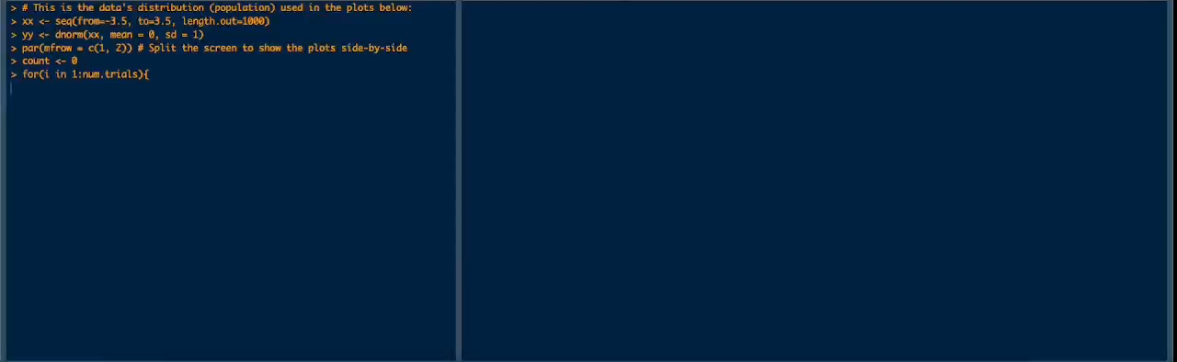
8,000 80% Tolerance Intervals for
75% Of The Data Population
Do at least 80% of these capture 75% of the data’s population?? Let’s see:

Slide 30
Type B Prediction/Tolerance
In “philosophically pure” Bayesian statistics, intervals aren’t that important and there is no canonical definition of “tolerance”.
Intervals are also not “random” like in Type A analysis
The GUM defines tolerance as “conformity”.
A Bayesian posterior probability interval (PI) covers plausible values of measurands said to “conform”.
Suppl: JCGM 106:2012
Type B tolerance interval: GUM effectively defines a “tolerance interval” as a Bayesian credibility interval for a measurand 🤯🤔.
Probability of conformity: Belief level for the credibility interval.

Slide 31
Type B Prediction/Tolerance … sort of
This is NOTHING like Type A tolerance, which says something about data taken in the measurement process, not the measurand(s).
Note: GUM does not specifically define Type A Prediction/Tolerance but such entities can be inferred from the main GUM document: JCGM 100:2008.
Note: Type A Prediction/Tolerance are standard concepts with respect to canonical statistics and business/industry language.

Slide 32
Type B Prediction/Tolerance … sort of
A better definition of Type B Prediction/Tolerance intervals really should be though the posterior predictive distribution.
Posterior predictive distribution: Measurement data (input quantities) we could plausibly now observe, considering that we have “updated” beliefs of what the measurands are.
It’s like an “inferred” data population distribution.
Prior beliefs about
measurands
(e.g. μ^{prior} and σ^{prior})
Updated beliefs about measurands
(e.g. μ^{posterior} and σ^{posterior})
“Inferred” measurement data population
×
Data
Bayes’ Theorem
Posterior distribution
Posterior predictive distribution

Slide 33
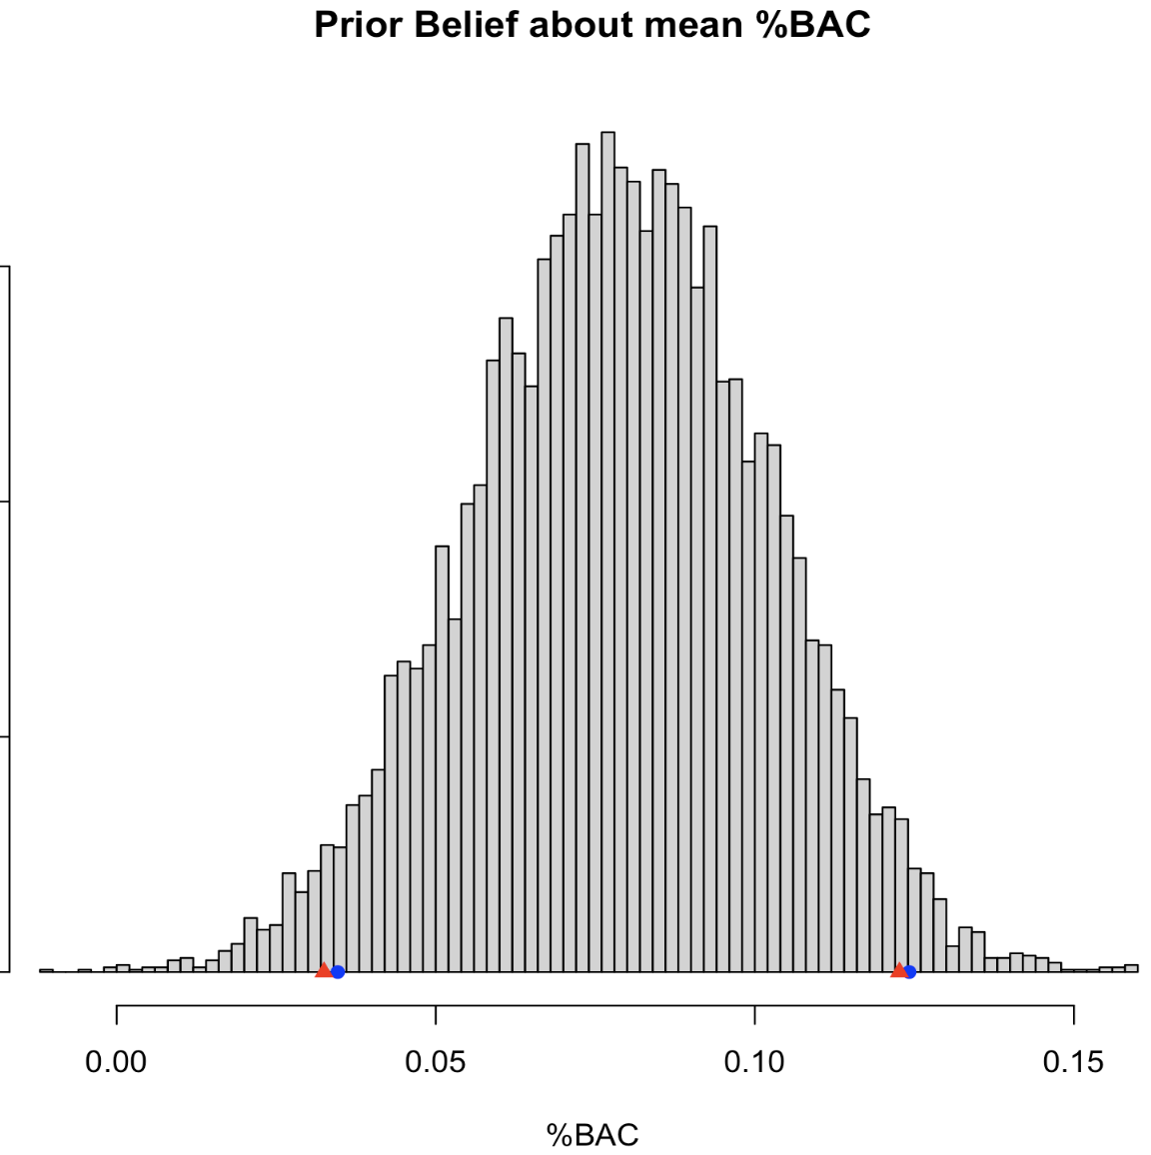
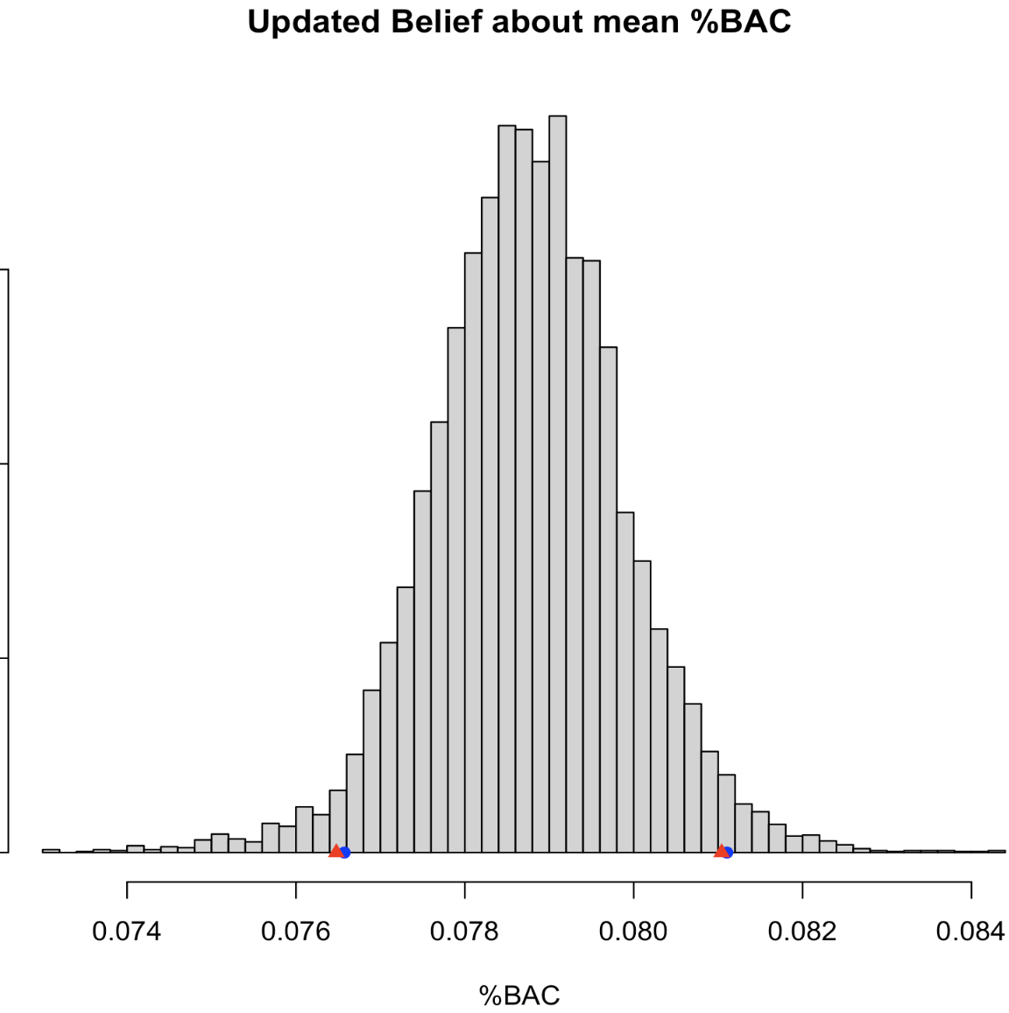
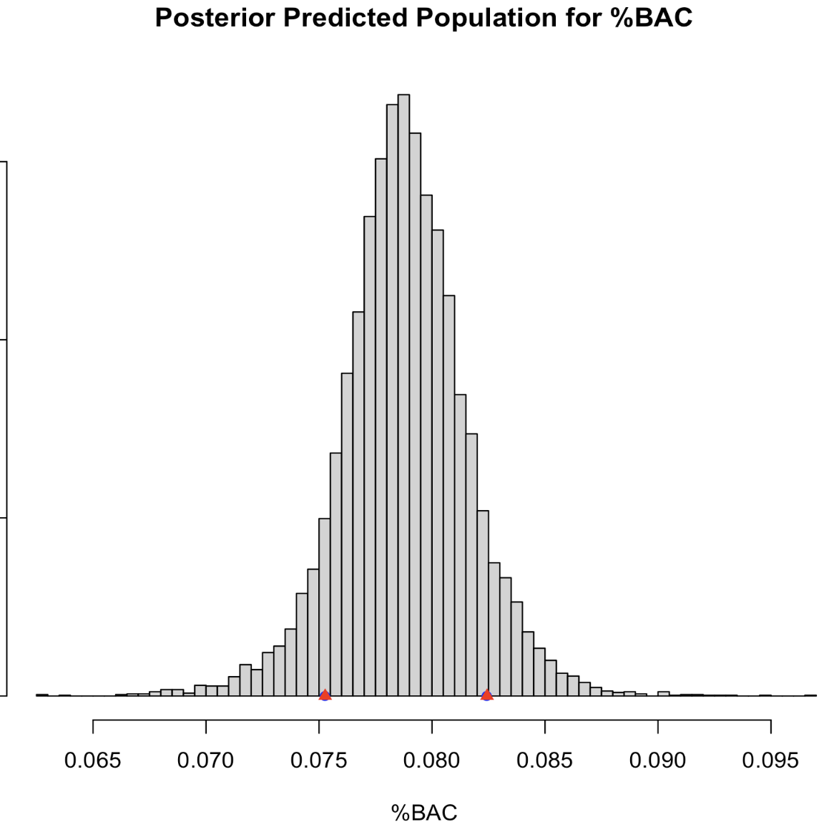

Slide 34
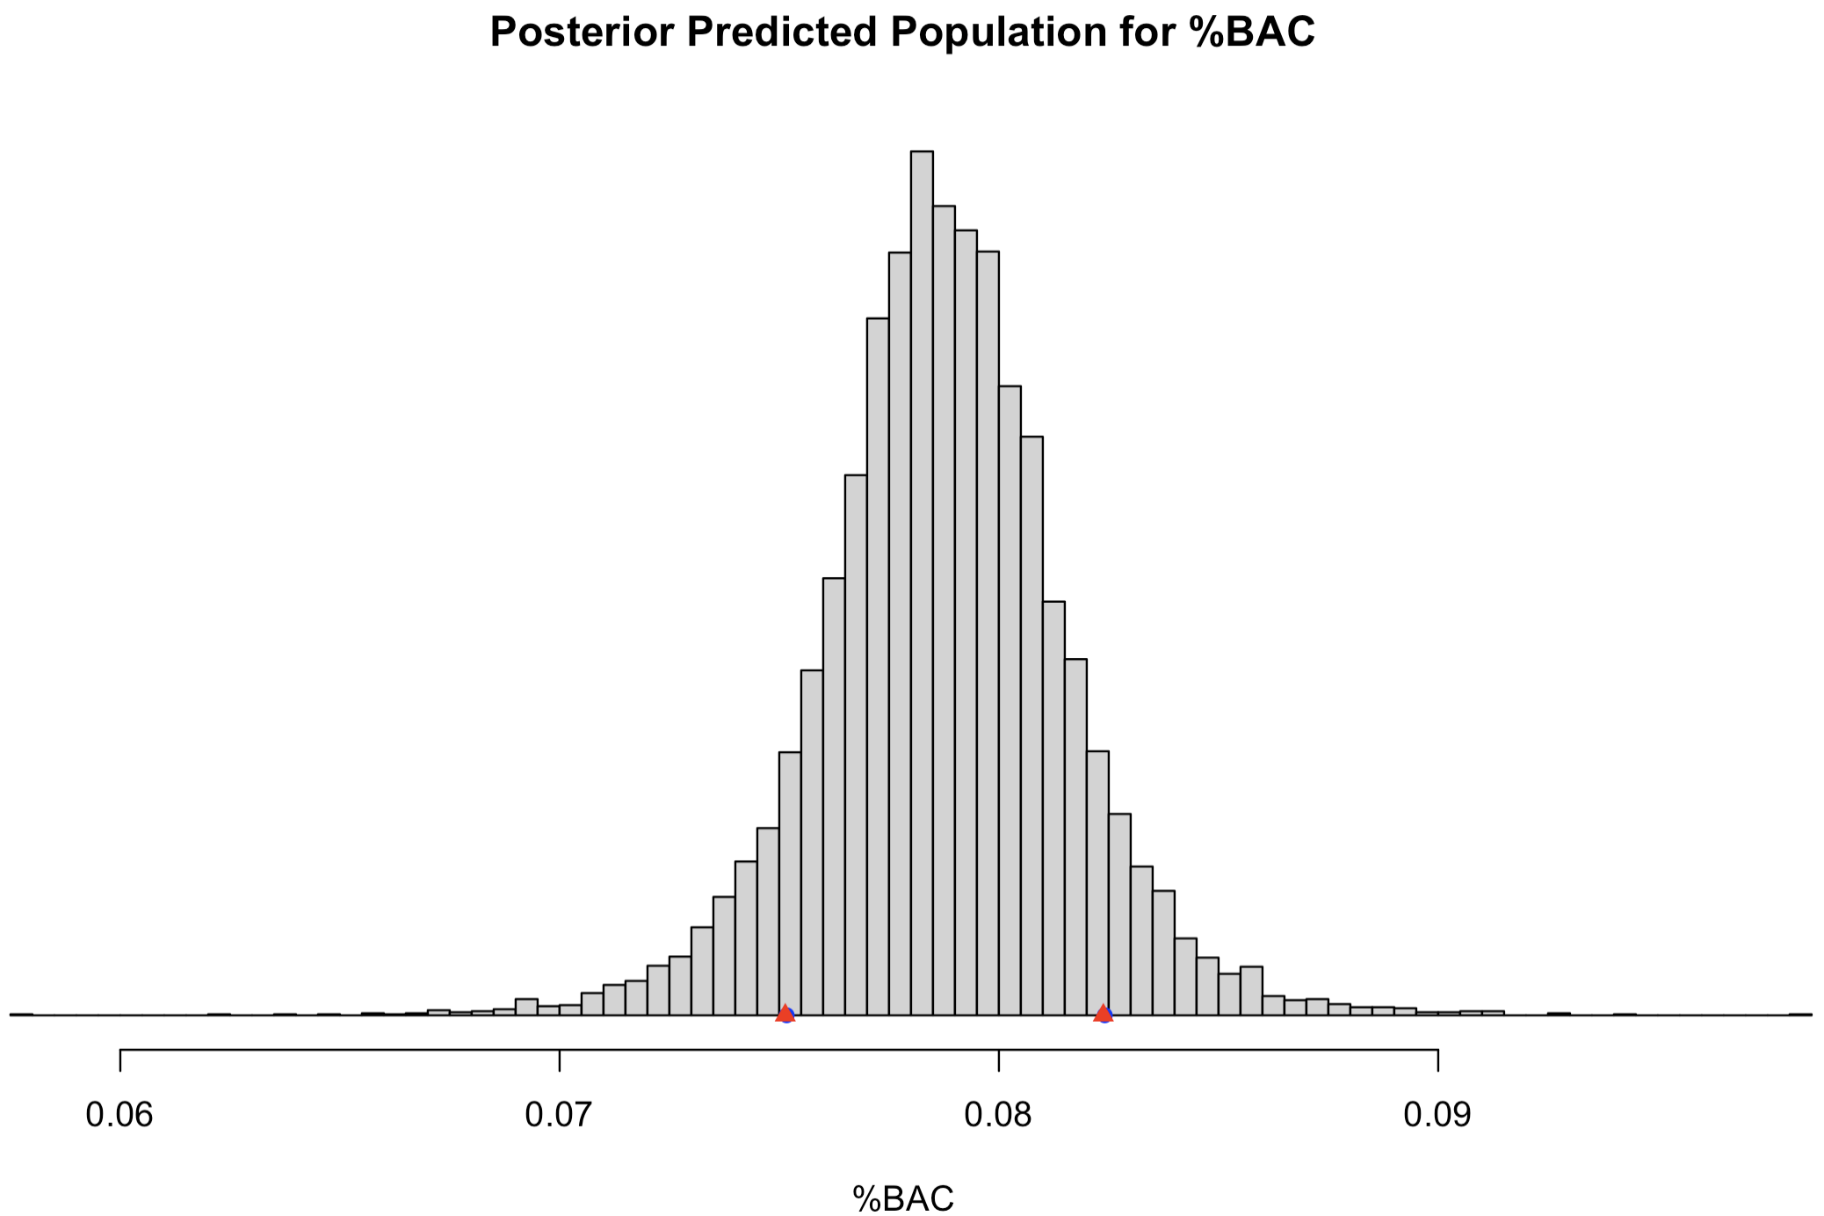
Type B Prediction/Tolerance … sort of
Example posterior predictive distribution inferred from %BAC data:
For comparison:
We believe the 83% most likely possible measurements we can make will fall between these.

