Slide 1
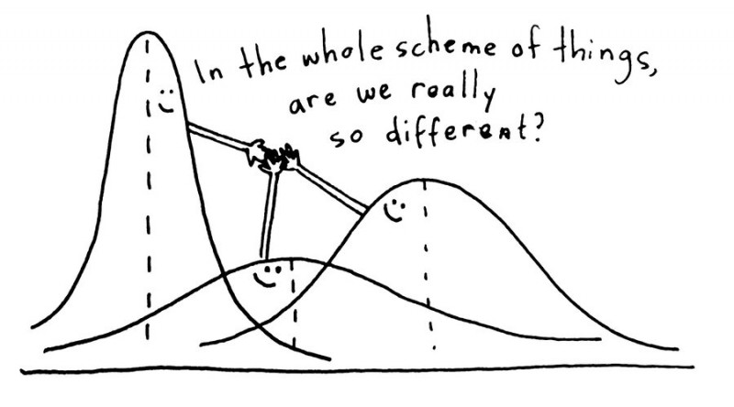
Analysis of Variance
Credit: https://www.questionpro.com/blog/anova-testing/

Slide 2
Analysis of Variance
Standard hypothesis testing is great for comparing parameter estimates for one or two samples, and .
What if we have more than two statistics to compare?
This is the subject of Experimental Design.
Experimental design is a very extensive field
We’ll start with the the basics
Usually the statistics we want to “compare” in the sciences are averages for experiments under different conditions
Most popular and simplest version is the experimental design method called one-way analysis of variance (ANOVA)

Slide 3
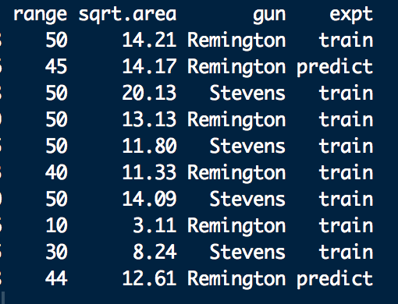
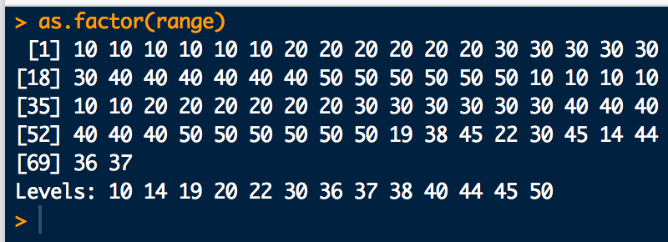
Some Lingo for Analysis of Variance
Experiment: understand how inputs (explanatory variables) affect outputs (responses)
Treatments: the input variables, i.e. the experimental conditions.
Typically, discrete factors with a fixed finite number of levels
Treatments can also be called groups
“range” is a factor with levels:
Experimental unit: environment in which the treatments are applied.
This should be as uniform as possible.
“gun” is a factor with levels: Remington
Stevens

Slide 4
One-Way Analysis of Variance Model
A one-way ANOVA model can be represented as:
i^{th}-treatment effect
observation (response) variable:
j^{th} datapoint in the i^{th} treatment
error for: j^{th} datapoint in the i^{th} treatment
overall mean
i^{th}-treatment mean
one-way/single factor fixed effects model
one-way/single factor ANOVA

Slide 5
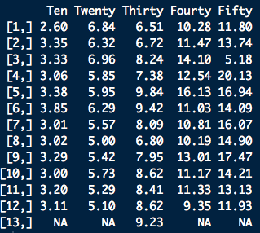

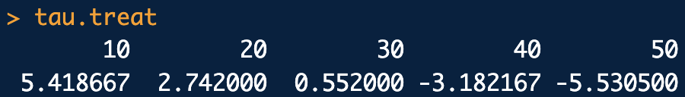
Analysis of Variance
“range” is the treatment
Index is i, column number in this case
# replicates per treatment is 12 or 13
Index is j, row number in this case

Slide 6
Analysis of Variance
The purpose of one-way ANOVA is to test for the equality of k treatment means:
H₀: The treatment means being compared are not statistically different at the (1-α)×100% level of confidence
H_{a} : At least one of the treatment means being compared is statically distinct from the others.
for at least one pair of treatment means
This is equivalent to:
for at least one treatment

Slide 7
Components of Variance
Instead of testing for the equality of all means pair-wise, or testing many individual treatment effects, we’ll use the components of variance to make one test
To start, for k treatments (groups) with n_{i} observations each* we’ll need:
total number of observations
treatment mean estimates
overall mean estimate
*n_{i}’s all the same: balanced design; n_{i}’s different: unbalanced design. Balanced designs are more powerful.

Slide 8
Components of Variance
Next, (recall) the sum squared variation for each observation:
We can partition this total variation into an explained variation of the observations and unexplained variation of the observations:
expand
SSA
explained variation:
variation between treatments
SSE
unexplained variation:
variation within treatments

Slide 9
Components of Variance
Now let’s turn these variations into variances by dividing by their degrees of freedom (df):
model (between treatment) variance
explained variance
within treatment variance
unexplained (error) variance
overall variance

Slide 10
ANOVA Table
Organizing all this information into a table:
Analysis of Variance Table
variance explained by the model
unexplained variance
Variation Source | Sum of Squares | DOF | Variance (Mean Squares) | F-ratio | p-val
Between/Model (Explained) | SSA | k − 1 | MSA | MSA/MSE
Within/Error (Unexplained) | SSE | N − k | MSE
Total | SSY | N − 1 | MSY
between:within variance ratio
H₀: the treatment means are all the same (most of the variation is unexplained)
p-value to gauge:
H_{a}: at least one treatment mean is differing (most of the variation is explained by the between treatment differences)

Slide 11
Reason for the F-ratio of variances
It turns out that:
Note that MSE estimates the model error variance (i.e. the unexplained variance),
It also turns out that:
So, IF THERE IS NO DIFFERENCE IN THE TREATMENT MEANS, τ_{i}’s = 0 and the MSA should also effectively estimate the model error variance (i.e. the unexplained variance)
If the treatment means differ, then MSA should be significantly bigger than MSE

Slide 12
Reason for the F-ratio of variances
So test ratio of MSA to MSE variances for evidence of differences between treatment means!
It can be shown that the sampling distribution for MSA/MSE under H₀ is the F distribution with k − 1, N − k dof:
“Bigness” of F-ratio is gauged by how far out MSA/MSE falls on the tail of F(k − 1, N − k)

Slide 13
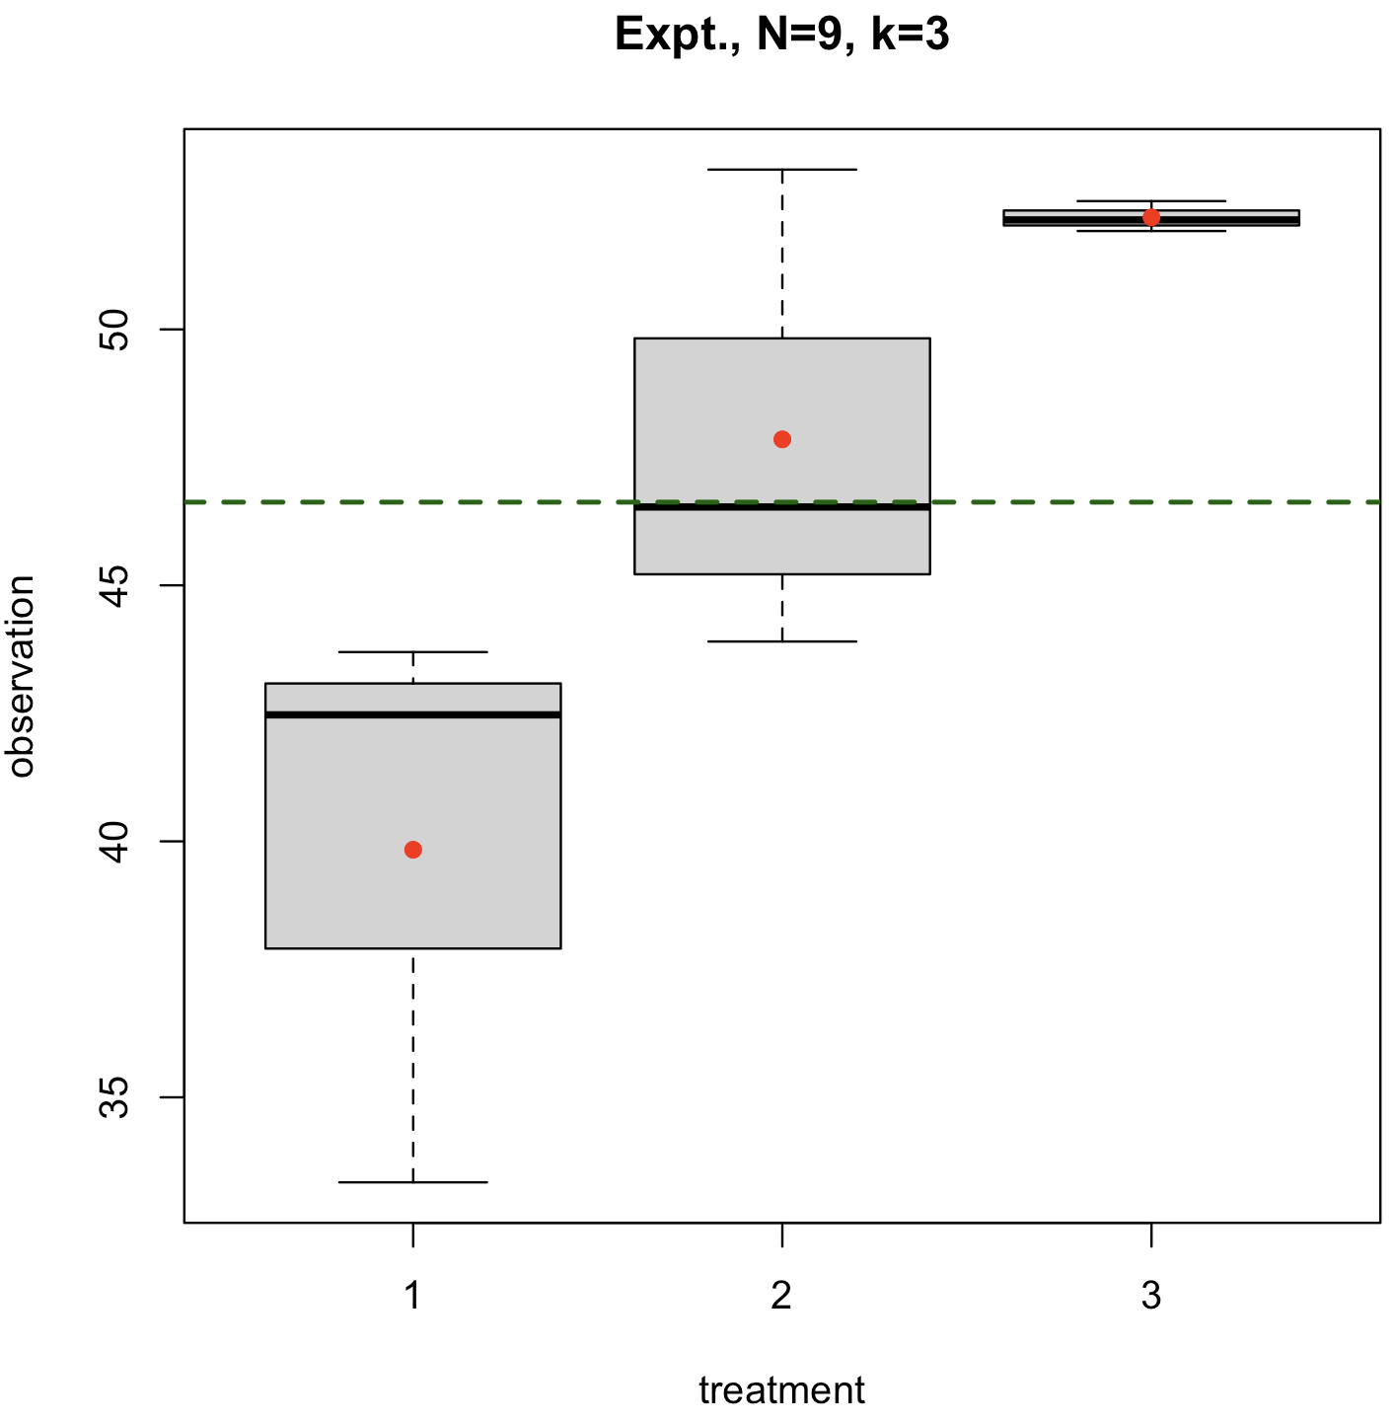
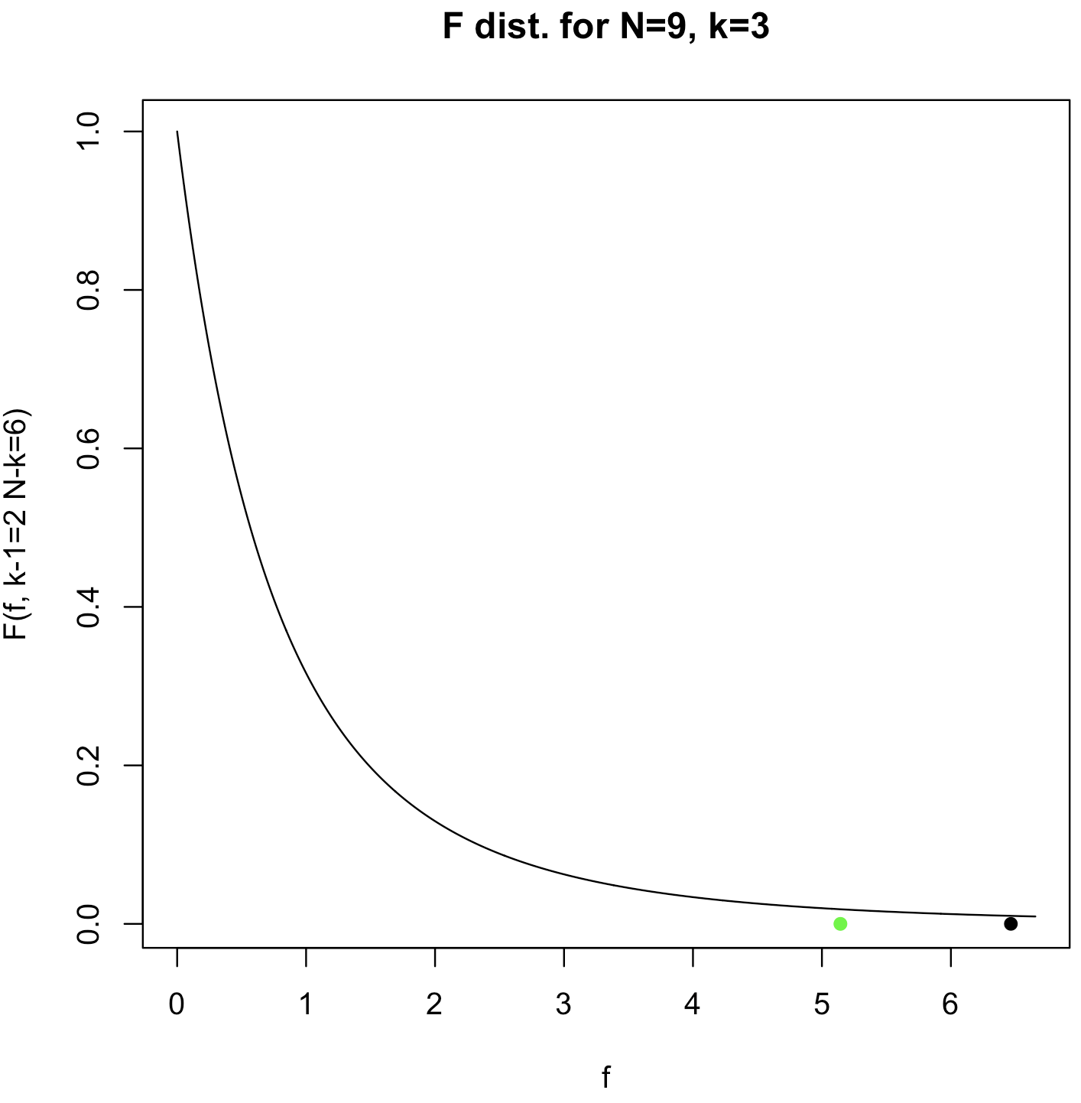
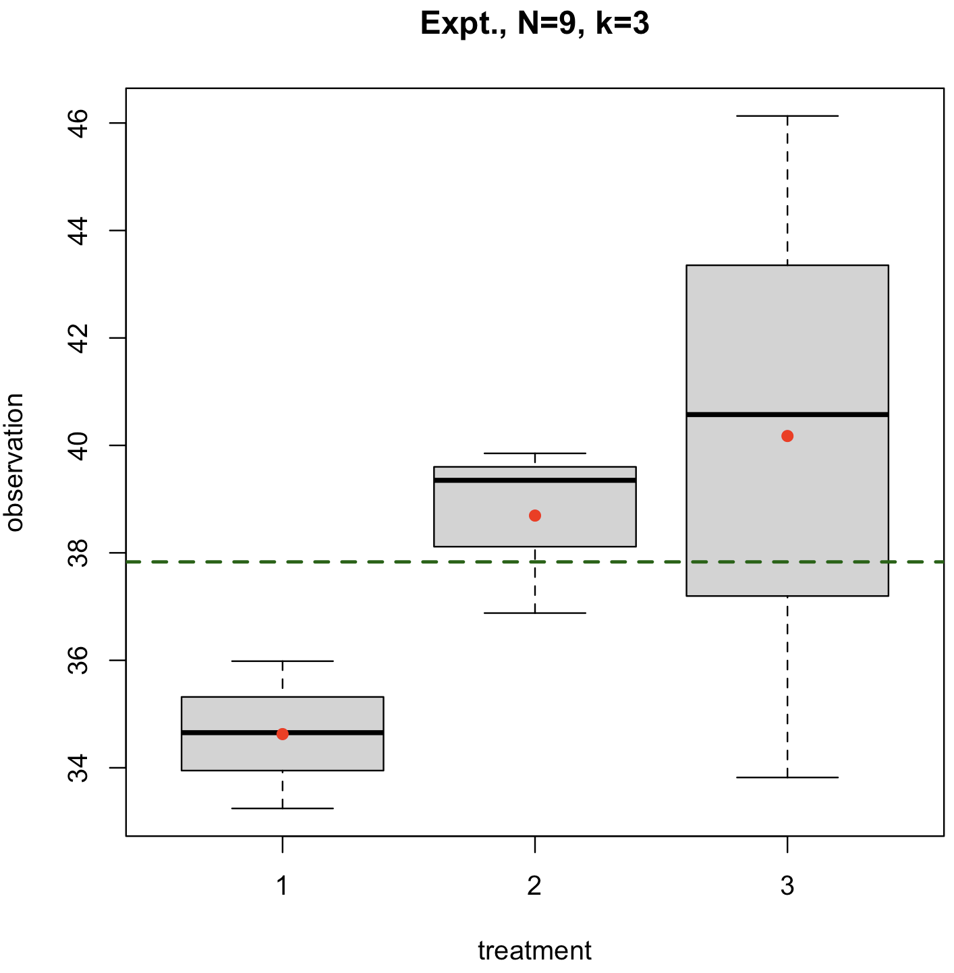
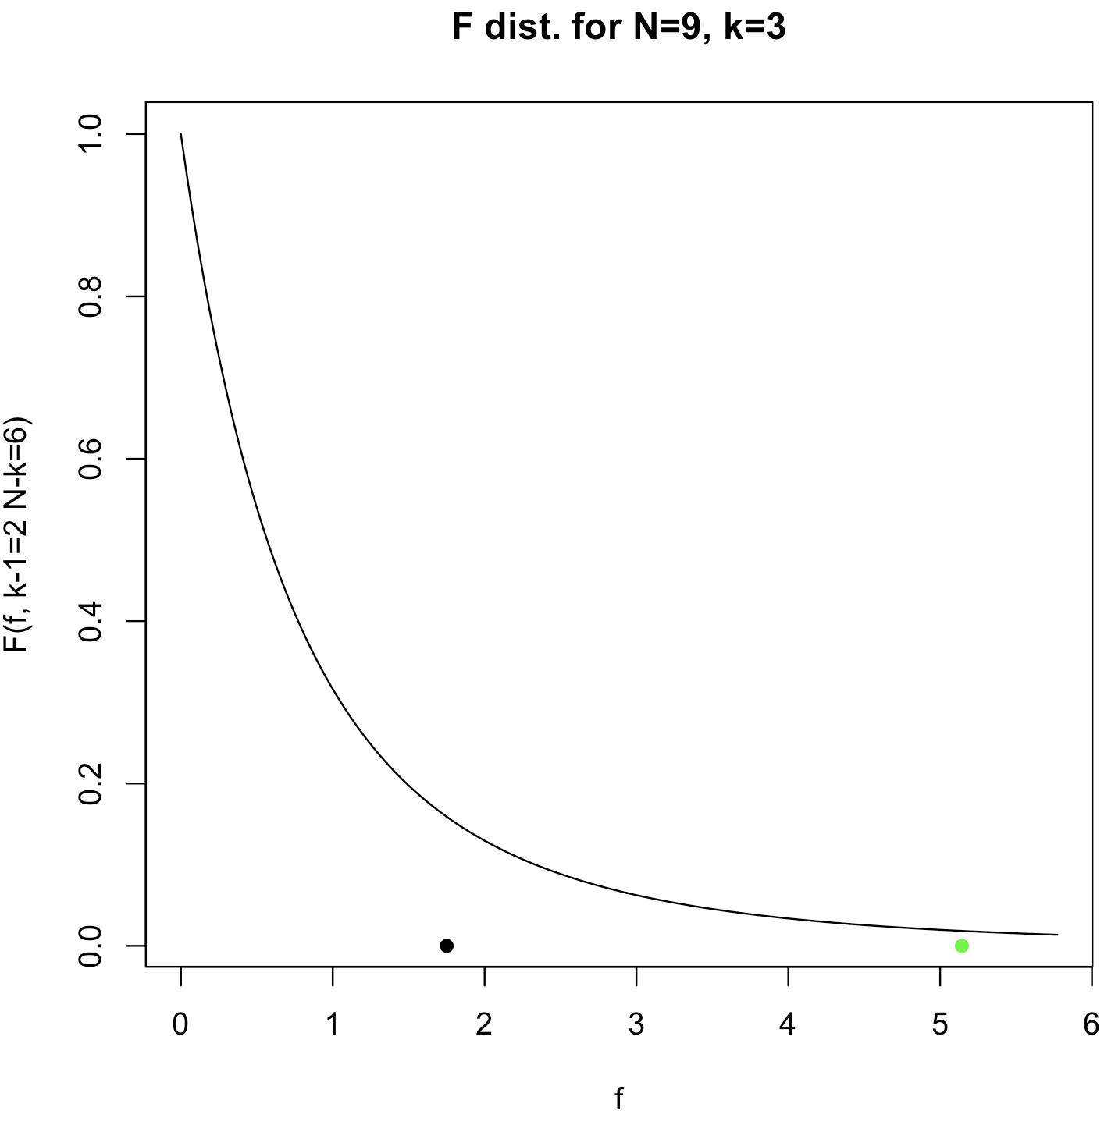
Reason for the F-ratio of variances
MSA/MSE big enough
MSA/MSE not big enough

Slide 14
Explained Variance
Since we have the components of the total variance, we can compute how much of the variation and variance is explained by the treatment differences:
fraction of variation explained by treatment differences (biased up)
fraction of variance explained by treatment differences

Slide 15
ANOVA Example
Consider the shotgun spread data (square-root area) as a function of range below:
10 feet
20 feet
30 feet
40 feet
50 feet
2.60, 3.35, 3.33, 3.06, 3.38, 3.85, 3.01, 3.02, 3.29, 3.00, 3.20, 3.11
6.84, 6.32, 6.96, 5.85, 5.95, 6.29, 5.57, 5.00, 5.42, 5.73, 5.29, 5.10
6.51, 6.72, 8.24, 7.38, 9.84, 9.42, 8.09, 6.80, 7.95, 8.62, 8.41, 8.62, 9.23
10.28, 11.47, 14.10, 12.54, 16.13, 11.03, 10.81, 10.19, 13.01, 11.17, 11.33, 9.35
11.80, 13.74, 5.18, 20.13, 16.94, 14.09, 16.07, 14.90, 17.47, 14.21, 13.13, 11.93
a. Use ANOVA to test for evidence of a significant difference between at least one of the treatment means.
b. Compute the fraction of explained variation (η²) and variance (ω²) of the treatments using the effectsize package.

Slide 16
ANOVA Example
# Data (responses)
y <- c(
2.60,3.35,3.33,3.06,3.38,3.85,3.01,3.02,3.29,3.00,3.20,3.11,
6.84,6.32,6.96,5.85,5.95,6.29,5.57,5.00,5.42,5.73,5.29,5.10,
6.51,6.72,8.24,7.38,9.84,9.42,8.09,6.80,7.95,8.62,8.41,8.62,9.23,
10.28,11.47,14.10,12.54,16.13,11.03,10.81,10.19,13.01,11.17,11.33,9.35,
11.80,13.74, 5.18,20.13,16.94,14.09,16.07,14.90,17.47,14.21,13.13,11.93
)
# Treatment labels for each data point
lbl.treat <- c(
10, 10, 10, 10, 10, 10, 10, 10, 10, 10, 10, 10,
20, 20, 20, 20, 20, 20, 20, 20, 20, 20, 20, 20,
30, 30, 30, 30, 30, 30, 30, 30, 30, 30, 30, 30, 30,
40, 40, 40, 40, 40, 40, 40, 40, 40, 40, 40, 40,
50, 50, 50, 50, 50, 50, 50, 50, 50, 50, 50, 50
)
# Box plots to visually compare treatments:
boxplot(y ~ as.factor(lbl.treat), range=0 )
# Quick look at the treatment means we will test
tapply(y, lbl.treat, mean)
# R can handle all the ANOVA calculations automatically:
fit <- aov(y ~ as.factor(lbl.treat))
summary(fit)
anova_ex1.R

Slide 17
ANOVA Example
# But the variances of each treatment do not look equal
# so let's try Welch's ANOVA which does not make this assumption:
# Test the treatment variances just to be sure:
bartlett.test(y ~ as.factor(lbl.treat))
# Welch's ANOVA (but no ANOVA table output)
fit.alt <- oneway.test(y ~ as.factor(lbl.treat), var.equal = F)
fit.alt
# Effects sizes:
library(effectsize)
# Effects sizes for equal variance model:
eta_squared(fit, ci = .95)
omega_squared(fit, ci = .95)
# Approximate effects sizes, for unequal variance model:
eta_squared(fit.alt, ci = .95)
omega_squared(fit.alt, ci = .95)
anova_ex1.R

Slide 18
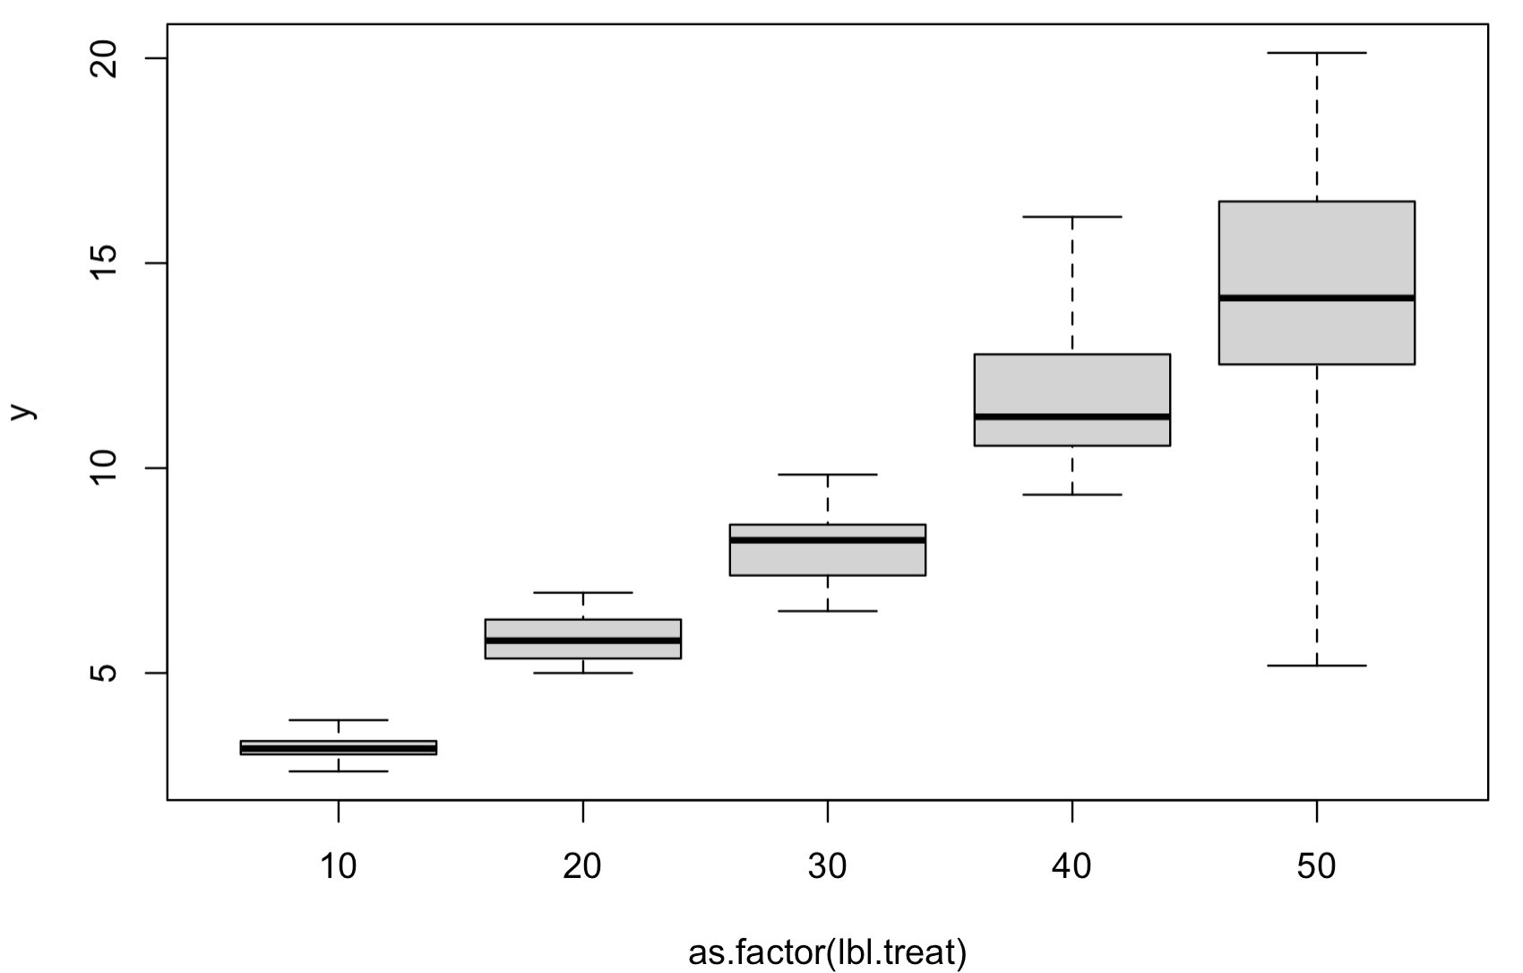
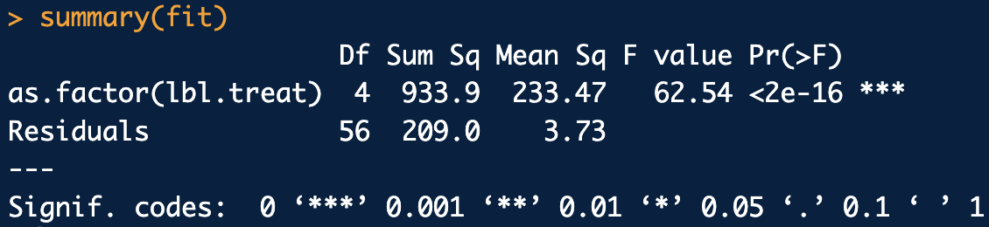
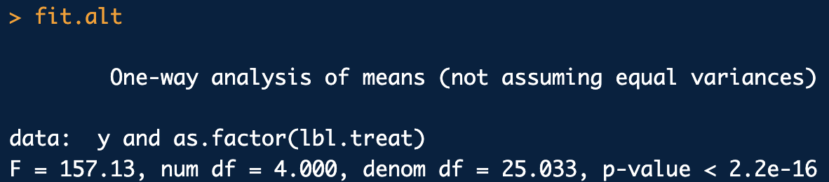
ANOVA Example
Equal variances ANOVA model:
Unequal variances (Welch) ANOVA model:

Slide 19
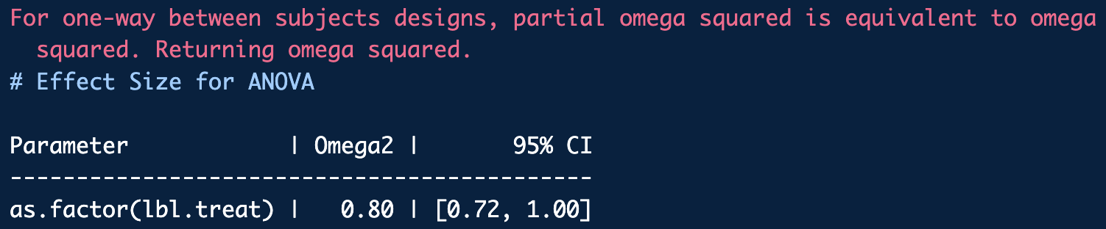
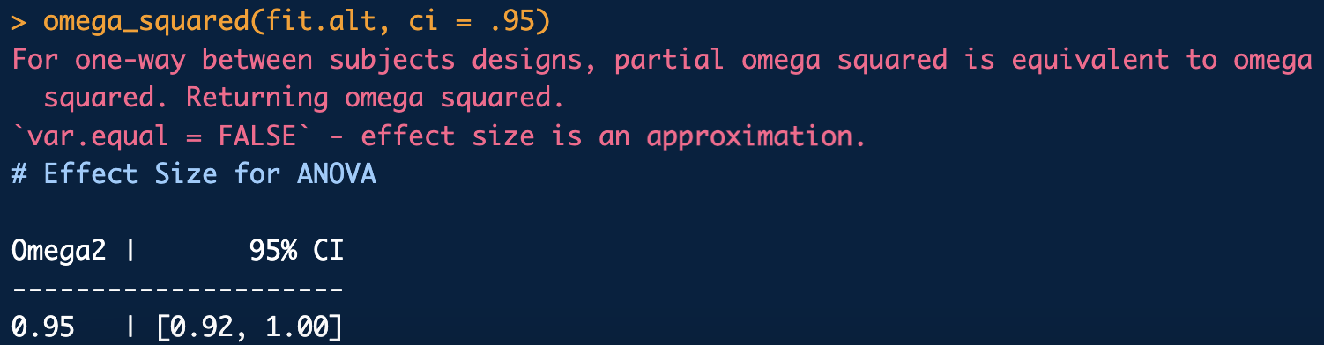
ANOVA Example
ω² equal variances ANOVA model:
ω² (approximate) unequal variances (Welch) ANOVA model:

Slide 20
Non-parametric Replacement for ANOVA
If it is suspected that the data is not normal the “non-parametric” Kruskal-Wallis test can replace parametric ANOVA
Kruskal-Wallis test is a generalization of the Wilcoxon rank sum test
It is fairly robust to violation of homogeneity of the treatment variance
Implemented with kruskal.test()

Slide 21
Kruskal-Wallis Example
Does the amount of DNA recovered from the surfaces of different drinking containers vary^{Curran-dafs}? Examine the data and use a Kruskal-Wallis test to render a decision. Compare to standard and Welch ANOVA.
DNA amount recovered:
0.50, 0.20, 0.50, 0.50, 0.50, 0.50, 0.20, 0.08, 0.50, 0.00, 0.50, 0.50, 0.08,
0.20, 0.08, 0.08, 0.40, 0.20, 0.40, 0.50, 0.50, 0.50, 0.50, 0.50, 0.50, 0.50,
0.08, 0.50, 0.50, 0.50, 0.50, 0.08, 0.20, 0.40, 0.20, 0.40, 0.80, 0.40, 0.40,
0.08, 0.50, 0.50, 0.50, 0.20, 0.20, 0.08, 0.50, 0.20, 0.50, 0.50, 0.00, 0.08,
0.40, 0.20, 0.08, 0.08, 0.40, 0.50, 0.50, 0.50, 0.20, 0.50, 0.50, 0.50, 0.40,
0.50, 0.50, 0.50, 0.50, 0.40, 0.20, 0.08, 0.20, 0.20, 0.40, 0.40, 0.50, 0.08,
0.50, 0.40, 0.50, 0.40, 0.50, 0.40, 0.50, 0.50, 0.50, 0.50, 0.20, 0.00, 0.20,
0.20, 0.20, 0.20, 0.40, 0.50, 0.40, 0.50, 0.08, 0.50, 0.08, 0.20, 0.50, 0.20,
0.50, 0.50, 0.40, 0.00, 0.20, 0.20, 0.08, 0.08, 0.20, 0.40
Drinking container types (data labels):
10, 10, 4, 4, 3, 3, 5, 5, 7, 7, 2, 2, 1, 1, 9, 9, 6, 6, 8, 10,
10, 4, 4, 3, 3, 5, 5, 7, 7, 2, 2, 1, 1, 9, 9, 6, 6, 8, 10, 10,
4, 4, 3, 3, 5, 5, 7, 7, 2, 2, 1, 1, 9, 9, 6, 6, 8, 10, 10, 4,
4, 3, 3, 5, 5, 7, 7, 2, 2, 1, 1, 9, 9, 6, 6, 8, 10, 10, 4, 4,
3, 3, 5, 5, 7, 7, 2, 2, 1, 1, 9, 9, 6, 6, 8, 10, 10, 4, 4, 3,
3, 5, 5, 7, 7, 2, 2, 1, 1, 9, 9, 6, 6, 8

Slide 22
Kruskal-Wallis Example
library(dafs)
data(abaz.df)
y <- abaz.df$dna.conc
lbl <- abaz.df$sample
# Quick look at the data
# Data obvioulsy not normal and variances differ
tapply(y, lbl, mean)
boxplot(y ~ as.factor(lbl))
# Do the regular ANOVA:
fit <- aov(y ~ lbl)
summary(fit)
# Welch doesn’t even work on this crazy data
bartlett.test(y ~ lbl)
fit2 <- oneway.test(y ~ lbl, var.equal = F)
fit2
# Kruskal-Wallis. "Nonparametric" substitute for ANOVA
fit3 <- kruskal.test(y ~ lbl)
fit3
kruskal_ex1.R

Slide 23
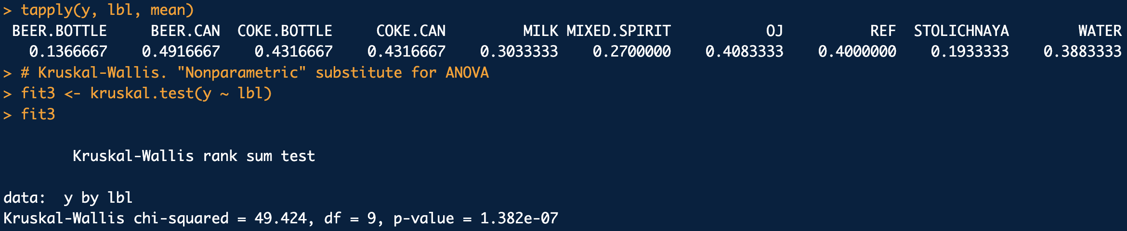
Kruskal-Wallis Example
At least one of the groups is different

Slide 24
Post Hoc Testing
If ANOVA returns a significant result, it makes sense to ask which means may be statistically different than the rest.
A way to accomplish this is to do pair-wise hypothesis tests on all pairs of treatment averages to see if the Null (μ_{A}-μ_{B} = 0) may be rejected.
The problem is, using regular t-tests the probability of falsely rejecting the Null is α.
For n-treatments there are _{n}C₂ pair-wise t-tests to perform, so the our level of confidence in _{n}C₂ simultaneous t-tests is at-least:
For 5-treatments, our overall confidence in all 10, 95% confidence t-tests would only be (at-least):

Slide 25
Post Hoc Testing
We could compensate for the problem by performing each t-test at the 1-α/_{n}C₂ confidence level (the Bonferroni correction).
This typically leads to unreasonable false negative reject rate, especially when lots of pair-wise average comparisons (>10) are involved
Another less conservative, but still conservative methodology is to adjust the m = _{n}C₂ p-values by a procedure called the Benjamini-Hochberg false discovery rate (FDR) method:
The modified p-values, called q-values, can be interpreted as Bayesian probabilities
Bonferroni and fdr adjusted p-values can be obtained with pairwise.t.test() or with pairwise.tests() in frequtils library

Slide 26
Post Hoc Testing
Something else we could do is use a test statistic which compensates well for the fact that we are doing simultaneous hypothesis tests (Tukey HSD)
p-values can be obtained with ptukey(q^{Tukey}, k, n-k), but TukeyHSD() packages up the whole calculation in an easy to use function.

Slide 27
Post Hoc Testing Example
Let’s re-examine the shotgun spread data (square-root area) but now to inter-compare the treatments:
10 feet
20 feet
30 feet
40 feet
50 feet
2.60, 3.35, 3.33, 3.06, 3.38, 3.85, 3.01, 3.02, 3.29, 3.00, 3.20, 3.11
6.84, 6.32, 6.96, 5.85, 5.95, 6.29, 5.57, 5.00, 5.42, 5.73, 5.29, 5.10
6.51, 6.72, 8.24, 7.38, 9.84, 9.42, 8.09, 6.80, 7.95, 8.62, 8.41, 8.62, 9.23
10.28, 11.47, 14.10, 12.54, 16.13, 11.03, 10.81, 10.19, 13.01, 11.17, 11.33, 9.35
11.80, 13.74, 5.18, 20.13, 16.94, 14.09, 16.07, 14.90, 17.47, 14.21, 13.13, 11.93
Re-compute regular and Welch ANOVA for this data set
Perform Tukey HSD on the regular ANOVA result to examine what differences (if any) are detected between the treatment sample averages.
Perform pairwise t-tests with un-pooled variances on the Welch ANOVA result. Adjust the p-values with both the fdr and Bonferroni corrections

Slide 28
Post Hoc Testing Example
library(frequtils)
library(dafs)
# Here is the GSR experiment data again: Let’s load it directly from dafs
data(shotgun.df)
dat <- shotgun.df[1:50, ]
y <- dat$sqrt.area
lbl <- as.factor(dat$range)
# Do a regular ANOVA:
fit1 <- aov(y ~ lbl)
summary(fit1)
# Do a Welch ANOVA also since we know the variance is not constant:
fit2 <- oneway.test(y ~ lbl, var.equal = F)
fit2
# Find a significant result from regular ANOVA? Do a Tukey HSD:
fit1.tukey <- TukeyHSD(fit1)
fit1.tukey # Tukey test outputs
plot(fit1.tukey) # Graphical version
# For anything other than regular ANOVA we must use pairwise tests:
pairwise.t.test(y, lbl, pool.sd = F, p.adjust.method = "fdr")
pairwise.tests(y, lbl, confidence = 0.95, type = "t.test",
p.adjust.method = "fdr", pool.sd = F)
pairwise.tests(y, lbl, confidence = 0.95, type = "t.test",
p.adjust.method = "bonferroni", pool.sd = F)
post_hoc_ex1.R

Slide 29
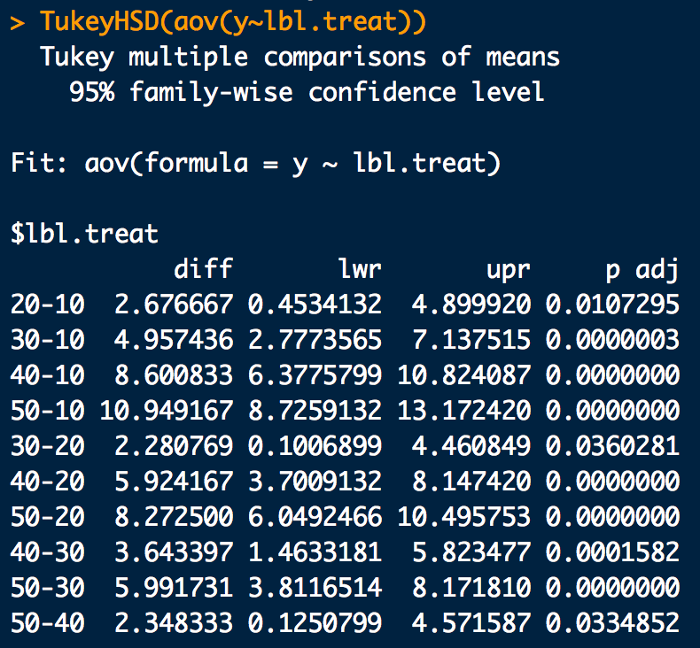
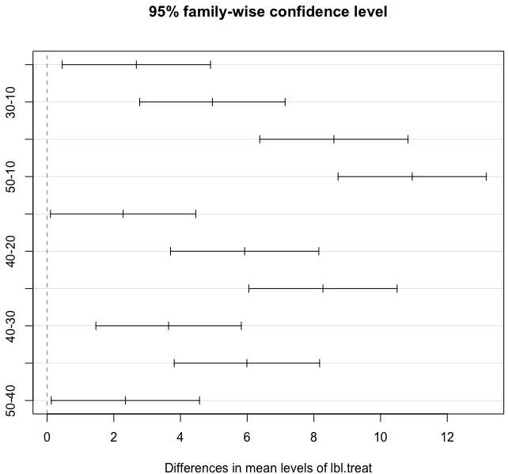
Post Hoc Testing Example

Slide 30
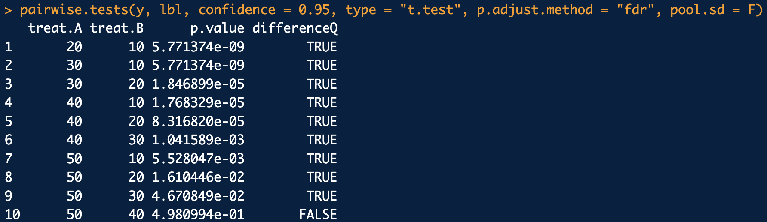
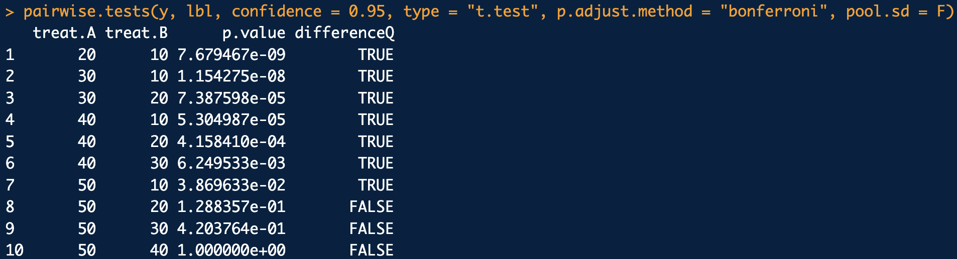
Post Hoc Testing Example
Pairwise t-tests with non-constant variance and fdr p-value adjustment:
Pairwise t-tests with non-constant variance and Bonferroni p-value adjustment:

Slide 31
Non-parametric Post Hoc Testing
For post hoc testing after a non-parametric Kruskal-Wallis test indicates a difference between treatments, non-parametric analogues of TukeyHSD and pairwise t-tests (with p-value adjustment) can be used:
Use pairwise.wilcox.test() or pairwise.tests() in frequtils library for non-parametric pairwise t-test analogues
Use dunn.test() in the dunn.test library for a non-parametric analogue for TukeyHSD

Slide 32
Non-parametric Post Hoc Testing Example
Re-visit the recovered DNA amount data from drinking containers data set.
Re-compute Kruskal-Wallis.
For post hoc testing, follow up with Dunn’s test and pairwise Wilcoxon tests at the 95% level of confidence using both fdr and Bonferonni p-value adjustments.

Slide 33
Non-parametric Post Hoc Testing Example
library(frequtils)
library(dafs)
library(dunn.test)
data(abaz.df)
y <- abaz.df$dna.conc
lbl <- abaz.df$sample
# Quick look at the data
# Data obvioulsy not normal and variances differ
tapply(y, lbl, mean)
boxplot(y ~ as.factor(lbl))
# Kruskal-Wallis:
fit <- kruskal.test(y ~ lbl)
fit
# Non-parametric post hoc testing:
pairwise.wilcox.test(y, lbl, p.adjust.method = "fdr")
pairwise.tests(y, lbl, confidence = 0.95,
type = "wilcox.test", p.adjust.method = "fdr")
dunn.test(y, lbl, alpha=0.01, kw=T, method="bh", list=T, table=F)
pairwise.tests(y, lbl, confidence = 0.95,
type = "wilcox.test", p.adjust.method = "bonferroni")
dunn.test(y, lbl, alpha=0.01, kw=T, method="bonferroni", list=T, table=F)
post_hoc_ex2.R

Slide 34
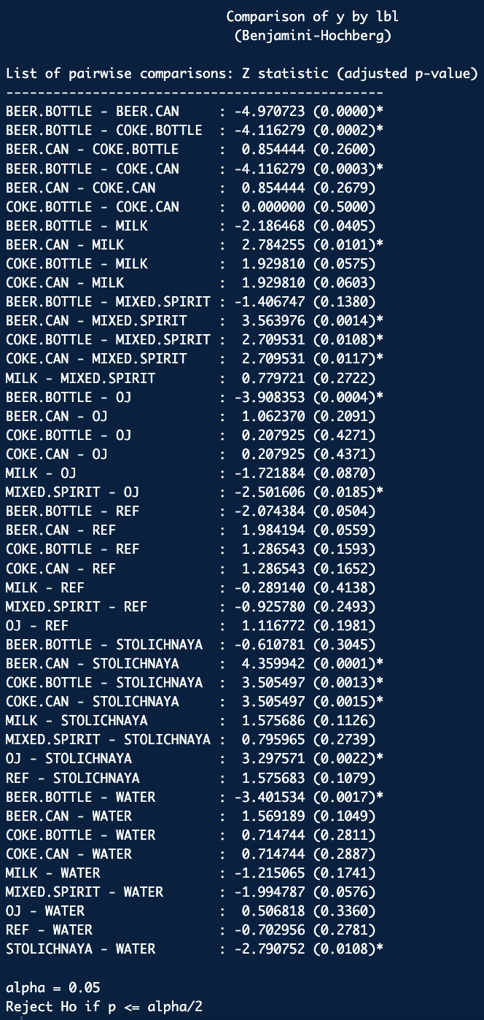
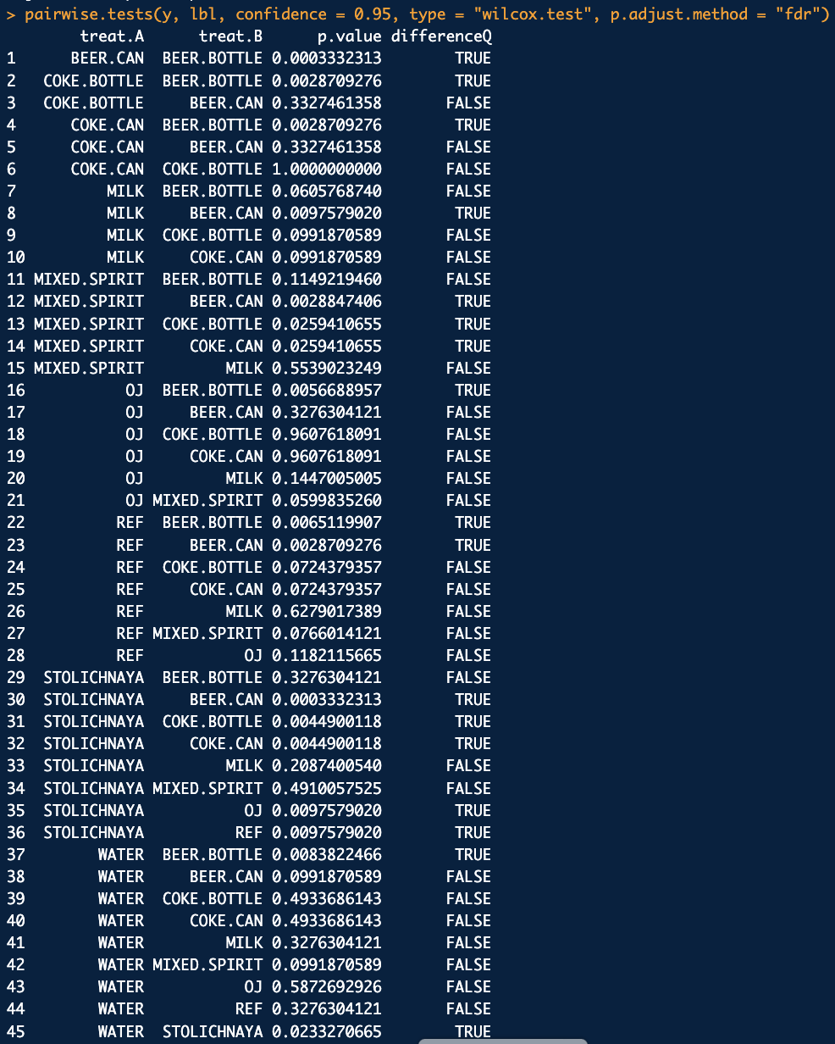
Non-parametric Post Hoc Testing Example
Dunn’s test (w/ fdr):
Pairwise Wilcoxon tests (w/ fdr):

