Slide 1
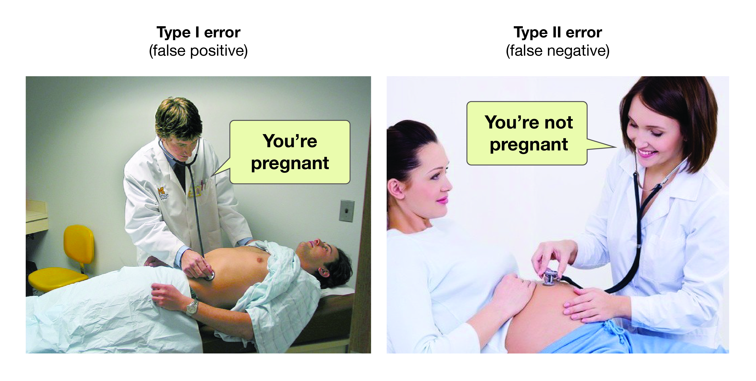
Introduction to Hypothesis Testing
https://opentextbc.ca/researchmethods/

Slide 2
The Basic Idea of Hypothesis Testing
A private tox lab is contracted to check an agency’s employees blood levels for Heroin metabolite.
The agency has a policy that if a mean level greater than 3 nM are detected the employee is subject to summary dismissal and potential prosecution.
Because estimates for the mean concentration can vary from sample to sample, we want to be 95% confident
After extensive QC (quality control), the agency establishes that the sample size should be 20 and that an acceptable specification for the uncertainty in the concentration determination is σ_{X} = 0.5 nM.
Question: Assuming the (mean) concentration of Heroin in an employee’s blood is less than or equal to 3 nM, can we detect evidence in a sample to reject this assumption?
Mathematically: Assume H₀: μ ≤ 3 nM
Is there evidence in a sample to reject this hypothesis?

Slide 3
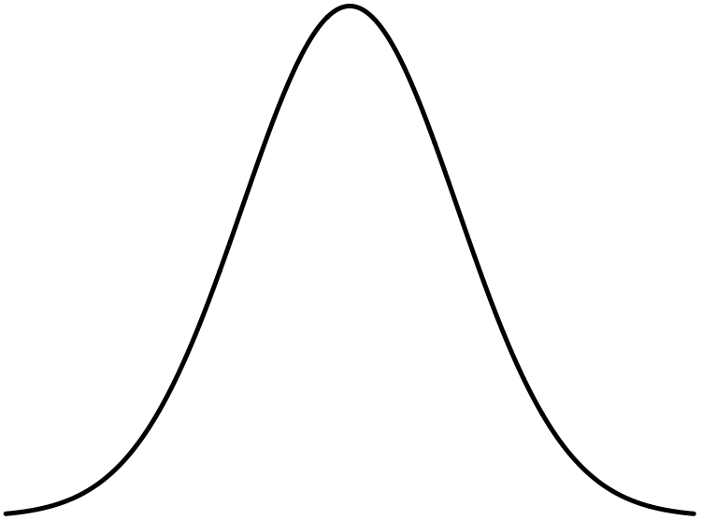
The Basic Idea of Hypothesis Testing
Sampling distribution for a known mean μ and known sd σ_{μ}= is:
Area from -∞ to 1.6 σ_{μ} is 95%
So: IF the mean conc is really less than 3 nM, then we could (95%) plausibly measure it up to here
Obtain a sample:
Measure the conc. 20 times
95% upper limit-CI for H₀: μ ≤ 3 nM
1.6 σ_{μ}
Compute sample average:
μ = 3 nM
Is the employee in trouble????

Slide 4
Hypothesis Testing
A hypothesis is an assumption about a parameter.
Form a hypothesis about the parameter
H₀, the null hypothesis: What we are “assuming” about the parameter. Typically:
Identify the alternative hypothesis, H_{a}
What we want to “prove”
Not really prove, but “reject the Null in favor of”

Slide 5
Hypothesis Testing
So there are two outcomes for a hypothesis test:
“Cannot Reject” H₀ or
“Reject” H₀ in favor of H_{a}
The outcome is quoted at a state level of confidence: (1-α)×100%
The procedure uses the sampling distribution of the parameter as the Null to see if the value of (i.e. the value you measure) is “unlikely” if the Null is true.
“Unlikely” is measured by a p-value for

Slide 6
Hypothesis Testing
Sampling distribution for
The “Null distribution”
p-value is this area.
If p-value is > α, it’s “big”: Don’t reject H₀
It’s “big”, so is “likely” if the Null is true
If p-value is < α, it’s “small”: Reject H₀ in favor of H_{a}
p-value is this area.
It’s “small”, so is “unlikely” if the Null is true.
Get a data set and compute . It falls here.
Get a data set and compute . It falls here.

Slide 7
Hypothesis Testing
Hypothesis testing can go wrong:
1-β is called test’s power
 | H₀ is really true | H₀ is really false
Test rejects H₀ | Type I error. Probability is α | OK
Test accepts H₀ | OK | Type II error. Probability is β

Slide 8
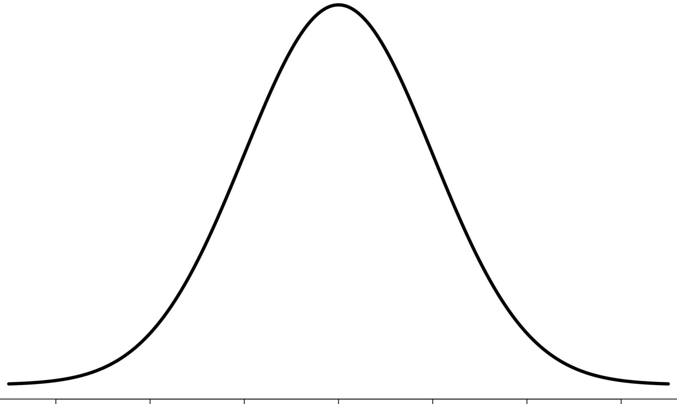
One Sample Hypothesis Testing for the Mean
Sampling distribution for
Compare sample mean to a fixed #
The “Null distribution” for a one sample hypothesis test: Assume μ = a fixed #

Slide 9
One Sample Hypothesis Testing for the Mean

Slide 10
One Sample Hypothesis Testing for the Mean

Slide 11
One Sample Hypothesis Testing for the Mean

Slide 12
One Sample Hypothesis Testing for the Mean
We will use t.test() to take care of the whole process

Slide 13
Example: One Sample Hypothesis Testing for the Mean
Consider again the case of Mr. B. Mayhew with seizure mass (in grams) measurements of:
49.9996, 49.9994, 49.9993, 49.9996, 49.9995, 49.9995,49.9995, 49.9994, 49.9995, 49.9994
Do a 95% confidence hypothesis test to test if (Ha) μ_{mass} ≠ 50.000g (H_{a}).
Do a 95% confidence hypothesis test to test if (Ha) μ_{mass} < 50.000g (H_{a}).
Do a 95% confidence hypothesis test to test if (Ha) μ_{mass} > 50.000g (H_{a}).

Slide 14
Let’s Start by Doing a Hypothesis Test By Hand
Assuming H0: μ_{mass} = 50.000g, test at the 95% level of confidence if there is evidence that Ha: μ_{mass} ≠ 50.000g.
# Two-sided test
# H0:mu=50 vs. Ha:mu!=50
x <- c(49.9996, 49.9994, 49.9993, 49.9996, 49.9995, 49.9995,49.9995, 49.9994, 49.9995, 49.9994)
mu <- 50 # mu for H0
conf <- 0.95 # chosen confidence level
# Ingredients we need for the t-test:
xbar <- mean(x)
sdx <- sd(x)
n <- length(x)
se <- sdx/sqrt(n)
alp <- 1-conf
t.samp <- (xbar - mu)/se # sample's t-statistic
2*pt(q = -abs(t.samp), df = n-1) # (two-sided) p-value (i.e. for H0:mu=50 vs. Ha:mu!=50)
hand_tst_ex1.R

Slide 15
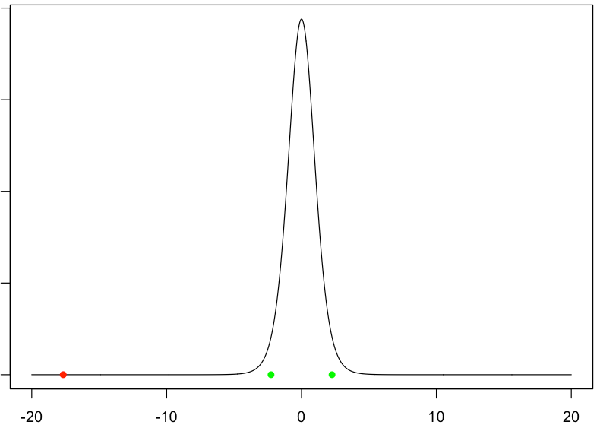
H0: μ = 50 vs. Ha: μ ≠ 50
Null density, H0: p(t | μ = 50)
p-value: What’s the probability of observing a t_{samp} this extreme or more, given H0: μ = 50?
3×10⁻⁸
t_{c}: ±2.262
t_{samp}
t-statistic

Slide 16
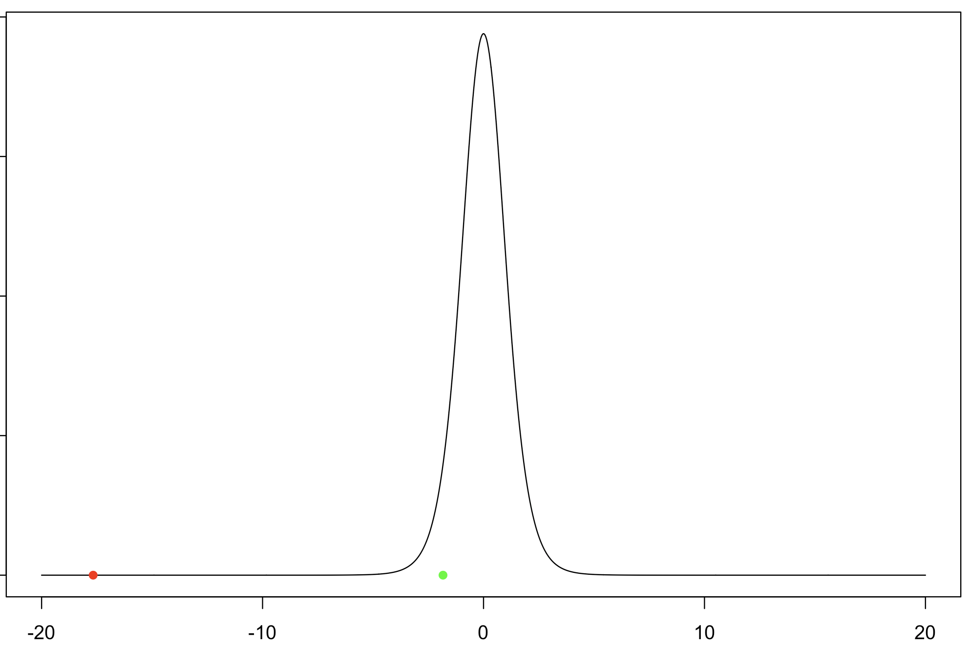
H0: μ ≥ 50 vs. Ha: μ < 50
Null density, H0: p(t | μ ≥ 50)
p-value: What’s the probability of observing a t_{samp} this extreme or more, given H0: μ ≥ 50?
1.4×10⁻⁸
t_{c}: -1.833
t_{samp}
t-statistic
hand_ostl_ex1.R

Slide 17
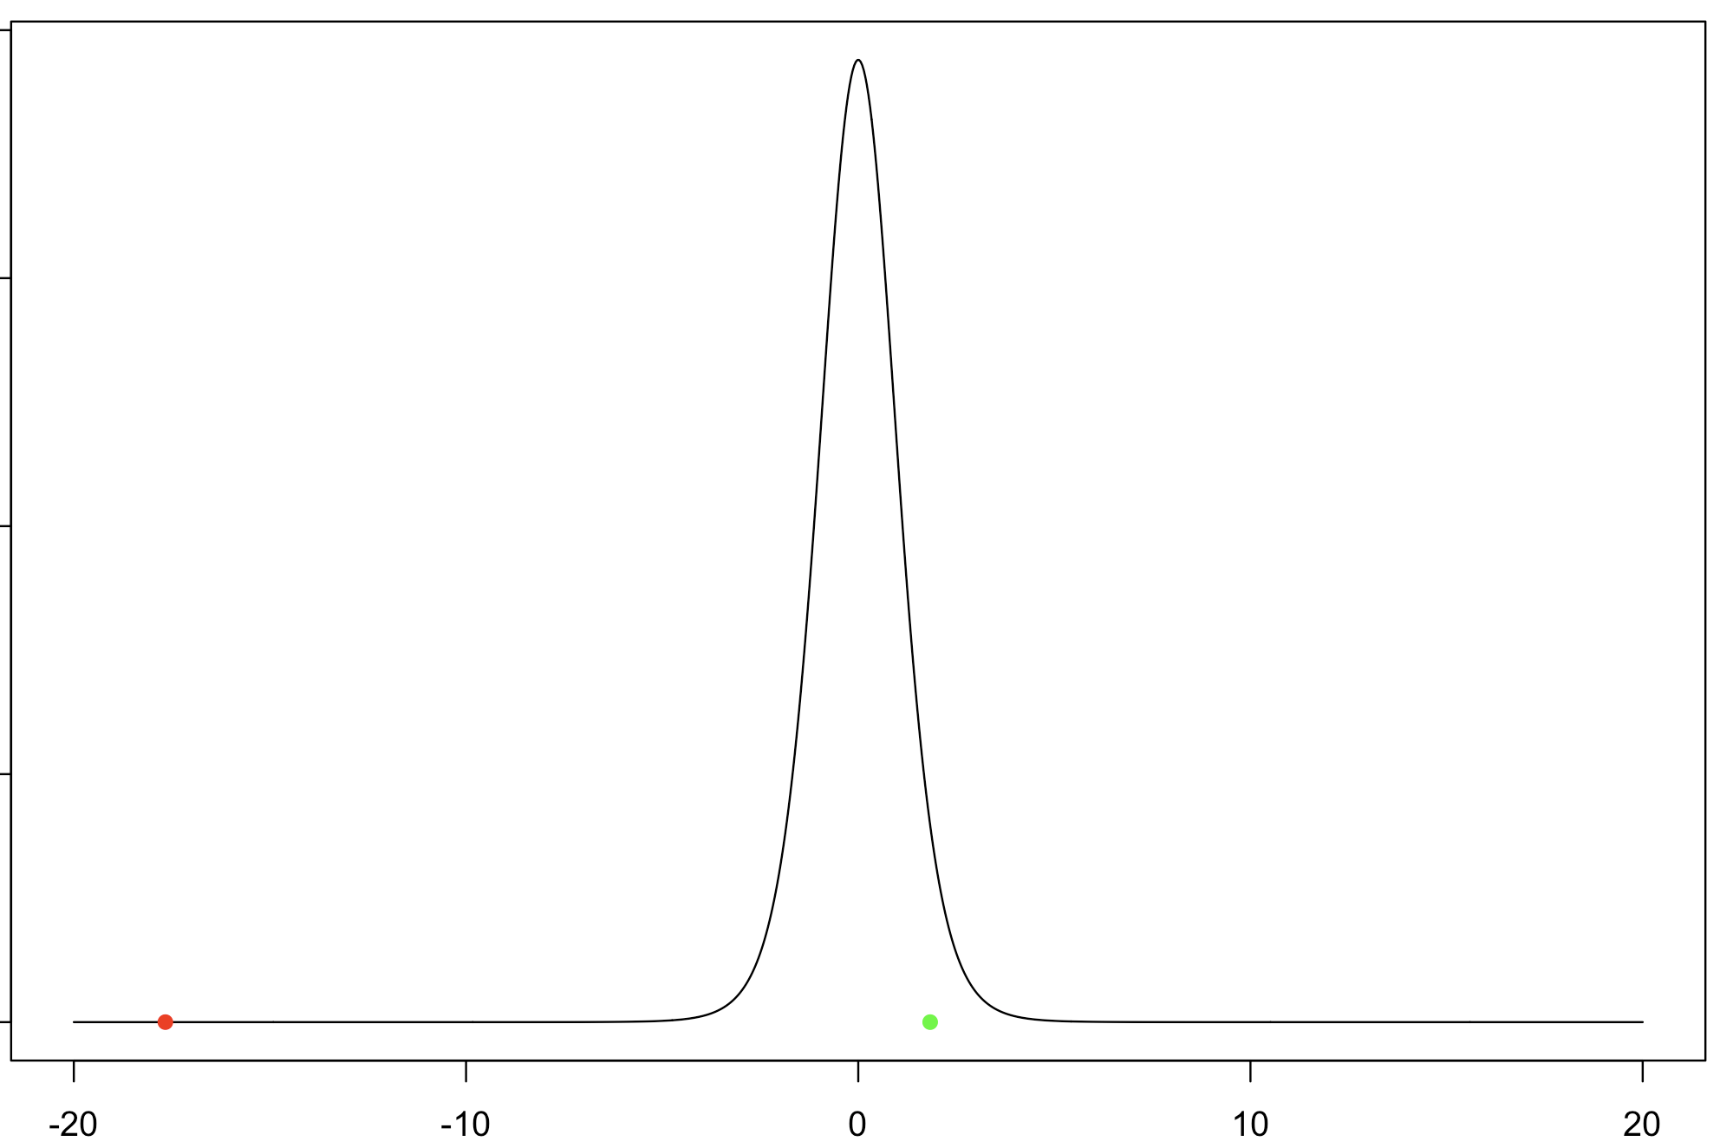
H0: μ ≤ 50 vs. Ha: μ > 50
Null density, H0: p(t | μ ≤ 50)
p-value: What’s the probability of observing a t_{samp} this extreme or more, given H0: μ ≤ 50?
~1
t_{c}: 1.833
t_{samp}
t-statistic
hand_ostu_ex1.R

Slide 18
Example: One Sample Hypothesis Testing for the Mean
# Question of interest: Is the mean mass == 50.000g ?
x <- c(49.9996,49.9994,49.9993,49.9996,49.9995,49.9995,49.9995,49.9994,49.9995,49.9994)
mean(x)
# NULL HYPOTHESIS: mu == 50.000g
# ALTERNATIVE HYPOTHESIS: mu != 50.000g
t.test(x, alternative = "two.sided", mu = 50.000, conf.level = 0.95)
# The meaning of the output for t.test:
# Can we REJECT the NULL HYPOTHESIS? => Is there evidence that the mean mass is not equal to 50.000g?
# p-value = 2.704e-08
#
# So p < 0.05. REJECT the NULL HYPOTHESIS. The data is "unlikely" under the null.
# Another interperitation: If the Null were true, we wouldn't see data like this too often.
# BUT: We CANNOT SAY that the data is more likely under the Alternative hypothesis.
# 95 percent confidence interval:
# 49.99940 49.99954
# This means: given your sample, a set of plausible values for the mean is [49.99940 49.99954], with 95% "plausibility"
hyp_test_twoside.R
Η₀: μ_{mass} = 50.000g
Η_{a}: μ_{mass} ≠ 50.000g

Slide 19
Example: One Sample Hypothesis Testing for the Mean
# Question of interest: Is there evidence that the mean mass is less than 50.000g ?
x <- c(49.9996,49.9994,49.9993,49.9996,49.9995,49.9995,49.9995,49.9994,49.9995,49.9994)
mean(x)
# NULL HYPOTHESIS: mu >= 50.000g
# ALTERNATIVE HYPOTHESIS: mu < 50.000g
t.test(x, alternative = "less", mu = 50.000, conf.level = 0.95)
# The meaning of the output for t.test:
# Can we REJECT the NULL HYPOTHESIS? => Is there evidence that the mean mass is less than 50.000g?
# p-value = 1.352e-08
#
# So p < 0.05. REJECT the NULL HYPOTHESIS. The data is "unlikely" under the null.
# Another interperitation: If the Null were true, we wouldn't see data like this too often.
# BUT: We CANNOT SAY that the data is more likely under the Alternative hypothesis.
# 95 percent confidence interval:
# -Inf 49.99952
# This means: given your sample, the GREATEST value the mean could be is 49.99952, with 95% "plausibility"
hyp_test_less.R
Η₀: μ_{mass} ≥ 50.000g
Η_{a}: μ_{mass} < 50.000g

Slide 20
Example: One Sample Hypothesis Testing for the Mean
# Question of interest: Is there evidence that the mean mass is greater than or equal to 50.000g ?
x <- c(49.9996,49.9994,49.9993,49.9996,49.9995,49.9995,49.9995,49.9994,49.9995,49.9994)
mean(x)
# NULL HYPOTHESIS: mu <= 50.000g Assumes the opposite of what you seek evidence for.
# ALTERNATIVE HYPOTHESIS: mu > 50.000g
t.test(x, alternative = "greater", mu = 50.000, conf.level = 0.95)
# The meaning of the output for t.test:
# Can we REJECT the NULL HYPOTHESIS? => Is there evidence that the mean mass is greater than 50.000g?
# p-value = 1 (Wow!)
#
# So p is not < 0.05. CANNOT REJECT the NULL HYPOTHESIS. The data is "likely" under the null.
# Another interperitation: If the Null were true, we would see data like this often.
# 95 percent confidence interval:
# 49.99942 Inf
# This means: given your sample, the LEAST value the mean could be is 49.99942, with 95% "plausibility”
hyp_test_greater.R
Η₀: μ_{mass} ≤ 50.000g
Η_{a}: μ_{mass} > 50.000g

Slide 21
Sampling Density for Difference of Two Means
Sampling distribution for
The “Null distribution” for a two sample hypothesis test

Slide 22
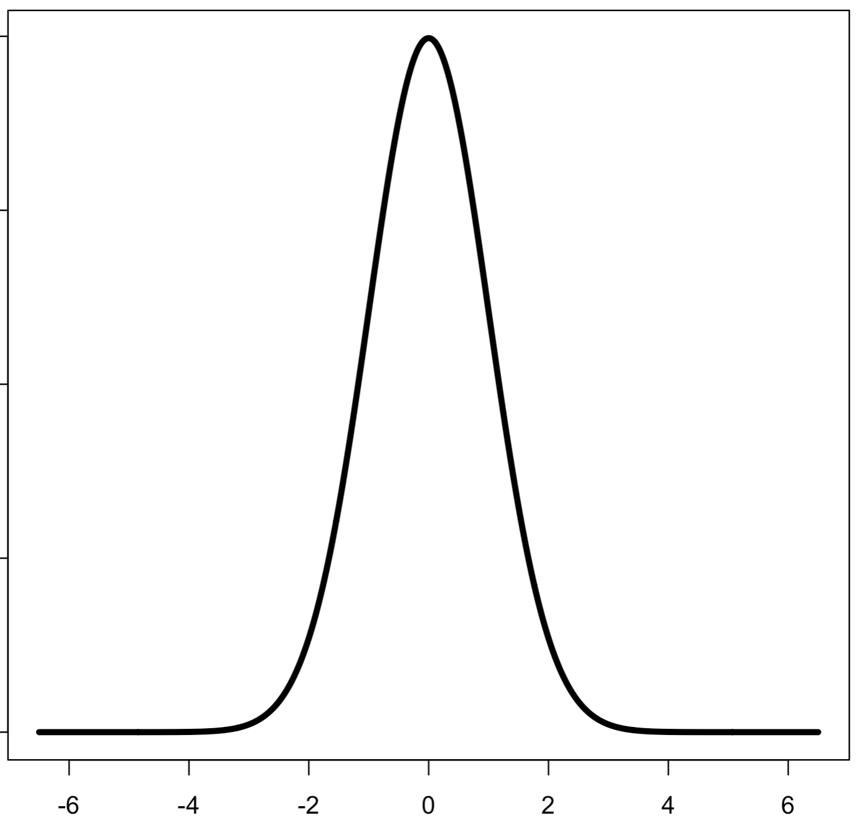
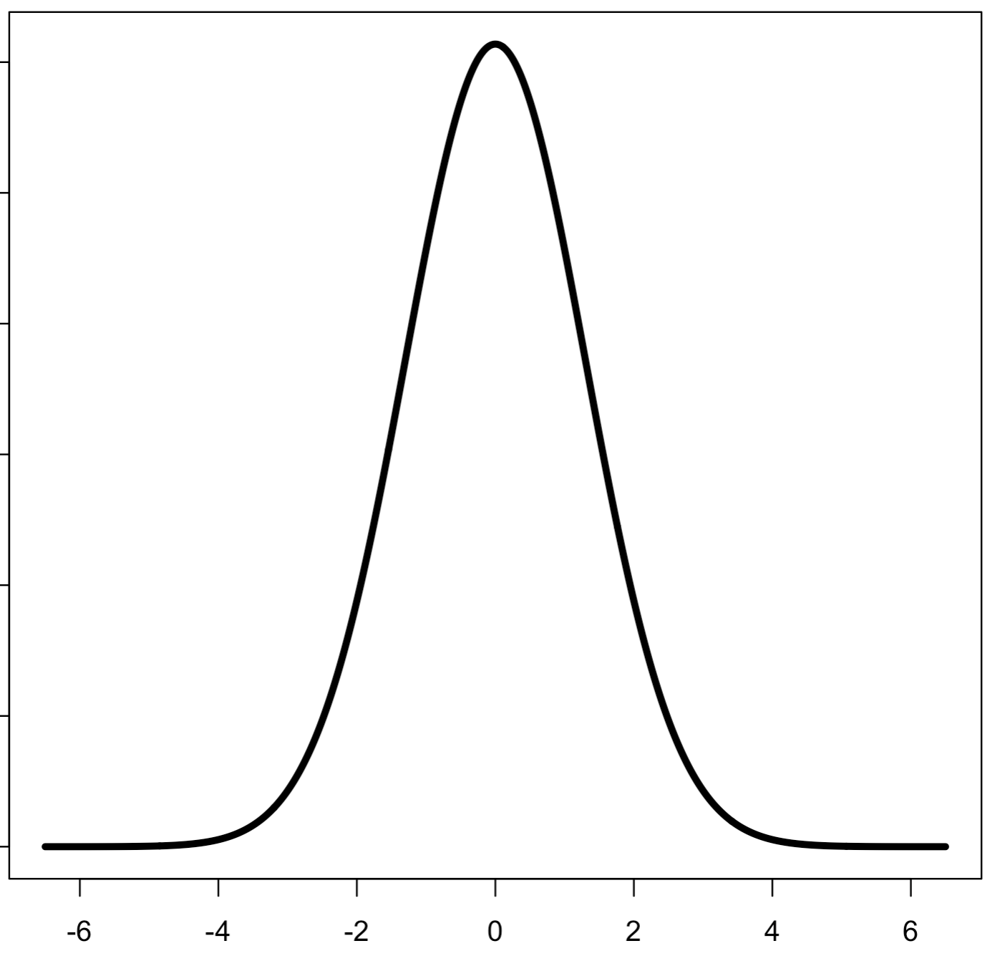
Check sample variances
A
B

Slide 23
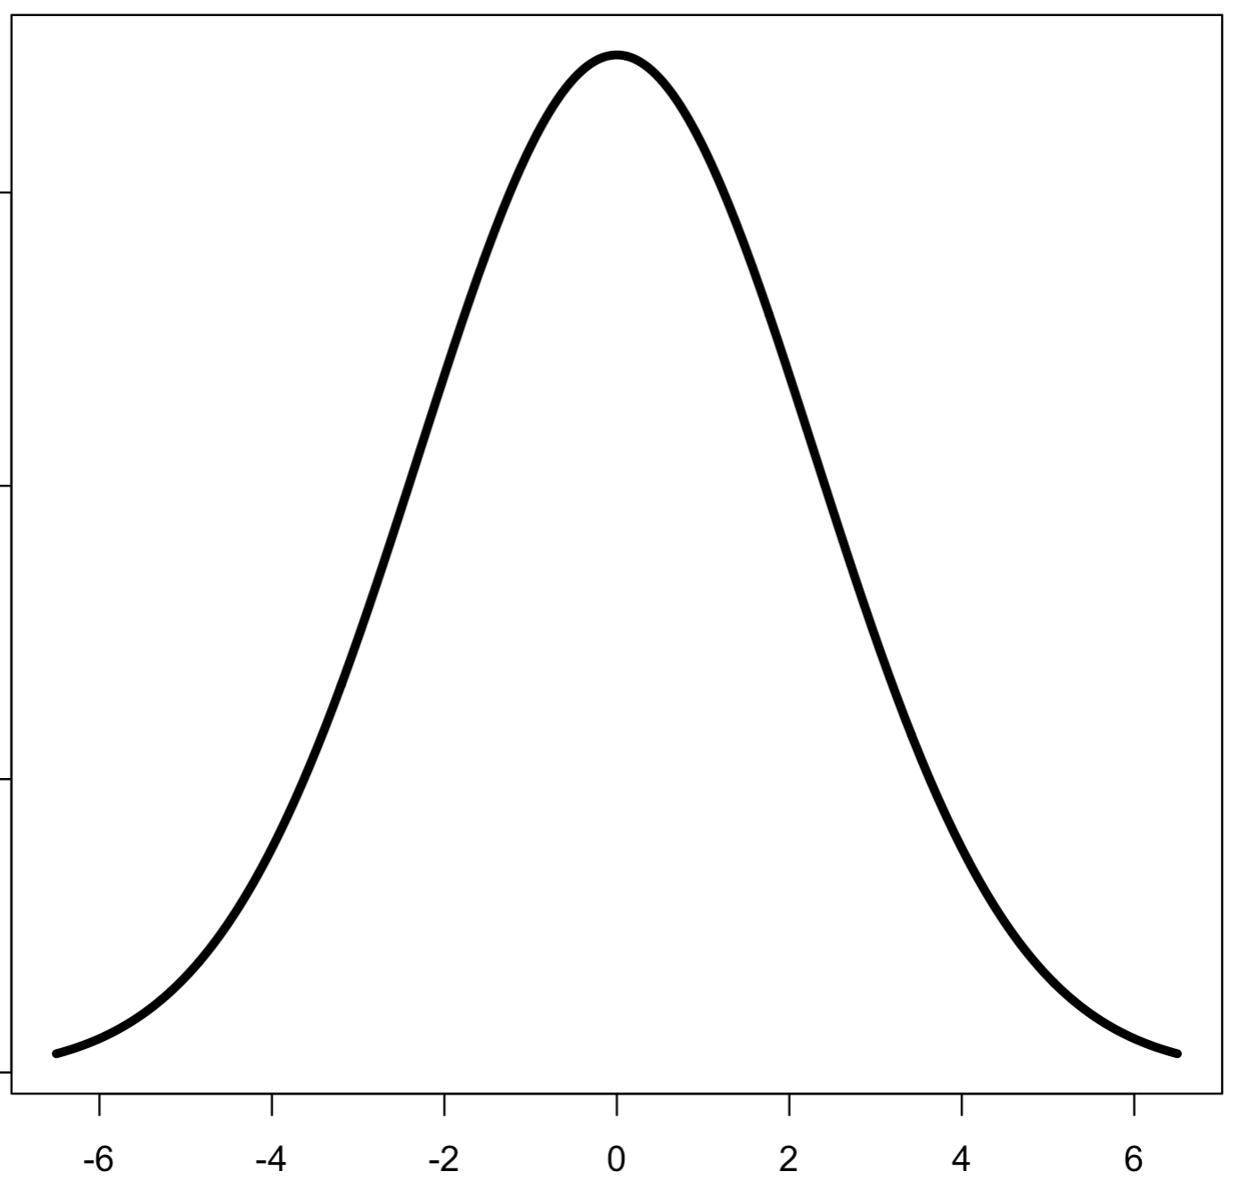
Check sample variances
A
B
Check with var.test()

Slide 24
Example: Two Sample Hypothesis Testing for the Mean
Could the two sets of glass shards be from the same window?
RIs # 1: 1.53419 1.53275 1.53345 1.53267 1.53292 1.53332 1.53464 1.53299 1.53430 1.53550
RIs # 2: 1.53577 1.53606 1.53602 1.53544 1.53618 1.53604 1.53551 1.53572 1.53580 1.53567
Do a two sample 95% confidence hypothesis test to test if : μ_{RI #1} ≠ μ_{RI #2} (H_{a}).

Slide 25
Example: Two Sample Hypothesis Testing for equivalence of Means
# Question of interest: Could the two sets of glass shards be from the same window ?
# NULL HYPOTHESIS: RI1 == RI2 (Side question: Problem here?)
# ALTERNATIVE HYPOTHESIS: RI1 != RI2
# RIs of shards from glass pane 1
RI1 <- c(1.53419, 1.53275, 1.53345, 1.53267, 1.53292, 1.53332, 1.53464, 1.53299, 1.53430, 1.53550)
# RIs of shards from glass pane 2
RI2 <- c(1.53577, 1.53606, 1.53602, 1.53544, 1.53618, 1.53604, 1.53551, 1.53572, 1.53580, 1.53567)
# It helps to look at a box-and-whiskers plot for two-sample tests:
boxplot(RI1, RI2)
# ****Check to see if (H0) variances of the two samples equal = 1
# (i.e. evidence that vars are not equal??):
var.test(RI1, RI2)
# Two sample two sided hypothesis test for equivalence between means:
t.test(RI1, RI2, var.equal = FALSE, alternative = "two.sided", conf.level = 0.95)
hyp_test_two_samp.R
Η₀: μ_{RI #1} = μ_{RI #2}
Η_{a}: μ_{RI #1} ≠ μ_{RI #2}

Slide 26
Paired T-Tests
If two samples come from paired observations, there can be some correlation:
e.g. two experiments made on the same person or object
e.g. two experiments at the same location
e.g. experimental results before and after
The correlation can actually reduce the standard error of difference between the sample means because the variance between the (correlated) sample differences is:

Slide 27
Paired T-Tests
Doing a t-tests which takes into account pairing is easy:
Do a one-sample t-test on the sample differences with respect to the mean difference = 0 (i.e. set mu = 0 in t.test) –or–
Do a two-sample t-test but set paired = T
If you suspect correlation between your samples, it doesn’t hurt to do the t-test as paired.

Slide 28
Example Paired T-Tests
Wear was measured on the shoe soles worn by 10 people. The sole material on the shoes for each person differed in composition. There were two materials examined A and B. The material was randomized between left (L) and right (R) shoes. The data below lists the wear measurements.
Material A:
13.2, 8.2, 10.9, 14.3, 10.7, 6.6, 9.5, 10.8, 8.8, 13.3
Material B:
14.0, 8.8, 11.2, 14.2, 11.8, 6.4, 9.8, 11.3, 9.3, 13.6

Slide 29
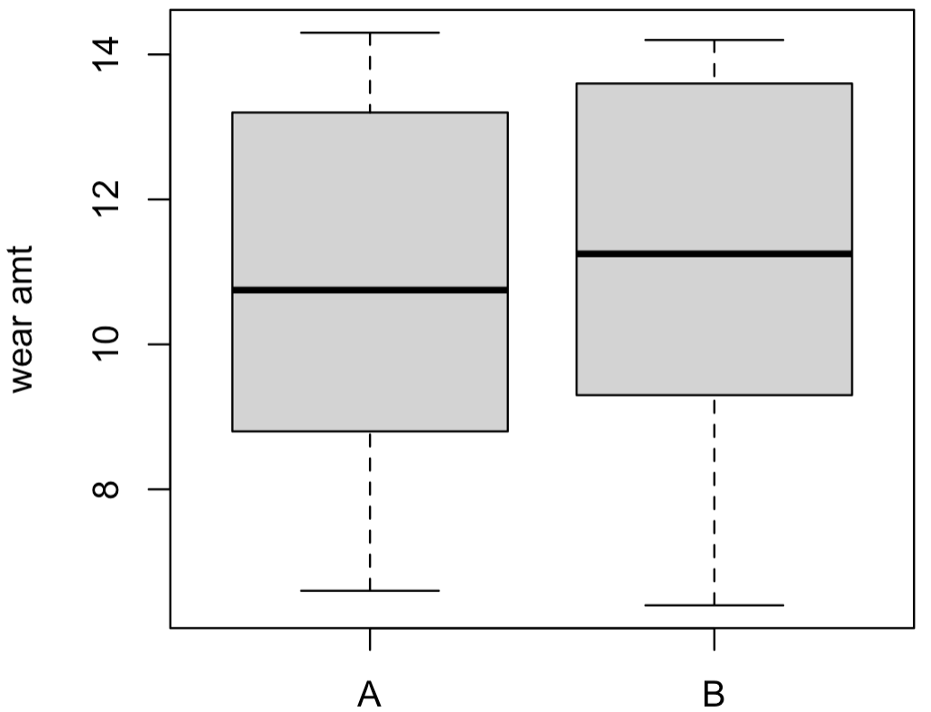
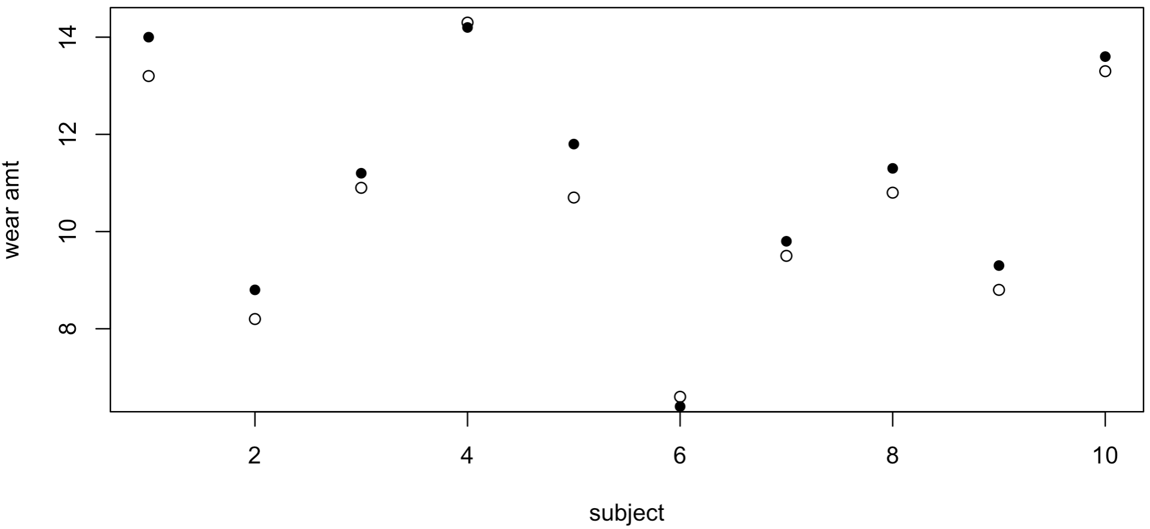
Example Paired T-Tests

Slide 30
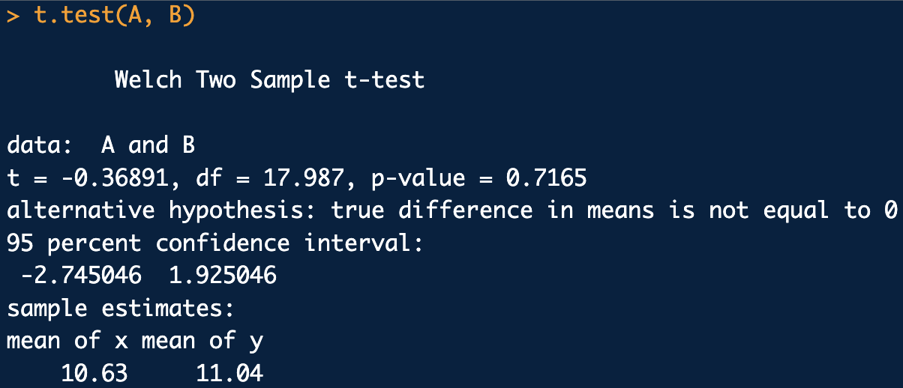
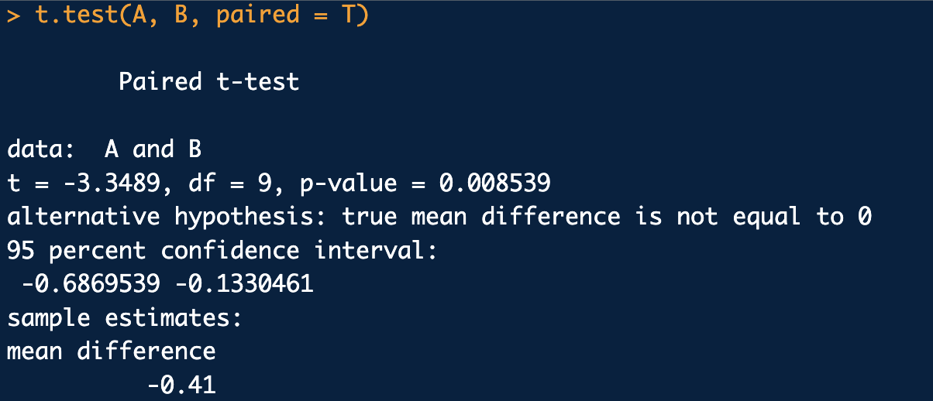
Example Paired T-Tests
A <- c(13.2, 8.2, 10.9, 14.3, 10.7, 6.6, 9.5, 10.8, 8.8, 13.3)
B <- c(14.0, 8.8, 11.2, 14.2, 11.8, 6.4, 9.8, 11.3, 9.3, 13.6)
boxplot(A,B, names = c("A", "B"), ylab="wear amt")
plot(1:10, A, xlab="subject", ylab="wear amt")
points(1:10, B, pch=16)
t.test(A, B)
t.test(A, B, paired = T)
t.test(A-B, mu = 0) # This works for testing paired samples too
hyp_test_two_samp_paired.R

Slide 31
Non-parametric Tests
If it is suspected that the data is not normal and/or the data set is small non-parametric tests can serve as alternatives to (parametric) t-tests
One sample for fixed “location” (mu): one-sample Wilcoxon signed-rank test
Two independent samples for “location” comparison: Mann-Whitney U test (also called Mann-Whitney-Wilcoxon test and Wilcoxon rank sum test)
Two paired samples for “location” comparison: Wilcoxon signed rank test
All of the above are implemented with wilcox.test()

Slide 32
Example Non-parametric Test
Consider the two independent data sets know not to be normally distributed*:
Sample A
0.50, 0.23, 1.10, 2.17, 0.24, 1.08, 0.41, 0.56, 0.89, 1.62, 0.92, 0.94, 0.61, 1.03, 1.28
1.19, 0.97, 1.32, 1.79, 1.50, 1.34, 0.96, 1.29, 1.48, 1.23, 0.88, 1.09, 1.03
Sample B
Perform a two-sample t-test to compare their mean.
Perform a two sample Mann-Whitney U test to compare their location
Discuss the differences
*The samples are from two different Weibull dist.

Slide 33
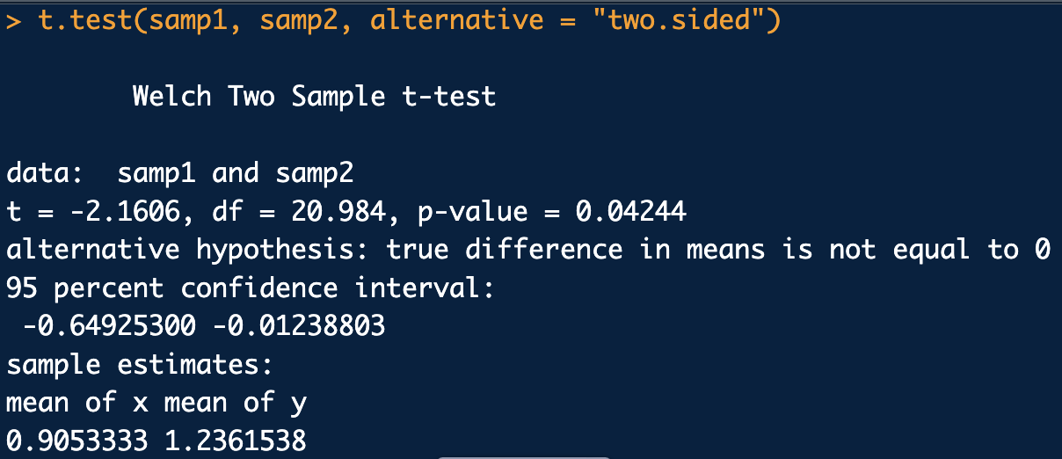
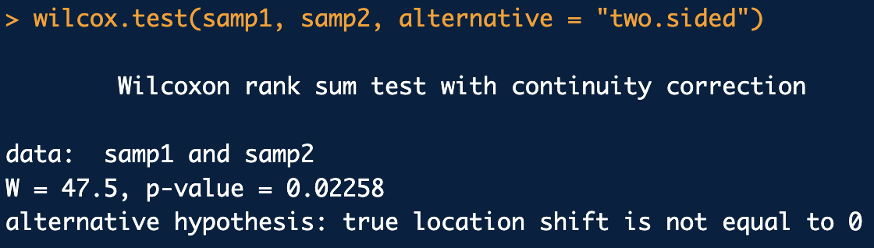
Example Non-parametric Test
A <- c(0.50, 0.23, 1.10, 2.17, 0.24, 1.08, 0.41, 0.56, 0.89,
1.62, 0.92, 0.94, 0.61, 1.03, 1.28)
B <- c(1.19, 0.97, 1.32, 1.79, 1.50, 1.34, 0.96, 1.29, 1.48,
1.23, 0.88, 1.09, 1.03)
boxplot(A, B)
# Parametric Test:
var.test(A, B, alternative = "two.sided")
t.test(A, B, alternative = "two.sided", var.equal = F)
# Non-parametric Test:
wilcox.test(A, B, alternative = "two.sided")
hyp_test_nonparametric.R

Slide 34
Hypothesis Tests for
Categorical/Discrete Variables
A contingency is the outcome of a discrete random variate.
Contingency table: collection of counts of outcomes for discrete random variates:
 | Factor A
Factor B | Outcome A₁ | Outcome A₂ | Outcome A₃ | Row (Marginal) Totals
Outcome B₁ | C₁₁ | C₁₂ | C₁₃ | r₁
Outcome B₂ | C₂₁ | C₂₂ | C₂₃ | r₂
Outcome B₃ | C₃₁ | C₃₂ | C₃₃ | r₃
Outcome B₄ | C₄₁ | C₄₂ | C₄₃ | r₄
Col (Marginal) Totals: | c₁ | c₂ | c₃ | N, Grand Total

Slide 35
Hypothesis Tests for
Categorical/Discrete Variables
For contingency tables, we are usually interested in uncovering if there is a relationship between the factors
The simplest relationship model to hypothesize is the independence model
Under this model we want to predict the cell counts assuming the factors are statistically independent (i.e. the expected counts under the model)
Next, we test if there is evidence in the data that the observed counts (O) significantly deviate from the expected counts (E) under the independence model

Slide 36
Chi-Squared Test
If there are no cells with zero counts and the sample size is fairly large, then the sampling distribution for the statistic below is a chi-squared distribution under the Null (independence) hypothesis:
Under H₀: factors are independent
Called the Pearson chi-squared test

Slide 37
Example Chi-Square Test
In 1013 samples of dust trace evidence, the number of occurrences of samples that have dog hair and cat hair are listed in the contingency table below:
 | Cat Hair?
Dog Hair? | Yes | No | Row (Marginal) Totals
Yes | 144 | 210 | 354
No | 260 | 399 | 659
Col (Marginal) Totals: | 404 | 609 | 1013 (Grand Total)
Test the independence of Dog hair/Cat hair occurrence in the trace evidence dust samples using a chi-squared test.

Slide 38
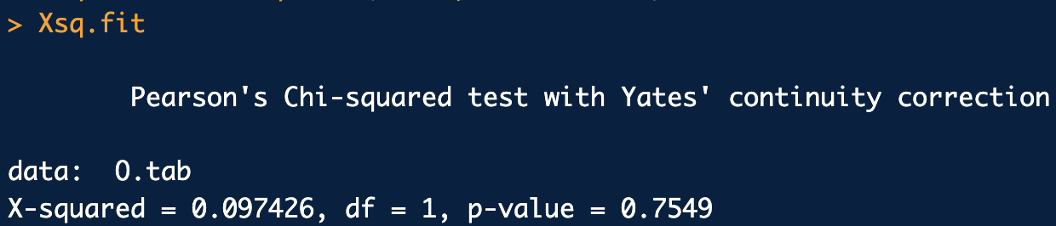
O.tab <- rbind(
c(144,210),
c(260,399)
)
N <- sum(O.tab)
r.tots <- rowSums(O.tab)
c.tots <- colSums(O.tab)
E.tab <- outer(rowSums(O.tab), colSums(O.tab))/N
E.tab
# Chi-square test:
Xsq.fit <- chisq.test(O.tab, correct = T)
Xsq.fit
chi_square_test.R
no evidence against assumption of independence

Slide 39
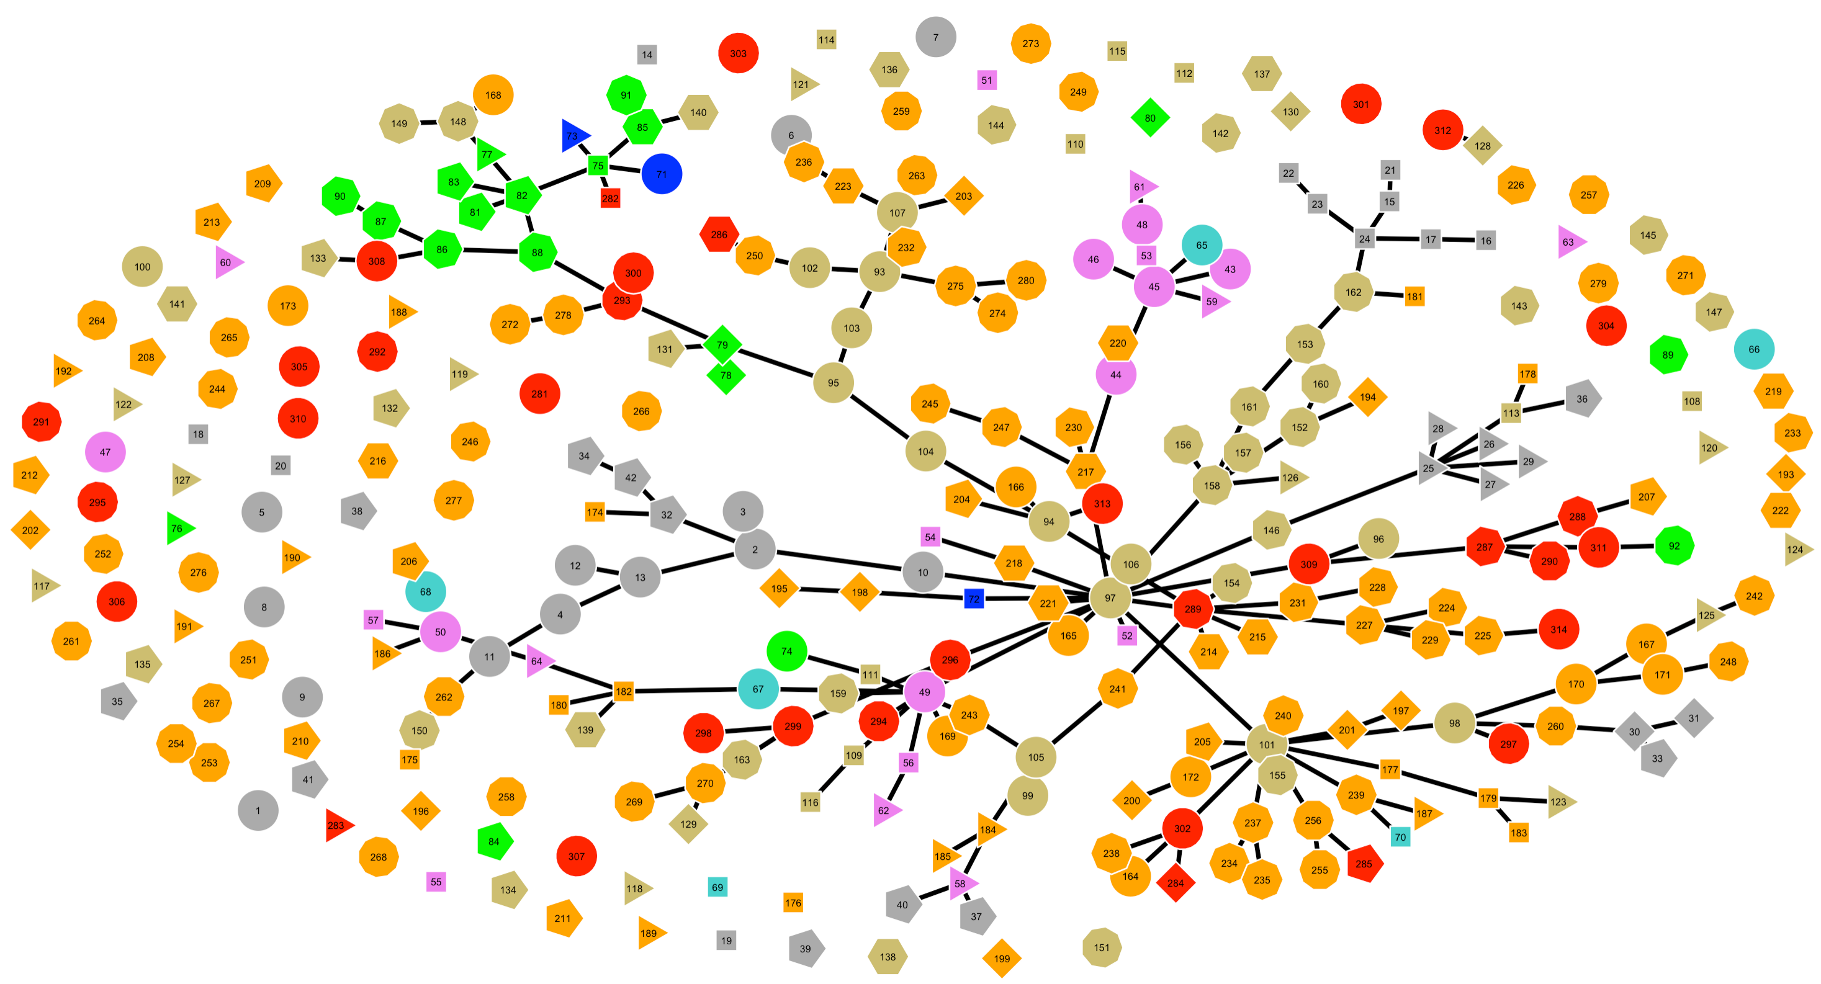
A Distribution of Materials Components in Household Dust
color =Class,
shape=Subclass in Class
number=Attribute, Subclass, Class code
Grey = animal hair
Violet = human hair natural
Turquoise = human hair treated
Blue = inorganic fibers
Green = inorganic grains
Dark Yellow = natural fibers
Orange = synthetic fibers
Red = various

Slide 40
Fisher Exact Test
If there are cells with zero counts and/or the sample size is small, use the the Fisher exact tests
Small cell counts cause the χ² statistic to be over-estimated.
To get around this we can calculate the probability of any pattern of counts in the contingency table (2 × 2 only shown):
This is the probability of a count pattern occurring by chance alone, given the factors are independent.
There is no problem handling 0 and small cell counts

Slide 41
Aside: A parameterization of a 2 × 2 Table and the Hypergeometric Distribution
Note the relationships (parameterization) in a 2 × 2 table:
 | Factor A
Factor B | Outcome A₁ | Outcome A₂ | Row (Marginal) Totals
Outcome B₁ | C₁₁ | r₁ − C₁₁ | r₁
Outcome B₂ | c₁ − C₁₁ | r₂ − (c₁ − C₁₁) | r₂
Col (Marginal) Totals: | c₁ | r₁ + r₂ − c₁ | r₁ + r₂
This is the parameterization of the hypergeometric distribution in R:
dhyper(C11, r1, r2, c1)
is also the hypergeometric distribution, but parameterized in terms of cell counts

Slide 42
Fisher Exact Test
The Fisher exact test works by computing the probability of the observed contingency table and the probabilities of any rearrangement of cell counts that gives a lower probability.
The sum of the observed table probability and any that are smaller (while maintaining the row and column totals) gives the p-value of the test
It can become extremely tedious determining all the contingency tables to do the above p-value calculation
We let R do it for us using fisher.exact()

Slide 43
Fisher Exact Test Example
Genes are characteristic of specific cell types. Genes are also associated with biological signaling pathways. Knowing the genes’ cell type (e.g. cancer) and signal pathway association can be used to treat disease.
50 genes are found to be characteristic of a type of tumor cells. 30 genes are involved in a suspected signaling pathway causing the tumor.
The following contingency table is observed:
 | Gene in pathway?
Gene in tumor? | Yes | No
Yes | 10 | 40
No | 30 | 0
Determine if there is evidence for an association between the tumor genes and the signaling pathway using a Fisher exact test

Slide 44
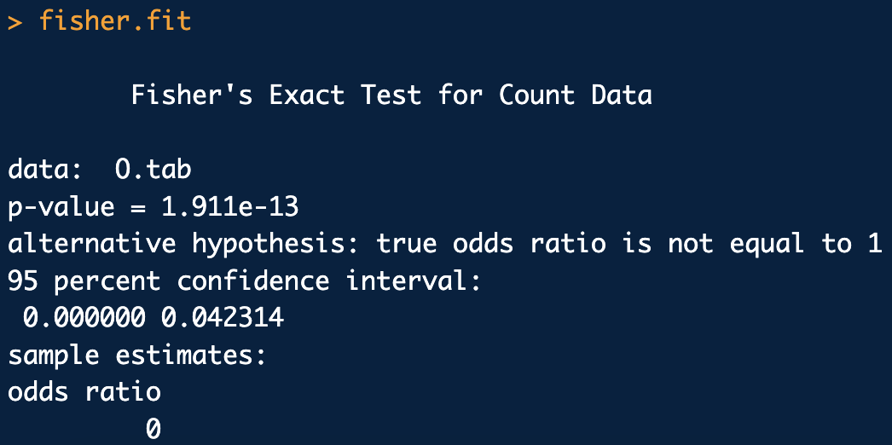
Fisher Exact Test Example
O.tab <- rbind(
c(10,40),
c(30,0)
)
# Fisher exact test:
fisher.fit <- fisher.test(O.tab)
fisher.fit
fisher_test.R
evidence for an association

Slide 45
Hypergeometric Sampling for Seized Materials
Seizures of "consignments" with potentially illegal "items" represent finite populations of size N.
To analyze such seizures (say a box full of pills) a model for sampling with out replacement is needed.
Hypergeometric distribution fits the "sampling without replacement" situation*:
Parameters:
N: Total number of items (e.g., packages) in the seizure.
p_{pop}: fraction of illegal items expected or claimed to be in the seizure
m: Number of "known" positives in seizure, adjusted (= M₀ = ceiling(N*p_{pop}) - 1) so that fraction of illegal items expected or claimed to be in the seizure is at least p_{pop}. cf. ENFSI doc section 4 and pp.11 Table 2.
n: Number of "known" negatives in seizure = N-m.
k, Sample Size. Number of items actually tested.
Data:
x: Number of observed positives in the sample.
*Parameterization in R is m, n, k; but usually well think in terms of N, p_{pop}, k.

Slide 46
Hypergeometric Hypothesis Test
H0: The observed number of drug-containing items in the seizure is less than X, X < x_{obs}.
I.E. the fraction of drug-containing items in the seizure, π is less than the expected or claimed proportion to be in the seizure, π < p_{pop}.
Ha: The observed number of drug-containing items in the seizure is greater than or equal to X, X ≥ x_{obs}.
I.E. the fraction of drug-containing items in the seizure is greater than or equal to the expected or claimed proportion to be in the seizure, π ≥ p_{pop}.
This is just a one-sided test for H0:π < p_{pop} vs. Ha:π ≥ p_{pop} but a little extra care must be taken because the Null distribution is discrete:
p-value:
dhyper(x = x, m = m, n = n, k = k) + 1-phyper(q = x, m = m, n = n, k = k)

Slide 47
Example: Hypergeometric Hypothesis Test
A seizure of 200 blister packs is made. Each pack has 10 pills. A random sample of 4 blister packs was chosen. All pills in the sample are found to contain MDMA.
Initially assuming that (H0) 80% of the pills in the seizure contain MDMA, test the hypothesis that at least 80% of the pills in the seizure are positive for MDMA at the 95% level of confidence*.
*ENFSI 2012 doc on the HYPERGEOMETRIC SAMPLING TOOL

Slide 48
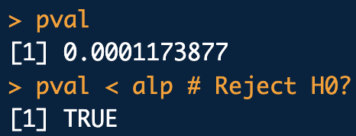
N <- 200*10 # population (seizure) size
p.pop <- 0.8 # fraction of pills claimed to be positive for MDMA to be in the seizure
conf <- 0.95
alp <- 1-conf
k <- 4*10 # Sample Size. Number of items actually tested.
x <- k # Number of MDMA-containing pills found in the sample of size k.
K <- ceiling(N*p.pop) # Expected number of MDMA-containing pills in the seizure | p.pop
m <- K-1 # Guarantees Ha p.pop > 0.8 ENFSI doc Section 4, pp.11 Table 2.
n <- N-m
# H0: p.pop <= 0.8 vs. Ha: p.pop > 0.8
# p-value:
# Pr(pi > p.pop | N, m, k) = Pr(X>=x | N, m, k) = Pr(X=x | N, m, k) + Pr(X>x | N, m, k)
pval <- dhyper(x = x, m = m, n = n, k = k) + 1-phyper(q = x, m = m, n = n, k = k)
pval
pval < alp # Reject H0?
hypergeometric_hyp_test_ex1.R

Slide 49
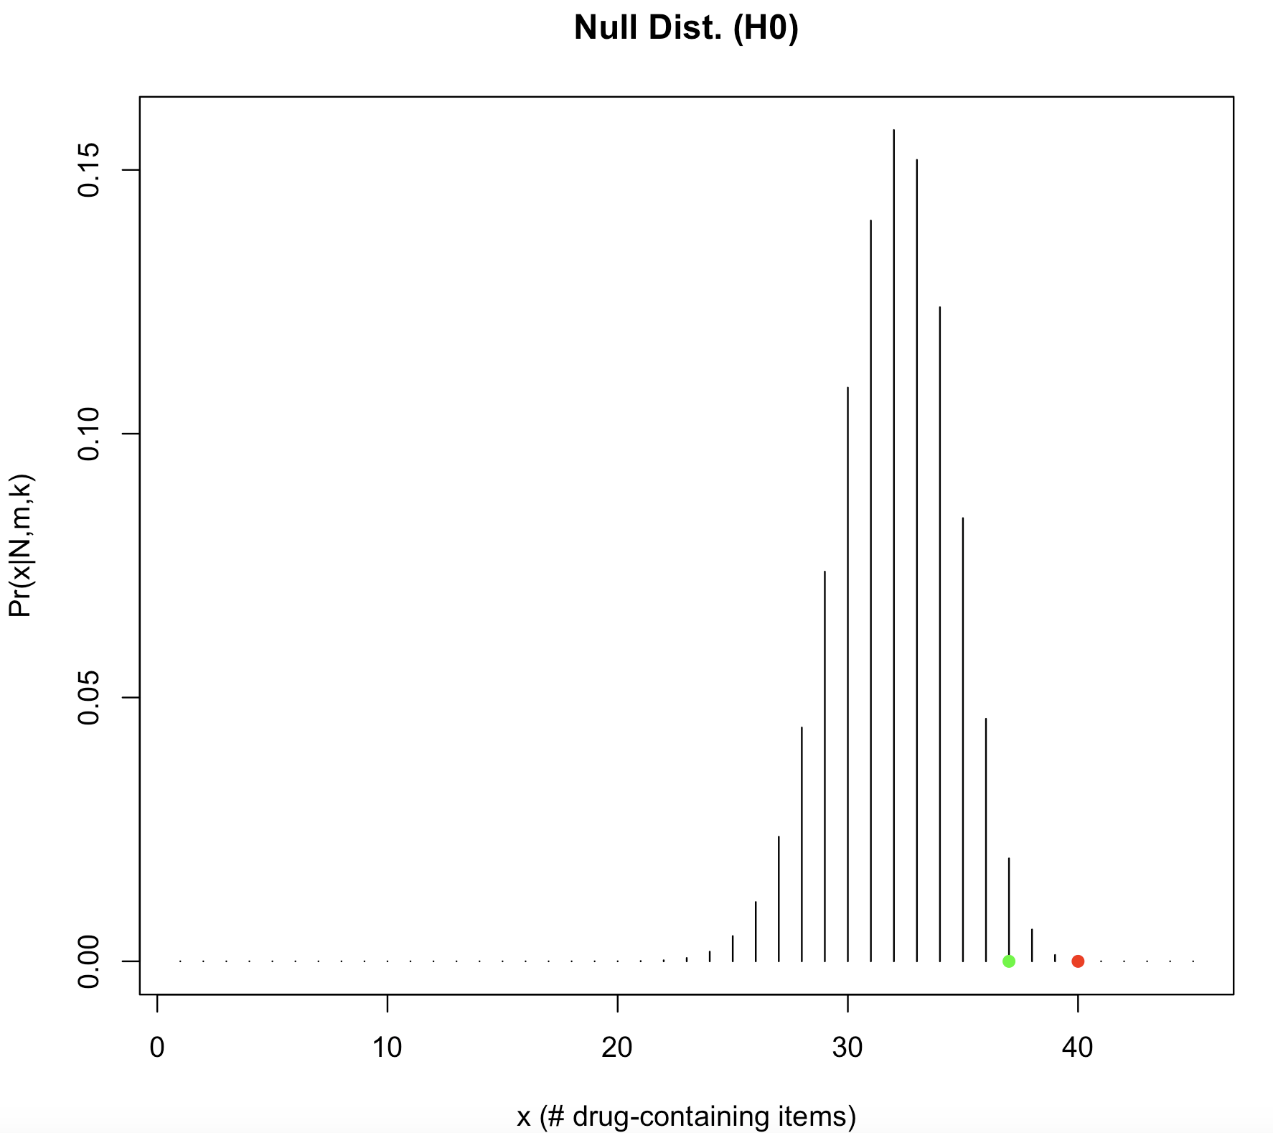
H0 parameters:
N =2000 pills
p_{pop}= 80% or less of seizure positive for MDMA
implies m = 1599 pills or less pos. for MDMA
n = 401 pills or less neg. for MDMA
k = 40 pill sample
obs. num. of MDMA pos. pills out of sample size k=40
Sample:
x = 40 pills obs. pos. for MDMA
Cut off for H0: p_{pop} ≤ 80%
@ 95% confidence

Slide 50
How Hypergeometric Sampling is Really
Used in Practice*
In a seizure of size N, what sample size is needed to reach a stipulated minimum confidence level if the fraction of drug-containing items in the seizure is at least p_{pos}?
Assume no negatives are observed, i.e. x=k.
Assume one negative is observed, i.e. x=k-1.
Use N=100, 95% confidence, p_{pop} at least 70%
*ENFSI doc on HYPERGEOMETRIC SAMPLING TOOL 2012
*ENFSI/SWGDRUG doc on HYPERGEOMETRIC SAMPLING TOOL 2016

Slide 51
N <- 100 # Population (N): Total number of items (e.g., packages) in the seizure.
p.pos <- 0.7 # Fraction of drug-containing items expected or claimed to be in the seizure
conf <- 0.95 # Stipulated minimum confidence level
alp <- 1-conf
k <- 1:100 # Sample Sizes
x <- k-1 # Number of positives in sample
K <- ceiling(N*p.pos) # cf. ENFSI doc pp.11 Table 2
m <- K-1 # The number of drug-containing items expected to garantee at least p.pos
n <- N-m
# p-values and effective confidences:
#Pr(X>=x) = Pr(X=x) + Pr(X>x)
pvals <- dhyper(x = x, m = m, n = n, k = k) + 1-phyper(q = x, m = m, n = n, k = k)
eff.confs <- (1-pvals)*100
# Tabulate:
conf.tab <- data.frame(k, eff.confs)
conf.idx <- which(eff.confs >= conf*100)[1]
conf.tab
conf.tab[conf.idx,]
# Plot:
# Significance plot:
plot(k, pvals, typ="h", xlab="sample size (k)", ylab="p-value",
main=paste0("H0: pi <= ", p.pos, " vs. Ha: pi > ", p.pos))
abline(a = alp, b=0) # Significance threshold line
# Confidence plot:
plot(k, eff.confs, typ="h", xlab="sample size (k)", ylab="Conf. (%)",
main=paste0("H0: pi <= ", p.pos, " vs. Ha: pi > ", p.pos))
abline(a = conf*100, b=0) # Confidence threshold line
hypergeometric_samp_size_ex1.R

Slide 52
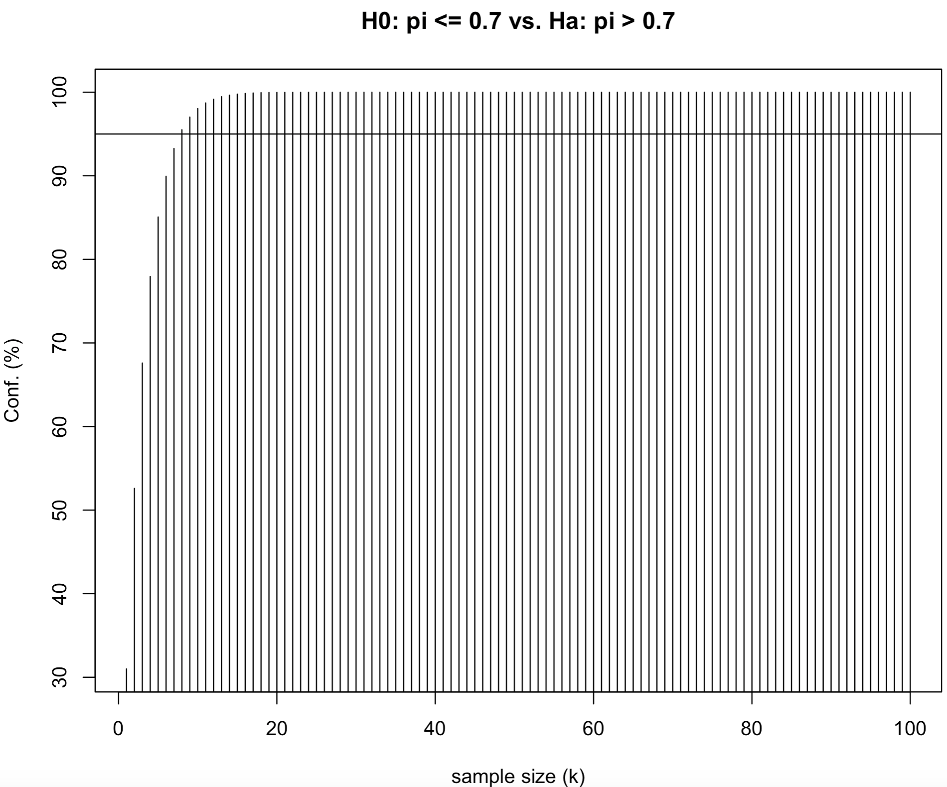
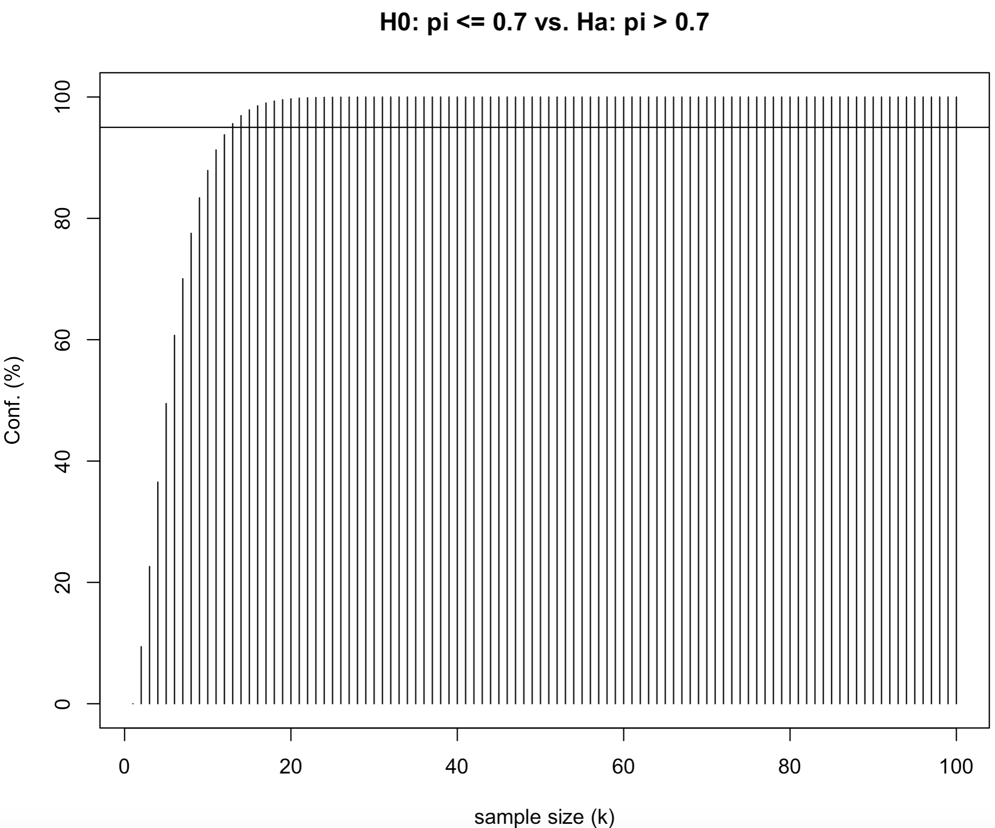
≥ 95% confidence
≥ 95% confidence
sample size should be k=8
sample size should be k=13
N=100
p_{pop}=70%
No negatives in sample observed
N=100
p_{pop}=70%
One negative in sample observed

Slide 53
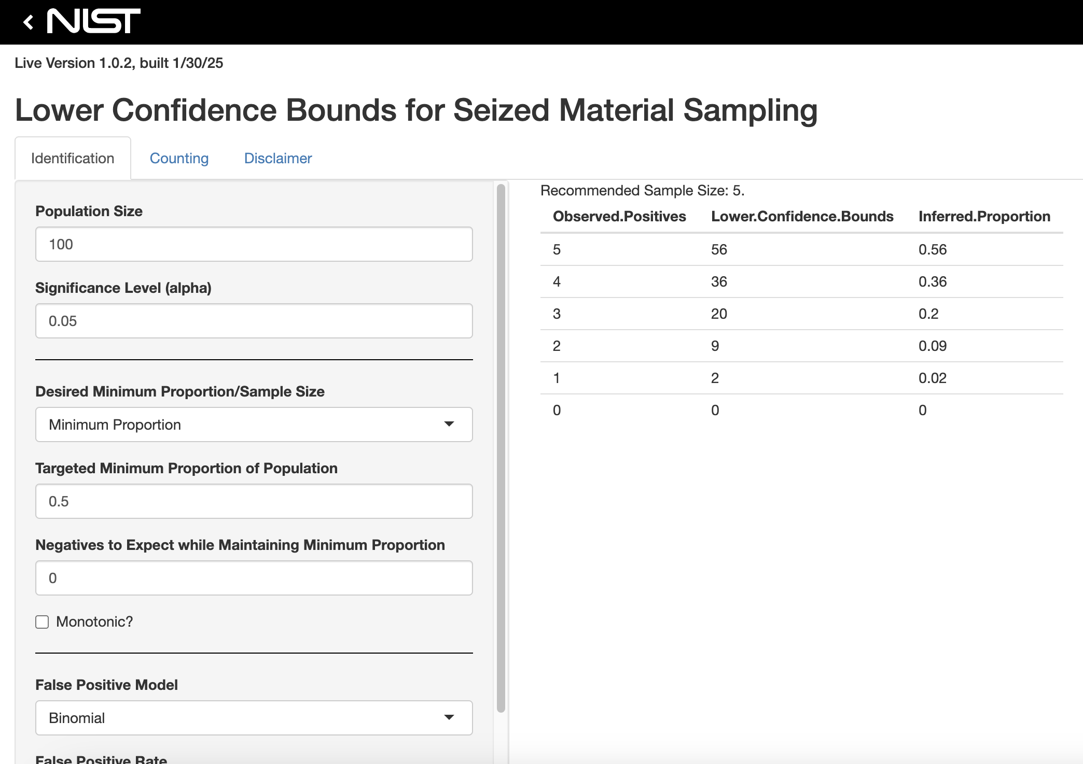
NIST Shiny-app for seized material sampling
https://pages.nist.gov/seized-material-sampling-app/
Documentation
SWGDRUG

Slide 54
Bootstrap Hypothesis Testing
Remember: for just about any parameter, you can try to obtain bootstrapped sampling distribution
We can use it to do hypothesis testing too
For a given sample x:
Choose a test and corresponding formula for test statistic
NOTE: Choosing can be a little tricky however….
Compute a bootstrap (Null) sampling distribution for test statistic using non-parametric or parametric bootstrap

Slide 55
Bootstrap Hypothesis Testing
Compute test statistic on original sample, and see where it falls on bootstrap sampling distribution
As usual, if falls on the tails, its less likely under the Null
Choose a confidence level and see where falls with respect to CI using quantile()
If falls within CI: cannot reject H₀
If falls outside of CI: reject H₀ in favor of H_{a}
Can also compute the achieved significance level (ASL, “bootstrap p-value”):
and
/or
Depending on which tail falls on and H₀
lower tail
upper tail

Slide 56
One Sample Bootstrap Hypothesis Test
For a one-sample hypothesis test for a specific fixed (Null) mean μ_{Null}:
Given a sample of size n, x, shift the mean to the Null value μ_{Null}:
sample mean
mean to compare sample mean to
Bootstrap out of x_{Null} and compute the mean for each iteration:
This gives an approximate Null sampling distribution for μ_{Null}
Examine where falls with respect to the bootstrapped Null :
One-tail upper ASL:
One-tail lower ASL:
*Two-tail ASL:
*Sampling dist. should be fairly symmetric for this to make sense

Slide 57
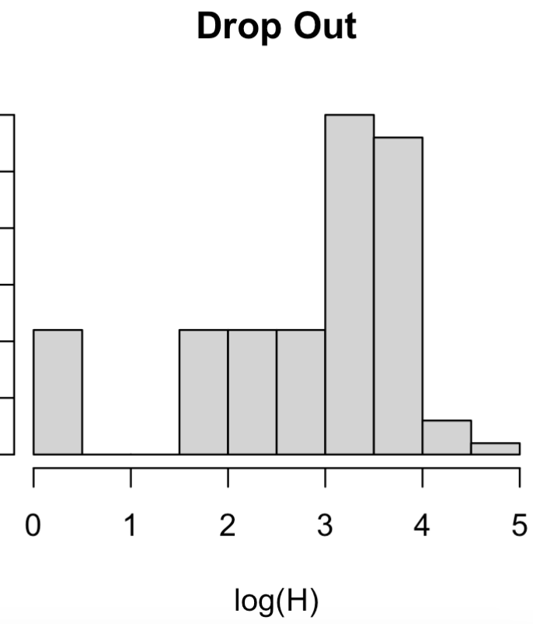
Example One Sample Bootstrap
Hypothesis Test
Consider the log “peak info” of DNA drop-out across eleven loci related to a 2012 study of DNA profiling peak drop-out rates. We can pull them out of the dropout.info dataset with:
library(frequtils)
data(dropout.info)
all.dat <- do.call(rbind, dropout.info)
lhp <- all.dat[all.dat[,3] == 0, 2] # Peak Present
lhd <- all.dat[all.dat[,3] == 1, 2] # Peak Drop out
hist(lhp)
hist(lhd)
bhyp_test_one_samp.R

Slide 58
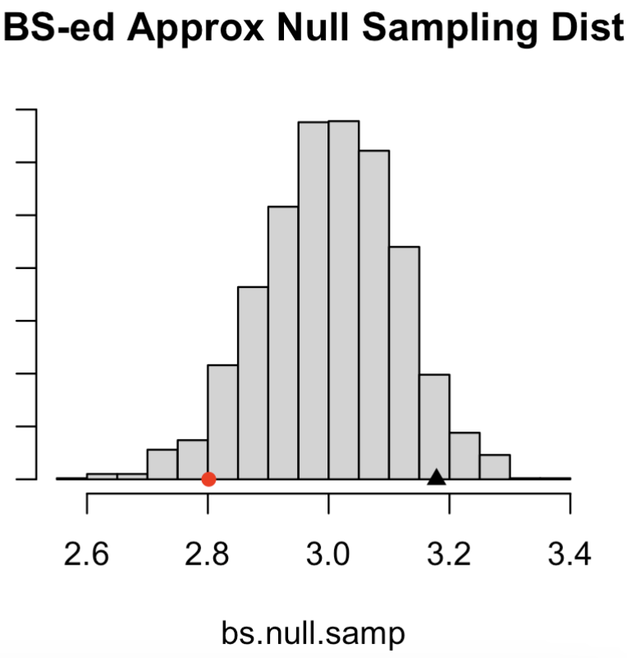
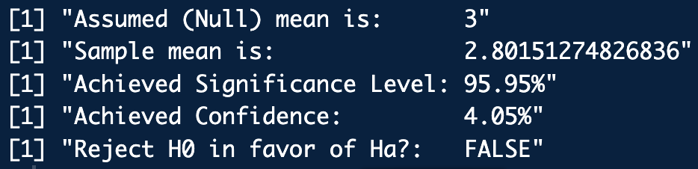
Example One Sample Bootstrap
Hypothesis Test
Do a one sample bootstrapped hypothesis test assuming H₀: the mean drop out [log(H)] is ≤ 3 or if there is evidence to support H_{a}: mean drop out [log(H)] is > 3.
library(frequtils)
# One sample bootstrapped hypothesis test:
one.sample.bs.hyp.for.mean(lhd, mu.null = 3, confidence = 0.95, alternative = "greater")
bhyp_test_one_samp.R

Slide 59
Two Sample Bootstrap Hypothesis Test
For two paired samples, use the same philosophy as a paired t-test
Do a bootstrap hypothesis test on the sample differences with respect to the mean difference = 0 (i.e. μ_{Null} = 0)
For two independent samples the most straightforward bootstrap hypothesis test is to check for the equality between the two sample populations:
A special case of this is the test for equality between means

Slide 60
Two Sample Bootstrap Hypothesis Test
To check for the equality between the two independent sample populations:
Given independent samples x and y, (of lengths n and m) compute the sample mean of the combined sample:
Shift the sample means to be :
These comprise our Null sample which we’ll bootstrap out of.
Bootstrap out of x_{Null} and y_{Null} to obtain
For each bootstrap sample and compute:
Examine where falls with respect to

Slide 61
Example Two Independent Sample Bootstrap
Hypothesis Test
Consider the financial transactions fraud scores data with data("transactions"):
a. Visualize the data
b. Perform a two sample bootstrap hypothesis test to assess the (Null) hypothesis of equivalence between the not fraud and fraud population of scores

Slide 62
Example Two Independent Sample Bootstrap
Hypothesis Test
library(frequtils)
data("transactions")
boxplot(suspicion.score~transaction.type, data = transactions)
nfs <- transactions[transactions$transaction.type == "not.fraud", 1]
fs <- transactions[transactions$transaction.type == "fraud", 1]
hist(fs)
hist(nfs)
boxplot(fs, nfs)
two.sample.bs.hyp.for.pop.compare(A.samp = fs, B.samp = nfs,
confidence = 0.95, alternative ="two.sided")
bhyp_test_two_samp.R

Slide 63
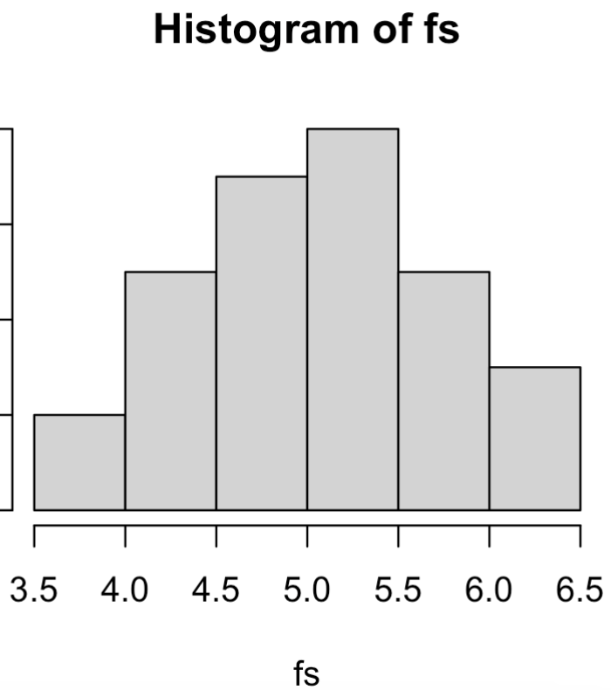
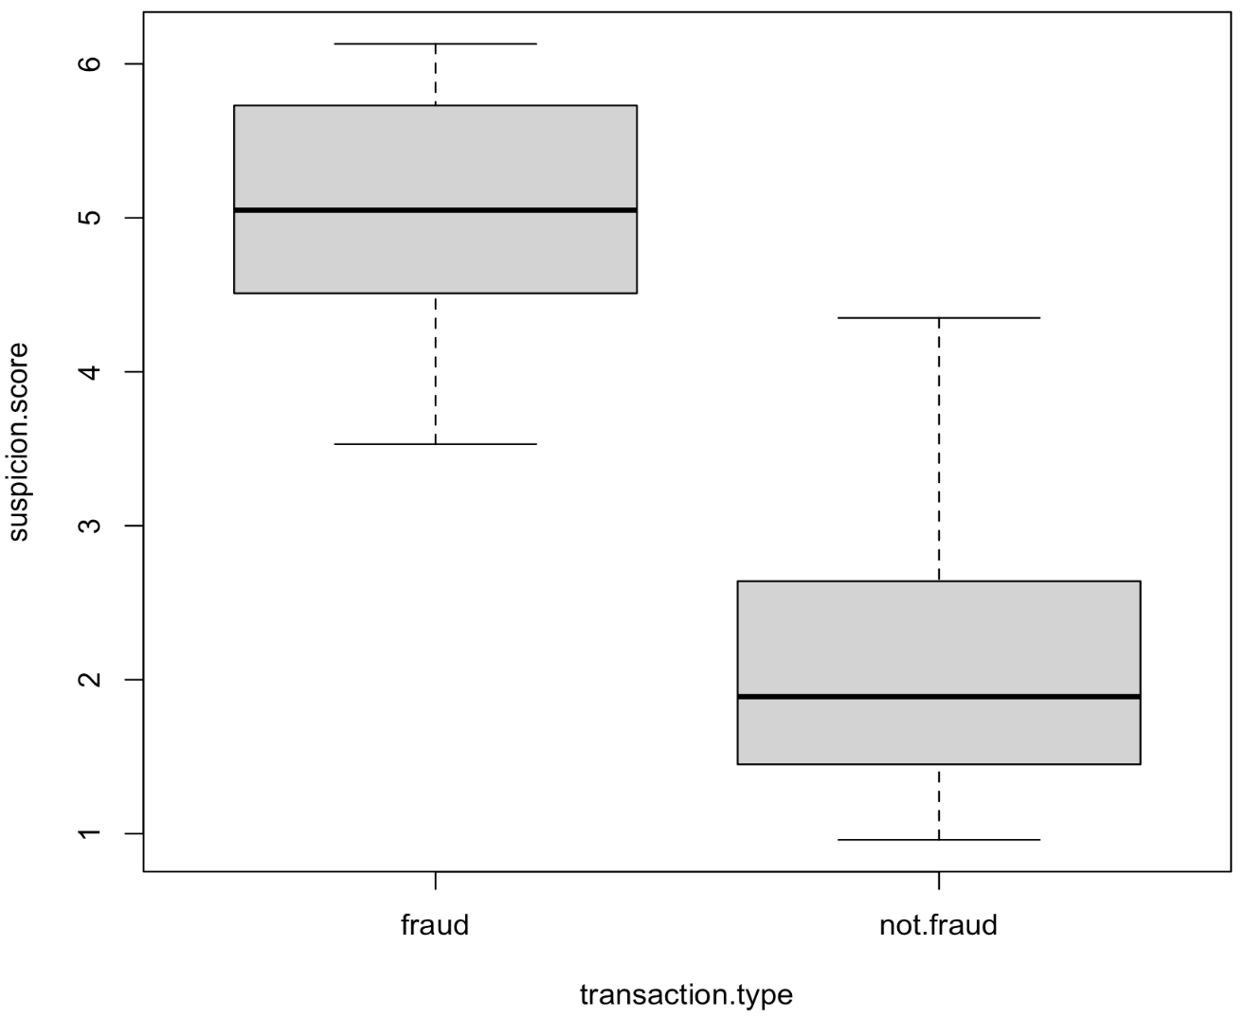
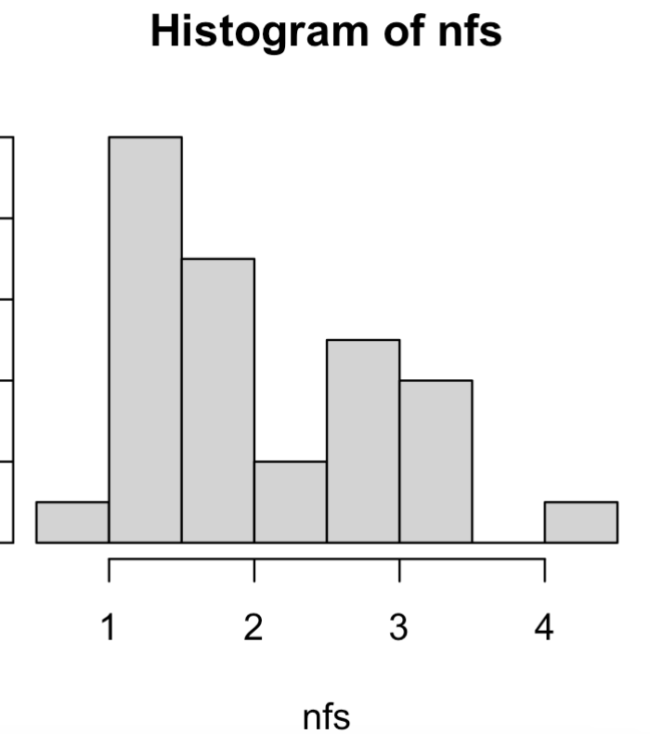
Example Two Independent Sample Bootstrap
Hypothesis Test

Slide 64
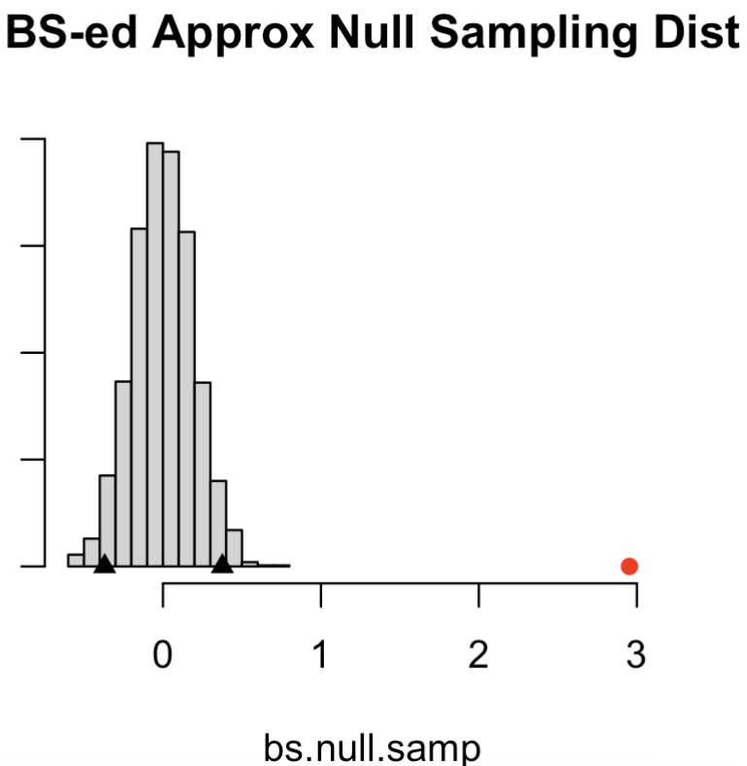
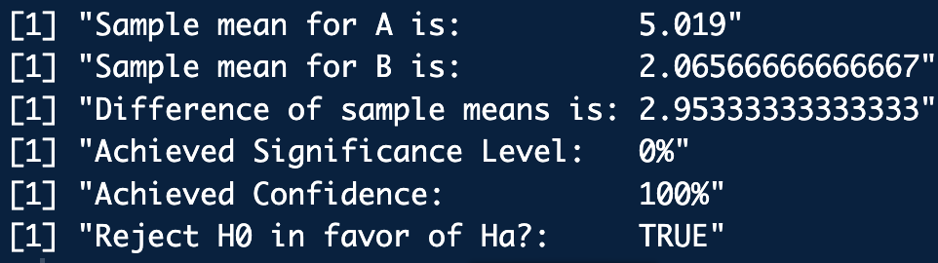
Example Two Independent Sample Bootstrap
Hypothesis Test

