Slide 1

Linear Regression

Slide 2
Linear Regression
Remember the equation of a line:
As scientists, we find it an irresistible temptation to put a straight line though something that looks like it needs one…
How do we do this in a principled, systematic way??

Slide 3
Linear Regression
Simple univariate linear model:
response variable
error
explanatory or predictor
variable
intercept
regression coefficients
In simple linear regression, error is assumed to be normally distributed with mean 0 and sd σ_{𝜖}
Estimated from the data

Slide 4
Linear Regression
y
Side note:
x

Slide 5
Method of Least Squares
Determine the “best” fit by:
Assume line must pass though , also denoted
Minimize the sum of squared errors, SSE (unexplained variation)
To do this, we need the (sum squares) ingredients:
total response variation

Slide 6
Method of Least Squares
observed response
is minimized when:
− predicted response
slope
intercept

Slide 7
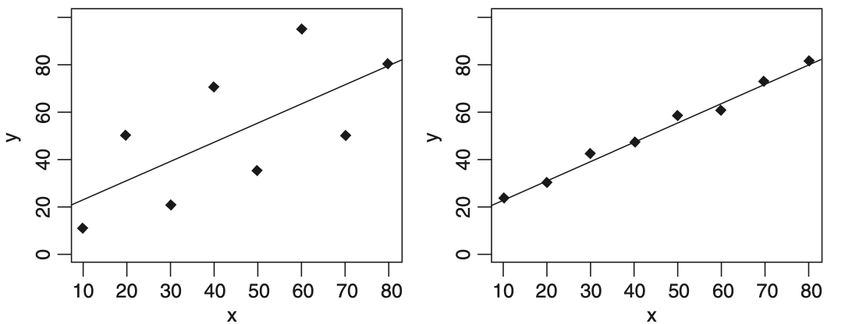
Data Scatter and Correlation
Problem: Data with different scatter can have the same slope and intercept
Crawley 2007
line fits “better”
line fits “worse”
The difference is in the degree of scatter
Measure of degree of fit

Slide 8
Data Scatter and Correlation
Degree of scatter (also called coefficient of variation and r-squared) is given by:
total variation of responses
unexplained variation
variation explained by model (explained variation)
fraction of variation in responses explained by model
Correlation coefficient:

Slide 9
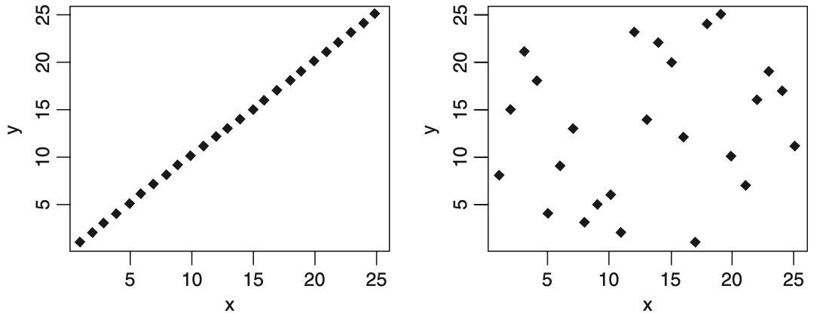
Data Scatter and Correlation
Crawley 2007
r² = 1
r² = 0.001
100% of variation in response explained by model
0.1% of variation in response explained by model

Slide 10
Components of Variance
A more formal way to characterize variations in the model is with their variances, ’s
Total variation is explained variation + unexplained variation:
It turns out that a quick way to compute unexplained variation if we have the other sum-squares laying around is:
unexplained variation
with
explained variation

Slide 11
Components of Variance
Next let’s turn these variations into variances by dividing by their degrees of freedom (dof)*:
model (regression) variance
error variance
unexplained variance
residual variance
overall variance
*dof: number of independent pieces of information needed to determine a statistic

Slide 12
Components of Variance
Now let's organize all this information into a table:
Analysis of Variance Table
variance explained by the model
unexplained variance
Variation Source | Sum of Squares | DOF | Variance (Mean Squares) | F-ratio | p-val
Model (Regression) | SSR | 1 | MSR | MSR/MSE
Error (Unexplained) | SSE | n − 2 | MSE
Total | SSY | n − 1 | MSY
model:error variance ratio
p-value to gauge:
H₀: the slope = 0 (most of the variation is unexplained)
H_{a}: the slope ≠ 0 (most of the variation is explained by the model)

Slide 13
Explained Variance
Now that we have the components of the total variance, we can formulate an adjusted version of r²:
fraction of variance explained by model
fraction of variation explained by model (biased up)

Slide 14
Hypothesis Tests for Regression Coefficients
The uncertainty in the slope and intercept parameter estimates can also be separately assessed by referencing their standard errors:
s.e. for slope
s.e. for intercept
and noting the null sampling distribution(s) for these parameters can be written in terms of a t-statistic with n-p-1 d.f.:
Using the above, we have the hypothesis test for regression coefficients:
H₀: the coefficient β = 0
H_{a}: the coefficient β ≠ 0

Slide 15
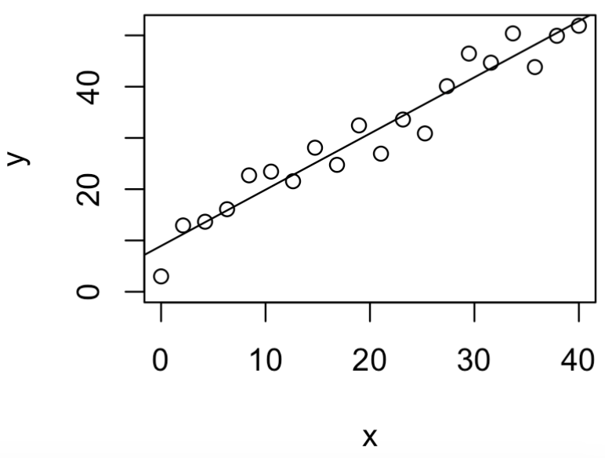
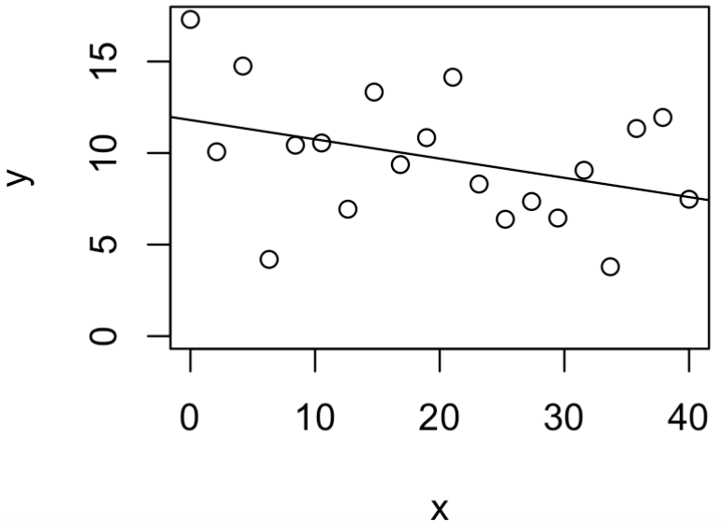
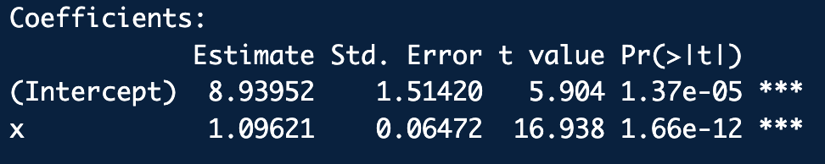
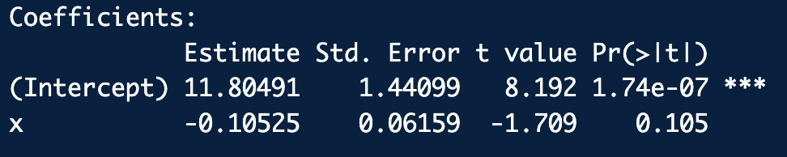
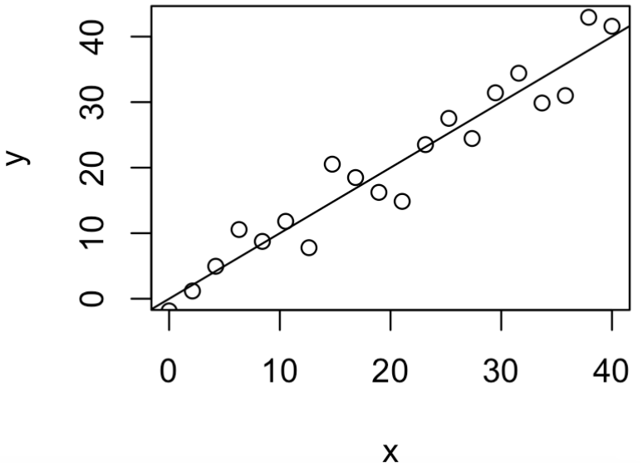
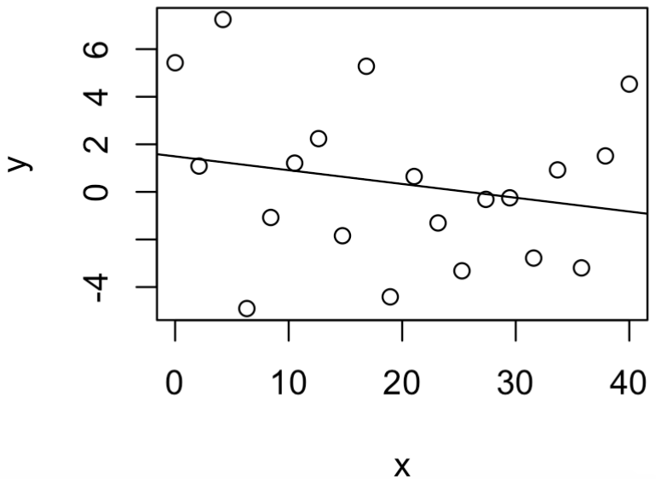
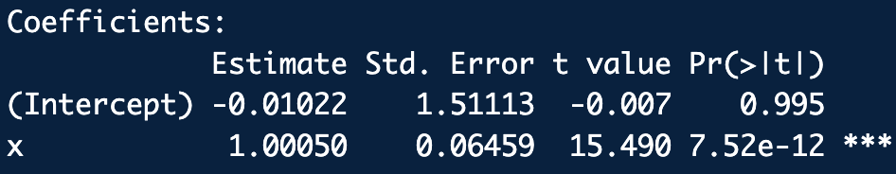
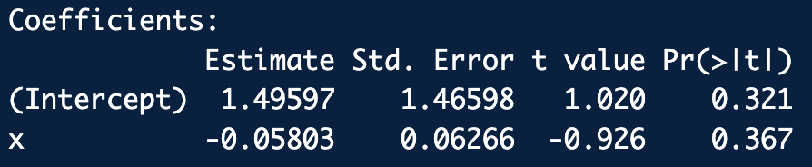
Hypothesis Tests for Regression Coefficients
β₁≠0, β₀ ≠ 0
y = β₁ x + β₀
β₁=0, β₀ ≠ 0
y = β₀
β₁≠0, β₀ = 0
y = β₁ x
β₁=0, β₀=0
y = 0

Slide 16
Checking Assumptions
Assumptions of simple univariate linear regression:
The x_{i} (and if measured y_{i}) are independent.
The variance of the errors is constant (homoscedastic) and =
The errors have mean zero and are normally distributed.

Slide 17
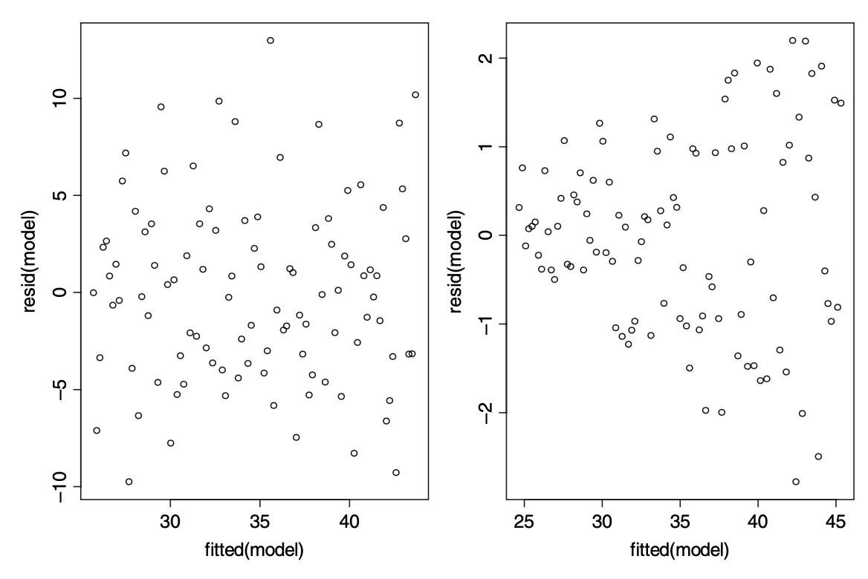
Checking Assumptions
The assumptions we really want to be sure about are constancy of variance and normality of errors.
The residuals should be uniformly scattered when plotted against the predicted response values:
OK Residuals
Residuals increasing with response values
Homoscedastic: error variance is constant
Heteroscedastic: error variance increase with response
Crawley 2007

Slide 18
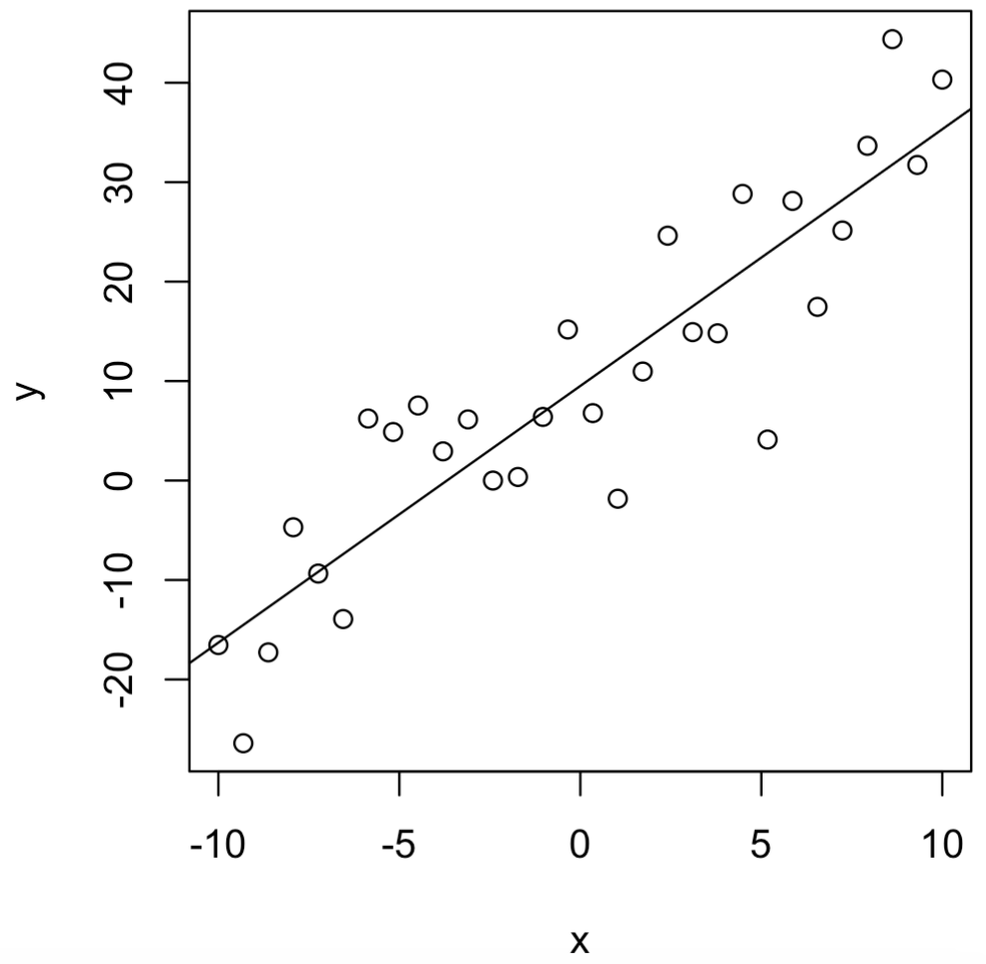
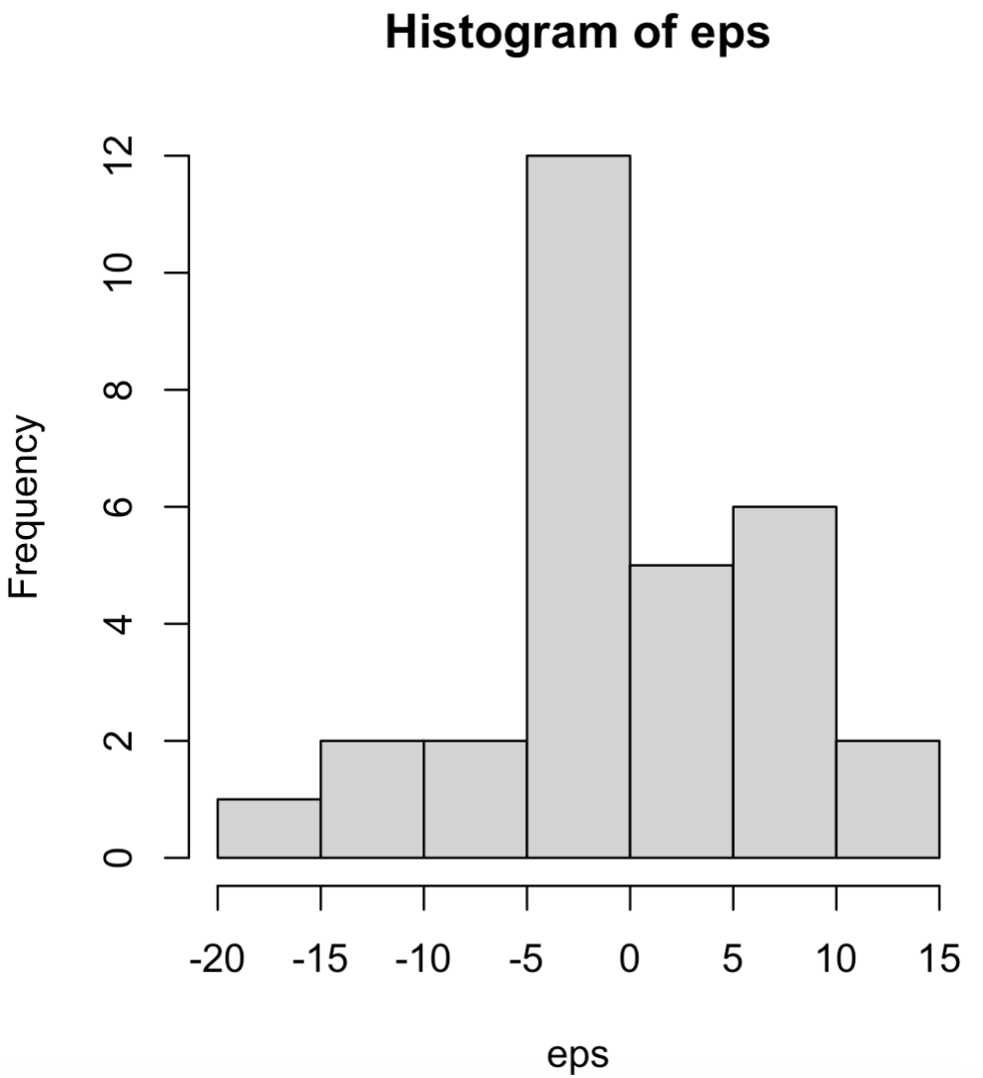
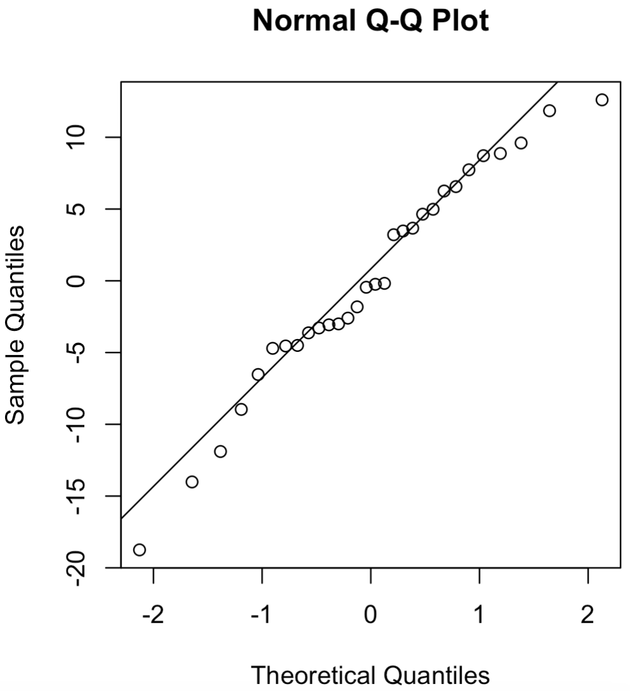
Checking Assumptions
The residuals should be pretty normal:

Slide 19
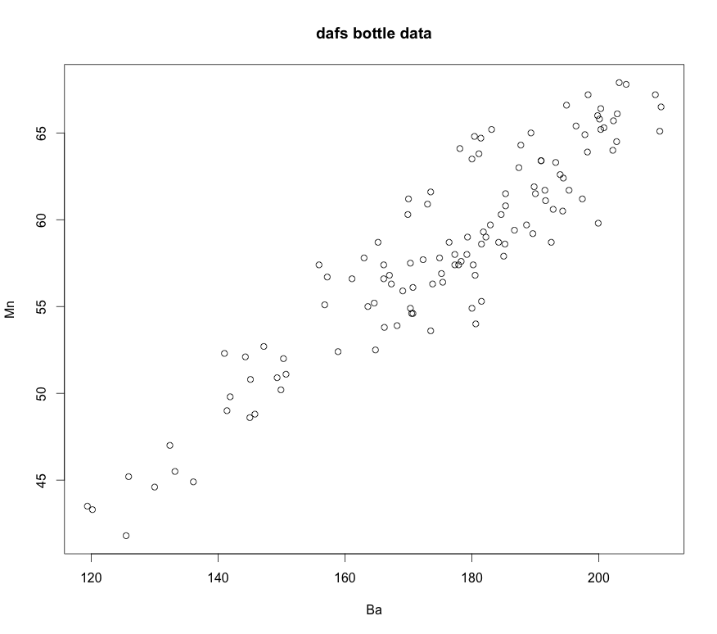
Basic Linear Regression Workflow

Slide 20
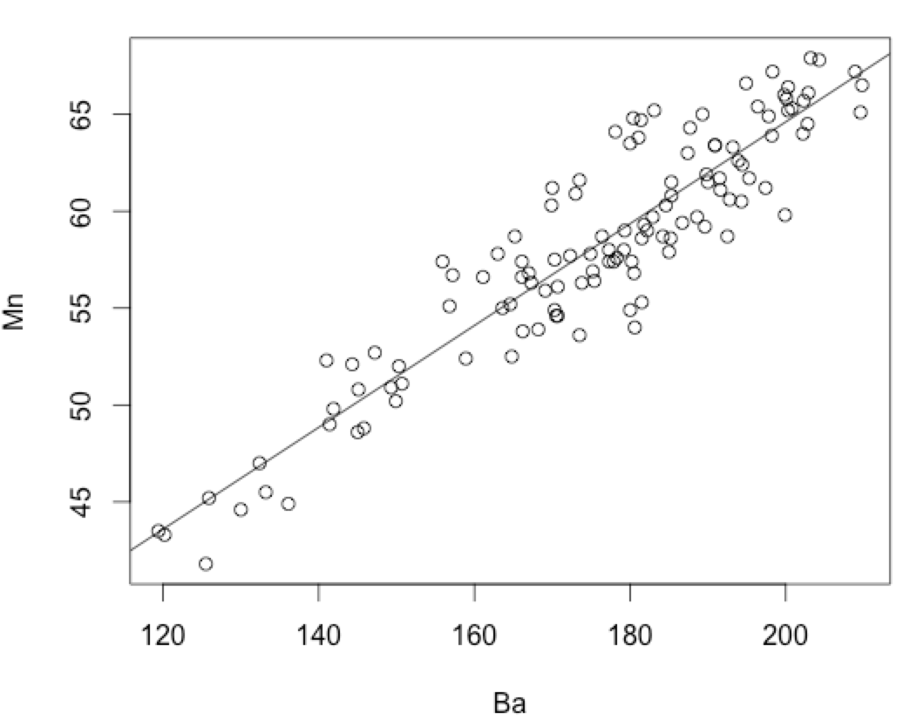
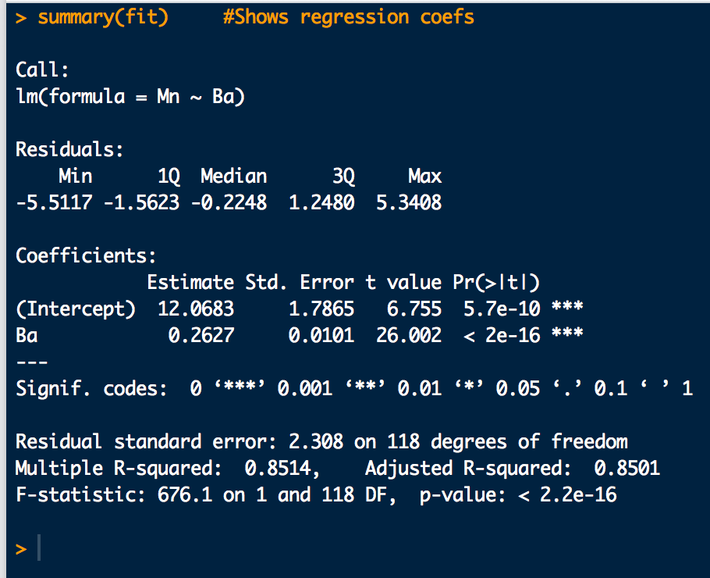
Basic Linear Regression Workflow
library(dafs)
data("bottle.df")
Ba <- bottle.df$Ba
Mn <- bottle.df$Mn
plot(Ba, Mn)
# Fit and assess overall fit:
fit <- lm(Mn ~ Ba) # Basic linear regression
abline(fit) # Show best fit line
summary(fit) # Shows regression coefs and some
# diagnostics
anova(fit) # Regression ANOVA table. "Total"
# row is absent
# Residuals based diagnostic checks:
preds <- predict(fit)
eps <- residuals(fit)
plot(preds, eps)
hist(eps)
qqnorm(eps)
qqline(eps)
regression_ex1.R
is significant =>keep it!
is significant =>keep it!

Slide 21
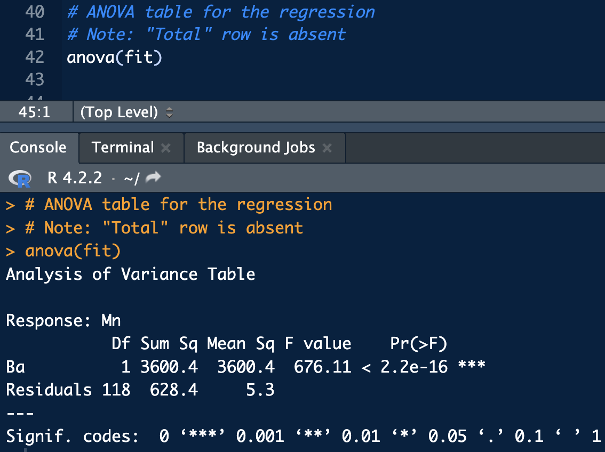
Basic Linear Regression Workflow
SSR
SSE
MSR
MSE
F-ratio: explained-to-unexplained variance

Slide 22
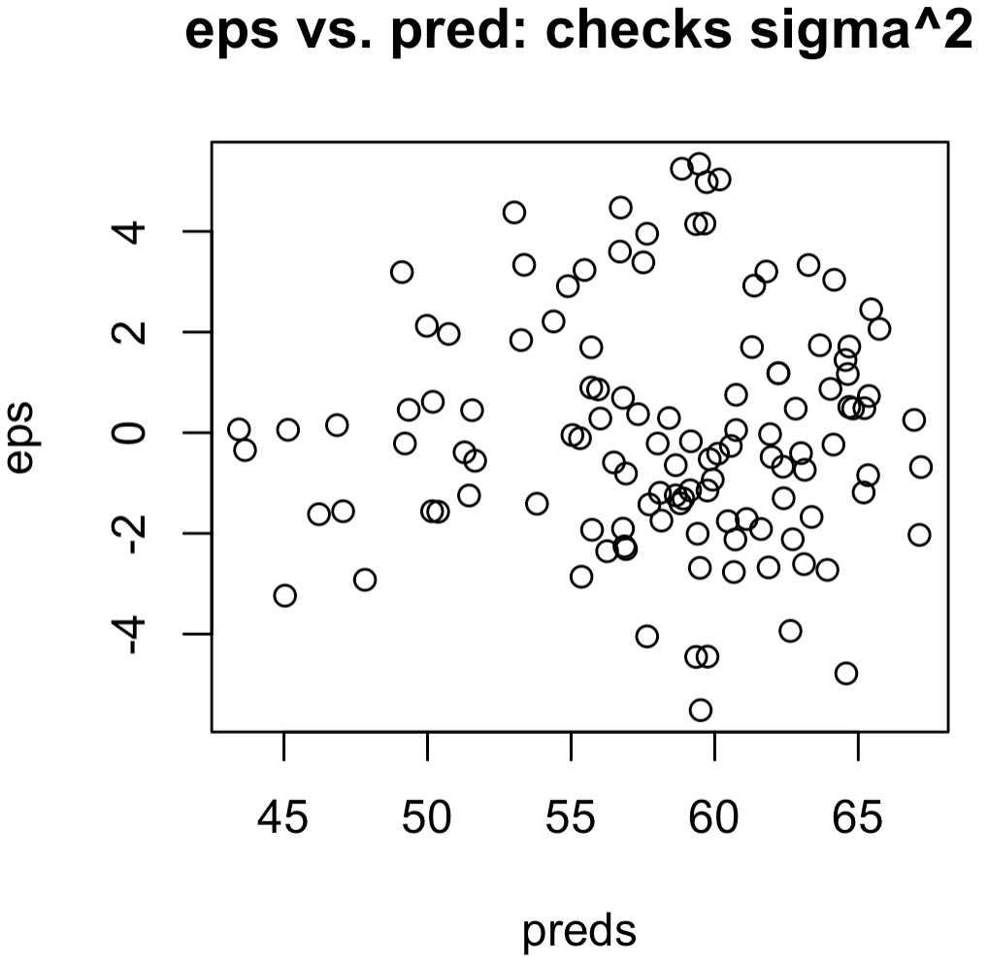
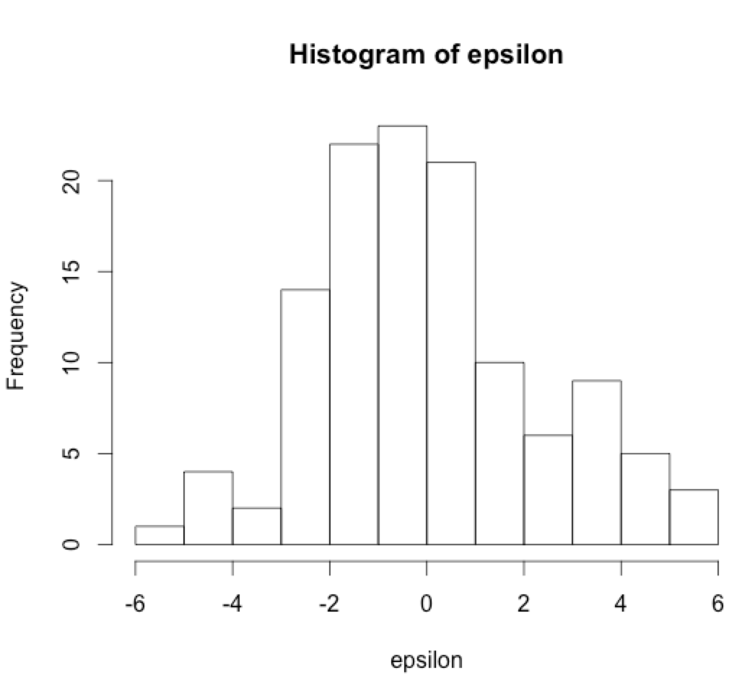
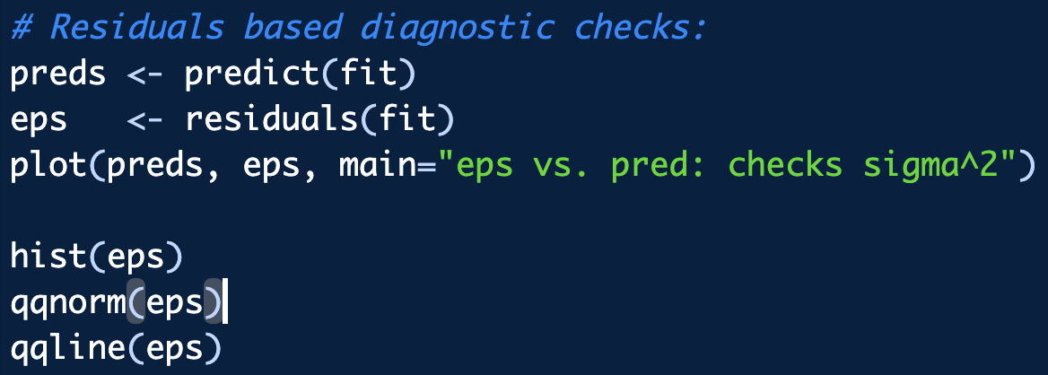
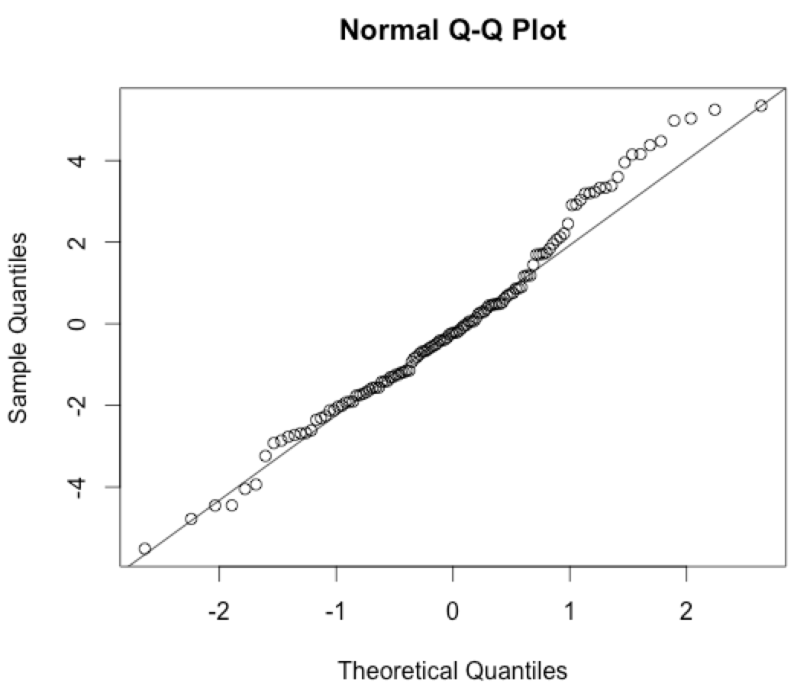
Basic Linear Regression Workflow
Residuals checks:
Look Gaussian?
“fuzzy-ness” remaining constant over predicted values?
Most of these fall in the line?

Slide 23
Interval Estimates for Linear Regression
Confidence Intervals around a regression line:
What simple linear regression is really trying to estimate is a conditional mean:
This is on average, what you’d expect the response to be, given the explanatory x_{i}
CIs put a confidence interval around the estimated mean at x_{i}.
See hypothesis testing slides for definition of confidence.

Slide 24
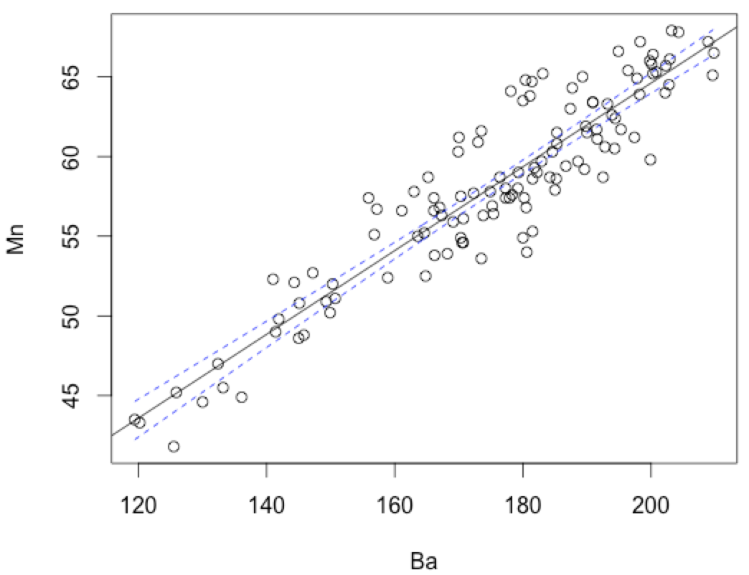
Interval Estimates for Linear Regression
95% Confidence Intervals around a regression line:
library(dafs)
data("bottle.df")
attach(bottle.df)
# Fit a linear regression:
fit <- lm(Mn ~ Ba)
plot(Mn ~ Ba)
abline(fit)
# Compute Regression CIs and plot them:
new.Ba <- seq(from=min(Ba), to=max(Ba), length.out=200)
cis <- predict(fit, newdata = data.frame(Ba=new.Ba),
interval = "confidence", level = 0.95)
lines(new.Ba, cis[,2], lty=2, col="blue")
lines(new.Ba, cis[,3], lty=2, col="blue")
regression_CI.R

Slide 25
Box-Cox Transformation
Heteroscedasticity is the increase in response variance, y, with an increase in x
Indicates non constant variance,
If some heteroscedasticity is observed, a Box-Cox transform of responses (y), predictors (x) or both may help to tamp down the problem.
CAUTION: use sparingly.
Interpretation under transformation becomes much more difficult
Heteroscedasticity can be a sign of problems with the experiment/instrumentation

Slide 26
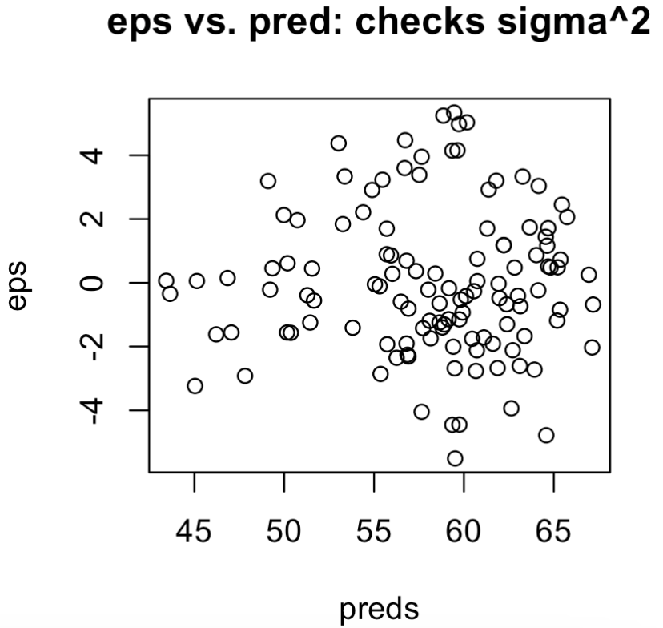
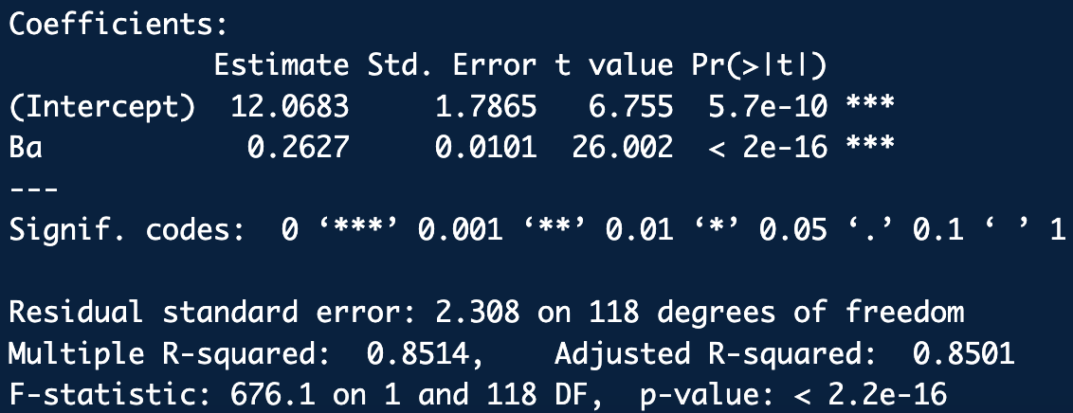
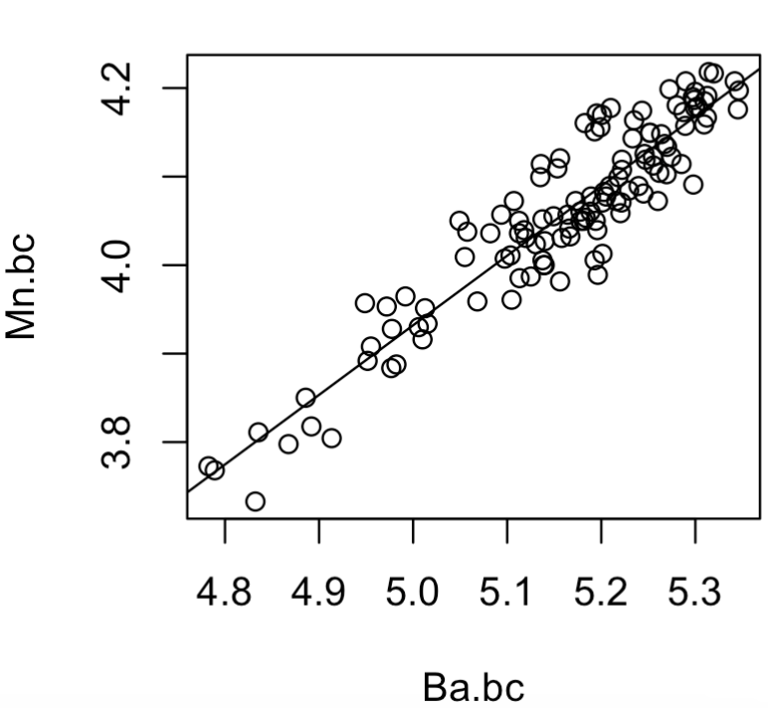
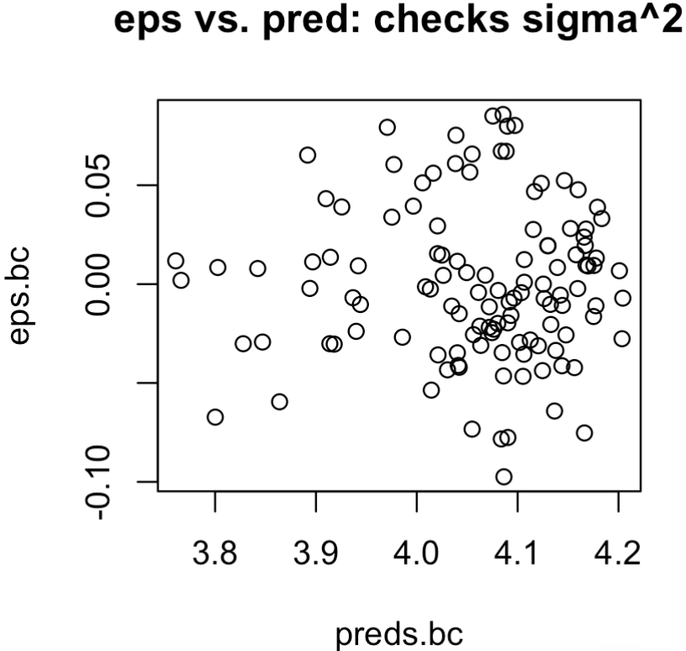
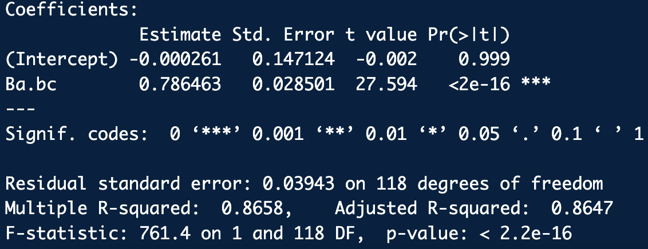
Box-Cox Transformation
Before Box-Cox:
# Box-Cox transform may reduce heteroscedasticity
library(MASS)
library(frequtils)
boxcox(fit)
Ba.bc <- box.cox.transform(Ba, lambda = 0)
Mn.bc <- box.cox.transform(Mn, lambda = 0)
plot(Ba.bc, Mn.bc)
fit.bc <- lm(Mn.bc ~ Ba.bc)
abline(fit.bc)
summary(fit.bc)
anova(fit.bc)
# Residuals based diagnostic checks:
preds.bc <- predict(fit.bc)
eps.bc <- residuals(fit.bc)
plot(preds.bc, eps.bc, main="eps vs. pred: checks sigma^2")
hist(eps.bc)
qqnorm(eps.bc)
qqline(eps.bc)
summary(fit)
summary(fit.bc)
regression_boxcox_ex.R
After Box-Cox: (ehh….)

Slide 27
What Can We Do With Replicate Responses?
If for each predictor (x), multiple responses (y) are measured:
Can average the responses:
Should bring down the standard error for the slope and intercept
Can assess the “lack of fit”:
Lack-of-fit is the terms that we could have fit to the model (e.g. non-linear terms) but chose not to^{Montgomery}.
To assess lack of fit we pick apart the sum of squared errors, SSE:

Slide 28
Lack Of Fit
Since we have #reps_{i} replicate responses for every x_{i} we can now write SSE a little more generally as:
new index, j, to account for replicate y_{i}’s
SSLF
Sum of squares due to lack of fit
SSPE
Sum of squares due to pure error
(unexplained variation)
If pred responses , are close to the corresponding average responses , this is a good indication the regression function is linear and vice versa.

Slide 29
Lack Of Fit
We can build up a formal test the lack of fit by turning these sum squares variations (SSLF, SSPE) into variances by dividing by their degrees of freedom (df):

Slide 30
Lack Of Fit
It turns out that:
It also turns out that:
So, IF THE FIT IS LINEAR then and the MSLF should also effectively estimate .
If the linear model is not a good fit, then MSLF should be significantly bigger than MSPE

Slide 31
Lack Of Fit
So, test ratio of MSLF to MSPE variances for evidence that MSLF is “significantly bigger” than MSPE:
H₀: The regression function is linear
H_{a}: The regression function is not linear
It can be shown that the sampling distribution for MSLF/MSPE under H₀ is the F distribution with n − 2, m − n dof:
“Bigness” of the ratio is gauged by how far out MSLF/MSPE falls on the tail of F(n − 2, m − n)

Slide 32
Example: Complete Linear Regression Workup
Consider the following concentration and absorbance data:
Concentrations:
Absorbances:
0.05, 0.05, 0.05,
0.10, 0.10, 0.10,
0.15, 0.15, 0.15,
0.20, 0.20, 0.20,
0.25, 0.25, 0.25,
0.30, 0.30, 0.30,
0.35, 0.35, 0.35,
0.40, 0.40, 0.40,
0.45, 0.45, 0.45,
0.50, 0.50, 0.50
0.014, 0.012, 0.013,
0.030, 0.030, 0.035,
0.045, 0.041, 0.046,
0.063, 0.065, 0.059,
0.078, 0.075, 0.080,
0.092, 0.092, 0.089,
0.107, 0.106, 0.108,
0.122, 0.121, 0.119,
0.132, 0.132, 0.137,
0.155, 0.148, 0.147

Slide 33
Example: Complete Linear Regression Workup
Compute a best fit line to the data of Concentration vs Absorbance and report:
a. The slope coefficient,
b. The intercept coefficient,
c. Is the slope coefficient significant at, at least the 95% level of confidence?
d. Is the intercept coefficient significant at, at least the 95% level of confidence?
e. The standard error of the residuals,
f. The multiple and adjusted R-squared correlation coefficient
g. What is the variation explained buy the regression model?
h. Regression ANOVA table (i.e. regression components of variance)
j. Perform a residuals analysis
k. Lack of fit analysis
l. Conclude whether the line seems to be a good model for this data using
your results above.
m. Plot the regression line with 99% confidence bounds
n. Plot the regression line with 99% prediction bounds
o. Obtain the predicted concentration for an observed absorbance of 0.102 with
99% confidence bounds.

Slide 34
Example: Complete Linear Regression Workup
library(EnvStats)
x <- c(
0.05, 0.05, 0.05, 0.10, 0.10, 0.10, 0.15, 0.15, 0.15, 0.20, 0.20, 0.20, 0.25, 0.25, 0.25,
0.30, 0.30, 0.30, 0.35, 0.35, 0.35, 0.40, 0.40, 0.40, 0.45, 0.45, 0.45, 0.50, 0.50, 0.50)
y <- c(
0.014, 0.012, 0.013, 0.030, 0.030, 0.035, 0.045, 0.041, 0.046, 0.063, 0.065, 0.059, 0.078,
0.075, 0.080,
0.092, 0.092, 0.089, 0.107, 0.106, 0.108, 0.122, 0.121, 0.119, 0.132, 0.132, 0.137, 0.155,
0.148, 0.147)
# Preliminary scatter plot: Look at the data
plot(x,y)
# a.-h.:
fit <- lm(y ~ x)
plot(x, y, xlab="concentration", ylab="absorbance")
abline(fit) # Show best fit line
summary(fit) # Shows regression coefs and some diagnostics
anova(fit) # Regression ANOVA table. "Total" row is absent
regression_ex2.R

Slide 35
Example: Complete Linear Regression Workup
# j. Residuals analysis:
eps <- residuals(fit)
preds <- predict(fit) # Predicted mean y's
plot(preds, eps, main="Hetroscedastic?")
qqnorm(eps, main="Residuals Normal?")
qqline(eps)
# k. Lack of fit analysis:
anovaPE(fit) # Use the lack of fit function in EnvStats
fit.f <- lm(y ~ factor(x)) # Alternative to using EnvStats anovaPE()
anova(fit, fit.f)
regression_ex2.R

Slide 36
Example: Complete Linear Regression Workup
# l. Put CIs on the regression:
conf <- 0.99
plot(x, y, xlab="concentration", ylab="absorbance")
new.x <- seq(from=min(x), to=max(x), length.out=length(x))
cis <- predict(fit, newdata = data.frame(x=new.x), interval = "confidence", level = conf)
lines(new.x, cis[,1], lty=1, col="black") # Regression line
lines(new.x, cis[,2], lty=2, col="blue") # Lower CI
lines(new.x, cis[,3], lty=2, col="blue") # Upper CI
# m. Can also put prediction intervals on the regression:
pis <- predict(fit, newdata = data.frame(x=new.x), interval = "prediction", level = conf)
lines(new.x, pis[,2], lty=2, col="red") # Lower CI
lines(new.x, pis[,3], lty=2, col="red") # Upper CI
# n. Predict x from a measured y (y.unk):
fit.cal <- calibrate(y ~ x, data=data.frame(x,y), max.order=1)
summary(fit.cal)
y.unk <- 0.102
inversePredictCalibrate(fit.cal, obs.y = y.unk, intervals = TRUE,
coverage = 0.99, individual = TRUE)
regression_ex2.R

Slide 37
Linear Response Regions
Most instrumentation produces a linear response with a certain range of inputs
Linear response can vary with instrumentation type and even from instrument to instrument.
Typically, the linear response region must be determined on a case by case basis.
Typically, this is done during instrument calibration studies in professional labs.
There is no settled method to determine region of linearity
Common to hold out suspected non-linear responses (sequentially if possible) and examine if fit diagnostics get better
Common to use outlier detection methods
Common to use model comparison techniques (e.g. AIC, BIC, etc.)

Slide 38
Example: Detect Linear Response Region
Consider the concentration vs. absorbance data below
Concentrations (ng/mol):
0, 2, 4, 6, 8, 10, 12, 14, 16, 18, 20
Intensity (Abs units):
2.1, 5.0, 9.0, 12.6, 17.3, 21.0, 24.7, 28.4, 31.0, 32.9, 33.9
Graph to identify if there is a region of linearity issue
Fit a linear regression and use Rosner’s test to see if outliers are detected
Compute fit diagnostics for the whole data set, then successively hold out the seemingly non-linear points and examine the fit diagnostics for improvement.

Slide 39
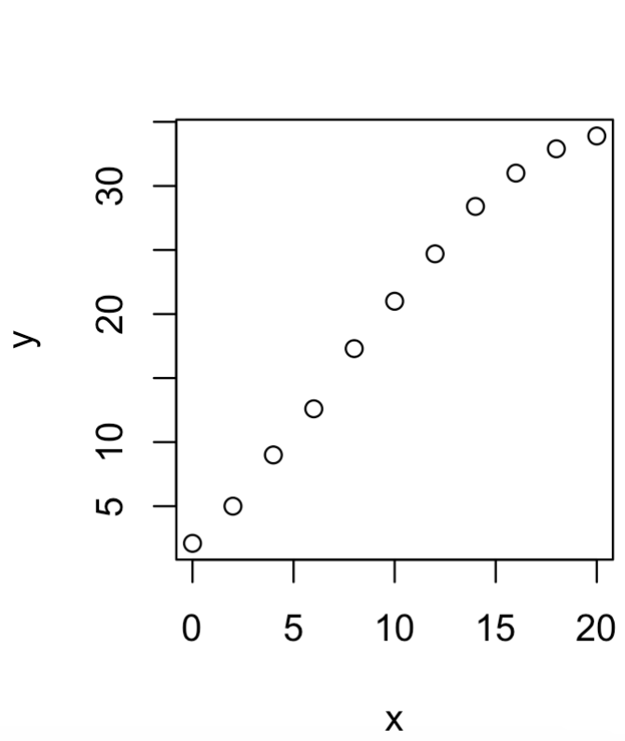
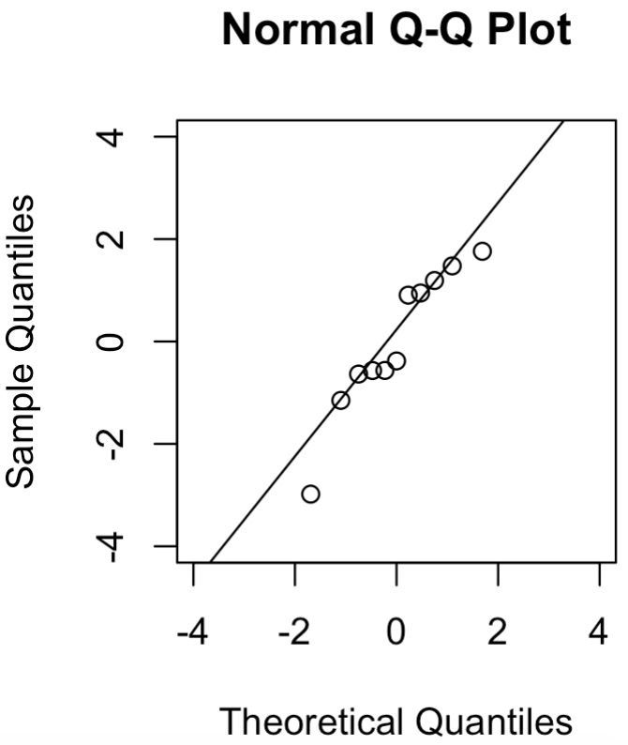
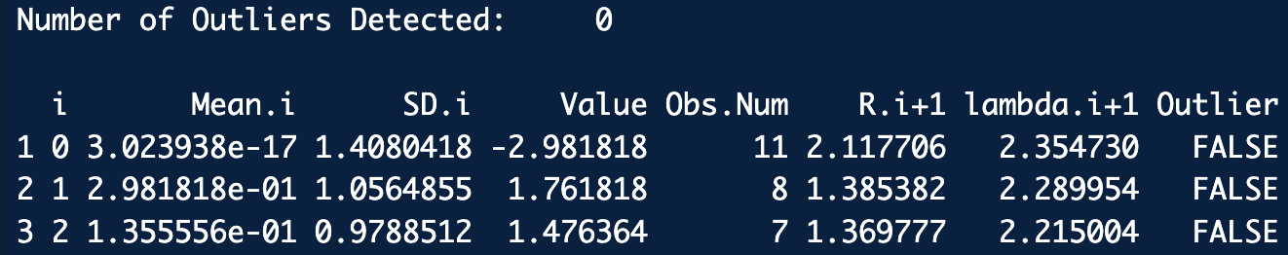
library(EnvStats)
# a. Plot
# Concentrations
x <- c(0, 2, 4, 6, 8, 10, 12, 14, 16, 18, 20)
# Intensity
y <- c(2.1, 5.0, 9.0, 12.6, 17.3, 21.0, 24.7, 28.4, 31.0, 32.9, 33.9)
plot(x, y)
# b. Fit initial linear regression:
fit <- lm(y ~ x)
summary(fit)
abline(fit)
# Check residuals:
eps <- residuals(fit)
hist(eps)
# Do the residuals look N(0, eps)-ish?: Not really . . .
qqnorm(eps)
qqline(eps)
# Try Rosner test on the residuals of the full data set
k <- 3 # Speculated max number of outliers
rosnerTest(eps, k = k, alpha = 0.05, warn = TRUE)
# Rosner is not super sensitive . . .
linear_region_ex.R

Slide 40
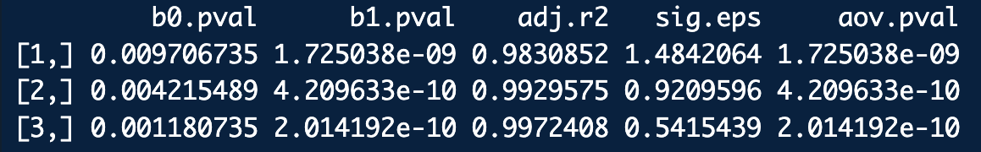
# c. A hold-out procedure:
# Hold-Out between 0 and (highest) two points:
ho.mat <- NULL
for(i in 1:3) {
n <- length(x)
m <- i-1
# Hold out data here:
x.red <- x[1:(n-m)]
y.red <- y[1:(n-m)]
plot(x.red, y.red)
# Fit reduced linear regression:
fit.red <- lm(y.red ~ x.red)
fit.summary <- summary(fit.red)
fit.anova <- anova(fit.red)
# Collect diagnositc information:
coef.pvals <- fit.summary$coefficients[,4]
adj.r2 <- fit.summary$adj.r.squared
sig.eps <- fit.summary$sigma
aov.pval <- fit.anova[[5]][1]
ho.mat <- rbind(ho.mat, c(coef.pvals, adj.r2, sig.eps, aov.pval))
}
colnames(ho.mat) <- c("b0.pval", "b1.pval", "adj.r2", "sig.eps", "aov.pval")
ho.mat
linear_region_ex.R
Full data set
Hold out 10th point
Hold out 9th and 10th point

