Slide 1
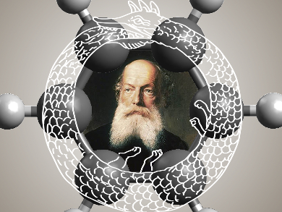
Molecular Orbital Theory

Slide 2
Model
Our model of an atom is layers of atomic orbitals (AOs):
1s
2p
3p
3s
2s
3d
As atoms approach each other their occupied AOs (waves) interfere
Add constructively and destructively
Result is molecular orbitals

Slide 3
Let’s start simple
Qualitative combinations of orbitals on different atoms, “add” phases:
Combining s-orbitals = σ and σ* molecular orbitals:
+
-
Opposite phase
+
-
σ* “anti-bonding” MO
AO 1
AO 2
σ “bonding” MO
Same phase
+
+
+

Slide 4
Let’s start simple
Qualitative combinations of orbitals on different atoms, “add” phases:
Combining s and p also = σ and σ* molecular orbitals:
+
-
+
Opposite phase
+
-
σ* “anti-bonding” MO
AO 1
AO 2
σ “bonding” MO
Same phase
+
+
+
-

Slide 5
Let’s start simple
Qualitative combinations of orbitals on different atoms, “add” phases:
Combining p and p also = σ and σ* molecular orbitals:
-
+
-
+
Opposite phase
+
-
σ* “anti-bonding” MO
AO 1
AO 2
σ “bonding” MO
Same phase
+
+
+
-
-

Slide 6
Let’s start simple
Qualitative combinations of orbitals on different atoms, “add” phases:
Combining p and p = π and π* molecular orbitals:
-
+
+
-
Opposite phase
+
-
π* “anti-bonding” MO
AO 1
AO 2
π “bonding” MO
+
+
+
Same phase
-

Slide 7
Let’s start simple
Qualitative combinations of orbitals on different atoms, “add” phases:
Combining d and d = σ and σ* molecular orbitals:
-
+
+
+
-
-
-
+
+
-
σ* “anti-bonding” MO
σ “bonding” MO
+
-
-
+
+
+
+
-
-

Slide 8
Let’s start simple
Qualitative combinations of orbitals on different atoms, “add” phases:
Combining d and d = π and π* molecular orbitals:
+
-
-
-
+
+
Opposite phase
+
-
+
-
π* “anti-bonding” MO
AO 1
AO 2
π “bonding” MO
+
+
+
Same phase
-
-
+

Slide 9
Let’s start simple
Qualitative combinations of orbitals on different atoms, “add” phases:
Combining d and d = δ and δ* molecular orbitals:
+
-
+
-
-
+
-
+
+
-
δ* “anti-bonding” MO
δ “bonding” MO
+
-
-
+
+
-
+
+

Slide 10
Let’s start simple
Summary of common combinations of AOs to form MOs:
s and s = σ’s only
p and p = σ’s and π’s only
d and d = σ’s, π’s, and δ’s only
In general when building molecules, all AOs can combine with each other in all possible to varying degrees!
Very quickly becomes a computationally demanding problems to predict molecular structures!

Slide 11
Computational MO Theory
To “build” an MO in general:
1. Assign a set of AOs to each atom in a molecule:
e.g. C can get 1s² 2s² 2p²
➔ a 1s a 2s and a set of 2p’s
➔ {1s, 2s, 2p}
➔ Minimal basis set for C
Nothing is stopping us from giving C more orbitals though, say ➔ {1s, 2s, 2p, 3d}
The bigger the basis set for each atom, the more accurate predictions we get
Calculation take a lot longer too!

Slide 12
Now You Try
Qualitatively guestimate the MOs and Energetic ordering for CO (carbon monoxide). Assume a minimal basis set. C has 6e- and O has 8e-.

Slide 13
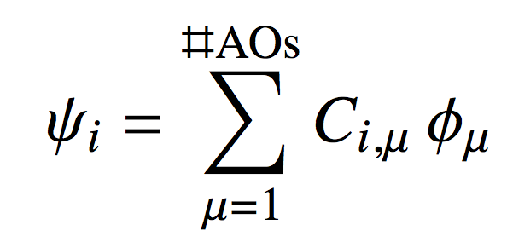
Computational MO Theory
To “build” an MO in general:
2. Write each MO as:
Linear combination of atomic orbitals (LCAO) approximation
“weight” of AO
AO
This says: For each MO, add up the contributions from each AO
There are as many MOs as AOs used to build them

Slide 14
Computational MO Theory
Put a basis set on each atom:
Augment with a set of d’s on C’s and N’s
H
H
{1s} on H’s
H
H
H
H
H
H
H
H
N
H
H
H
H
H
H
H
~340 basis functions
H
H
H
H
H
H
H
H
{1s,2s,2p} on C’s and N’s
Augment with a set of p’s on H’s

Slide 15
Computational MO Theory
So for this molecule with the chosen basis set:
340 AOs
340 MOs
170 e-
85 of the MOs are occupied (up to 2 e-/MO)
255 of the MOs are “virtual” (empty)
The highest occupied MO (HOMO) and the lowest unoccupied MO (LUMO) is where most of the chemistry happens
Valence MOs
N

Slide 16
Computational MO Theory
There are 340 ψ_{i} for this molecule in the chosen basis set
340 term in the sum too
The C_{m,i} are called MO coefficients
C_{m,i} can be arranged in a 340 340 matrix C
But how do we find C??

Slide 17
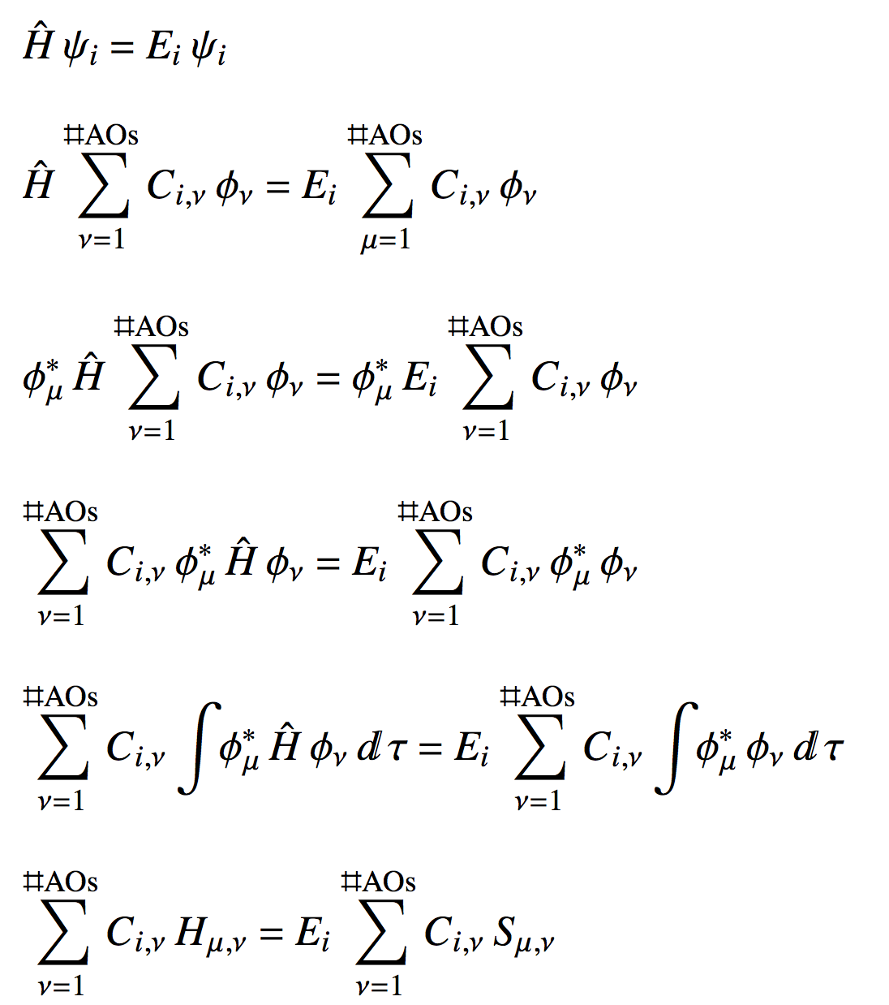
Computational MO Theory
3. Inset the LCAO expansion into the Schrodinger equation:
Left multiply by φ_{μ}*
Rearrange
Integrate
Abbreviate

Slide 18
Computational MO Theory
3. Inset the LCAO expansion into the Schrodinger equation:
Abbreviate
HC = SCE
Schrodinger equation in matrix form
MO Coefs.
MO energies
Hamiltonian matrix
“Overlap” matrix
Different approximation for elements of H and S result in different quantum chemistry methodologies

Slide 19
Computational MO Theory
4. Solve for C and E by “diagonalization”
HC = SCE
Orthonormalize the AO basis:
HC = CE
Left multiply by C⁻¹ = C^{T}
C^{T}HC = E
E is a diagonal matrix of MO energies
Eigenvalues of H
C is said to diagonalize H
Eigenvectors of H

Slide 20
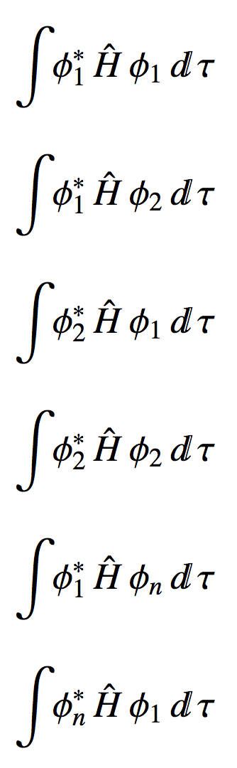
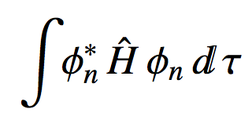
Computational MO Theory
5. Hardest thing for us to do is put together H
…
φ₁
φ₂
φ_{n}
φ₁
H =
φ₂
…
…
φ_{n}

Slide 21
Computational MO Theory
6. Huckel approximation
Goals are to:
Cut down on the number if H_{μν} and S_{μν} to evaluate
Easily evaluate the H_{μν} and S_{μν} that remain
Assume:
Only p_{z} AOs are important. Neglect everything else
There is only 1 valence electron/atom
6 valence e-

Slide 22
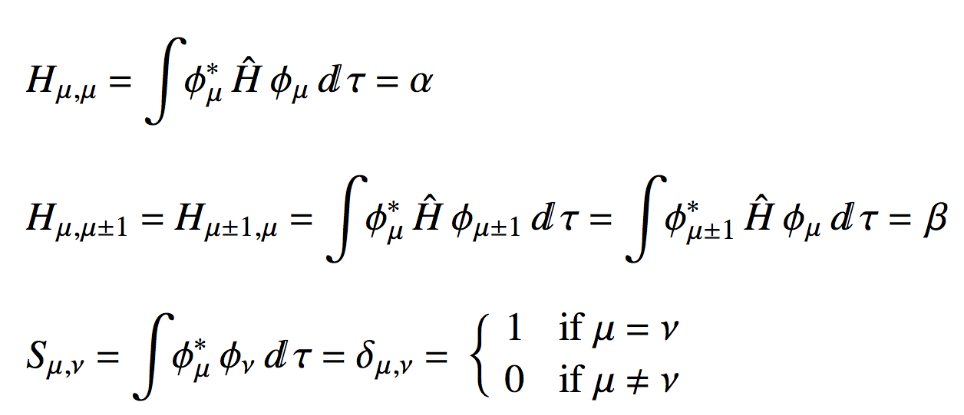
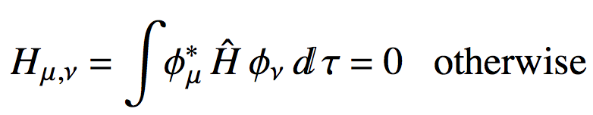
Computational MO Theory
6. Huckel approximation
The only integrals we have to evaluate are for nearest neighbours:
Nearest neighbour integrals

Slide 23
Computational MO Theory
6. Huckel approximation
This model works great for conjugated carbon molecules
We’ll set α = 0 and β = -1
1
2
φ₁
φ₂
φ₃
φ₄
φ₅
φ₆
φ₁
α
β
0
0
0
β
6
3
φ₂
β
α
β
0
0
0
H =
φ₃
0
β
α
β
0
0
φ₄
0
0
β
α
β
0
5
4
φ₅
0
0
0
β
α
β
φ₆
β
0
0
0
β
α

Slide 24
Computational MO Theory
6. Huckel approximation
This model works great for conjugated carbon molecules
We’ll set α = 0 and β = -1
1
2
φ₁
φ₂
φ₃
φ₄
φ₅
φ₆
φ₁
1
0
0
0
0
0
6
3
φ₂
0
1
0
0
0
0
S =
φ₃
0
0
1
0
0
0
φ₄
0
0
0
1
0
0
5
4
φ₅
0
0
0
0
1
0
φ₆
0
0
0
0
0
1

Slide 25
Computational MO Theory
6. Huckel approximation
This model works great for conjugated carbon molecules
We’ll set α = 0 and β = -1
1
2
HC = SCE
HC = CE
6
3
C^{T}HC = E
5
4
Build H in the computer and send it to a diagonalization routine

Slide 26
Computational MO Theory
6. Huckel approximation
This model works great for conjugated carbon molecules
We’ll set α = 0 and β = -1
[,1] [,2] [,3] [,4] [,5] [,6]
[1,] 0 -1 0 0 0 -1
[2,] -1 0 -1 0 0 0
[3,] 0 -1 0 -1 0 0
[4,] 0 0 -1 0 -1 0
[5,] 0 0 0 -1 0 -1
[6,] -1 0 0 0 -1 0
1
2
MO #1
H =
6
3
E =
2 1 1 -1 -1 -2
0.4 0.6 0.0 0.0 -0.6 -0.4
-0.4 -0.3 -0.5 -0.5 -0.3 -0.4
0.4 -0.3 0.5 -0.5 0.3 -0.4
-0.4 0.6 0.0 0.0 0.3 -0.4
0.4 -0.3 -0.5 0.5 0.3 -0.4
-0.4 -0.3 0.5 0.5 -0.3 -0.4
5
4
C =

Slide 27
Computational MO Theory
6. Huckel approximation
This model works great for conjugated carbon molecules
We’ll set α = 0 and β = -1
[,1] [,2] [,3] [,4] [,5] [,6]
[1,] 0 -1 0 0 0 -1
[2,] -1 0 -1 0 0 0
[3,] 0 -1 0 -1 0 0
[4,] 0 0 -1 0 -1 0
[5,] 0 0 0 -1 0 -1
[6,] -1 0 0 0 -1 0
1
2
MO #2
H =
6
3
E =
2 1 1 -1 -1 -2
0.4 0.6 0.0 0.0 -0.6 -0.4
-0.4 -0.3 -0.5 -0.5 -0.3 -0.4
0.4 -0.3 0.5 -0.5 0.3 -0.4
-0.4 0.6 0.0 0.0 0.3 -0.4
0.4 -0.3 -0.5 0.5 0.3 -0.4
-0.4 -0.3 0.5 0.5 -0.3 -0.4
5
4
C =

Slide 28
Computational MO Theory
6. Huckel approximation
This model works great for conjugated carbon molecules
We’ll set α = 0 and β = -1
[,1] [,2] [,3] [,4] [,5] [,6]
[1,] 0 -1 0 0 0 -1
[2,] -1 0 -1 0 0 0
[3,] 0 -1 0 -1 0 0
[4,] 0 0 -1 0 -1 0
[5,] 0 0 0 -1 0 -1
[6,] -1 0 0 0 -1 0
1
2
MO #3
H =
6
3
E =
2 1 1 -1 -1 -2
0.4 0.6 0.0 0.0 -0.6 -0.4
-0.4 -0.3 -0.5 -0.5 -0.3 -0.4
0.4 -0.3 0.5 -0.5 0.3 -0.4
-0.4 0.6 0.0 0.0 0.3 -0.4
0.4 -0.3 -0.5 0.5 0.3 -0.4
-0.4 -0.3 0.5 0.5 -0.3 -0.4
5
4
C =

Slide 29
Computational MO Theory
6. Huckel approximation
This model works great for conjugated carbon molecules
We’ll set α = 0 and β = -1
[,1] [,2] [,3] [,4] [,5] [,6]
[1,] 0 -1 0 0 0 -1
[2,] -1 0 -1 0 0 0
[3,] 0 -1 0 -1 0 0
[4,] 0 0 -1 0 -1 0
[5,] 0 0 0 -1 0 -1
[6,] -1 0 0 0 -1 0
1
2
MO #4
H =
6
3
E =
2 1 1 -1 -1 -2
0.4 0.6 0.0 0.0 -0.6 -0.4
-0.4 -0.3 -0.5 -0.5 -0.3 -0.4
0.4 -0.3 0.5 -0.5 0.3 -0.4
-0.4 0.6 0.0 0.0 0.3 -0.4
0.4 -0.3 -0.5 0.5 0.3 -0.4
-0.4 -0.3 0.5 0.5 -0.3 -0.4
5
4
C =

Slide 30
Computational MO Theory
6. Huckel approximation
This model works great for conjugated carbon molecules
We’ll set α = 0 and β = -1
[,1] [,2] [,3] [,4] [,5] [,6]
[1,] 0 -1 0 0 0 -1
[2,] -1 0 -1 0 0 0
[3,] 0 -1 0 -1 0 0
[4,] 0 0 -1 0 -1 0
[5,] 0 0 0 -1 0 -1
[6,] -1 0 0 0 -1 0
1
2
MO #5
H =
6
3
E =
2 1 1 -1 -1 -2
0.4 0.6 0.0 0.0 -0.6 -0.4
-0.4 -0.3 -0.5 -0.5 -0.3 -0.4
0.4 -0.3 0.5 -0.5 0.3 -0.4
-0.4 0.6 0.0 0.0 0.3 -0.4
0.4 -0.3 -0.5 0.5 0.3 -0.4
-0.4 -0.3 0.5 0.5 -0.3 -0.4
5
4
C =

Slide 31
Computational MO Theory
6. Huckel approximation
This model works great for conjugated carbon molecules
We’ll set α = 0 and β = -1
[,1] [,2] [,3] [,4] [,5] [,6]
[1,] 0 -1 0 0 0 -1
[2,] -1 0 -1 0 0 0
[3,] 0 -1 0 -1 0 0
[4,] 0 0 -1 0 -1 0
[5,] 0 0 0 -1 0 -1
[6,] -1 0 0 0 -1 0
1
2
MO #6
H =
6
3
E =
2 1 1 -1 -1 -2
0.4 0.6 0.0 0.0 -0.6 -0.4
-0.4 -0.3 -0.5 -0.5 -0.3 -0.4
0.4 -0.3 0.5 -0.5 0.3 -0.4
-0.4 0.6 0.0 0.0 0.3 -0.4
0.4 -0.3 -0.5 0.5 0.3 -0.4
-0.4 -0.3 0.5 0.5 -0.3 -0.4
5
4
C =

Slide 32
Now You Try
Write out the Hamiltonian for:
From C sketch the MOs.
Without looking at E, write an MO energy diagram. Fill it with (Huckel) valence electrons.
What would happen to bond lengths for this molecule in the first excited state? Why?
2
4
1
3
MOs
[,1] [,2] [,3] [,4]
[1,] 0.371748 0.601501 -0.601501 0.371748
[2,] -0.601501 -0.371748 -0.371748 0.601501
[3,] 0.601501 -0.371748 0.371748 0.601501
[4,] -0.371748 0.601501 0.601501 0.371748
AOs
C =

Slide 33
Now You Try
2
4
2
4
1
3
1
3
[,1] [,2] [,3] [,4]
[1,] 0.37 0.60 -0.60 0.37
[2,] -0.60 -0.37 -0.37 0.60
[3,] 0.60 -0.37 0.37 0.60
[4,] -0.37 0.60 0.60 0.37
C =
2
2
4
4
1
1
3
3

Slide 34
Now You Try
Energy Diagram
MO#
4
3
E_{MOs}
2
E_{Huc} = 2(-1.6) + 2(-0.6)
E_{Huc} = -4.4 total (Huckel) energy
1
E =
[1] 1.618034 0.618034 -0.618034 -1.618034
MO energies

Slide 35
The Molecular Orbital Model
Huckel bond order gives an idea of the strength of the “bond” between any two atoms:
coefficient for AO μ, MO i
Number of e- in MO i
Sum is over occupied MOs

Slide 36

Now You Try
AO
AO
[,1] [,2] [,3] [,4]
[1,] 1.00 XXXX XXXX XXXX
[2,] 0.89 1.00 XXXX XXXX
[3,] 0.00 0.45 1.00 XXXX
[4,] -0.45 0.00 0.89 1.00
O =
0.45
“about a half strength π-bond”
0.89
“almost full strength π-bond”
2
4
1
3
0.89
“almost full strength π-bond”

